Slide 1
Linearizability
By Mila Oren

Slide 2
Outline
Sequential and concurrent specifications.
Define linearizability (intuition and formal model).
Composability.
Compare linearizability to other correctness condition.

Slide 3
Motivation
An object in languages such as Java and C++ is a container for data.
Each object provides a set of methods that are the only way to manipulate that object’s state.
Each object has a class which describes how its methods behave.
There are many ways to describe an object’s behavior, for example: API.

Slide 4
Motivation
In a sequential model computation, where a single thread manipulates a collection of objects, this works fine.
But, for objects shared by multiple threads, this successful and familiar style of documentation falls apart!
So that is why we need ‘Linearizability’ to describe objects.
Linearizability is a correctness condition for concurrent objects.

Slide 5
Motivation
It permits programmers to specify and reason about concurrent objects using known techniques from the sequential domain.
Linearizability provides the illusion that each operation applied by concurrent processes takes effect instantaneously between its invocation and its response.

Slide 6
Concurrent objects
Consider a FIFO queue:
q.enq( )
q.deq() /

Slide 7
Here is one implementation of a concurrent FIFO queue:
class LockBasedQueue<T> {
int head, tail;
T[] items;
Lock lock;
public LockBasedQueue(int capacity) {
head = 0; tail = 0;
lock = new ReentrantLock();
items = (T[]) new Object[capacity];
}

Slide 8
deq operation:
public T deq() throws EmptyException {
lock.lock();
try {
if (tail == head)
throw new EmptyException();
T x = items[head % items.length];
head++;
return x;
} finally {
lock.unlock();
}
}
This implementation should be correct because all modifications are mutual exclusive (we use a lock)

Slide 9
Let’s consider another implementation:
Wait-free 2-thread Queue
So, how do we know if it is “correct”?
Here modifications are not mutual exclusive…
public class WaitFreeQueue {
int head = 0, tail = 0;
items = (T[]) new Object[capacity];
public void enq(Item x) {
if (tail-head == capacity) throw
new FullException();
items[tail % capacity] = x; tail++;
}
public Item deq() {
if (tail == head) throw
new EmptyException();
Item item = items[head % capacity]; head++;
return item;
}}

Slide 10
Defining concurrent queue implementations:
In general, to make our intuitive understanding that the algorithm is correct we need a way to specify a concurrent queue object.
Need a way to prove that the algorithm implements the object’s specification.

Slide 11
Correctness and progress
There are two elements in which a concurrent specification imposes terms on the implementation: safety and liveness, or in our case, correctness and progress.
We will mainly talk about correctness.

Slide 12
Sequential Specification
We use pre-conditions and post-conditions.
Pre-condition defines the state of the object before we call the method.
Post-condition defines the state of the object after we call the method. Also defines returned value and thrown exception.
Pre-condition:
queue is not empty.
Post-condition:
Returns first item in queue.
Removes first item in queue.
This makes your life easier, you don’t need to think about interactions between methods and you can easily add new methods without changing descriptions of old methods.
deq method
Pre-condition:
queue is empty.
Post-condition:
Throws EmptyException.
Queue state is unchanged.

Slide 13
Concurrent Specifications
We need to understand that methods here “take time”.
In sequential computing, methods take time also, but we don’t care.
  In sequential: method call is an event.
  In concurrent: method call is an interval.
Methods can also take overlapping time.
Method call
Method call
Method call
time

Slide 14
Sequential vs. Concurrent
Sequential | Concurrent
Each method described independently. | Need to describe all possible interactions between methods. (what if enq and deq overlap? …)
Object’s state is defined between method calls. | Because methods can overlap, the object may never be between method calls…
Adding new method does not affect older methods. | Need to think about all possible interactions with the new method.

Slide 15
Here we come – Linearizability!
A way out of this dilemma: The Linearizability Manifesto:
  Each method call should appear to “take effect” instantaneously at some moment between its invocation and response.
This manifesto is not a scientific statement, it cannot be proved or disapproved. But, it has achieved wide-spread acceptance as a correctness property.

Slide 16
Here we come – Linearizability!
An immediate advantage of linearizability is that there is no need to describe vast numbers of interactions between methods.
We can still use the familiar pre- and post- conditions style.
But still, there will be uncertainty.
example: if x and y are enqueued on empty FIFO queue during overlapping intervals, then a later dequeue will return either x or y, but not some z or exception.

Slide 17
Linearizability
Linearizability has 2 important properties:
local property: a system is linearizable iff each individual object is linearizable. It gives us composability.
non-blocking property: one method is never forced to wait to synchronize with another.

Slide 18
So why the first implementation was obviously correct?
Let’s try to explain the notion “concurrent” via “sequential”:
q.deq
lock()
unlock()
q.enq
lock()
unlock()
So actually we got a “sequential behaviour”!
time

Slide 19
Linearizability is the generalization of this intuition to general objects, with or without mutual exclusion.
So, we define an object to be “correct” if this sequential behavior is correct.
To reinforce out intuition about linearizable executions, we will review a number of simple examples:

Slide 20
Examples(1)
Is this linearizable?
Yes!
q.enq(x)
q.deq(y)
q.enq(y)
q.deq(x)
time

Slide 21
Examples(1)
What if we choose other points of linearizability?
q.enq(x)
q.deq(y)
q.enq(y)
q.deq(x)
time

Slide 22
Examples(2)
Is this linearizable?
No!
q.enq(x)
q.deq(y)
q.enq(y)
time

Slide 23
Examples(3)
Is this linearizable?
Yes!
q.enq(x)
q. deq(x)
time

Slide 24
Examples(4)
Here we got multiple orders!
Is this linearizable?
Yes!
Option1:
Option2:
q.enq(x)
q.deq(y)
q.enq(y)
q.deq(x)
time

Slide 25
Read/Write registers
In this point, we conclude that write(1) has already occurred.
Is this linearizable?
No!
Write(0)
Read(1)
Write(2)
Write(1)
Read(0)
time

Slide 26
Read/Write registers
Is this linearizable?
What if we change to Read(1)?
No!
Write(0)
Read(1)
Write(2)
Write(1)
Read(0)
Read(1)
time

Slide 27
Read/Write registers
Is this linearizable?
Yes!
Write(0)
Write(2)
Write(1)
Read(0)
Read(1)
time

Slide 28
Formal model
This approach of identifying the atomic step where an operation takes effect (“linearization points”) is the most common way to show that an implementation is linearizable.
In some cases, linearization points depend on the execution.
We need to define a formal model to allow us to precisely define linearizability (and other correctness conditions).

Slide 29
Formal model
We split a method call into 2 events:
  Invocation: method names + args
    q.enq(x)
  Response: result or exception
    q.enq(x) returns void
    q.deq() returns x or throws emptyException

Slide 30
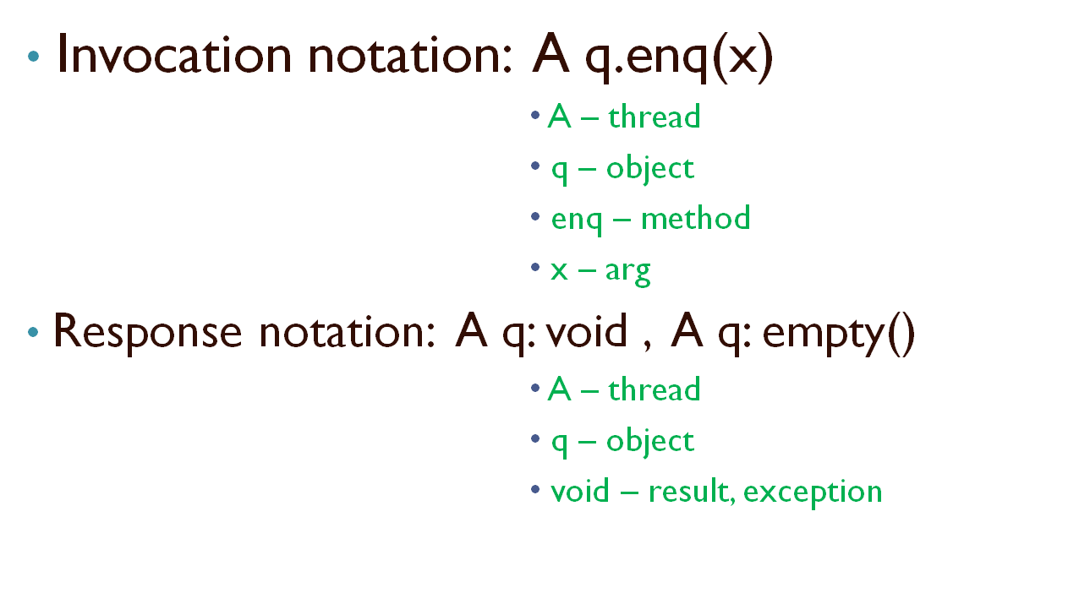
Formal model

Slide 31
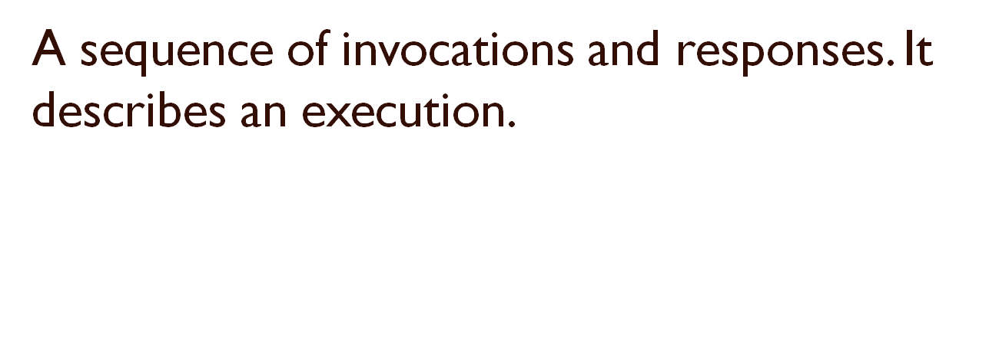
History
A q.enq(3)
A q:void
A q.enq(5)
B p.enq(4)
B p:void
B q.deq()
B q:3
H =

Slide 32
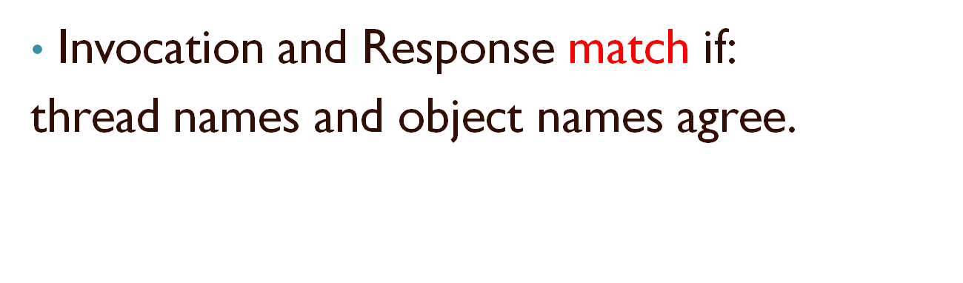
Definitions
A q.enq(3)
A q:void
And this is what we used before as:
q.enq(3)

Slide 33
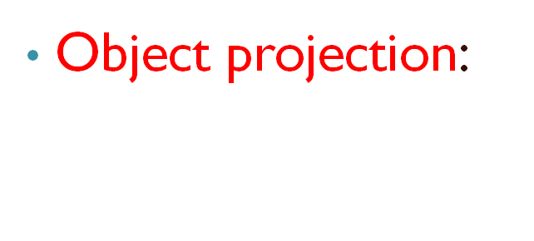
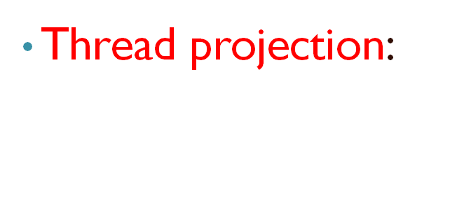
Definitions
H| q=
H| A =
A q.enq(3)
A q:void
A q.enq(5)
B q.deq()
B q:3
A q.enq(3)
A q:void
A q.enq(5)

Slide 34
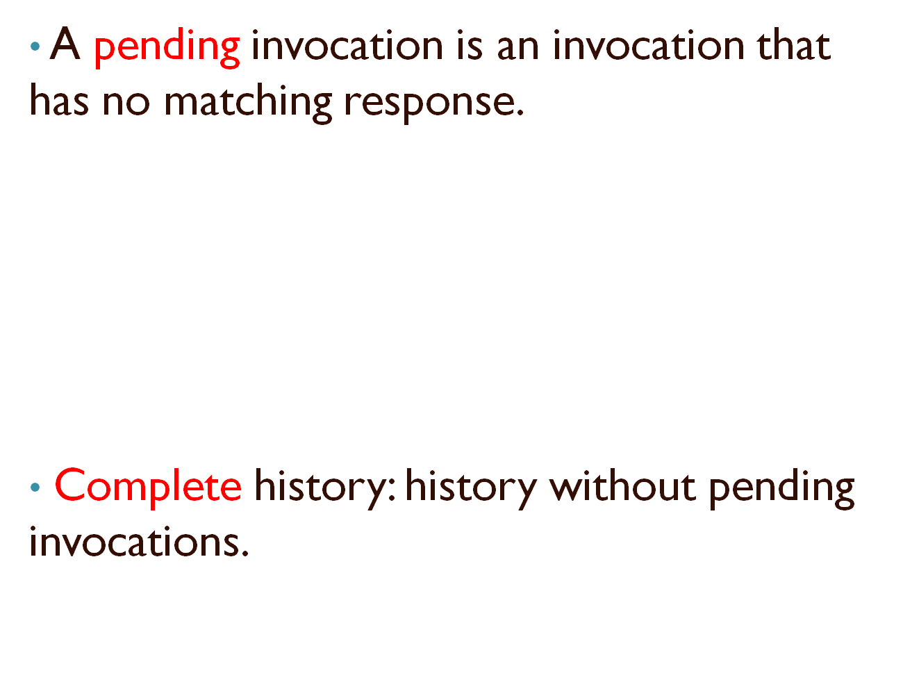
Definitions
A q.enq(3)
A q:void
A q.enq(5)
B q.deq()
B q:3

Slide 35
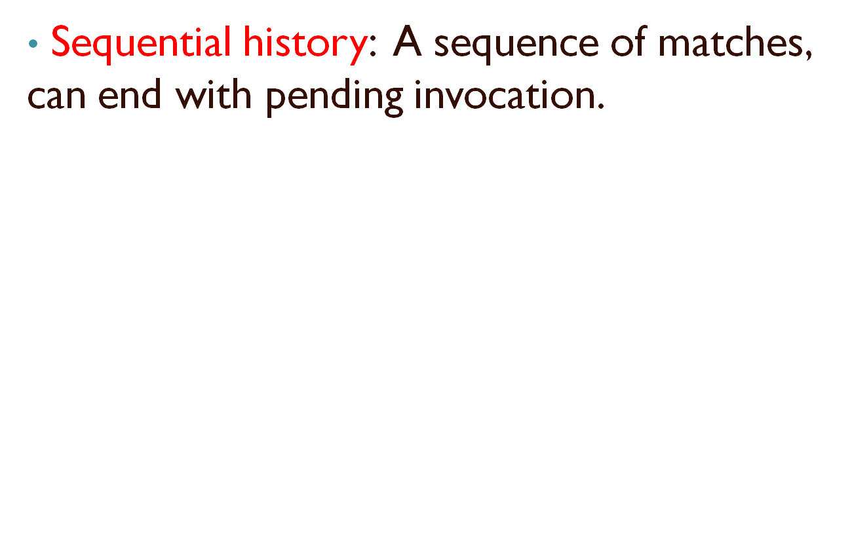
Definitions
A q.enq(3)
A q:void
B p.enq(4)
B p:void
B q.deq()
B q:3
A q:enq(5)

Slide 36
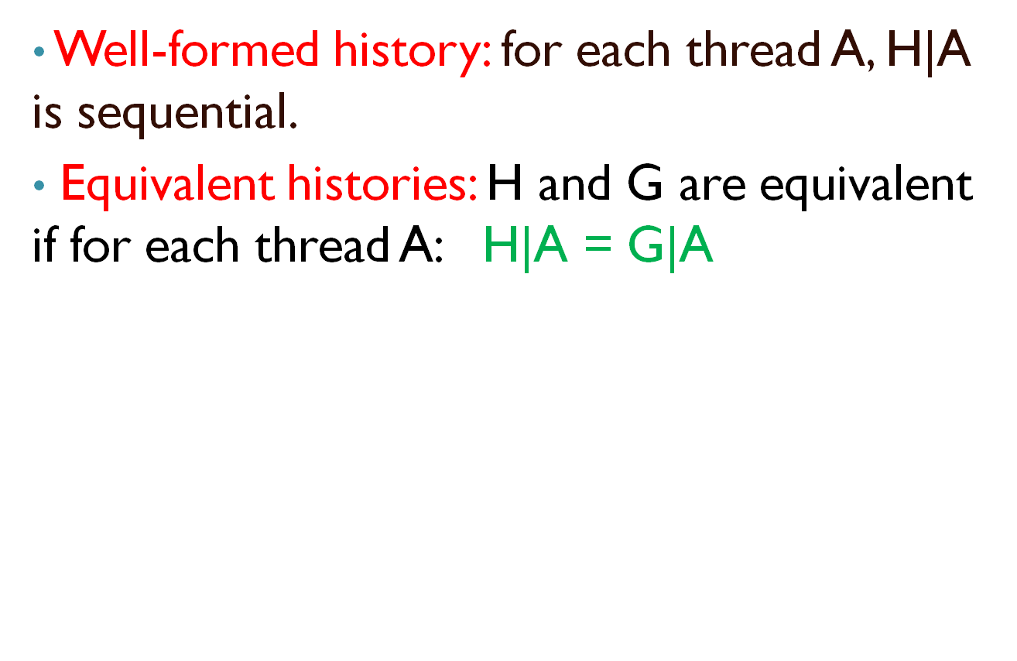
Definitions
A q.enq(3)
B p.enq(4)
B p:void
B q.deq()
A q:void
B q:3
A q.enq(3)
A q:void
B p.enq(4)
B p:void
B q.deq()
B q:3
H =
G =

Slide 37
Definitions
A method call precedes another if response event precedes invocation event.
A q.enq(3)
B p.enq(4)
B p.void
A q:void
B q.deq()
B q:3
Notation:
m₀ ➔_{H} m₁
m₀ precedes m₁
(it defines partial order)
q.enq(3)
q.deq()
time

Slide 38
Definitions
Methods can overlap
A q.enq(3)
B p.enq(4)
B p.void
B q.deq()
A q:void
B q:3
q.enq(3)
q.deq()
time

Slide 39
Sequential Specifications
This is a way of telling if single-thread, single-object history is legal.
We saw one technique:
    Pre-conditions
    Post-conditions
but there are more.

Slide 40
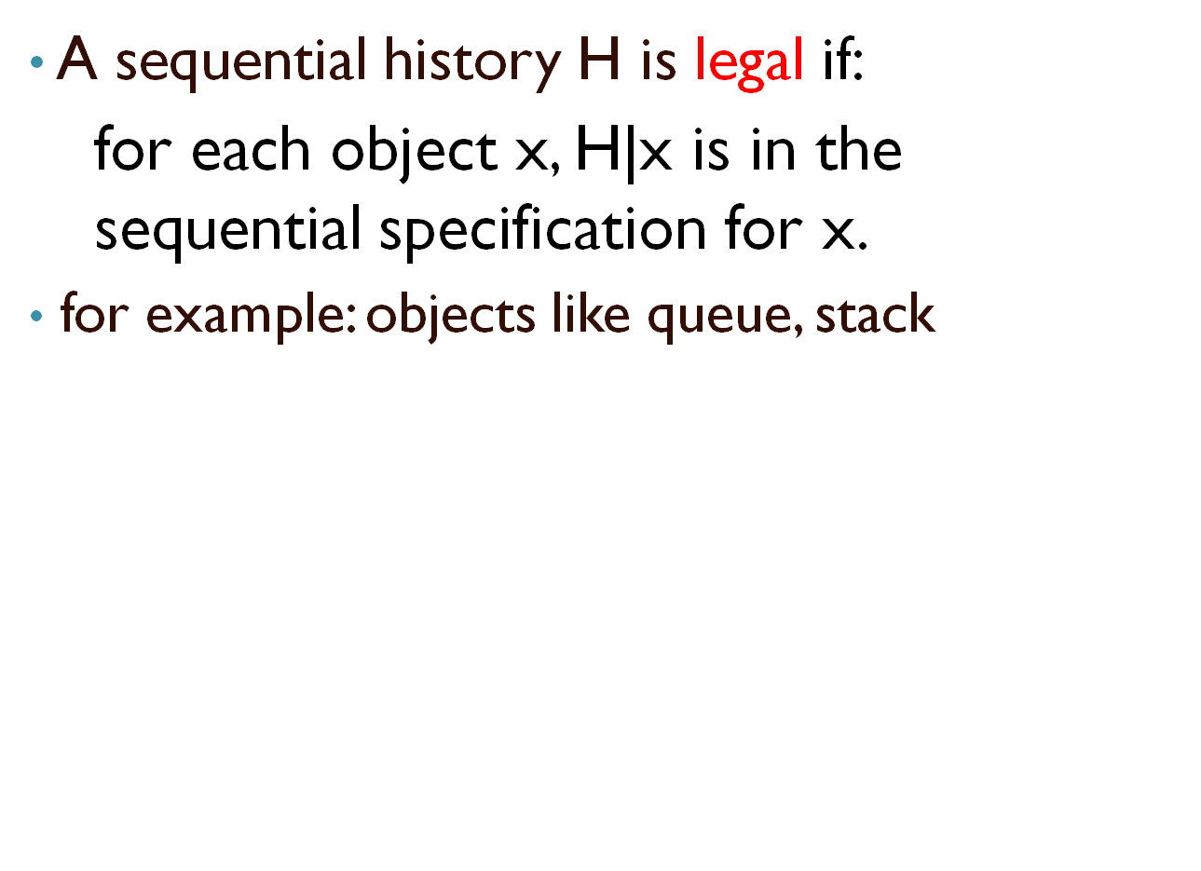
Legal history

Slide 41
Linearizability - formally
History H is linearizable if it can be extended to history G so that G is equivalent to legal sequential history S where ➔_{G} ⊂ ➔_{S.}
G is the same as H but without pending invocations:
  append responses to pending invocations.
  discard pending invocations.

Slide 42
Linearizability - formally
Let’s explain what is ➔_{G} ⊂ ➔_{S.}
Example:
➔_{G} = {a→c,b→c}
➔_{S} = {a→b,a→c,b→c}
a
b
c
time

Slide 43
Add response to this pending invocation:
Example:
A q.enq(3)
B q.enq(4)
B q:void
B q.deq()
B q:4
Discard this pending invocation:
H =
B q.enq(6)
A q:void
q.enq(3)
q.enq(4)
q.dec()
q.enq(6)
time

Slide 44
Example (cont’):
The equivalent sequent history:
A q.enq(3)
B q.enq(4)
B q:void
B q.deq()
B q:4
A q:void
B q.enq(4)
B q:void
A q.enq(3)
A q:void
B q.deq()
B q:4
G =
S =
q.enq(3)
q.enq(4)
q.dec()
time

Slide 45
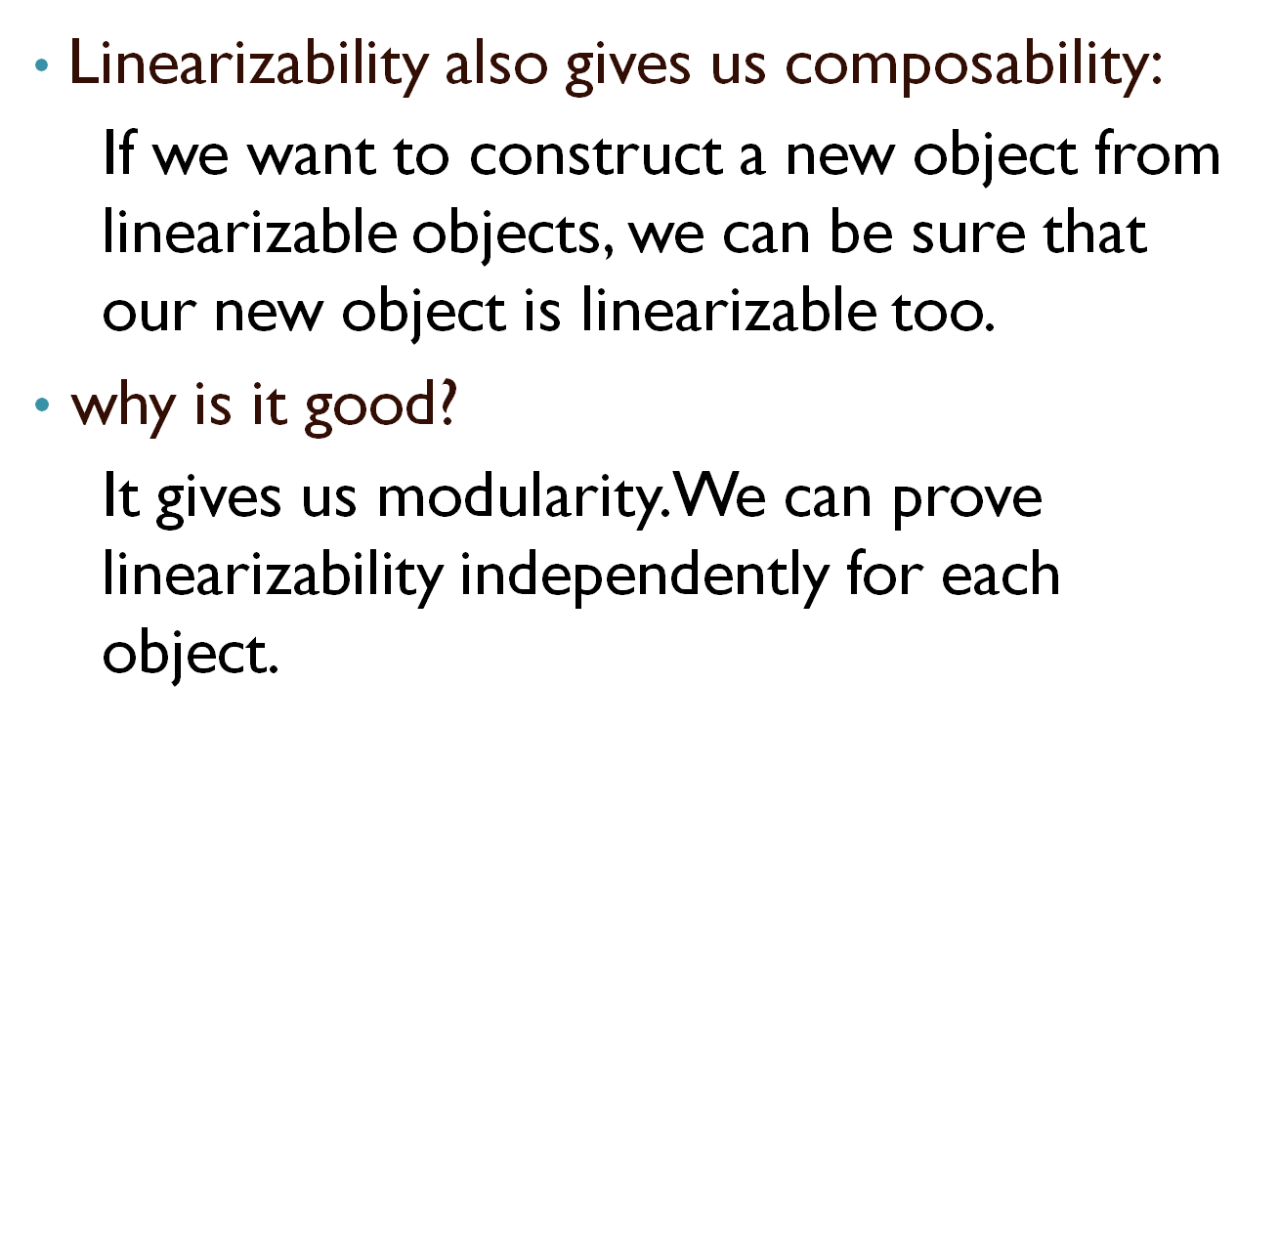
Composability

Slide 46
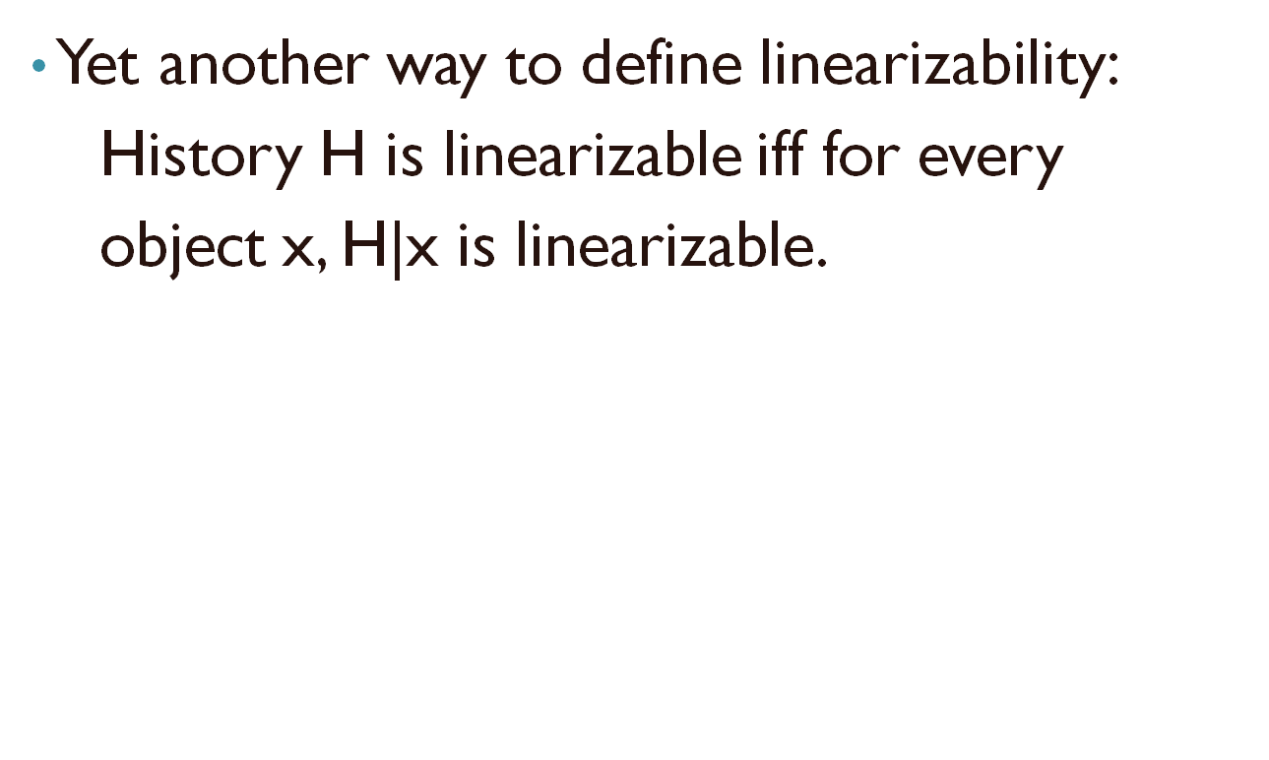
Composability

Slide 47
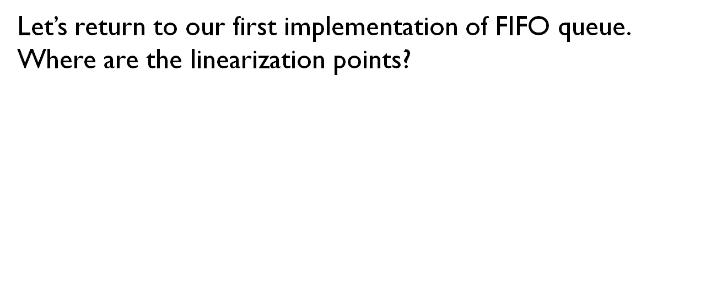
Linearizability in 1st implementation
public T deq() throws EmptyException {
lock.lock();
try {
if (tail == head)
throw new EmptyException();
T x = items[head % items.length];
head++;
return x;
} finally {
lock.unlock();
}
}
Linearization points are when locks are released.

Slide 48
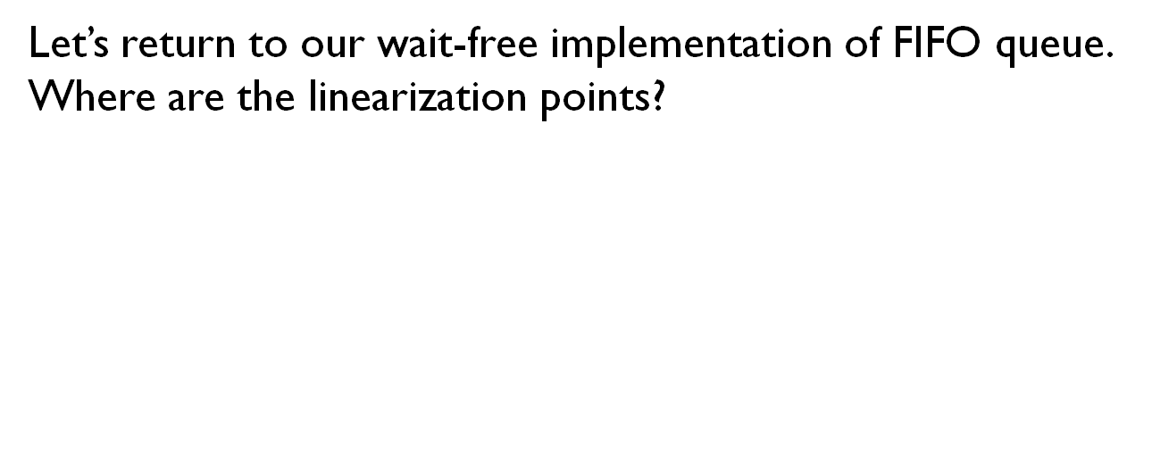
Linearizability in 2nd implementation
public class WaitFreeQueue {
int head = 0, tail = 0;
items = (T[]) new Object[capacity];
public void enq(Item x) {
if (tail-head == capacity) throw
new FullException();
items[tail % capacity] = x; tail++;
}
public Item deq() {
if (tail == head) throw
new EmptyException();
Item item = items[head % capacity]; head++;
return item;
}}
Here linearization points are the same for every execution.
Linearization points are when fields are modified.

Slide 49
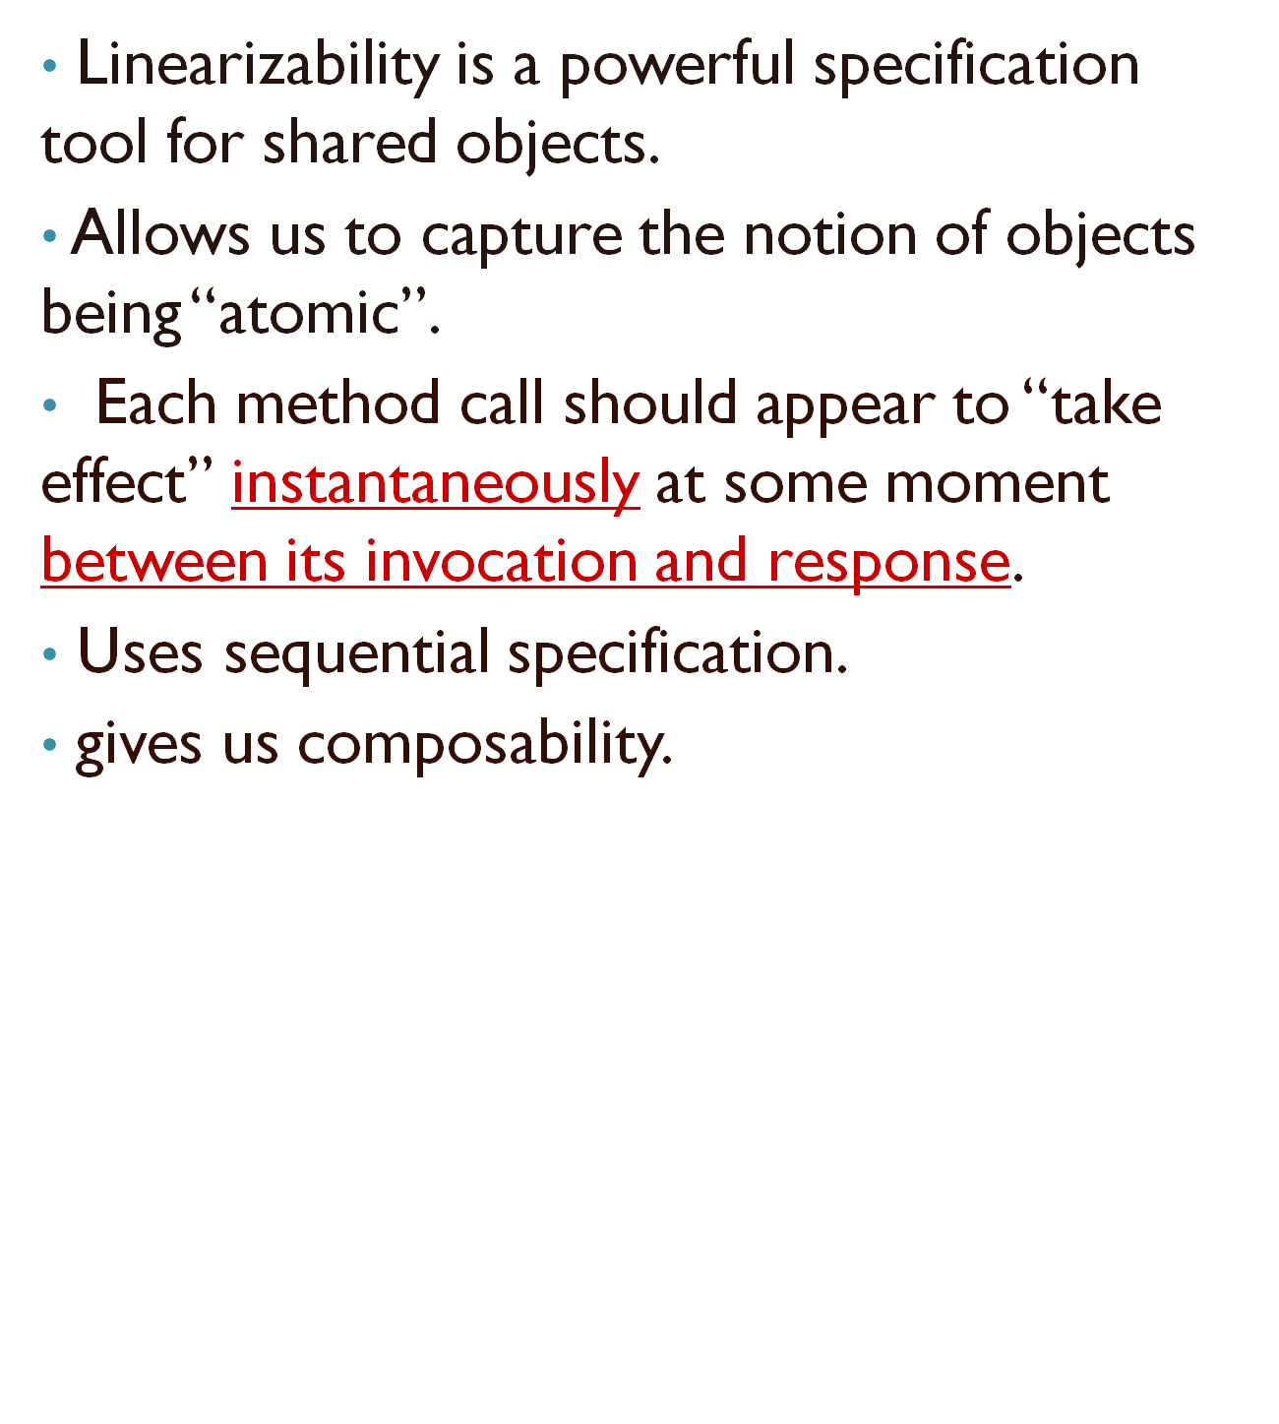
Linearizability - summary

Slide 50
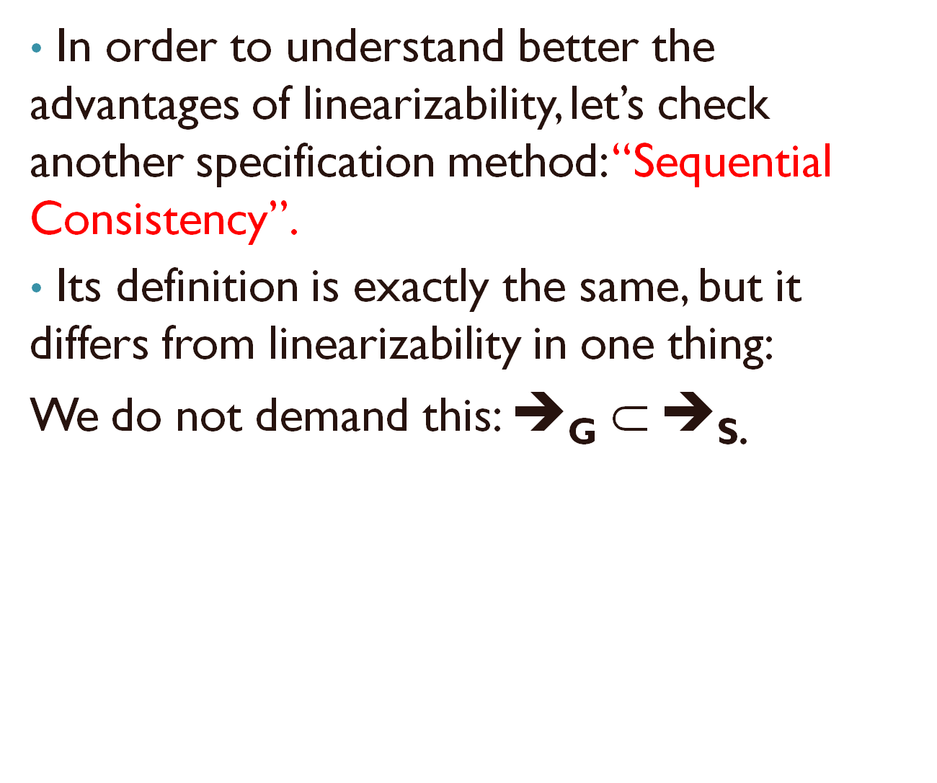
Alternative: Sequential Consistency

Slide 51
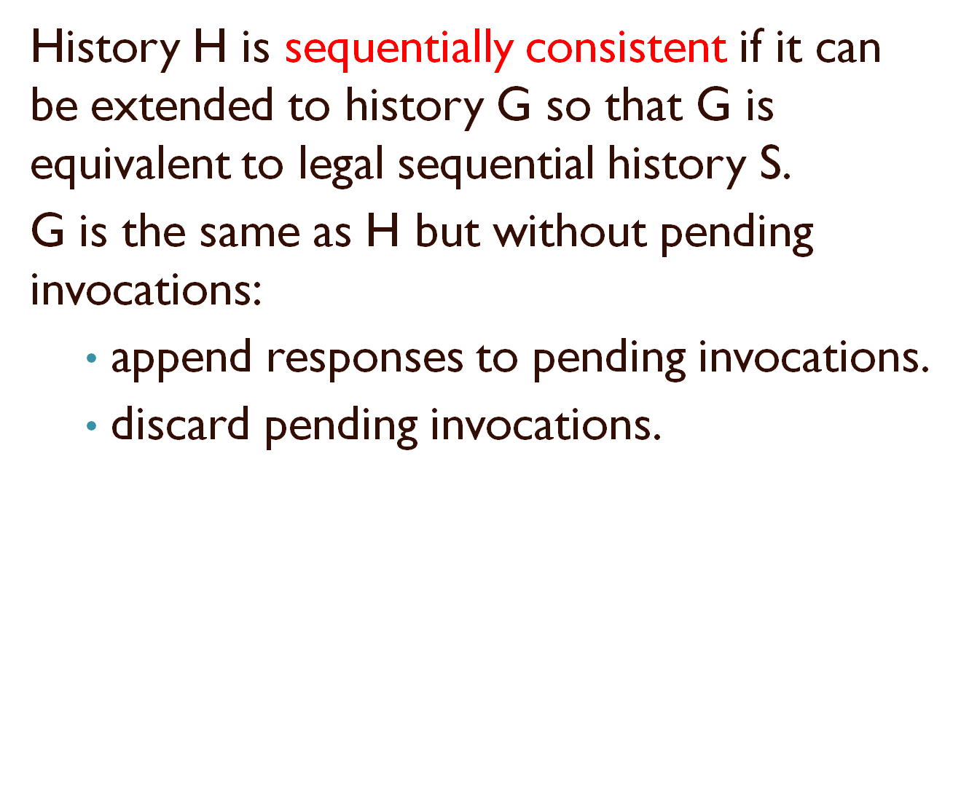
Alternative: Sequential Consistency

Slide 52
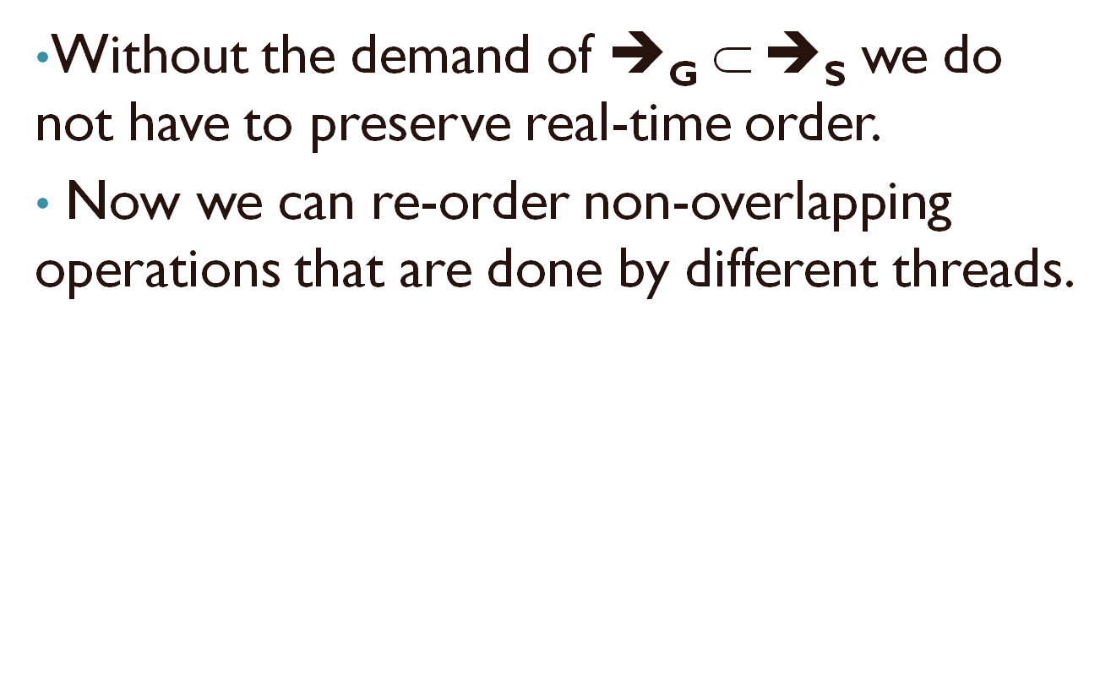
Alternative: Sequential Consistency

Slide 53
Alternative: Sequential Consistency
Example in queue:
Is it linearizable?
No!
q.enq(x)
q.deq(y)
q.enq(y)
time

Slide 54
Alternative: Sequential Consistency
Is it sequentially consistent?
Yes!
q.enq(x)
q.deq(y)
q.enq(y)
time

Slide 55
Alternative: Sequential Consistency
In sequential consistency we lose the composability property.
Let’s see a FIFO queue example:
Consider the following history H:
p.enq(x)
q.enq(x)
p.deq(y)
q.enq(y)
p.enq(y)
q.deq(x)
time

Slide 56
Alternative: Sequential Consistency
What is H|p?
p.enq(x)
q.enq(x)
p.deq(y)
q.enq(y)
p.enq(y)
q.deq(x)
Is it sequentially consistent?
Yes!
time

Slide 57
Alternative: Sequential Consistency
What is H|q?
p.enq(x)
q.enq(x)
p.deq()/y
q.enq(y)
p.enq(y)
q.deq()/x
Is it sequentially consistent?
Yes!
time

Slide 58
Alternative: Sequential Consistency
So we get order:
Ordering imposed by p:
Ordering imposed by q:
p.enq(y)
p.enq(x)
p.deq()/y
q.enq(x)
q.enq(y)
q.deq()/x
time

Slide 59
Alternative: Sequential Consistency
Order imposed by both p,q:
If we combine the two orders, we can get a circle.
Therefore the whole history is not sequentially consistent!
p.enq(x)
q.enq(x)
p.deq()/y
q.enq(y)
p.enq(y)
q.deq()/x
time

Slide 60
The End...
Bibliography:
“The Art of Multiprocessor Programming” by Maurice Herlihy & Nir Shavit, chapter 3.
http://www.cs.brown.edu/~mph/HerlihyW90/p463-herlihy.pdf - “Linearizability: A Correctness Condition for Concurrent Objects” by Herlihy and Wing, Carnegie Mellon University.

