Slide 1
Mutual Exclusion – SW & HW
By Oded Regev

Slide 2
Outline:
Short review on the Bakery algorithm
Black & White Algorithm
Bounded timestamp
L-exclusion
Mutex and semaphore in HW

Slide 3
Starvation-free Algorithms
Bakery and Black & White algorithms are both acting as solutions to enable the program to be starvation free
Starvation freedom: “if a process is trying to enter its critical section, then this process must eventually enter its critical section”
Lets review some attributes of SF Algorithms…

Slide 4
Bounded-waiting: “There exists a positive integer r for which the algorithm is r-bounded waiting. That is, if a given process is in its entry code, then there is a bound on the number of times any other process is able to enter its critical section before the given process does so”.
Linear-waiting: “actually 1-bounded-waiting, meaning no process can execute its critical section twice while some other process is kept waiting”.
FIFO: “no beginning process can pass an already waiting process (sometimes called 0-Bounded-waiting)”.
r-Fairness: “A waiting process will be able to enter its CS before all the other processes collectively are able to enter their CS r+1 times”.

Slide 5
Bakery Algorithm
The idea is similar to a line at the bakery
A customer takes a number greater than numbers of other customers
Each of the threads gets a unique identifier

Slide 6
Bakery Algorithm
Thread i
number[i] = -1
number[i] = 1 + max {number[j] | (1 ≤ j ≤ n) , 0}
for j = 1 to n {
await number[j] ≠ -1
await (number[j] ≤ 0) ∨ (number[j],j) ≥ (number[i],i)
}
critical section
number[i] = 0

Slide 7
Bakery Attributes:
Deadlock-freedom: If a thread is trying to enter its critical section, then some thread, not necessarily the same one, eventually enters its critical section.
Starvation-free (each process waiting to get into its CS part will eventually get there)
FIFO

Slide 8
What are the problems with this algorithm??
Computing the Maximum
The size of the register number[i] must be unbounded.
Is it possible to fix this problem while using only one additional shared bit??

Slide 9
The Black-White Bakery Algorithm
Bounding the space of the Bakery Algorithm
Bakery (FIFO, unbounded)
The Black-White Bakery Algorithm
FIFO
Bounded space
+ one bit

Slide 10
The Black-White Bakery Algorithm
Every process i gets a colored ticket - color(i) and number(i) in its entry section. The color is the same as the current value of the shared bit color. The number is greater than the maximum between the processes who share the same color as process i.
The order between the colored tickets is defined as follows:
  If 2 tickets have different colors – the ticket with the color different from the shared bit color is smaller.
  If 2 tickets have the same color, the ticket with the smaller number is smaller.
  If 2 tickets have the same color and number (how is it possible?) the process with the smaller identifier enters the CS first.

Slide 11
How does the shared color bit is written?
The first thing process i does when it leaves its critical section is to set the color bit to a value which is different from the color of its ticket.
3 data structures are used:
  A single shared bit named “color”
  A boolean array choosing[1…n]
  An array with n-entries where each entry is a colored ticket.

Slide 12
The Black-White Bakery Algorithm
color bit
1
2
3
4
5
n
0
0
0
0
0
0
0
0
remainder
0
0
0
1
0
2
0
1
0
2
0
doorway
2
entry
waiting
1
2
1
2
2
1
2
CS
1
2
time
1
2
exit
1
2

Slide 13
The Black-White Bakery Algorithm code of process i , i ∈ {1 ,..., n}
choosing[i] = true
mycolor[i] = color
number[i] = 1 + max{number[j] | (1 ≤ j ≤ n) ∧ (mycolor[j] = mycolor[i])}
choosing[i] = false
for j = 0 to n do
await choosing[j] = false
if mycolor[j] = mycolor[i]
then await (number[j] = 0) ∨ (number[j],j) ≥ (number[i],i) ∨
(mycolor[j] ≠ mycolor[i])
else await (number[j] = 0) ∨ (mycolor[i] ≠ color) ∨
(mycolor[j] = mycolor[i]) fi od
critical section
if mycolor[i] = black then color = white else color = black fi
number[i] = 0

Slide 14
Algorithm correctness:
Lemma 1: Assume that at time t, the value of the color bit is c(black|white). Then, any process which at time t is in its entry section and holds a ticket with a color different than c must enter its CS before any process with a ticket of color c can enter its CS.
Lemma 2: Assume that at time t the value of the color bit has changed from c to the other value. Then, at time t, every process that is in its entry section has a ticket of color c.

Slide 15
Summary – Black & White
mutual exclusion
deadlock-freedom
FIFO
Uses finite number of bounded size registers, the numbers taken by waiting processes can grow only up to n, where n is the number of processes.

Slide 16
Bounded Timestamps
Black & White is a private case solution to a much bigger problem.
The numbers in the Bakery (and in B&W) actually represented a timestamp.
the time is infinite of course, so how can we make sure that our time labeling will not over flow in time??
How important is the overflow problem in the real world?

Slide 17
We will focus on a sequential timestamping system, in which we assume that a thread can scan and label in a single atomic step.
Think of the set of timestamps as nodes of a directed graph (called a precedence graph). There is an edge from node a to node b if a is a later timestamp than b.
Think of assigning a timestamp to a thread as placing that thread’s token on a node.
The precedence graph is irreflexive, antisymmetric, not necessarily transitive.

Slide 18
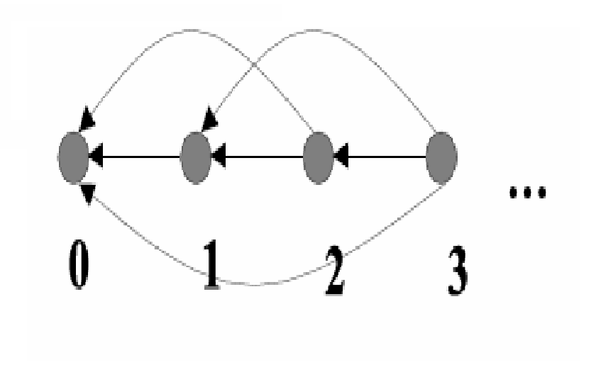
A thread performs a scan by locating the other threads tokens, and it performs a label by moving its own token to a node a such that there is an edge from a to every other thread’s node.

Slide 19
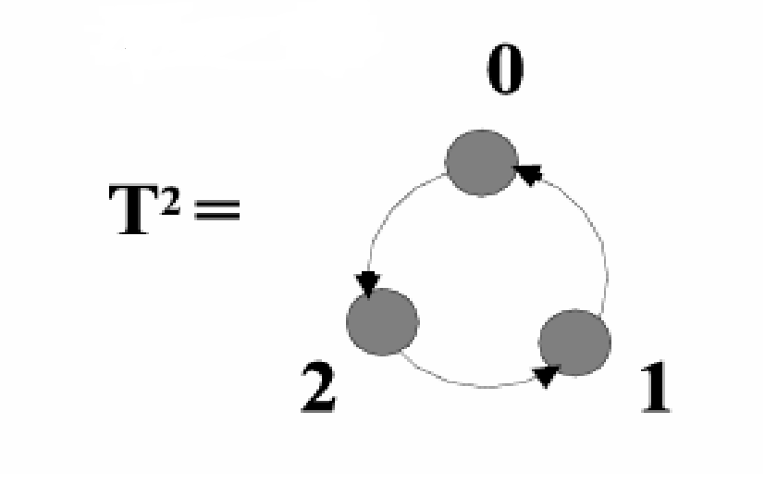
The precedence graph for the unbounded counter used in the Bakery array appears in the last figure. Not surprisingly, the graph is infinite
Let’s view a solution for 2 threads only:

Slide 20
The only cycle in the graph T2 has length three, and there are only two threads, so the order among the threads is never ambiguous.
Let G be a precedence graph, and A and B subgraphs of G (possibly single nodes). We say that A dominates B in G if every node of A has edges directed to every node of B.
Let graph multiplication be the following composition operator for graphs: G * H, for graphs G and H, is the following non-commutative operation:

Slide 21
Replace every node v of G by a copy of H (denoted Hv), and let Hv dominate Hu in G * H if v dominates u in G.
Define the graph Tk inductively to be:
  1. T1 is a single node.
  2. T2 is the three-node graph defined above.
  3. For k > 2, Tk = T2 * Tk-1.

Slide 22
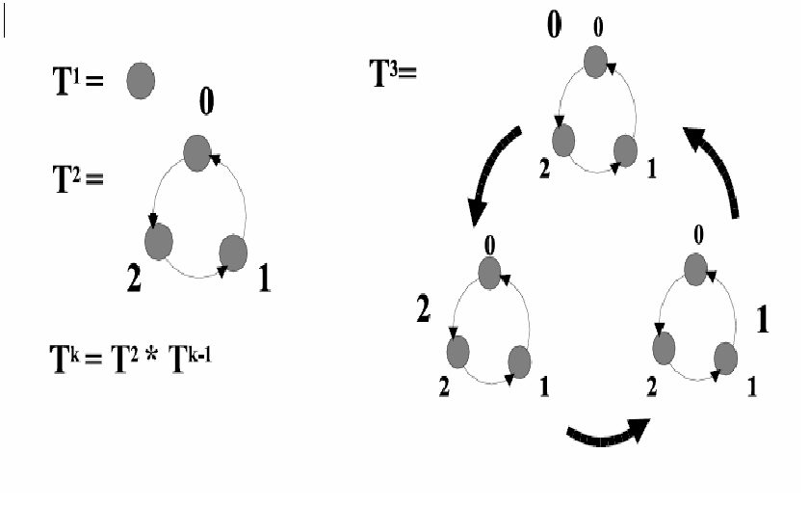
How can we scale this to more than 2 threads?

Slide 23
Summary - Bounded Timestamps
The key to understanding the n-thread labeling algorithm is that the nodes covered by tokens can never form a cycle. As mentioned, two thread can never form a cycle on T2, because the shortest cycle in T2 requires three nodes.
How does the label method work for three threads? When A calls the label method, if both of the other threads have tokens on the same T2 subgraph, then move to a node on the next highest T2 subgraph, the one whose nodes dominate that T2 subgraph.

Slide 24
L-exclusion problem:
How to design an algorithm which guarantees that up to L processes and no more may simultaneously access some shared resource (their CS).
A solution is required to withstand the slow-down or even crash of up to L-1 processes (more explicitly, a single failure of a process at the head of the queue should not tie up all the resources).
The bus ride story…
Teller in a bank story…

Slide 25
Some definitions:
L-exclusion: “no more than l processes are at their CS at the same time.”
L-deadlock-freedom: “if strictly fewer than l processes fail, then if a process is trying to enter its CS, then some process, not necessarily the same one, eventually enters its CS.”
L- starvation-freedom: “if strictly fewer than l processes fail, then any correct process that is trying to enter its CS must eventually enter it.”

Slide 26
Explain why the FIFO property and the L-deadlock-freedom property cannot be mutually satisfied when L>1 ??
Lets see an example of a L-starvation-free algorithm…

Slide 27
Peterson L-starvation-free algorithm
Initially b[1..n] all 0, turn[1…n-L] all 1
for level = 1 to n-L do
b[i] = level;
turn[level] = i;
repeat
counter = 0;’
for k = 1 to n do
if b[k] >= level then counter = counter + 1;
until (counter <= n-level or turn[level] != i)
od;
Critical section;
B[i] = 0;

Slide 28
Properties of the algorithm:
Satisfied L-exclusion and L-starvation-freedom.
L-exclusion: exactly one process waits at each level. Once L processes enter their CS any other active process must be waiting on the n-L levels.
L-deadlock-free: assume to the contrary…
The fact that the algorithm is L-deadlock-free and the fact that at any level a new process always releases (by setting turn[level] to its value) all the other processes at the level that came before it to climb up to the next level ensures L-starvation-freedom

Slide 29
Mutex and semaphore in HW
HW features can make any programming task easier and improve system efficiency.
In general we can state that any solution to the CS problem requires that critical regions be protected by locks.
in this section we will explore some simple HW instructions that are avilable on many systems and show how they can be used effectively to solve the CS problem

Slide 30
The CS could be solved simply in a uniprocessor environment if we could prevent interrupts from occurring while a shared variable was being modified. This is the approach taken by nonpreemptive kernels. This approach is extremly inefficient in multi processor environment.
We will explore 4 HW based atomic instructions:
  TestAndSet()
  Swap()
  Wait()
  Signal()

Slide 31
Boolean TestAndSet (boolean *target) {
boolean rv = *target;
*target = TRUE;
return rv;
}
Mutex implementation with TestAndSet()
Do {
while (TestAndSet(&lock) )
; // do nothing
// critical section
lock = FALSE;
//remainder section
}while(TRUE)
Is this implementation is good enough to fulfill our needs??

Slide 32
void Swap (boolean *a, boolean *b) {
boolean temp = *a;
*a = *b;
*b = temp;
}
Mutex implementation with Swap()
do {
key = TRUE;
while (key == TRUE)
Swap(&lock, &key);
// critical section
lock = FALSE;
//remainder section
} while (TRUE)

Slide 33
Although the last 2 algorithm satisfy the mutual-exclusion requirement, they do not satisfy the bounded-waiting requirement.
The next algorithm will stasfied all the CS requirments:
The common data-structures are:
  Boolean waiting[n];
  Boolean lock;
Process i can enter its CS only if either (waiting[i] == false) or (key == false)

Slide 34
do {
waiting[i] = TRUE;
key = TRUE;
while (waiting[i] && key)
key = TestAndSet(&lock);
waiting[i] = FALSE;
//critical section
j = (i+1) % n;
while ((j != i) && !waiting[j])
j = (j+1) % n;
if (j==i)
lock = FALSE;
else
waiting[j] = FALSE:
//remainder section
} while (TRUE)

Slide 35
Semaphores:
A semaphore S is an integer variable that, apart from initialization, is accessed only through 2 standard atomic operations: wait() and signal().
wait(S) {
while (S <= 0)
; //no-op
S--;
}
Signal(s) {
S++;
}

Slide 36
Usage:
Operating systems often distinguish between counting and binay semaphores.
The value of a counting semaphore can range over unrestricted domain.
The value of a binary semaphore can range only between 0 and 1.
Binary semaphore can be used to solve the critical section problem.
Counting semaphore can be used to control access to a given resource consisting of a finite number of instances.
We can also use semaphores to solve various synchronization problems.

Slide 37
For example, consider 2 running processes P1 with a statement S1 and P2 with S2. suppose we require that S2 be executes only after S1 has completed.
In P1
S1;
Signal(S)
In P2
Wait(S);
S2;
S is initialized to 0.

Slide 38
Implementation
The main disadvantage of the semaphore definition given here is that it requires busy waiting.
Busy waiting wastes CPU cycles that some other process might be able to use productively.
This type of semaphore is also called a spinlock
We can modify the definition of the wait() and signal() operations as follows…

Slide 39
Instead of engaging in busy-waiting the process can block itself.
The block() operation places a process into a waiting queue associated with the semaphore, and the state of the process is switched to waiting state.
A process that is blocked, waiting on a semaphore S, should be restarted when some other process execute a signal() operation.
The process is restarted by wakeup() operation, which changes the state of at most one process from waiting to ready.

Slide 40
To implement semaphores under this definition we define a semaphore as a C struct.
typedef struct {
int value;
struct process *list;
} semaphore;
The wait() operation can now be defined as:
wait(semaphore *S) {
S->value--;
if (S->value < 0) {
add this process to S->list;
block();
}
}

Slide 41
The signal() operation can now be defined as:
signal(semaphore *S) {
S->value++;
if (S->value <= 0) {
remove a process P from S->list
wakeup(P);
}
}
The block() operation suspends the process that invokes it. The wakeup(P) operation resumes the execution of a blocked process P.
These 2 operations are provided by the operating system as a basic system calls.

Slide 42
Some notes:
In the definition with the busy-waiting, the value of the semaphore is never negative.
In the second definition, if the value is negative it represent the number of processes waiting on that semaphore.
The critical aspect of semaphores is that they must be executed atomically.
We must guarantee that no 2 processes can execute wait() and signal() on the same semaphore at the same time.
How can we do it in a single processor environment?
What about multiprocessor environment??

Slide 43
In conclusion:
Short review on the Bakery algorithm
Black & White Algorithm
Bounded timestamp
L-exclusion
Mutex and semaphore in HW
Thank You

