Slide 1
REBIRTH
: 재생
Jaehyung Lee
Introduction
This is a project that recorded
Incidents of people’s interest by homage to
Video artist namJune paik’s <다다익선>
Intention
Braun tube tv that constitutes original work is getting old and breaks down.
Since it is difficult to find replacement parts,
one or two of them have been neglected and the work is currently turned off.
I thought that this was similar to human memory,
and that people also chose to recall incidents according to their interest.
Therefore, I want to move the real TV to 3d screen
and play incidents for a TV that will not break down forever,
and I want to keep a record, not a memory.

Slide 2
REBIRTH
: 재생
Jaehyung Lee
Function & Feature
Rotate 3D grid automatically
Rotate X, Y, Z
Sound
Show Gifs : PImage[]
Tool
Processing
Online mp4 to gif converter & spliter
How to make
Loop Statement
Class
Array
rotate(), translate()
box, image
Design & Concept
Homage to paiks’ artwork

Slide 3
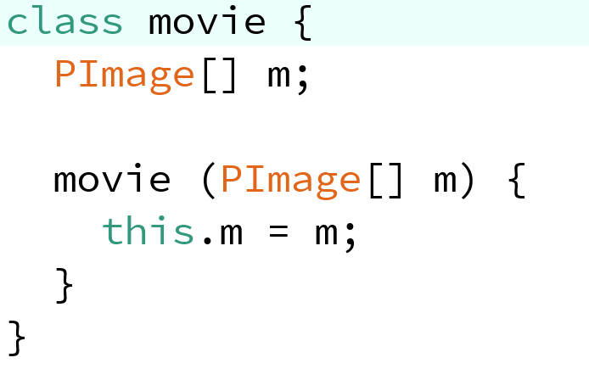
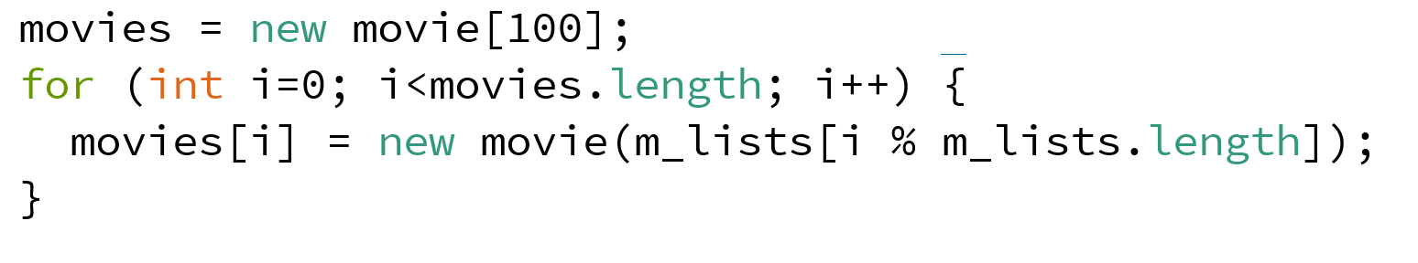
REBIRTH
: 재생
Jaehyung Lee
Using <Class> & <for statement> & <array.index>
Repeat formula to reuse a finite array as many times as you want

Slide 4
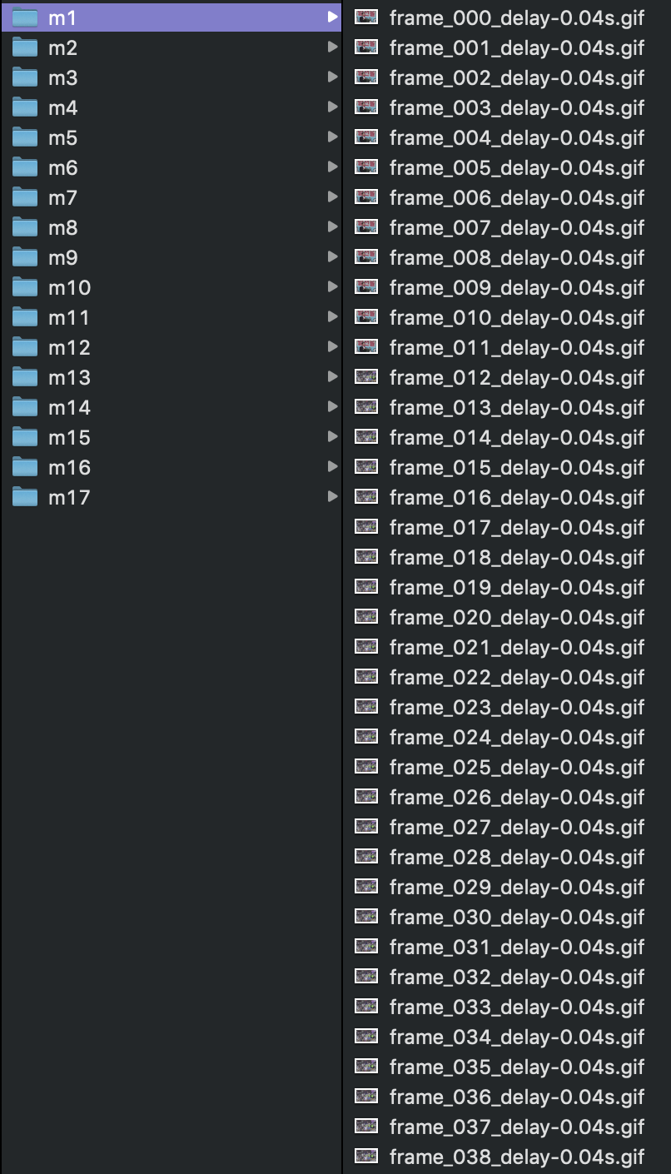
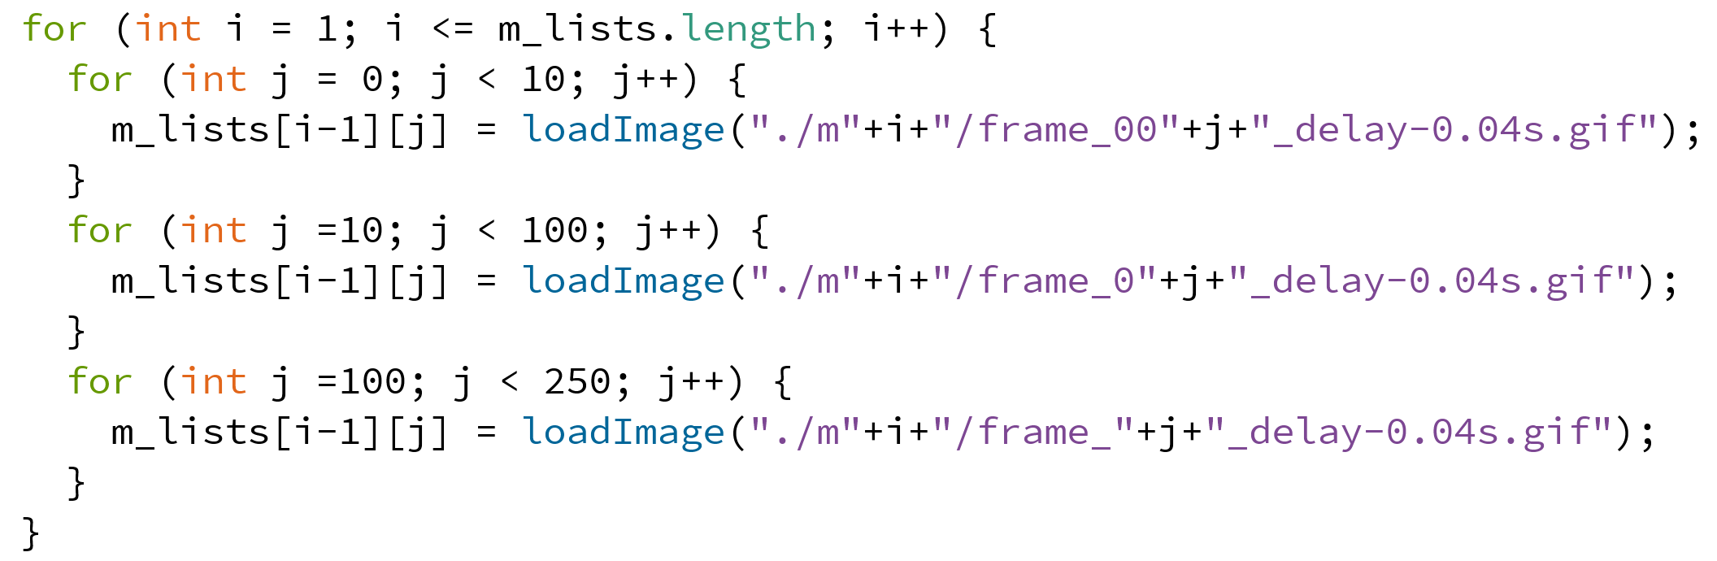
REBIRTH
: 재생
Jaehyung Lee
Import 250 gif files for each data folder
Filename: frame_000_...gif ~ frame_249_...gif

Slide 5
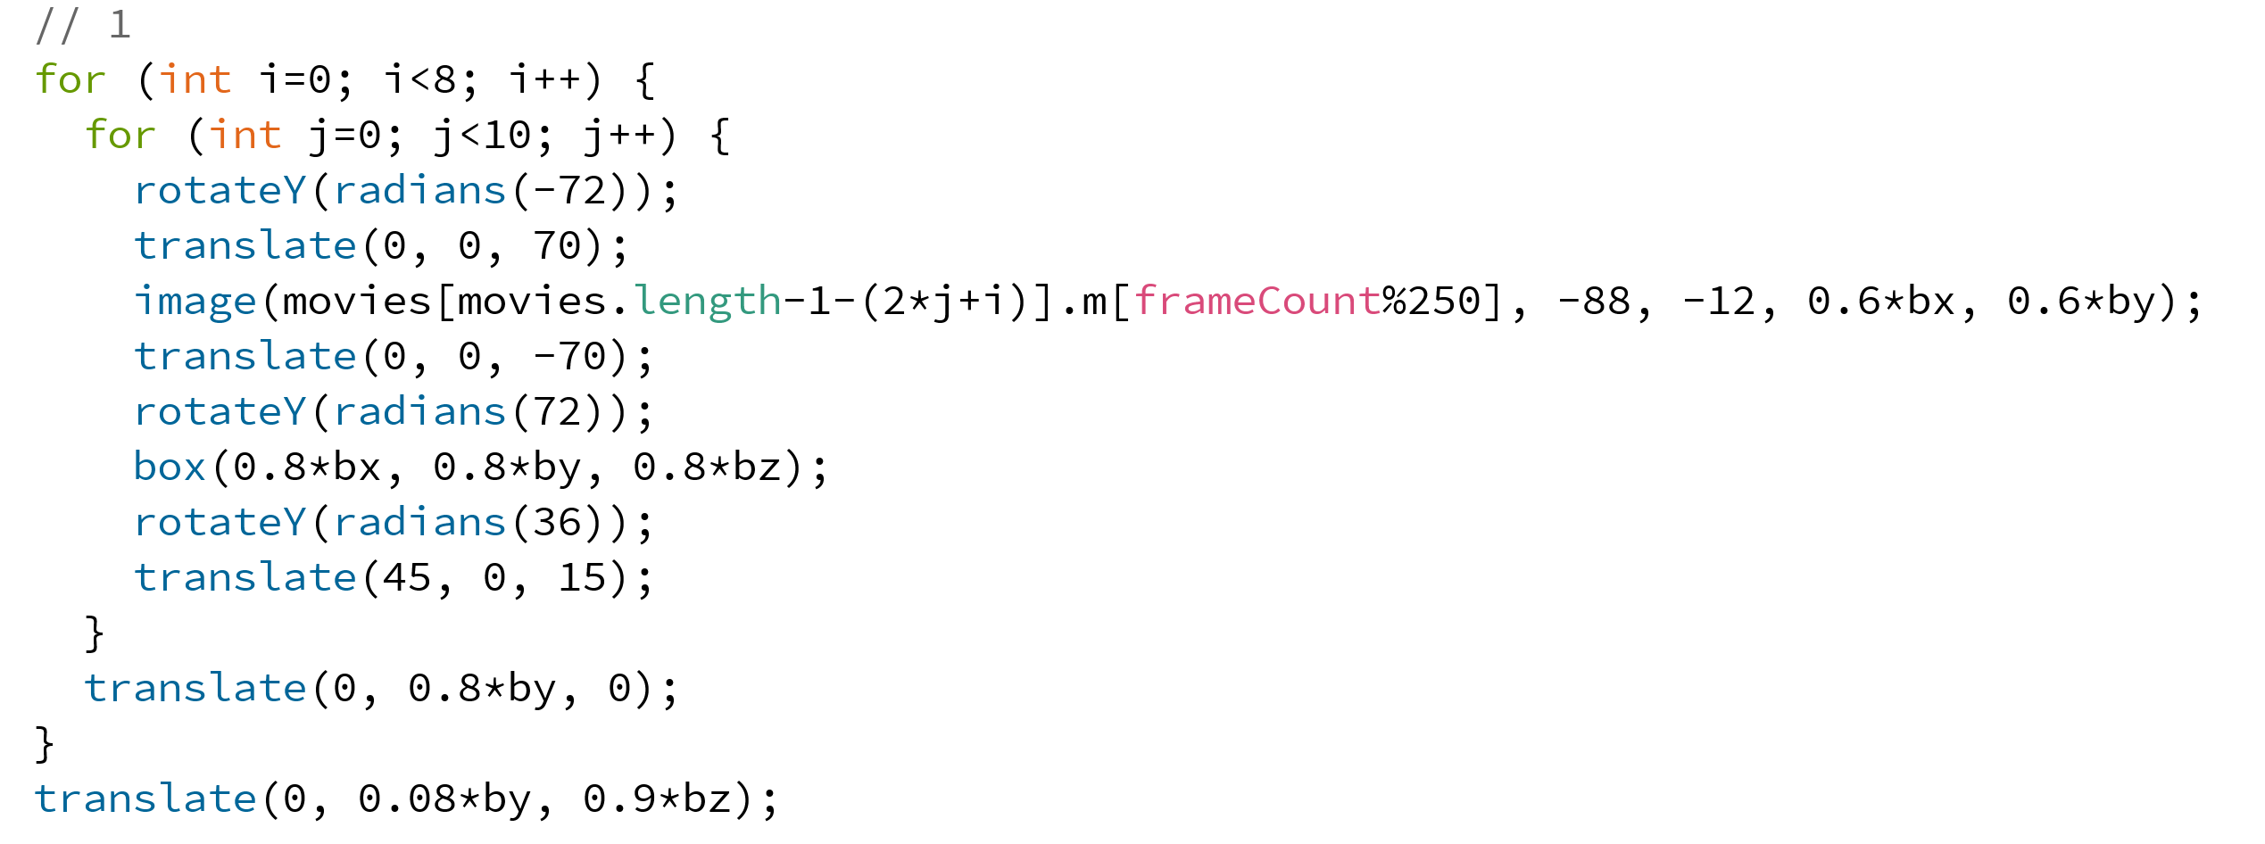
REBIRTH
: 재생
Jaehyung Lee
Import 250 gif files for each data folder
Filename: frame_000_...gif ~ frame_249_...gif
Loop statement
Makes each stage of video tower

