Slide 1
AskSlotMachine iOS iphone app entertainment/ free
When a puzzle is number-based, how does one get from a number or group of numbers to a word?

Slide 2

Hint
In simplest terms, this can be written as A=1, B=2 ... Z=26.
Through random word to measuring fortune
Knowledge（知識）
K + N + O +W + L + E + D +G +E=
11 +14 +15 +23+12 + 5 + 4 +7 +5= 96

Slide 3
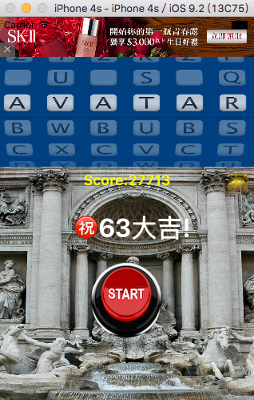

AskSlotMachine
Through random word to measuring fortune, enhance self-confidence, act alert, and increase understanding of English words

Slide 4
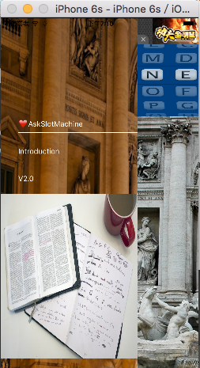
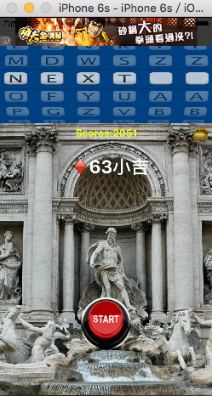
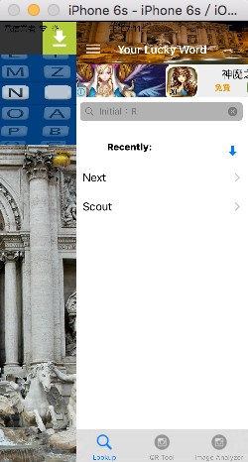
Clean and easy to use
Allow user to quickly swipe between sections

Slide 5
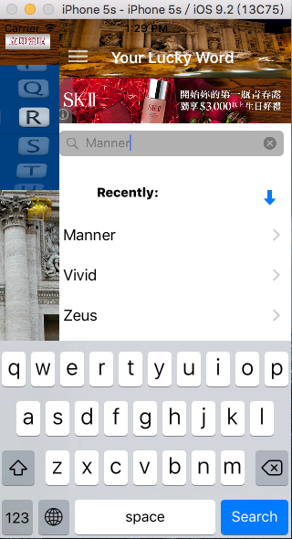
Look up word in just one tap
History tab lists words recently looked up

Slide 6
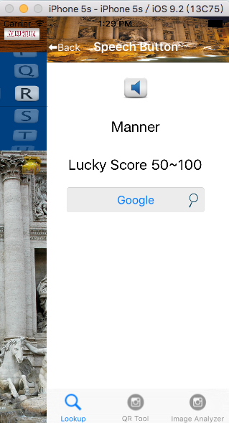
Speech Button
Has more than 26,000 words, including pronunciation audio.

Slide 7
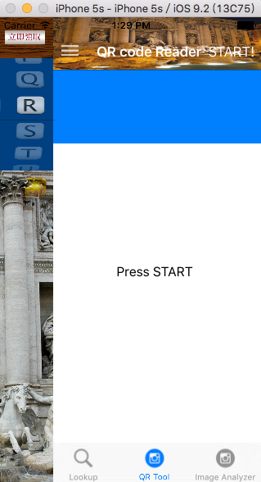
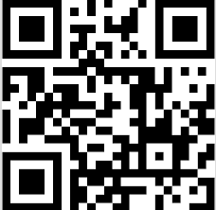
QR code Reader
Allow user to look up QR code
Your app works!

Slide 8
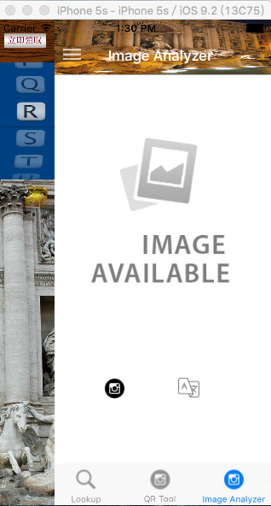
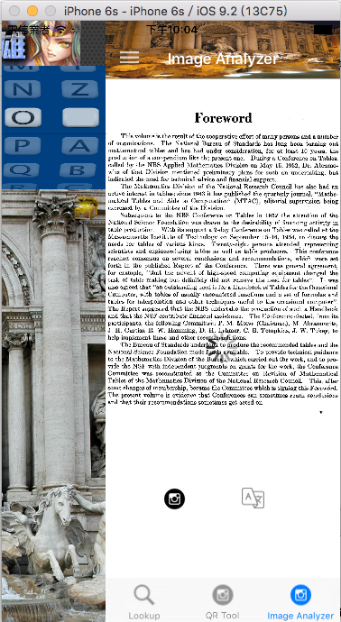
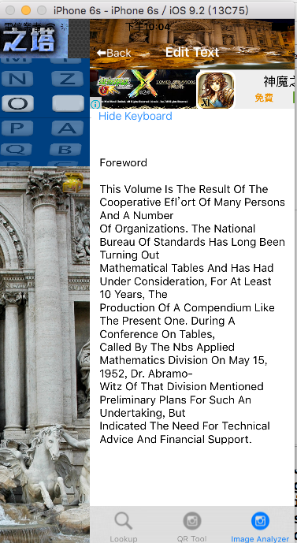
Image Analyzer
Supports use camera to translate picture to a whole English text.

Slide 9
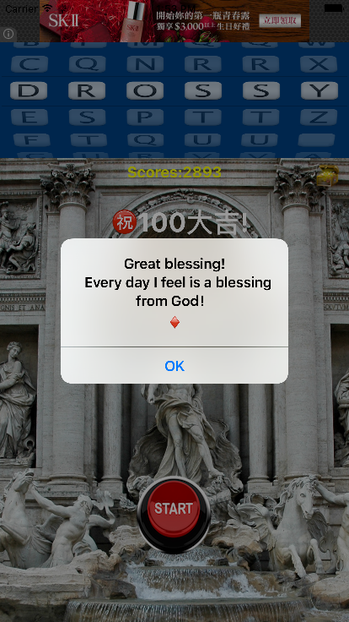
Open iTunes and download
AskSlotMachine iOS iPhone
Free
Entertainment
https://itunes.apple.com/us/app/askslotmachine/id1072576674?mt=8

