Slide 1
OptiNAA v3.0: Optimization of Neutron Activation Analysis
Author: Fulvio Farina email: fulviofarina@gmail.com
** WHY OPTINAA?**
In KayZero for Windows:
1- The elemental concentration of Cerium in a sample (for example) is determined by assuming that the monitored radioisotope ¹⁴¹Ce was produced by ¹⁴⁰Ce(n,γ)¹⁴¹Ce reactions.
2- If the sample contains Uranium, a correction is suggested for Cerium, since fission of ²³⁵U produces ¹⁴¹Ce also. This correction is calculated by assuming that the Uranium is in its natural abundance.
In OptiNAA:
1- Assumes the contrary. The monitored radioisotope ¹⁴¹Ce was produced by fission of the ²³⁵U in the sample and NOT by ¹⁴⁰Ce(n,y)¹⁴¹Ce reactions. Elemental concentrations are “apparent”.
2- Compares the data for the ²³⁵U fission products (like ¹⁴¹Ce) versus the data for the ²³⁸U(n,y) activation products (like ²³⁹Np). Determines if the Uranium in the sample is enriched, depleted or natural and calculates the true Uranium elemental concentration, ²³⁵U vs. ²³⁸U Isotopic Ratio and abundances and the true U Molar Weight.
3- A correction is suggested for the elemental concentration of Cerium (for example), based on the obtained true isotopic abundance of ²³⁵U in the sample.

Slide 2
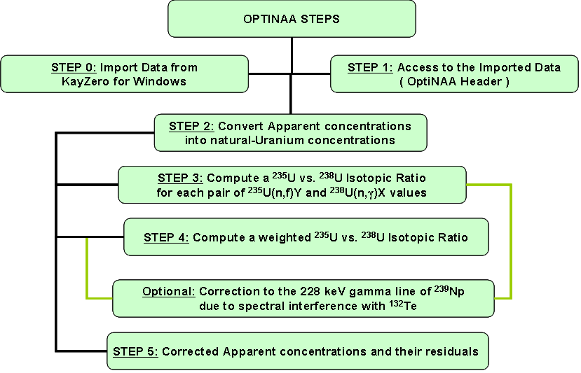
OptiNAA v3.0: Optimization of Neutron Activation Analysis
Author: Fulvio Farina email: fulviofarina@gmail.com
** OPTINAA STEPS**

Slide 3
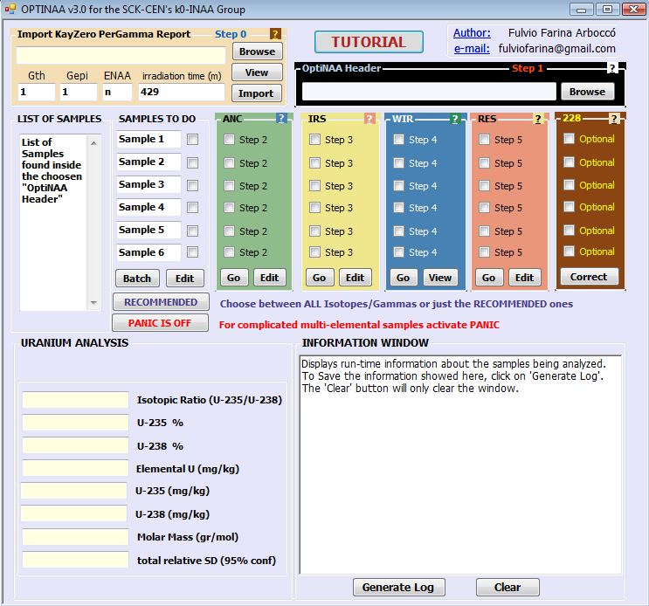

Slide 4
OptiNAA v3.0: Optimization of Neutron Activation Analysis
Author: Fulvio Farina email: fulviofarina@gmail.com
** STEP 0: Import KayZero PerGamma Report**
The data relative to an irradiated sample (or series of samples) containing Uranium, needs to be introduced into OptiNAA in a format that the program can interpret and process.
Since at the SCK•CEN’s k0-NAA Laboratory the software of choice for calculating elemental concentrations is KayZero for Windows, it was clearly necessary to avoid re-introducing manually the same data into the OptiNAA program, which is cumbersome and time consuming.
This module was intended for allowing the analyst to quickly input into the OptiNAA program, the Apparent & natural-Uranium concentrations obtained from a previous elemental analysis of samples with KayZero for Windows.
What’s an apparent concentration?
What’s a natural-Uranium concentration?
Back
Next

Slide 5
OptiNAA v3.0: Optimization of Neutron Activation Analysis
Author: Fulvio Farina email: fulviofarina@gmail.com
** VADEMECUM**
- What’s an apparent concentration?
In k0-NAA of samples, an elemental concentration is obtained from the assumption that a monitored radioisotope was produced, directly or indirectly, by (n,γ) reactions with isotopes of the element of interest.
If different neutron capture mechanisms (i.e. fission of ^{235U}, threshold reactions) for producing the same monitored radioisotopes occurred during irradiation of the samples, the elemental concentrations obtained from the previous assumption will be biased (interfered) from their true value.
Example: ¹⁴⁰Ce(n,γ)¹⁴¹Ce interfered by ²³⁵U(n,f)¹⁴¹Ce
In such cases, the elemental concentration obtained corresponds to an apparent concentration and not to a true concentration.
In NAA of samples containing Uranium, this is generally the case for many elemental concentrations, since fission of ²³⁵U gives rise to several radioisotopes normally used for monitoring standard (n,γ) reactions (See List).
In 1989 an attempt was made by L. Xilei and F. De Corte to introduce correction factors for neutron induced reaction interferences in the k0-standardization method of NAA. From this work, several correction factors (k0-fission factors) were made available to account for fission of ²³⁵U in samples containing natural Uranium.
Back

Slide 6
OptiNAA v3.0: Optimization of Neutron Activation Analysis
Author: Fulvio Farina email: fulviofarina@gmail.com
** VADEMECUM**
- What’s a natural-Uranium concentration?
In k0-NAA of samples containing Uranium, a natural-Uranium concentration is obtained by monitoring the radioisotopes: ²³⁹U and/or its daughter ²³⁹Np, produced from (n,γ) reactions on ²³⁸U and by using their k0 factors, defined for ²³⁸U in its natural isotopic abundance: ~ 99.275 %
Another way to obtain natural-U concentrations is by monitoring the radioisotopes produced by fission of ^{235U} and applying the k0-fission factors introduced by L. Xilei and F. De Corte. These k0-fission factors were defined for ²³⁵U present in its natural isotopic abundance: ~ 0.72 %
Back

Slide 7
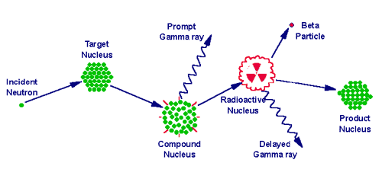
OptiNAA v3.0: Optimization of Neutron Activation Analysis
Author: Fulvio Farina email: fulviofarina@gmail.com
** VADEMECUM**
(n,γ) Reaction
http://archaeometry.missouri.edu/naa_overview.html
Back

Slide 8
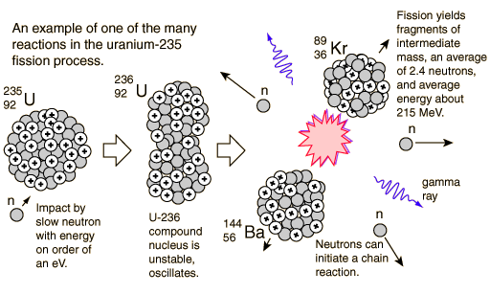
OptiNAA v3.0: Optimization of Neutron Activation Analysis
Author: Fulvio Farina email: fulviofarina@gmail.com
** VADEMECUM**
²³⁵U(n,f) Reaction
Back
http://hyperphysics.phy-astr.gsu.edu/hbase/NucEne/u235chn.html#c1

Slide 9
OptiNAA v3.0: Optimization of Neutron Activation Analysis
Author: Fulvio Farina email: fulviofarina@gmail.com
** VADEMECUM**
List of some generally monitored radioisotopes that can be produced by fission of ²³⁵U
with the correspondent elemental determination that would be interfered
Back

Slide 10
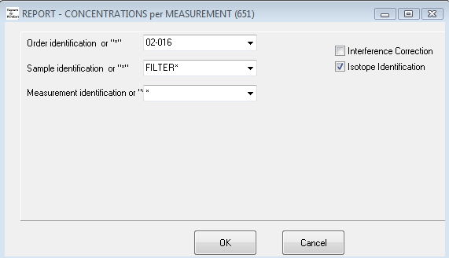
OptiNAA v3.0: Optimization of Neutron Activation Analysis
Author: Fulvio Farina email: fulviofarina@gmail.com
** STEP 0: Import KayZero PerGamma Report**
Go to KayZero for Windows → Reports → Results → PerGamma, One Measurement →Samples
A screen like this will pop-up
Select the corresponding ‘Sample’ and ‘Measurement Identification’ that contains the data you want to Import into OptiNAA. You can use the * wildcard for Importing data from a series of samples and/or measurements
Uncheck ‘Interference Correction’ box since this option is not working properly in KayZero for Windows
Click the ‘OK’ button
Back
Next

Slide 11
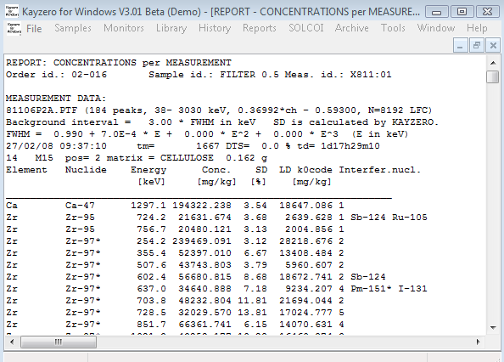
OptiNAA v3.0: Optimization of Neutron Activation Analysis
Author: Fulvio Farina email: fulviofarina@gmail.com
** STEP 0: Import KayZero PerGamma Report**
A ‘KayZero for Windows PerGamma Report’ like this will be generated:
Go to File → Save As…
Select a destination folder (for example: Q:\ X811 )
Assign a file name to this report with file extension ‘.kpg’ (example: filters.kpg)
Click ‘Save’
Back
Next

Slide 12

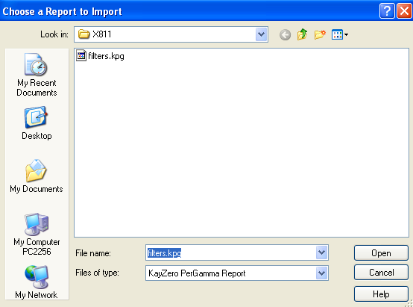

OptiNAA v3.0: Optimization of Neutron Activation Analysis
Author: Fulvio Farina email: fulviofarina@gmail.com
** STEP 0: Import KayZero PerGamma Report**
Look for the module ‘Import KayZero PerGamma Report’
Click ‘Browse’. Go to the folder where you saved the KPG
Report (example: Q:\ X811 )
Select the file containing the KayZero PerGamma Report
previously generated (example: filters.kpg )
Click ‘View’ if you want to see the contents of this file.
Fill in the values for the Gth, Gepi and the irradiation time
(in minutes) if they differ from the default values displayed
Please specify if the irradiation was Cadmium-covered (ENAA)
Click ‘Import’ when ready.
All data from this report will be imported into OptiNAA. Step 0 will not be necessary for future work with this data, which can be accessed by Step 1 from now on. Repeating Step 0 is useful for restoring the original data.
Back
Next

Slide 13
OptiNAA v3.0: Optimization of Neutron Activation Analysis
Author: Fulvio Farina email: fulviofarina@gmail.com
** VADEMECUM**
- What’s a G-thermal and G-epithermal factor?
In k0-NAA of samples, the G-thermal and G-epithermal factors are correction factors that account for thermal and epithermal neutron self-shielding (respectively) in the sample. These factors are equal to unity (=1) if there was no thermal or epithermal neutron self-shielding.
For introducing G-thermal and G-epithermal factors in KayZero for Windows, a trick has to be made, since G-epithermal is always equal to unity (=1) in the formulae that the software uses for calculating elemental concentrations.
Go to KayZero for Windows → Sample → Measurement. Select the measurement you whish to modify
In Sample Data → Self absorption factor for thermal neutrons → Introduce G-thermal divided by G-epithermal
In Sample Data → Sample mass in gram → Replace the value as the mass multiplied by G-epithermal
Re-do the calculation for the modified samples under Kayzero for Windows and re-generate the KayZero PerGamma Report as showed previously.
In OptiNAA, when asked for introducing the Gth and Gepi factors, no tricks or modifications are needed, so you should introduce the values as they are.
Back

Slide 14

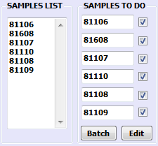
OptiNAA v3.0: Optimization of Neutron Activation Analysis
Author: Fulvio Farina email: fulviofarina@gmail.com
** STEP 1: OptiNAA Header**
After importing a KPG Report, a OptiNAA Header is generated.
This is just a pointer to the files containing the sample(s)
data previously imported. To acces the OptiNAA Header,
Click ‘Browse’ and look for it inside the folder (example Q:\ X811 )
When a OptiNAA Header is chosen, its ‘List of Samples’ is displayed.
OptiNAA allows a maximum of 6 samples to be analyzed simultaneously
as showed in the ‘Samples To Do’ section. By default, OptiNAA takes
the first 6 samples from the list, but you can always copy or type in
the label name (or ID) of another sample displayed there.
Clicking on the ‘List of Samples’ text will refresh the list.
To Edit/View the raw data of a sample, just check its corresponding checkbox and click ‘Edit’.
Clicking the ‘Samples To Do’ text will do the old ‘Select All / None’ trick.
You can Edit/View the 6 samples simultaneously. Closing these files before proceeding to the next Steps
is not necessary, but if any error shows up, then… please close them.
The ‘Batch’ button will be explained later…
Back
Next

Slide 15
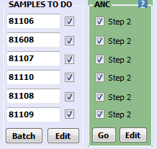
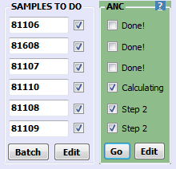
OptiNAA v3.0: Optimization of Neutron Activation Analysis
Author: Fulvio Farina email: fulviofarina@gmail.com
** STEP 2: The ANC Module**
The ‘ANC Module’ allows to convert the Apparent concentrations
into natural-Uranium concentrations by assuming they are due to
fission of ²³⁵U. How is this done? Click me!
However, the obtained new data set of natural-Uranium concentrations
must be filtered, in order to discard the outliers (or incoherent values)
from the total data set. How is the data filtered? Click me!
Just check the sample that you want to process by clicking its checkbox
inside the ‘ANC Module’. Then, when ready, click ‘Go’.
You can process the 6 samples simultaneously.
Finally, the end of the conversion and filtering process for a sample
is showed by the text ‘Done’ next to the corresponding sample place.
To Edit/View the converted and filtered data of a sample, just check the
Corresponding checkbox and click ‘Edit’.
Clicking the ‘ANC’ text will do the old ‘Select All / None’ trick.
Click me for an example of the results from this process
Back
Next

Slide 16

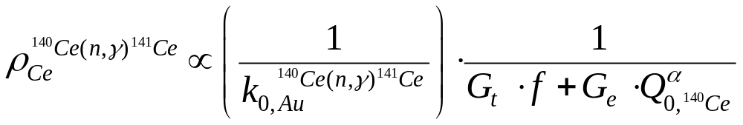
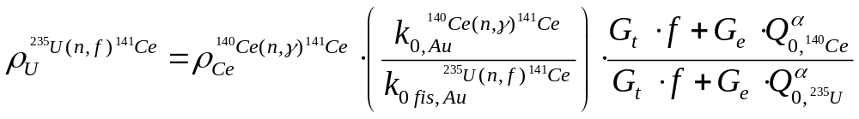
OptiNAA v3.0: Optimization of Neutron Activation Analysis
Author: Fulvio Farina email: fulviofarina@gmail.com
** STEP 2: The ANC Module**
Conversion of Apparent concentrations into natural-Uranium concentrations
In k0-NAA, the elemental concentration of Cerium (for example; ) is calculated from the Conventional Reaction Rate and k0 factor of the ¹⁴⁰Ce(n,γ) reaction that produced the monitored radioisotope ¹⁴¹Ce:
But, if the production of ¹⁴¹Ce comes only from fission of ²³⁵U, the previous apparent concentration can be transformed into a natural-Uranium concentration by considering the Conventional Reaction rate and k0-fission factor of the ²³⁵U(n,f)¹⁴¹Ce reaction:
Back

Slide 17
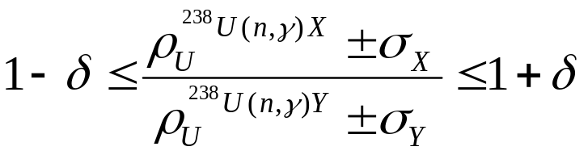
OptiNAA v3.0: Optimization of Neutron Activation Analysis
Author: Fulvio Farina email: fulviofarina@gmail.com
** STEP 2: The ANC Module**
Filtering the outliers from the data set: PART 1
The natural-Uranium concentrations obtained from the monitoring of the ²³⁸U(n,γ) radioisotopes (²³⁹U and its daughter ²³⁹Np) are compared between each other, since no matter the radioisotope or gamma-line of choice, their ratio (considering their statistical uncertainty) should lie between:
Where δ ≥ 0 is a uncertainty gap that starts at δ=0.2 (or 20%) for the first trial and is slowly reduced in the following trials until δ=0 (or 0%).
X= ²³⁹U or ²³⁹Np can be equal to Y= ²³⁹U or ²³⁹Np as long as γ^{X}-line ≠ γ^{Y}-line (different gamma lines)
Every time that the previous criteria is satisfied, a match is assigned and from the total number of trials a normalized frequency factor can be obtained for each value.
Values with a frequency factor less than 1/3 of the maximum frequency obtained are discarded (considered as outliers)
Back
Next

Slide 18

OptiNAA v3.0: Optimization of Neutron Activation Analysis
Author: Fulvio Farina email: fulviofarina@gmail.com
** STEP 2: The ANC Module**
Filtering the outliers from the data set: PART 2
The natural-Uranium concentrations obtained from the conversion of the apparent concentrations (due to fission of ²³⁵U) are compared between each other, since no matter the radioisotope or gamma-line of choice, their ratio (considering their statistical uncertainty) should lie between:
Where δ ≥ 0 is a uncertainty gap that starts at δ=0.3 (or 30%) for the first trial and is slowly reduced in the following trials until δ=0 (or 0%).
Where X = ⁹⁹Mo, ⁹⁵Zr, ¹⁰³Ru, … and Y = ⁹⁹Mo, ⁹⁵Zr, ¹⁰³Ru, … but X ≠ Y
Every time that the previous criteria is satisfied, a match is assigned and from the total number of trials a normalized frequency factor can be obtained for each value.
Values with a frequency factor less than 1/3 of the maximum frequency obtained are discarded (considered as outliers)
Back

Slide 19
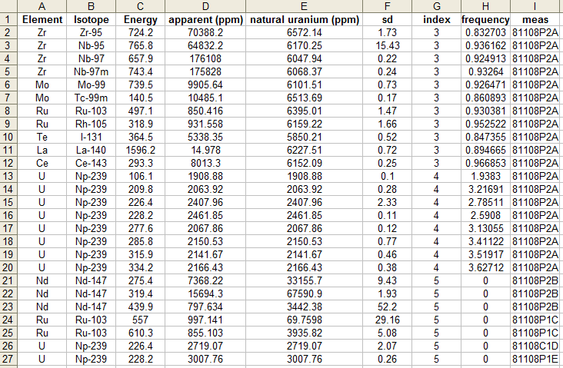
OptiNAA v3.0: Optimization of Neutron Activation Analysis
Author: Fulvio Farina email: fulviofarina@gmail.com
** STEP 2: The ANC Module**
Excel file: header.sample.anc.xls
Example Data from the conversion of Apparent concentrations into natural-U concentrations
Index = 3 refers to a ²³⁵U fission product value that is reliable
Index = 4 refers to a ²³⁸U activation product value that is reliable
Index = 5 refers to outlier value (not reliable)
sd = uncertainty (one standard deviation)
frequency = normalized weight (or frequency) obtained from the filtering process (the greater the value the more reliable it is)
Back

Slide 20
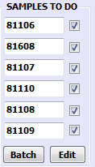



OptiNAA v3.0: Optimization of Neutron Activation Analysis
Author: Fulvio Farina email: fulviofarina@gmail.com
** STEP 3: The IRS Module**
The ‘IRS Module’ allows to determine a ²³⁵U vs. ²³⁸ Isotopic Ratio
from each ²³⁵U(n,f)X and ²³⁸U(n,y)Y pair of natural-Uranium
concentration values
How is this done? Click me!
Just check the sample that you want to process by clicking
its checkbox inside the ‘IRS Module’. Then, when ready,
click ‘Go’. You can process the 6 samples simultaneously.
Finally, the end of the process for a sample is showed by the
text ‘Done’ next to its corresponding sample place.
To Edit/View the converted and filtered data of a sample, just
check the corresponding checkbox and click ‘Edit’.
Clicking the ‘IRS’ text will do the old ‘Select All / None’ trick.
Click me for an example of the results from this process
Back
Next

Slide 21
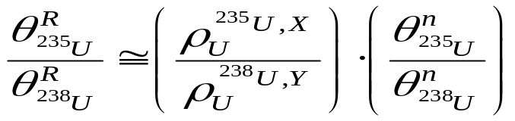
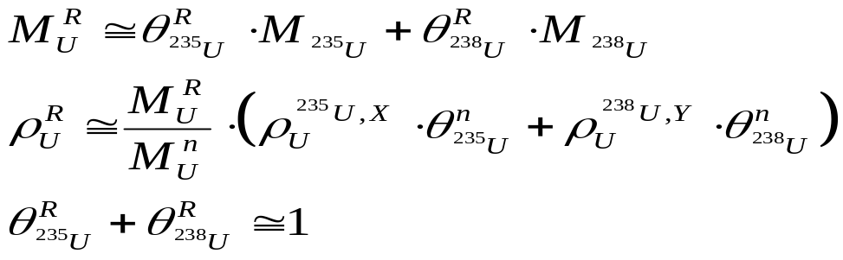
OptiNAA v3.0: Optimization of Neutron Activation Analysis
Author: Fulvio Farina email: fulviofarina@gmail.com
** STEP 3: The IRS Module**
²³⁵U vs. ²³⁸U Isotopic Ratios per gamma-lines
A ²³⁵U vs. ²³⁸U Isotopic Ratio can be obtained from the ratio between the natural-Uranium concentrations coming from ²³⁵U(n,f)X (fission of ²³⁵U) versus the ones coming from ²³⁸U(n,y)Y (activation of ²³⁸U). Since the natural-Uranium concentrations are defined for natural abundances, they have to be normalized, this is:
Where R refers to the true value and n refers to the natural value.
From this, a true elemental Uranium concentration, true Molar Mass and true ²³⁵U & ²³⁸U abundances can be calculated also:
Back

Slide 22
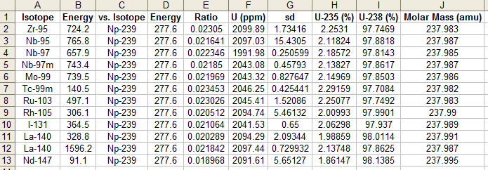
OptiNAA v3.0: Optimization of Neutron Activation Analysis
Author: Fulvio Farina email: fulviofarina@gmail.com
** STEP 3: The IRS Module**
Excel file: header.sample.irs.xls
²³⁵U vs. ²³⁸U Isotopic Ratios from each pair of natural-Uranium values
Back

Slide 23

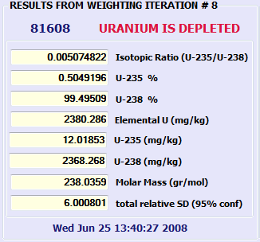
OptiNAA v3.0: Optimization of Neutron Activation Analysis
Author: Fulvio Farina email: fulviofarina@gmail.com
** STEP 4: The WIR Module**
The ‘WIR Module’ allows to determine an overall, weighted
235U vs. 238 Isotopic Ratio for a given sample.
How is this done? Click me!
Just check the sample that you want to process by clicking its
checkbox inside the ‘WIR Module’. Then, when ready, click ‘Go’.
You can process the 6 samples simultaneously.
After obtaining a first weighted Isotopic Ratio, the program will begin
an iteration process for discarding outliers from this value.
The iteration process will stop when the last weighted Isotopic Ratio
obtained has not changed from the previous iteration.
Finally, the end of the weighting process for a sample
is showed by the text ‘Done’ next to the corresponding place.
To View the results from the iteration process, just check the
sample’s corresponding checkbox and click ‘View’.
Clicking the ‘WIR’ text will do the old ‘Select All / None’ trick.
Click me for an example of the results from this process
Back
Next

Slide 24
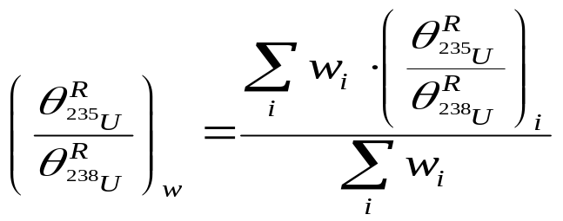
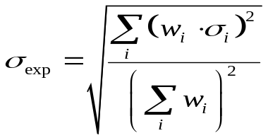
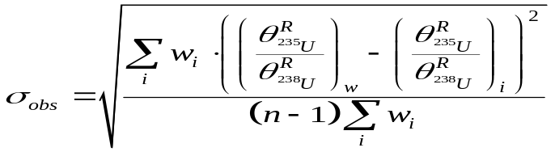
OptiNAA v3.0: Optimization of Neutron Activation Analysis
Author: Fulvio Farina email: fulviofarina@gmail.com
** VADEMECUM**
Weighted ²³⁵U vs. ²³⁸U Isotopic Ratio
A weighted ²³⁵U vs. ²³⁸U Isotopic Ratio can be obtained according to:
Where w_{i} =1 / σ_{i} ² . This means that the Isotopic Ratios are weighted according to their statistical uncertainty.
A weighted experimental (index exp) and observed (index obs) uncertainty are calculated from:
A expanded relative uncertainty (1 sigma ), is obtained after quadratic sum of the greater weighted uncertainty obtained with a 3% uncertainty budget.
Back

Slide 25
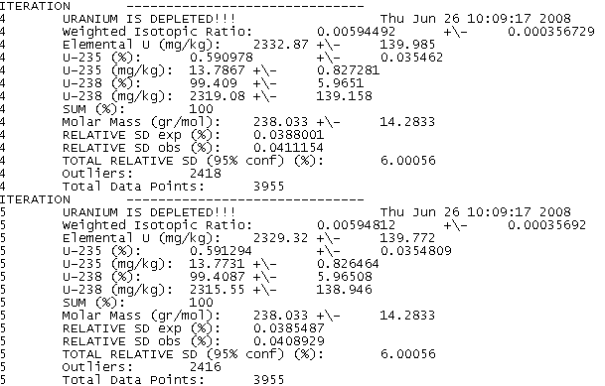
OptiNAA v3.0: Optimization of Neutron Activation Analysis
Author: Fulvio Farina email: fulviofarina@gmail.com
** VADEMECUM**
Text file: header.sample.wir.txt
weighted ²³⁵U vs. ²³⁸U Isotopic Ratio for each iteration
The last iteration is the final result
Back

Slide 26


OptiNAA v3.0: Optimization of Neutron Activation Analysis
Author: Fulvio Farina email: fulviofarina@gmail.com
** STEP 5: The RES Module**
The ‘RES Module’ allows to determine a correction and residual
concentration for each Apparent concentration due to fission of ²³⁵U.
How is it done? Click me!
Just check the sample that you want to process by clicking its
checkbox inside the ‘RES Module’. Then, when ready, click ‘Go’.
You can process the 6 samples simultaneously.
Finally, the end of this process for a sample is showed by
the text ‘Done’ next to the corresponding sample place.
To View the results from the iteration process, just check the
sample’s corresponding checkbox and click ‘Edit’.
Clicking the ‘RES’ text will do the old ‘Select All / None’ trick.
Click me for an example of the results from this process
Back
Next

Slide 27
OptiNAA v3.0: Optimization of Neutron Activation Analysis
Author: Fulvio Farina email: fulviofarina@gmail.com
** VADEMECUM**
Residual concentrations and the Panic button
Our initial assumption was that all the apparent concentrations reported In KayZero for Windows are coming only from fission of ²³⁵U and not by (n,γ) reactions. This allowed us to determine the ²³⁵U isotopic abundance in the sample from a given data set.
However, apart from Uranium, some of those elements might be truly present in the sample too. Hopefully, a correction value can be estimated based on the ²³⁵U content (which is now known). If subtraction of an apparent concentration by its correction value is not equal to 0 (as expected, based on our hypothesis), then this residual concentration is an indicator of the element amount in the sample. Statistically speaking, every element must have a coherent residual concentration along its element’s data set, in order to be considered valid (otherwise it could be due to spectral interferences for example).
A wrong Isotopic Ratio determination will result from a sample which contains all these possible elements (See List), since our assumption is not valid anymore. In this case I suggest you to use only the ¹³¹I from reaction ²³⁵U(n,f)¹³¹Te →¹³¹I, since is Tellurium is a very rare element and is most likely that its apparent concentration is due to ²³⁵U fission.
For doing this →
Back

Slide 28
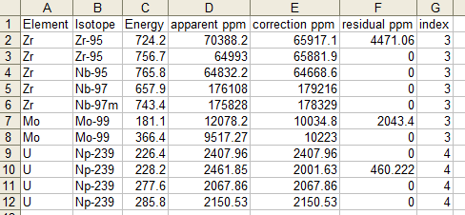
OptiNAA v3.0: Optimization of Neutron Activation Analysis
Author: Fulvio Farina email: fulviofarina@gmail.com
** VADEMECUM**
Excel file: header.sample.res.xls
The Apparent concentrations, corrections and residuals concentrations obtained
Back

Slide 29


OptiNAA v3.0: Optimization of Neutron Activation Analysis
Author: Fulvio Farina email: fulviofarina@gmail.com
** STEP Optional: The 228 Module**
The ‘228 Module’ allows to correct the natural-Uranium concentrations
obtained from the 228 keV gamma line of 239Np, since this line is
spectrally interfered by a ²³⁵U fission product: ¹³²Te.
When the utility is available for a given sample, the text ‘Ready!’
is displayed next to the corresponding sample place.
Just check the sample that you want to process by clicking its
checkbox inside the ‘228 Module’. Then, when ready, click ‘Go’.
You can process the 6 samples simultaneously.
After correction, Steps 3, 4 and 5 are automatically re-processed,
since any correction to the 228 keV gamma line values affects the
previous Isotopic Ratio determination.
The results from this process are listed in the same file generated
in the ‘RES module’ for the sample in question.
Back
Next

Slide 30
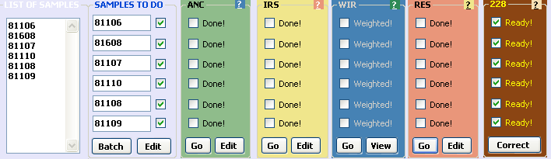
OptiNAA v3.0: Optimization of Neutron Activation Analysis
Author: Fulvio Farina email: fulviofarina@gmail.com
** Further considerations **
The ‘Batch’ button will analyze all the selected samples by going automatically through Steps 2, 3, 4 and 5.
A Batch evaluation is very useful for obtaining preliminary data which can be further accessed and modified at any time, and afterwards, re-processed.
Also, as you may noticed, every ‘Go’ button of a module offers the same batch capability but only for its own module.
The analyst can delete any values inside the files of each module and observe the variations or fluctuations in the Isotopic Ratio determination of a sample.
Please delete by selecting whole rows in the Excel file, not just individual cells
Help yourself with the: Excel → Data → Filter → Auto-Filter tool
Don’t be afraid of playing with your data, the original one can be restored at any time by just re-importing the ‘KayZero PerGamma Report’ according to Step 0.
Back

Slide 31
OptiNAA v3.0: Optimization of Neutron Activation Analysis
Author: Fulvio Farina email: fulviofarina@gmail.com
** fission radioisotopes to monitor after irradiation **
priority | isotope | half-life | Energy (keV) | Decay times | remarks
1 | Ba-139 | 1.4 hours | 165.9 | 0.5 to 3 hours | Not interfered
2 | Ru-105 | 4.4 hours | 262.8 | 2 to 9 hours | interference from I-132
 |  |  | 469.4 |  | Not interfered
 |  |  | 724.3 |  | interference from Zr-95
3 | Rh-105m | 45 sec | 129.6 | 2 to 9 hours | Not interfered
4 | Nb-97m | 1 min * | 743.3 | 9 to 50 hours | Not interfered
5 | Nb-97 | 1.2 hours * | 658.2 | 9 to 50 hours | Not interfered
6 | Tc-99m | 6 hours * | 140.5 | 20 to 80 hours | Not interfered.
7 | Ce-143 | 1.4 days | 231.6 | 1 to 4 days | Not interfered
 |  |  | 293.3 |  | Not interfered
 |  |  | 350.6 |  | Not interfered
 |  |  | 664.6 |  | interference from Te-131m
 |  |  | 721.9 |  | interference from I-131

Slide 32
OptiNAA v3.0: Optimization of Neutron Activation Analysis
Author: Fulvio Farina email: fulviofarina@gmail.com
** fission radioisotopes to monitor after irradiation **
priority | isotope | half-life | Energy (keV) | decay times | remarks
8 | Rh-105 | 1.5 days | 306.1 | 1 to 4 days | Not interfered
 |  |  | 318.9 |  | interference from Nd-147
9 | Mo-99 | 2.7 days | 181.1 | 1.3 to 6 days | interference from Np-239
 |  |  | 366.4 |  | interference from Nd-147
 |  |  | 739.5 |  | Not interfered
 |  |  | 777.9 |  | Not interfered
10 | I-131 | 8 days | 284.3 | 6 to 18 days | interference from Np-239
 |  |  | 364.5 |  | Not interfered
Make sure to monitor I-131 if you want to use the PANIC Mode

Slide 33
OptiNAA v3.0: Optimization of Neutron Activation Analysis
Author: Fulvio Farina email: fulviofarina@gmail.com
** fission radioisotopes to monitor after irradiation **
priority | isotope | half-life | Energy (keV) | decay times | remarks
11 | La-140 | 1.67 days | 328.8 | 6 to 18 days | Not interfered
 |  |  | 487 |  | Not interfered
 |  |  | 815.8 |  | Not interfered
 |  |  | 1596.2 |  | Not interfered
12 | Nd-147 | 11 days | 91.1 | 6 to 18 days | high Compton continuum
 |  |  | 275.4 |  | No coherent
 |  |  | 319.4 |  | No coherent
 |  |  | 439.9 |  | No coherent
 |  |  | 531 |  | Not interfered
13 | Ce-141 | 32.5 days | 145.4 | 10 to 30 days | Not interfered
14 | Zr-95 | 64 days | 724.2 | 10 to 60 days | Not interfered
 |  |  | 756.7 |  | Not interfered
15 | Nb-95 | 35 days | 765.8 | 10 to 60 days | Not interfered
Make sure to type in the correct irradiation time during Step 0 or the La-140 values will be wrong

Slide 34
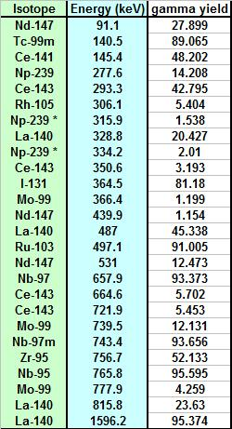
OptiNAA v3.0: Optimization of Neutron Activation Analysis
Author: Fulvio Farina email: fulviofarina@gmail.com
** RECOMMENDED GAMMAS TO MONITOR **

