Slide 1
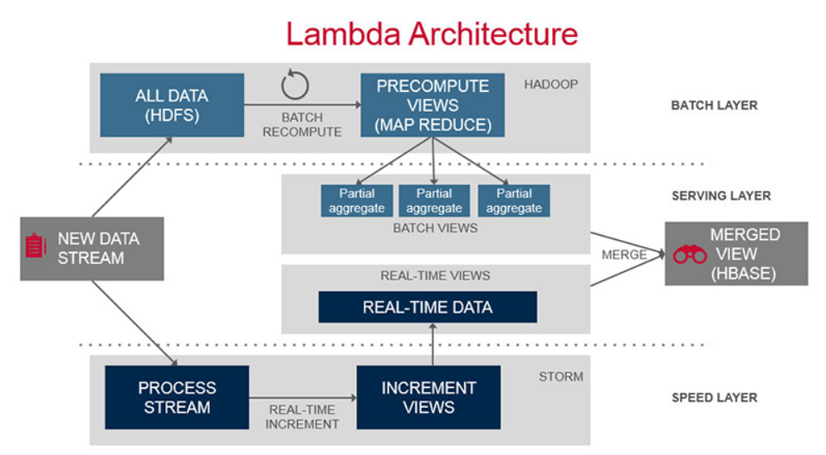

Slide 2
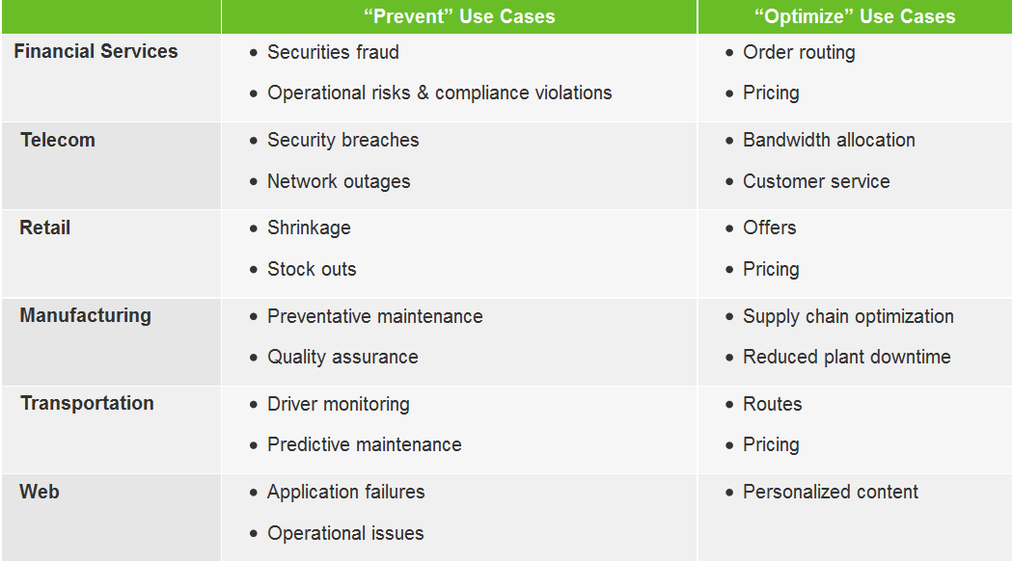
Use Cases
Data Application Lab 数据应用学院

Slide 3
Storm
Data Application Lab 数据应用学院

Slide 4
History
Nathan Marz and team at BackType
Acquired by Twitter
Opensourced by Twitter
Initial release 9-2011
Data Application Lab 数据应用学院

Slide 5
Characteristics
Fast – benchmarked as processing one million 100 byte messages per second per node
Scalable – with parallel calculations that run across a cluster of machines
Fault-tolerant – when workers die, Storm will automatically restart them. If a node dies, the worker will be restarted on another node
Reliable – Storm guarantees that each unit of data (tuple) will be processed at least once or exactly once. Messages are only replayed when there are failures.
Easy to operate – standard configurations are suitable for production on day one. Once deployed, Storm is easy to operate
Data Application Lab 数据应用学院

Slide 6
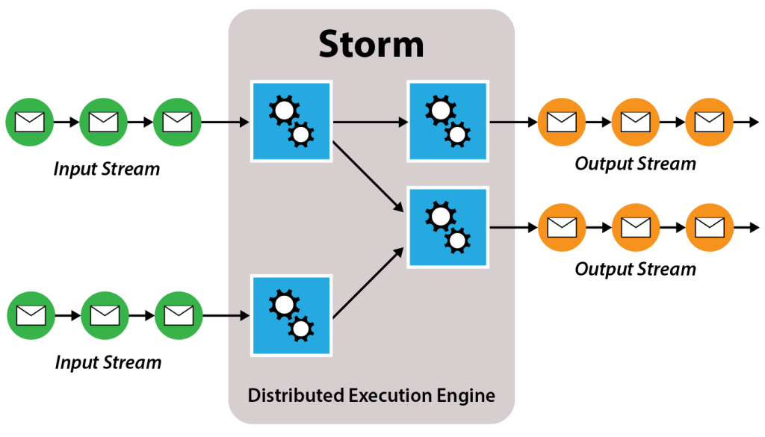
Big Picture
Data Application Lab 数据应用学院

Slide 7
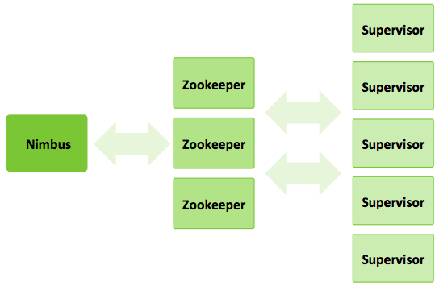
Storm Cluster
Data Application Lab 数据应用学院

Slide 8
Storm Cluster Components
Nimbus node (master node, similar to the Hadoop JobTracker):
Uploads computations for execution
Distributes code across the cluster
Launches workers across the cluster
Monitors computation and reallocates workers as needed
ZooKeeper nodes – coordinates the Storm cluster
Supervisor nodes – communicates with Nimbus through Zookeeper, starts and stops workers according to signals from Nimbus
Data Application Lab 数据应用学院

Slide 9
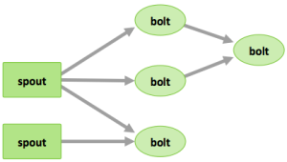
Topology
Tuples– an ordered list of elements. For example, a “4-tuple” might be (7, 1, 3, 7)
Streams – an unbounded sequence of tuples.
Spouts –sources of streams in a computation (e.g. a Twitter API)
Bolts – process input streams and produce output streams. They can: run functions; filter, aggregate, or join data; or talk to databases.
Topologies – the overall calculation, represented visually as a network of spouts and bolts (as in the following diagram)
Data Application Lab 数据应用学院

Slide 10
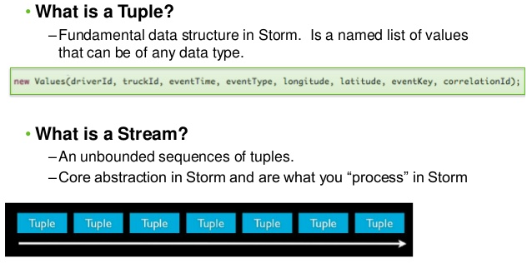
Tuple and Stream
Data Application Lab 数据应用学院

Slide 11
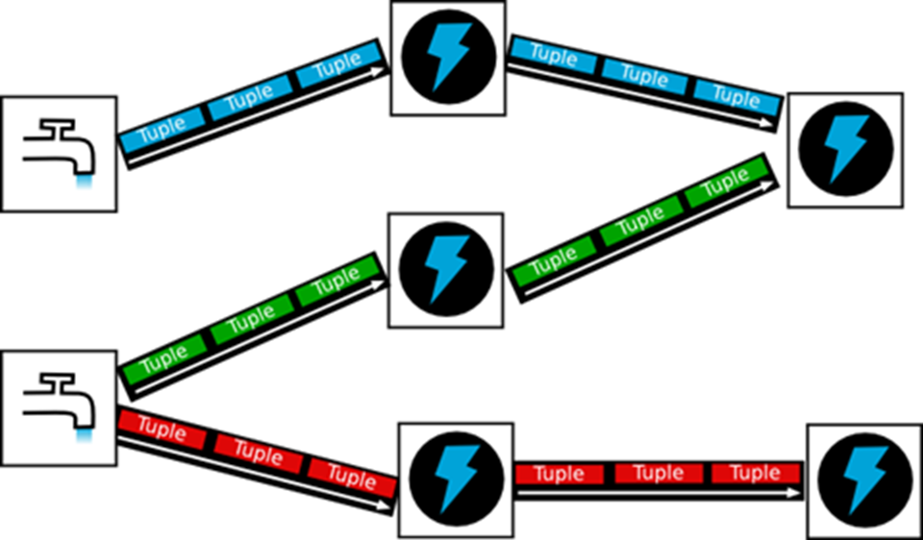
Inside Topology
Data Application Lab 数据应用学院

Slide 12
Command Line Tool
storm jar topology-jar-path class ...
storm kill topology-name [-w wait-time-secs]
storm deactivate topology-name
storm activate topology-name
storm rebalance topology-name [-w wait-time-secs]
Data Application Lab 数据应用学院

Slide 13
Storm Demo
Data Application Lab 数据应用学院

Slide 14
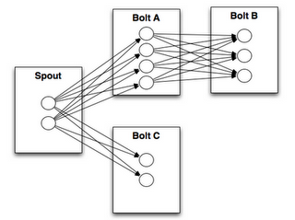
Storm Grouping
Shuffle grouping
Fields grouping
Partial Key grouping
Data Application Lab 数据应用学院

Slide 15
Storm Trident
Exactly-Once Processing
Batch Processing
Ordered State Updates
Fast, Persistent Aggregation

Slide 16
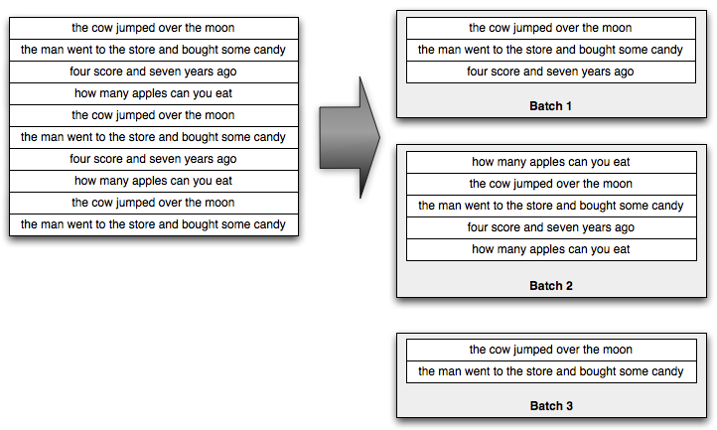
Batched Processing

Slide 17
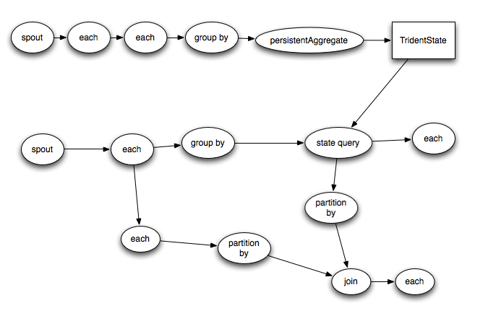
Trident Concepts
Spouts
Bolts
Streams
Operations
States

Slide 18
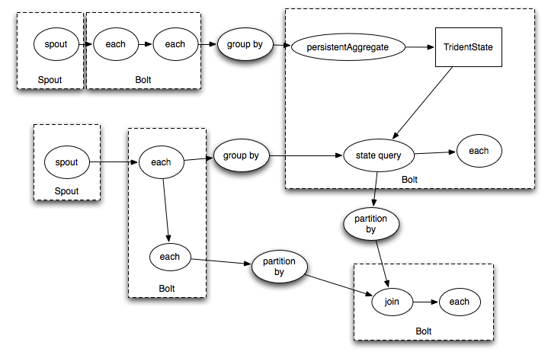
Under the Hood

Slide 19
Trident Demo
Data Application Lab 数据应用学院

Slide 20
Reference
http://storm.apache.org/documentation/Documentation.html
https://storm.apache.org/documentation/Tutorial.html
http://nathanmarz.github.io/storm/doc-0.8.1/index.html
Data Application Lab 数据应用学院

