Slide 1
kafka
Data Application Lab 数据应用学院

Slide 2
History
Originally developed by LinkedIn
Opensourced in early 2011
“Confluent” with a focus on Kafka
Written in Scala
9 core committers, + 20 contributors
Data Application Lab 数据应用学院

Slide 3
Features
Distributed messaging system
Provide a unified, high-throughput, low-latency platform for handling real-time data feeds
Up to 2M writes/reads on 3 commodity machine cluster
Data Application Lab 数据应用学院

Slide 4
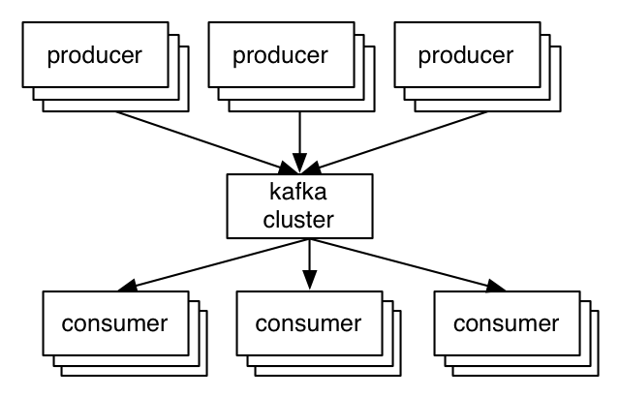
Kafka Abstract
Data Application Lab 数据应用学院

Slide 5
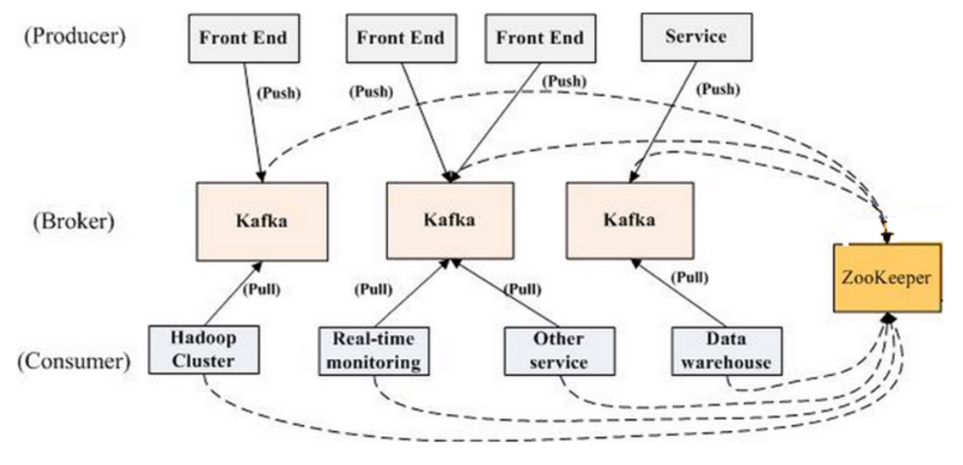
Data Application Lab 数据应用学院

Slide 6
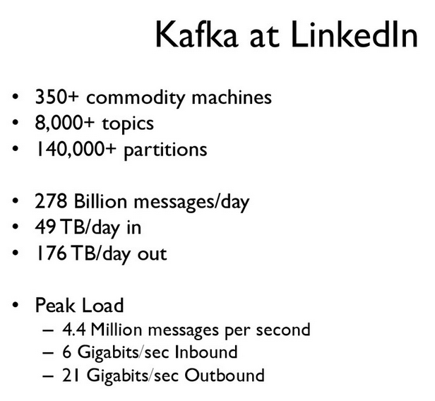
Data Application Lab 数据应用学院

Slide 7
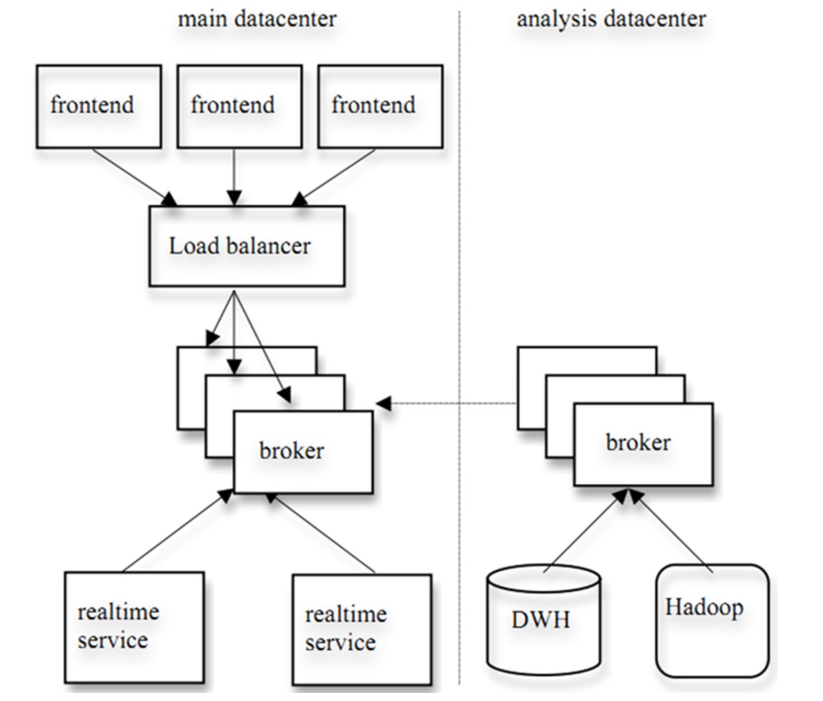
Real-time and Batch Processing

Slide 8
Messaging Component
Maintains feeds of messages in categories called topics
Call processes that publish messages to a Kafka topic producers
Call processes that subscribe to topics and process the feed of published messages consumers
Run as a cluster comprised of one or more servers each of which is called a broker
Data Application Lab 数据应用学院

Slide 9
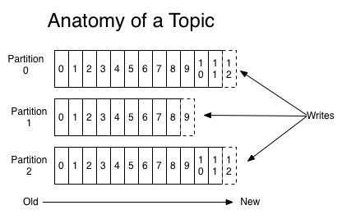
Topic
Category or feed name to which messages
partitioned log
Data Application Lab 数据应用学院

Slide 10
Topic Partition Distribution
Each partition is replicated
Each partition has one server which acts as the "leader“
The leader handles all read and write requests
One or more servers which act as "followers“
If the leader fails, one of the followers will automatically become the new leader
Data Application Lab 数据应用学院

Slide 11
Producer
Publish data to the topics
Decide message to assign to which partition
Data Application Lab 数据应用学院

Slide 12
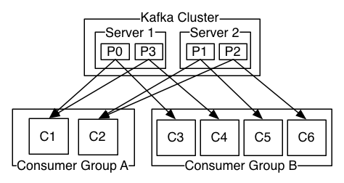
Consumer
Consumers assign to consumer group name
If only one group, work like message queue
If not, work like publish-subscribe
Data Application Lab 数据应用学院

Slide 13
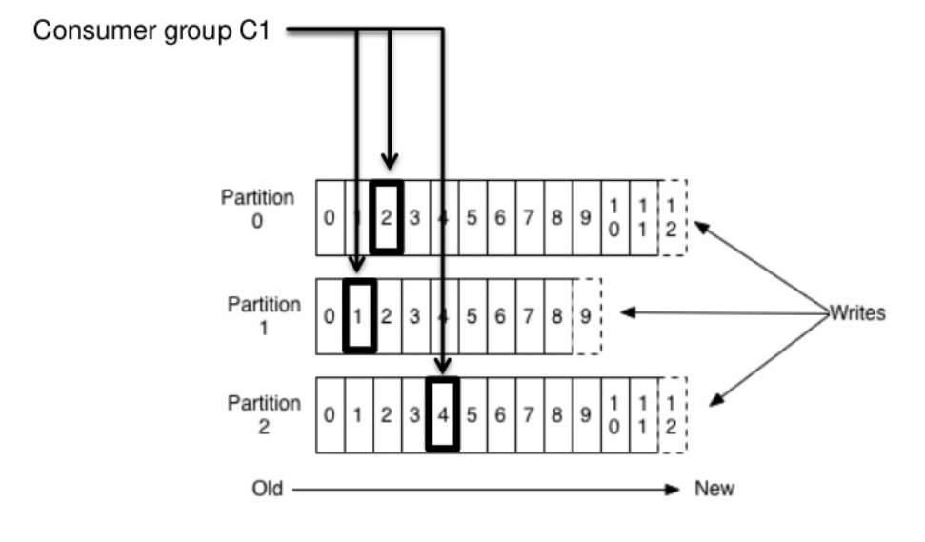
Partition Offset
Data Application Lab 数据应用学院

Slide 14
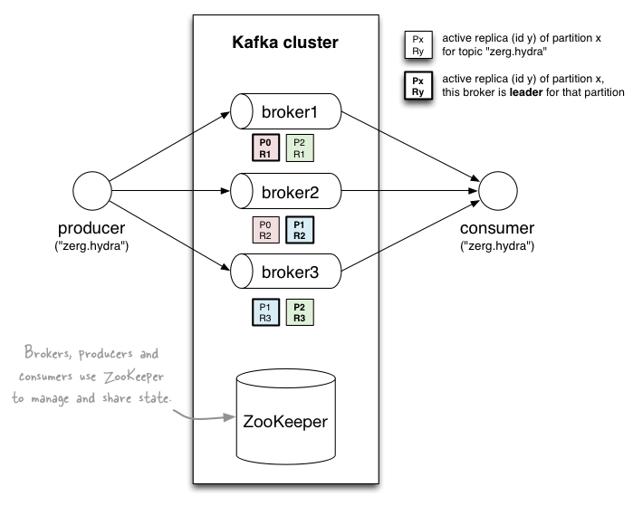
Data Flow
Data Application Lab 数据应用学院

Slide 15


Properties/Yaml File

Slide 16
Major Use Case
Messaging
Website Activity Tracking
Metrics – operational monitoring data
Log Aggregation
Stream Processing
Event Sourcing
Commit Log
Data Application Lab 数据应用学院

Slide 17
Quick Start Demo
Create a topic
Describe a topic
List topics
Send message
Consume message
Data Application Lab 数据应用学院

Slide 18
Reference
http://kafka.apache.org/documentation.html
http://www.confluent.io/blog/how-to-choose-the-number-of-topicspartitions-in-a-kafka-cluster/
Data Application Lab 数据应用学院

