Slide 1
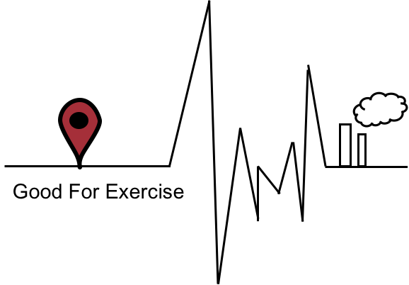

好運氣
TEAM：
SooChow University BigData Department

Slide 2
CONTENTS
Introduction
Operation
Team intro
Motivation attributed
Timeline
Website
Conclusion

Slide 3
INTRODUCTION

Slide 4
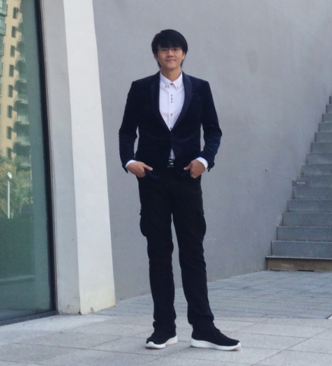

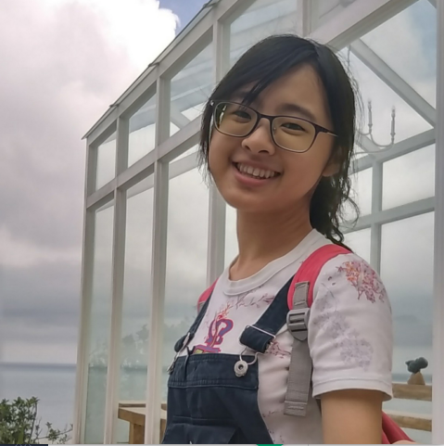

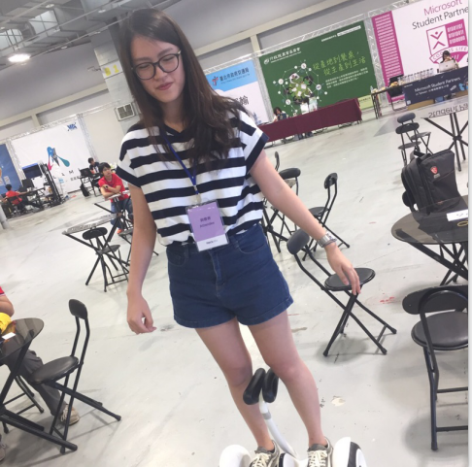

Team Intro
Angus Huang
Jenny Yang
Sophie Liu
Lily Li
Liz Li

Slide 5
Timeline
Data collecting
Presentation
Setting subject
Operation&revise

Slide 6
Motivation attributed
exercise
air quality
Recently,
more and more people go to exercise for their health and body shape.
空氣品質在每個地區都不一樣，而民眾若想得知資料，卻又不知道從何看起。
Therefore, by the yearly information of air quality and the normal please that people go exercise. We will analyze what kind of exercise is proper enough to fix the air quality there. So that we will not do harm to our body instead because of the bad air quality.

Slide 7
WEBSITE

Slide 8
OPERATION

Slide 9
CONCLUSION

Slide 10
THANK YOU!

Slide 11
Timeline
Motivation attributed
Data collecting
Operation&revise
Presentation
Sales
The assurance that the product or brand has presence in the market and among presentation services consumers.
Investment
Applicable for presentations for financial and banking proposals to acquire capital for start-up businesses or investments in real estate, manufacturing, or insurance.
Manufacturing
Management
This involves the acquisition or purchase and processing of raw materials, equipment, and labor required to assemble the final product.
This consists the design and organization of the company, defining its policies, objectives, and strategies.

