Slide 1
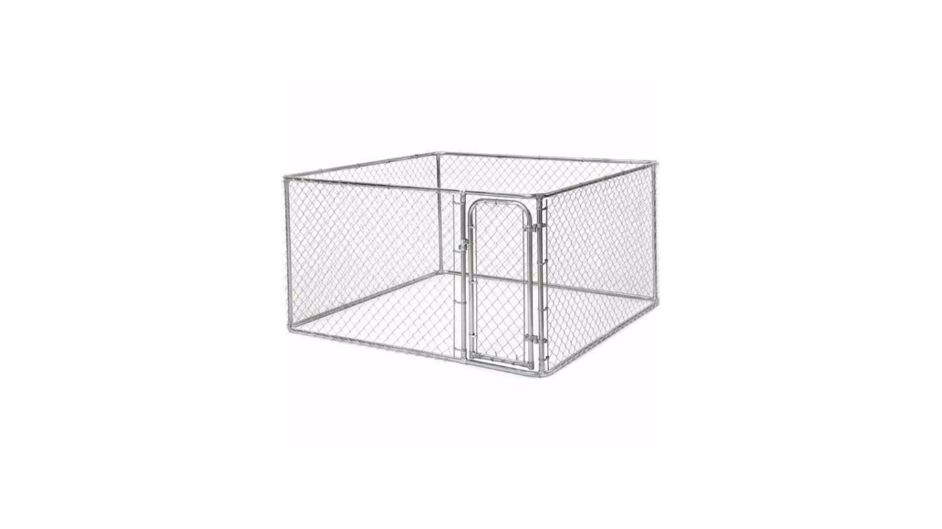
Design Phase Presentation Kennels R Us WORLDWIDE PRESTIGE
CSCI 4750
Group 4
Robert Bell
Angel Ganter
Ryan Kent
Dimitrei Nazi
Ryan Rodriguez

Slide 2
Summary of problems and opportunities
All inventory is tracked on spreadsheet
No formal production order closing
No formal shipping labels
No formal purchase orders
No formal upkeep with vendors
No formal processes for returns
No formal sales reports
No formal representation of customers
No formal billing
No formal online orderings
No formal monthly reports
No way to interact with people outside of the local store

Slide 3
Statement of system improvement Targets
Improve Day-to-day operations
Database management of inventory to limit spreadsheet and labor
Database will handle invoices, order records, and reorders
Online system orders for customers
Friendly-user interface
Increase productivity and efficiency

Slide 4
Report contents
Background information
This section contains the history of meetings
Overview of current system and their flaws
Analysis of current system
Target problems and make areas for improvements of the system
Detailed Recommendations
Implementations of system improvements objectives and priorities

Slide 5
Background information
List of Meetings Conducted: The team of Worldwide Prestige has covered three meetings over Zoom, and one over Group Me.
Meeting 1
September 12, 7:00pm, whole class participation
Meeting 2
September 15, 7:00pm, team introductions and discussions
Meeting 3
September 20, 7:00pm, team discussion with Teacher
Meeting 4
September 22, 7:00pm, performed over chat due to scheduling conflicts
Team has kept consistently in touch with each other through Group Me besides these listed days, as well

Slide 6
Summary of Analytic Techniques Used
Ryan Kent and Robert Bell used PIECES to analyze the system and find its flaws.

Slide 7
Overview of the Current System
Kennels R Us builds custom dog and cat kennels. Records are created daily and updated manually. The current system promotes inefficient time management, doesn’t create a decent environment for good decision making, and takes more time to record information that it ought to.

Slide 8
Overview of the Current System
Retail Operations
System processes orders manually
Most orders are taken over the phone
Current production order closing is time consuming
Currently, there are no good processes for returns
Customers have trouble getting the company to take the kennels back in a timely fashion
Customer records are not documented very well

Slide 9
Overview of the Current System
Inventory
Current inventory system is inefficient:
Current system uses paper spreadsheets for inventory tracking
Purchase orders are not accurate, creating either a surplus or deficiency in inventory

Slide 10
Overview of the Current System
Distribution
Shipping labels are sloppy
Vendors are not kept up with
Online ordering is nonexistent for customers
Customers cannot interact with the store without going into it first

Slide 11
Overview of the Current System
Accounting
Current method of billing is inefficient
There are no formal monthly reports
Sales reports are written down, not automated

Slide 12
Current Process Model
Customer
Calls for product
Paper order is created
Comes in to talk to employees
Paper record is created
Cannot find company website in search engines, as it does not exist

Slide 13
Current Process Model
Employees
Receive orders
Via call
Records are written down, stored in file cabinet
Via walk-in
Records are written down, stored in file cabinet

Slide 14
Current Process Model
Billing
Done manually
Records get lost
Bills sometimes are not paid on time
Payment gets lost in mail

Slide 15
Analysis of the current system
Performance, information, economics, control, efficiency and services
Notes:
The following is an analysis of the current system using
Wetherbe’s PIECES framework. The framework focuses on six areas:
performance, information, economics, control, efficiency, and
services. In each of these areas, problems are made into
opportunities by use of a directive. It also examines cause-and- effect
relationships of both the problems and the opportunities in order to
target areas for improvement.

Slide 16
Performance – Problems
Order processing and returns done manually
Inventory levels are recorded manually
Notes:
Performance is a target area for improvement. By increasing
the performance of a system, the work of employees is magnified
with increased efficiency. This allows for employees of all levels of a
business to thrive. Performance improvements help reduce the work
needed to complete tasks and the response time of a system.
Having orders and returns processed by phone results in poor performance. Each phone call requires not only work by the customer making the call, but also from the employee taking down their request. This results in an increased workload and a slow response time due to the one-on-one nature of phone calls.
Manually reordering inventory is a time-consuming process. Each product takes careful consideration to have the proper amount on hand at a given time. Knowing inventory levels is currently dependent on a spreadsheet that is kept manually. This process is both slow and prone to human error.

Slide 17
Performance – Opportunities
Having a web form for orders and returns
Automating inventory records
Notes:
By implementing a web form, usability is promoted for both customers and employees. When on the web, the entire process is clarified and easily accessible. This reduces the throughput for both parties. The response time is also improved as customers will receive invoices and feedback from an automated system all without making a phone call.
Through use of an automated ordering system the computer anticipates when inventory levels are getting low. This lessens the workload of having to manually track and reorder supplies. Reducing the number of backorders also leads to better response times to orders and increased customer satisfaction.

Slide 18
information – problems
Inventory level tracking is done manually
Bills of materials are not automated
Notes:
In the digital age information is more available than ever before. It is the core of any system that tracks records. Any issues with inputting, outputting or storing data can hamper the success of a business. For data to be useful it must be accessible and defined with a sufficient degree of detail.
Hand-kept records depend on the diligence and accuracy of employees. Often changes to such data is not logged. This makes tracking when an error occurs a costly process further decreasing reliability of important information. Such errors are often only apparent when the damage has already been done.
Production workflow depends on bills of materials to complete work orders.

Slide 19
information – Opportunities
Automating inventory adjustments based on work orders
Having bills of materials sent automatically as orders are placed
Notes:
Inventory tracking is vital to many businesses and Kennels R Us is no exception. Automating the process allows information on inventory to be both more accurate and up-to-date with no time investment needed from employees. This allows the information to be more accessible to the system and to the whole company. If errors do occur, changes can be logged and information can be restored.
Automating bills of materials allows the production crew to begin assembly as soon as an order is received by the system. Having the bills of materials as a digital copy allows for better record keeping and streamlines assembly.

Slide 20
Economic
Problem: Monthly reports are not automatically created
Opportunity: System generates monthly reports
Notes:
Automating monthly reports addresses economy one important way. The accountant will spend less time creating reports and more time analyzing the expenditures of the company. This allows the accountant to serve their specialized role to further improve the profits of the company and anticipate future areas of improvement.

Slide 21
Control

Slide 22
problems
Manager requires reports by section to stay updated
Orders are recorded and prioritized by staff
Prone to human error
Harder to trace customer data exposure
Monthly bookkeeping done manually
Prone to human error
Less auditing capabilities

Slide 23
Opportunities
Computerized system allows management to monitor sections directly
Automatic ordering system
Correctly ques orders
Allows customer data to be tracked and secured
Automatic bookkeeping system
Prevents report errors
Shows who made what changes to company records

Slide 24
Cause & effect analysis
Cause | Effect
Management must request reports from each section | Time spent generating/reading reports
Orders possibly mishandled | Customers wait longer than necessary to receive order
Human Error | Incorrect bill of materials generated for order Orders processed in wrong order Monthly reports contain misleading data
Staff willfully misrepresent data | Loss of profit Legal action against company

Slide 25
efficiency

Slide 26
Problems
Orders are prioritized in order received
Cannot immediately tell if supplies are sufficient for order
Bill of materials manually generated for each order
Prone to human error
Time consuming

Slide 27
Opportunities
Inventory managed manually
Orders processed manually
No system for tracking custom orders
Invoices generated manually
Prone to human error
Time consuming

Slide 28
opportunities
Automated ordering system will alert customers to backorders
Computerized system will generate bill of materials for orders
Automatically generate orders for new supplies when low
Free time for sales staff by automatically processing orders
Automated system can provide historical order data
Automatically generated invoices save time and reduce errors

Slide 29
Cause & effect analysis
Cause | Effect
Incorrect bill of materials generated for order | Order delayed or returned
Inventory of stock managed manually | Stock not sufficient to fill orders
Stock not sufficient to fill orders | Orders delayed or canceled
Orders processed manually | Order details prone to human error Staff spends time taking orders
No system for tracking custom orders | No way to determine which customizations are in high demand
No system for tracking orders | No way to anticipate demand for products
Invoices generated manually | Prone to error Time consuming

Slide 30
service

Slide 31
problems
Human error leads to
Incorrect orders
Delayed orders
Lost orders
Incorrect invoices
Supply and ordering systems are independent from each other
When stock runs out, customer orders are delayed (backordered)

Slide 32
opportunities
Automated ordering system
Provides error free orders
Informs customers of backorders
Ensures orders filled as quickly as possible
When stock is low supply orders generated automatically

Slide 33
Cause & effect analysis
Cause | Effect
Stock not sufficient to fill orders | Customers lost due to delays
Human error | Delayed orders Lost orders Incorrect orders Incorrect invoices
Supply and ordering systems not coordinated | Stock not sufficient to fill orders

Slide 34
Detailed recommendations
System Improvement Objectives & Priorities

Slide 35
Overall system
Replace manual bookkeeping with computerized system
Able to create reports
Method for creating and tracking discounts
Provide required security depending on employee role
Designed to be operated and maintained by non-IT employees

Slide 36
Inventory tracking
Automatic bill of materials for standard products
Monitor levels of materials on hand and purchase prices
Generate orders when materials fall below assigned threshold

Slide 37
Order processing
Online ordering process
Notify customer for backordered items
Automatically send completed orders to production
Automatically generated customer invoices
Send confirmation e-mail to customers when order is placed
Ability to track open orders
Allow for returns

Slide 38
Tracking historical data
Maintain data from past customers
Track sales to anticipate required materials
Monitor profit and loss
Record high volume customizations to adapt standard product

Slide 39
Conclusion
Constraints
Project Plan
Project Timeline

Slide 40
CONSTRAINTS
Intuitive for all.
Database using the best AKA SQL.
Website constructed Efficiently with PHP.
No local hardware – all outside.

Slide 41
CONSTRAINTS cont.
Little maintenance.
Customize, Order, and Return all at the fingertips.
Inventory tracked by database. No paper required.
Up to date and mobile compatible.

Slide 42
OUR PROJECT PLAN
Let us at Worldwide Prestige take care of it.

Slide 43
PROJECT PLAN
We strive for efficiency and optimization.
Streamline your business.
Easy to use for both employee and customer.
Better work experience, raise profits, drive customer satisfaction.

Slide 44
WHEN AND HOW?
GLAD YOU ASKED

Slide 45
PROJECT TIMELINE
Oct 2 BEGIN DESIGN OF SYSTEM
Oct 24 Complete Design of System
Oct 27 Provide Design Presentation
Oct 30 BEGIN IMPLEMENTATION
Nov 3 Project Implementation Phase Progress Report Due
Nov 10 Project Implementation Phase Progress Report Due
Nov 17 Project Implementation Phase Progress Report Due
Nov 22 Project Implementation Phase Progress Report Due
Dec 4 COMPLETE ASSIGNED PROJECT SYSTEM
Dec 6 Provide Complete Project Presentation

Slide 46
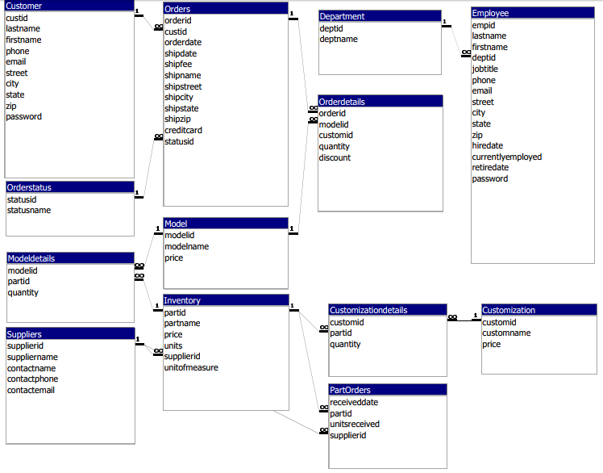
ER Diagram

Slide 47
Table Descriptions

Slide 48
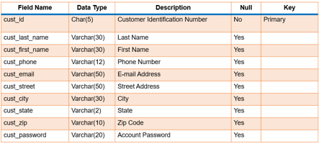
Customer

Slide 49

Customization

Slide 50

Customization Details

Slide 51

Department

Slide 52
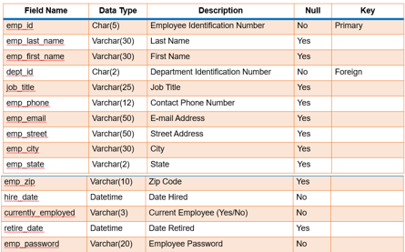
Employee

Slide 53
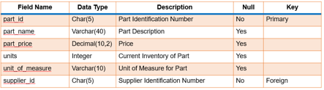
Inventory

Slide 54

Model

Slide 55
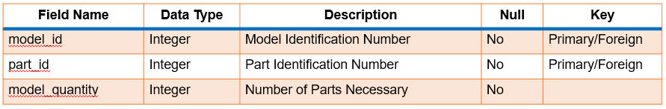
Model Details

Slide 56
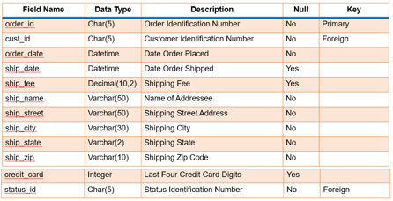
Orders

Slide 57
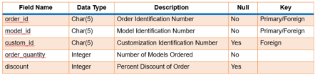
Order Details

Slide 58

Order Status

Slide 59
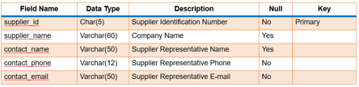
Suppliers

Slide 60

Monthly Inventory Report

Slide 61

Monthly Sales Report

Slide 62
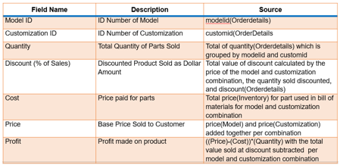
Monthly Profit/Loss Report

Slide 63
Hierarchy Chart

Slide 64
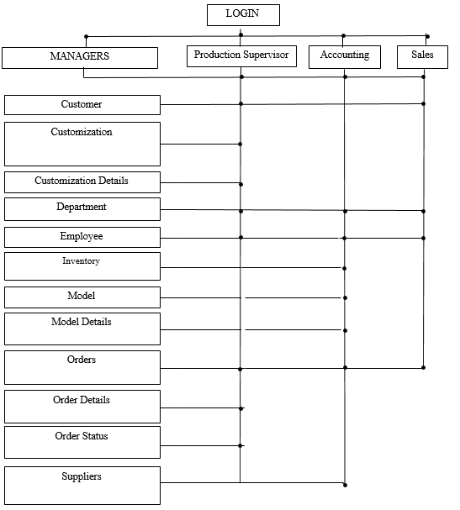

Slide 65
Detailed Screen Layouts

Slide 66
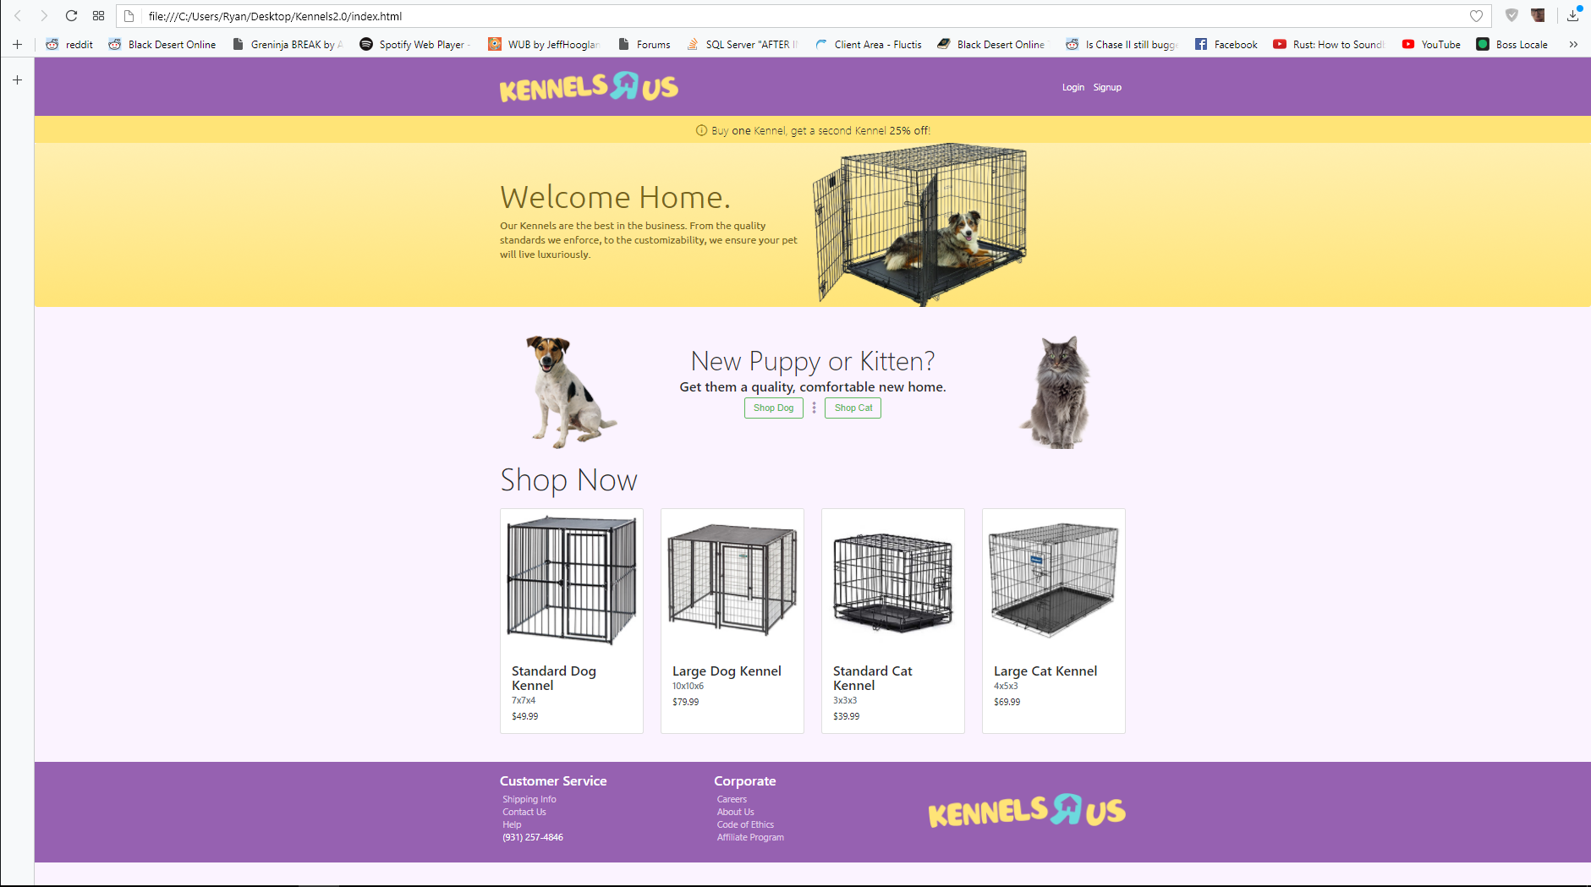
Index.html/home page

Slide 67
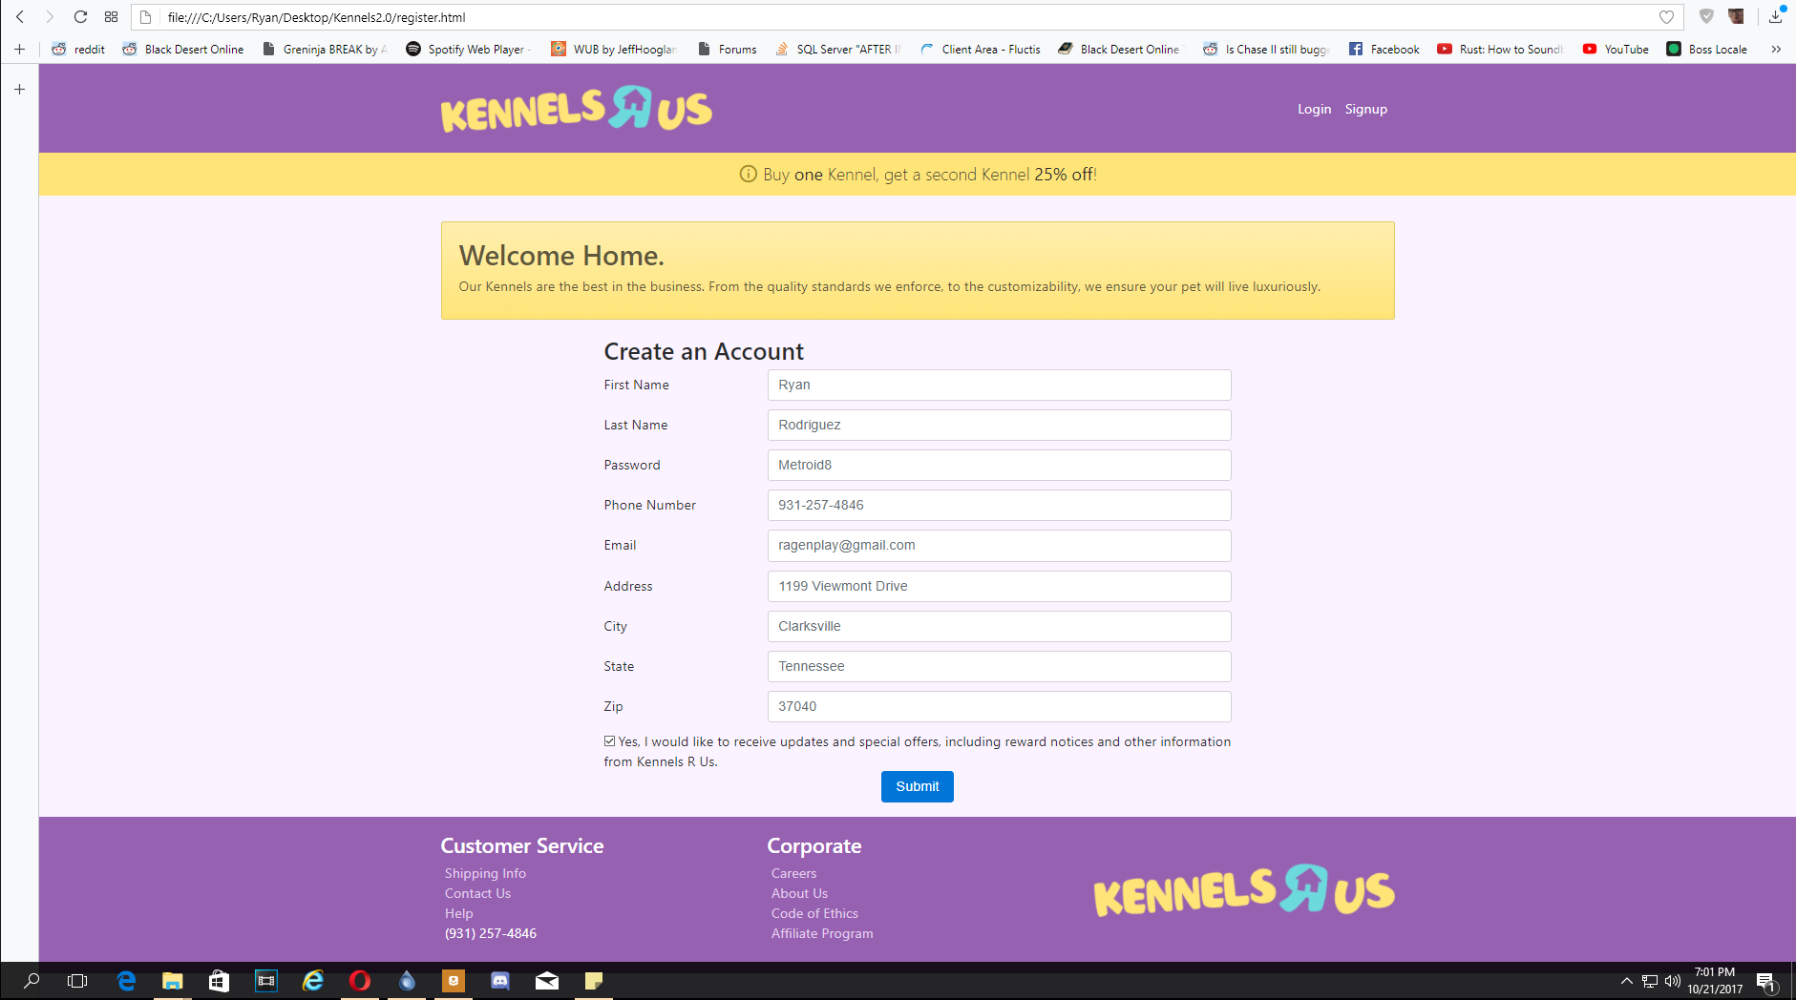
Register.html/Register page

Slide 68
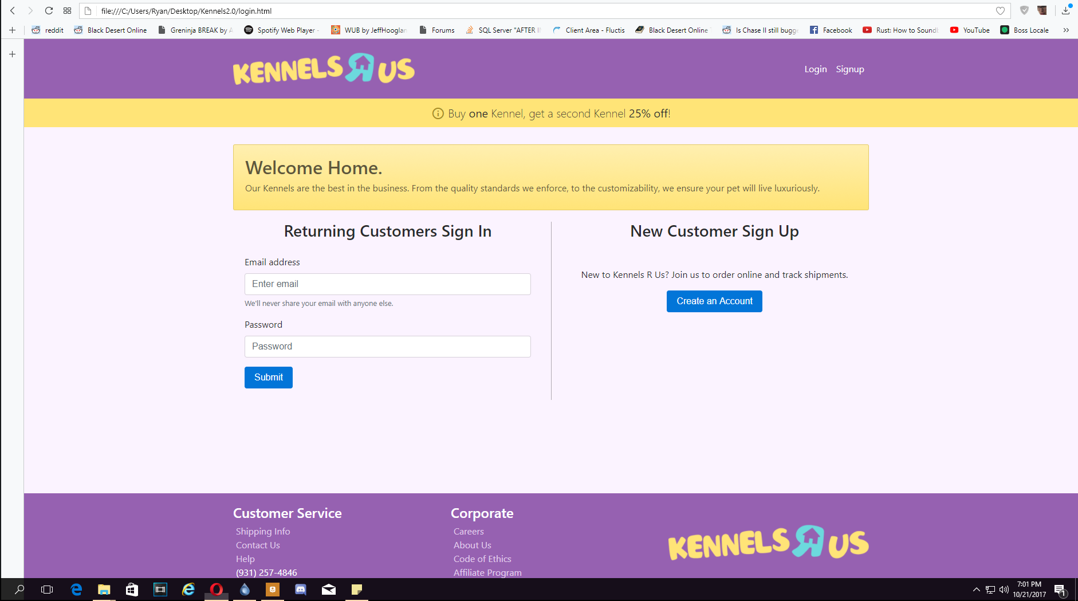
Login.html/Login page

Slide 69
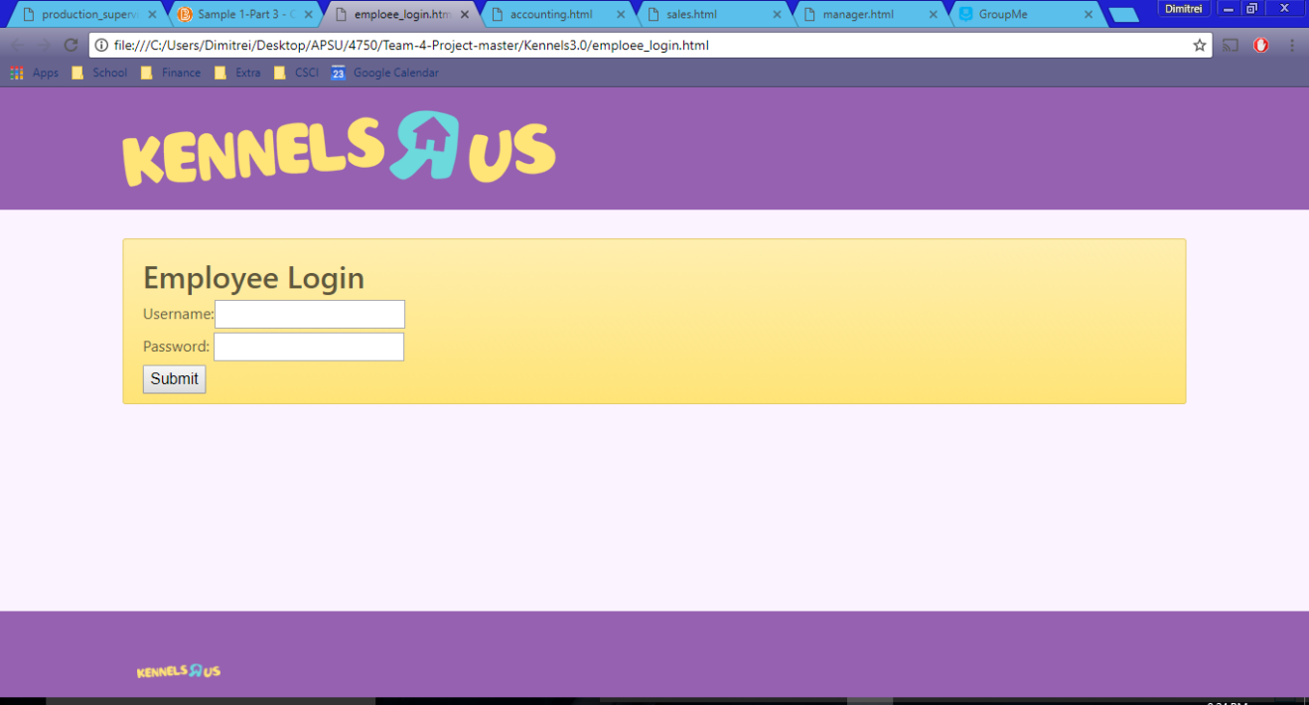
Employee_login.html/ Employee Login page

Slide 70
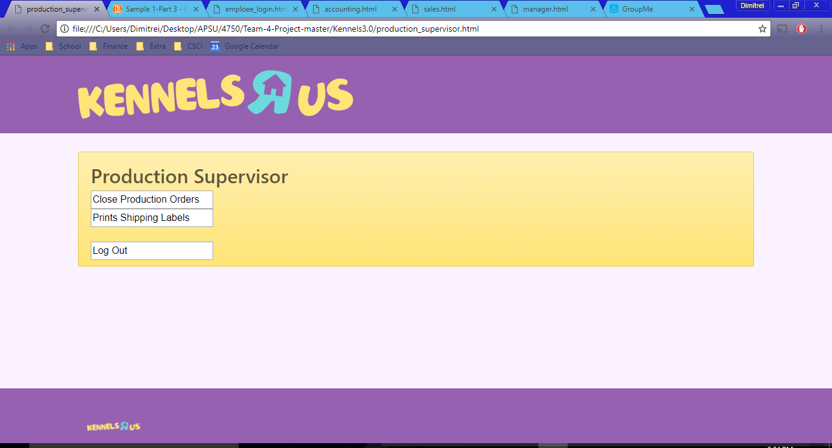
production_login.html/ production Login page

Slide 71
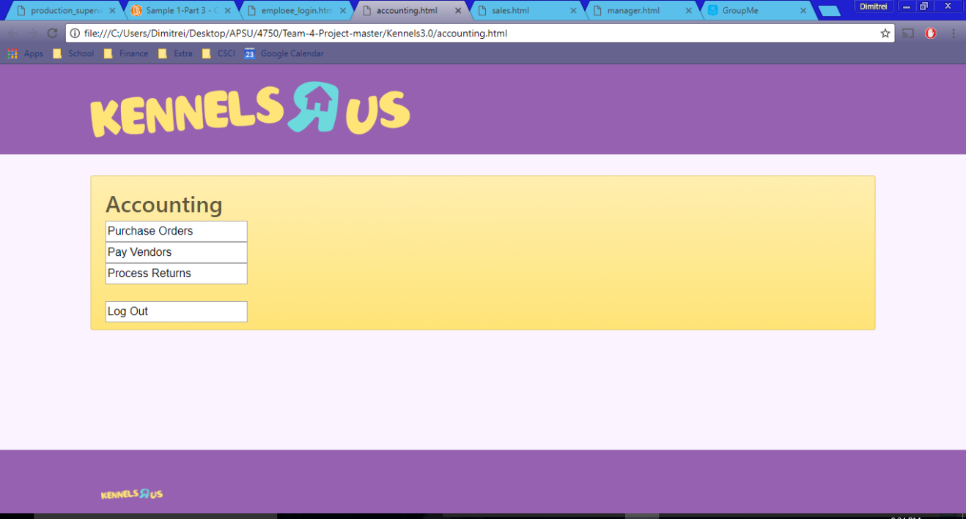
Accounting.html/ Accounting page

Slide 72
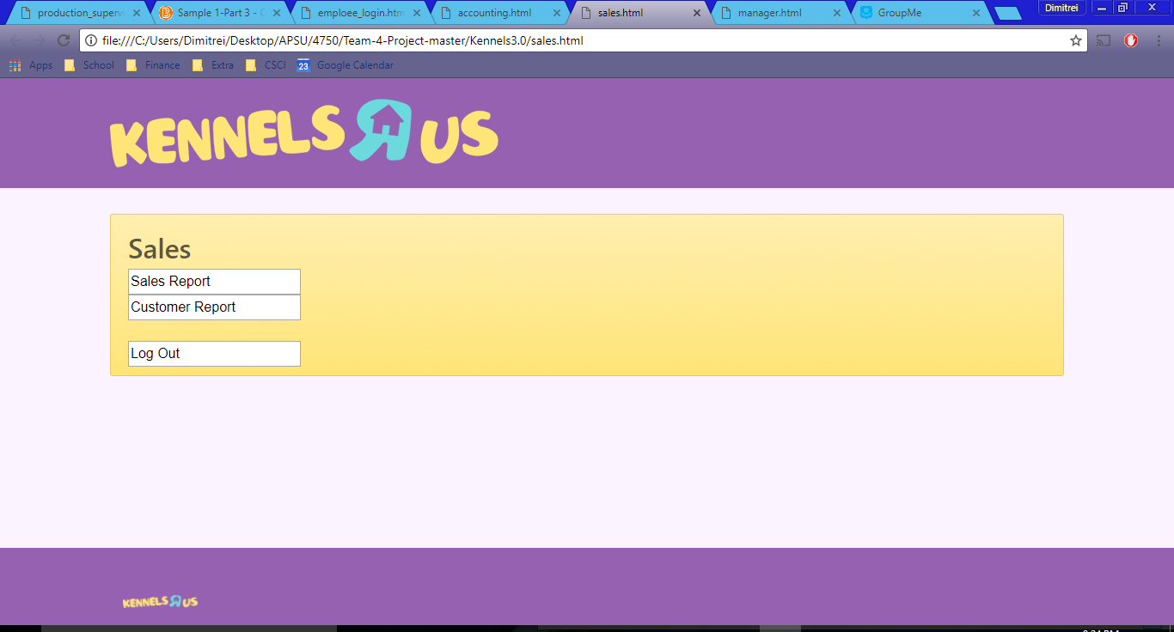
sales.html/ sales page

Slide 73
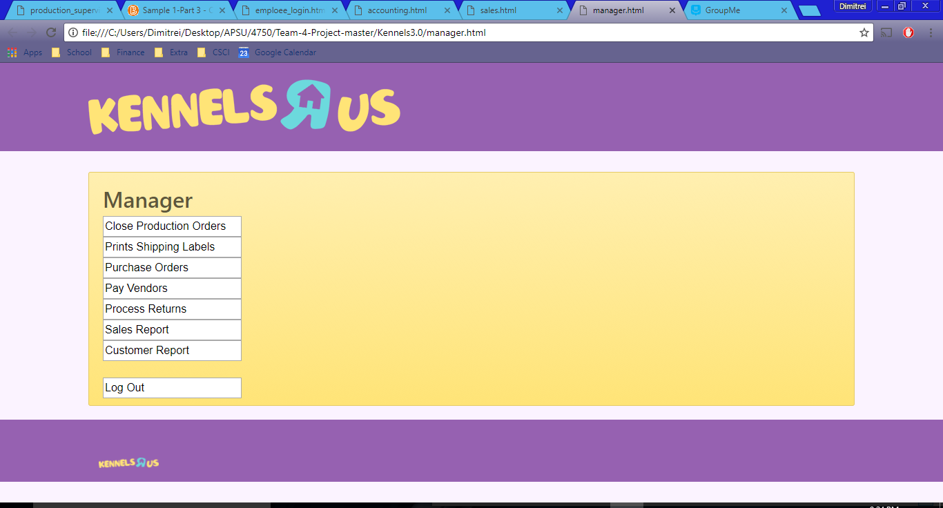
Manager.html/ manager page

