Slide 1
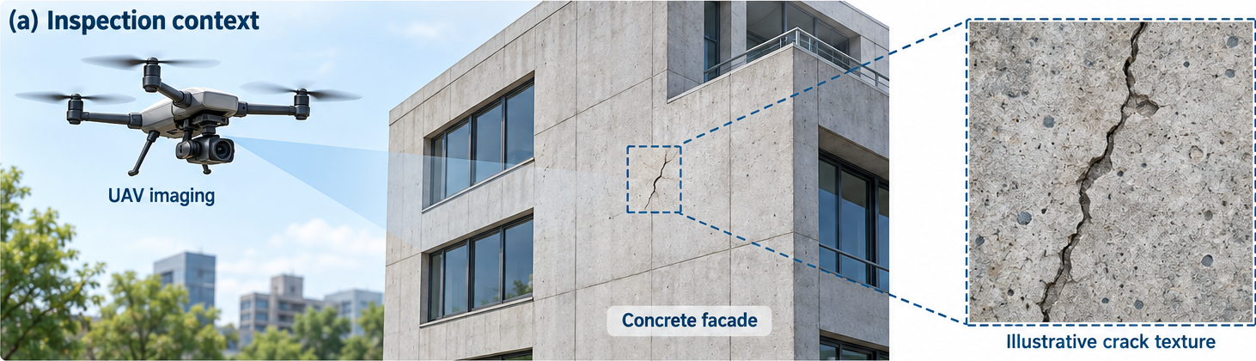








AI-Assisted Structural Defect Inspection and Risk Assessment
Illustrative workflow — no experimental results
(b) Analysis and decision workflow
Acquisition
Parallel analysis
Evidence fusion
Assessment
Crack
segmentation
Severity
estimation
UAV image
capture
Image quality
control
Defect
evidence fusion
Risk review
Surface
mapping
Exposure
assessment
Human review required
Information flow
Analysis step
Synthetic / illustrative — not a validated inspection system

