Slide 1
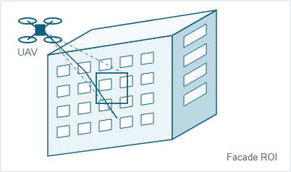
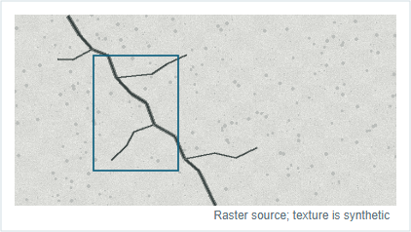
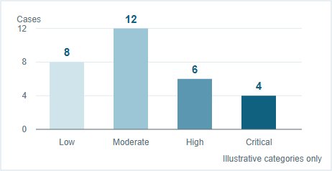
UAV-Based Structural Defect Inspection
and Risk Assessment
ORIGINAL SOURCE FIGURE
Synthetic / Illustrative
NOT RECONSTRUCTED BY THE SKILL
A UAV survey context
B Surface evidence
D Illustrative risk distribution
Conceptual geometry; no real site
Program-generated concrete / crack texture
30 synthetic cases; not inferred from panel B
C Inspection, evidence analysis and decision workflow
Branching and fusion are conceptual. No real detection, measurement or risk model is claimed.
I Acquisition & quality
II Evidence preparation
III Assessment & reporting
04
Geometric
registration
07
Crack
characterization
01
Mission
design
02
UAV RGB
capture
03
Image quality
control
06
Evidence
fusion
09
Risk
grading
05
Surface ROI
review
08
Member context
assessment
10
Inspection
report
Inputs
Preserve uncertain evidence
RGB imagery + mission metadata
No guessed geometry or physical measurements
Native candidate: labels / route nodes
Raster candidate: textured surface evidence
Directed scientific relation
Illustration only · not a detection result, measurement dataset or validated Skill reconstruction

