Slide 1
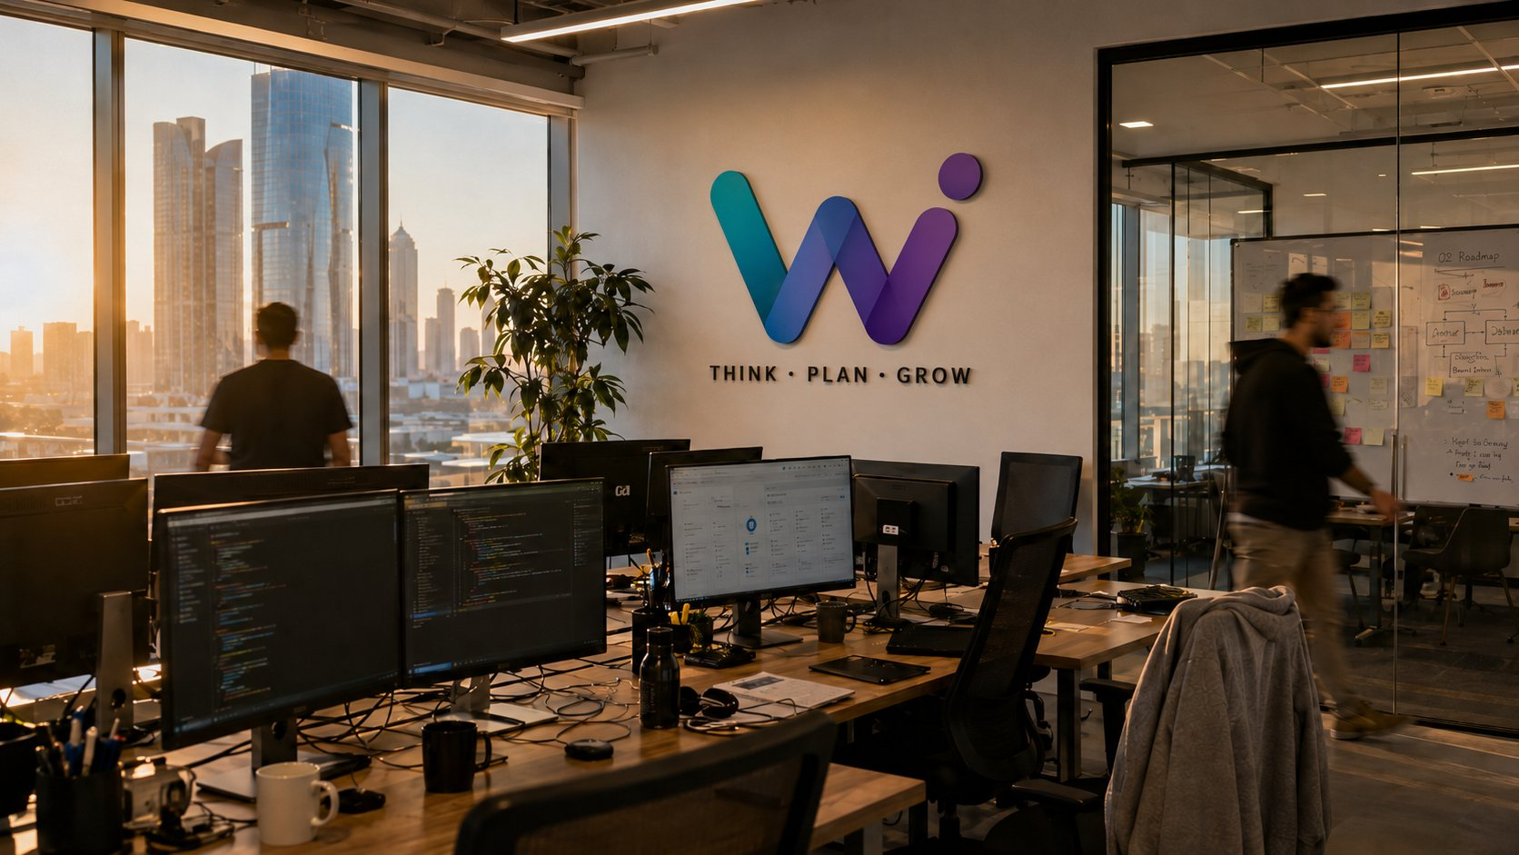
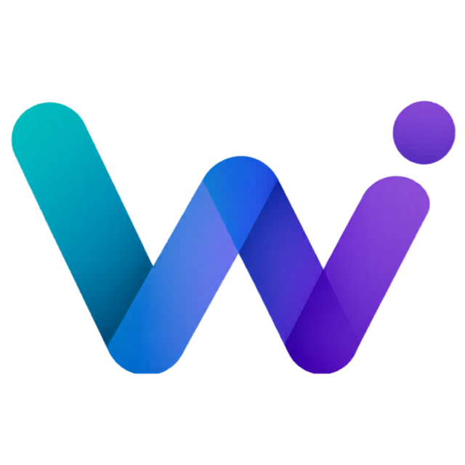
WeThink
THINK · PLAN · GROW
Company
Profile
Your Digital Transformation Partner
Consulting – Cloud – Cybersecurity – Custom Software – Data & AI
Abu Dhabi, United Arab Emirates · Est. 2019 · wethink.ae
2026

Slide 2
WETHINK
About Us
AT A GLANCE
WeThink Information Technology Consulting is an Abu Dhabi-based digital consultancy founded in 2019 by Rasha Aljalam. We take businesses from idea to impact — combining strategy, engineering, and design under one roof so our clients never have to stitch together a dozen vendors.
COMPANY OVERVIEW
2019
8
We work side-by-side with founders launching their first product and with established organisations modernising their technology stack — across the UAE and the wider Gulf.
Founded in
Abu Dhabi
Core service
lines
5,000+
1,000+
Projects
delivered
Clients
served
Rasha Aljalam
Founder & Chief Executive Officer
"We don't just advise — we execute, deliver, and stay accountable until you win."
SOLUTION DOMAINS
Digital Transformation
Strategic Consulting
Cloud Services
Cybersecurity
Credentials & Alignment
Custom Software
Data & Analytics
IT Solutions
Project Management
ISO 27001 Ready
NESA-aligned
UAE Gov Compliant
AWS Partner
Microsoft Azure
UAE PDPL Aware
INDUSTRY FOCUS
Startups · Retail · Real Estate · Education · Healthcare · Logistics · F&B
WeThink · Digital Smart Solutions · wethink.ae
02

Slide 3

Our Journey
WeThink started in 2019 as an entrepreneurial venture in Abu Dhabi. Since then it has grown into a full-spectrum digital consultancy — adding practice areas year on year while staying founder-led and delivery-obsessed.
WeThink founded in Abu Dhabi — IT consulting and web delivery for local businesses
Cybersecurity practice added — ISO 27001 and NESA-aligned programmes
Data & AI practice: BI dashboards, analytics, and ML-assisted tooling
Six venture launches delivered; digital business card and app initiatives
2019
2021
2023
2025
2020
2022
2024
2026
Cloud practice launched: AWS and Azure migrations for UAE SMEs
Custom software studio formed: web, mobile, and API engineering
Pre-launch venture programme — building brands from idea to market
New brand identity and expanded portfolio across the Gulf
WeThink · Digital Smart Solutions · wethink.ae
03

Slide 4
Mission, Vision & Values
Our Mission
Our Vision
Our Promise
To transform ideas into impactful realities — giving UAE businesses and founders the strategy, engineering, and momentum they need to compete in the digital age.
To be the Gulf's most trusted end-to-end digital partner: the first call for anyone who wants technology delivered right the first time.
One partner, every layer. We stay accountable from the first workshop to long after launch — with radical transparency at every step.
Values We Work By
Think
Plan
Grow
Own It
Stay Human
Understand deeply before building anything
Tailored roadmaps — never templates
Ship, measure, and keep improving
Accountable until the outcome lands
Founder-level attention on every account
WeThink · Digital Smart Solutions · wethink.ae
04

Slide 5
Our Services — 1 of 2
Digital Transformation
Strategic Consulting
End-to-end overhaul of business processes, culture, and technology — aligned with UAE Vision 2031.
Data-driven strategy and C-suite advisory that turns complexity into competitive advantage.
Process Design
Change Management
Technology Roadmaps
C-Suite Advisory
Digital Roadmaps
Legacy Modernisation
OKRs & Governance
Vendor Selection
Cloud Services
Cybersecurity
Multi-cloud architecture, migration, and optimisation on AWS, Azure, and GCP.
Security assessments, threat monitoring, and compliance frameworks that protect critical assets.
Cloud Architecture
Migration
Zero-Trust Design
ISO 27001 Programmes
Managed Operations
FinOps & Cost Control
NESA Alignment
SOC Monitoring
WeThink · Digital Smart Solutions · wethink.ae
05

Slide 6
Our Services — 2 of 2
Custom Software
Data & Analytics
Bespoke web, mobile, and enterprise applications engineered from the ground up.
Dashboards, predictive models, and BI platforms that turn raw data into decisions.
Web & Mobile Apps
API Engineering
BI Dashboards
Data Warehousing
AI-Powered Platforms
MVPs in 8–12 Weeks
ML Models
Real-Time Reporting
IT Solutions
Project Management
Tailored infrastructure, systems integration, and managed IT that scales with ambition.
Agile, structured delivery that keeps complex technology projects on time and on scope.
Infrastructure
Systems Integration
Agile Delivery
PMO Governance
Managed IT
99.98% Uptime Targets
Stakeholder Management
On-Time Delivery
WeThink · Digital Smart Solutions · wethink.ae
06

Slide 7
How We Work
We don't push templates. Every engagement starts with your challenges, gets a tailored roadmap, and is delivered against it — with radical transparency at every step.
01
02
03
04
05
Discover
Design
Deliver
Deploy
Drive
Deep-dive workshops to map challenges, goals, and current-state technology
Architecture blueprints and a phased delivery plan built for your budget
Agile sprints, dedicated PMs, and weekly progress reports — on time
Zero-downtime rollouts with full testing, security sign-off, and training
Post-launch monitoring, optimisation, and long-term partnership
Engagement models: monthly retainers (Essentials · Growth · Enterprise), fixed-scope projects, and dedicated-team arrangements — in AED, with no hidden fees.
WeThink · Digital Smart Solutions · wethink.ae
07

Slide 8
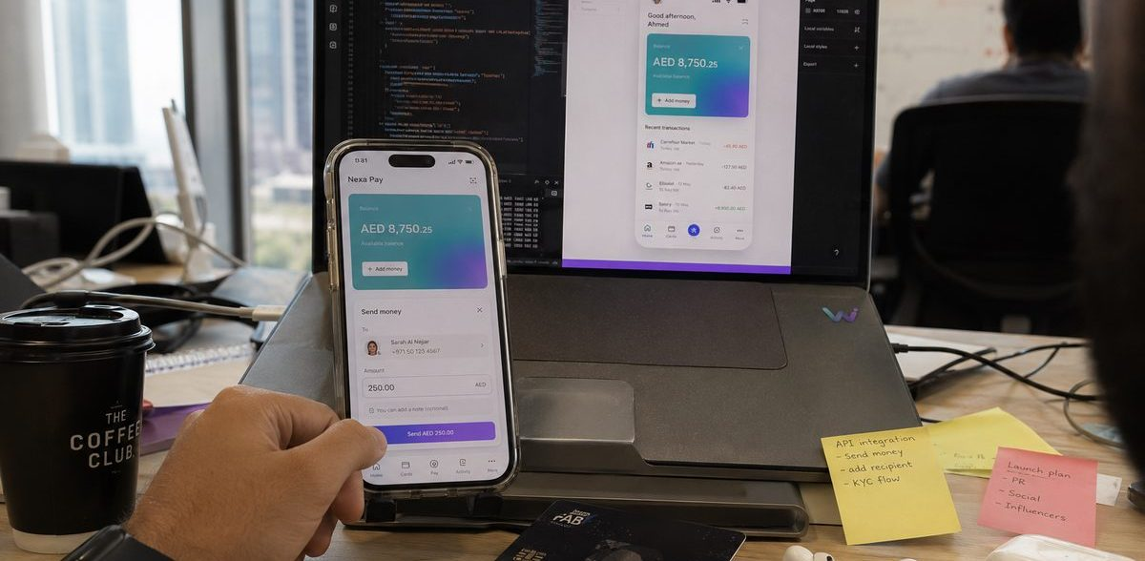
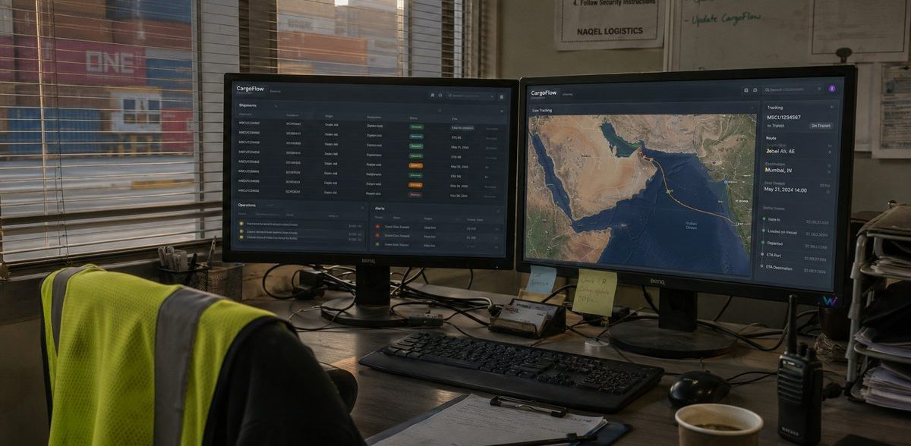
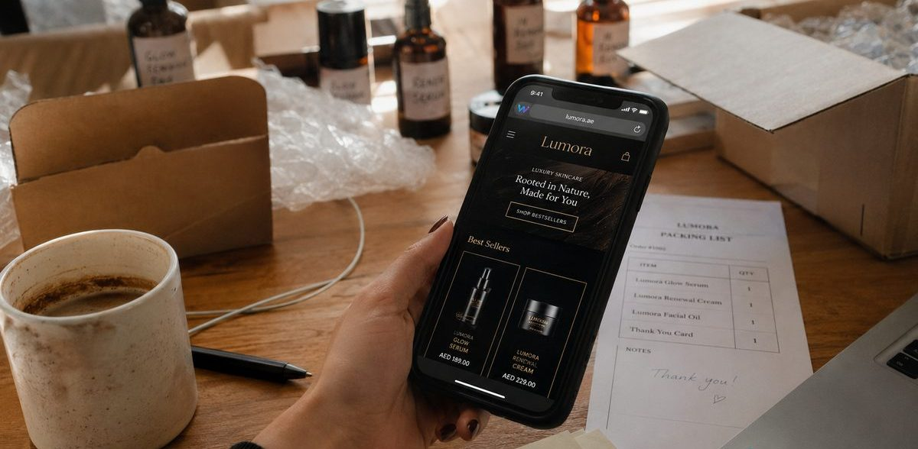
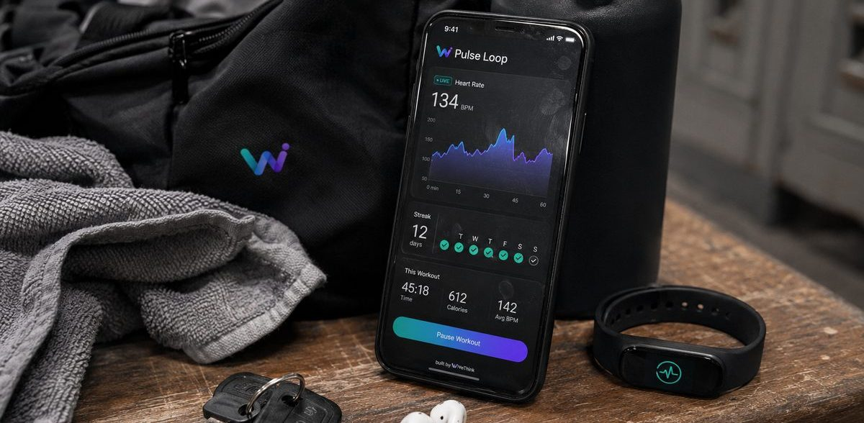
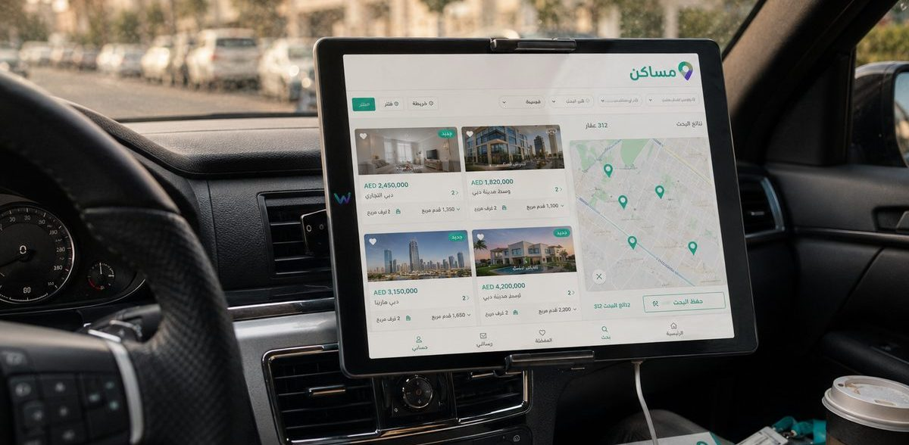
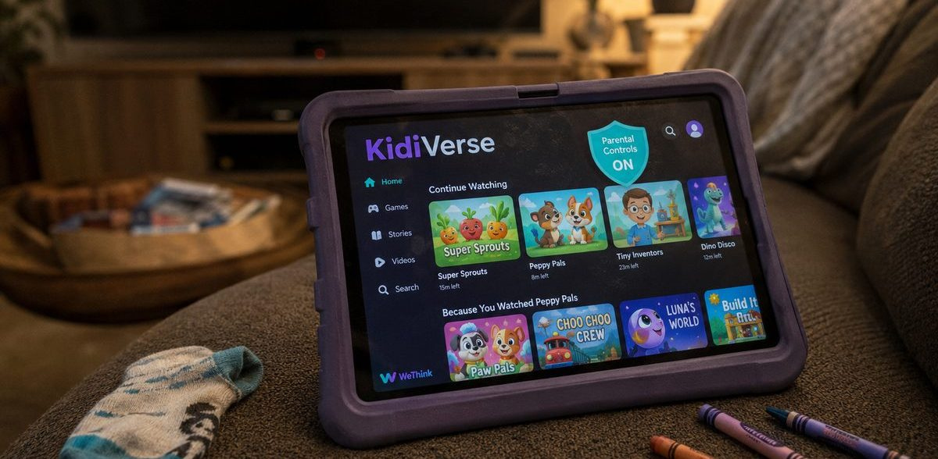
Ventures We Helped Launch
Through our pre-launch venture programme we build brands from idea to market — product, engineering, and identity under one roof.
Nexa Pay
CargoFlow
Lumora
Payments app — idea to pilot in 8 weeks
Shipment tracking SaaS — 40% less manual dispatch
D2C skincare launch — 3× launch-month ROAS
Pulse Loop
Masakin مساكن
KidiVerse
Wellness app MVP — app-store beta in 12 weeks
Bilingual property portal — 2.5K monthly leads
Kids-safe streaming — full parental-control layer
WeThink · Digital Smart Solutions · wethink.ae
08

Slide 9



Featured Cases
OUR MOST RECENT & MOST CREATIVE WORK
CONTRACTING · ABU DHABI
HOSPITALITY · ABU DHABI
EVENTS · UAE
Albina Alareeq Contracting — Digital Transformation
Nabe Eldiyafa Brand & Digital Ecosystem
Diamond Events — Weddings & Flowers
Digital transformation for Albina Alareeq Contracting & General Maintenance — a corporate website plus a project-management portal unifying field reporting and head-office visibility.
Full digital launch for a heritage Damascene restaurant — brand identity refresh, a bilingual reservations website, and a 12-month social media programme that filled weekend covers.
A luxury identity and digital launch for a weddings-and-flowers studio — gold-standard branding, a portfolio website with enquiry and booking flows, and an Instagram-first content system.
Corporate platform
Brand identity
Luxury brand identity
PM portal
Bilingual site
Booking website
Unified reporting
12-month campaign
Content system
WeThink · Digital Smart Solutions · wethink.ae
09

Slide 10
Why Choose WeThink
01
02
03
One Partner, Every Layer
Founder-Level Attention
UAE-Rooted, Gulf-Ready
Strategy, engineering, design, and operations under one roof — no vendor patchwork, no finger-pointing.
Founder-led and delivery-obsessed. Senior people stay on your account from kickoff to long after launch.
Bilingual Arabic/English delivery, UAE Vision 2031 alignment, and local regulatory awareness (NESA, PDPL).
04
05
06
Security By Default
Speed Without Chaos
Honest Commercials
ISO 27001-aligned practices and zero-trust thinking baked into every build — not bolted on afterwards.
MVPs in 8–12 weeks with agile governance: weekly demos, transparent backlogs, no surprises.
AED pricing, published retainers, and fixed-scope options. No hidden fees, cancel anytime.
WeThink · Digital Smart Solutions · wethink.ae
10

Slide 11
Technology Expertise
Vendor-neutral by principle — we recommend and build on the platforms that fit your goals, not our margins.
CLOUD & INFRASTRUCTURE
ENGINEERING
DATA & AI
SECURITY & DELIVERY
AWS
React & Next.js
Power BI
Zero Trust
Microsoft Azure
Node.js
Data Warehousing
SOC Monitoring
Google Cloud
Flutter
ML Models
DevOps & CI/CD
Kubernetes
React Native
Real-Time Analytics
Azure DevOps
Terraform
Python
AI Assistants
Microservices
Docker
PostgreSQL & MongoDB
ETL Pipelines
SAP Integration
Standards & Compliance Awareness
ISO 27001 (aligned)
NESA / UAE IA
UAE PDPL
WCAG Accessibility
OWASP Practices
UAE Gov Digital
WeThink · Digital Smart Solutions · wethink.ae
11

Slide 12
Engagement Models
Transparent AED retainers — no hidden fees, cancel anytime. Fixed-scope projects and dedicated teams also available.
Essentials
Growth
MOST POPULAR
Enterprise
AED 1,499 /month
AED 4,499 /month
Custom
Reliable IT support and a clear technology roadmap for small businesses.
Managed IT + cloud for scaling teams that want a hands-on partner.
Tailored transformation programmes, scoped and priced per engagement.
✓
IT helpdesk support (8×5)
✓
Everything in Essentials
✓
Everything in Growth
✓
Network & device monitoring
✓
24×7 monitoring & response
✓
End-to-end digital transformation
✓
Annual security health check
✓
Cloud architecture & cost control
✓
Custom software & AI solutions
✓
Cloud readiness assessment
✓
Security hardening & training
✓
ISO 27001 / NESA programmes
✓
Monthly reports & advisory call
✓
Quarterly strategy workshops
✓
Dedicated engineering team
✓
Up to 15 users
✓
Dedicated account manager · 60 users
✓
Custom SLAs & user count
All prices exclusive of VAT (5%). Yearly billing includes two months free.
WeThink · Digital Smart Solutions · wethink.ae
12

Slide 13
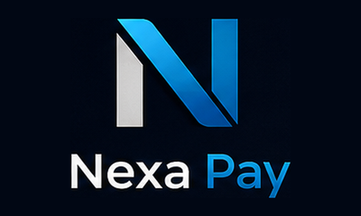
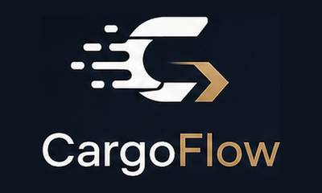







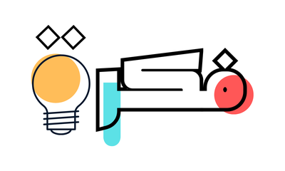




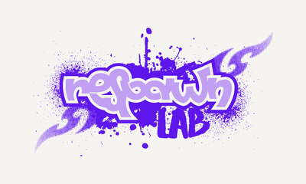
Brands In Our Portfolio
Identities we designed and launched — English and Arabic, across fintech, logistics, retail, wellness, F&B, media, events, and more.
Nexa Pay · Fintech
CargoFlow · Logistics
Lumora · Skincare
Pulse Loop · Wellness
سترك · Fashion
قهوة الأصالة · Café
أنماط · Fashion
عبير الديار · Fragrance
مساكن · Real Estate
فكرة · Creative Studio
بصمة · Software House
نشرة · News Platform
وجدان · Yoga Space
Vet Clinic · Pet Care
Respawn Lab · Gaming
WeThink · Digital Smart Solutions · wethink.ae
13

Slide 14
Think. Plan. Grow.
Since 2019, WeThink has been helping UAE businesses and founders turn ideas into impactful realities. Let's build what's next — together.
VISIT
EMAIL
CALL / WHATSAPP
HEADQUARTERS
www.wethink.ae
info@wethink.ae
+971 50 312 5078
Pixel, Al Reem Island
Abu Dhabi, UAE
Instagram @wethink.ae · LinkedIn Rasha Aljalam · Facebook wethink.ae
© 2026 WeThink Information Technology Consulting. All rights reserved.

