Slide 1
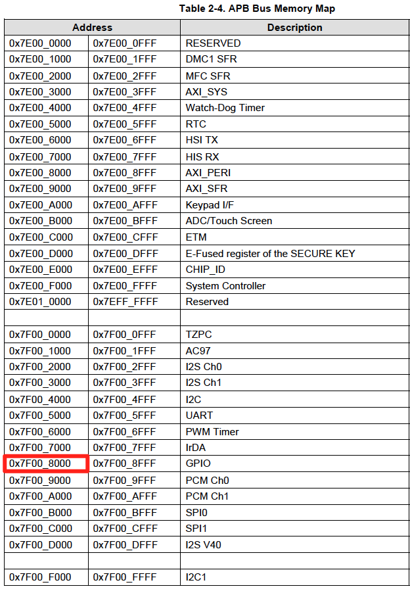
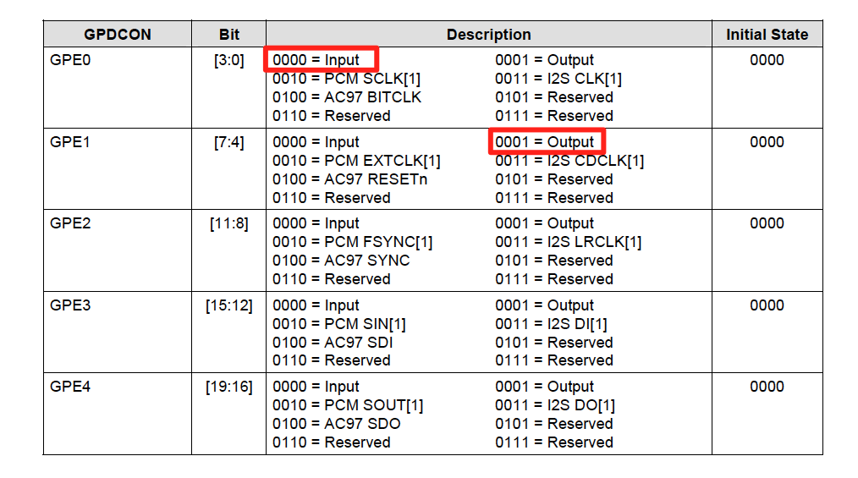
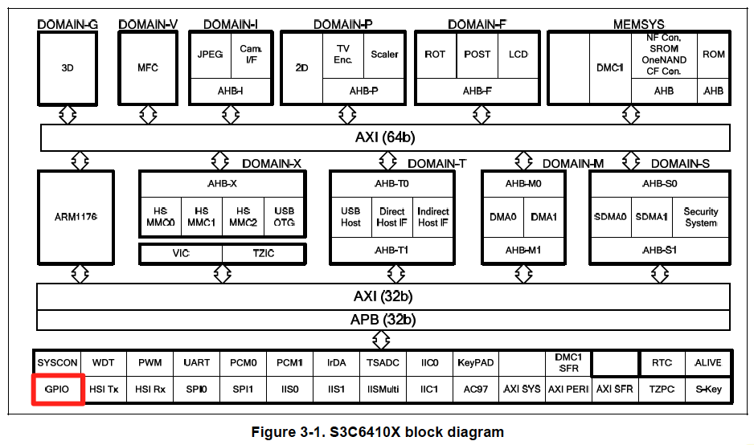
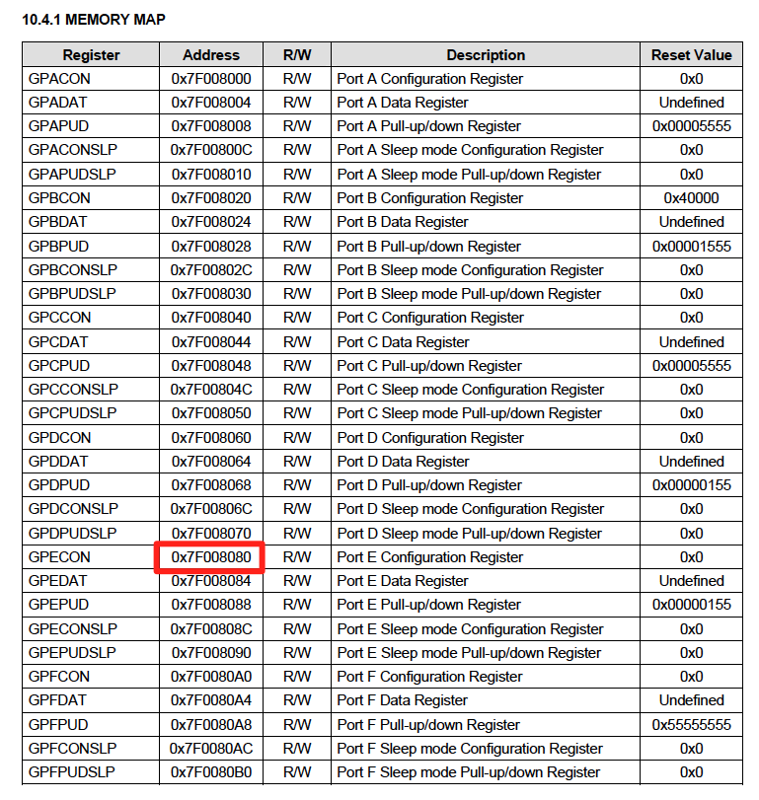
GPIO-E CONFIGURATION
Register | Value | Description
GPECON | 0xXXXXXXXXXXXX00010000 | GPECON has a total of 20 bits for config. of GPIOE peripheral. Setting bits [3:0] = 0000 configures GPE0 as input. Setting bits [7:4] = 0001 configures GPE1 as output.

