Slide 1
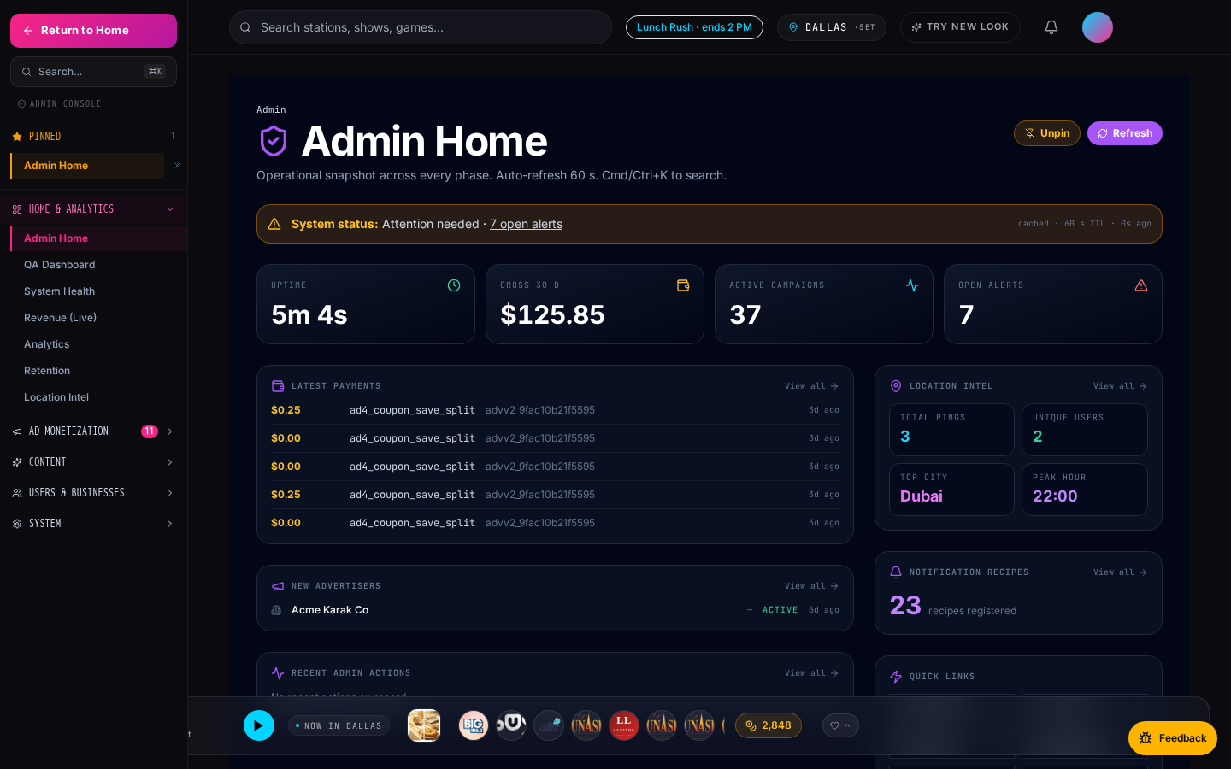
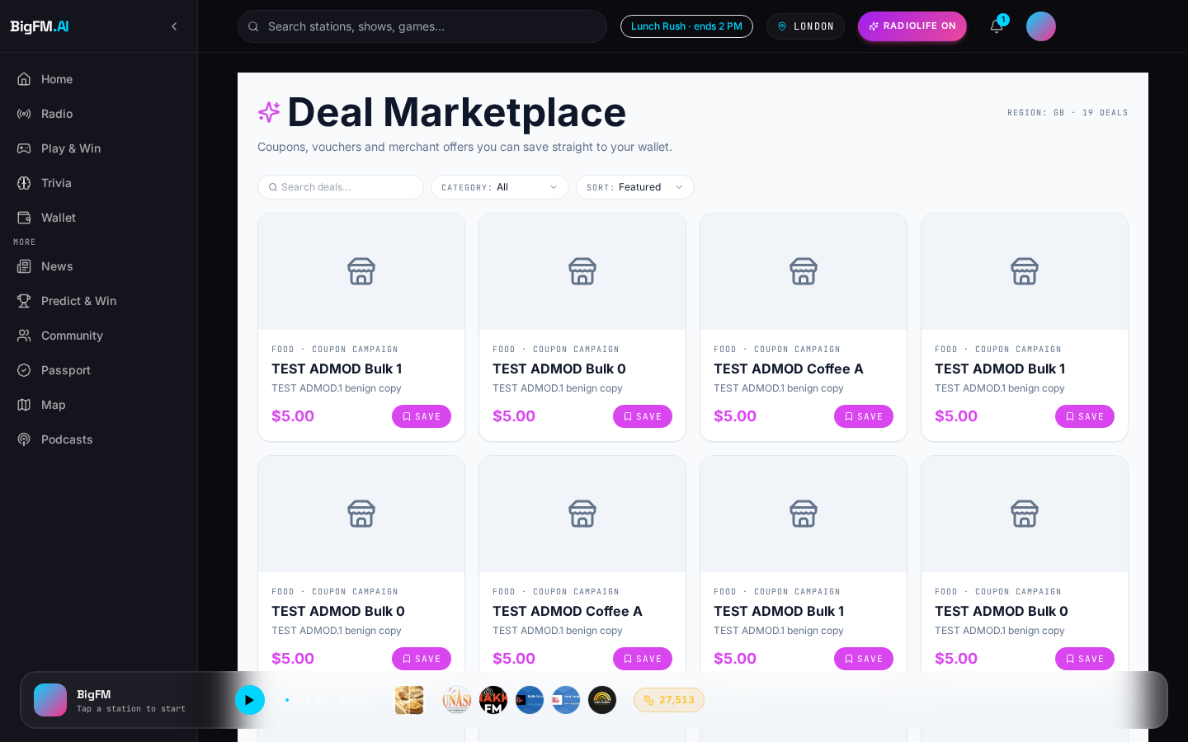
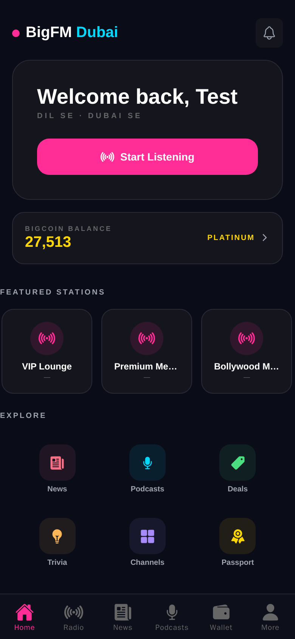
SERIES-A · PITCH
BigFM
AI-powered radio + rewards + local commerce
July 2026 · BigFM · Confidential

Slide 2
The Vision
Personalized live radio that turns listening
into real-world rewards.
Web, mobile — one player, one wallet, one AI RJ.
BigFM · Confidential
2 / 18

Slide 3
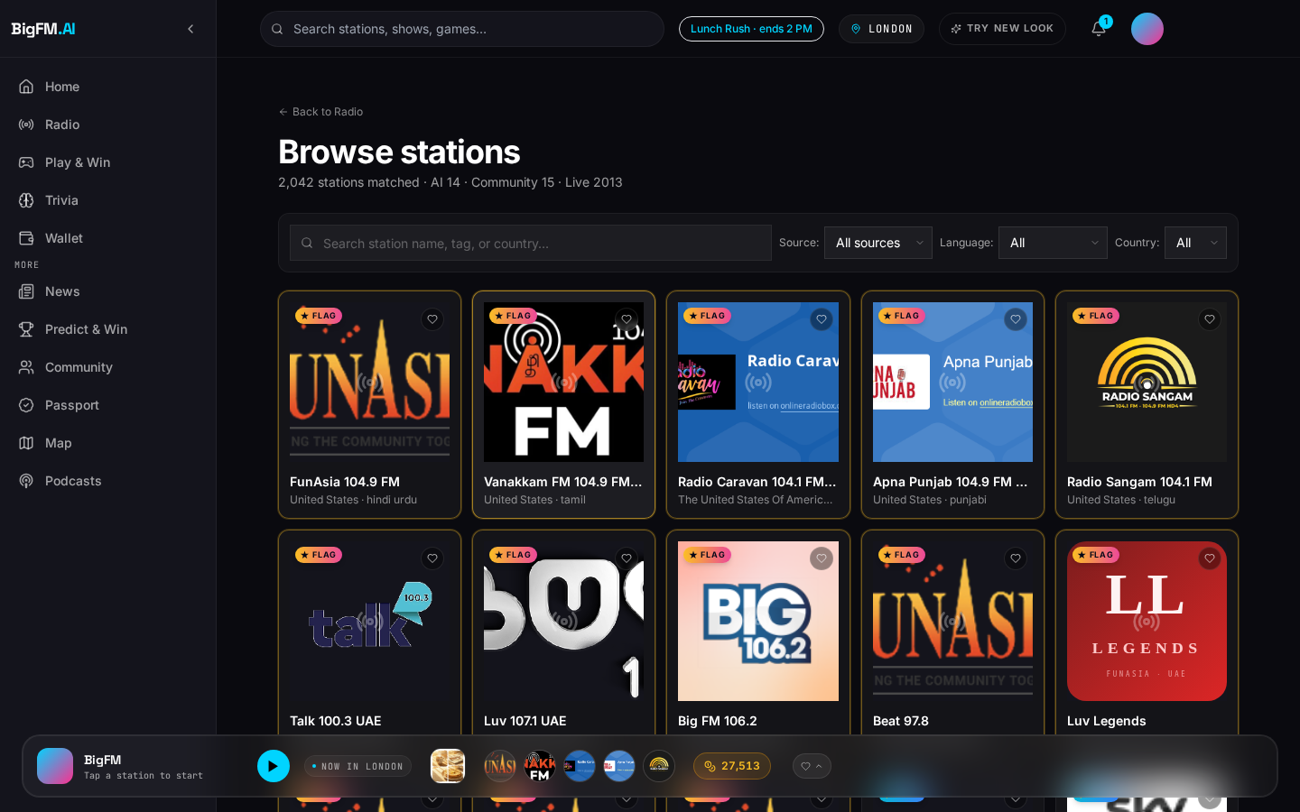
The Problem
Audio is broken along three axes.
▸ Legacy radio is one-way and un-personalized — every listener hears the same content at the same time.
▸ Spotify solved on-demand but killed the shared radio moment — no live curation, no serendipity, no AI host.
▸ Local businesses can't buy hyperlocal audio ads programmatically — radio's ad stack still runs on faxed spot orders.
Today's audio: fragmented, un-monetized locally, one-way.
BigFM · Confidential
3 / 18

Slide 4
The Solution
One AI-curated radio stack — engagement layer + ad platform + local commerce.
1
Live radio · podcasts · news · trivia
Non-interactive queue, AI RJ personas, breaking news ribbon
2
Marketplace · wallet · rewards
Save → visit → redeem → earn points loop
3
11 ad products
Boosts, sponsored reads, retargeting, coupon CPA, takeover…
Listener
4
Admin console · analytics · ops
QA dashboard, location intel, revenue live, notifications
BigFM · Confidential
4 / 18

Slide 5
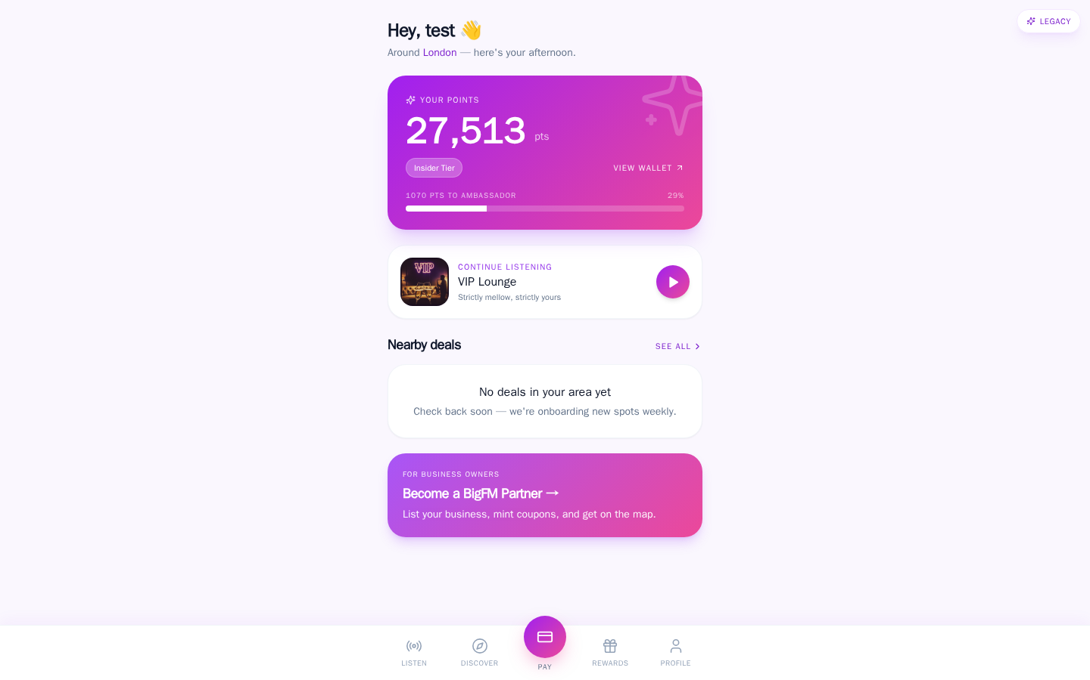
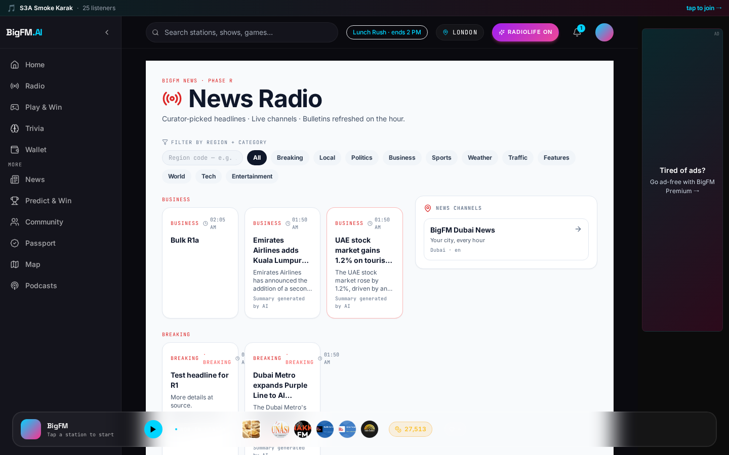
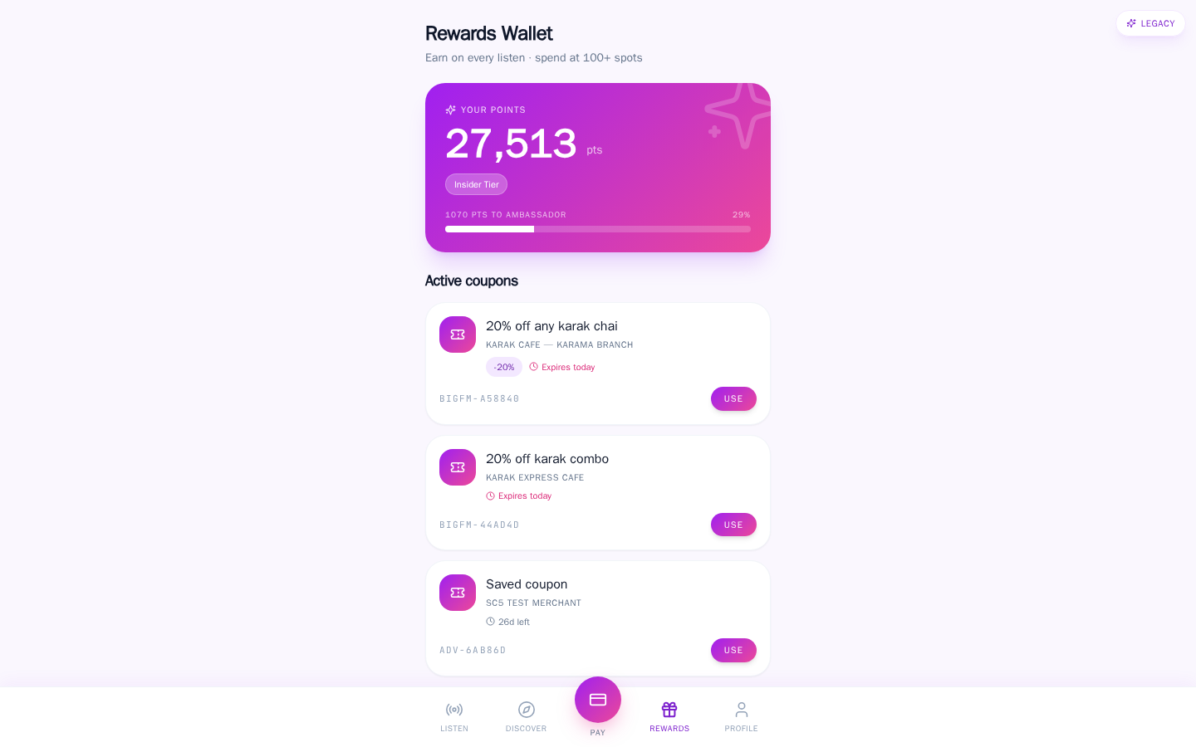
Listener Experience
One player. Every discovery / save / learn / redeem in one flow.
Home · Discover
Marketplace · Save
BigFM · Confidential
5 / 18
News · Learn
Wallet · Redeem

Slide 6
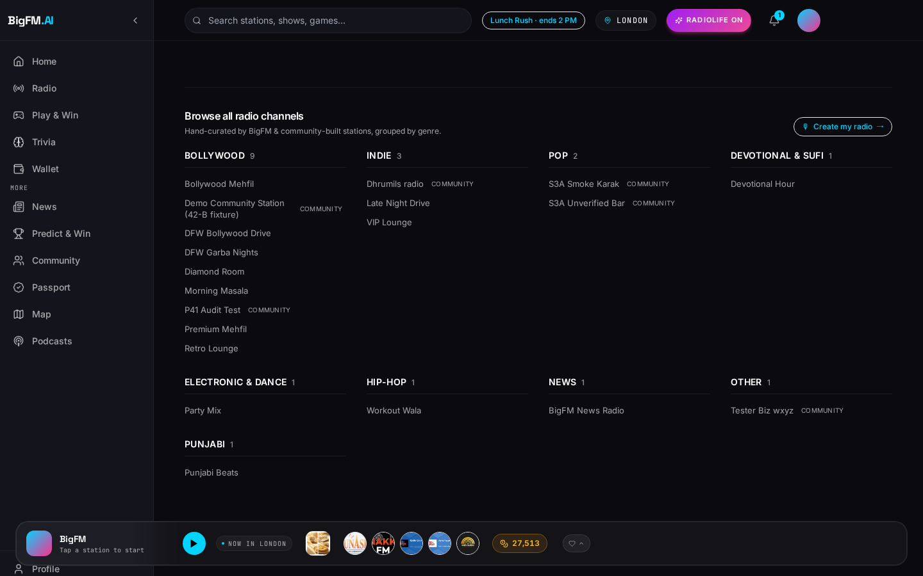
The Radio Engine
Server-side personalized queue + AI RJ voiceovers + geo-flagship routing.
▸ Non-interactive queue: no on-demand search, no per-song skip abuse — protects rights + creates a moment.
▸ AI RJ personas (ElevenLabs) bridge songs with real-time weather / commute / mood context.
▸ Flagship routing gives 15 stations first-shelf placement per region, with pre-roll parity across community stations.
▸ Compliance rules baked in: hourly skip cap, cross-station artist cooldown, sponsor read frequency guard.
Big FM 106.2 station page · flagship + AI RJ chips.
BigFM · Confidential
6 / 18

Slide 7
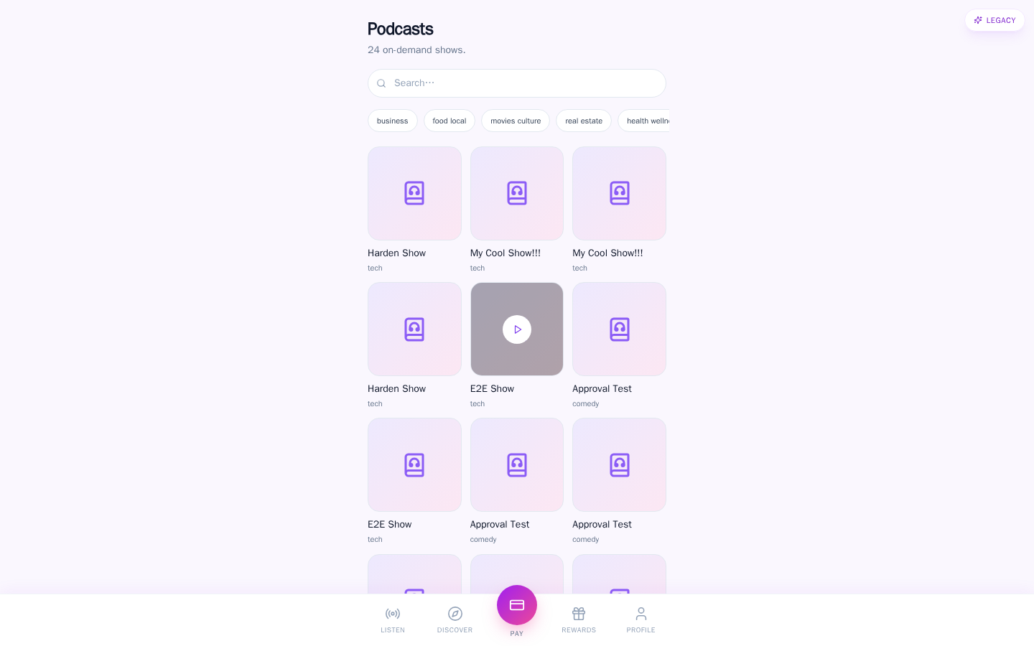
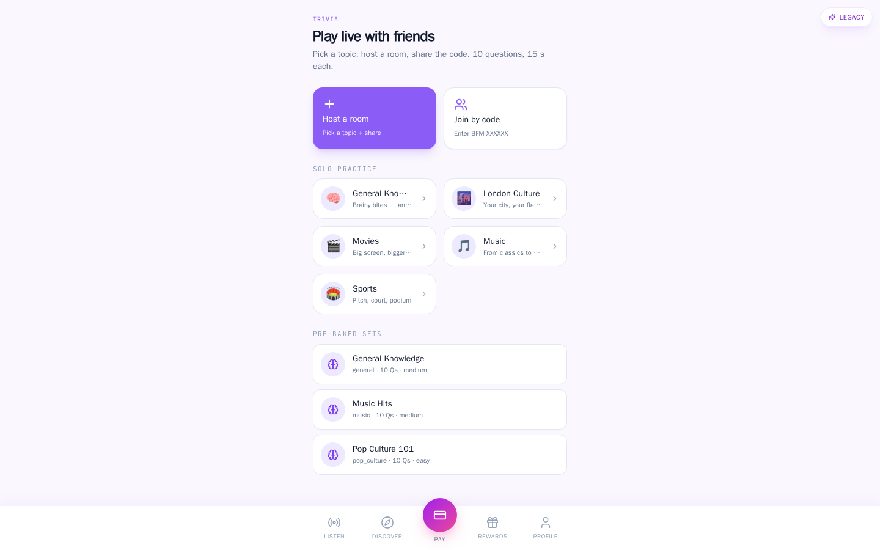
The Engagement Flywheel
Complementary formats, one login, one wallet — every action feeds points.
Podcasts
News · Live
BigFM · Confidential
7 / 18
Trivia lobby
Rewards wallet

Slide 8
Commerce Loop: Marketplace + Wallet + Rewards
Save → visit → redeem → earn — three monetization tiers baked in.
▸ Save a coupon in-app → adds to Wallet, redeemable at merchant.
▸ Visit merchant → geofence detects proximity → passive reward accrual.
▸ Scan-to-pay flow: Stripe Connect app fee split, real-time reconciliation.
▸ Points ledger: earn from listening, saving, redeeming — spend on premium unlocks.
▸ Every merchant txn: platform fee, coupon CPA charge, referral bonus — three layers.
BigFM · Confidential
8 / 18

Slide 9
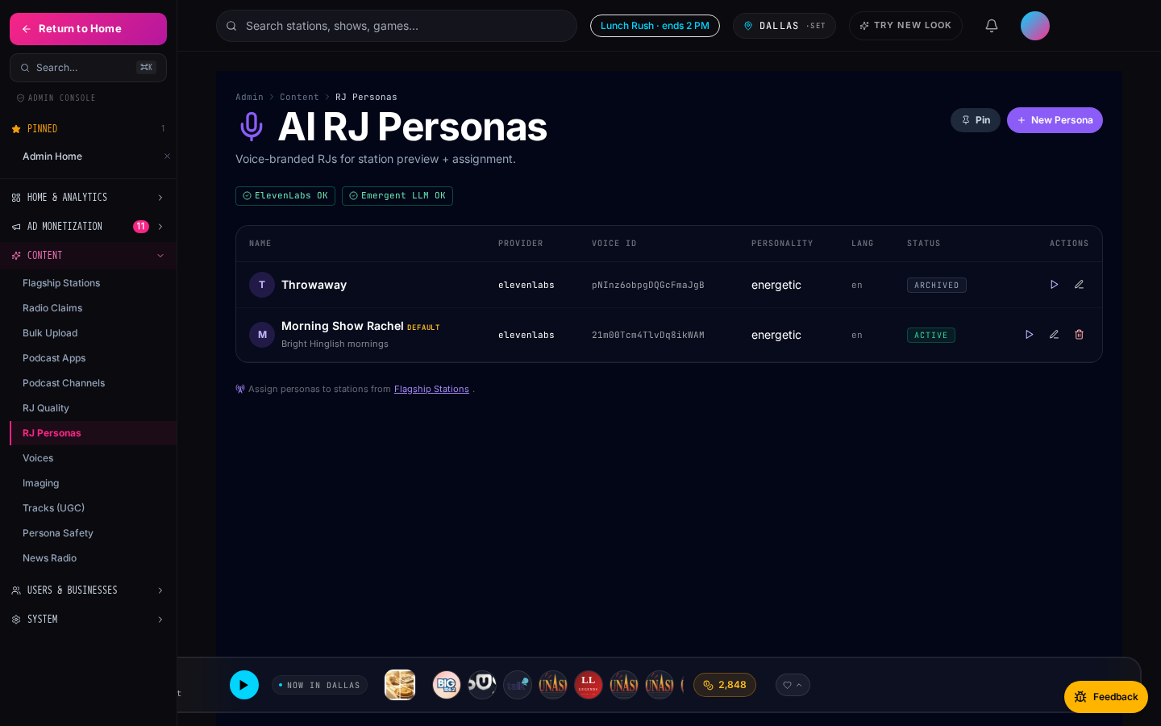
AI RJ Personas
Voice-branded AI hosts (ElevenLabs) — advertisers can sponsor their reads.
▸ 10 curated personas across dayparts (morning, drive, lunch, night, Friday, devotional).
▸ Each persona has voice + tagline + LLM-driven script conditioned on song, weather, hour, city.
▸ Sponsored RJ reads are a first-class ad product — pay-per-play or takeover-hour bundles.
▸ Admins govern persona safety + brand consistency from the console.
Admin RJ personas management console.
BigFM · Confidential
9 / 18

Slide 10
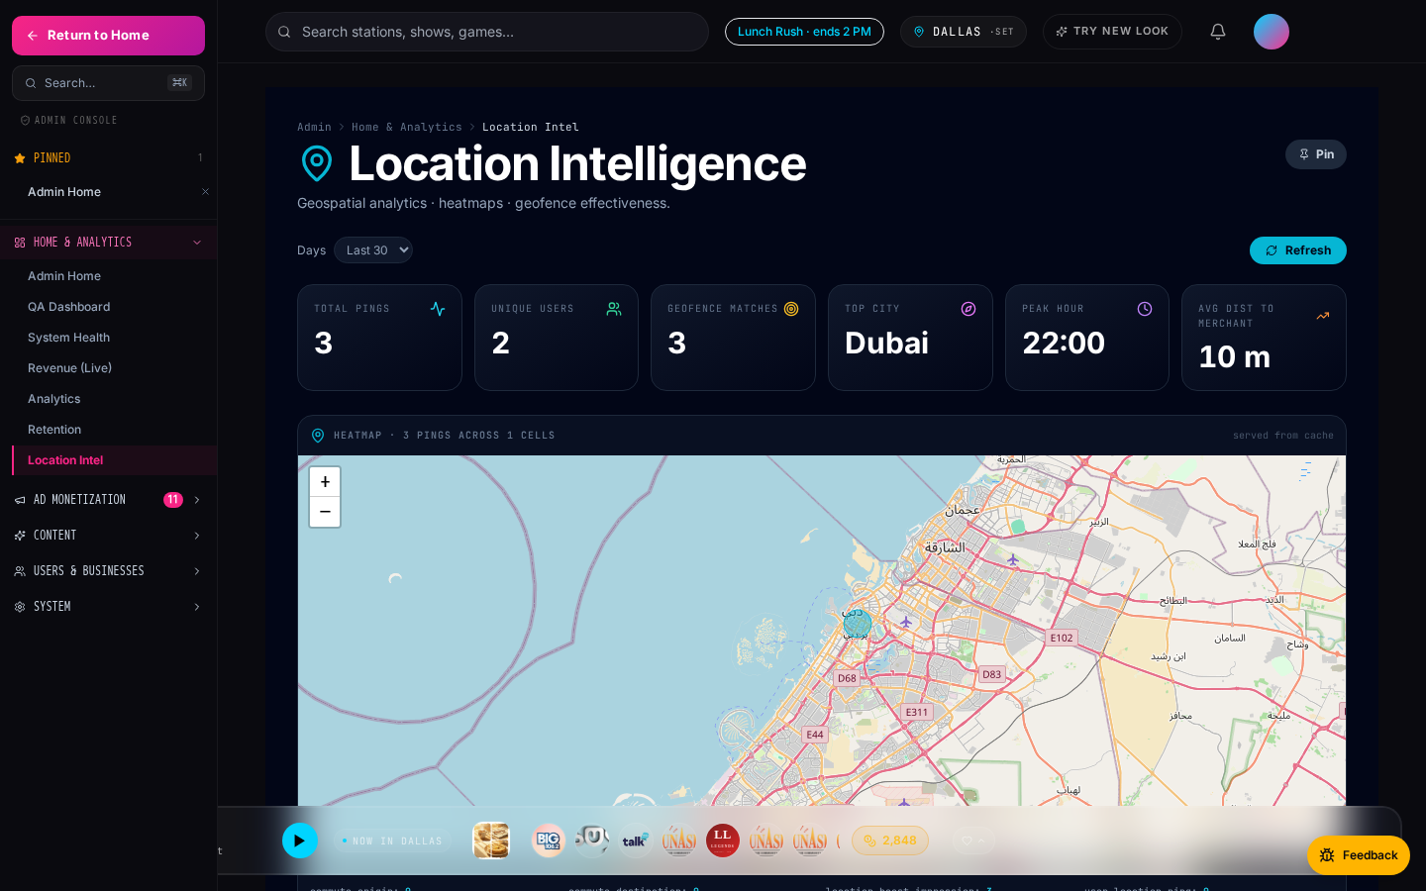
Location-Aware Everything
Commute mode + geofenced ads + hyperlocal analytics all share one geo pipeline.
▸ Commute mode auto-detects morning / evening drive windows and swaps into a shorter-song queue.
▸ Geofences drive location-boost ads — advertisers reach listeners within 500 m of their storefront.
▸ Foot-traffic linkage attributes scan-to-pay conversions to the ad impression within a 60-min window.
▸ Admin location-intel dashboard exposes it all: heatmaps, regions rank, geofence effectiveness.
Admin location intelligence dashboard.
BigFM · Confidential
10 / 18

Slide 11
The Monetization Stack
11 ad products in one platform · one payment rail · one analytics view.
Product | One-line pitch | Pricing model
Flagship Boosts | Direct-bid auction for time-boxed slots on flagship stations. | CPA (bid) + Stripe
Sponsored AI RJ Reads | Advertisers sponsor the AI host's bridge between songs. | CPM · pack
Location-Boost Ads | Geofenced audio + banner ads reaching listeners within 500 m. | CPM · geofence
Marketplace Featured Slots | Boosted deal placement above the marketplace grid. | Flat · slot
Radio Takeover Hour | Own an entire hour: branded overlay + 4 sponsor reads + bonus. | $100 – $1000 / hr
Retargeting Audiences | Re-engage listeners who saved but didn't redeem. 11 signals. | CPM · audience
Coupon Campaigns (CPA/CPS/Hybrid) | Pay only when a real customer redeems your coupon. | $2 / redemption avg
Podcast Completion Rewards | Sponsor a podcast episode + bonus points to finishers. | CPM + reward
Trivia Sponsorships | Sponsor a trivia round with branded prize + logo. | Flat · round
Banner Ads | Persistent skyscraper + billboard slots across web. | CPM · placement
Notification Campaigns | Push a targeted deal / promo to segmented users. | CPA · send
BigFM · Confidential
11 / 18

Slide 12
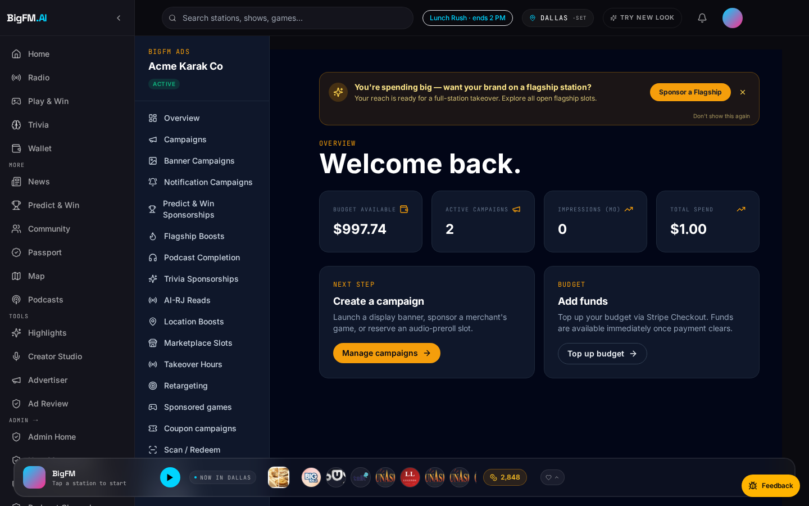
Advertiser Self-Serve
From signup → live campaign in under 10 minutes. Stripe Connect + prepaid budgets.
▸ Register, verify, top up — same flow as Uber advertising or Meta Ads Manager.
▸ Wizard-driven creation for every ad product (no sales rep required for < $500).
▸ Real-time budget burn indicator + impression cap enforcement.
▸ Admin gate kicks in at $500+ for compliance + brand-safety review.
▸ Every campaign wires into the same conversion attribution pipeline (scan-to-pay, coupon redeem, wallet save).
Advertiser dashboard overview.
BigFM · Confidential
12 / 18

Slide 13
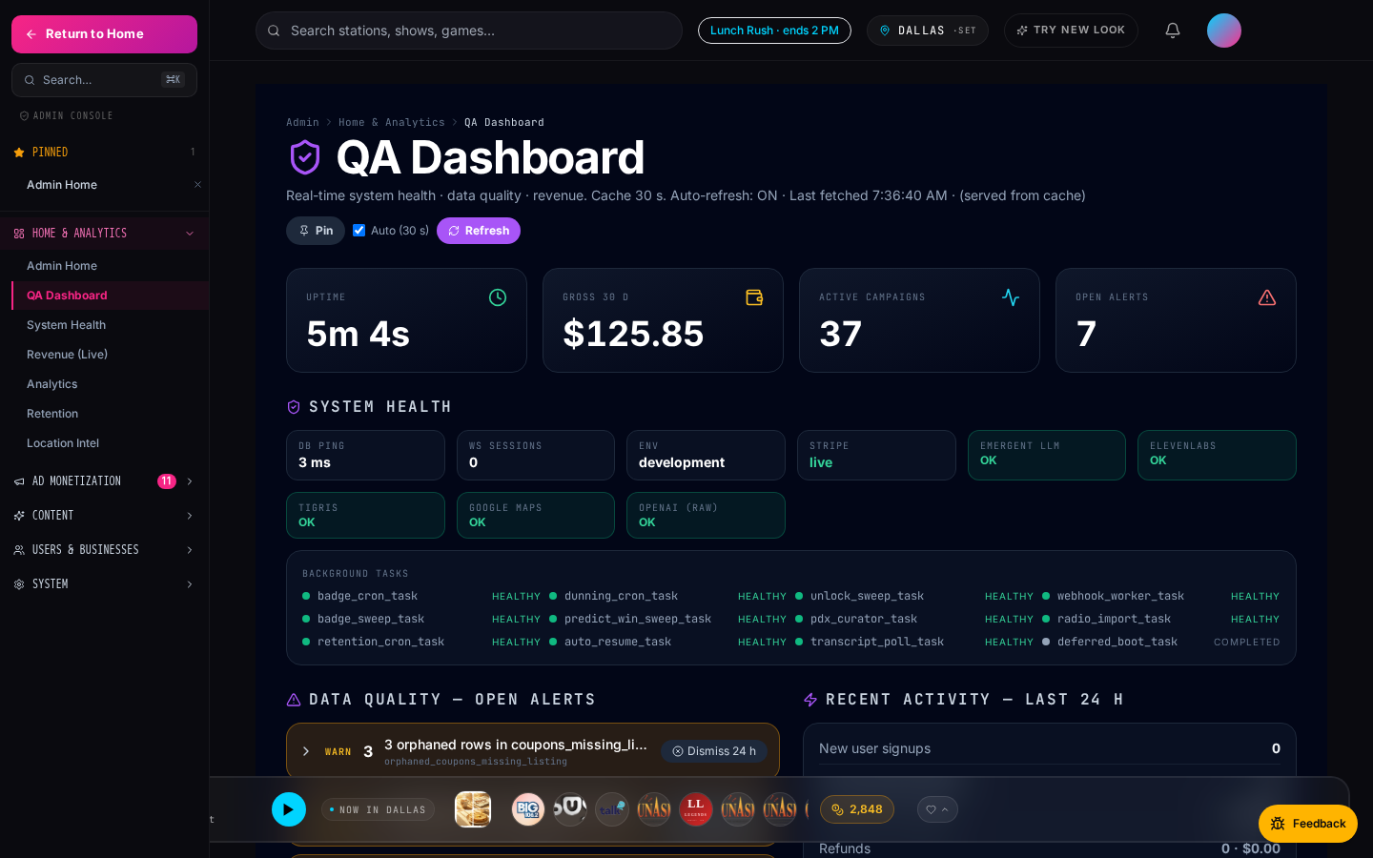
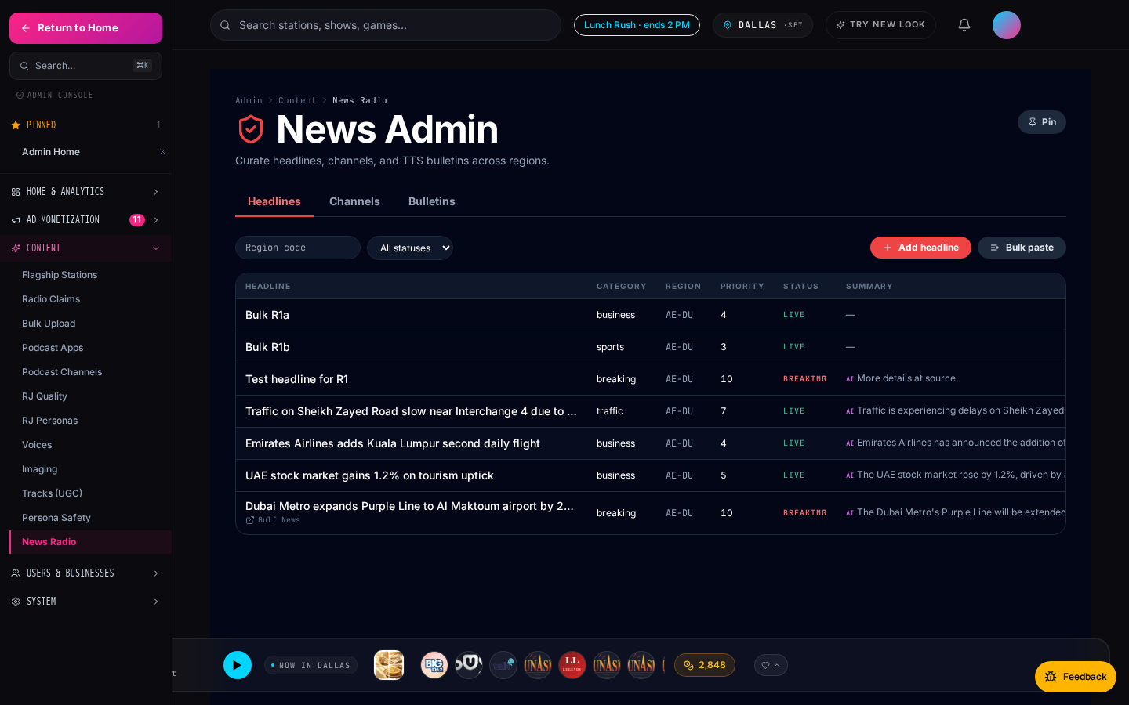
Admin Ops & Analytics
Full operational cockpit — every phase from R (news) to T (admin home) unified.
Admin Home
QA Dashboard
BigFM · Confidential
13 / 18
Location Intel
News moderation

Slide 14
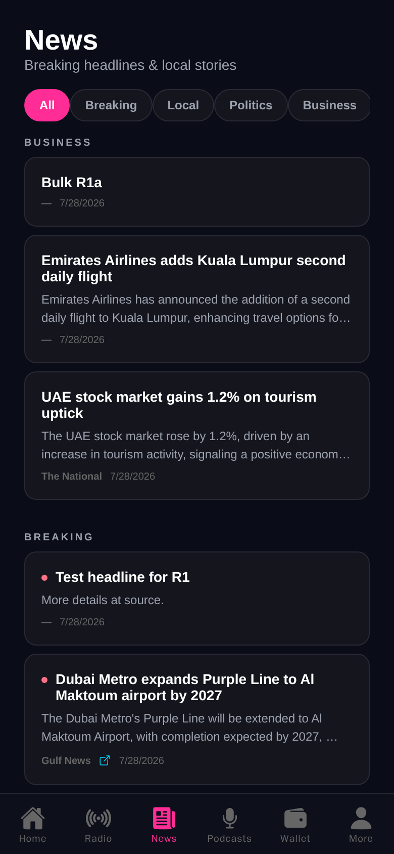
Dual Platform — Web + Mobile
Same backend. Native Expo mobile app mirrors every web surface.
Web · Home
Mobile · Home
BigFM · Confidential
14 / 18
Web · News
Mobile · News

Slide 15
Traction Highlights
Engineering velocity translates directly to product surface.
▸ 58,557 imported radio stations · fully searchable · dual-scheme (HTTP-proxy + HTTPS).
▸ 818 podcast channels · 3,935 episodes · progressive completion rewards.
▸ 23 notification recipes wired · segmented by geo + role + behavior.
▸ 21 shipped phases · dual-design system (Legacy dark + RadioLife light).
▸ Complete admin ops surface: QA dashboard, location intel, revenue-live, ad-review queue.
▸ Web + Expo mobile mirror sharing 100% of the same backend + ad pipeline.
BigFM · Confidential
15 / 18

Slide 16
Business Model
Diversified revenue. Marginal cost per additional listener is near zero.
▸ Platform take: 20–40% of ad prepayments across 11 products (highest on takeover + coupon CPA).
▸ Stripe app-fee on every scan-to-pay txn: 2.5–5% depending on merchant tier.
▸ Premium listener tier (Q1 roadmap): $2.99 / mo — skip-limit removal, ad-free, HD stream.
▸ Unit economics: no COGS per listener beyond streaming bandwidth + LLM/TTS variable cost.
▸ Revenue-share with claimed stations: 70/30 direct-sold, 50/50 programmatic backfill.
BigFM · Confidential
16 / 18

Slide 17
Roadmap · Next 4 Quarters
Growth + platform depth + partner integrations.
Quarter | Focus | Outcome
Q1 | Mobile Tier 2 · user_location_pings real persistence · premium subs | Push adoption + new revenue tier
Q2 | Retargeting hooks across remaining 6 ad types · ML slot recommendation | +25% campaign ROI
Q3 | OpenRTB adapter · partner POS APIs · station claim wizard v2 | Programmatic backfill · POS attribution
Q4 | Expansion markets (SG, IN) · creator marketplace · social passport | Multi-market SaaS + creator economy
BigFM · Confidential
17 / 18

Slide 18
The Ask
[ Placeholder ]
$X to accelerate to Y outcome.
▸ Use of funds: engineering (mobile Tier 2 + OpenRTB), sales team ramp, expansion markets, creator marketplace pilot.
▸ Milestones: 3 expansion markets live, 100+ paying advertisers, $X ARR, premium subs revenue mix.
▸ Contact: [ your contact block here — email, phone, calendar link ].
BigFM · Confidential
18 / 18

