Slide 1
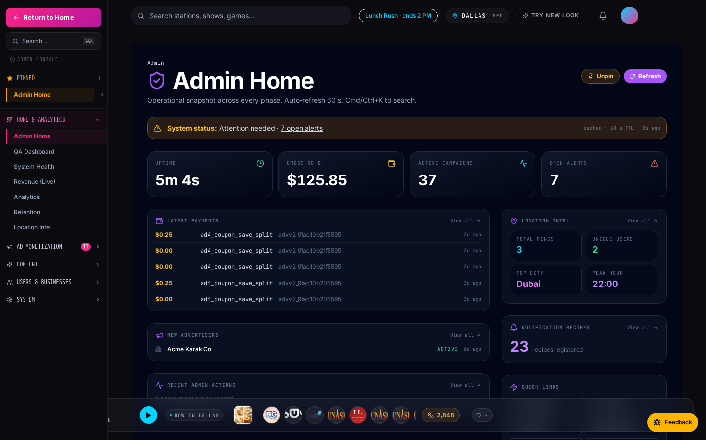
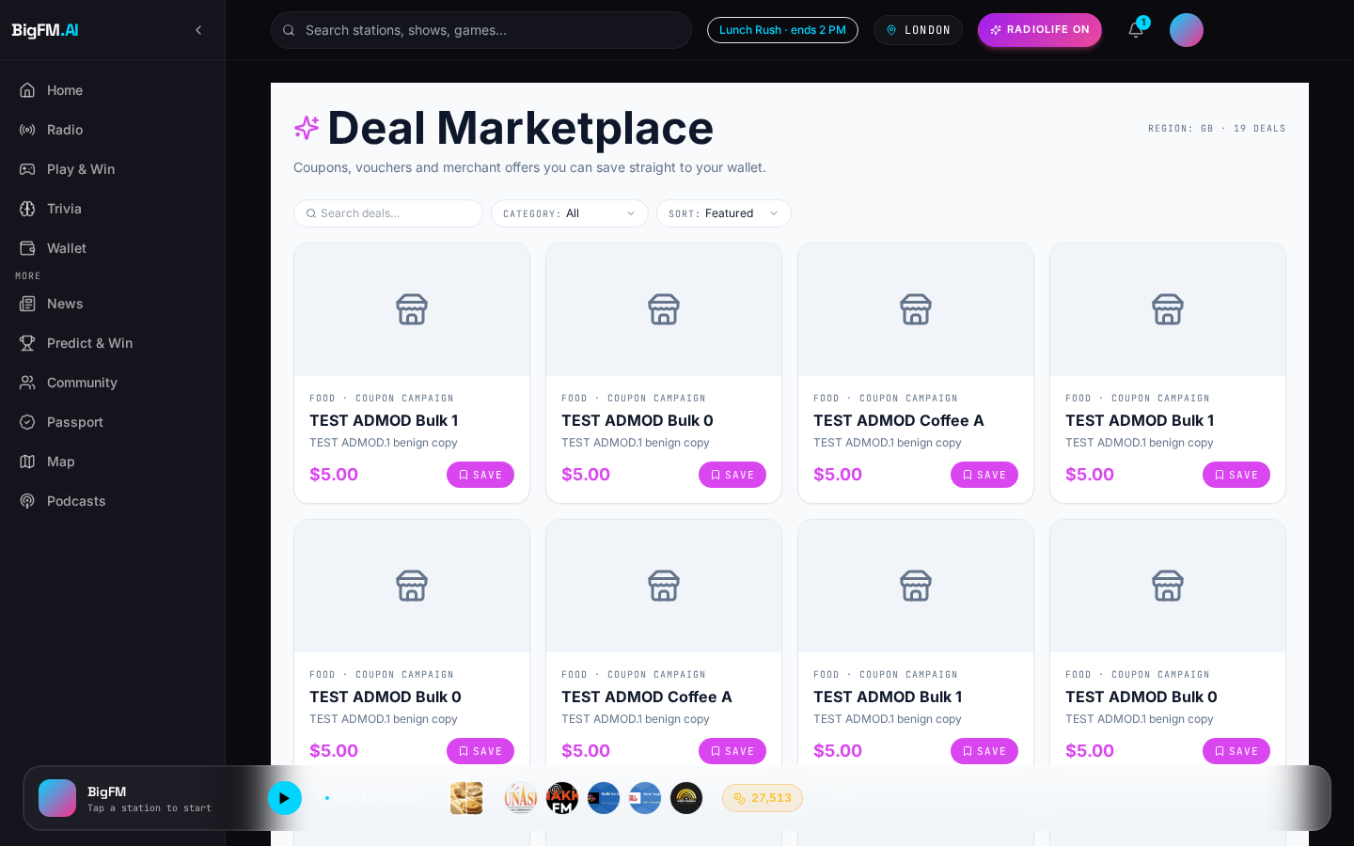
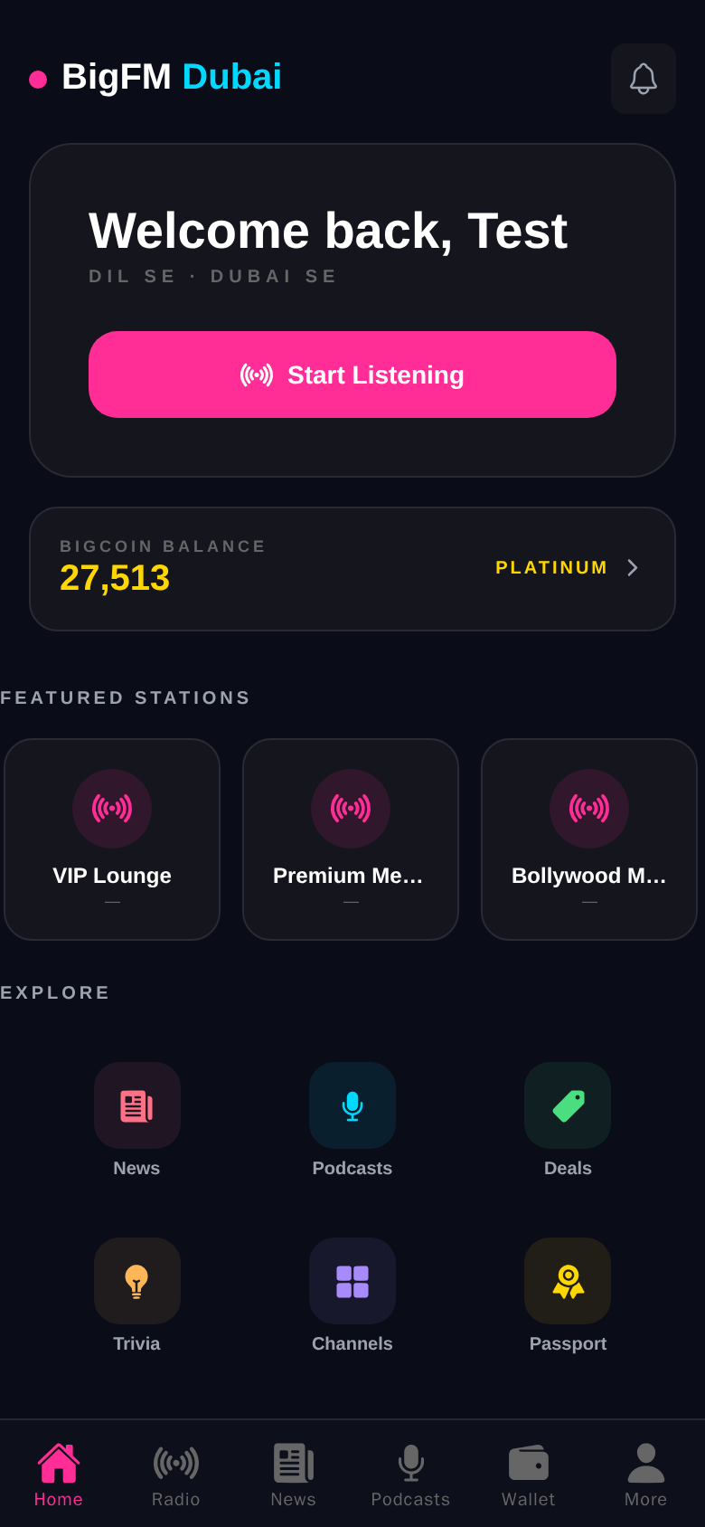
SERIES-A · PITCH
BigFM
AI-powered radio + rewards + local commerce.
July 2026 · BigFM · Confidential

Slide 2
The Vision
Personalized live radio that turns listening
into real-world rewards.
Web, mobile — one player, one wallet, one AI RJ.
BigFM · Confidential
2 / 36

Slide 3
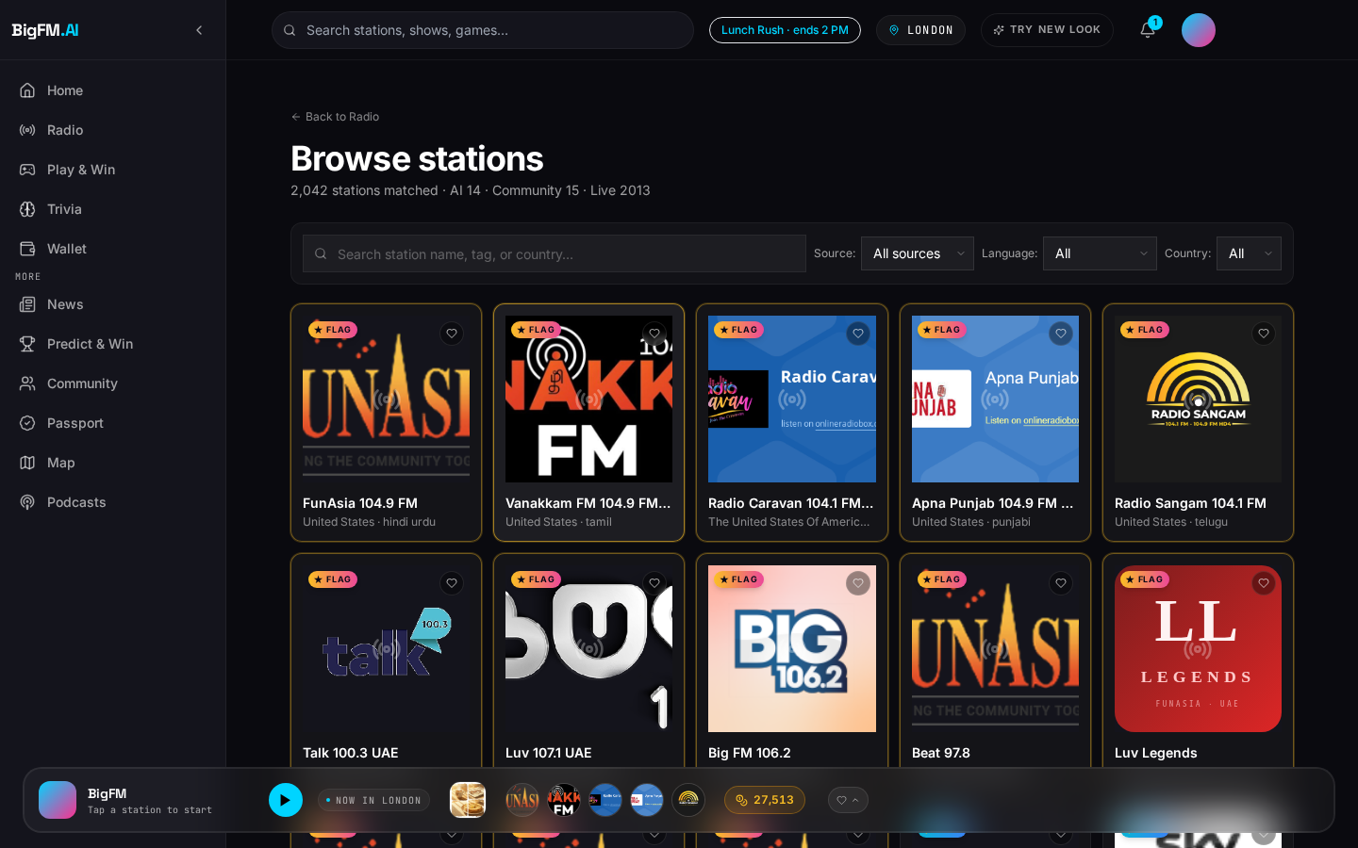
The Problem
Audio is broken along three axes.
▸ Legacy radio is one-way and un-personalized — every listener hears the same content at the same time.
▸ Spotify solved on-demand but killed the shared radio moment — no live curation, no serendipity, no AI host.
▸ Local businesses can't buy hyperlocal audio ads programmatically — radio's ad stack still runs on faxed spot orders.
Today's audio: fragmented, un-monetized locally, one-way.
BigFM · Confidential
3 / 36

Slide 4
The Solution
One AI-curated radio stack — engagement layer + ad platform + local commerce.
1
Live radio · podcasts · news · trivia
Non-interactive queue, AI RJ personas, breaking news
2
Marketplace · wallet · rewards
Save → visit → redeem → earn
3
11 ad products
Boosts, sponsored reads, retargeting, coupon CPA…
Listener
4
Admin console · analytics · ops
QA dashboard, location intel, revenue live
BigFM · Confidential
4 / 36

Slide 5
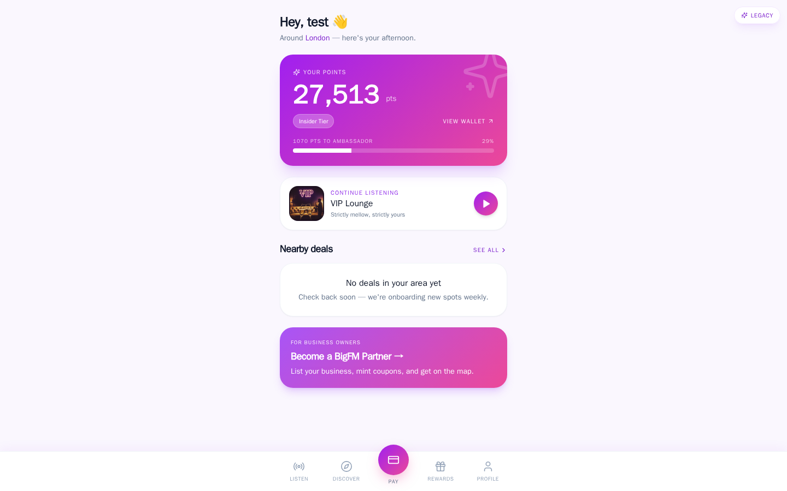
Listener · Discover
Home tab · flagship stations + breaking news + trending.
RadioLife light theme — Home tab.
BigFM · Confidential
5 / 36

Slide 6
Listener · Save
Marketplace tab · deals grid + featured slots + geo-relevant offers.
RadioLife light theme — Marketplace.
BigFM · Confidential
6 / 36

Slide 7
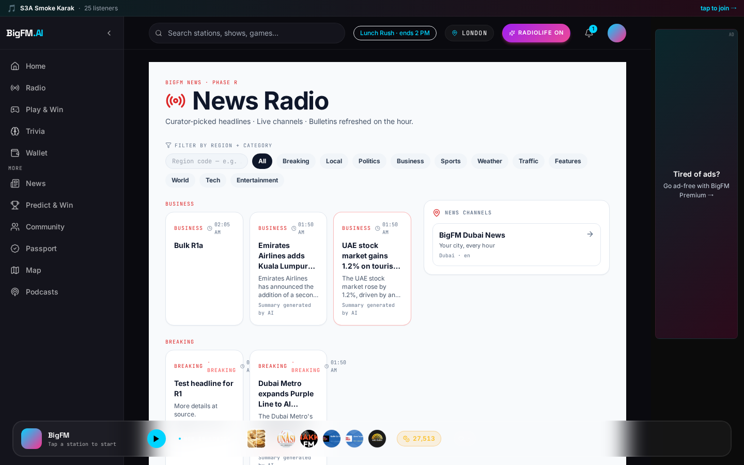
Listener · Learn
News tab · breaking ribbon + AI-summarised regional headlines + on-demand bulletins.
RadioLife light theme — News · Live.
BigFM · Confidential
7 / 36

Slide 8
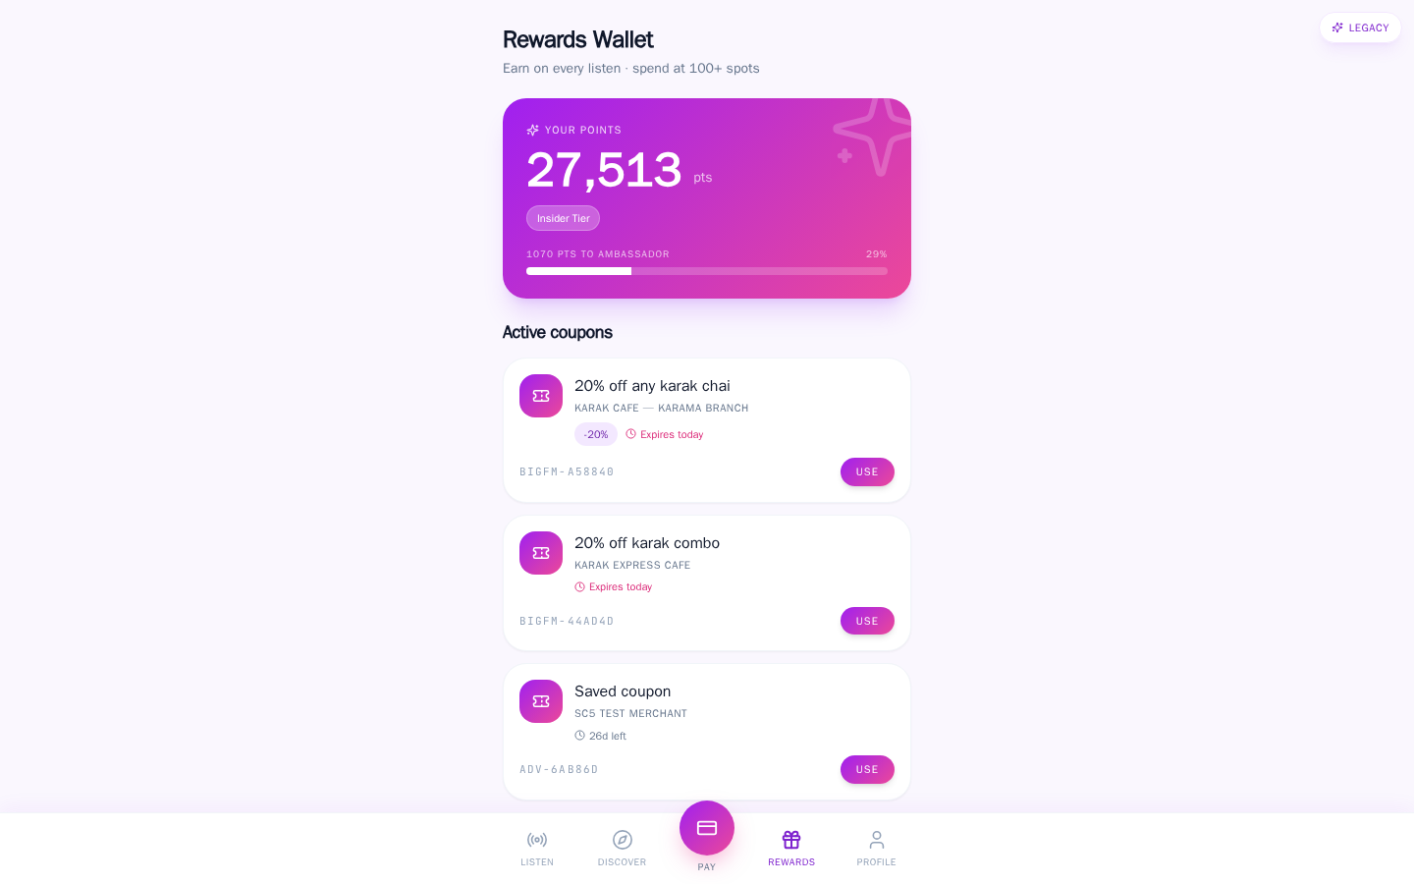
Listener · Redeem
Wallet tab · coupons + points ledger + tier badges + scan-to-pay history.
RadioLife light theme — Wallet.
BigFM · Confidential
8 / 36

Slide 9
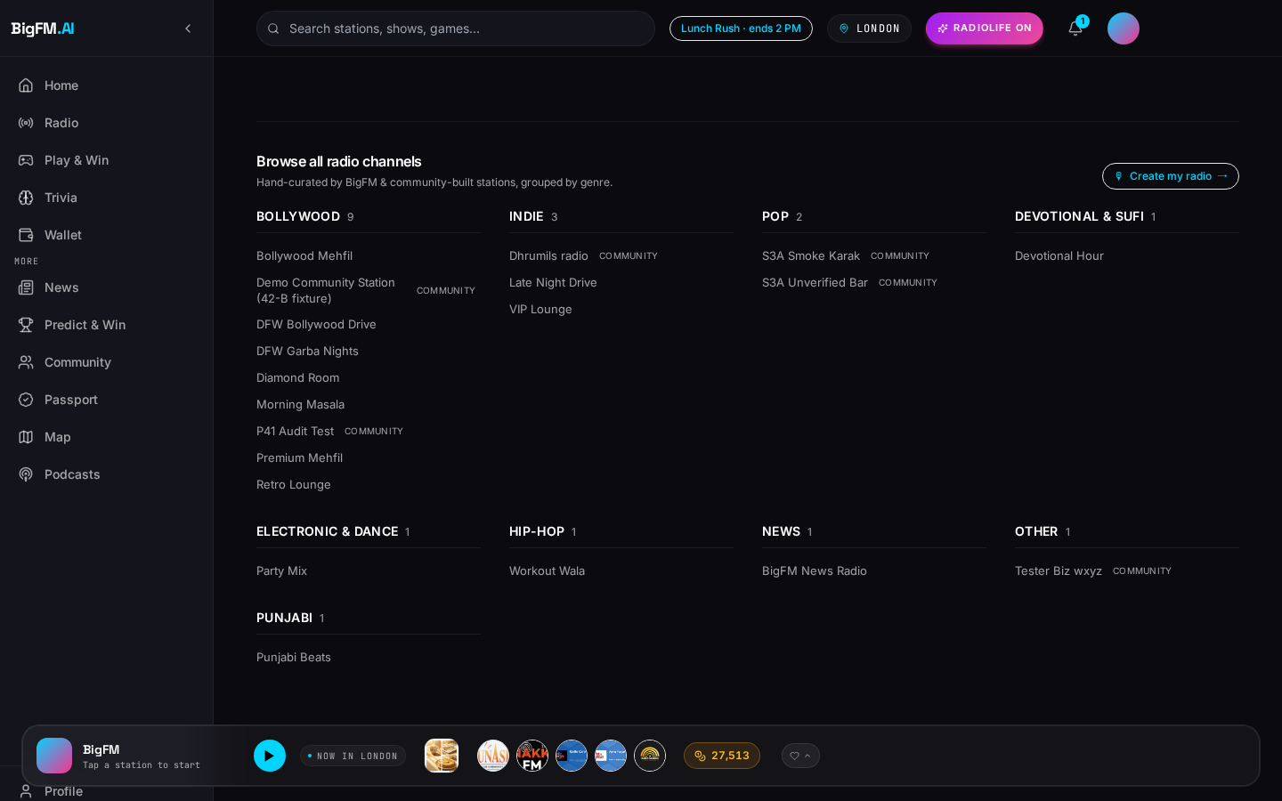
The Radio Engine
Server-side personalized queue + AI RJ voiceovers + geo-flagship routing.
▸ Non-interactive queue: no on-demand search, no per-song skip abuse — protects rights + creates the moment.
▸ AI RJ personas (ElevenLabs) bridge songs with real-time weather / commute / mood context.
▸ Flagship routing gives 15 stations first-shelf placement per region, with pre-roll parity across community stations.
▸ Compliance rules baked in: hourly skip cap, cross-station artist cooldown, sponsor read frequency guard.
Big FM 106.2 · station page with flagship + AI RJ chips.
BigFM · Confidential
9 / 36

Slide 10
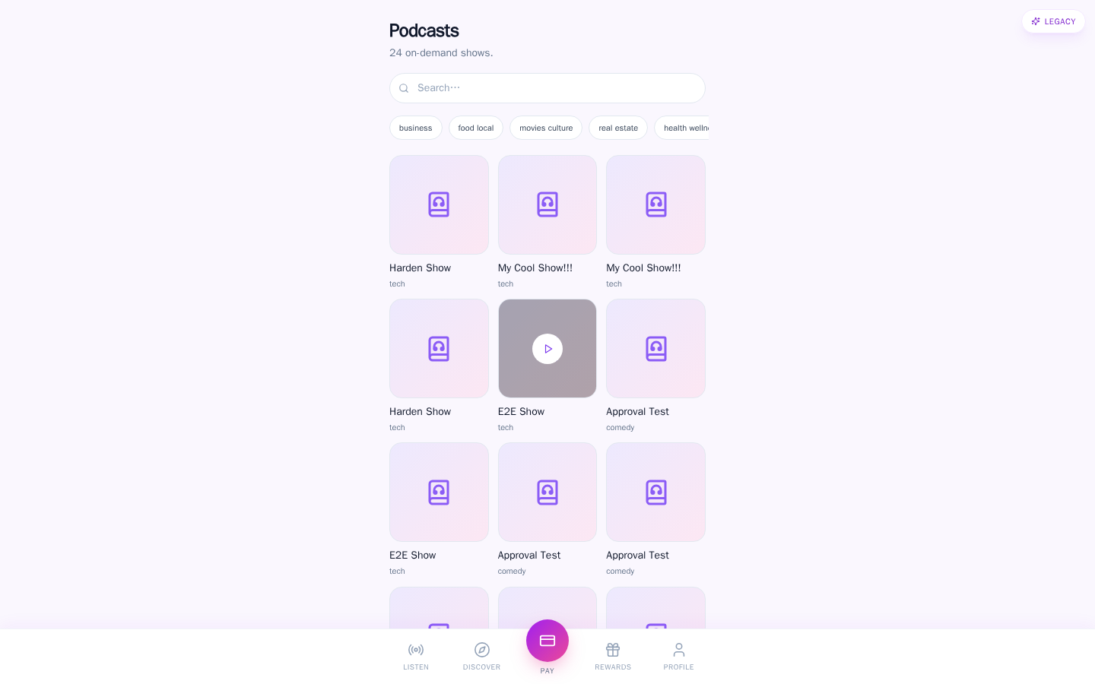
Engagement · Podcasts
818 channels · 3,935 episodes · progressive completion rewards.
RadioLife — Podcasts catalog.
BigFM · Confidential
10 / 36

Slide 11
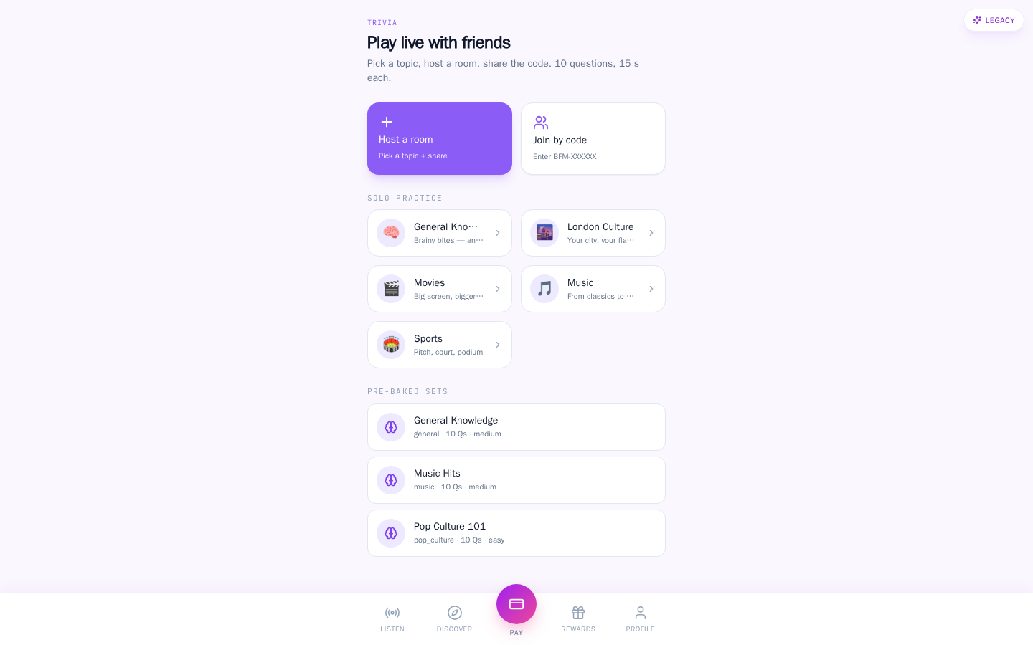
Engagement · Trivia
Live trivia lobbies · sponsored rounds · leaderboard.
RadioLife — Trivia lobby.
BigFM · Confidential
11 / 36

Slide 12
Commerce Loop: Marketplace + Wallet + Rewards
Save → visit → redeem → earn — three monetization tiers baked in.
▸ Save a coupon in-app → adds to Wallet, redeemable at merchant.
▸ Visit merchant → geofence detects proximity → passive reward accrual.
▸ Scan-to-pay flow: Stripe Connect app fee split, real-time reconciliation.
▸ Points ledger: earn from listening, saving, redeeming — spend on premium unlocks.
▸ Every merchant txn: platform fee, coupon CPA charge, referral bonus — three layers.
BigFM · Confidential
12 / 36

Slide 13
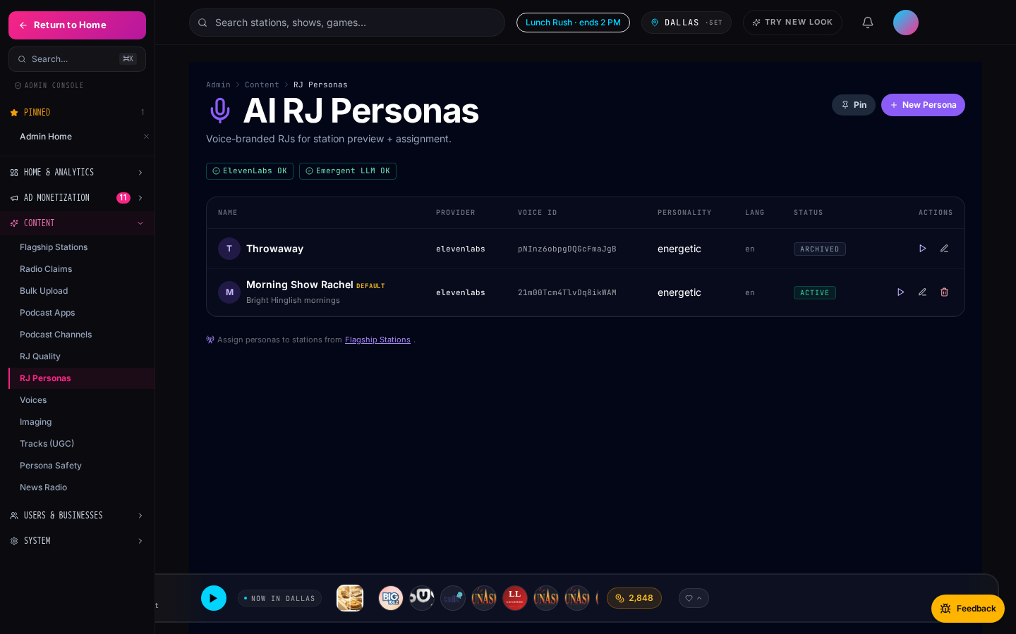
AI RJ Personas
Voice-branded AI hosts (ElevenLabs) — advertisers can sponsor their reads.
▸ 10 curated personas across dayparts (morning, drive, lunch, night, Friday, devotional).
▸ Each persona has voice + tagline + LLM-driven script conditioned on song, weather, hour, city.
▸ Sponsored RJ reads are a first-class ad product — pay-per-play or takeover-hour bundles.
▸ Admins govern persona safety + brand consistency from the console.
Admin RJ personas management console.
BigFM · Confidential
13 / 36

Slide 14
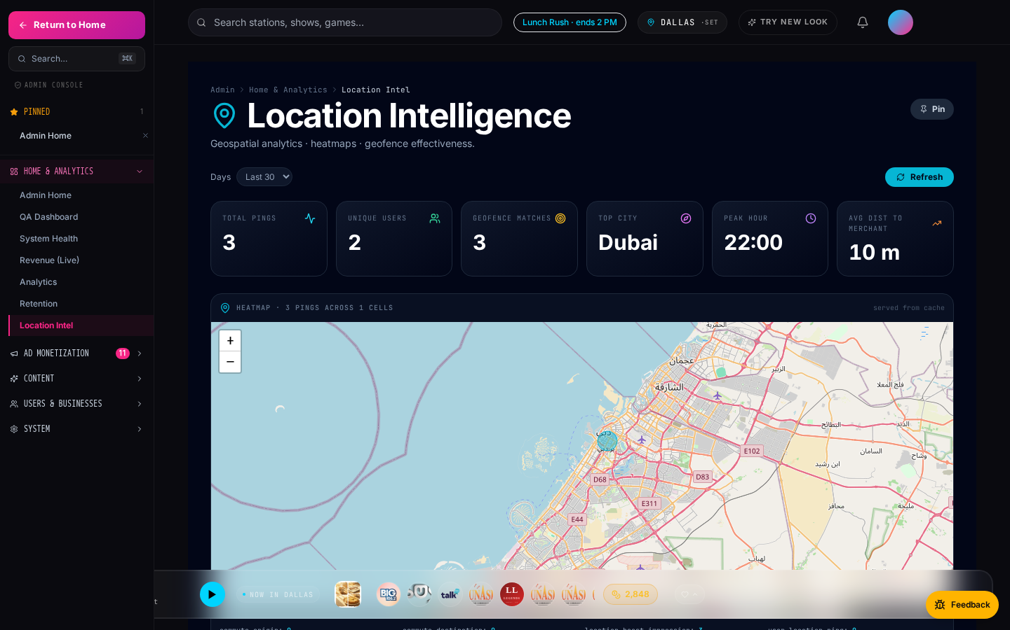
Location-Aware Everything
Commute mode + geofences + hyperlocal analytics all share one geo pipeline.
▸ Commute mode auto-detects morning / evening drive windows and swaps into a shorter-song queue.
▸ Geofences drive location-boost ads — advertisers reach listeners within 500 m of their storefront.
▸ Foot-traffic linkage attributes scan-to-pay conversions to the ad impression within a 60-min window.
▸ Admin location-intel dashboard exposes it all: heatmaps, regions rank, geofence effectiveness.
Admin location intelligence dashboard.
BigFM · Confidential
14 / 36

Slide 15
SECTION · ADVERTISER MODULE
One dashboard.
Eleven ad products.
Stripe test-mode Connect · prepaid wallet · advertiser ships live in under 10 minutes.
BigFM · Confidential
15 / 36

Slide 16
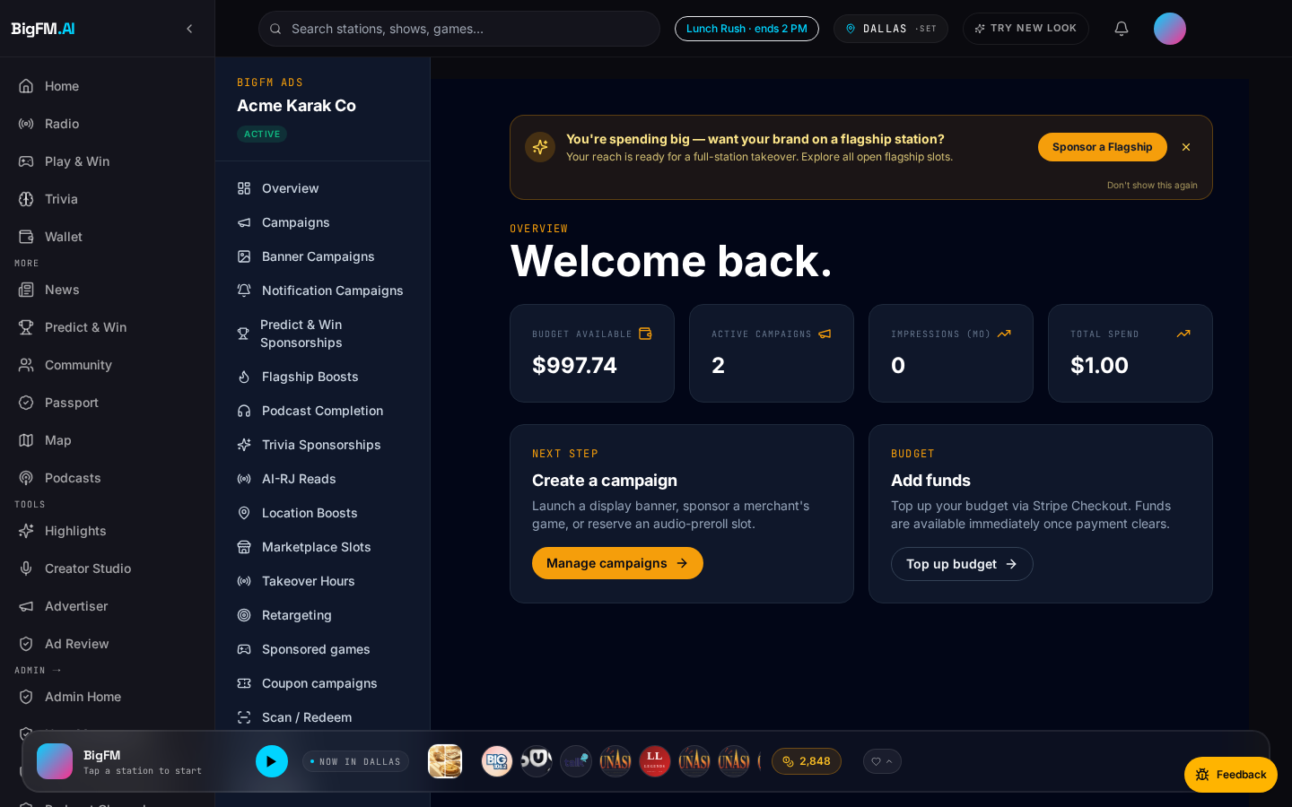
Advertiser · Command Center
One dashboard. 11 ad products. Stripe test-mode Connect. Ships live in <10 minutes.
/advertiser/dashboard — overview view.
BigFM · Confidential
16 / 36

Slide 17
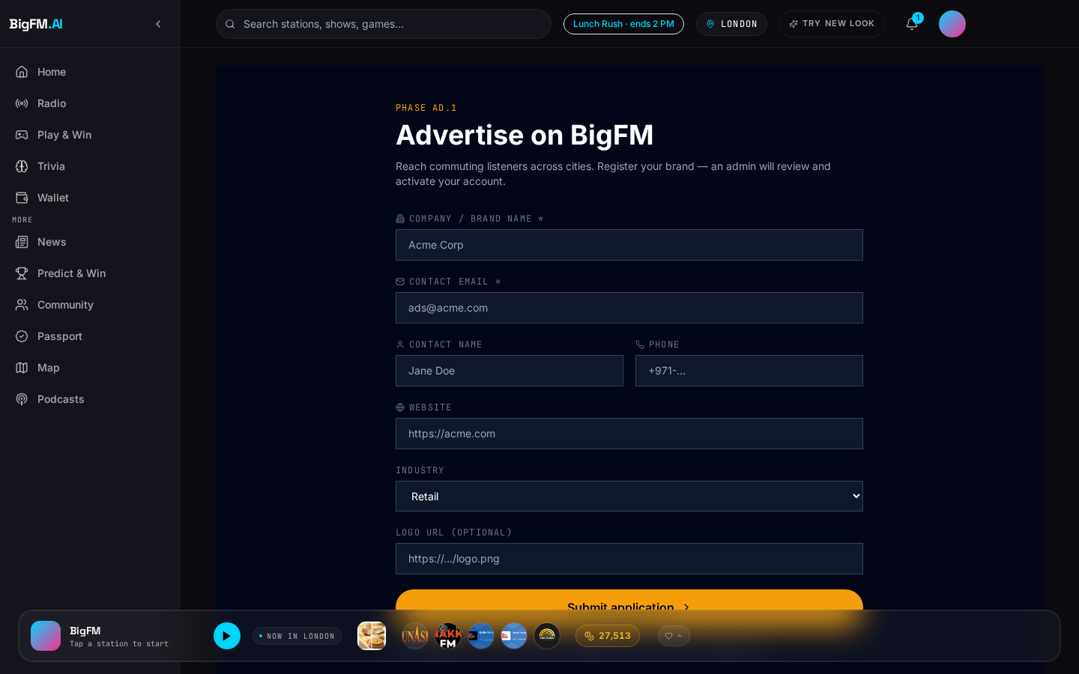
Business Setup + Stripe Connect
Advertiser signup → advertisers_v2 record → Stripe onboarding — one flow, three steps.
▸ Signup captures business name, category, geo, GST/VAT ID.
▸ Auto-creates an advertisers_v2 record; owner_user_id links back to the auth user.
▸ Stripe Connect Express hand-off — test-mode by default, live-mode toggle after admin approval.
▸ Same flow lets an owner add staff members with per-permission roles.
▸ Approval < 24 h for spends < $500; instant self-serve for CPA coupons < $50 wallet.
/advertiser/apply — new-business intake form.
BigFM · Confidential
17 / 36

Slide 18
Wallet-Based Prepay Model
One wallet · every campaign draws from it · no per-campaign checkout friction.
▸ Advertiser tops up once (Stripe test-mode Connect) → wallet holds a prepaid balance.
▸ Every campaign — coupon CPA, takeover, banner, location-boost — draws from the same wallet.
▸ Budget cascade across active campaigns; per-campaign daily caps enforced.
▸ Auto-pause when wallet < 20% of daily burn — email + notification alert.
▸ Refunds land back in the wallet within one billing cycle (Stripe reversal + admin note).
Wallet widget lives on /advertiser/dashboard.
BigFM · Confidential
18 / 36

Slide 19
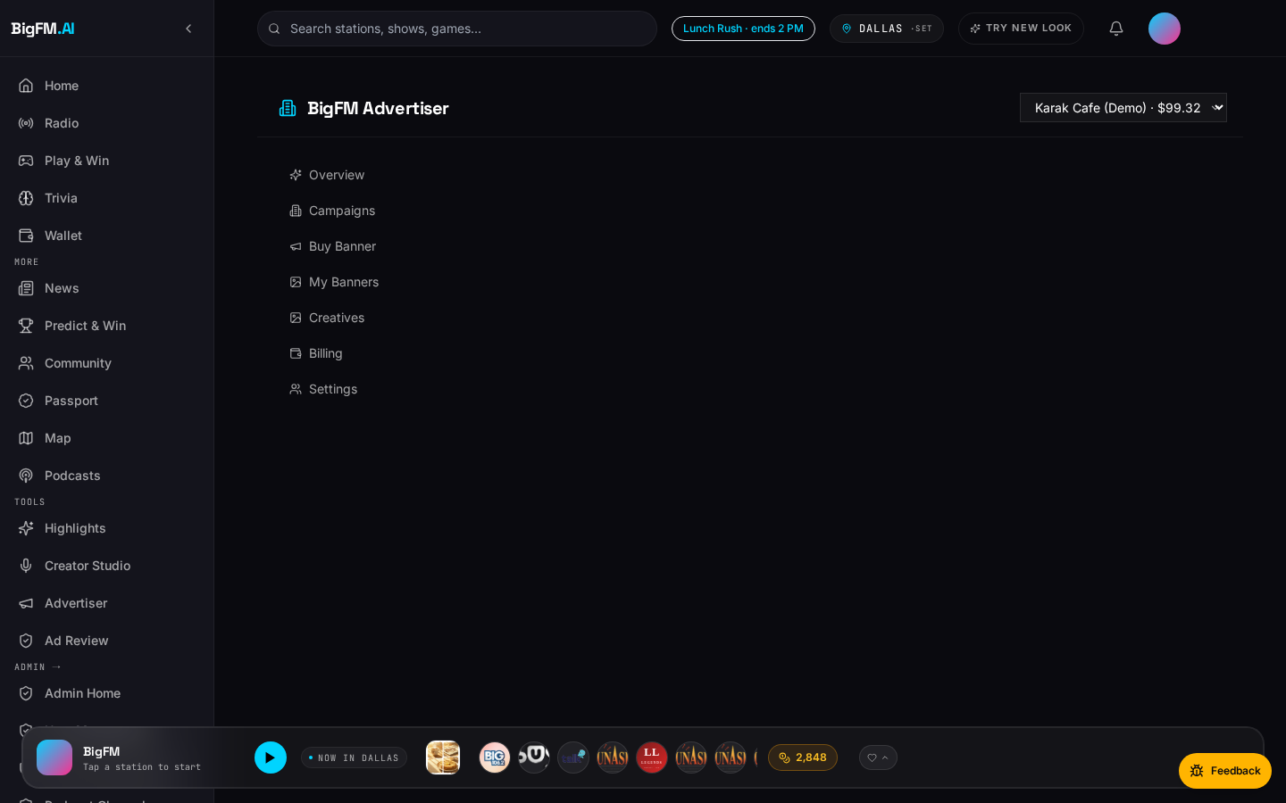
Campaign Creation Wizard
One 3-step pattern used across all 11 ad products: metadata → creative → budget.
▸ Step 1 · Metadata: name, geo, category, days-active window.
▸ Step 2 · Creative: audio spot upload (or generate via Sora 2), banner image, CTA text.
▸ Step 3 · Budget: $ amount, daily cap, kill-switch threshold.
▸ Preview + reach estimate + expected redemption count before you commit.
▸ Same wizard shape for location-boost, retargeting, takeover — no relearning per product.
Coupon Campaign wizard — CPS / CPA / Hybrid pricing.
BigFM · Confidential
19 / 36

Slide 20
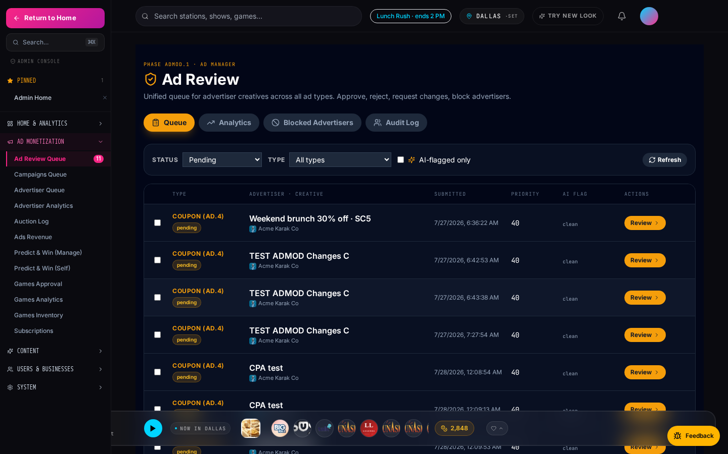
Approval + Moderation Queue
LLM ad-copy moderation (ADMOD.1) + admin gate at $500+ ensures brand safety.
▸ Every ad creative auto-runs through the LLM moderator (Phase ADMOD.1): profanity, brand claims, risky verticals.
▸ Flagged copy sits in the admin ad-review queue with the LLM's rationale + suggested rewrites.
▸ Spends ≥ $500 → mandatory admin gate; smaller spends auto-approve.
▸ Admin decisions logged to audit_log; advertiser sees status + reason in-dashboard.
▸ Rejected creatives get one-tap 'edit + resubmit' — no full-wizard restart.
/admin/ad-review — moderation queue with LLM flags surfaced.
BigFM · Confidential
20 / 36

Slide 21
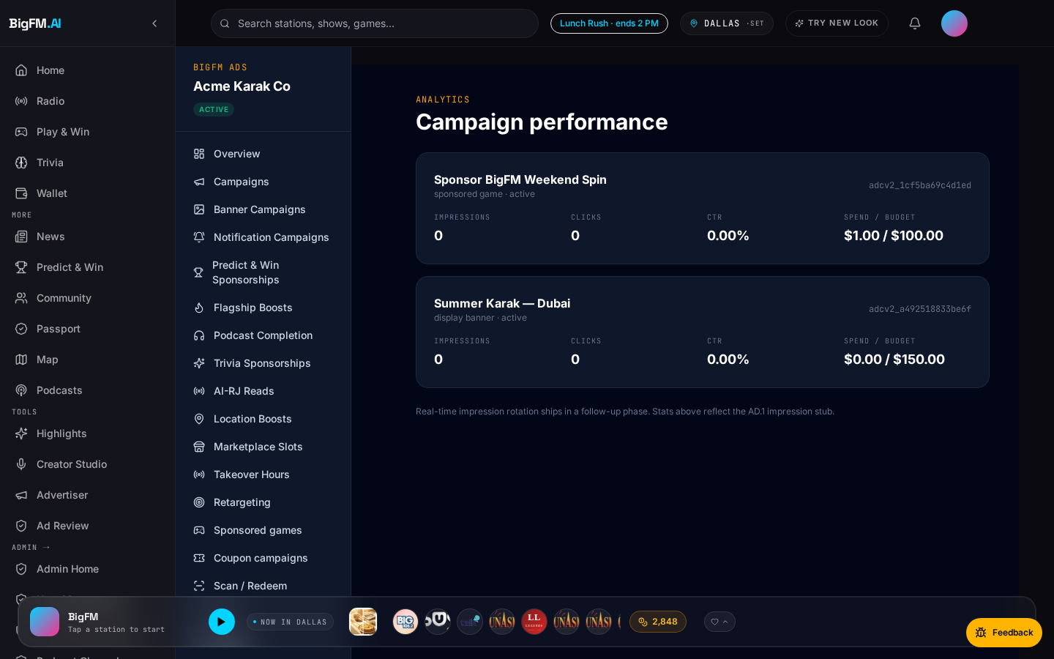
Live Analytics + Auction Transparency
Real-time impressions · saves · redemptions · budget burn — plus 'why did I win/lose' per auction.
▸ Impressions, saves, redemptions refresh every 30 s.
▸ Budget-burn indicator: current burn rate + hours until wallet-empty at that pace.
▸ Auction transparency: for every flagship-boost bid you lost, see the min winning bid + slot fill %.
▸ CPM / CPA / CPS derived metrics computed server-side — no client math bugs.
▸ Export CSV of every impression + attribution event within retention window.
/advertiser/dashboard/analytics — per-campaign metrics.
BigFM · Confidential
21 / 36

Slide 22
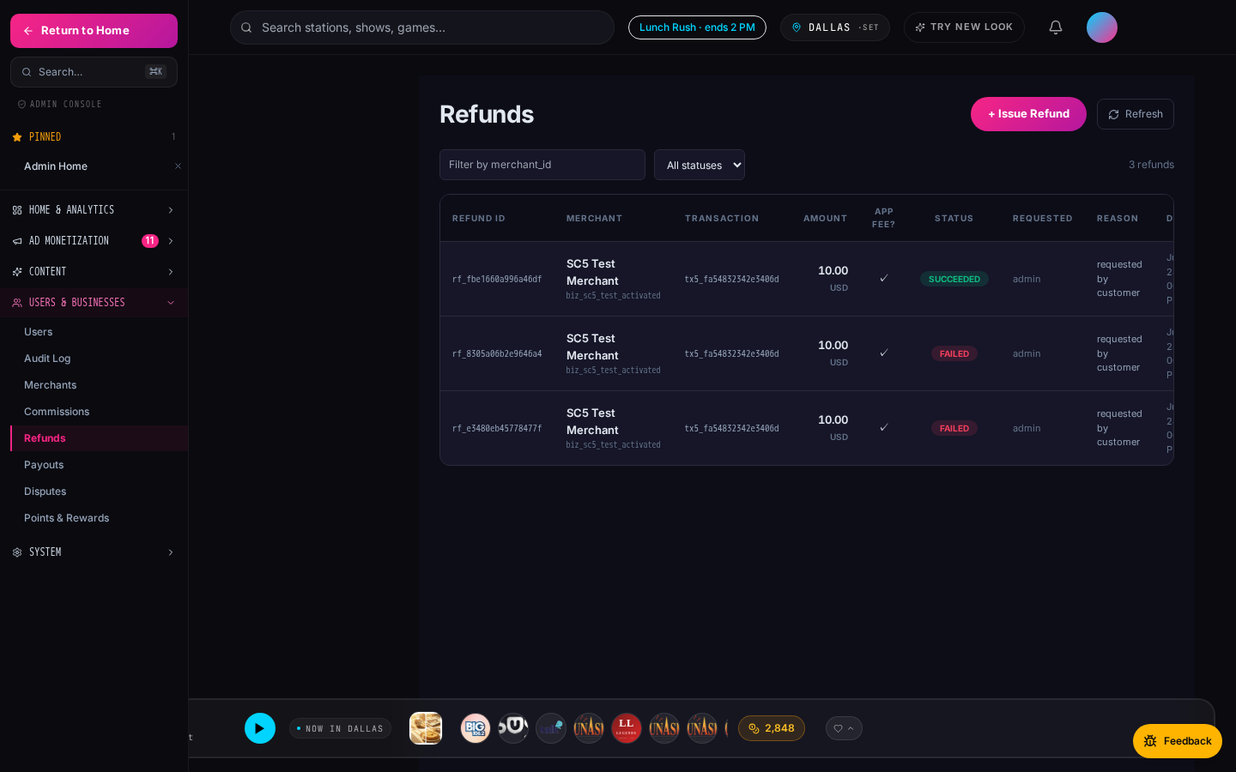
Dispute + Refund Path
Fraud-flagged redemptions auto-refund. Advertiser can dispute any charge in-dashboard.
▸ Every CPA redemption is scored for fraud (velocity, IP, device fingerprint, geo mismatch).
▸ Auto-refund fires for suspicious rows; advertiser sees the refund entry with reason code.
▸ Advertiser can raise a dispute on any charge — routed to admin refund queue.
▸ Admin reviews with the full event trail (impression → save → redemption timestamps).
▸ Reliability guarantee: broken creatives auto-skip → NOT billed (yesterday's Phase 42-B-redux.2 fix).
/admin/refunds — pending refund + dispute queue.
BigFM · Confidential
22 / 36

Slide 23
Why It's Advertiser-Native
Every design decision is made from the advertiser's side of the table.
▸ Self-serve first: campaign live in < 10 minutes for spends < $500.
▸ Prepaid wallet: no invoice cycles, no net-30 politics for small merchants.
▸ No minimums per phase — start with a $50 CPA coupon, pay only per redemption.
▸ Test-mode-first onboarding: build + preview every campaign against test-mode Stripe before flipping to live.
▸ Admin transparency: every auto-refund, every LLM flag, every auction loss is visible in-dashboard.
BigFM · Confidential
23 / 36

Slide 24
The Monetization Stack
11 ad products in one platform · one payment rail · one analytics view.
Product | One-line pitch | Pricing model
Flagship Boosts | Direct-bid auction for time-boxed slots on flagship stations. | CPA (bid) + Stripe
Sponsored AI RJ Reads | Advertisers sponsor the AI host's bridge between songs. | CPM · pack
Location-Boost Ads | Geofenced audio + banner ads reaching listeners within 500 m. | CPM · geofence
Marketplace Featured Slots | Boosted deal placement above the marketplace grid. | Flat · slot
Radio Takeover Hour | Own an entire hour: branded overlay + 4 sponsor reads + bonus. | $100 – $1000 / hr
Retargeting Audiences | Re-engage listeners who saved but didn't redeem. 11 signals. | CPM · audience
Coupon Campaigns (CPA/CPS/Hybrid) | Pay only when a real customer redeems your coupon. | $2 / redemption avg
Podcast Completion Rewards | Sponsor a podcast episode + bonus points to finishers. | CPM + reward
Trivia Sponsorships | Sponsor a trivia round with branded prize + logo. | Flat · round
Banner Ads | Persistent skyscraper + billboard slots across web. | CPM · placement
Notification Campaigns | Push a targeted deal / promo to segmented users. | CPA · send
BigFM · Confidential
24 / 36

Slide 25
SECTION · MERCHANT LEAD-GEN FLYWHEEL
A separate revenue stream:
Merchant-sponsored lead-gen.
0% commission on prediction volume · merchants pay for LEAD DELIVERY. A category-defining shape.
BigFM · Confidential
25 / 36

Slide 26
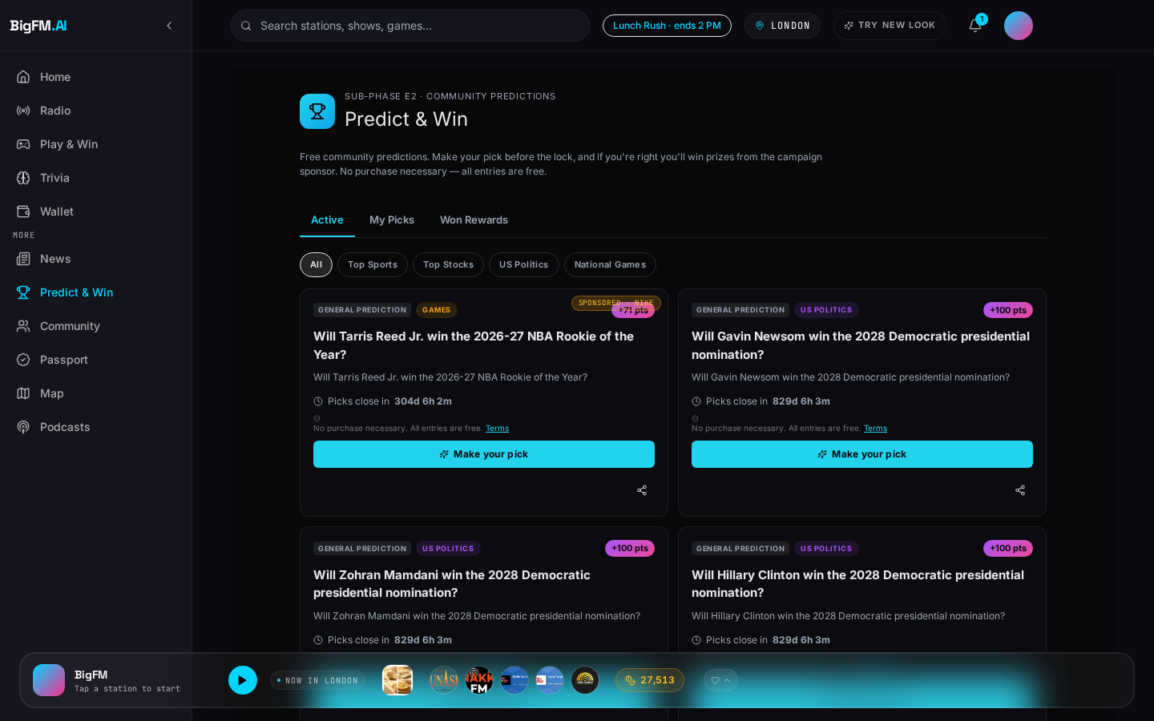
Introducing Predict & Win
Kalshi-style prediction markets, native to the radio listening surface.
▸ Users bet on outcomes (sports, weather, entertainment, news) using BigCoin.
▸ Live markets settle against real-world events; participants earn or lose BigCoin.
▸ Built on Polymarket via Predexon proxy — same prediction infrastructure as Kalshi + Polymarket.
▸ Audio-native surface: listeners hear an AI RJ tease → tap in-player → participate without leaving the station.
▸ Radio-first, hyperlocal — no one else is doing this shape.
/predict-win — customer-facing prediction market lobby.
BigFM · Confidential
26 / 36

Slide 27
Merchant Lead-Gen Model — 0% Commission
BigFM does NOT take a cut of prediction volume. This is not a monetization ad product — it's a lead-gen channel.
▸ BigFM takes 0% commission on prediction market transactions.
▸ Merchants sponsor Predict & Win campaigns to acquire high-intent users.
▸ Each participant is a warm lead — geo-matched, engagement-verified, wallet-active.
▸ Merchants pay for LEAD DELIVERY (per opt-in + qualifying action) — not for prediction volume.
▸ Cleanly separated from ad-product revenue in the P&L: (a) ad campaigns and (b) lead-gen sponsorships.
BigFM · Confidential
27 / 36

Slide 28
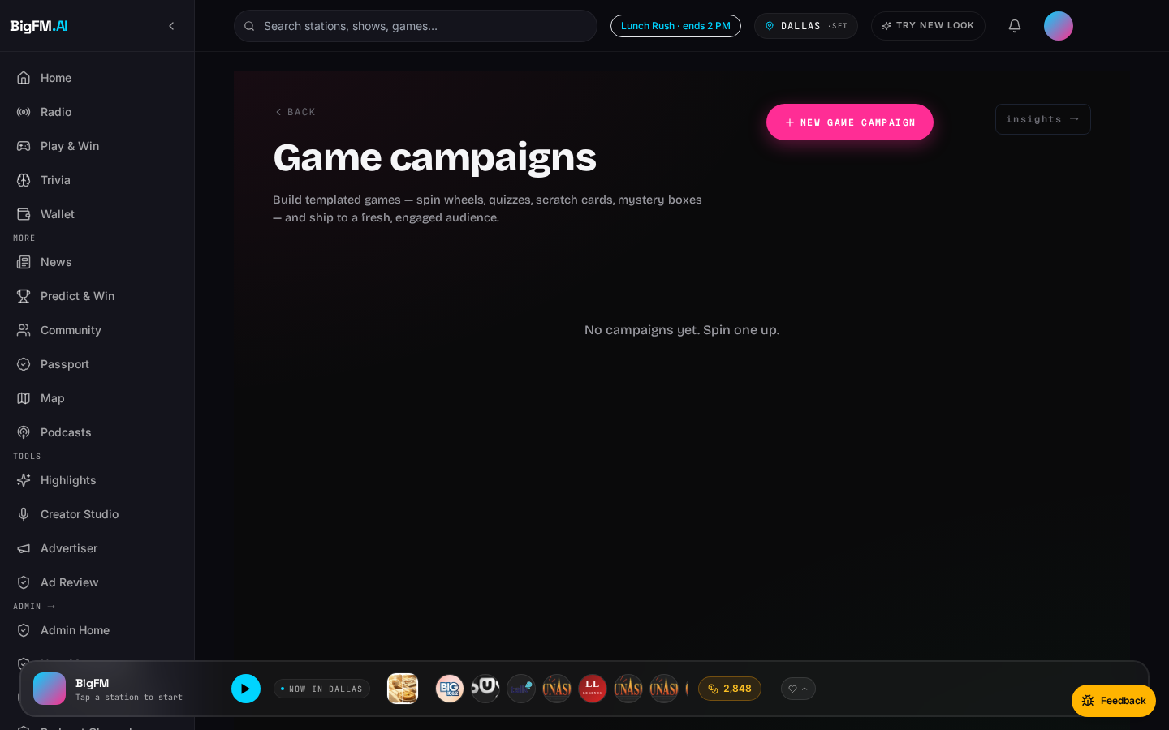
The Merchant Lead-Gen Flywheel
Predict & Win + Live Trivia + Sponsored Games — one funnel category, three surfaces.
▸ Predict & Win (Phase PW-M): merchants sponsor markets tied to their category.
▸ Live Trivia Sponsorships (Phase H): merchants own a themed trivia round with logo + prize.
▸ Sponsored Games (Phase AD.2): merchant-branded games on the radio surface (Spin, Scratch, Trivia).
▸ All three flow into the same lead ledger — merchants see cost-per-lead + qualifying-action metrics.
▸ Distinct from ad impressions: users EARN something (BigCoin, points, prizes) in exchange for their engagement.
/advertiser/games — sponsored games marketplace for merchants.
BigFM · Confidential
28 / 36

Slide 29
Radio + Prediction Markets — A New Category
No competitor is doing this shape today.
▸ Kalshi: desktop-focused prediction markets, no radio integration, no local surface.
▸ Polymarket: crypto-native, high-friction on-ramp, US-restricted for many markets.
▸ BigFM: audio-first · hyperlocal · merchant-embedded · Predexon-brokered · no crypto UX friction.
▸ The wedge: predictions become a NATIVE part of the radio listening moment, not a separate app.
▸ The moat: merchants get lead-gen from a fully-attributed audio audience they can't reach elsewhere.
BigFM · Confidential
29 / 36

Slide 30
Admin Ops · Command Center
Phase T — Admin Home dashboard · system status ribbon + KPIs + real-time revenue.
/admin — unified admin dashboard (Phase T).
BigFM · Confidential
30 / 36

Slide 31
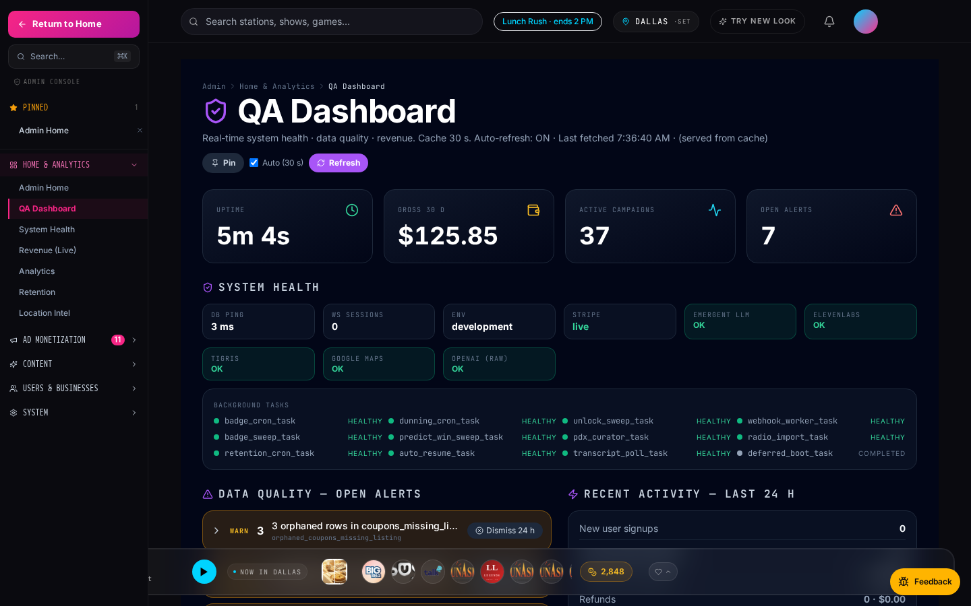
Admin Ops · Quality + Location Intel
QA dashboard (Phase Q) + geospatial analytics (Phase S) — same design system.
/admin/qa — 30 s auto-refresh, cache-transparent.
BigFM · Confidential
31 / 36

Slide 32
Dual Platform — Web + Mobile
Same backend. Same 24 admin routes. Same 11 ad products. Native Expo mobile app.
Web · RadioLife theme
Mobile · Expo native app
BigFM · Confidential
32 / 36

Slide 33
Traction Highlights
Engineering velocity translates directly to product surface.
▸ 58,557 imported radio stations · fully searchable · dual-scheme (HTTP-proxy + HTTPS).
▸ 818 podcast channels · 3,935 episodes · progressive completion rewards.
▸ 23 notification recipes wired · segmented by geo + role + behavior.
▸ 21+ shipped phases (P → T) · dual-design system (Legacy dark + RadioLife light).
▸ Complete admin ops surface: QA dashboard, location intel, revenue-live, ad-review queue.
▸ Web + Expo mobile mirror sharing 100% of the same backend + ad pipeline.
BigFM · Confidential
33 / 36

Slide 34
Business Model — Two Revenue Streams
Ad-product revenue + Merchant lead-gen revenue — cleanly separated in the P&L.
▸ Ad revenue: 20–40% platform take on ad prepayments across 11 products (highest on takeover + coupon CPA).
▸ Lead-gen revenue: merchant sponsorship fees for Predict & Win, Trivia, Sponsored Games (0% prediction-volume take).
▸ Stripe app-fee on every scan-to-pay txn: 2.5–5% depending on merchant tier.
▸ Premium listener tier (Q1 roadmap): $2.99 / mo — skip-limit removal, ad-free, HD stream.
▸ Rev-share with claimed stations: 70/30 direct-sold, 50/50 programmatic backfill (Q3 roadmap).
BigFM · Confidential
34 / 36

Slide 35
Roadmap · Next 4 Quarters
Growth + platform depth + partner integrations.
Quarter | Focus | Outcome
Q1 | Mobile Tier 2 · user_location_pings real persistence · premium subs | Push adoption + new revenue tier
Q2 | Retargeting hooks across remaining 6 ad types · ML slot recommendation | +25% campaign ROI
Q3 | OpenRTB adapter · partner POS APIs · station claim wizard v2 | Programmatic backfill · POS attribution
Q4 | Expansion markets (SG, IN) · creator marketplace · social passport | Multi-market SaaS + creator economy
BigFM · Confidential
35 / 36

Slide 36
The Ask
[ Placeholder ]
$X to accelerate to Y outcome.
▸ Use of funds: engineering (mobile Tier 2 + OpenRTB), sales ramp, expansion markets, creator marketplace pilot.
▸ Milestones: 3 expansion markets live, 100+ paying advertisers, $X ARR, premium subs revenue mix, merchant-lead-gen revenue mix.
▸ Contact: [ your contact block here — email, phone, calendar link ].
BigFM · Confidential
36 / 36

