Slide 1
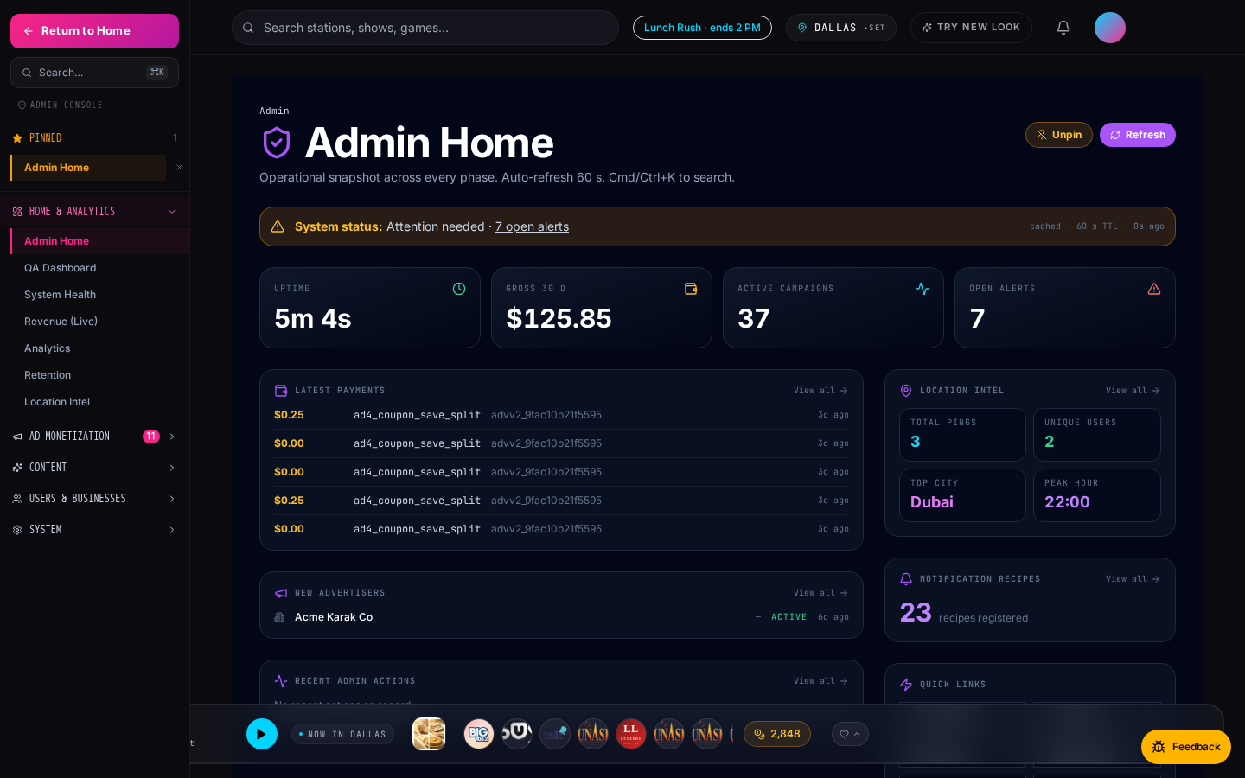
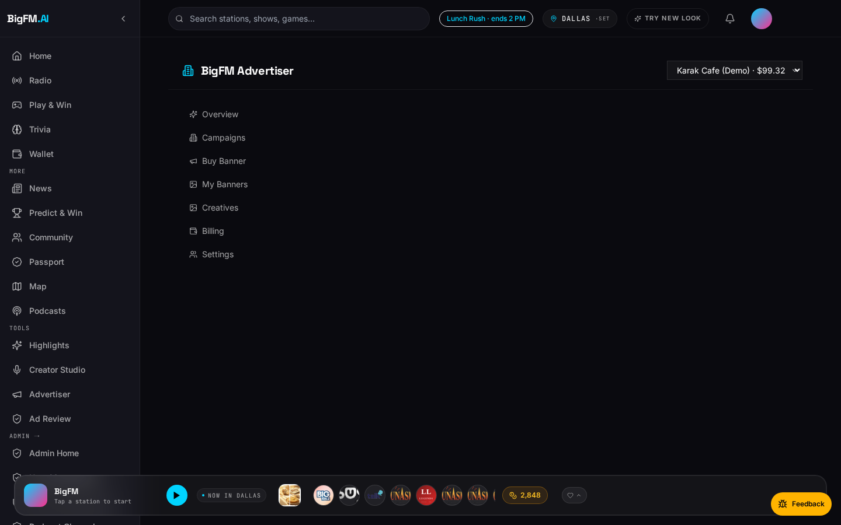
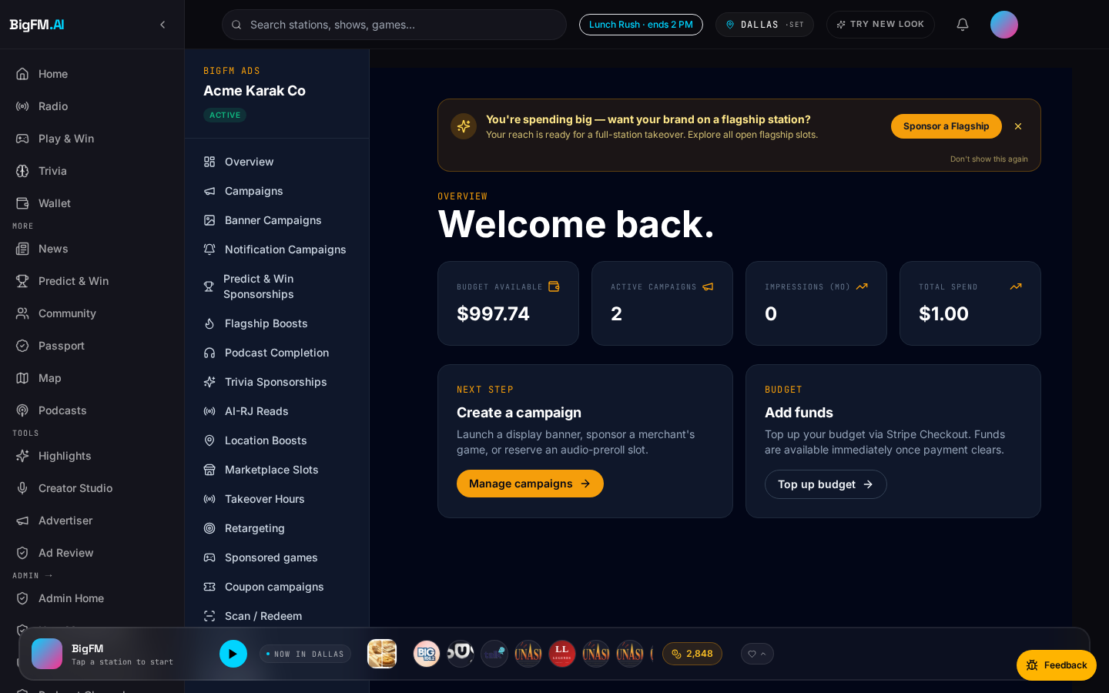
SALES PLAYBOOK · V1
BigFM Sales Playbook
How to sell BigFM — to advertisers AND radio stations.
July 2026 · BigFM · Confidential · Internal

Slide 2
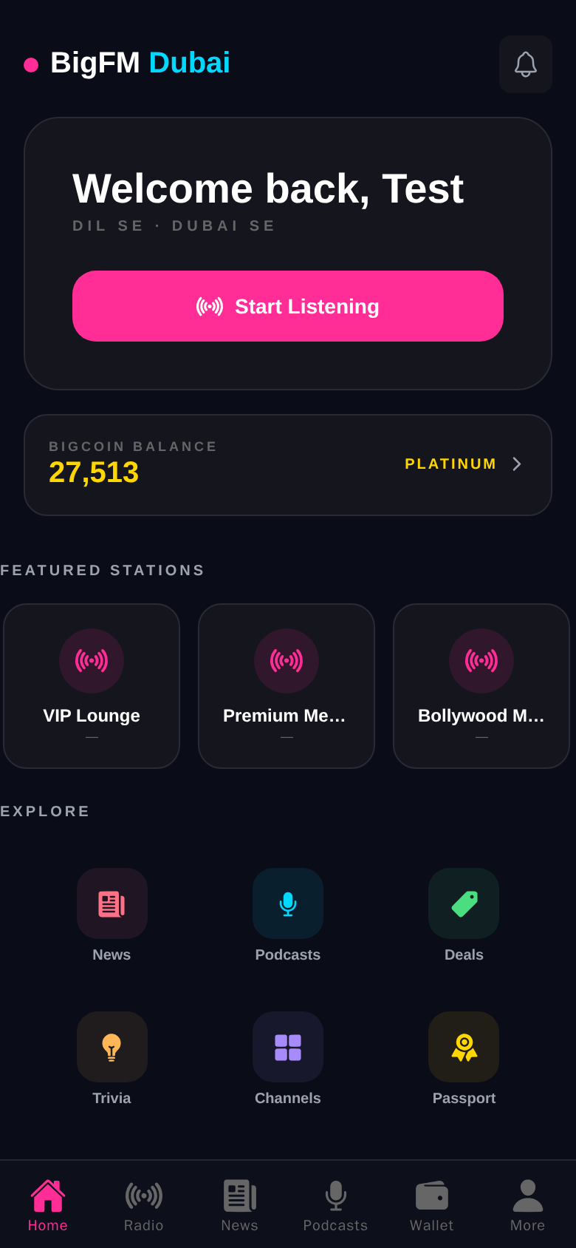
What Is BigFM · 60-second Pitch
▸ BigFM is a personalized live radio + local commerce + rewards platform.
▸ Listeners get an AI-curated stream with real AI radio hosts (ElevenLabs voices).
▸ Every action — listen, save a coupon, visit a merchant — earns points redeemable in-app.
▸ Advertisers self-serve 11 ad products via one dashboard (Stripe Connect, prepaid).
▸ Radio station owners monetize their digital stream through BigFM's ad demand + 70/30 rev share.
Mobile home · listener view (Expo app).
BigFM · Confidential
2 / 20

Slide 3
Who We Sell To
Two very distinct personas — pitch each with the same product but different lenses.
LOCAL BUSINESSES
Restaurants · retail · events · clinics
Pain:
"I can't reach commuters at lunchtime. Facebook ads no longer convert. Radio ads are too expensive for a 3-store chain."
Sell: coupons (CPA), location-boost, sponsored RJ reads.
Entry point: $50 first campaign, pay-per-redemption.
RADIO STATION OWNERS
Community · flagship · religious · niche
Pain:
"Traditional ad-slot revenue is capped. My digital stream serves listeners but nobody pays for it. Salespeople for programmatic ads never call back."
Sell: partnership · 70/30 rev share · zero-cost onboarding.
Entry point: free claim + owner dashboard.
BigFM · Confidential
3 / 20

Slide 4
Why Now · Why BigFM
Three category shifts converging in 2026.
▸ Personalized audio adoption: 70%+ of drive-time listeners now stream (not FM antenna).
▸ Hyperlocal ad spend shifting from Facebook / Meta back to native audio + geo — attribution finally works.
▸ AI voice branding: ElevenLabs-grade voices at $0.05/min make sponsored RJ reads cost-competitive with pre-recorded spots.
▸ Radio station owners have LOTS of digital reach but zero programmatic revenue — a supply-side gap begging for demand.
BigFM · Confidential
4 / 20

Slide 5
The BigFM Product
One player · four value layers · one wallet across all of them.
1
Live radio · podcasts · news · trivia
Engagement surface
2
Marketplace · wallet · rewards
Commerce loop
3
11 ad products
Monetization engine
Listener
4
Admin console · analytics · ops
Governance + insights
BigFM · Confidential
5 / 20

Slide 6
11 Ad Products At A Glance
Every product ships with real-time analytics + a Stripe test-mode entry.
Flagship Boost
Direct-bid auction, hour-length flagship slot.
Bid $50+
Best for: Big brands, launches
Sponsored RJ Read
AI host bridges songs with your brand.
CPM $8-15
Best for: Personal-voice brands
Location Boost
Geofence within 500 m of your storefront.
$0.10-0.50 / imp
Best for: QSR, dine-in
Marketplace Featured
Above-the-fold placement in the deals grid.
$5-25 / day
Best for: Any merchant
Takeover Hour
Own the entire hour: overlay + 4 reads.
$100-$1000 / hr
Best for: Movies, festivals
Retargeting
Re-engage listeners who saved but never redeemed.
CPM $12
Best for: Chains, services
Coupon (CPA / CPS)
Pay only per redemption or per sale.
$2 / redemption
Best for: Restaurants, retail
Podcast Reward
Bonus points to listeners who finish your episode.
CPM + bonus
Best for: Media, brand storytelling
Trivia Sponsor
Sponsor a trivia round with logo + prize.
$25-$150 / round
Best for: Toys, snacks, brands
Banner Ads
Persistent skyscraper + billboard slots.
CPM $5-10
Best for: Awareness campaigns
Notification Campaign
Push a segmented offer to your ideal user.
CPA $0.20-1.50
Best for: Retention, promos
BigFM · Confidential
6 / 20

Slide 7
Deep-dive · Coupon Campaigns (CPS / CPA / Hybrid)
Only pay when a real customer redeems. Fraud-refund built in.
▸ Advertiser sets: $ per redemption, cap per day, geo, category.
▸ Every redemption is verified merchant-side (scan-to-pay or manual code).
▸ Fraud detection: velocity + IP + device fingerprint → auto-refund suspicious rows.
▸ Real-time dashboard: impressions → saves → redemptions.
▸ Price: $2 / redemption typical. Ideal for: restaurants, retail.
BigFM · Confidential
7 / 20

Slide 8
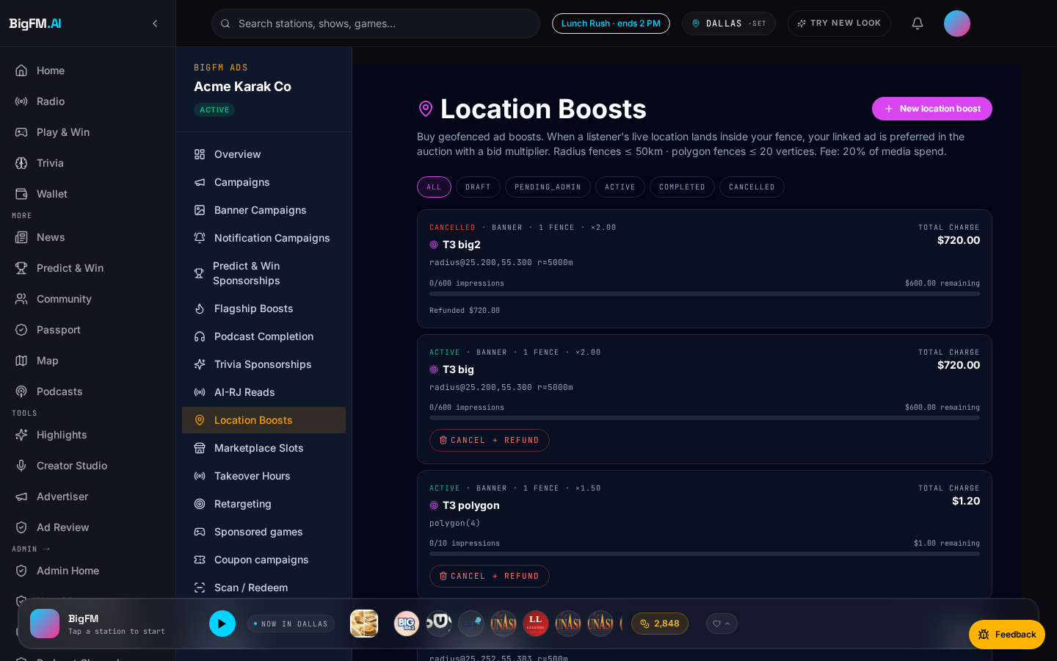
Deep-dive · Location-Boost Ads
Geofence your storefront. Reach listeners within 500 m at lunch / dinner.
▸ Draw a fence on the map — up to 5 zones per campaign.
▸ Density preview shows estimated reach + competing campaigns before you launch.
▸ Ad plays as a mid-stream audio spot + companion banner on mobile.
▸ Scan-to-pay conversions within 60 min → automatically attributed to the impression.
▸ Price: $0.10-$0.50 / impression. Ideal for: QSR, dine-in.
BigFM · Confidential
8 / 20

Slide 9
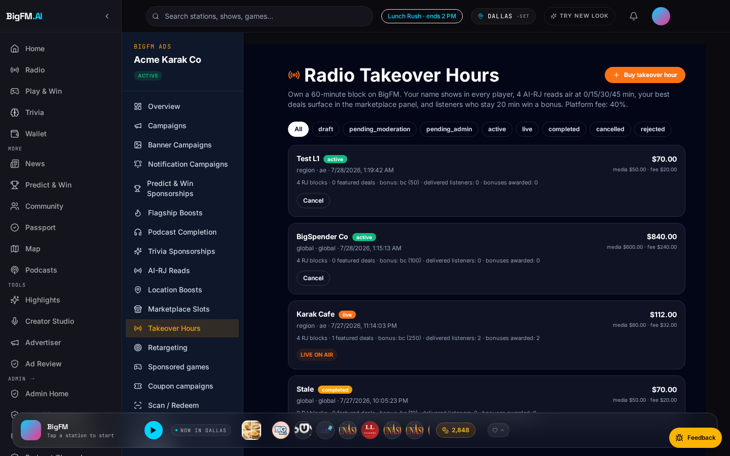
Deep-dive · Radio Takeover Hour
Own an entire hour on a flagship station. Branded overlay + 4 sponsor reads + featured deals + 20-min-listen bonus.
▸ One brand · one flagship station · one hour · saturated presence.
▸ Includes: 4 AI-RJ sponsor reads, banner takeover, hero deal on marketplace, bonus points to listeners who tune in ≥ 20 min.
▸ Live analytics: unique reach, avg time-on-station, deal saves.
▸ Price: $100 – $1,000 / hour depending on station tier and daypart.
▸ Ideal for: movie launches, festivals, product releases, election campaigns.
BigFM · Confidential
9 / 20

Slide 10
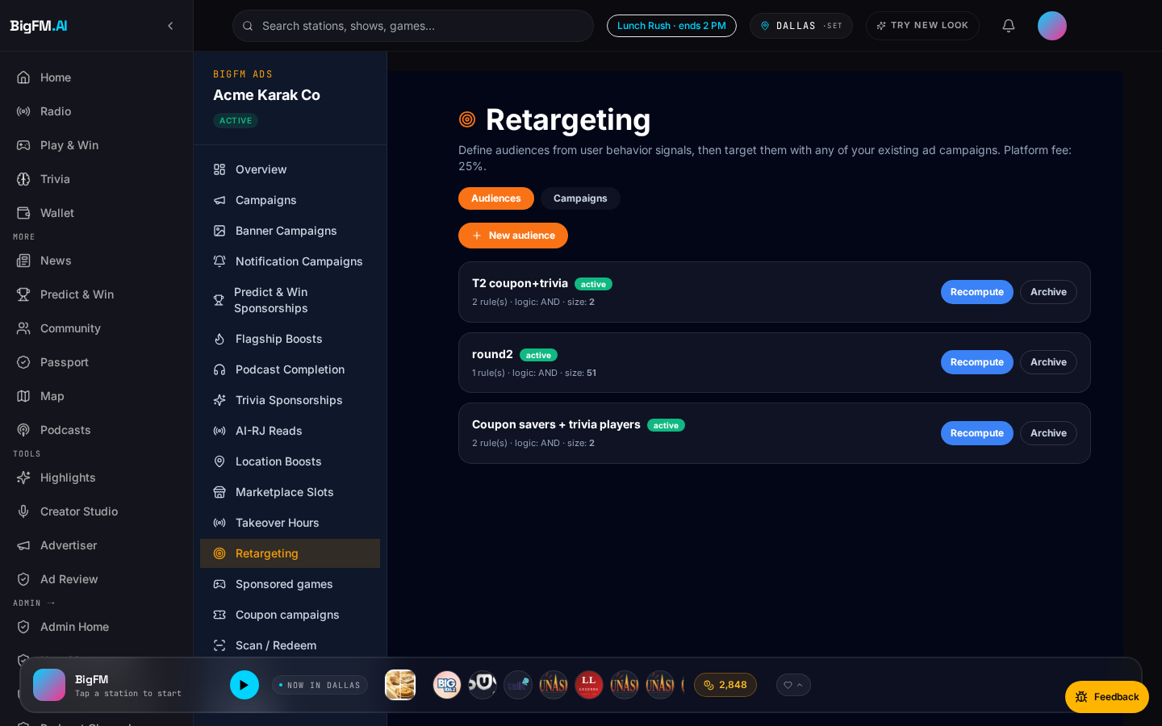
Deep-dive · Retargeting Audiences
Re-engage people who saved your coupon but haven't redeemed. 11 behavioral signals to slice.
▸ Signal library: saved-not-redeemed, viewed-but-not-saved, scanned-once-not-repeat, geo-frequent, hour-consistent, and 6 more.
▸ Build an audience via drag + drop signals → run any ad product against it.
▸ Attribution: each redemption/scan is tagged with the audience it fired from.
▸ Ideal for: mid-size chains + service businesses with a nurture cycle.
BigFM · Confidential
10 / 20

Slide 11
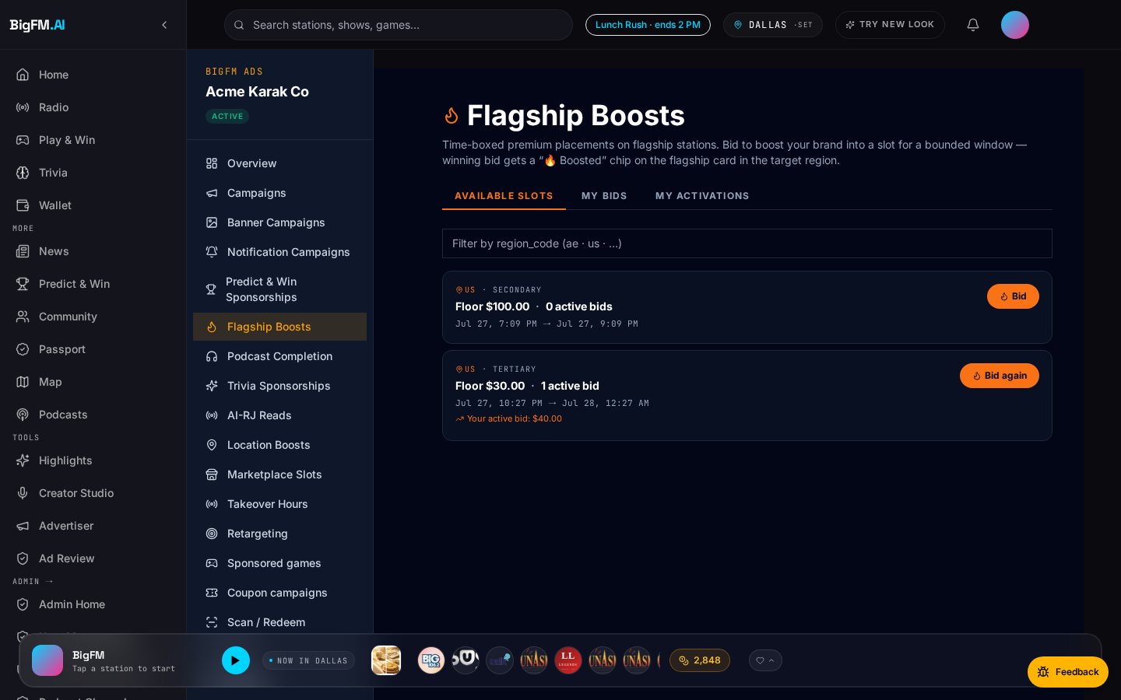
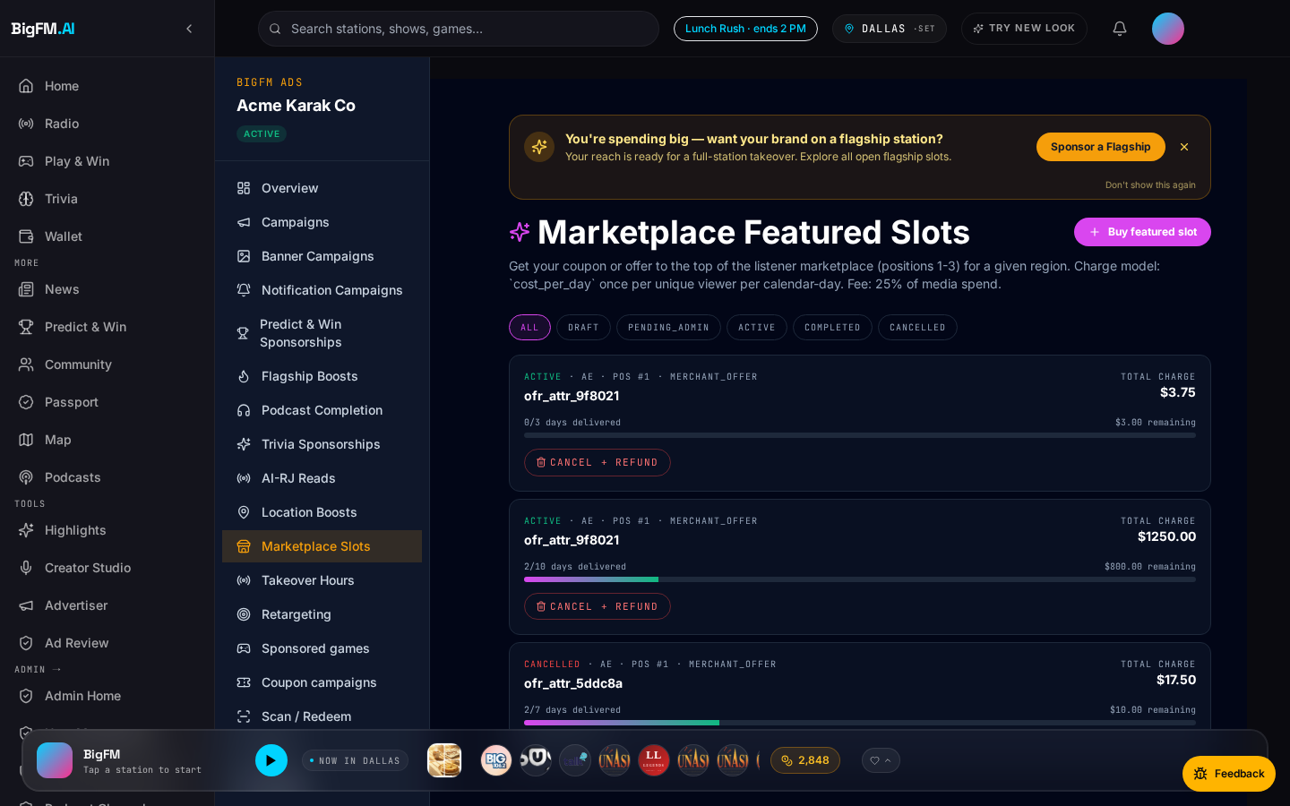
Advertiser Onboarding · Comic Strip
From signup to live campaign in under 10 minutes.
1 · Sign up + top up (Stripe test-mode)
2 · Pick a product (Flagship Boost shown)
BigFM · Confidential
11 / 20
3 · Configure creative + budget
4 · Ship it — analytics live in 60 s

Slide 12
Objection Handling · Rehearsed Responses
Six common objections + tight rebuttals. Practice these.
Objection | Response
"Too small for radio." | Start with $50 CPA coupon — pay only per redemption. No minimum spend.
"How do I know it works?" | Every campaign shows real-time impressions + saves + redemptions in the advertiser dashboard. Numbers refresh every 30 s.
"I already use Facebook." | Great — retargeting hooks let you upload your Facebook Custom Audience and re-engage on audio. Complementary, not substitute.
"Radio is dead." | 58,557 stations streaming, 70%+ commute audio via streaming. We serve HTTPS-safe streams to any browser. Radio moved online — you missed it.
"How is this different from Spotify Ads?" | Spotify sells CPM against a global impression pool. We sell CPA against locally-attributed conversions. You pay only when someone shows up.
"What if you go down / bug in your platform?" | Same-day fixes. Ad Ops rigor: broken creatives auto-skip in 2 s. See next slide.
BigFM · Confidential
12 / 20

Slide 13
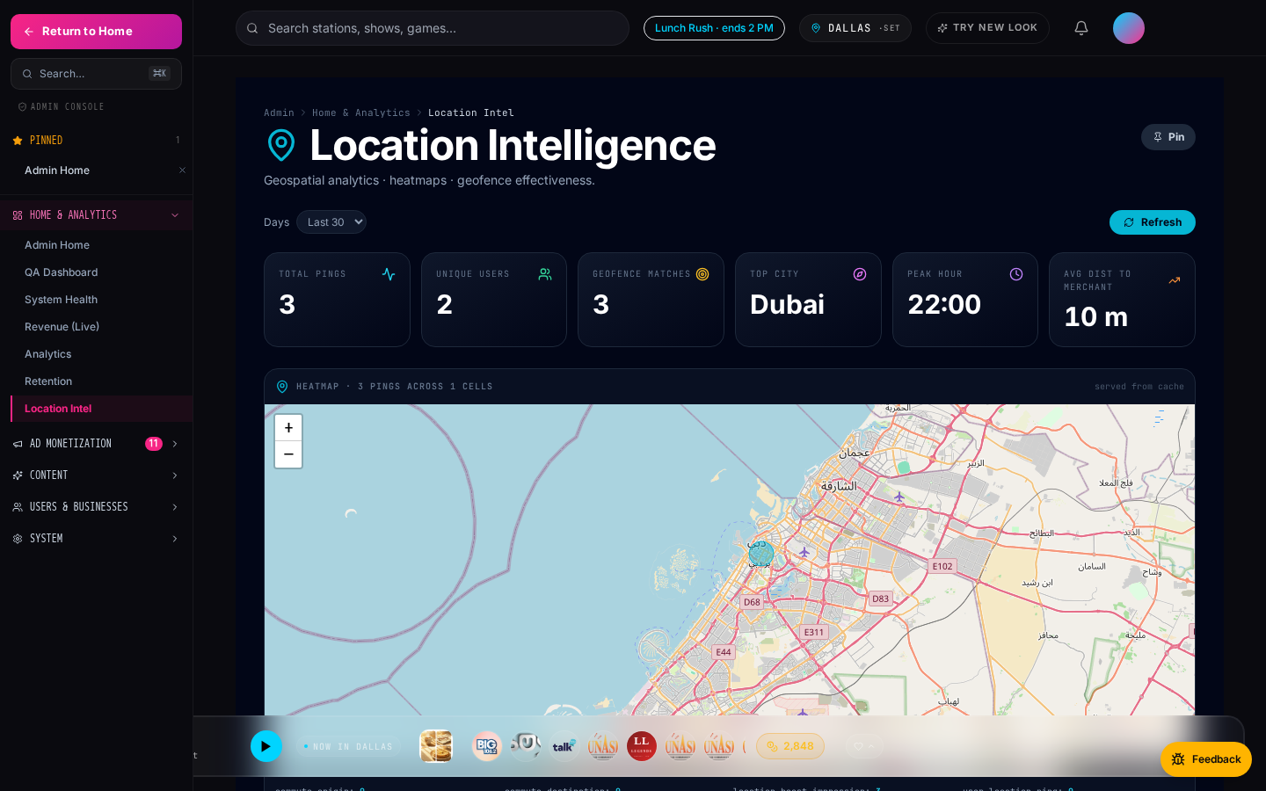
Case Study · Karak Cafe
End-to-end flow demonstrated in test mode — real DB rows, real conversions.
▸ Karak Cafe · Karama location · lat/lng geofenced 500 m.
▸ Ran a $2/redemption coupon + a location-boost during lunch (11:30 – 14:00).
▸ 3 nearby-user pings within the geofence · 2 unique users · 1 scan-to-pay conversion tied to the impression.
▸ QA dashboard shows the flow live under Location Intel + Recent Activity.
▸ Real Stripe test-mode charge captured on the merchant side.
Admin location intel · Karak proximity view.
BigFM · Confidential
13 / 20

Slide 14
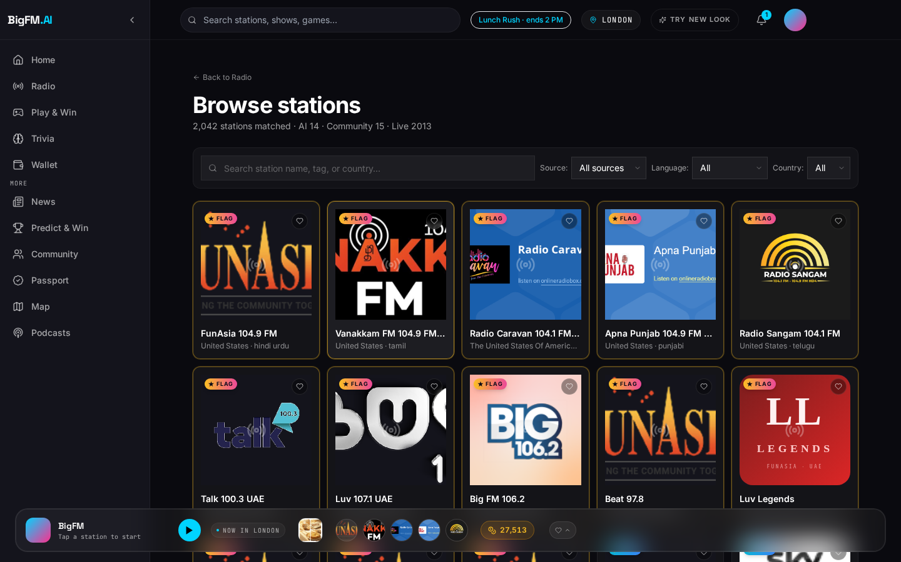
Station Partnership · Value Prop
Three reasons every station owner should claim their listing today.
▸ Add BigFM's stream proxy to your player — instantly monetize your digital audience with zero infra work.
▸ Access BigFM's advertiser network — we bring you demand, you keep 70% (direct-sold) or 50% (programmatic backfill).
▸ Owner dashboard shows real listener count, geographic distribution, revenue by product, pre-roll fill rate.
▸ Free HTTPS stream proxy fixes mixed-content bugs that kill your browser audience today.
BigFM · Confidential
14 / 20

Slide 15
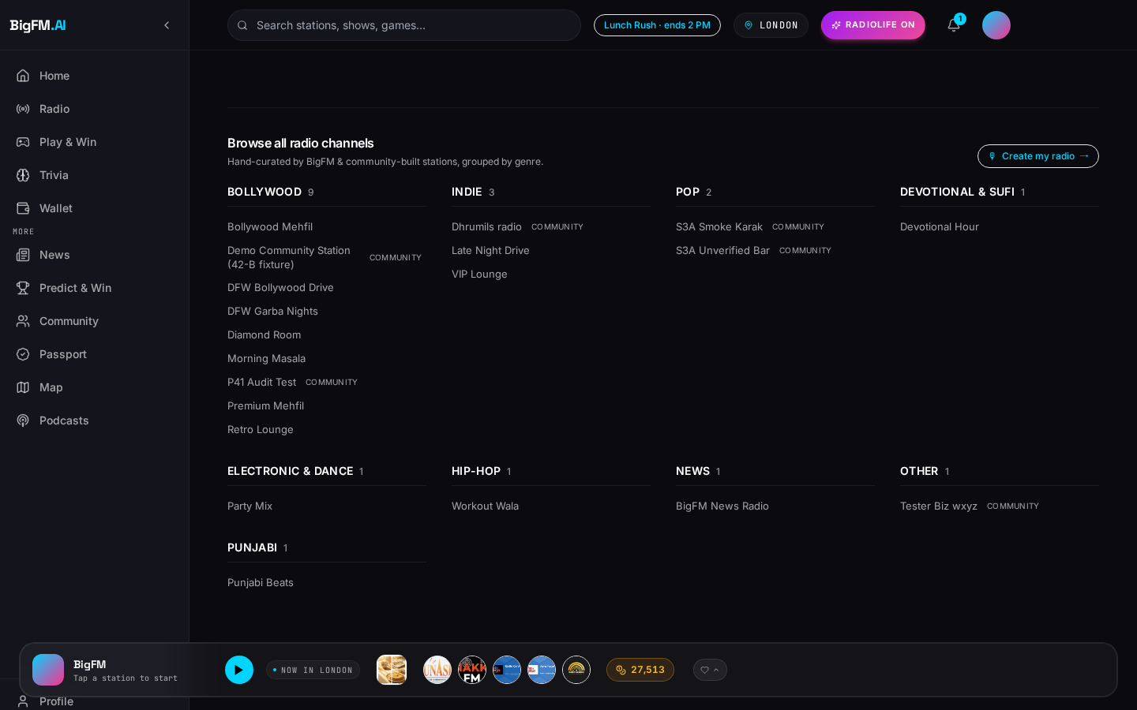
Station Onboarding · 4 Steps
Free. Under 15 minutes. Revenue starts flowing on the next month's cycle.
▸ 1 · Claim your station in the BigFM catalog (search + click).
▸ 2 · Verify ownership (broadcast email match OR admin manual review).
▸ 3 · Enable pre-roll + AI RJ personas (per-station toggles).
▸ 4 · Revenue starts on next month's payout cycle (Stripe Connect).
▸ Bonus: your station gets flagship consideration if you serve a language / region under-represented in the current catalog.
Big FM 106.2 · station detail page with claim CTA.
BigFM · Confidential
15 / 20

Slide 16
Revenue Share Model
Configurable per station in admin panel · numbers below are our default proposal.
Revenue source | Station | BigFM | Notes
Direct-sold ad plays on your station | 70% | 30% | Advertiser-picked stations only
Sponsored AI RJ reads on your station | 60% | 40% | BigFM handles voice + LLM cost
Programmatic backfill (network-wide auction) | 50% | 50% | OpenRTB adapter (Q3 roadmap)
Takeover Hour hosted on your station | 80% | 20% | Station carries the whole hour
Marketplace featured slot conversions | 0% | 100% | Merchant-side ad, not station-attributed
Coupon redemptions (CPA) | 0% | 100% | Merchant-side conversion
BigFM · Confidential
16 / 20

Slide 17
Station Owner Dashboard
Every claimed station gets its own analytics + revenue view.
▸ Listener count: 24h · 7d · 30d rolling windows.
▸ Top listener geos: country + city rank.
▸ Revenue by product: direct-sold, RJ reads, takeover, programmatic.
▸ Pre-roll fill rate: % of playbacks served with an ad + revenue per playback.
▸ Payouts: Stripe Connect statement + downloadable CSV.
Admin home dashboard reference (station owner view is a subset scoped to the claimed station).
BigFM · Confidential
17 / 20

Slide 18
What Stations Get For Free
Five tools included on Day 1, no strings, no upfront cost.
▸ Auto-import of RSS news feeds — instant news bulletins on your station without editorial staff.
▸ AI RJ persona voice branding — 10 personas, or bring your own voice via ElevenLabs sample.
▸ HTTPS stream proxy — fixes the mixed-content block that silently kills your browser audience.
▸ Pre-roll ad marketplace — you keep 70% direct-sold, 50% programmatic (Q3+).
▸ Geo-flagship routing — first-shelf placement to boost discoverability in your region.
BigFM · Confidential
18 / 20

Slide 19
Reliability & Ad Ops Rigor
Ad creative rot is auto-remediated — broken creative URLs auto-skip in 2 s + fire analytics events so ops can rotate them. Your campaign never gets stranded.
The Advertiser Promise
▸ Your campaign will never sit stuck on a broken creative.
▸ If our ad-serving layer can't decode the audio, the player auto-skips in 2 seconds — the listener never gets stranded.
▸ Every auto-skip fires a `skip` impression with reason=audio_load_error → ops sees it, rotates the creative, and refunds the wasted impression.
▸ You are not billed for auto-skipped impressions.
Case in point · Jul 31 2026
An upstream demo ad's audio URL rotted (returned HTML instead of MP3). Detected + fixed in one dev cycle:
• Root cause: 3 seed preroll ads' external audio URLs (kozco.com / pixabay) started returning text/html + 403.
• Fix — code: 1-file, 6-line change to PrerollOverlay.onError → auto-skip after 2 s + fire `skip` impression event with reason=audio_load_error.
• Fix — data: repointed the 3 rows to a backend-hosted asset (`persona_samples/p39_dawn_caller.mp3`).
• Non-regression: AI radio stations kept playing throughout.
• Advertiser billing impact: zero — auto-skips are free.
BigFM · Confidential
19 / 20

Slide 20
Next Steps + FAQ
How to close · what a first-month customer actually gets.
How to Close
Mini-FAQ
▸ Schedule a 30-min demo · in-person if possible.
▸ Offer $100 credit for the first-month campaigns (any product).
▸ Set up a joint QBR calendar (monthly for the first quarter).
▸ Send a follow-up email with the advertiser onboarding link + Stripe test-mode key note.
▸ Track them in Salesforce under the 'BigFM · first campaign' pipeline stage.
▸ Payment terms: prepaid budget (Stripe Connect wallet). Net-15 for approved chains > $2 k / mo.
▸ Minimum spend: none for coupon CPA. $50 minimum wallet top-up.
▸ Cancellation: pause anytime; unused budget refundable within 30 days.
▸ Refunds: full refund on fraud-flagged redemptions + auto-skipped impressions (Reliability slide).
▸ Support: dedicated Slack channel for spend > $500/mo, email support otherwise (< 24 h SLA).
BigFM · Confidential
20 / 20

