Slide 1
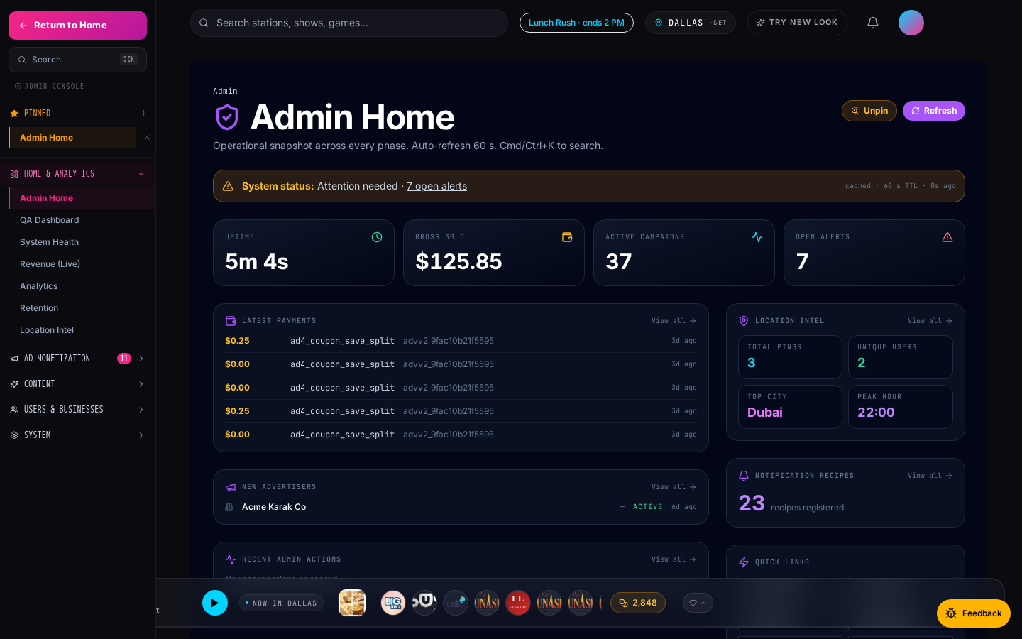
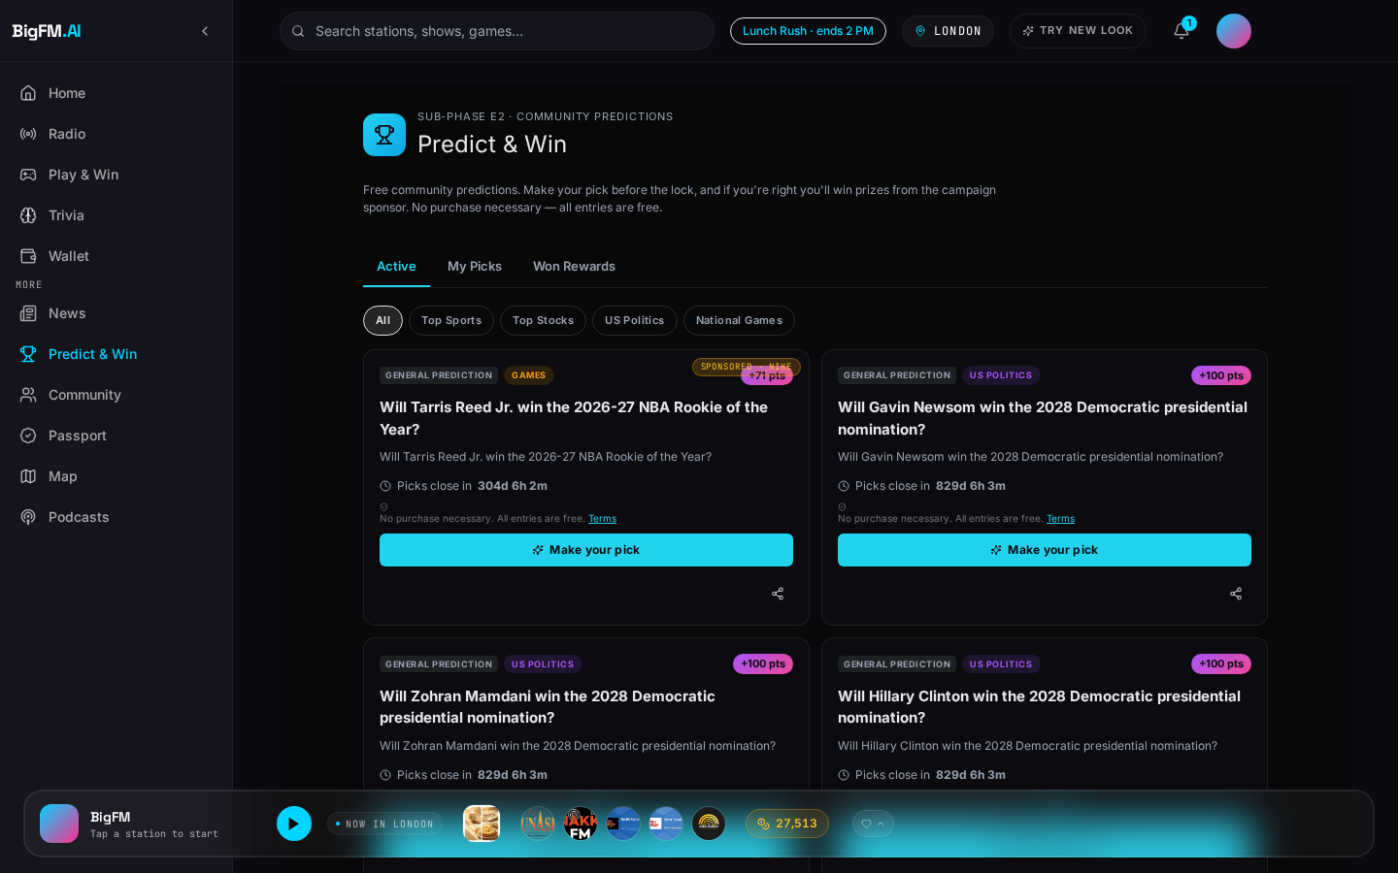
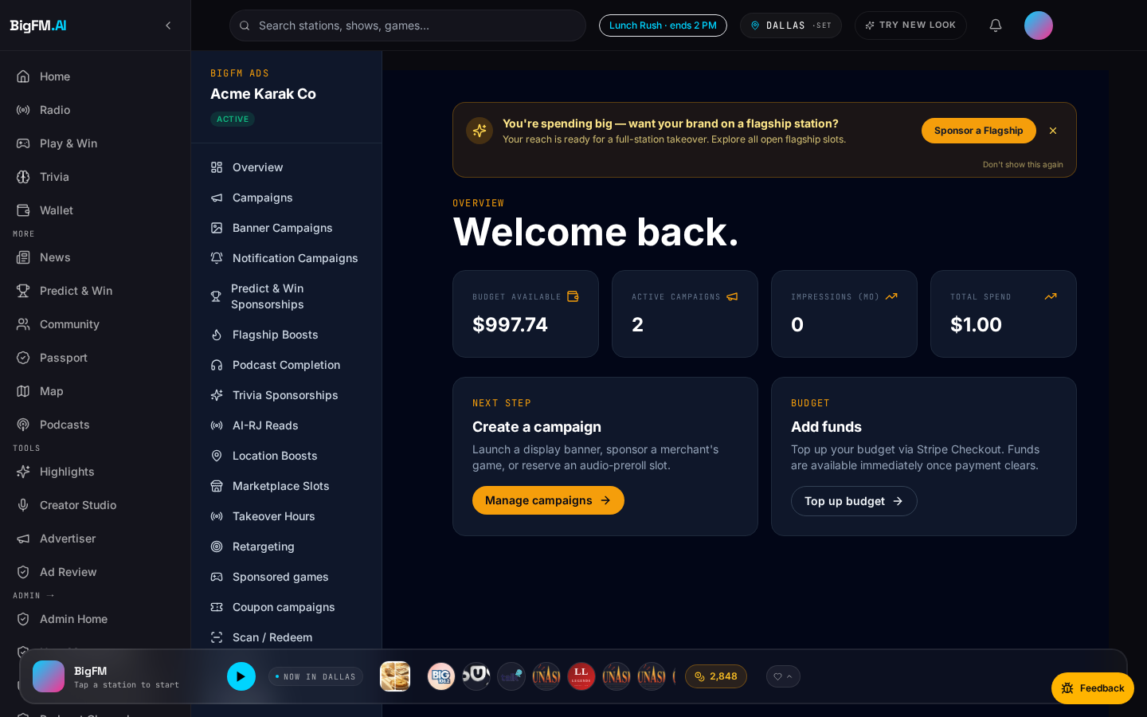
SALES PLAYBOOK · V2
BigFM Sales Playbook
How to sell BigFM — to advertisers AND radio stations.
July 2026 · BigFM · Confidential · Internal

Slide 2
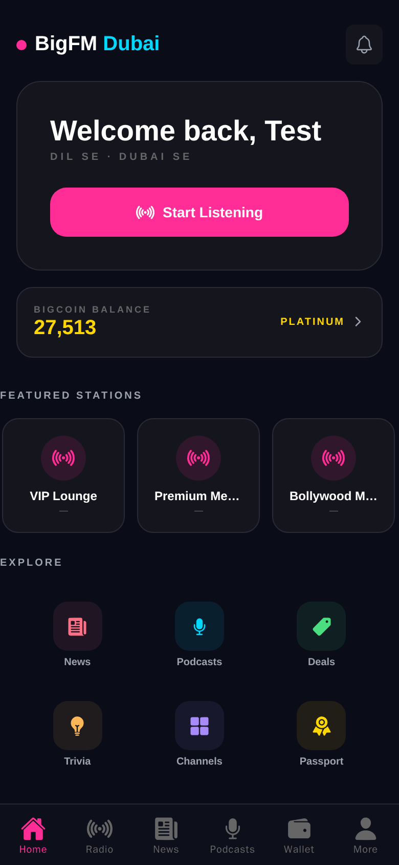
What Is BigFM · 60-second Pitch
▸ BigFM is a personalized live radio + local commerce + rewards platform.
▸ Listeners get an AI-curated stream with real AI radio hosts (ElevenLabs voices).
▸ Every action — listen, save a coupon, visit a merchant — earns points redeemable in-app.
▸ Advertisers self-serve 11 ad products via one dashboard (Stripe Connect, prepaid).
▸ Radio station owners monetize their digital stream through BigFM's ad demand + 70/30 rev share.
Mobile home · listener view (Expo app).
BigFM · Confidential
2 / 37

Slide 3
Who We Sell To
Two very distinct personas — pitch each with the same product but different lenses.
LOCAL BUSINESSES
Restaurants · retail · events · clinics
Pain:
"I can't reach commuters at lunchtime. Facebook ads no longer convert. Radio ads are too expensive for a 3-store chain."
Sell: coupons (CPA), location-boost, sponsored RJ reads, Predict & Win lead-gen sponsorships.
Entry point: $50 first campaign, pay-per-redemption.
RADIO STATION OWNERS
Community · flagship · religious · niche
Pain:
"Traditional ad-slot revenue is capped. My digital stream serves listeners but nobody pays for it. Salespeople for programmatic ads never call back."
Sell: partnership · 70/30 rev share · zero-cost onboarding.
Entry point: free claim + owner dashboard.
BigFM · Confidential
3 / 37

Slide 4
Why Now · Why BigFM
Three category shifts converging in 2026.
▸ Personalized audio adoption: 70%+ of drive-time listeners now stream (not FM antenna).
▸ Hyperlocal ad spend shifting from Facebook / Meta back to native audio + geo — attribution finally works.
▸ AI voice branding: ElevenLabs-grade voices at $0.05/min make sponsored RJ reads cost-competitive with pre-recorded spots.
▸ Radio station owners have LOTS of digital reach but zero programmatic revenue — a supply-side gap begging for demand.
BigFM · Confidential
4 / 37

Slide 5
Section A · The BigFM Product
One player · four value layers · one wallet across all of them.
1
Live radio · podcasts · news · trivia
Engagement surface
2
Marketplace · wallet · rewards
Commerce loop
3
11 ad products
Monetization engine
Listener
4
Admin console · analytics · ops
Governance + insights
BigFM · Confidential
5 / 37

Slide 6
SECTION A.5 · ADVERTISER MODULE
The Advertiser Command Center.
One dashboard · 11 ad products · Stripe test-mode Connect. Ships live in <10 min.
BigFM · Confidential
6 / 37

Slide 7
Advertiser · Command Center
One dashboard. 11 ad products. Stripe test-mode Connect. Ships live in <10 minutes.
/advertiser/dashboard — overview view.
BigFM · Confidential
7 / 37

Slide 8
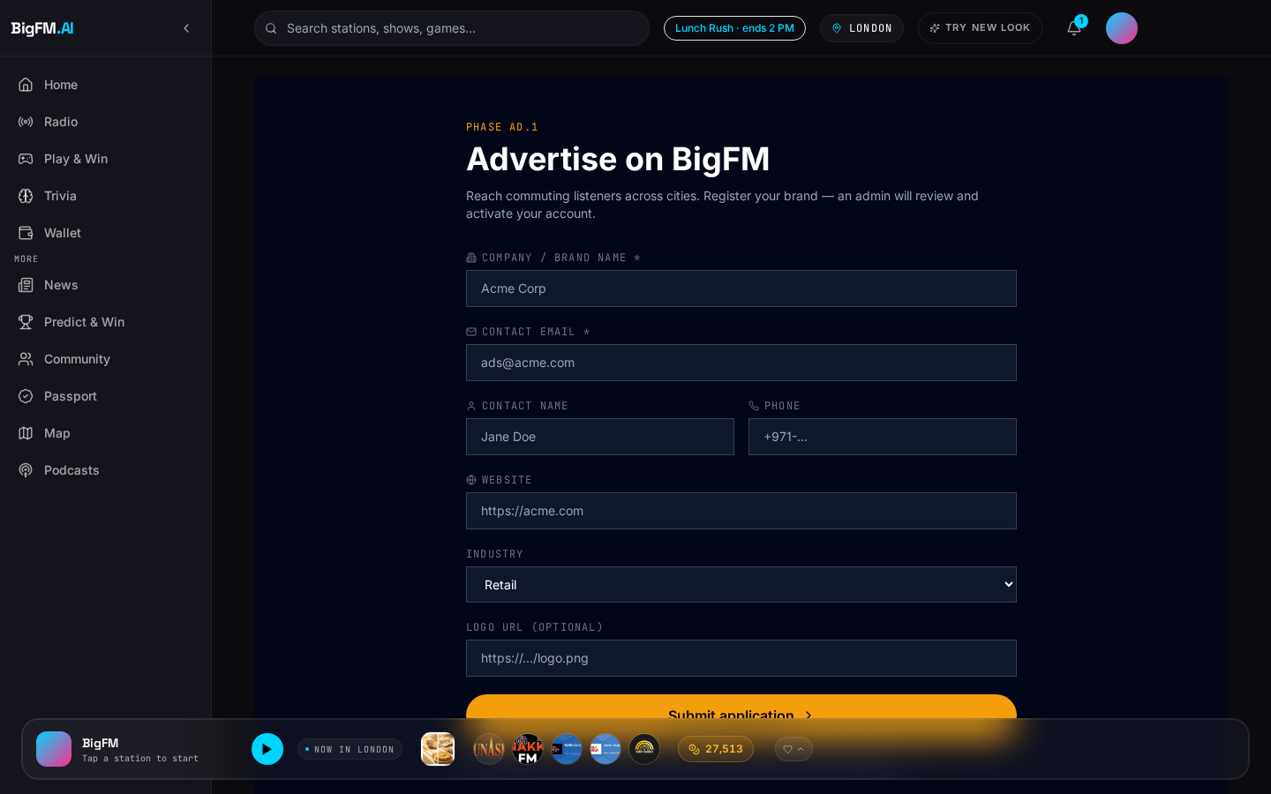
Business Setup + Stripe Connect
Advertiser signup → advertisers_v2 record → Stripe onboarding.
▸ Signup captures business name, category, geo, GST/VAT ID.
▸ Auto-creates advertisers_v2 record; owner_user_id links back to auth user.
▸ Stripe Connect Express hand-off — test-mode by default.
▸ Approval < 24 h for spends < $500; instant self-serve for CPA < $50.
▸ Multi-user: owner can add staff via /advertiser/staff/invite.
/advertiser/apply — new-business intake.
BigFM · Confidential
8 / 37

Slide 9
Wallet-Based Prepay Model
One wallet · every campaign draws from it · zero per-campaign checkout friction.
▸ Advertiser tops up once → wallet holds a prepaid balance.
▸ Every campaign draws from the same wallet — no re-authorization.
▸ Budget cascade across active campaigns; per-campaign daily caps.
▸ Auto-pause at wallet < 20% of daily burn — email + notification alert.
▸ Refunds land back in the wallet within one billing cycle.
Wallet widget on /advertiser/dashboard.
BigFM · Confidential
9 / 37

Slide 10
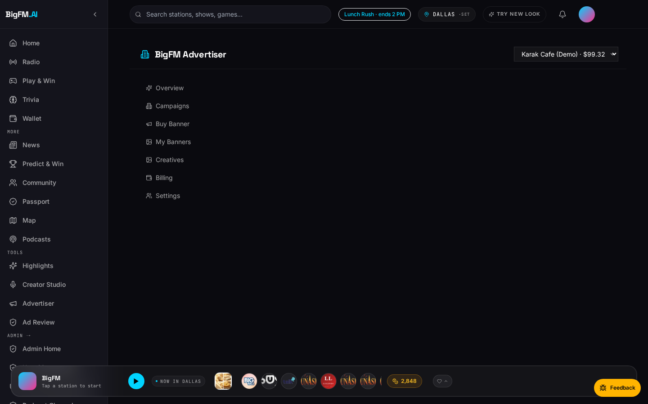
Campaign Creation Wizard
One 3-step pattern used across all 11 ad products.
▸ Step 1 · Metadata: name, geo, category, days-active.
▸ Step 2 · Creative: audio spot (or Sora 2 generate), banner, CTA.
▸ Step 3 · Budget: $ amount, daily cap, kill-switch threshold.
▸ Preview + reach estimate before you commit.
▸ Same shape for location-boost, retargeting, takeover — no relearning.
Coupon Campaign wizard (CPS / CPA / Hybrid).
BigFM · Confidential
10 / 37

Slide 11
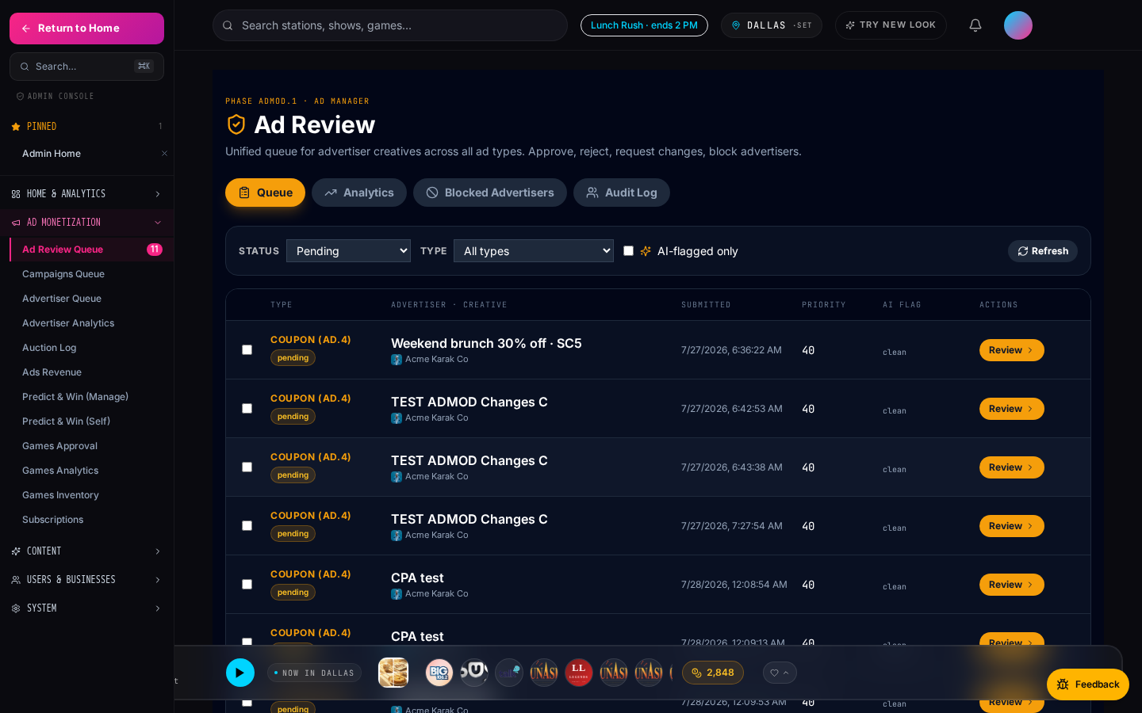
Approval + Moderation Queue
LLM ad-copy moderation + admin gate at $500+.
▸ LLM moderator flags profanity, brand claims, risky verticals.
▸ Flagged copy sits with LLM rationale + suggested rewrites.
▸ $500+ spends → mandatory admin gate; smaller = auto-approve.
▸ Admin decisions logged to audit_log; advertiser sees status inline.
▸ Rejected creatives: one-tap 'edit + resubmit' — no full-wizard restart.
/admin/ad-review — LLM flags + admin decisions.
BigFM · Confidential
11 / 37

Slide 12
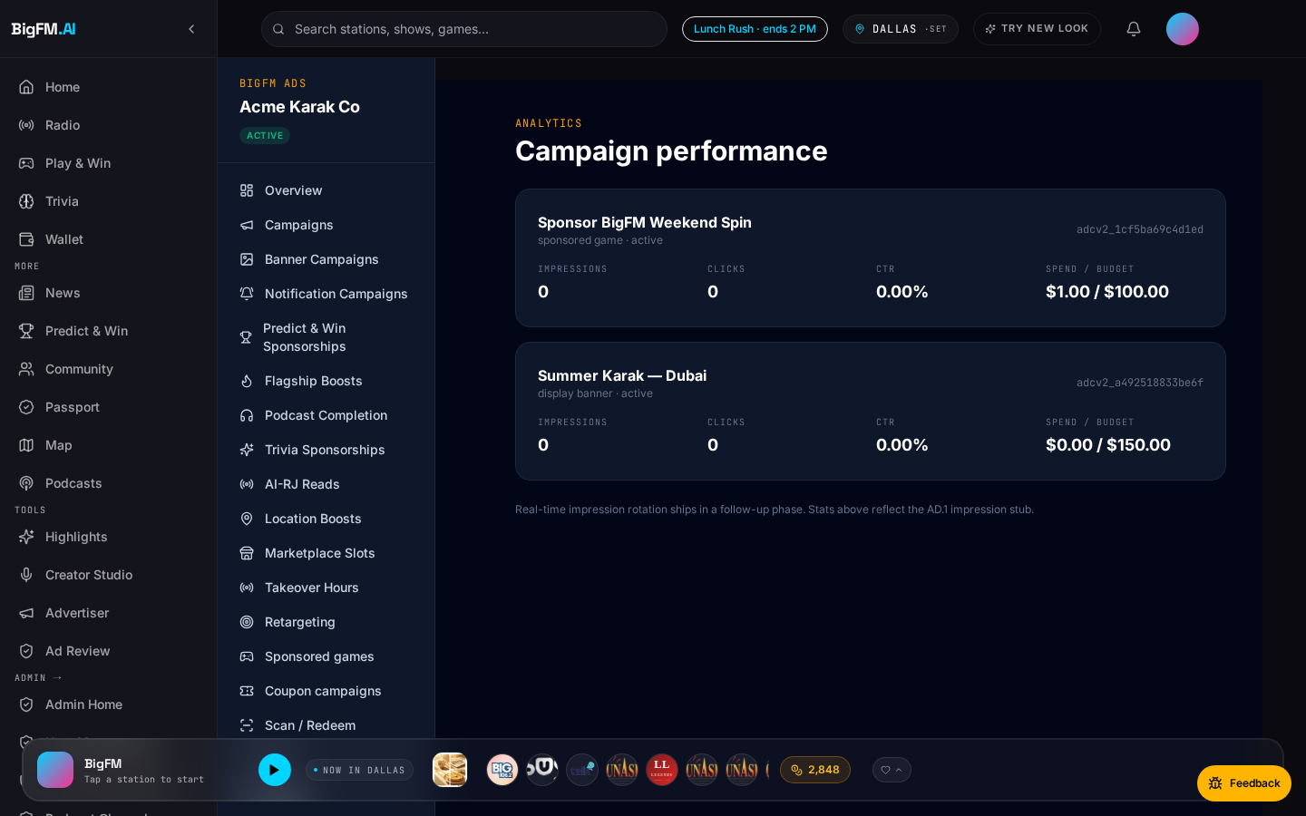
Live Analytics + Auction Transparency
Real-time impressions · saves · redemptions · budget burn.
▸ Metrics refresh every 30 s.
▸ Budget-burn indicator with wallet-empty ETA.
▸ Auction transparency: min winning bid + slot fill % per loss.
▸ Derived metrics computed server-side (no client math bugs).
▸ CSV export of every impression + attribution event.
/advertiser/dashboard/analytics — per-campaign.
BigFM · Confidential
12 / 37

Slide 13
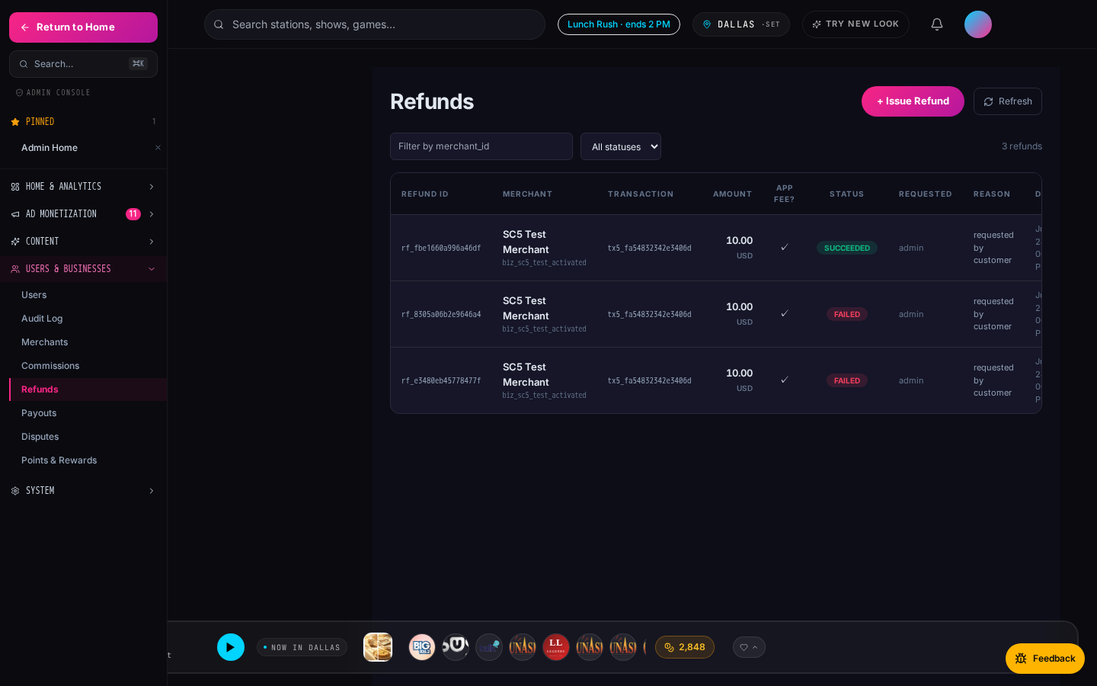
Dispute + Refund Path
Fraud-flagged redemptions auto-refund. Advertiser disputes in-dashboard.
▸ CPA redemptions scored for fraud (velocity, IP, device, geo).
▸ Auto-refund fires; advertiser sees entry with reason code.
▸ In-dashboard dispute button routes to admin queue.
▸ Admin reviews with full event trail.
▸ Broken creatives auto-skip → NOT billed (Phase 42-B-redux.2).
/admin/refunds — pending refund + dispute queue.
BigFM · Confidential
13 / 37

Slide 14
Section B · 11 Ad Products at a Glance
Every product ships with real-time analytics + a Stripe test-mode entry.
Flagship Boost
Direct-bid auction, hour-length flagship slot.
Bid $50+
Best for: Big brands, launches
Sponsored RJ Read
AI host bridges songs with your brand.
CPM $8-15
Best for: Personal-voice brands
Location Boost
Geofence within 500 m of your storefront.
$0.10-0.50 / imp
Best for: QSR, dine-in
Marketplace Featured
Above-the-fold placement in the deals grid.
$5-25 / day
Best for: Any merchant
Takeover Hour
Own the entire hour: overlay + 4 reads.
$100-$1000 / hr
Best for: Movies, festivals
Retargeting
Re-engage listeners who saved but never redeemed.
CPM $12
Best for: Chains, services
Coupon (CPA / CPS)
Pay only per redemption or per sale.
$2 / redemption
Best for: Restaurants, retail
Podcast Reward
Bonus points to listeners who finish your episode.
CPM + bonus
Best for: Media, brand storytelling
Trivia Sponsor
Sponsor a trivia round with logo + prize.
$25-$150 / round
Best for: Toys, snacks, brands
Banner Ads
Persistent skyscraper + billboard slots.
CPM $5-10
Best for: Awareness campaigns
Notification Campaign
Push a segmented offer to your ideal user.
CPA $0.20-1.50
Best for: Retention, promos
BigFM · Confidential
14 / 37

Slide 15
Deep-dive · Coupon Campaigns (CPS / CPA / Hybrid)
Only pay when a real customer redeems. Fraud-refund built in.
▸ Advertiser sets: $ per redemption, cap per day, geo, category.
▸ Every redemption verified merchant-side (scan-to-pay or manual code).
▸ Fraud detection: velocity + IP + device fingerprint → auto-refund.
▸ Real-time dashboard: impressions → saves → redemptions.
▸ Price: $2 / redemption typical. Ideal for: restaurants, retail.
BigFM · Confidential
15 / 37

Slide 16
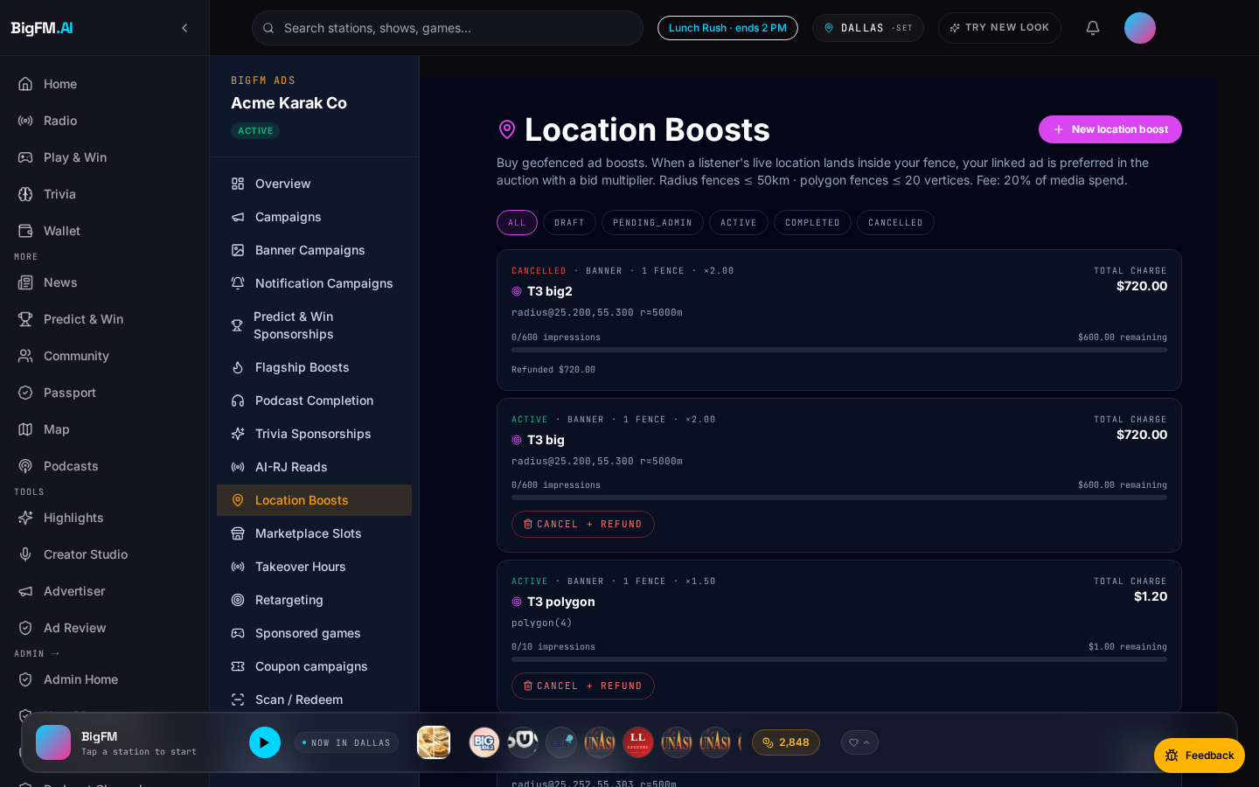
Deep-dive · Location-Boost Ads
Geofence your storefront. Reach listeners within 500 m at lunch / dinner.
▸ Draw a fence on the map — up to 5 zones per campaign.
▸ Density preview shows estimated reach + competing campaigns.
▸ Ad plays as a mid-stream audio spot + companion banner on mobile.
▸ Scan-to-pay within 60 min → automatically attributed to the impression.
▸ Price: $0.10-$0.50 / impression. Ideal for: QSR, dine-in.
BigFM · Confidential
16 / 37

Slide 17
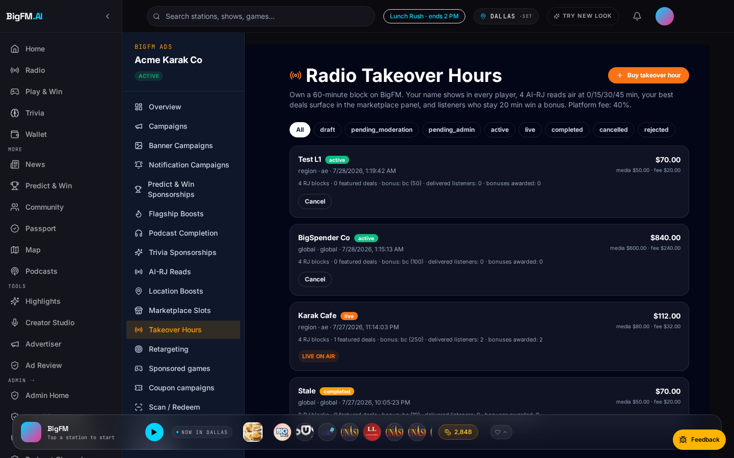
Deep-dive · Radio Takeover Hour
Own an entire hour on a flagship station.
▸ One brand · one flagship · one hour · saturated presence.
▸ 4 AI-RJ sponsor reads, banner takeover, hero deal, listener bonus.
▸ Live analytics: unique reach, avg time-on-station, deal saves.
▸ Price: $100 – $1,000 / hour by tier and daypart.
▸ Ideal for: movie launches, festivals, product releases.
BigFM · Confidential
17 / 37

Slide 18
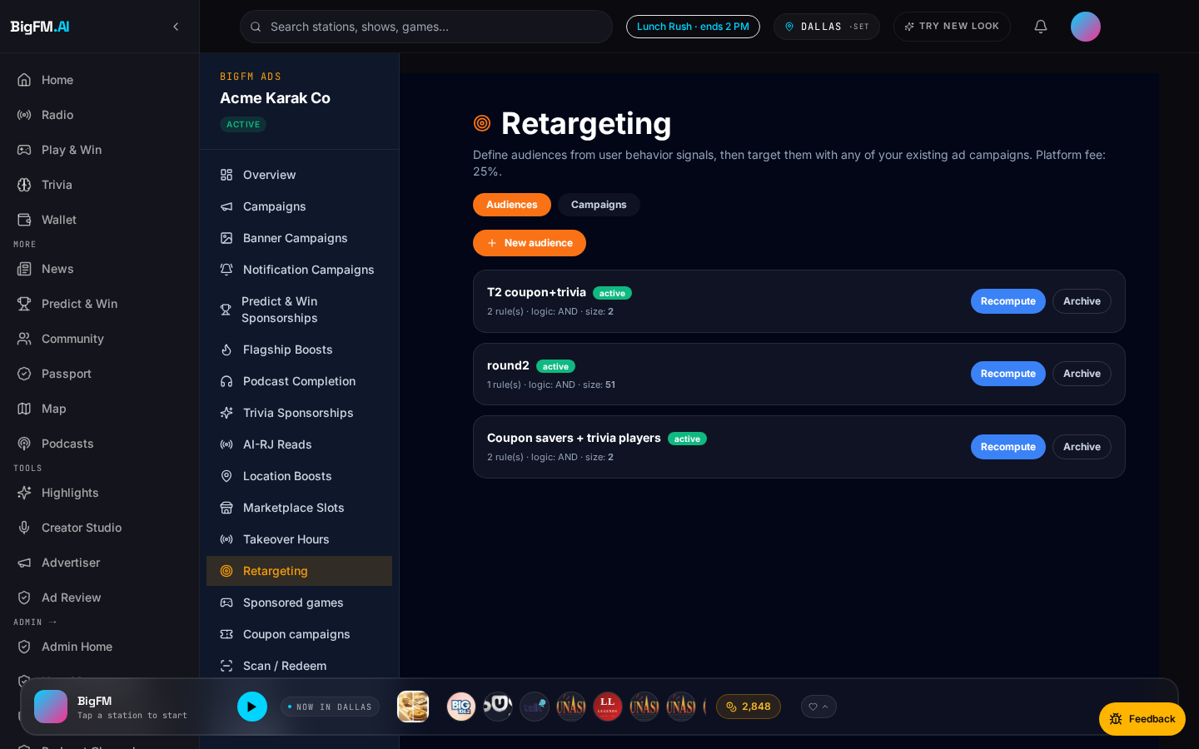
Deep-dive · Retargeting Audiences
Re-engage people who saved your coupon but haven't redeemed.
▸ 11 behavioral signals: saved-not-redeemed, viewed-not-saved, scanned-once, geo-frequent, hour-consistent, and 6 more.
▸ Drag+drop audience builder → run any ad product against it.
▸ Attribution: each redemption tagged with the audience it fired from.
▸ Ideal for: mid-size chains + service businesses with a nurture cycle.
BigFM · Confidential
18 / 37

Slide 19
Advertiser Onboarding · Step 1
Sign up + top up (Stripe test-mode Connect).
Step 1 · /advertiser/apply — business intake.
BigFM · Confidential
19 / 37

Slide 20
Advertiser Onboarding · Step 2
Pick a product from the command center.
Step 2 · /advertiser/dashboard — pick from 11 products.
BigFM · Confidential
20 / 37

Slide 21
Advertiser Onboarding · Step 3
Configure creative + budget in the wizard.
Step 3 · Coupon Campaign wizard.
BigFM · Confidential
21 / 37

Slide 22
Advertiser Onboarding · Step 4
Ship it — live analytics in 60 s.
Step 4 · /advertiser/dashboard/analytics.
BigFM · Confidential
22 / 37

Slide 23
Objection Handling · Rehearsed Responses
Six common objections + tight rebuttals. Practice these.
Objection | Response
"Too small for radio." | Start with $50 CPA coupon — pay only per redemption. No minimum.
"How do I know it works?" | Every campaign shows real-time impressions + saves + redemptions in the advertiser dashboard. Refreshes every 30 s.
"I already use Facebook." | Retargeting hooks let you upload your Facebook Custom Audience and re-engage on audio. Complementary.
"Radio is dead." | 58,557 stations streaming, 70%+ commute audio via streaming. Radio moved online — you missed it.
"How is this different from Spotify Ads?" | Spotify sells CPM against global impressions. We sell CPA against locally-attributed conversions.
"What if you go down?" | Same-day fixes. Broken creatives auto-skip in 2 s. See Reliability slide.
BigFM · Confidential
23 / 37

Slide 24
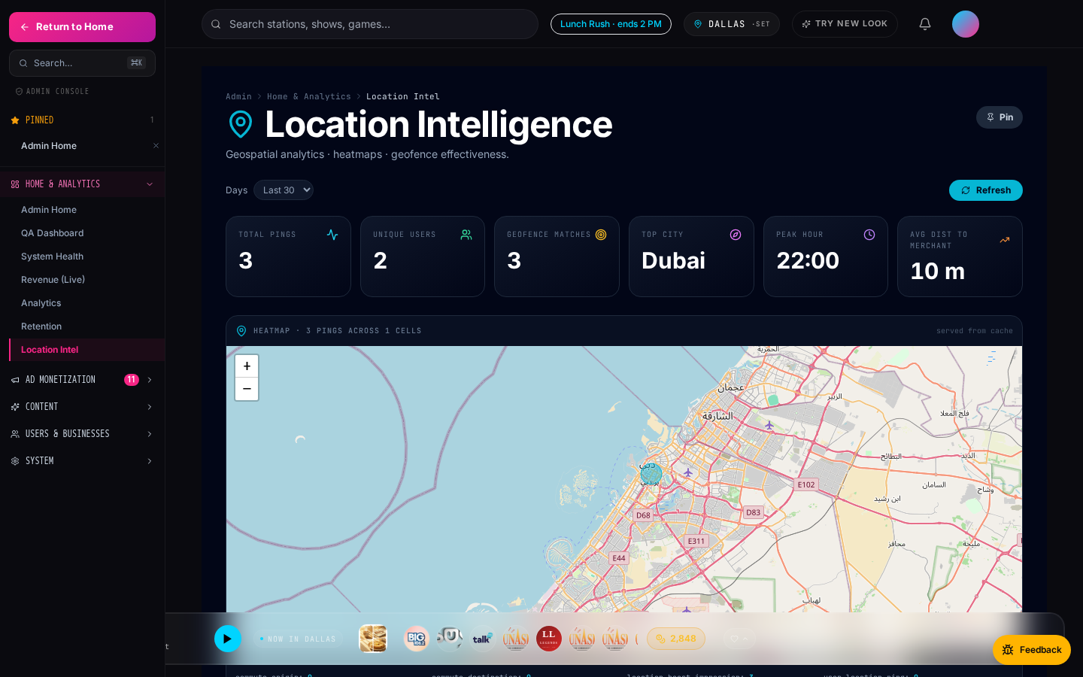
Case Study · Karak Cafe
End-to-end flow demonstrated in test mode.
▸ Karak Cafe · Karama location · lat/lng geofenced 500 m.
▸ Ran a $2/redemption coupon + a location-boost during lunch (11:30–14:00).
▸ 3 nearby-user pings within the geofence · 2 unique users · 1 scan-to-pay conversion tied to the impression.
▸ QA dashboard shows the flow live under Location Intel + Recent Activity.
▸ Real Stripe test-mode charge captured on the merchant side.
Location intel · Karak proximity view.
BigFM · Confidential
24 / 37

Slide 25
SECTION B.5 · MERCHANT LEAD-GEN FLYWHEEL
A distinct product category:
Merchant-sponsored lead-gen.
0% commission on prediction volume · merchants pay for LEAD DELIVERY. This is NOT an ad product.
BigFM · Confidential
25 / 37

Slide 26
Introducing Predict & Win
Kalshi-style prediction markets, native to radio listening.
▸ Users bet on outcomes (sports, weather, entertainment, news) using BigCoin.
▸ Live markets settle against real-world events; participants earn or lose BigCoin.
▸ Built on Polymarket via Predexon proxy — the same infra as Kalshi + Polymarket.
▸ Audio-native surface: AI RJ tease → tap in-player → participate without leaving.
▸ Radio-first, hyperlocal — no one else is doing this shape.
/predict-win — customer-facing prediction market lobby.
BigFM · Confidential
26 / 37

Slide 27
Merchant Lead-Gen Model — 0% Commission
BigFM does NOT take a cut of prediction volume. Merchants pay for LEAD DELIVERY.
▸ BigFM takes 0% commission on prediction market transactions.
▸ Merchants sponsor Predict & Win campaigns to acquire high-intent users.
▸ Each participant is a warm lead — geo-matched, engagement-verified, wallet-active.
▸ Merchants pay for LEAD DELIVERY (per opt-in + qualifying action) — not for prediction volume.
▸ Different budget line from ad campaigns — cleanly separated in the invoice.
BigFM · Confidential
27 / 37

Slide 28
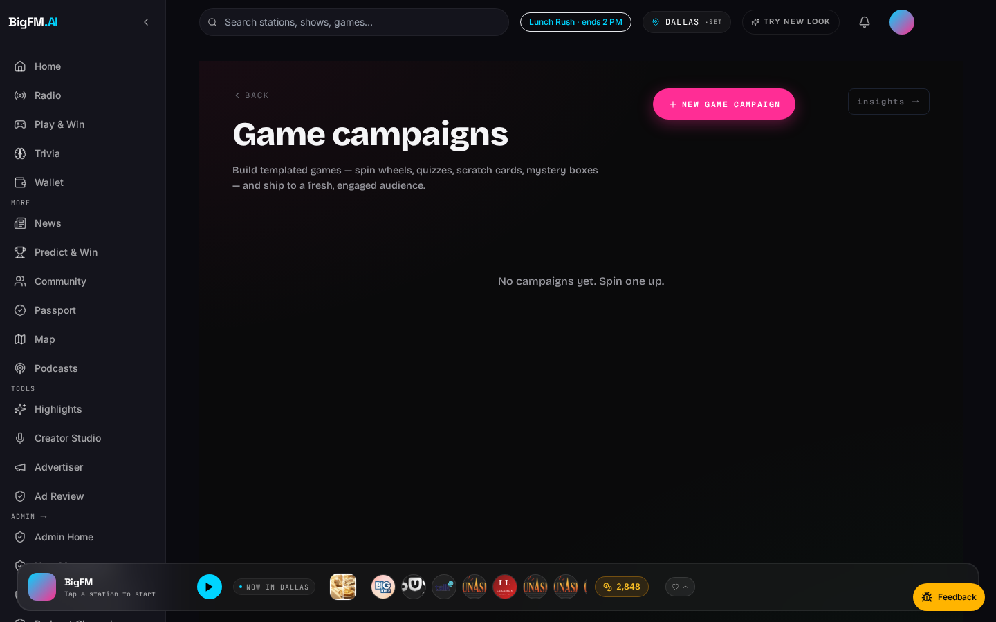
The Merchant Lead-Gen Flywheel
Predict & Win + Live Trivia + Sponsored Games — one funnel, three surfaces.
▸ Predict & Win (Phase PW-M): merchants sponsor category-tied markets.
▸ Live Trivia Sponsorships (Phase H): themed round with logo + prize.
▸ Sponsored Games (Phase AD.2): merchant-branded Spin, Scratch, Trivia.
▸ All three flow into the same lead ledger — cost-per-lead + qualifying-action metrics.
▸ Distinct from ad impressions: users EARN something in exchange for engagement.
/advertiser/games — sponsored games marketplace.
BigFM · Confidential
28 / 37

Slide 29
Radio + Prediction Markets — A New Category
No competitor is doing this shape today.
▸ Kalshi: desktop-focused prediction markets, no radio integration.
▸ Polymarket: crypto-native, high-friction on-ramp, US-restricted.
▸ BigFM: audio-first · hyperlocal · merchant-embedded · Predexon-brokered · no crypto UX friction.
▸ The wedge: predictions become NATIVE to the radio listening moment.
▸ The moat: merchants get lead-gen from a fully-attributed audio audience.
BigFM · Confidential
29 / 37

Slide 30
SECTION C · STATION PARTNERSHIP
Bring us your station.
We bring you demand.
Free claim · 70/30 rev share direct-sold · 50/50 programmatic backfill (Q3).
BigFM · Confidential
30 / 37

Slide 31
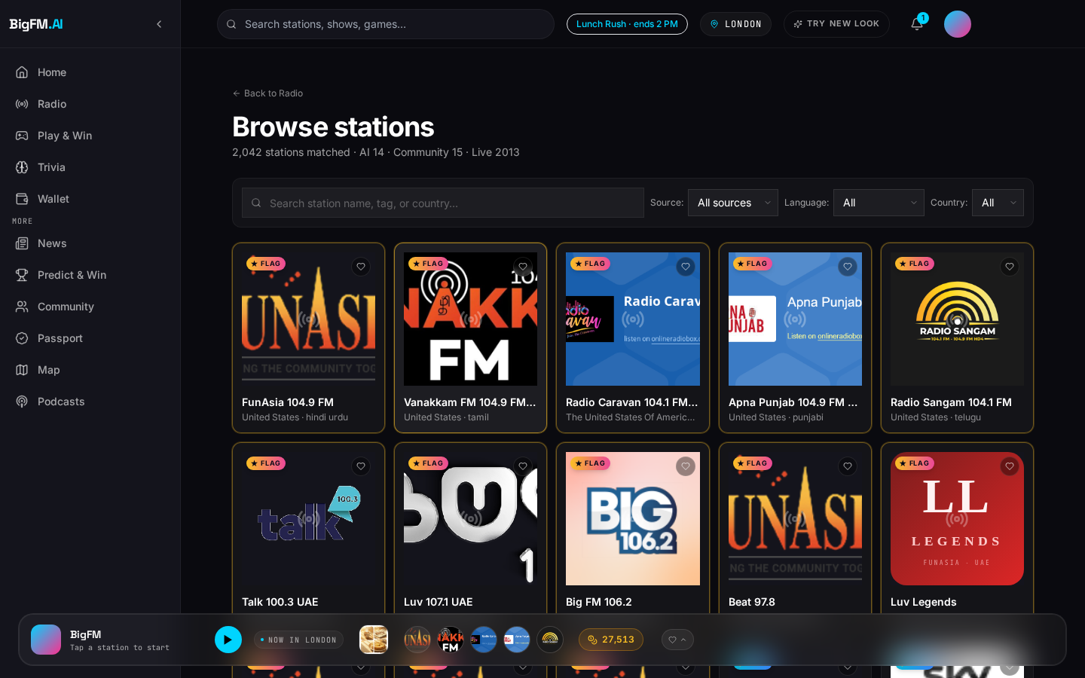
Station Partnership · Value Prop
Three reasons every station owner should claim their listing today.
▸ Add BigFM's stream proxy to your player — instantly monetize your digital audience.
▸ Access BigFM's advertiser network — we bring you demand, you keep 70% direct-sold.
▸ Owner dashboard: real listener count + geo + revenue by product + pre-roll fill rate.
▸ Free HTTPS stream proxy fixes mixed-content bugs killing your browser audience.
BigFM · Confidential
31 / 37

Slide 32
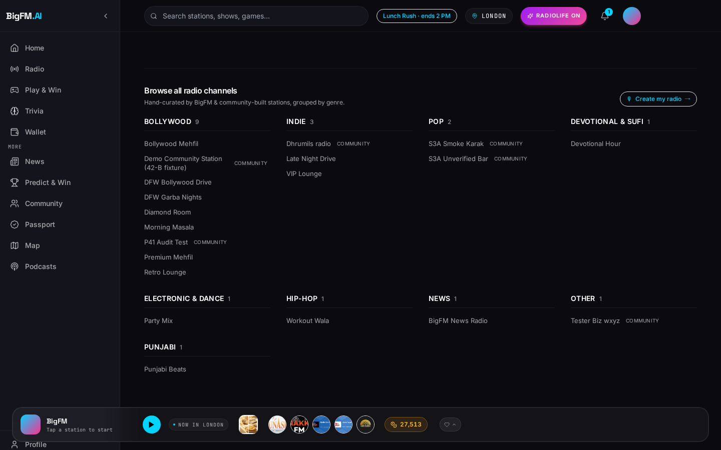
Station Onboarding · 4 Steps
Free. Under 15 minutes. Revenue starts on next month's payout cycle.
▸ 1 · Claim your station in the BigFM catalog (search + click).
▸ 2 · Verify ownership (broadcast email match OR admin manual review).
▸ 3 · Enable pre-roll + AI RJ personas (per-station toggles).
▸ 4 · Revenue starts on next month's cycle (Stripe Connect).
Big FM 106.2 · station detail with claim CTA.
BigFM · Confidential
32 / 37

Slide 33
Revenue Share Model
Configurable per station in the admin panel · numbers are our default proposal.
Revenue source | Station | BigFM | Notes
Direct-sold ad plays on your station | 70% | 30% | Advertiser-picked stations only
Sponsored AI RJ reads | 60% | 40% | BigFM handles voice + LLM cost
Programmatic backfill | 50% | 50% | OpenRTB adapter (Q3 roadmap)
Takeover Hour hosted on your station | 80% | 20% | Station carries the whole hour
Marketplace featured slot conversions | 0% | 100% | Merchant-side ad
Coupon redemptions (CPA) | 0% | 100% | Merchant-side conversion
Predict & Win / Games lead-gen | 20% | 0% | Merchant pays for leads (0% commission)
BigFM · Confidential
33 / 37

Slide 34
Station Owner Dashboard
Every claimed station gets its own analytics + revenue view. Same admin design system.
Admin Home reference (station-owner view is a scoped subset).
BigFM · Confidential
34 / 37

Slide 35
What Stations Get For Free
Five tools included on Day 1, no strings, no upfront cost.
▸ Auto-import of RSS news feeds — instant news bulletins on your station.
▸ AI RJ persona voice branding — 10 personas, or bring your own via ElevenLabs sample.
▸ HTTPS stream proxy — fixes the mixed-content block that silently kills your browser audience.
▸ Pre-roll ad marketplace — 70% direct-sold, 50% programmatic (Q3+).
▸ Geo-flagship routing — first-shelf placement to boost discoverability.
BigFM · Confidential
35 / 37

Slide 36
Reliability & Ad Ops Rigor
Ad creative rot is auto-remediated — broken creative URLs auto-skip in 2 s + fire analytics events so ops can rotate them. Your campaign never gets stranded.
The Advertiser Promise
▸ Your campaign will never sit stuck on a broken creative.
▸ If our ad-serving layer can't decode the audio, the player auto-skips in 2 seconds — the listener never gets stranded.
▸ Every auto-skip fires a `skip` impression with reason=audio_load_error → ops sees it, rotates the creative, and refunds the wasted impression.
▸ You are not billed for auto-skipped impressions.
Case in point · Jul 31 2026
An upstream demo ad's audio URL rotted (HTML instead of MP3). Detected + fixed in one dev cycle:
• Root cause: 3 seed preroll ads' external audio URLs (kozco.com / pixabay) started returning text/html + 403.
• Fix — code: 1-file, 6-line change to PrerollOverlay.onError → auto-skip after 2 s + fire `skip` impression event.
• Fix — data: repointed the 3 rows to a backend-hosted asset.
• Non-regression: AI radio stations kept playing throughout.
• Advertiser billing impact: zero — auto-skips are free.
BigFM · Confidential
36 / 37

Slide 37
Next Steps + FAQ
How to close · what a first-month customer actually gets.
How to Close
Mini-FAQ
▸ Schedule a 30-min demo · in-person if possible.
▸ Offer $100 credit for the first-month campaigns (any product).
▸ Set up a joint QBR calendar (monthly for the first quarter).
▸ Send a follow-up email with the advertiser onboarding link.
▸ Track in Salesforce under 'BigFM · first campaign' pipeline stage.
▸ Payment terms: prepaid wallet (Stripe Connect). Net-15 for chains > $2 k / mo.
▸ Minimum spend: none for coupon CPA. $50 minimum wallet top-up.
▸ Cancellation: pause anytime; unused budget refundable within 30 days.
▸ Refunds: full refund on fraud + auto-skipped impressions.
▸ Predict & Win: 0% commission, merchant sponsorship priced per lead.
BigFM · Confidential
37 / 37

