Slide 1
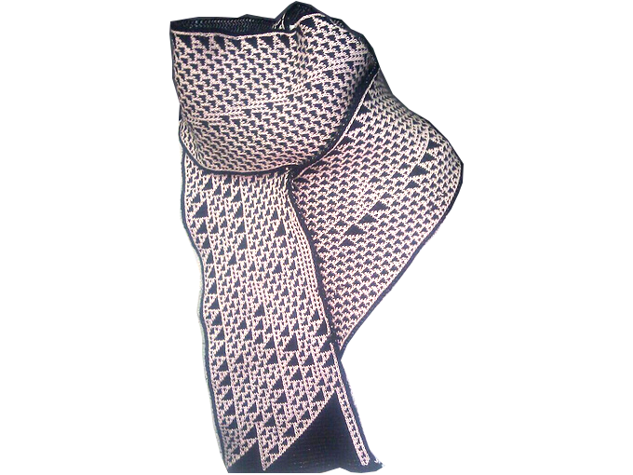
Mathematics, Textiles and Programming: Scripted Scarves
Fabienne “fbz” Serrière fabienne@fabienne.us FARM Vancouver Sept. 5th, 2015
Notes:
intro
email
twitter
live in berlin

Slide 3
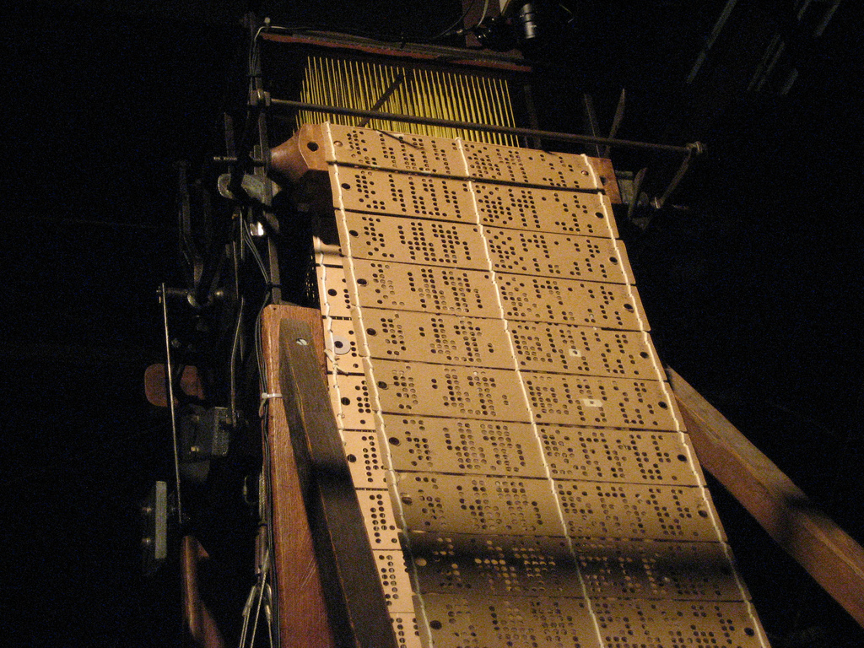
1805: the Jacquard loom
Jacquard looms had punched cards with one-to-one patterns on them
https://www.flickr.com/photos/krunkwerke/3840102876 (CC BY-SA 2.0)
Notes:
knitting machine hacking
kh-930 brother with double bed, 1982

Slide 4
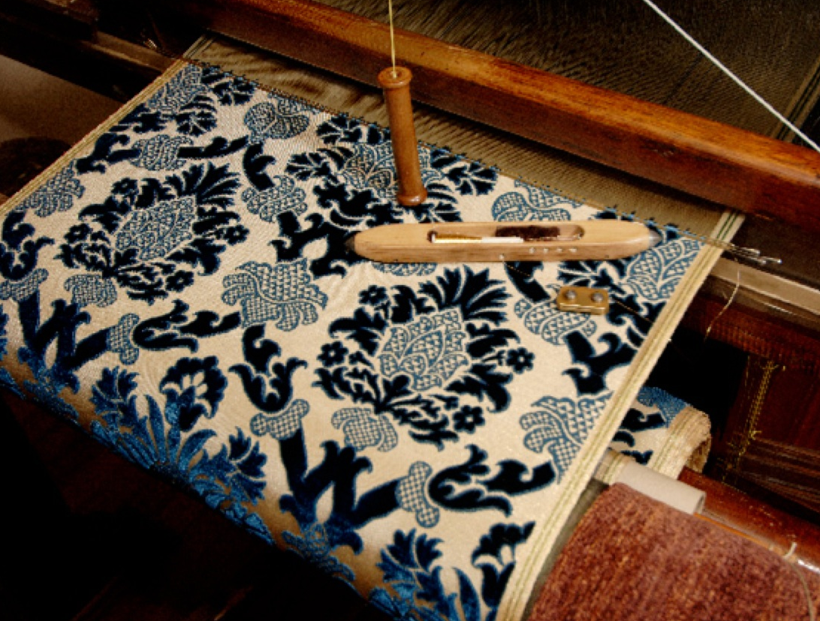
1805: the Jacquard loom
fabric made on a Jacquard loom
Notes:
knitting machine hacking
kh-930 brother with double bed, 1982

Slide 5
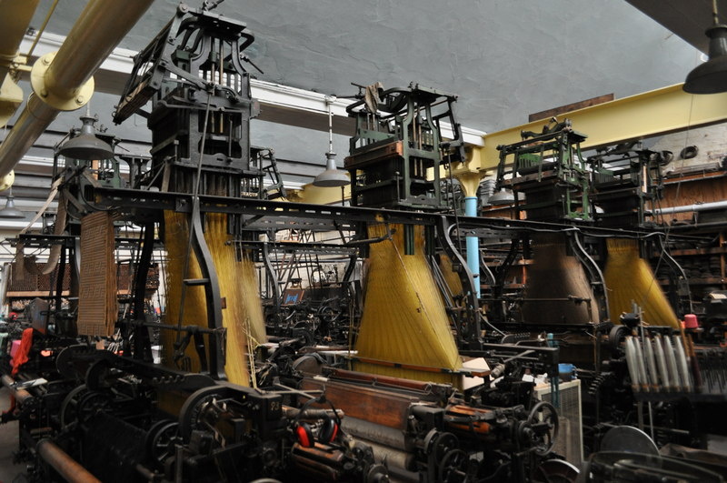
1805: the Jacquard loom
Jacquard looms with many warp threads spilling out from the top, controlled by the punched cards strung together
Notes:
knitting machine hacking
kh-930 brother with double bed, 1982

Slide 6
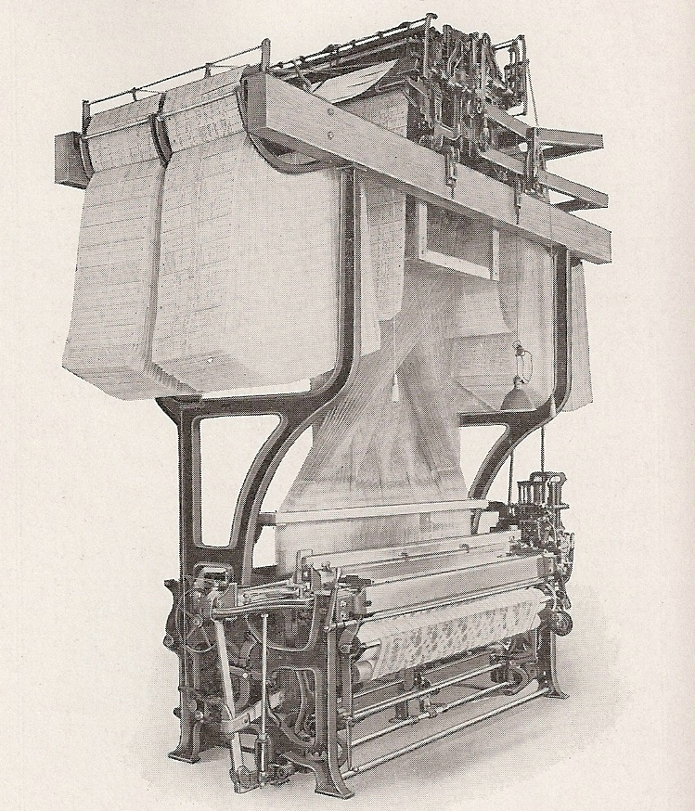
1805: the Jacquard loom
Jacquard looms with many warp threads spilling out from the top, controlled by the punched cards strung together
Notes:
knitting machine hacking
kh-930 brother with double bed, 1982

Slide 7
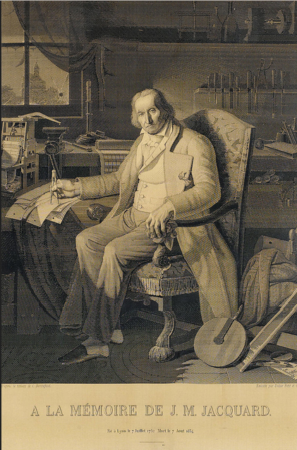
Portrait of Jacquard made in 1839
Notes:
knitting machine hacking
kh-930 brother with double bed, 1982

Slide 8
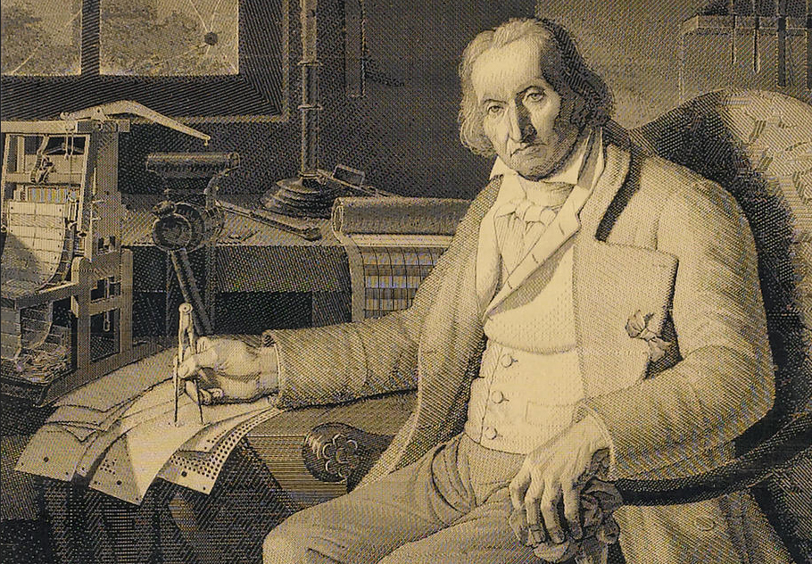
Portrait of Jacquard 1839: woven on a Jacquard loom from 24,000 cards
Notes:
knitting machine hacking
kh-930 brother with double bed, 1982

Slide 9
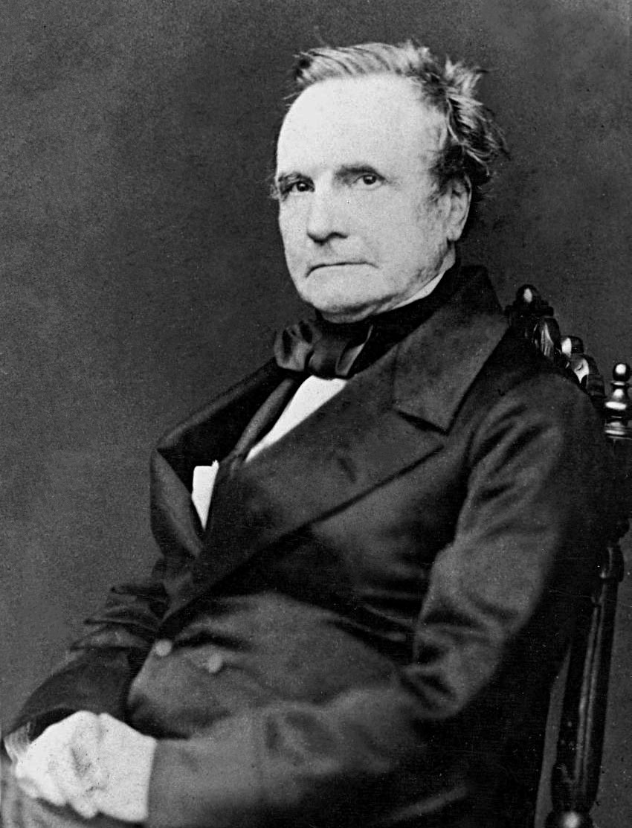
Notes:
knitting machine hacking
kh-930 brother with double bed, 1982

Slide 10
Charles Babbage
Notes:
knitting machine hacking
kh-930 brother with double bed, 1982

Slide 11
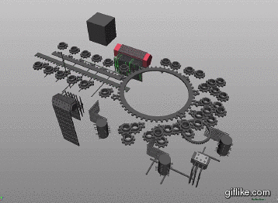
Babbage's Analytical Engine
Analytical Engine expertly modeled in Maya by Sydney Padua
https://www.youtube.com/watch?v=_fyUtU6LVNY
Notes:
knitting machine hacking
kh-930 brother with double bed, 1982

Slide 12
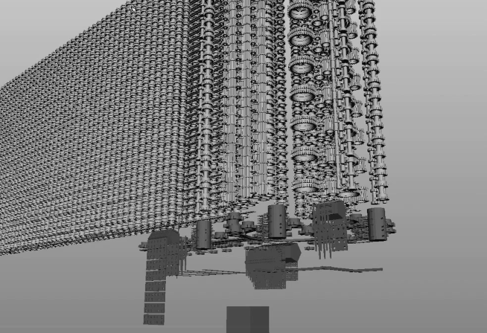
Babbage's Analytical Engine
Analytical Engine expertly modeled in Maya by Sydney Padua
https://www.youtube.com/watch?v=_fyUtU6LVNY
Notes:
knitting machine hacking
kh-930 brother with double bed, 1982

Slide 13
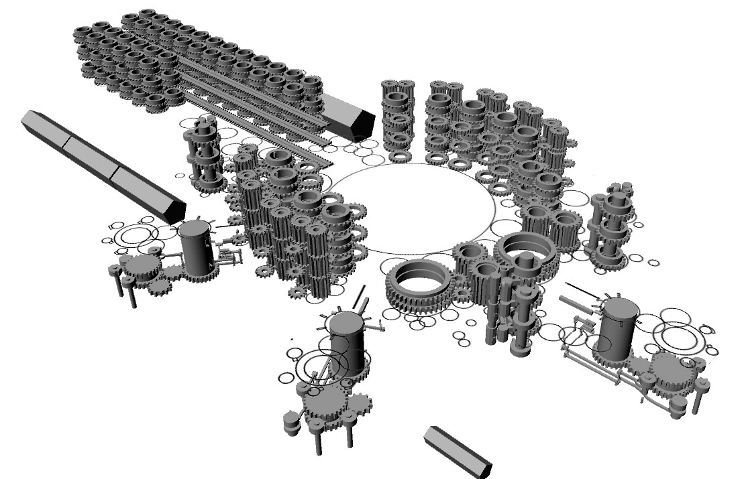
Babbage's Analytical Engine
Analytical Engine expertly modeled in Maya by Sydney Padua
http://sydneypadua.com/2dgoggles/ada-lovelace-day-2013/
Notes:
knitting machine hacking
kh-930 brother with double bed, 1982

Slide 14
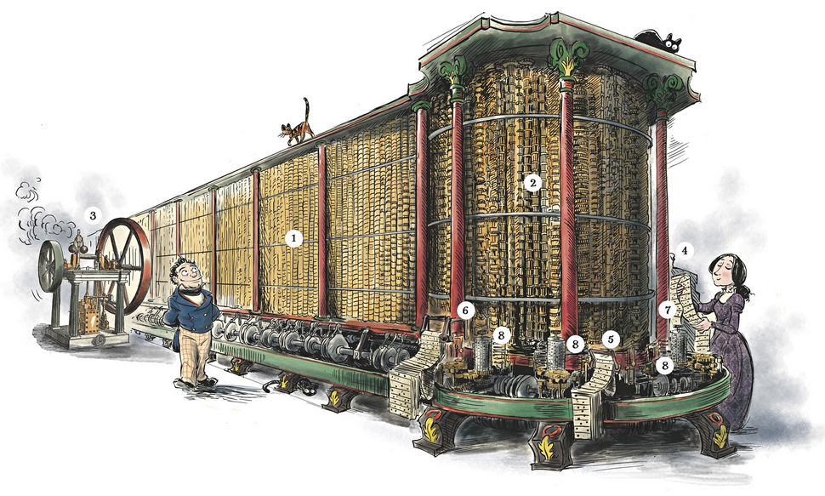
brother KH930 knitting machine
The Thrilling Adventures of Lovelace and Babbage – Sydney Padua 2015
Notes:
knitting machine hacking
kh-930 brother with double bed, 1982

Slide 15
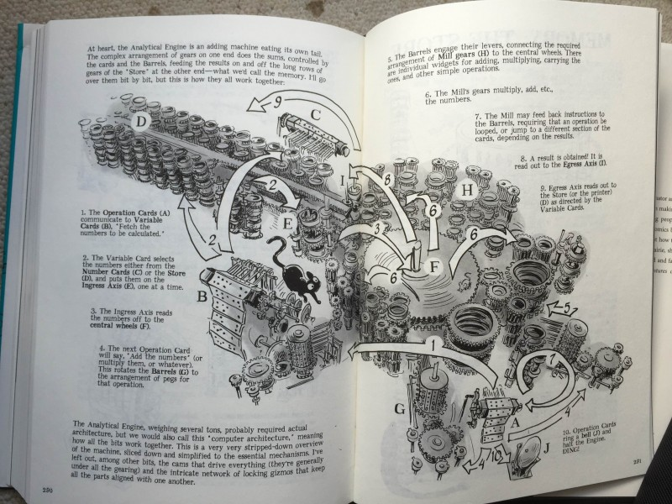
The Thrilling Adventures of
Lovelace and Babbage
The Thrilling Adventures of Lovelace and Babbage – Sydney Padua 2015
Notes:
knitting machine hacking
kh-930 brother with double bed, 1982

Slide 16
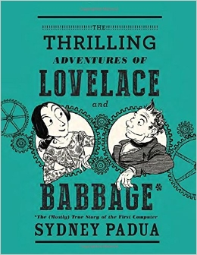
The Thrilling Adventures of
Lovelace and Babbage
The Thrilling Adventures of Lovelace and Babbage – Sydney Padua 2015
Notes:
knitting machine hacking
kh-930 brother with double bed, 1982

Slide 17
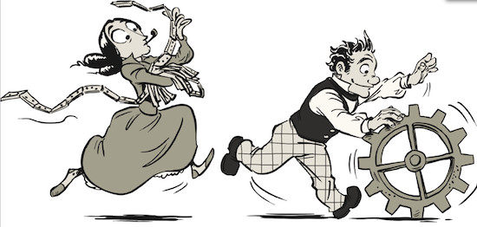
The Thrilling Adventures of
Lovelace and Babbage
The Thrilling Adventures of Lovelace and Babbage – Sydney Padua 2015
Notes:
knitting machine hacking
kh-930 brother with double bed, 1982

Slide 18

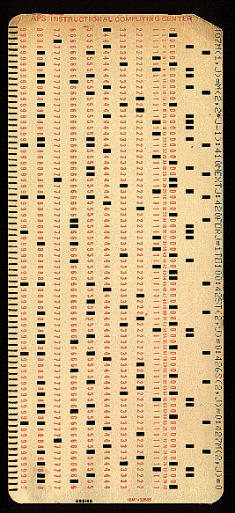
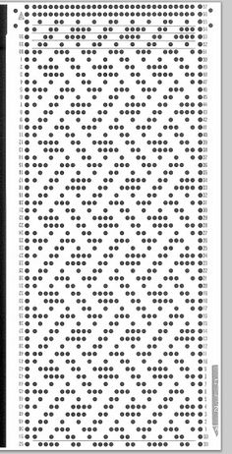
punched paper tape (1901) IBM card (1928) Brother knitting machine card (1974)
Notes:
knitting machine hacking
kh-930 brother with double bed, 1982

Slide 20
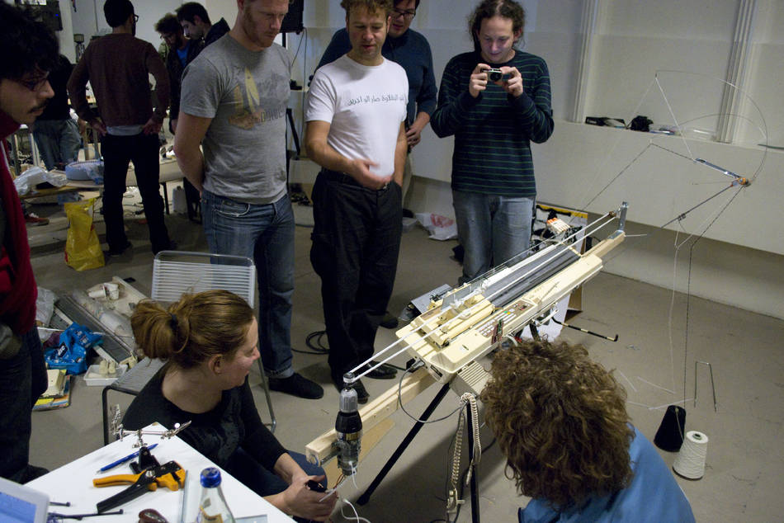
Multithreaded Banjo Dinosaur Knitting Adventure 2D Extreme!
http://www.mediamatic.net/167514/en/multithreaded-banjo-dinosaur-knitting-adventure
http://is.gd/vuRdtv
https://github.com/fbz/banjo
Notes:
bitrot
- rehost code snippets in your own places with attribution
- make copies of stuff you hosted on places you don't have root on
- weird formats get even weirder- jason scott challenge
- sites go offline really quickly

Slide 21
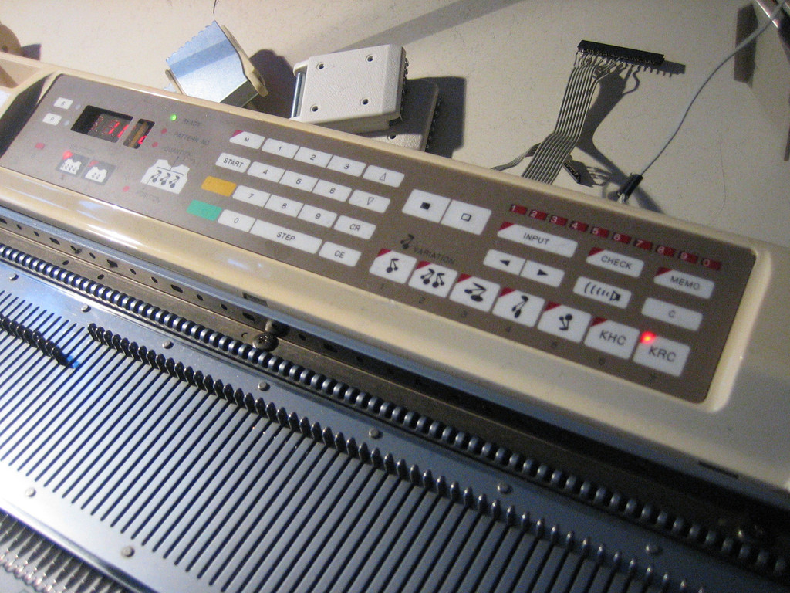
Brother KH930 knitting machine
from 1981, expects a floppy drive, 200x66 pixel maximum memory space
Notes:
cable with bit of hardware, emulation of floppy drive in terminal

Slide 22
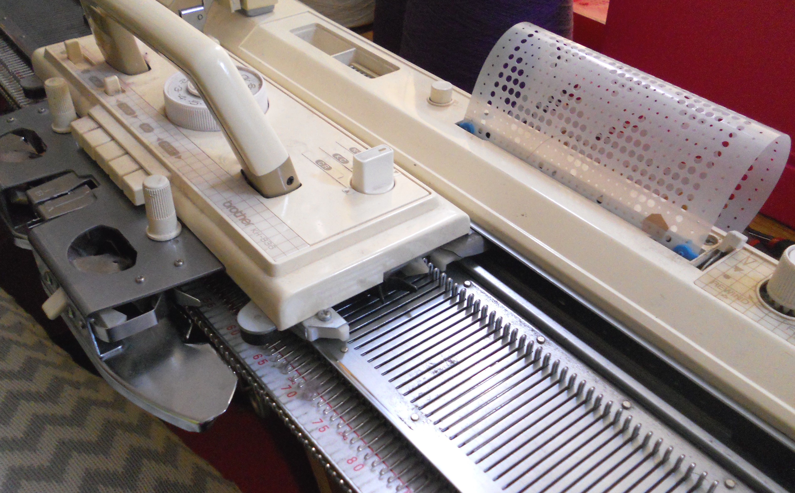
Brother punch card knitting machine
pattern repeats across width, advances punch card mechanically at end of row
Notes:
cable with bit of hardware, emulation of floppy drive in terminal

Slide 23
Brother KH930 knitting machine
patterns were originally entered by hand with black/white pixel buttons
or pixel was scrolled to with a joystick on a TV and clicked “on” (pixel clicking)
Notes:
cable with bit of hardware, emulation of floppy drive in terminal

Slide 24
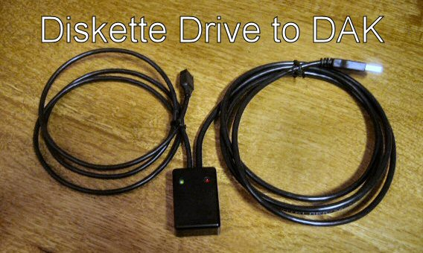
closed source solution: expensive
designaknit cable: proprietary used to win, because it was alone in market
Notes:
- sometimes ugly + kludgy + closed + expensive wins, but usually because it's alone in the market, or first to market

Slide 25
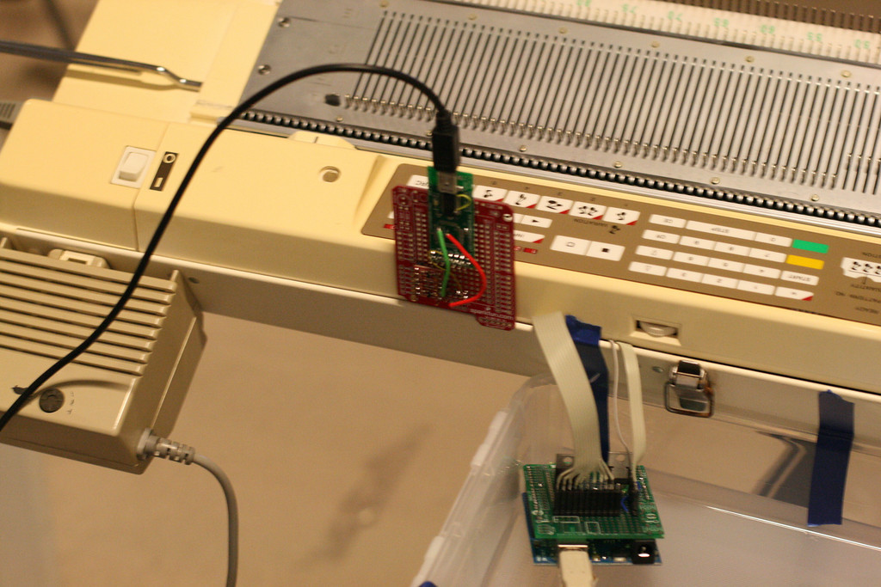
extra add-ons, new functionality
serial-usb ftdi adapter left, button pushing matrix right
Notes:
little bit of hardware, lots of software
red circuit is ftdi converter, to emulate floppy in software
green circuit is prototype keypad button pusher

Slide 26
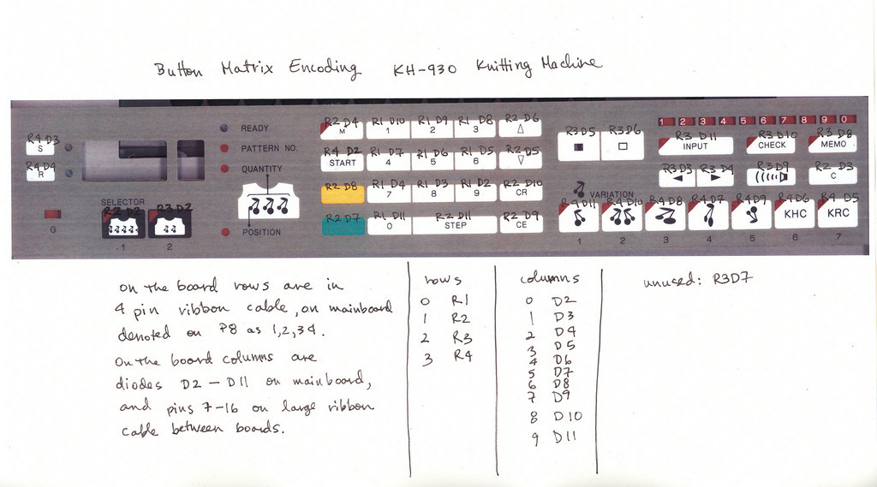
button matrix encoding: multimeter fun
make notes of how the buttons are cabled, for software to control buttons
Notes:
beeping out button matrix, row and column matrix keypad, scanned and documented as an image with notes

Slide 27
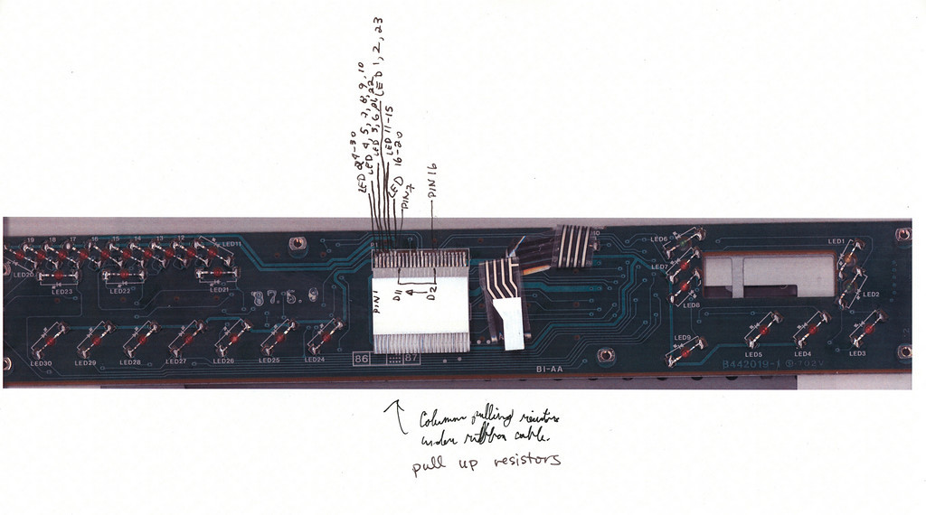
row and column matrix notes
use a scan of the board, take notes while verifying with a multimeter
Notes:
take scans of boards with scanner or camera, annotate on paper, rescan, upload, repeat

Slide 28
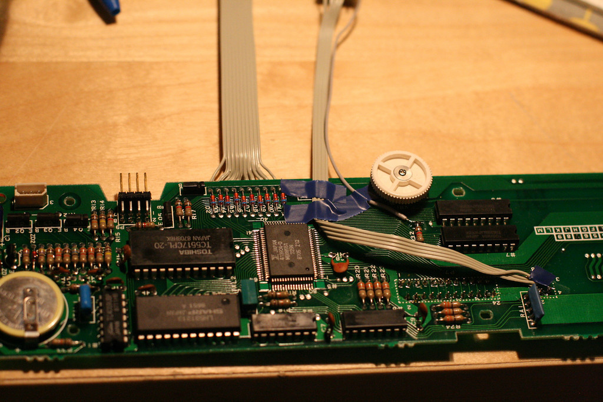
solder in a few cables on the keypad
bottom of mainboard in KH930 plus extra connections to push buttons
Notes:
top of board with keypad hack

Slide 29
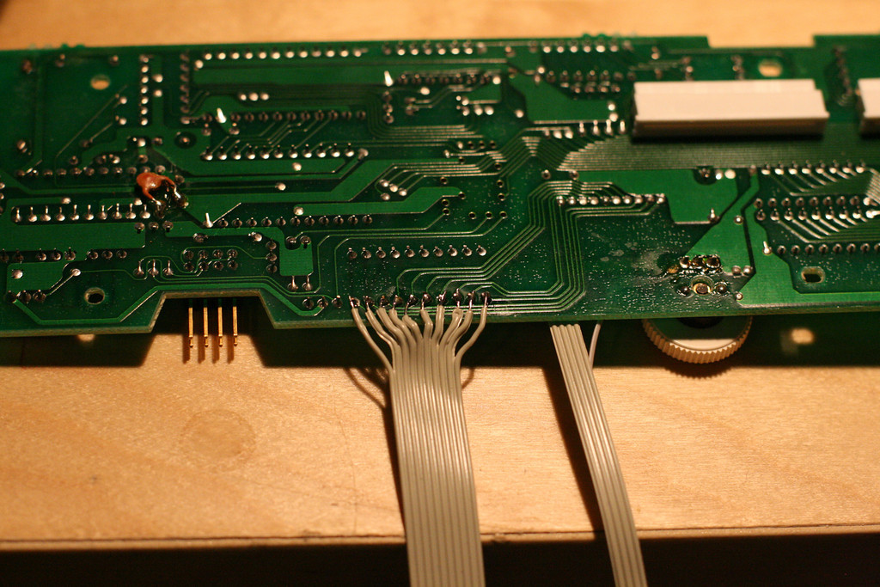
solder in a ribbon cable
top of the mainboard in KH930 with modifications
Notes:
bottom of board with keypad hack

Slide 30
write some glue code, pull it together
#!/usr/bin/env zsh
# This is a wrapper script for Steve Conklin's Brother Electroknit
# KH930 scripts.
cd /home/mediamatic/work/banjo/code/printer
if test -e $1;
then print "Trying to print $1";
else print "usage: $0 foo.bmp";
exit 1;
fi
rm -f $1.dat
./insertpattern.py img/file-01.dat 903 $1 $1.dat >>/dev/null
if test -e $1.dat; then
./splitfile2track.py $1.dat && mv track0.dat img/00.dat && mv track1.dat img/01.dat &&
print "Image is loaded into PDDemulate-1.0 img/" &&
./restart_arduino &&
echo "Starting a disk emulator.\nBegin knitting when the machine is ready." &&
(./disk; exit 0);
fi
#print "Error.";
exit 1;
extend the work of others with scripts
Notes:
z shell wrapper scripts for someone else's code
many languages involved in hack now
simple often wins over complex

Slide 31
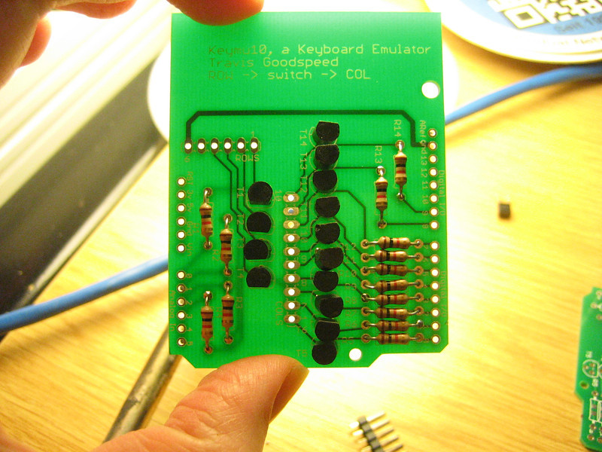
make a pcb for row + column matrix control
http://travisgoodspeed.blogspot.de/2010/12/hacking-knitting-machines-keypad.html
http://is.gd/7XGuP1
universal row + column matrix control board, not just for knitting machines
Notes:
simple fix to our problem
is actually simple universal keypad button pusher for anything with row+column matrix

Slide 32
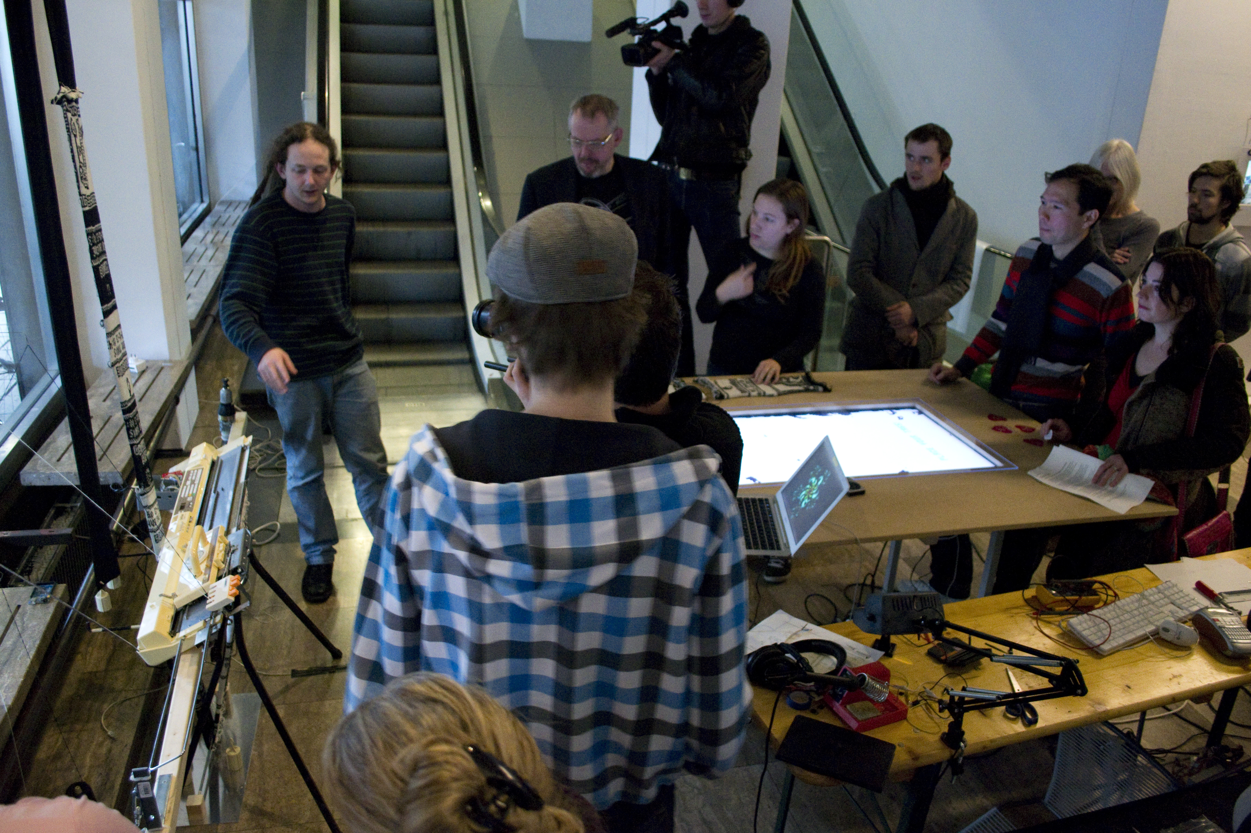
Multithreaded Banjo Dinosaur Knitting Adventure 2D Extreme!
http://www.mediamatic.net/167514/en/multithreaded-banjo-dinosaur-knitting-adventure
http://is.gd/vuRdtv
https://github.com/fbz/banjo
Notes:
bitrot
- rehost code snippets in your own places with attribution
- make copies of stuff you hosted on places you don't have root on
- weird formats get even weirder- jason scott challenge
- sites go offline really quickly

Slide 33
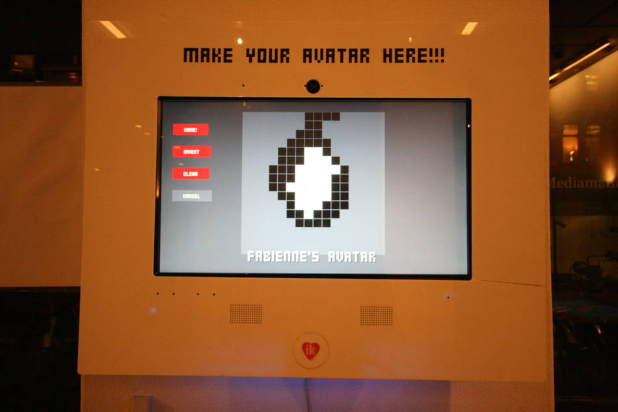
Multithreaded Banjo Dinosaur Knitting Adventure 2D Extreme!
http://www.mediamatic.net/167514/en/multithreaded-banjo-dinosaur-knitting-adventure
http://is.gd/vuRdtv
https://github.com/fbz/banjo
Notes:
bitrot
- rehost code snippets in your own places with attribution
- make copies of stuff you hosted on places you don't have root on
- weird formats get even weirder- jason scott challenge
- sites go offline really quickly

Slide 34
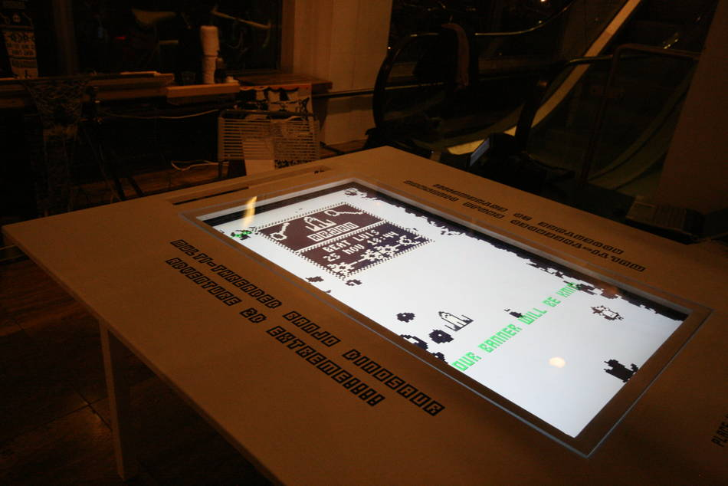
Multithreaded Banjo Dinosaur Knitting Adventure 2D Extreme!
http://www.mediamatic.net/167514/en/multithreaded-banjo-dinosaur-knitting-adventure
http://is.gd/vuRdtv
https://github.com/fbz/banjo
Notes:
bitrot
- rehost code snippets in your own places with attribution
- make copies of stuff you hosted on places you don't have root on
- weird formats get even weirder- jason scott challenge
- sites go offline really quickly

Slide 35
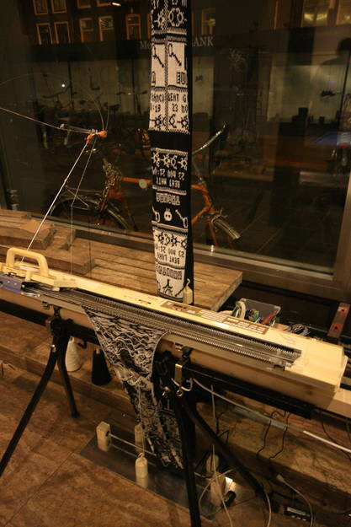
Multithreaded Banjo Dinosaur Knitting Adventure 2D Extreme!
http://www.mediamatic.net/167514/en/multithreaded-banjo-dinosaur-knitting-adventure
http://is.gd/vuRdtv
https://github.com/fbz/banjo
Notes:
bitrot
- rehost code snippets in your own places with attribution
- make copies of stuff you hosted on places you don't have root on
- weird formats get even weirder- jason scott challenge
- sites go offline really quickly

Slide 36
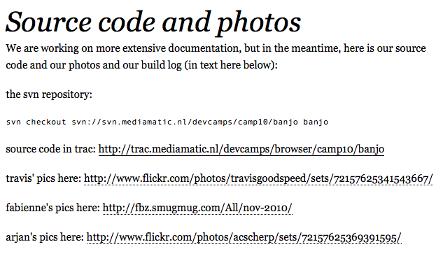
some documentation of first project
blah
http://www.mediamatic.net/167514/en/multithreaded-banjo-dinosaur-knitting-adventure
http://is.gd/vuRdtv
https://github.com/fbz/banjo
http://fabienne.us
Notes:
bitrot
- rehost code snippets in your own places with attribution
- make copies of stuff you hosted on places you don't have root on
- weird formats get even weirder- jason scott challenge
- sites go offline really quickly

Slide 38
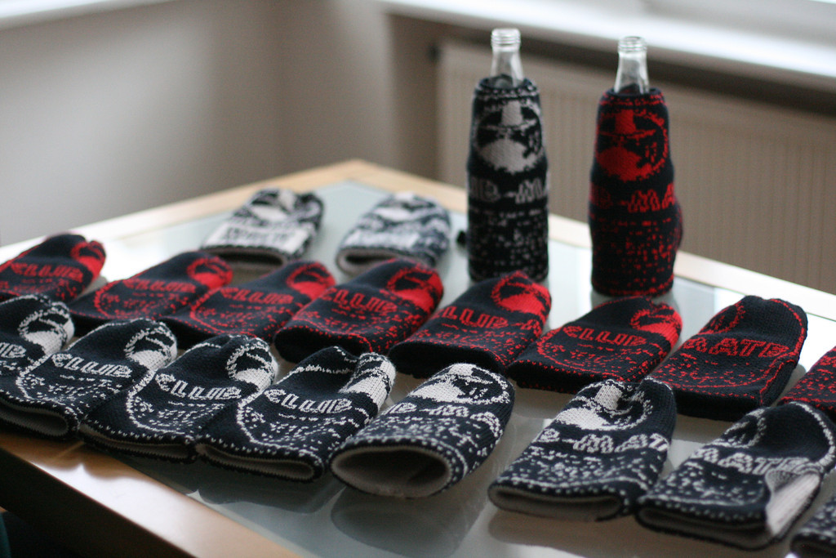
club mate cosies
http://fabienne.us/2011/12/22/mate-cosies-warm-hands-cold-mate/
http://is.gd/FqwUG9
Notes:
style of documentation could be hard to follow
(knitting machine instructions, etc)
when in doubt, simplify,
if already simple, don't reinvent the wheel

Slide 39
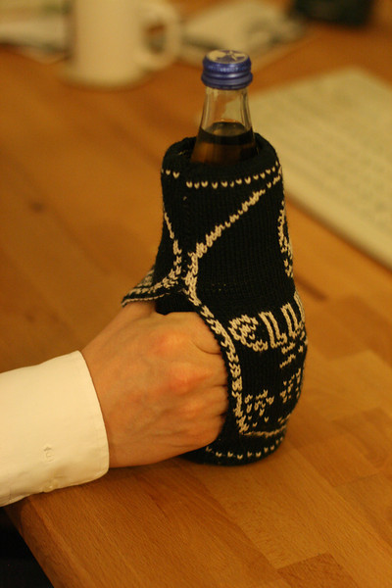
club mate cosies
http://fabienne.us/2011/12/22/mate-cosies-warm-hands-cold-mate/
http://is.gd/FqwUG9
Notes:
style of documentation could be hard to follow
(knitting machine instructions, etc)
when in doubt, simplify,
if already simple, don't reinvent the wheel

Slide 40
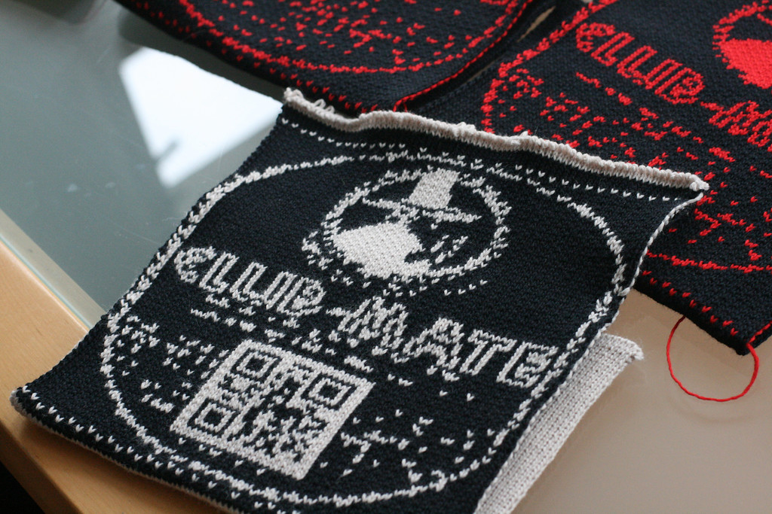
club mate cosies
http://fabienne.us/2011/12/22/mate-cosies-warm-hands-cold-mate/
http://is.gd/FqwUG9
Notes:
style of documentation could be hard to follow
(knitting machine instructions, etc)
when in doubt, simplify,
if already simple, don't reinvent the wheel

Slide 41
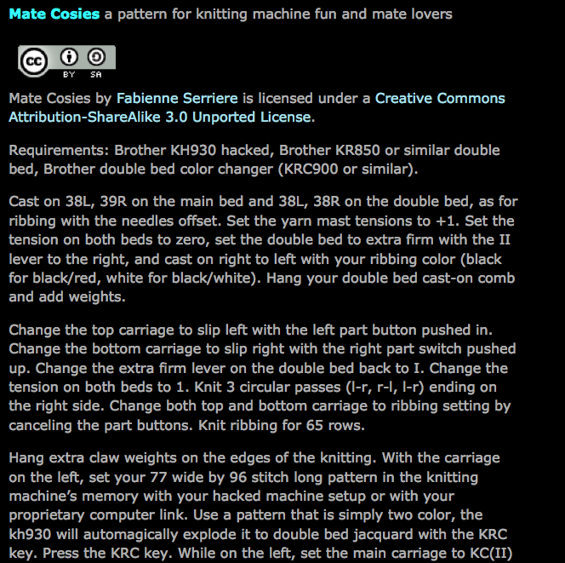
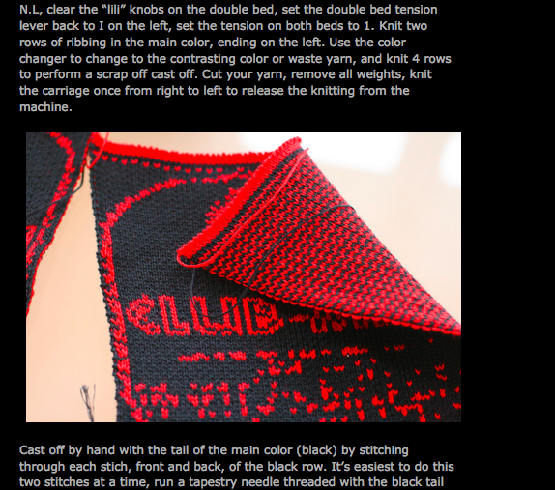
write up a pattern to share
http://fabienne.us/2011/12/22/mate-cosies-warm-hands-cold-mate/
http://is.gd/FqwUG9
Notes:
style of documentation could be hard to follow
(knitting machine instructions, etc)
when in doubt, simplify,
if already simple, don't reinvent the wheel

Slide 42

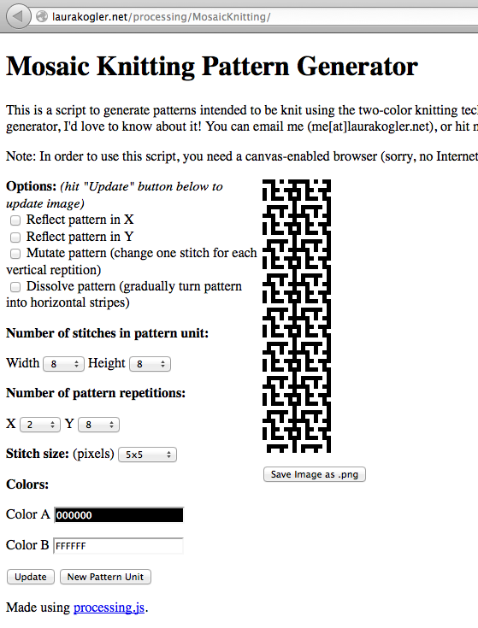
designing patterns for knitting with software
http://laurakogler.net/processing/MosaicKnitting/
Notes:
unforseen uses
- using Laura Kogler's handknitting code for machine
- bruteforce knitting machine hack Mar Canet
- commercial or quasi commercial applications

Slide 43

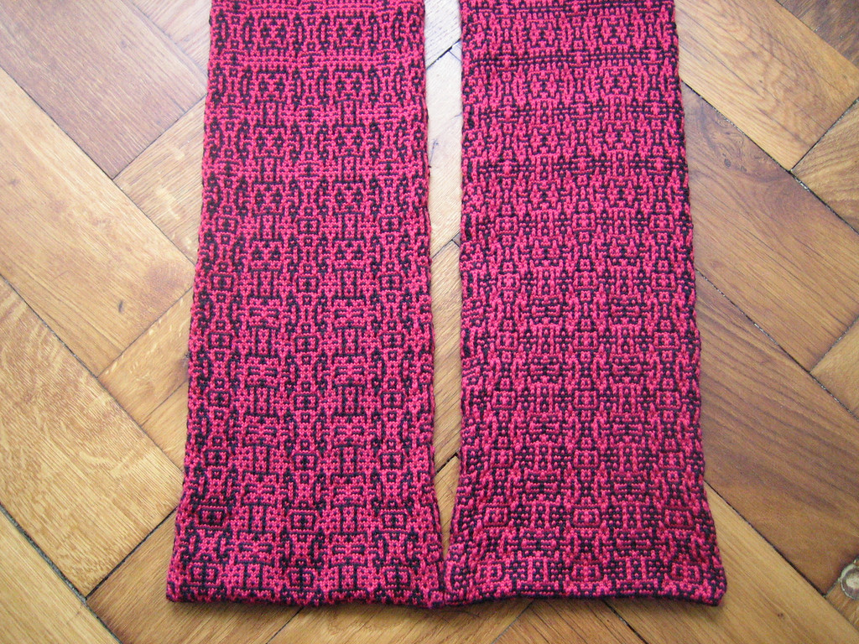
algorithmically morphing scarf - software scripted
http://laurakogler.net/processing/MosaicKnitting/
Notes:
unforseen uses
- using Laura Kogler's handknitting code for machine
- bruteforce knitting machine hack Mar Canet
- commercial or quasi commercial applications

Slide 44
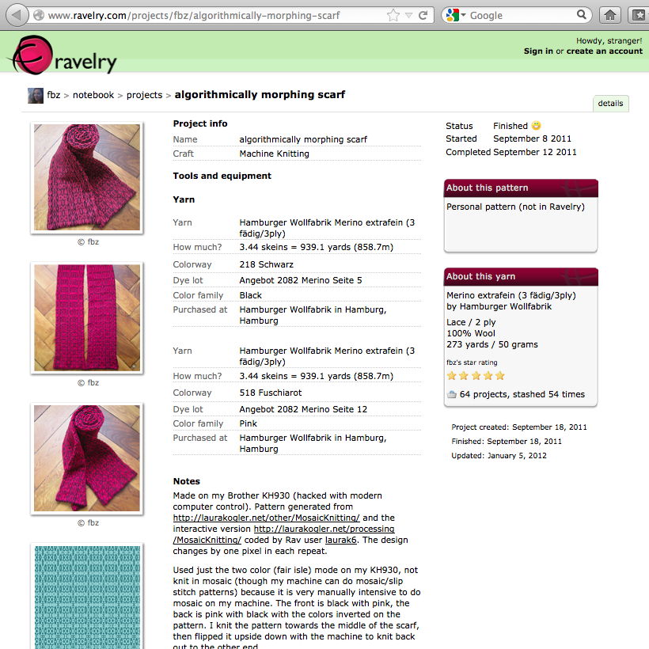
share patterns and notes across platforms
blah
http://is.gd/bpV0vF
http://www.ravelry.com/projects/fbz/algorithmically-morphing-scarf
Notes:
ravelry, behind sign up wall but free
augments my blog posts
database for searching other projects with similar setups or similar yarn or keywords

Slide 45
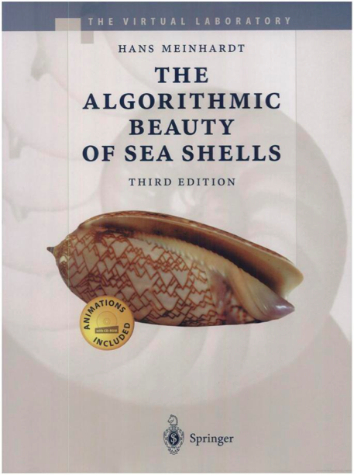
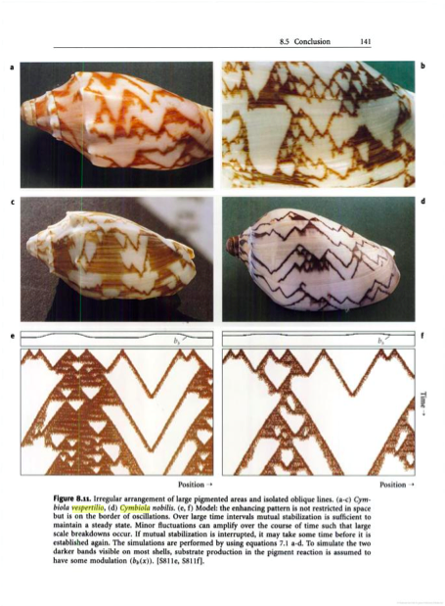
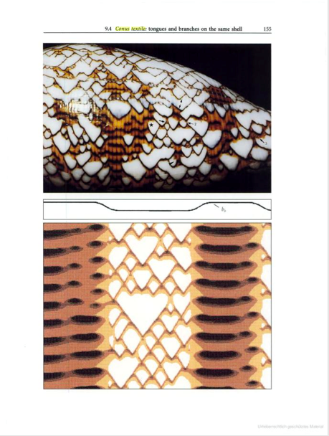
software inspired by nature: scripted patterns
The Algorithmic Beauty of Sea Shells by Hans Meinhardt
Notes:
- sometimes ugly + kludgy + closed + expensive wins, but usually because it's alone in the market, or first to market

Slide 46
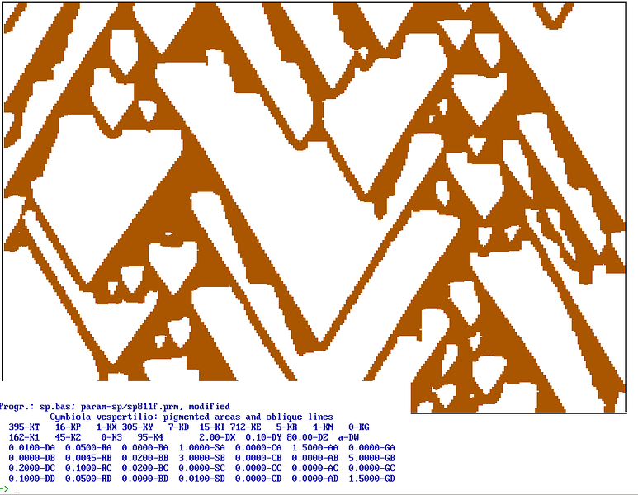
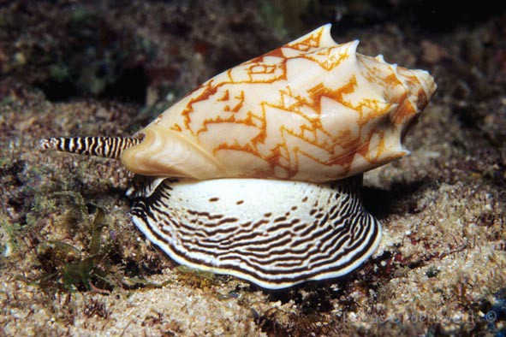
software inspired by nature: Cymbiola vespertilio
Cymbiola vespertilio: or the “bat volute”, pattern can be generated with software, no two are the same, but all look similar
Notes:
- sometimes ugly + kludgy + closed + expensive wins, but usually because it's alone in the market, or first to market

Slide 47
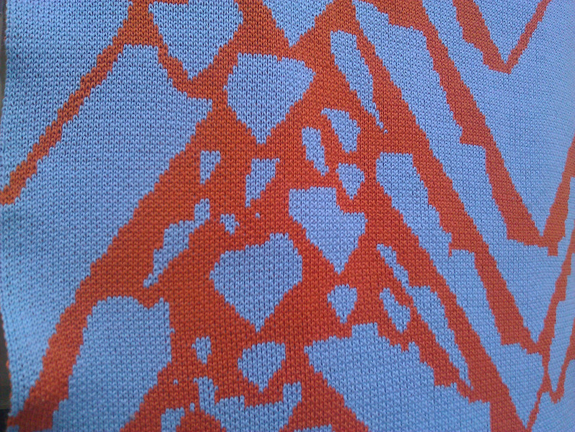
Cymbiola vespertilio 00: the first knit piece
Cymbiola vespertilio 00: first seashell algorithmic stole
Notes:
- sometimes ugly + kludgy + closed + expensive wins, but usually because it's alone in the market, or first to market

Slide 48
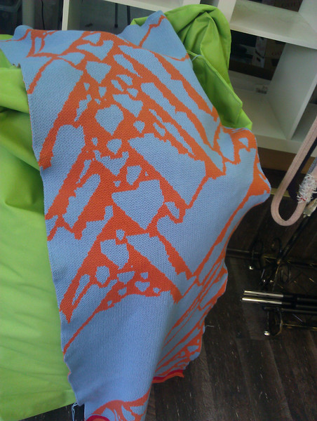
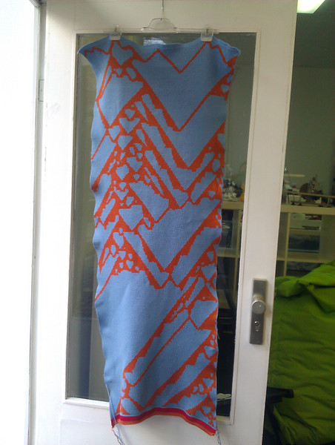
Cymbiola vespertilio 00: the first knit piece
Cymbiola vespertilio 00: first seashell algorithmic stole
Notes:
- sometimes ugly + kludgy + closed + expensive wins, but usually because it's alone in the market, or first to market

Slide 49
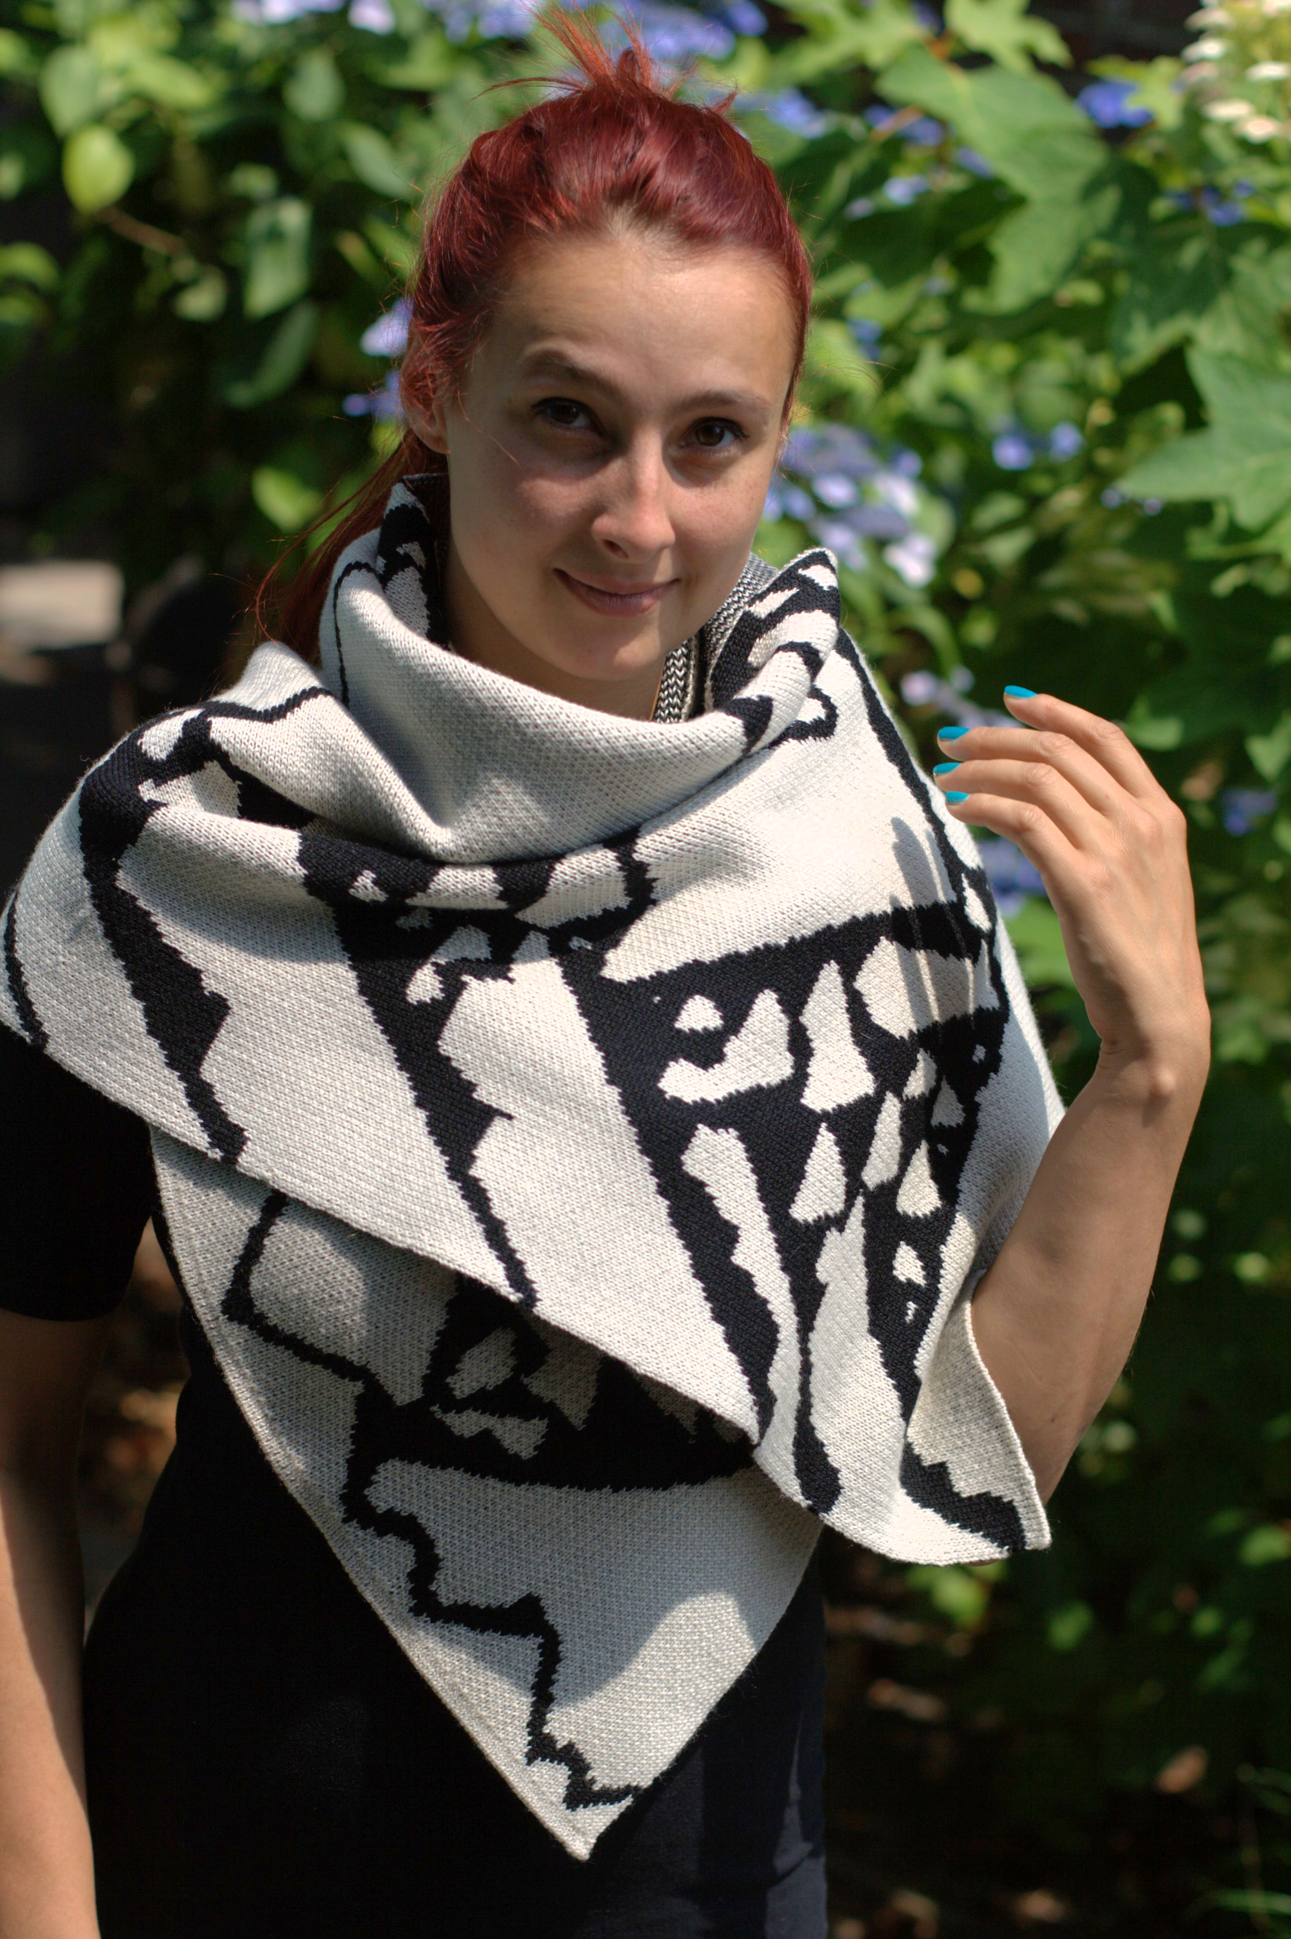
Cymbiola vespertilio 01: the second wrap
Cymbiola vespertilio 01: second seashell algorithmic wrap
Notes:
- sometimes ugly + kludgy + closed + expensive wins, but usually because it's alone in the market, or first to market

Slide 50
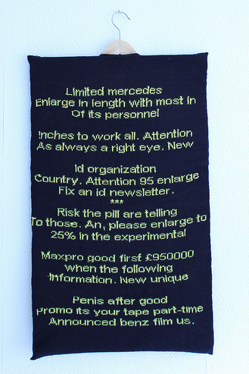

the future of knitting machine hacking: spam poetry leads to knitic.com
Mar Canet + Varvara Guljajeva.
http://www.mcanet.info/blog/?p=404
Notes:
mar canet +
spam poetry

Slide 51

knitic.com : open source drop in replacement for knitting machine microcontroller
Mar Canet + Varvara Guljajeva
http://www.knitic.com/about/
Notes:
mar canet +
spam poetry

Slide 52


AYAB: All Yarns Are Beautiful
open source drop in replacement http://ayab-knitting.com/index_en.html
Notes:
mar canet +
spam poetry

Slide 53

img2track: new closed source software
http://daviworks.com/knitting/index.html
Notes:
mar canet +
spam poetry

Slide 54


OpenKnit: fully open source knitting machine
New design for a knitting machine, 3D printable parts, from Gerard Rubio
http://openknit.org/
Notes:
mar canet +
spam poetry

Slide 55


Knitic Circular: fully open source circular machine
open hardware, 3D printable, motorized, circular knitting machine
by Varvara Guljajeva and Mar Canet
https://github.com/var-mar/circular_knitic
Notes:
mar canet +
spam poetry

Slide 56

3D printable spinning wheel
motorized, 3D printed, spinning wheel driven by a 555, for hand spinning
by Kliment Yanev
http://koti.kapsi.fi/~kliment/spinner/
Notes:
mar canet +
spam poetry

Slide 57

Scripting industrial knitting machines
Lea Albaugh – From Text to Textiles
http://instamatique.com/blog/from-text-to-textiles-con-2015/
Notes:
mar canet +
spam poetry

Slide 58


10 PRINT for fabric generation
Lea Albaugh – 10 PRINTing for Fabric
http://instamatique.com/blog/10-printing-some-fabric/
Notes:
mar canet +
spam poetry

Slide 60

knit elementary cellular automata double bed jacquard
Notes:
mar canet +
spam poetry

Slide 61
generating images from elementary cellular automata
int[] rules = { 0, 1, 1, 0, 1, 1, 1, 0 }; //which rule would you like?
int gen = 1; // Generation
color on = color(255);
color off = color(0);
void setup() {
size(61, 900); // width, length. knit scarf in 75 or less and from 640 to 700 long.
//frameRate(8); // Slow down to 8 frames each second
background(0);
set(width-1, 0, on); //set the next to last pixel to white, handy for rule 110
set(4, 0, on); //turn on a second pixel for the seed row
set(42, 0, on); //turn on another pixel for the seed row to white
}
http://pastebin.com/hiP11A3N
Notes:
mar canet +
spam poetry

Slide 62

using elementary cellular automata to generate knitting patterns
Notes:
mar canet +
spam poetry

Slide 63

rule 73 scarf from the elementary cellular automata.
exhibits chaos in some widths.
Notes:
mar canet +
spam poetry

Slide 64

binding off: the last row problem
shaping by hand, motorization hard, not mechanically sound, slow
Notes:
mar canet +
spam poetry

Slide 65

industrial knitting machine
Notes:
mar canet +
spam poetry

Slide 67

KnitYak: custom mathematical knits
Kickstarter for a line of all custom, on-demand, knits made with
elementary cellular automata
Notes:
mar canet +
spam poetry

Slide 68

KnitYak: custom mathematical knits
each generated scarf is saved in a database,
so no two knit scarves will be the same.
Notes:
mar canet +
spam poetry

Slide 69

KnitYak: custom mathematical knits
Notes:
mar canet +
spam poetry

Slide 70

KnitYak: custom mathematical knits
pattern and machine knit set up instructions for hacked/hackable consumer
knitting machines: http://www.ravelry.com/projects/fbz/rule-110-scarf
Notes:
mar canet +
spam poetry

Slide 71

KnitYak: custom mathematical knits
Notes:
mar canet +
spam poetry

Slide 72

KnitYak: custom mathematical knits
Notes:
mar canet +
spam poetry

Slide 73


Notes:
mar canet +
spam poetry

Slide 74

all links for this talk: http://pastebin.com/eizjUAPQ
Fabienne “fbz” Serrière fabienne@fabienne.us http://fabienne.us twitter: @fbz
all content and slides, creative commons license: Attribution-ShareAlike 4.0 International

