Slide 1
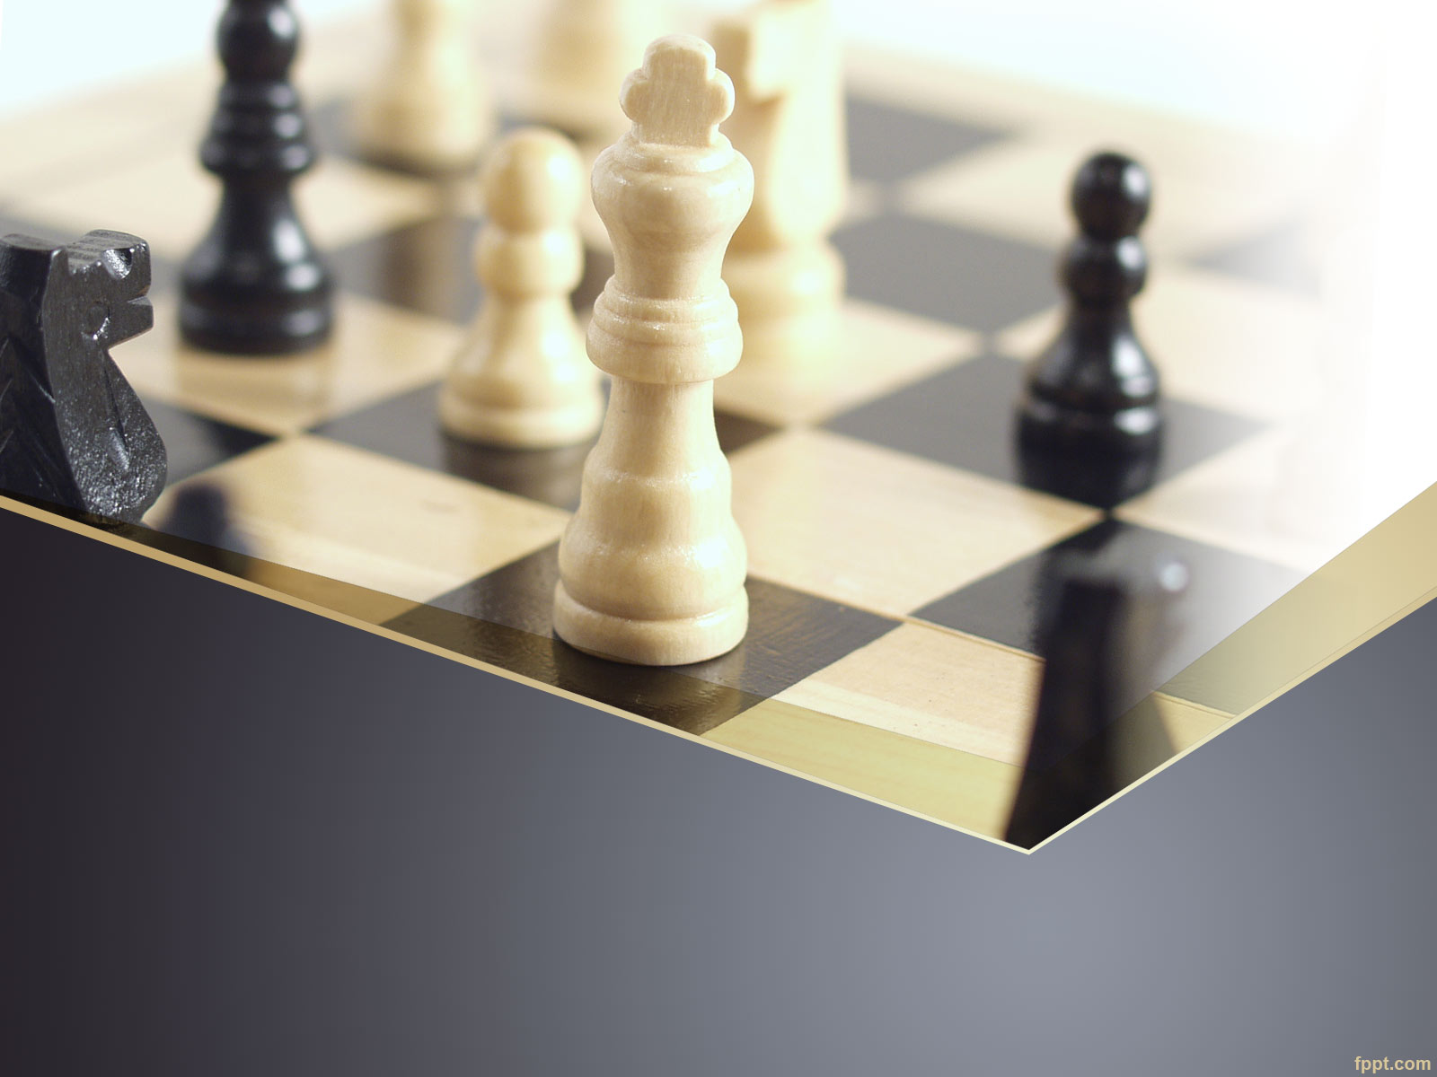
Chess App: Architecture
The SLACKERS: Kousei Richeson, George Torres, Gilbert Carrilllo

Slide 2

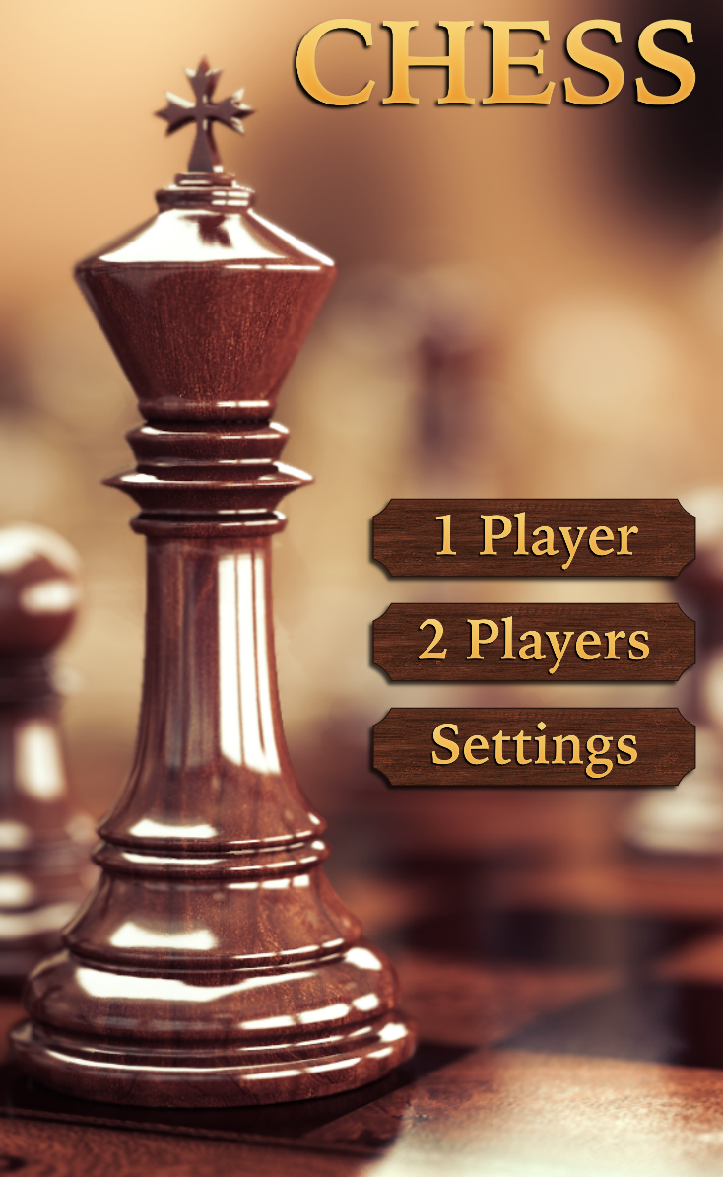
Chess iOS App Overview
Our application is a mobile edition of the popular game chess!
Two different game modes
3D model
Background music
AI implementation

Slide 3

Architectural drivers
Event style processing of data
Interaction between multiple classes
Use of reusable components
Object inheritance
Don’t need to connect the user to the internet, server or database
Needed an architecture that supports an interactive user interface
Simple and Effective

Slide 4
Architectural Choices
Pipe & Filter
Layering
Event-Driven
We can reuse filters for other pipes
Ease of development
Adding components is as simple as “changing the filter.”
Works well locally
Simple and easy organization
Event generator
Even handler
CPU will handle next event based on users chess move
We decided to utilize the Pipe & Filter architectural style, due to it better showing how we want to design the game and how we want the game to function. Another reason is because Xcode doesn't’t support layering well.

Slide 5
Our Architecture
2 PLAYER
PLAYER1 TURN
PLAYER2 TURN
HOME
1 PLAYER
PLAYER1 TURN
AI MOVE
SETTINGS

Slide 6
Conclusion
Pipe & Filter style was chosen to better match our design ideals.
Issues: Game Loop
Risks: Scaling issues if there are too many pipes and filters.
QUESTIONS?

