Slide 1
IBM Data Science Professional Certificate Capstone Project
The Battle of Neighborhoods

Slide 2
Introduction: Business Problem
Istanbul = Population of approximately 15 million people in the metropolitan area and world's fourteenth largest city
Despite such a crowded city, vegetarian or vegan individuals may find it difficult to find vegetarian or vegan restaurants.
The questions we want to answer at the end of the project are:
Which districts in Istanbul have vegetarian or vegan restaurants?
What are the number of restaurants by district?
What are the popular districts for someone who wants to open a new restaurant, taking into account district populations and restaurant numbers?

Slide 3
Data
Based on definition of our problem, factors that will influence our decisions are:
number of existing restaurants in the borough (vegetarian or vegan)
population of borough
which boroughs have restaurants
Following data sources will be needed to extract/generate the required information:
The dataset which can be reached at https://geo.nyu.edu/catalog/stanford-nj696zj1674, contains all the cities and borough lists of Turkey and information on the location of these cities and towns.
Total population, female and male population percentages data of all these boroughs to the boroughs data. We can access the population data for 2018 boroughs at https://www.nufusu.com/ilceleri/istanbul-ilceleri-nufusu.

Slide 4
Using Geopy web service, location information of Istanbul was obtained
Folium and districts of Istanbul, restaurants in districts and clusters obtained as a result of k-means are shown on the map
Population information was obtained from the website with BeautifulSoup
Restaurant information around coordinates determined with GoogleMaps Place API

Slide 5
Methodology and Analysis
Find boroughs and locations of İstanbul
Find all vegetarian restaurants in a specified area (1km from each borough)
Find all vegan restaurants in a specified area
Get restaurant counts by each borough
Cluster the data with K-Means according to the population of boroughs
Evaluate the number of restaurants by clusters

Slide 6
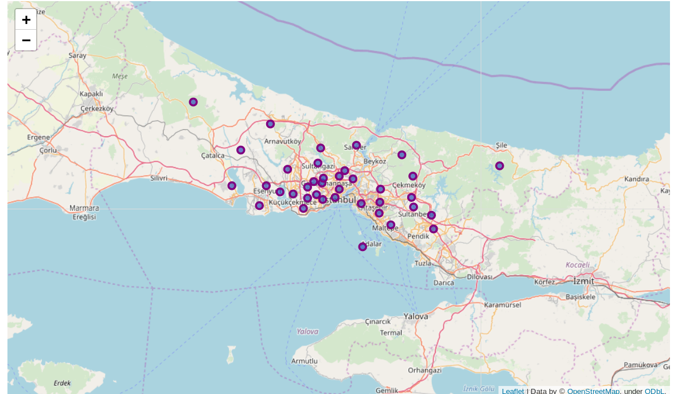
38 boroughs of İstanbul

Slide 7
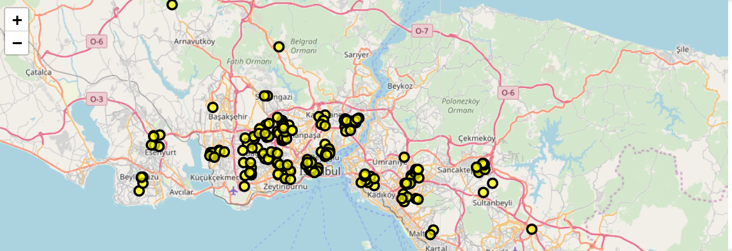
For each district 1km (walking distance) from the district coordinates of the vegetarian (total 197) and vegan restaurants (total 34) located in areas separately obtained by combining information (total 218).

Slide 8
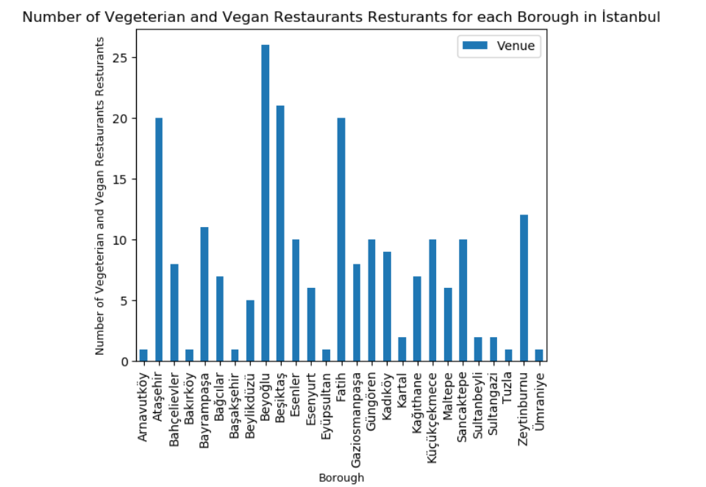
The numbers of restaurants found in each district were obtained. It was reached that 27 of 38 districts had vegetarian or vegan restaurants.

Slide 9
Then k-means clustering was applied with k = 4 in the dataset. 4 clusters were obtained with the following characteristics;
Cluster0: population between 16K and 72K, 30 venues
Cluster1: population between 181K and 342K, 48 venues
Cluster2: population between 383K and 594K, 121 venues
Cluster3: population between 690K and 891K, 18 venues

Slide 10
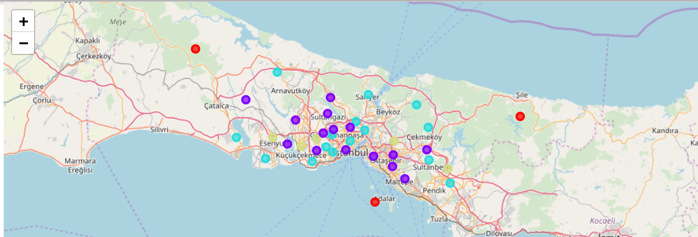
Clusters

Slide 11
Results And Discussion
Cluster0: population between 16K and 72K, 30 venues
Cluster1: population between 181K and 342K, 48 venues
Cluster2: population between 383K and 594K, 121 venues
Cluster3: population between 690K and 891K, 18 venue
Starting from here; Cluster3 includes the 5 most populated regions in Istanbul. However, there are only 18 vegetarian or vegan restaurants. Cluster0; Unlike Cluster3, it contains 3 regions with the least population. The total population of the regions in this cluster is not as large as a region in Cluster3. However, there are 30 restaurants in this area.
From here; we can say that the number of vegetarian or vegan restaurants in the regions where population density is low is due to the socioeconomic and sociocultural structures of the people living in that region.

Slide 12
Conclusion
This project answers the following questions;
What is the best location in Istanbul for vegan or vegetarian Cuisine?
Which areas have potential vegan or vegetarian restaurant?
Which areas in İstanbul lack vegan or vegetarian?

