Slide 1

Fundamentals of AI in Manufacturing (FAIM) Digitization and Encodings Lecturers: Abhilash Puthanveettil Madathil, PhD Olga Bylya, PhD Applied Industrial Intelligence (AI²) NMIS

Slide 2
Contents
Encoding techniques
Digitization + regression

Slide 3
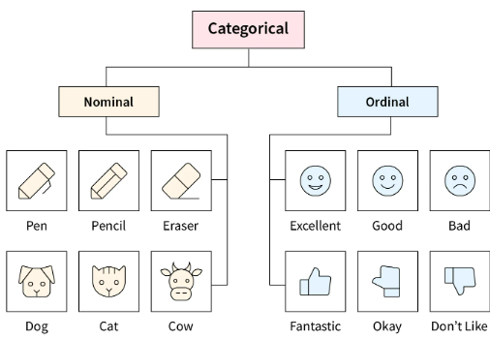
Encoding
Process of transforming raw data into a numerical format that machine learning models can understand and process. This involves converting various data types, such as text, images, and categorical variables, into numerical representations like vectors

Slide 4
Common Encoding Techniques
One-Hot Encoding: Converts each category in a nominal feature (like "colour") into a new binary (0 or 1) column. This is useful for data without an inherent order, such as a "city" column.
Frequency Encoding: Replaces categorical values with their frequency or count of occurrences in the dataset, transforming them into a numerical format that machine learning models can process
Ordinal Encoding: Assigns a unique integer to each category in an ordered feature (like "low," "medium," "high"), maintaining the inherent order.
Target/mean Encoding: Replaces categories with the average target value of that category, which is helpful for high-cardinality features (features with many unique values).
Embeddings: For text data, these techniques, like Word2Vec or BERT, capture deeper semantic relationships between words, representing them as numerical vectors in a multi-dimensional space.

Slide 5
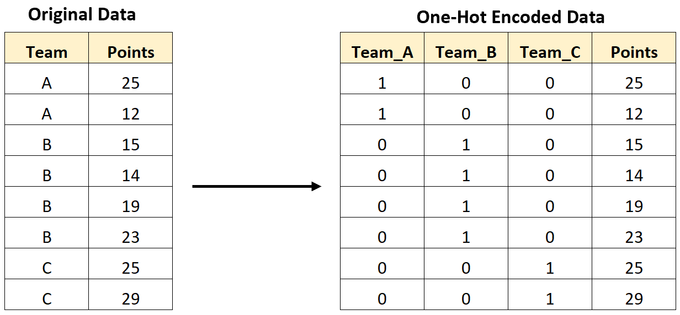
One hot encoding
Team column has 3 categories: A, B or C
Column Team → 3 columns ???

Slide 6
Frequency Encoding
Frequency encoding (or count encoding) is a simple categorical encoding technique where each category is replaced by its frequency of occurrence in the dataset.
More frequent categories receive higher values and vice versa
Customer | City
C1 | London
C2 | Paris
C3 | London
C4 | Berlin
C5 | London
C6 | Paris
Customer | City_Freq
C1 | 3
C2 | 2
C3 | 3
C4 | 1
C5 | 3
C6 | 2
City | Frequency
London | 3
Paris | 2
Berlin | 1

Slide 7
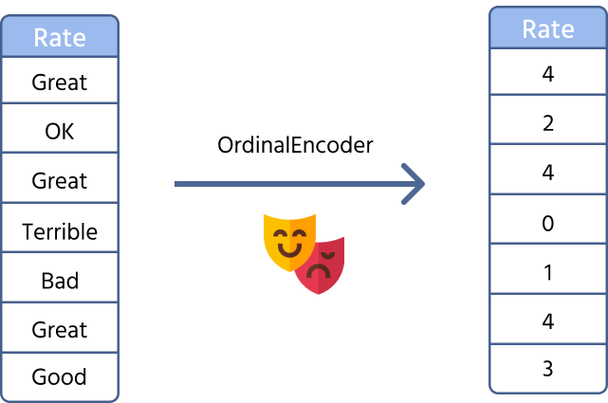
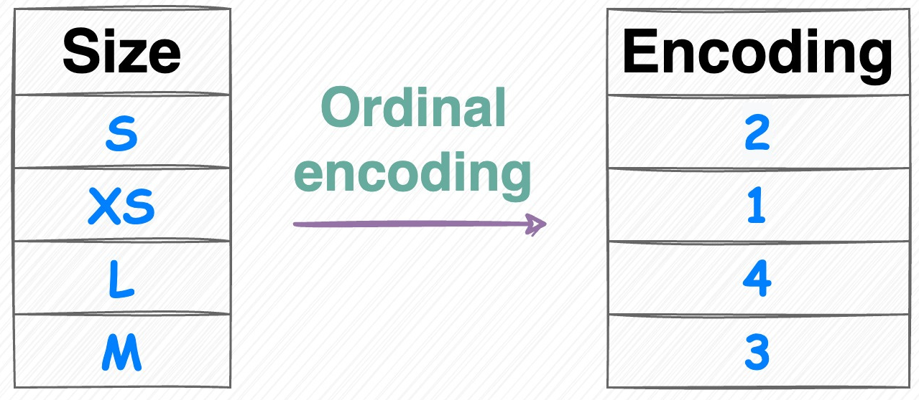
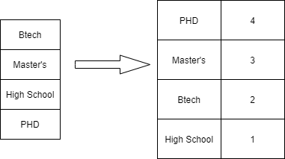
Ordeal encoding

Slide 8
Mean Encoding
House_ID | Neighborhood | Price ($1000s)
1 | A | 250
2 | B | 180
3 | C | 210
4 | A | 270
5 | B | 190
6 | C | 230
7 | A | 260
8 | C | 200
House_ID | Neighborhood | Price | Mean Encoded Neighborhood
1 | A | 250 | 260.0
2 | B | 180 | 185.0
3 | C | 210 | 213.3
4 | A | 270 | 260.0
5 | B | 190 | 185.0
6 | C | 230 | 213.3
7 | A | 260 | 260.0
8 | C | 200 | 213.3

Slide 9
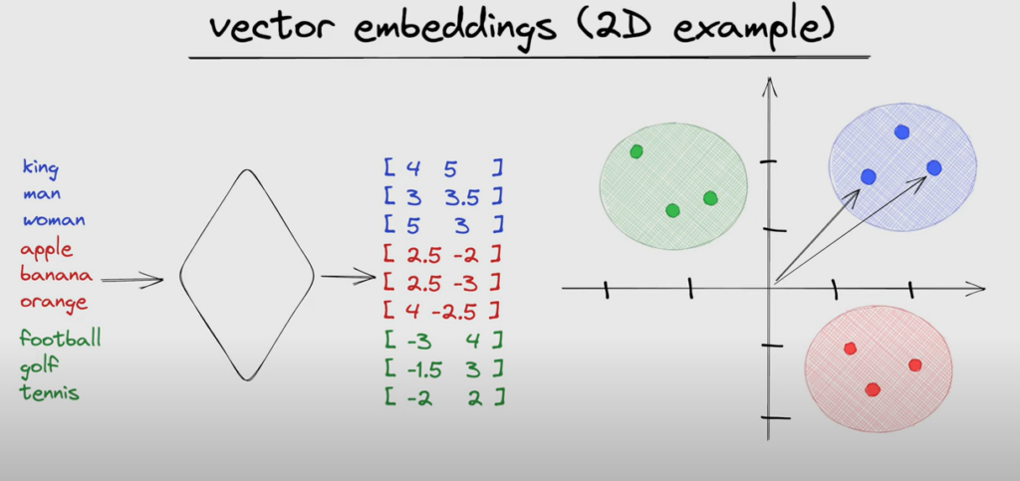
Vector Embeddings
vector("king") - vector("man") + vector("woman") ≈ vector("queen")

