Slide 1
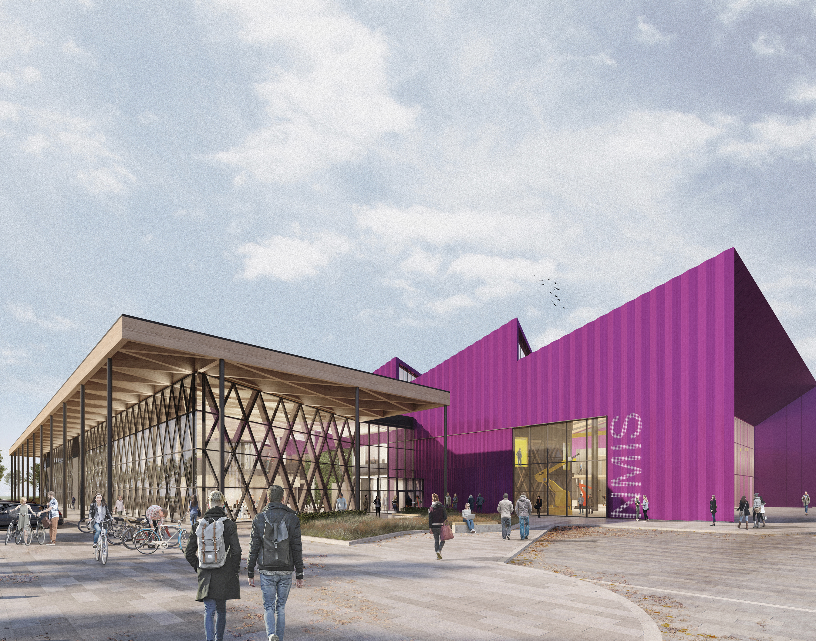
Fundamentals of AI in Manufacturing (FAIM) ANN Classification: Digit Recognition Lecturers: Abhilash Puthanveettil Madathil Olga Bylya. Applied Industrial Intelligence (AI²)

Slide 2
Practical problem: Handwritten Digit Recognition

Slide 3
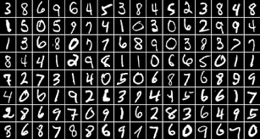
About the dataset
The MNIST database (Modified National Institute of Standards and Technology database) is a large database of handwritten digits that is commonly used for training various image processing systems
A collection of 70,000 handwritten digits (0–9).
Each image is 28x28 pixels (784 numbers total).
Goal: Train an ANN to recognize these digits.

Slide 4
Our task: Automate the digit recognition
Somehow identifying digits is incredibly easy for your brain to do, but almost impossible to describe how to do.
The traditional methods of computer programming, with if statements and for loops and classes and objects and functions, just don’t seem suitable to tackle this problem.
We will try to use Artificial neural networks to solve the digit recognition task

Slide 5
ANN training
“ANNs (or any supervised learning models) learn by seeing many examples”
We’ll show it many examples of hand-drawn digits together with labels (training data)
While “training”, the network adapts (tunes its parameters – weights and biases) itself to correctly predict each example
Finally, we test its ability to predict unseen digits (testing)

Slide 6
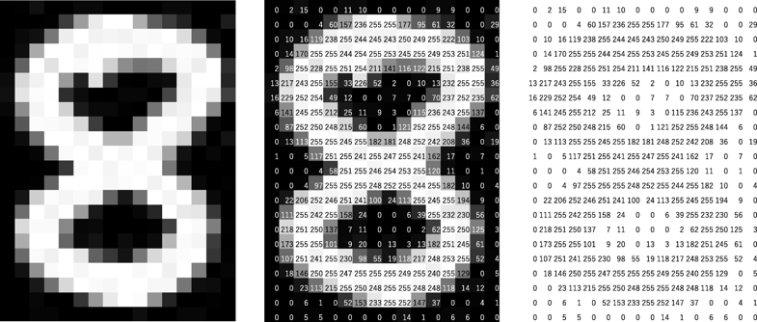
Data preparation
60k training images, 10k testing images
Convert 28x28 grayscale image into number matrix based on pixel value
Convert 28x28 number matrix into 784-number vector (flattening).
Normalize the pixel values (0–255) to 0–1 for faster training (normalizing).
X training data
(image 28x28)
Just one data within the entire 60k training dataset looks like this
Y training data
8

Slide 7
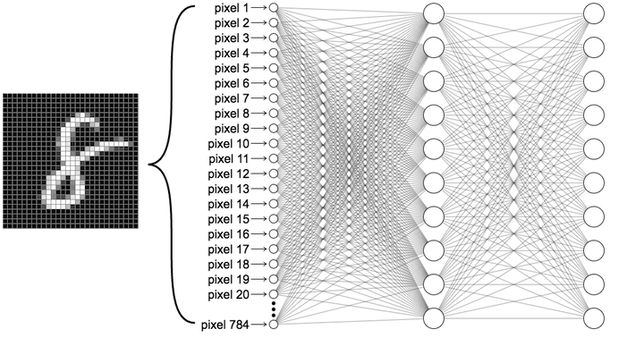
Designing ANN architecture
Layers: Input layer (pixels), hidden layers (compute patterns), output layer (digit probabilities).
Neurons: "Nodes" that process inputs using weights and biases.
Learning: Adjust weights/biases to minimize errors
How many neurons are required in the input layer?
How many neurons are required in the output layer?

Slide 8
Encoding- One hot encoding
Transforms categorical data (data with a finite set of label values) into a numerical format suitable for machine learning algorithms by creating new binary (0 or 1) columns for each category
Example
Input/output categories: ["Mon", "Tue", "Wed", "Thu", "Fri", "Sat", "Sun"]
One-hot encoded: Mon → [1, 0, 0, 0, 0, 0, 0]
Wed → [0, 0, 1, 0, 0, 0, 0]

Slide 9
Encoding- One hot encoding
Our Outputs (class labels) | One-hot encoded output
0 | [1, 0, 0, 0, 0, 0, 0, 0, 0, 0]
1 | [0, 1, 0, 0, 0, 0, 0, 0, 0, 0]
2 | [0, 0, 1, 0, 0, 0, 0, 0, 0, 0]
3 | [0, 0, 0, 1, 0, 0, 0, 0, 0, 0]
4 | [0, 0, 0, 0, 1, 0, 0, 0, 0, 0]
5 | [0, 0, 0, 0, 0, 1, 0, 0, 0, 0]
6 | [0, 0, 0, 0, 0, 0, 1, 0, 0, 0]
7 | [0, 0, 0, 0, 0, 0, 0, 1, 0, 0]
8 | [0, 0, 0, 0, 0, 0, 0, 0, 1, 0]
9 | [0, 0, 0, 0, 0, 0, 0, 0, 0, 1]

Slide 10
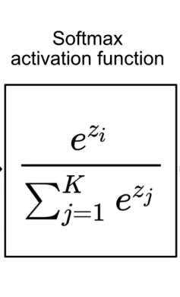
Output activation function - SoftMax
Output neuron
1.2
3.4
2.1
4.8
3.9
2.7
5.0
0.9
6.0
4.5
Probabilities
0.0016
0.0130
0.0036
0.0480
0.0194
0.0059
0.0791
0.0012
0.8160
0.0123

Slide 11
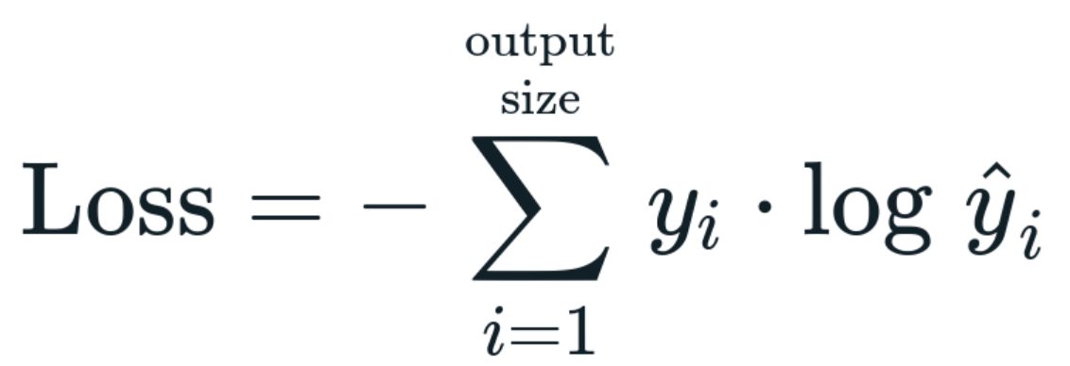
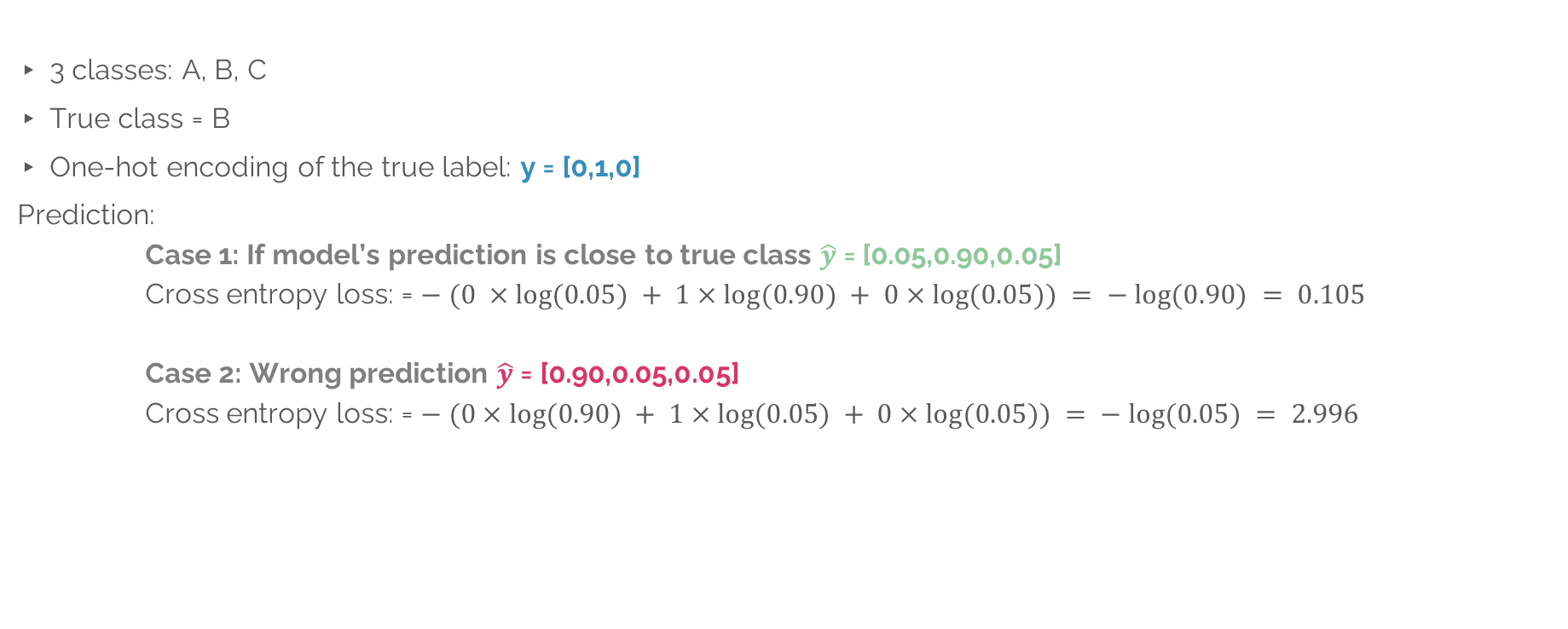
Cross entropy loss function
3 classes: A, B, C
True class = B
One-hot encoding of the true label: y = [0,1,0]
Prediction:
Case 1: If model’s prediction is close to true class $\hat{y}$ = [0.05,0.90,0.05]
Cross entropy loss: = $− (0 ×log⁡(0.05) + 1×log⁡(0.90) + 0×log⁡(0.05)) = − log⁡(0.90) = 0.105$
Case 2: Wrong prediction $\hat{y}$ = [0.90,0.05,0.05]
Cross entropy loss: = $− (0×log⁡(0.90) + 1×log⁡(0.05) + 0×log⁡(0.05)) = − log⁡(0.05) = 2.996$

Slide 13
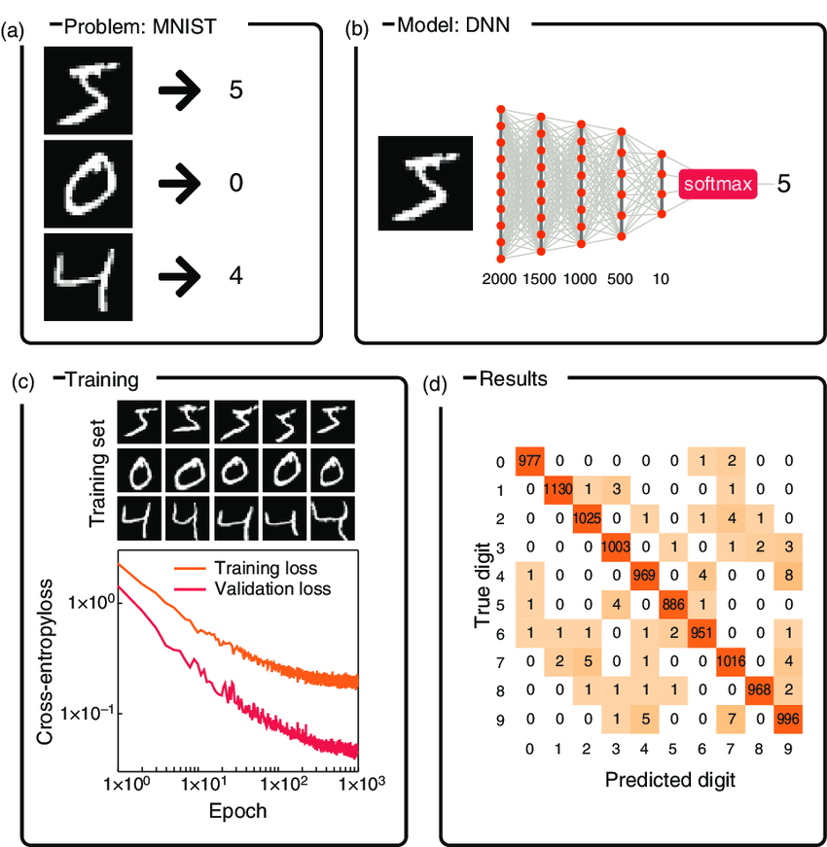

Slide 14
Write some digits by yourself
MS PowerPoint
https://www.autodraw.com/

