Slide 1
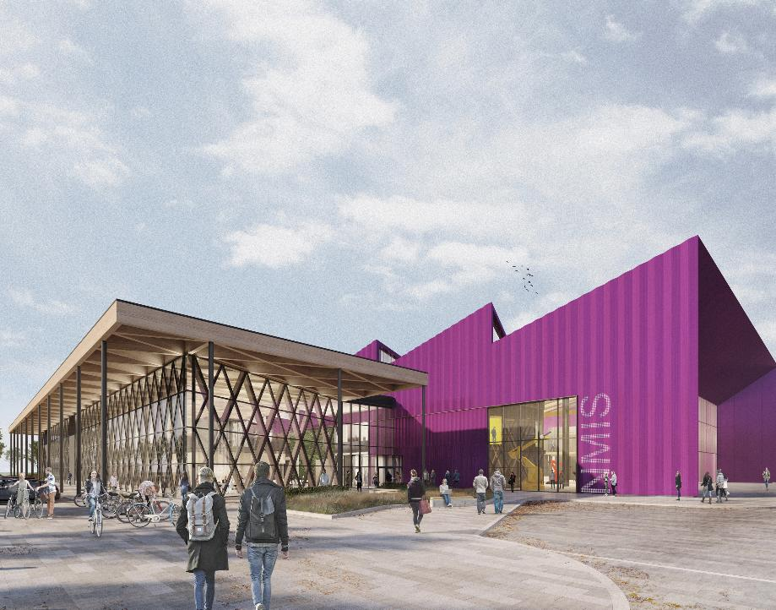
Fundamentals of AI in Manufacturing (FAIM) Convolutional Neural Networks (CNNs) Lecturers: Abhilash Puthanveettil Madathil, PhD Olga Bylya, PhD Applied Industrial Intelligence (AI²) NMIS

Slide 2
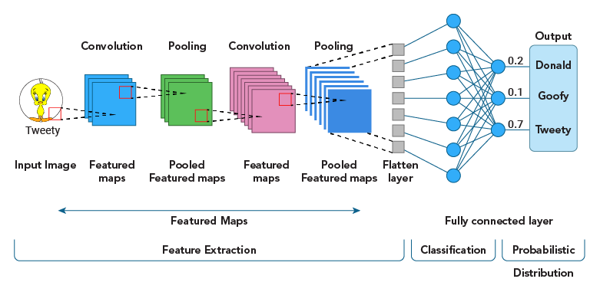
Convolutional Neural Networks

Slide 3
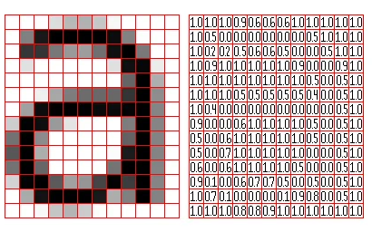
Convolutional Neural Network (CNN)
A convolutional neural network (CNN) is a type of deep learning algorithm that analyzes and learns features from data that has a grid-like topology, such as an image.
CNNs are particularly useful for finding patterns in images to recognize objects, classes, and categories.
Source: pippin.gimp.org

Slide 4
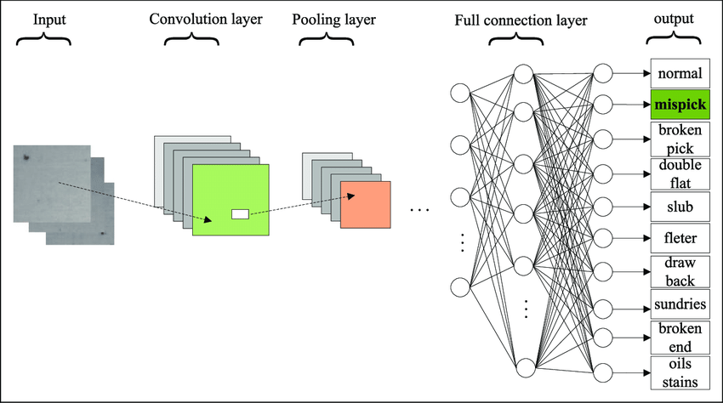
CNN: Applications
A few applications
Character recognition
Digit recognition
Object recognition
Defect detection

Slide 5
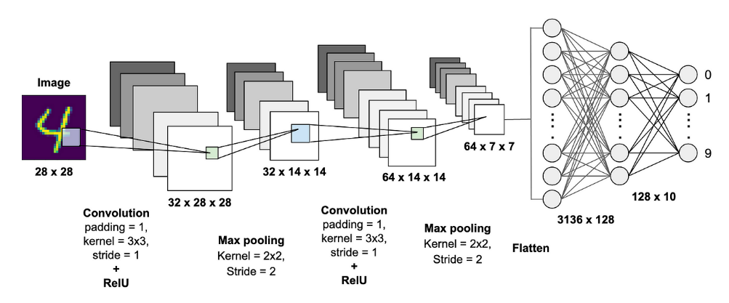
CNN Architecture
Convolutional layer (Uses a kernel/filter to detect features in an image)
Pooling layer (non trainable) (Compresses information from one layer into a smaller space in the next layer)
Fully connected layer

Slide 6
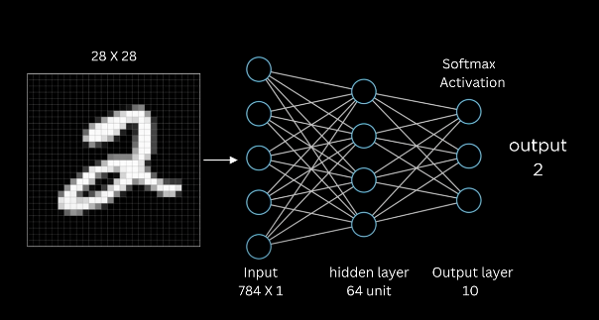
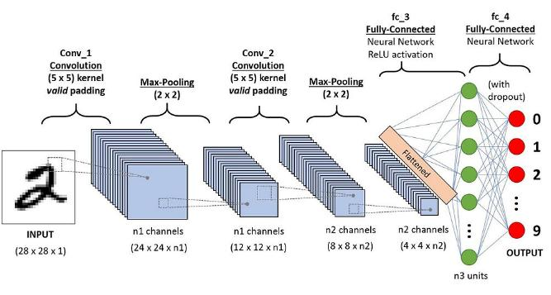
ANN
vs
CNN

Slide 7
Digit recognition: Fully connected vs Convolutional NN approach
Key points | Fully connected NN | Convolutional NN
Input Representation and Feature Extraction | Directly takes the entire image as a flat vector (No spatial awareness: scaling, orientation, location issues) | Extract local patterns/features preserving the 2D structure
Efficiency (Number of Parameters) | Requires many parameters (fully connected nature) | Lesser parameters and computations through kernel convolution
Performance and Accuracy | Lower accuracy due to incapability to capture spatial relationships | Higher accuracy due to its ability to capture local patterns
Fully connected NN
CNN
Notes:
Scaling,

Slide 8
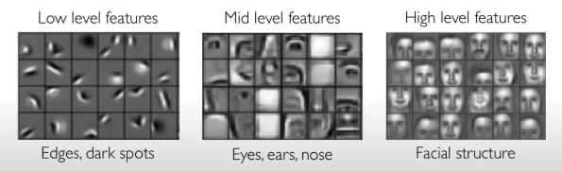
Convolutional layer
Captures features from the input image
Low-level features : edges, corners
Mid-level features : Contours, object parts
High-level features : faces, objects
http://introtodeeplearning.com

Slide 9
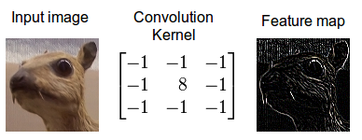

Slide 10
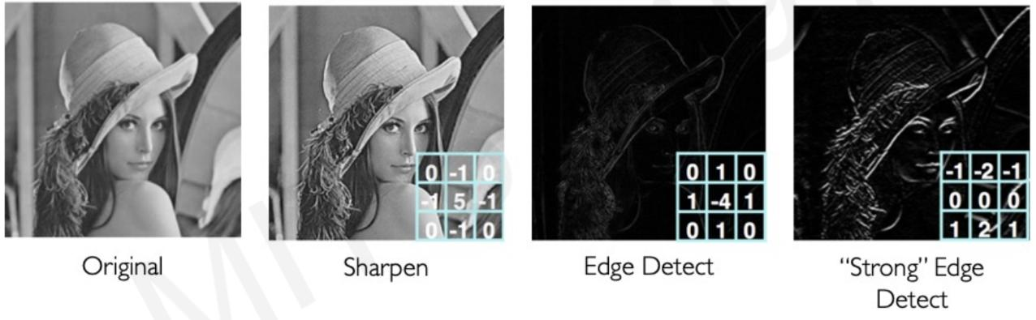

Slide 11
1 | 1 | 1 | 0 | 0
0 | 1 | 1 | 1 | 0
0 | 0 | 1 | 1 | 1
0 | 0 | 1 | 1 | 0
0 | 1 | 1 | 0 | 0
Convolutional layer’s operation
? | ? | ?
? | ? | ?
? | ? | ?
1 | 0 | 1
0 | 1 | 0
1 | 0 | 1
1. Input image
Feature map
Input
Kernel
1 | 1 | 1 | 0 | 0
0 | 1 | 1 | 1 | 0
0 | 0 | 1 | 1 | 1
0 | 0 | 1 | 1 | 0
0 | 1 | 1 | 0 | 0
1 | 1 | 1 | 0 | 0
0 | 1 | 1 | 1 | 0
0 | 0 | 1 | 1 | 1
0 | 0 | 1 | 1 | 0
0 | 1 | 1 | 0 | 0
1 | 1 | 1 | 0 | 0
0 | 1 | 1 | 1 | 0
0 | 0 | 1 | 1 | 1
0 | 0 | 1 | 1 | 0
0 | 1 | 1 | 0 | 0
1 | 0 | 1
0 | 1 | 0
1 | 0 | 1
1 | 0 | 1
0 | 1 | 0
1 | 0 | 1
1 | 0 | 1
0 | 1 | 0
1 | 0 | 1
2. Kernel (Filter): small matrix of weights
3. Dot Product at Each Position
1x1+1x0+1x1+0x0+1x1+1x0+0x1+0x0+1x1=4
4. Sliding the Kernel (Convolution Operation): Shifting the kernel by a certain step size, called the stride. If the stride is 1, the kernel moves one pixel at a time. If the stride is 2, the kernel jumps two pixels, etc
4 | ? | ?
? | ? | ?
? | ? | ?
5. Output feature map

Slide 12
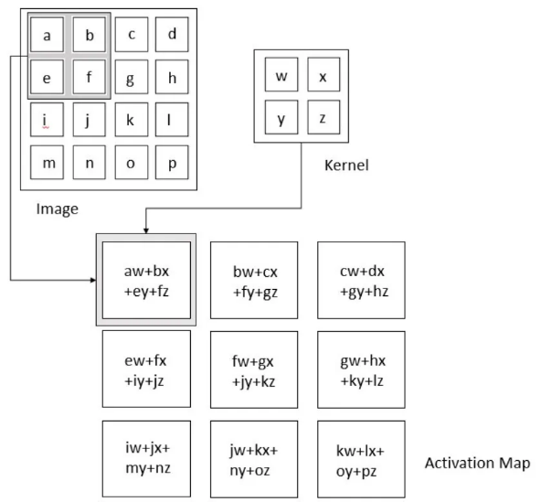
1 | 1 | 1 | 0 | 0
0 | 1 | 1 | 1 | 0
0 | 0 | 1 | 1 | 1
0 | 0 | 1 | 1 | 0
0 | 1 | 1 | 0 | 0
Kernel
1 | 0 | 1
0 | 1 | 0
1 | 0 | 1

Slide 13
Concept of strides
Stride is the step size followed while shifting the kernel over the input image
Stride = 1
Stride = 2
https://github.com/vdumoulin/conv_arithmetic

Slide 14
Concept of Strides
The stride’s value impacts the model in a few ways
Dimensionality Reduction: Larger stride values result in smaller output dimensions
Computation Speed: Larger strides can speed up computation, as the filter needs to be applied fewer times.
Model Capacity: Larger strides may result in the model losing some detailed information. This could potentially reduce model accuracy, particularly in tasks that require capturing fine-grained details.

Slide 15
Concept of padding
Padding = ‘same’ → size (feature map) = size (input)
Padding is the addition of extra pixels around the borders of the input images
Prevents information loss at the edges;
Controlling output size (same size as input)
Zero-Padding in Convolutional Neural Networks

Slide 16
Pooling Layer
Pooling in convolutional neural networks is a technique for generalizing features extracted by convolutional filters
Source: towardsai.net

Slide 17
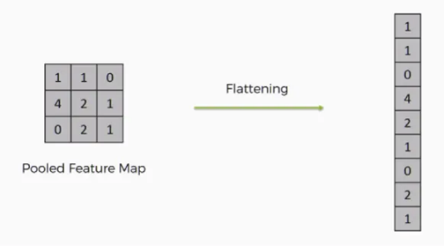
Flattening
Flattening is used to convert all the resultant 2-Dimensional arrays from pooled feature maps into a single long continuous linear vector. The flattened matrix is fed as input to the fully connected layer to classify the image.

Slide 18
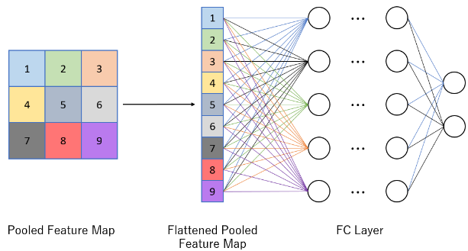
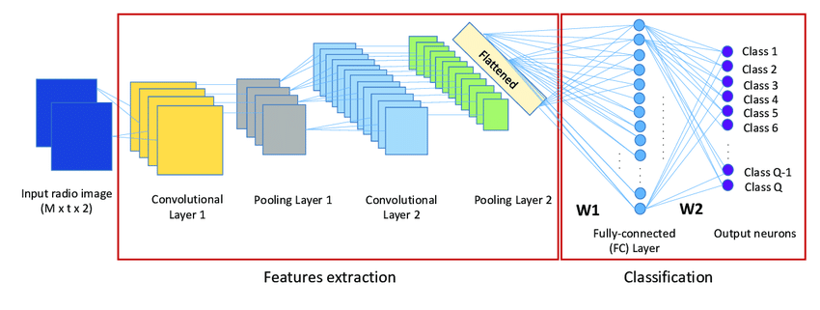
Fully connected Layer
Function: They take the output from the convolutional and pooling layers (usually flattened into a vector) and use their connections to learn complex relationships between features, leading to the final prediction.
Connection pattern: Unlike convolutional layers where neurons only connect to a local region, in a fully connected layer, each neuron connects to every neuron in the previous layer.
Classification task: The final fully connected layer often has the same number of output nodes as the number of classes in a classification problem, allowing the network to output probabilities for each class.

Slide 19
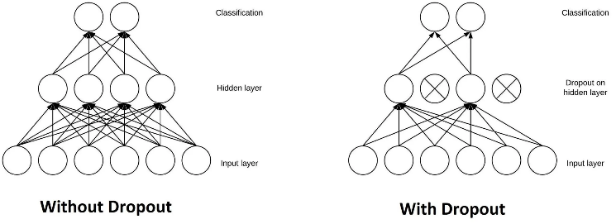
Dropout
The Dropout layer is a mask that nullifies the contribution of some neurons towards the next layer and leaves unmodified all others.
Dropout reduces overfitting: By randomly dropping neurons, dropout prevents the network from becoming overly reliant on specific neurons.
Dropout improves generalization: It forces the network to learn more robust features that generalize better to unseen data

Slide 20
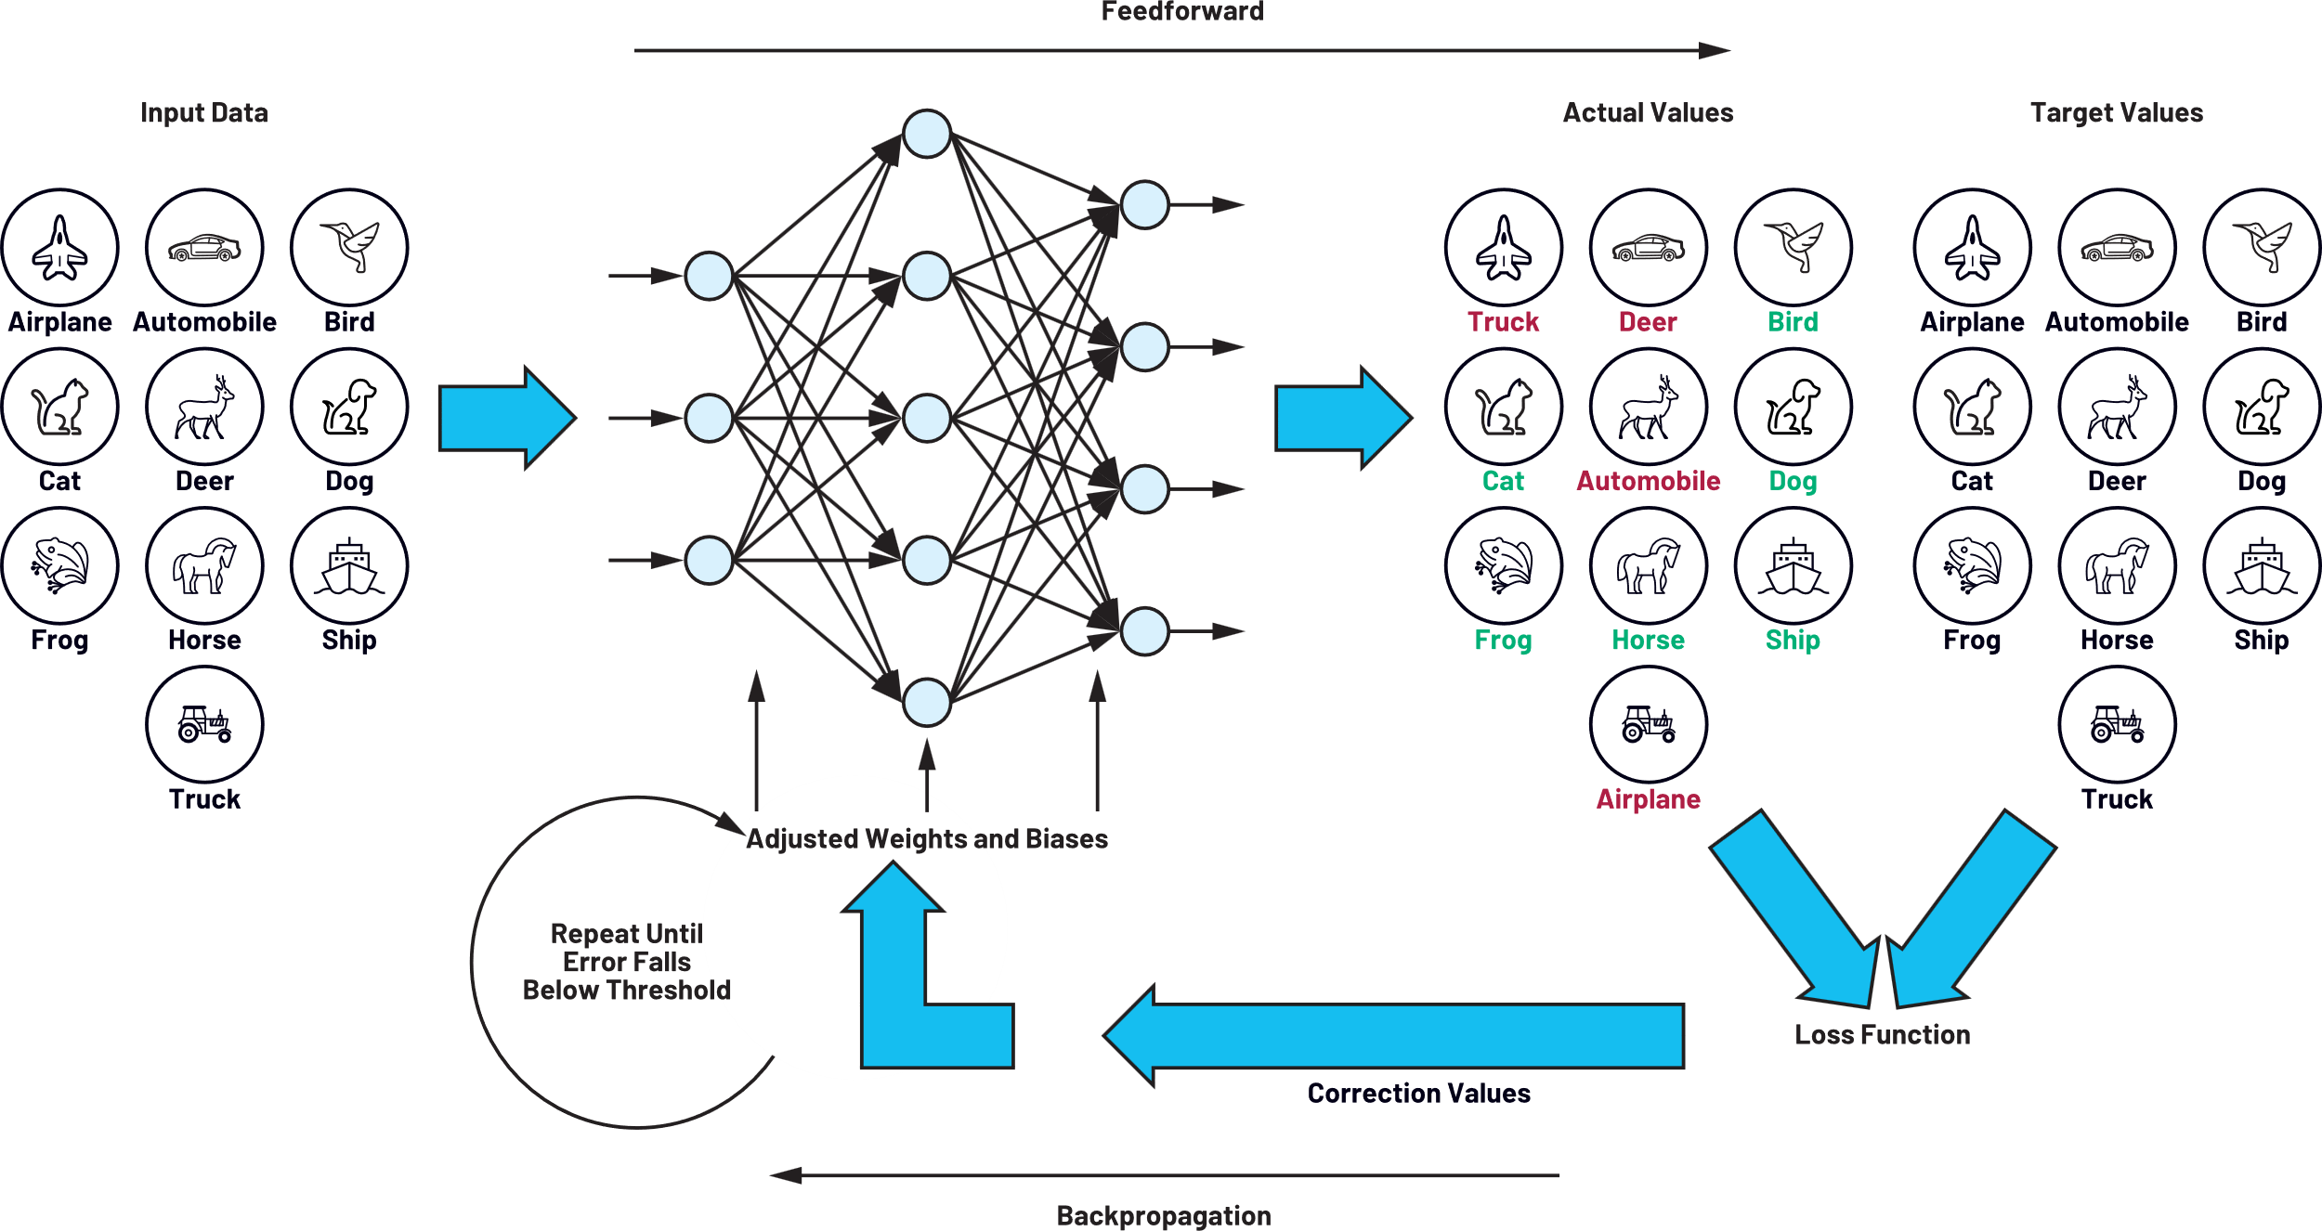
Training

Slide 21
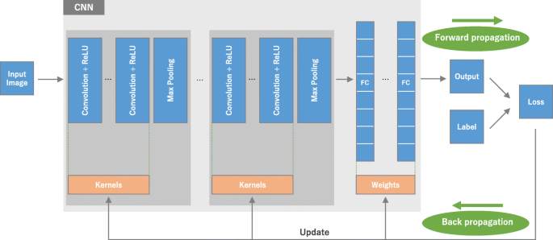
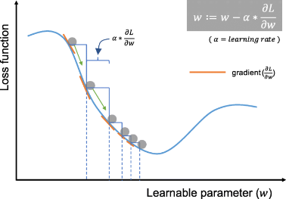
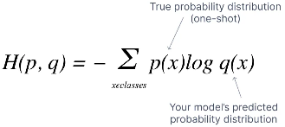
Training
Optimization: Gradient descent (GD)
Loss function: Categorical Cross-Entropy Loss

Slide 22
CNN explainers
https://adamharley.com/nn_vis/cnn/2d.html
https://poloclub.github.io/cnn-explainer/
Train a computer to recognize your own images, sounds, & poses
https://teachablemachine.withgoogle.com/

Slide 23
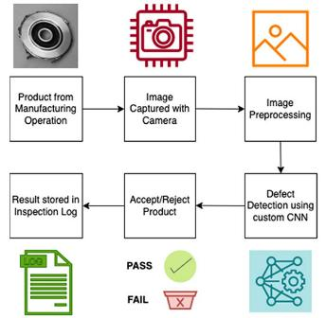
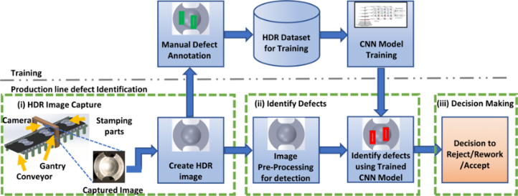
CNN: Industrial Applications
http://dx.doi.org/10.1007/s00170-022-10763-6
https://www.assemblymag.com/

Slide 24
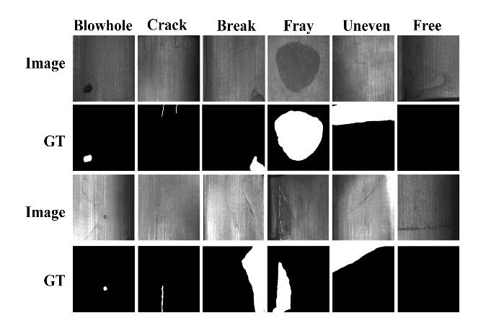
Practice dataset: Magnetic tile defect detection
https://github.com/Charmve/Surface-Defect-Detection/tree/master/Magnetic-Tile-Defect
https://www.kaggle.com/datasets/yidazhang07/bridge-cracks-image?resource=download

