Slide 1
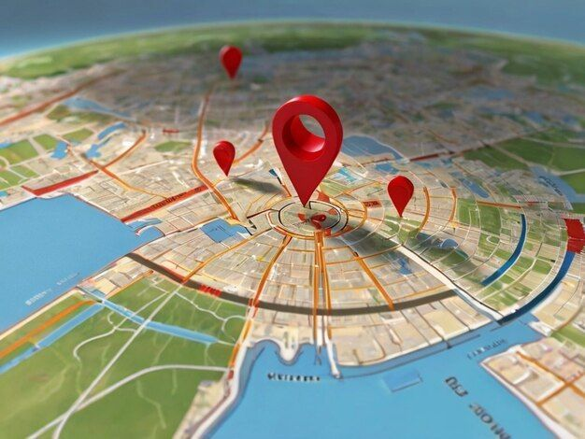
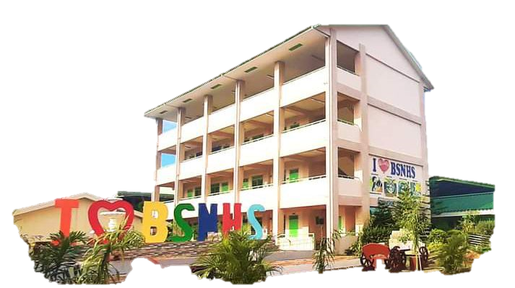
DESIGN AND DEVELOPMENT OF A DIGITAL SCHOOL MAP FOR BARTOLOME SANGALANG NATIONAL HIGH SCHOOL ACCESSIBLE VIA QR CODE USING VISUAL STUDIO CODE
Researchers Name:
Jamella Nairine R. Mapa
Mary Ann P. Malasaga
Gwen Dannica D. Ruz
Prince Noel O. Galapon
Reycris D. Acosta
Jenison P. Te
Jacob Jed V. Narcisco
10-MIXXY (SP-ICT)
BARTOLOME SANGALANG NATIONAL HIGH SCHOOL
RESEARCH PROPOSAL

Slide 2

I. Introduction
Many students and visitors get lost on
their first day at school because the
campus is often crowded, and printed maps
are difficult to use, causing confusion, delays,
and stress. Developing a Digital School Map,
that can be accessible via QR Code
we can address this problem.
BARTOLOME SANGALANG NATIONAL HIGH SCHOOL
RESEARCH PROPOSAL

Slide 3
I. Introduction
This interactive system allows users to scan QR codes to instantly view the campus layout providing accurate, real-time navigation. A Digital School Map not only improves orientation and accessibility compared to static printed maps but also enhances safety by highlighting emergency exits, hazard points, and safe zones.
BARTOLOME SANGALANG NATIONAL HIGH SCHOOL
RESEARCH PROPOSAL

Slide 4
I. Introduction
The purpose of this research is to
create a user-friendly, technologically advanced platform that
ensures efficient campus navigation that promotes independence
for students, teachers, staff, and visitors. By
providing instant access to campus information and
the ability to update locations in real-time,
this system fosters a convenient school environment.
BARTOLOME SANGALANG NATIONAL HIGH SCHOOL
RESEARCH PROPOSAL

Slide 5
II. Review of Related Literature
Significance of Digital Map in Campus Life
The integration of digital mapping in schools
has significantly enhanced navigation, accessibility, overall campus
experience by reducing confusion, boosting efficiency and
increasing overall happiness. (Samreen & Jha, 2020)
BARTOLOME SANGALANG NATIONAL HIGH SCHOOL
RESEARCH PROPOSAL

Slide 6
II. Review of Related Literature
Integration of QR Codes In Wayfinding Systems
The QR code can be scanned via
the student mobile phones or mobile device
when scanned it can redirect to show
real-time routes and be useful for new
students who are still learning their way
around the school (Anusiuba, Umeh, Ezuruka
& Adejumo, 2025).
BARTOLOME SANGALANG NATIONAL HIGH SCHOOL
RESEARCH PROPOSAL

Slide 7
II. Review of Related Literature
Integration of GPS Technology in Campus Digital Maps and Wayfinding
The GPS, sensors, and maps improve campus navigation system accurately and provide guidance for students and visitors, replacing paper maps with digital innovations, promoting modern, user-friendly, and ensuring smooth around campus ( Naik and Adsul, 2023).
BARTOLOME SANGALANG NATIONAL HIGH SCHOOL
RESEARCH PROPOSAL

Slide 8
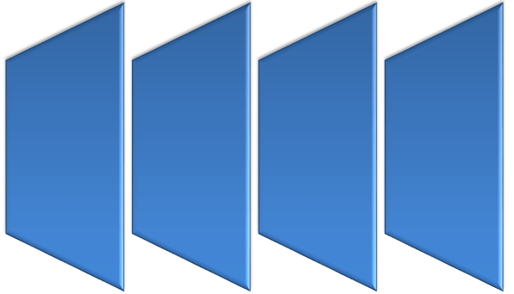
III. Conceptual Framework
Software Development Life Cycle Steps
Define Requirements
System Design
Development
Quality Assurance
User Acceptance
Testing
Releasing
Purposive Sampling
Statistical Analysis
Implementation
Developed Web-based Application
Digital School Map Accessible Via QR Code Using Visual Studio Code
F E E D B A C K
BARTOLOME SANGALANG NATIONAL HIGH SCHOOL
RESEARCH PROPOSAL

Slide 9
IV. Statement of the Problem
1.How may the Digital School Map for Bartolome Sangalang National High School accessible via QR Code using Visual Studio Code be developed using the Agile Model Phases in terms of:
1.1 defining requirements;
1.2 system design;
1.3 development;
1.4 quality assurance;
1.5 user acceptance testing; and
1.6 releasing?
BARTOLOME SANGALANG NATIONAL HIGH SCHOOL
RESEARCH PROPOSAL

Slide 10
IV. Statement of the Problem
2. How may IT Experts evaluate the developed Digital School Map for Bartolome Sangalang National High School accessible via QR Code using Visual Studio Code in terms of the following criteria:
2.1 functional suitability;
2.2 performance efficiency;
2.3 compatibility;
2.4 usability;
2. 5 reliability
2.6 security
2.7 maintainability; and
2.8 portability?
BARTOLOME SANGALANG NATIONAL HIGH SCHOOL
RESEARCH PROPOSAL

Slide 11
IV. Statement of the Problem
3.How may the Users evaluate the developed Digital School Map for Bartolome Sangalang National High School Accessible via QR Code using Visual Studio Code in terms of the following selected criteria:
3.1 functional suitability;
3.2 performance efficiency; and
3.3 usability;
BARTOLOME SANGALANG NATIONAL HIGH SCHOOL
RESEARCH PROPOSAL

Slide 12
IV. Statement of the Problem
4. How may the level of effectiveness of
the Digital School Map for Bartolome Sangalang
National High School Accessible via QR Code
Using Visual Studio Code upon implementation be described?
BARTOLOME SANGALANG NATIONAL HIGH SCHOOL
RESEARCH PROPOSAL

Slide 13
IV. Statement of the Problem
5. How much do the Digital School Map
for Bartolome Sangalang National High School Accessible via QR Code using Visual Studio Code cost
(hardware, software, and training) upon implementation?
BARTOLOME SANGALANG NATIONAL HIGH SCHOOL
RESEARCH PROPOSAL

Slide 14
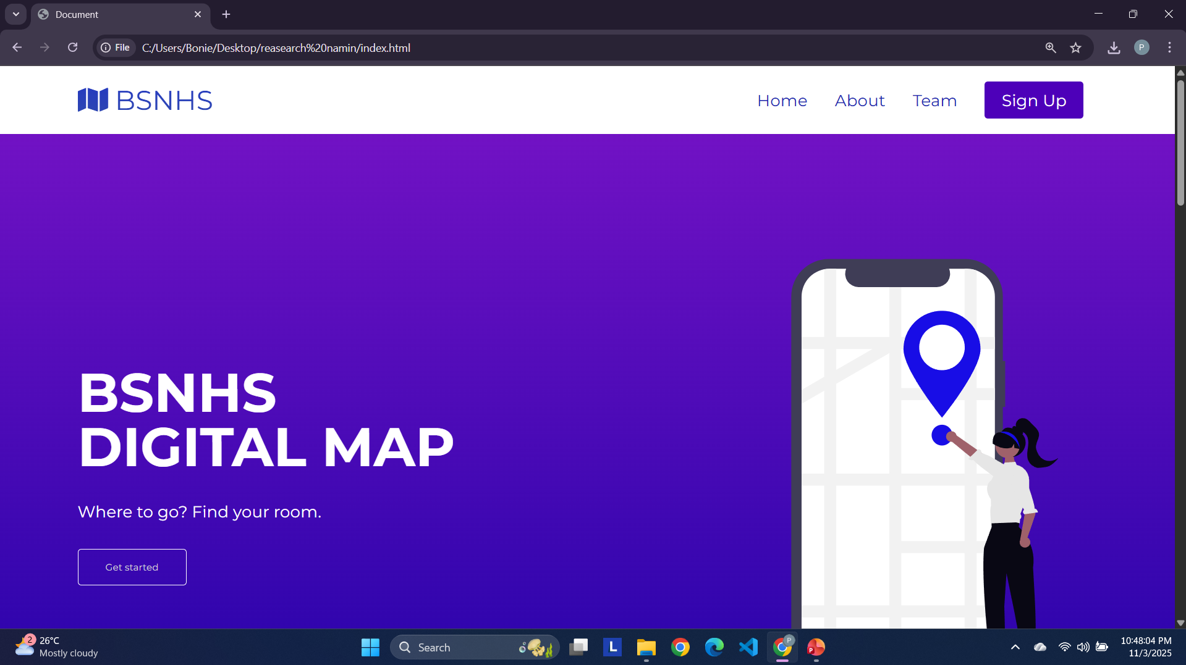
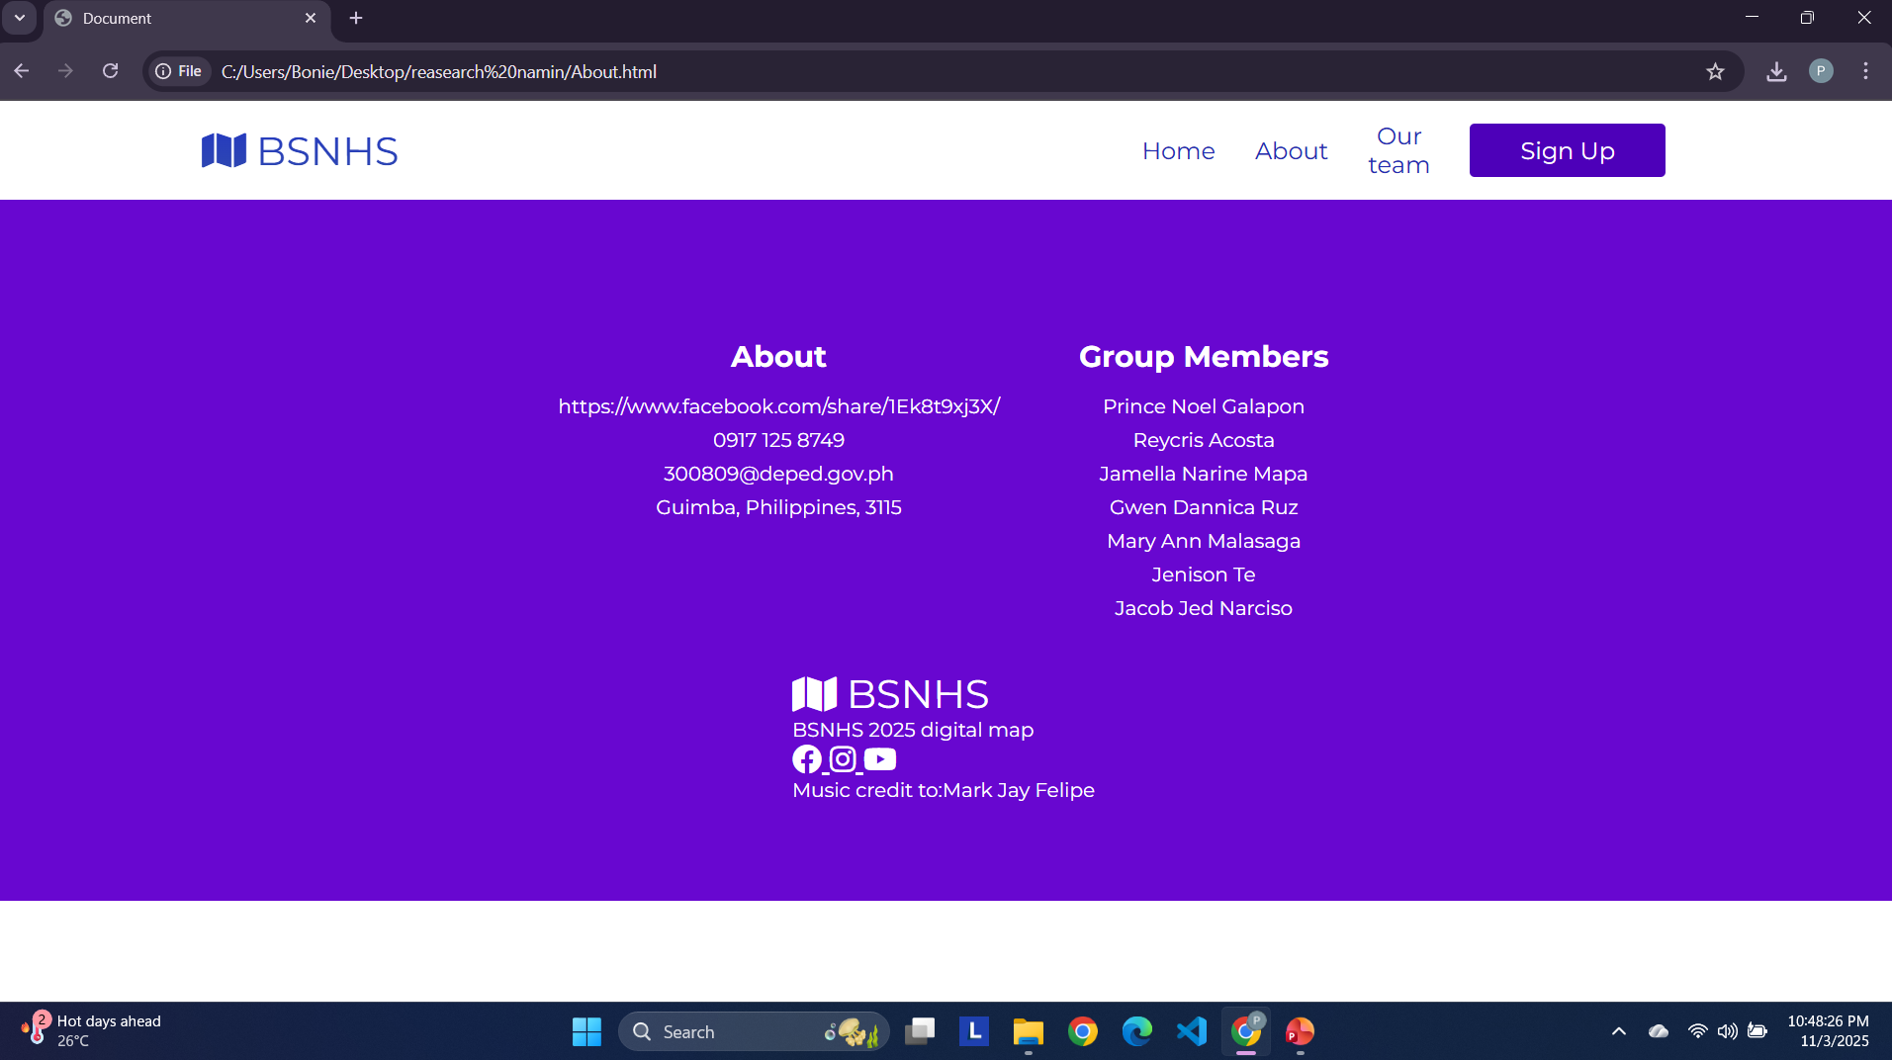
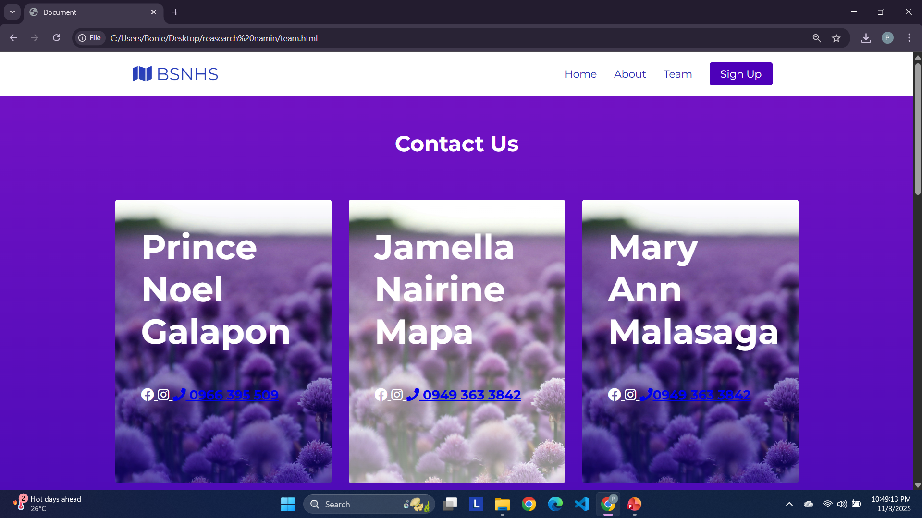
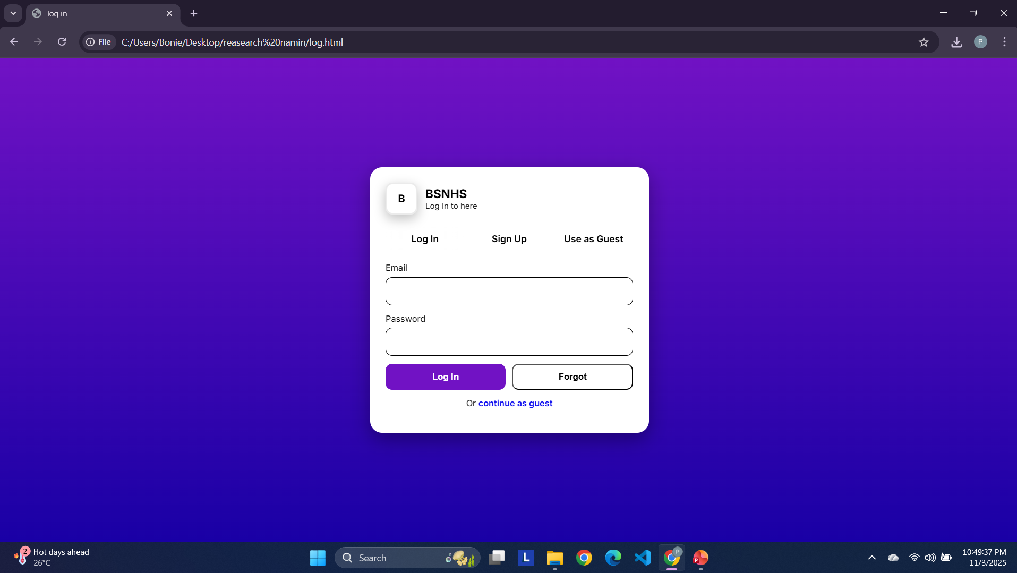
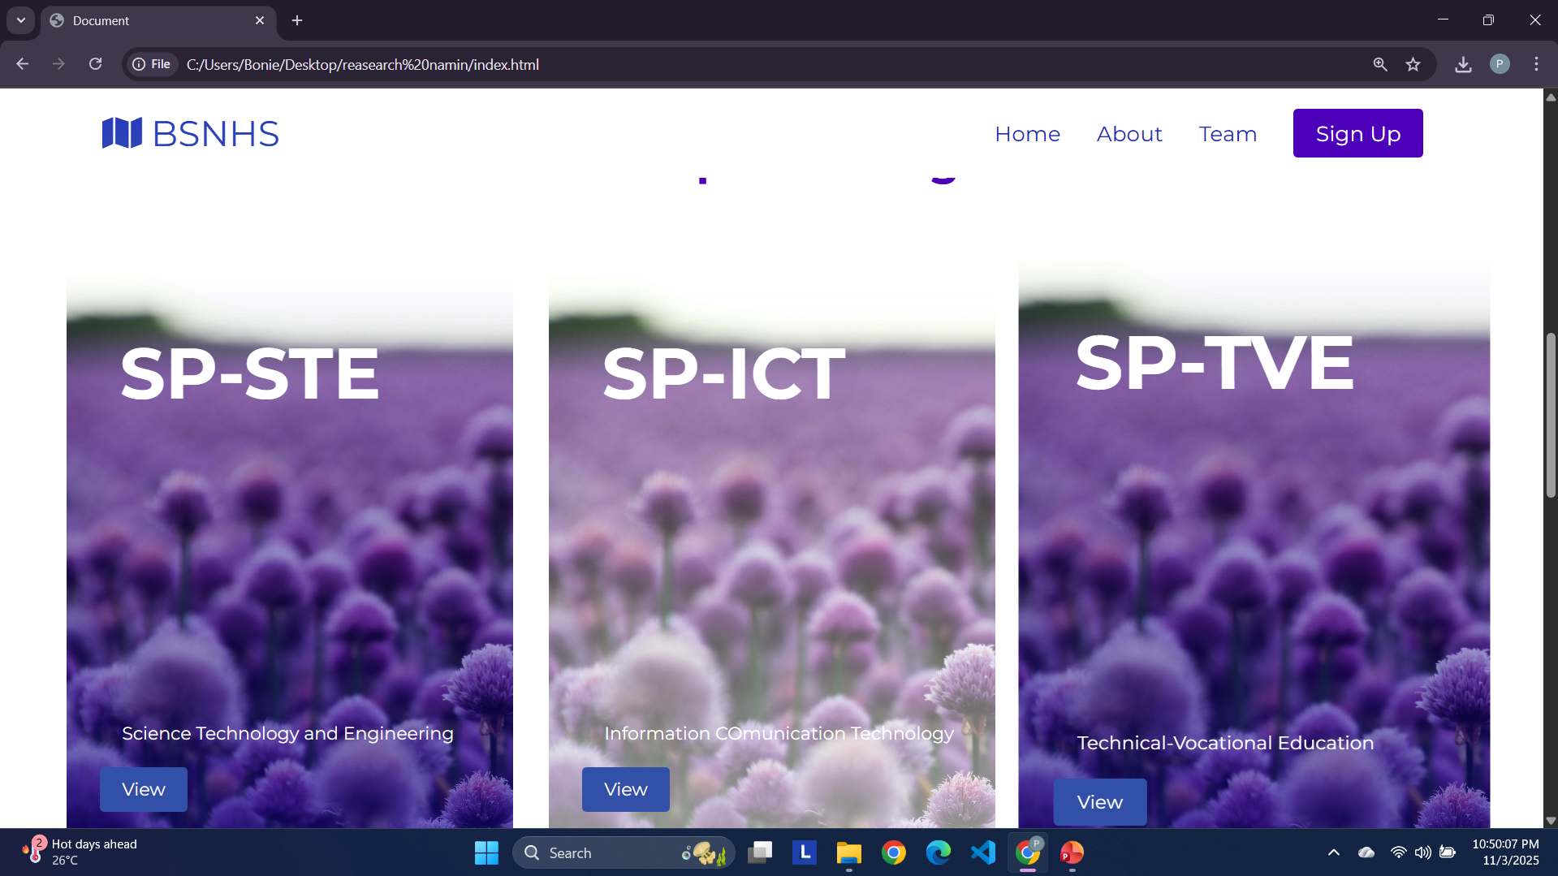
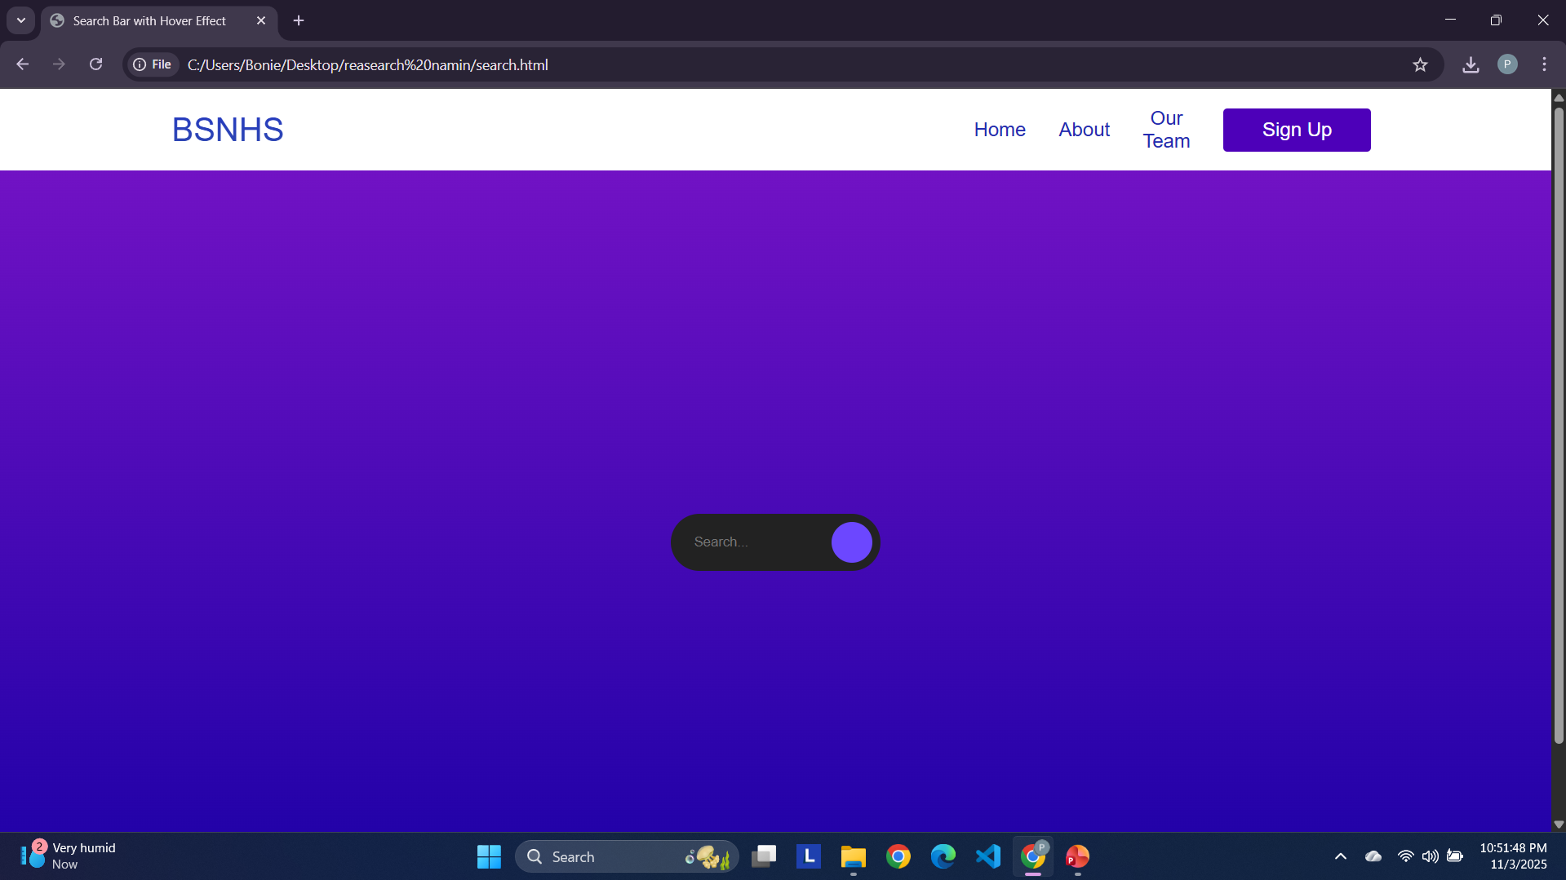
V. Scope and Limitations

Slide 15
V. Scope and Limitations
1. The digital map system requires a stable internet connection to function properly, especially when scanning the QR code for access. Users may not be able to view the map in areas with weak or no internet connection.
2. This study is limited only to Bartolome Sangalang National High School. It does not cover other schools or campuses.
BARTOLOME SANGALANG NATIONAL HIGH SCHOOL
RESEARCH PROPOSAL

Slide 16
VI. Significance of the Study
Students – The digital school map helps students
find classrooms and facilities quickly. It saves
time, reduces stress, and assists new students in
navigating the campus easily.
Teachers – The map helps teachers locate rooms and offices faster, allowing more focus on teaching and essential duties.
BARTOLOME SANGALANG NATIONAL HIGH SCHOOL
RESEARCH PROPOSAL

Slide 17
VI. Significance of the Study
Staff – The system helps staff move efficiently around the school, reducing time spent helping lost students or visitors.
Visitors – The digital map guides visitors through QR codes, helping them explore and find destinations easily. It makes their experience convenient and welcoming.
BARTOLOME SANGALANG NATIONAL HIGH SCHOOL
RESEARCH PROPOSAL

