Slide 1

Data 698 - Final presentation
Topic: Portfolio optimization and Machine learning with visualization analysis for S&P 500
Tze Fung Lung, Jim

Slide 2
Introduction
We are looking at the S&P 500, an index of the largest US companies. The S&P 500 is an American stock market index based on the market capitalization of 500 large companies having common stock listed on the NYSE, NASDAQ Exchange.
I loaded all 500 dataset in S&P 500 for analysis by using portfolio optimization to get the possible several stocks with higher return and lower risk. And using the machine learning predict the investment trend for S&P 500 index.

Slide 3
Methodology
This project are separated parts of analysis from data exploration, visualization, correlation and monthly return for data extraction by mathematical programming, portfolio optimization and machine learning .
1. Data Exploration
2. Higher monthly return
3. Portfolio Optimization
4. Machine Learning

Slide 4
Data Exploration
We considered if it plot all 500 stock shares, it can't appear a meaningful comparation graph. Initially, we view the first 5 column including S&P 500 index in the time series from 2008 to 2019 (2019-04-18).
We will further see the top 10 monthly return, top 10 for higher correlation with S&P 500 index, and top 10 investing stocks strategic from the portfolio optimization in our data time series.

Slide 5
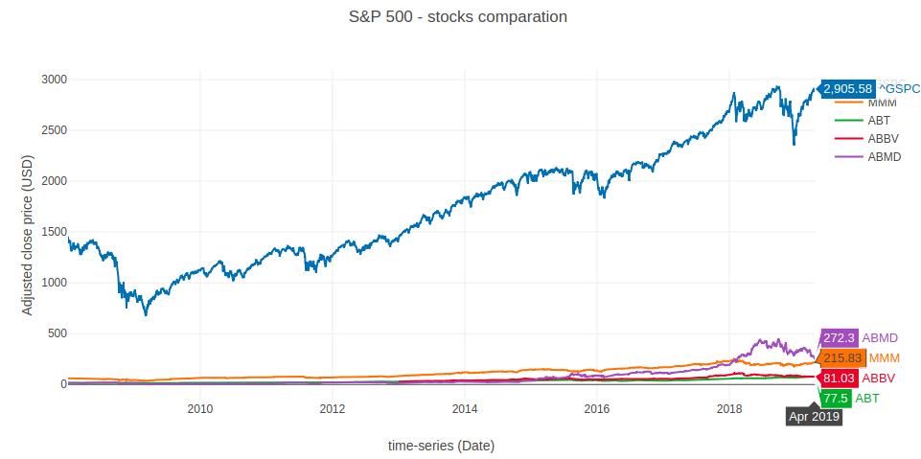
Data Exploration

Slide 6
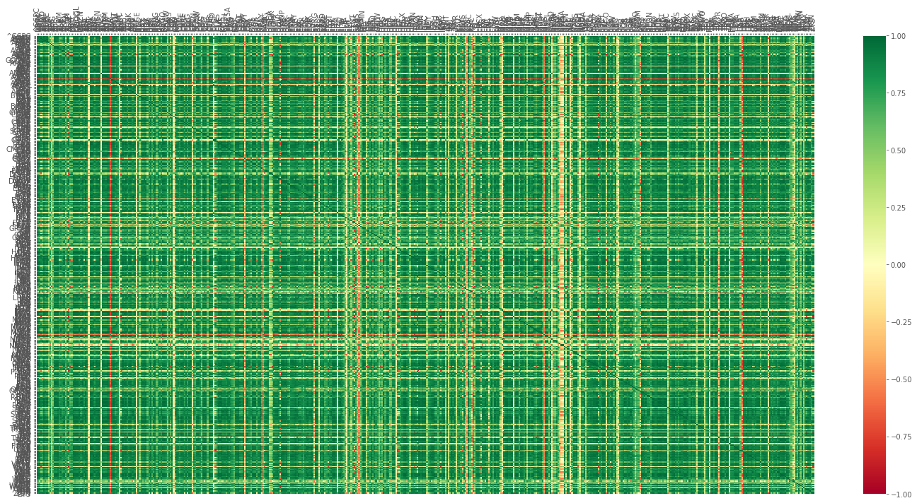
Correlation for all 500 stocks
Most people think that they will get higher return when the main index going up, so we can calculate the correlation to check which stocks share are strong relationship and low relationship.

Slide 7
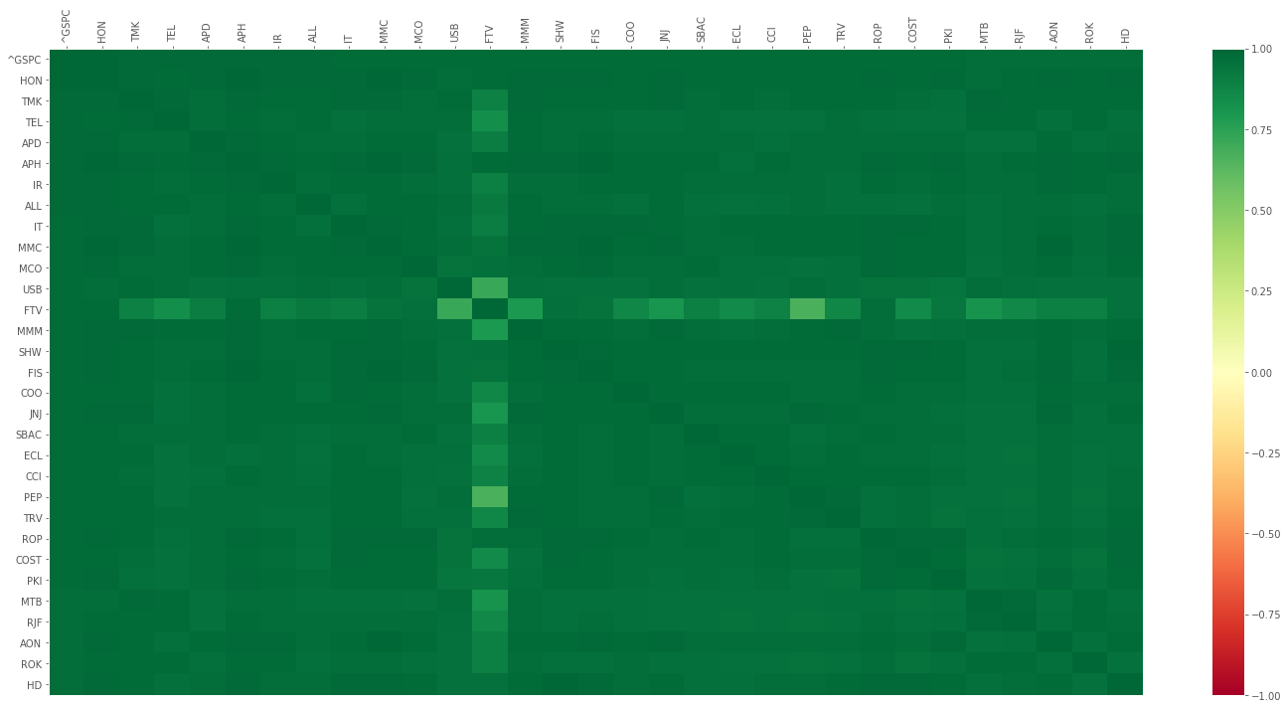
Highest Correlation (Sort out top 30 from all 500 stocks share)
to find out the top 30 stocks which are higher correlation with S&P 500 index from 500 stocks share.
Last part of this project will conduct the prediction of machine learning for S&P 500 index

Slide 8
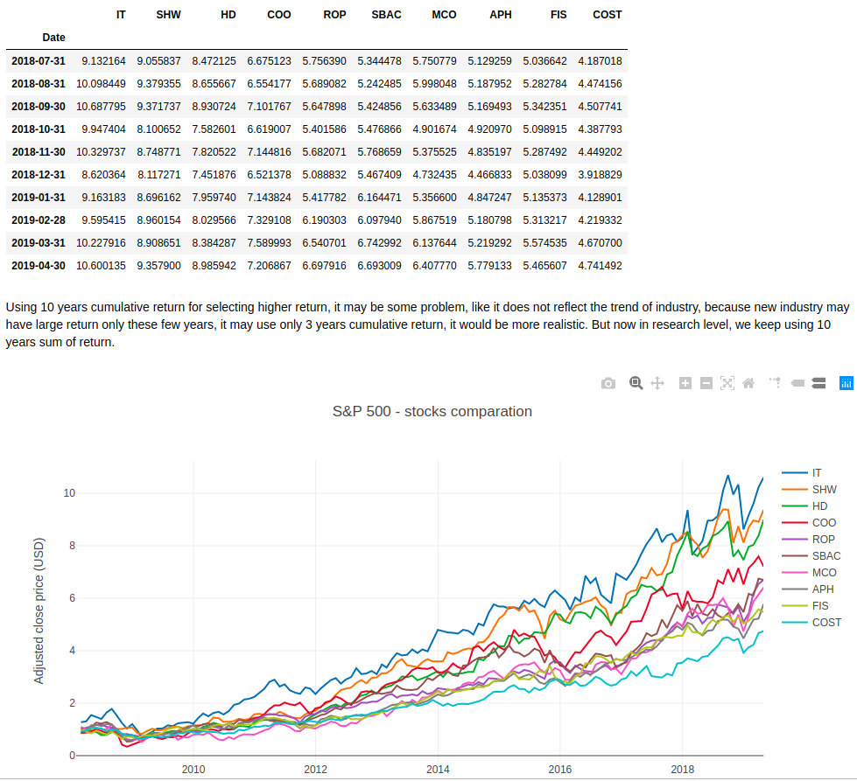
Highest monthly return (Sort out top 10 from 30 stocks share)
Apart from the risk consideration, the percentage of increasing return can be 9.8 times over 10 year if just only invest "IT" tickers of stock.

Slide 9
Highest monthly return (Sort out top 10 from 30 stocks share)
Gartner Inc
Sherwin-Williams
Home Depot
The Cooper Companies
Roper Technologies
SBA Communications
Moody's Corp
Amphenol Corp
Fidelity National Information Services
Costco Wholesale Corp.

Slide 10
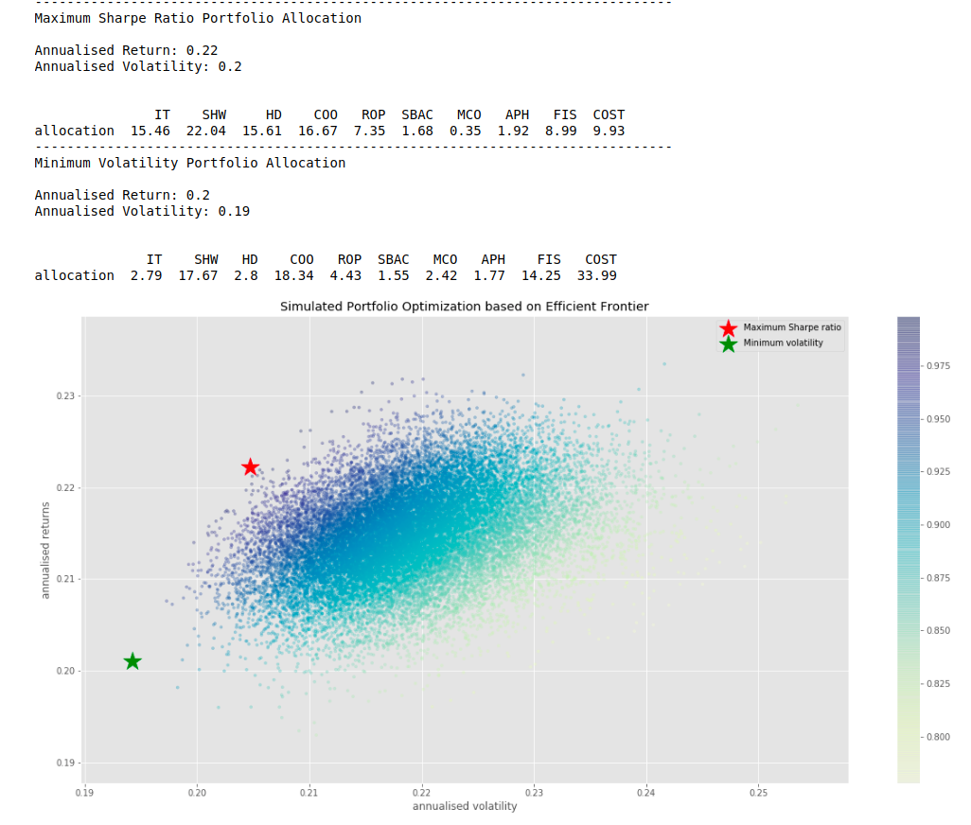
Portfolio Optimization - Random Portfolios
In order to choose from 10 number of stocks share from the result of last part which are higher monthly return and lower risk as our final medium or long term investment strategic.

Slide 11
Portfolio Optimization - Random Portfolios
For minimum risk portfolio, we can see around 30% of our budget is allocated to "Cost" - Costco. If you take another look at the daily return plot from earlier, the Costco is the least volatile among these stocks, so allocating a large percentage to Costco for minimum risk portfolio makes sense.
In this scenario, we are allocating a significant portion to "SHW" - Sherwin-Williams and "IT" - Gartner Inc, which are quite volatile stocks from the previous plot of daily returns. And "Cost" - Costco which had around 30% in the case of minimum risk portfolio, has only 10% budget allocated to it.

Slide 12
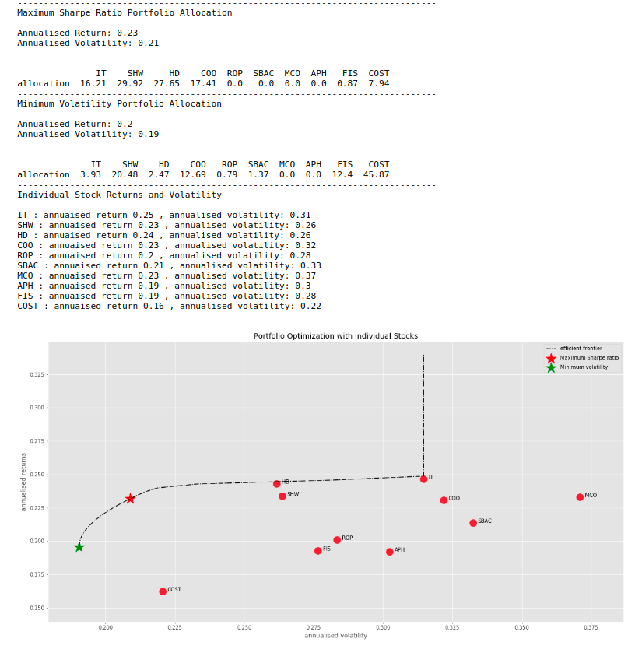
Portfolio Optimization - Efficient Frontier
Stocks with the least risk is COST at around 0.22, but the return is only around 0.16. If we will to take slightly more risk around 0.225 return, we should consider to choose HD and SHW rather than IT with higher risk with portfolio optimisation.

Slide 13
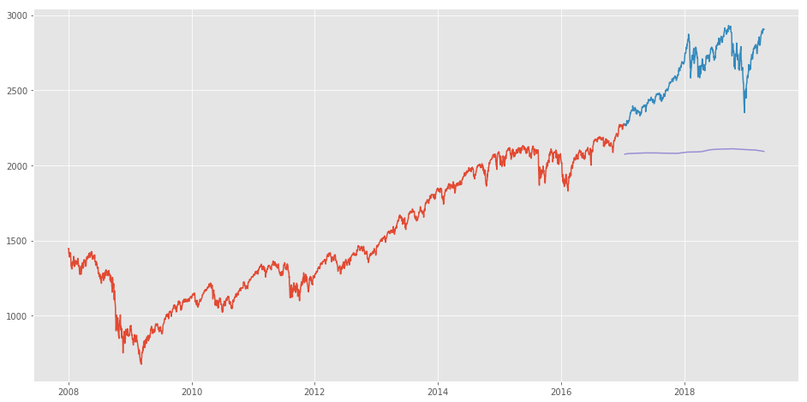
Machine Learning - Moving Average
The root mean square error is 556.7202, prediction is 2092.7282
the results are not very promising, the predicted values are not the same range as the observed values in the train set
(there is not obvious an increasing trend and then a slow decrease)

Slide 14
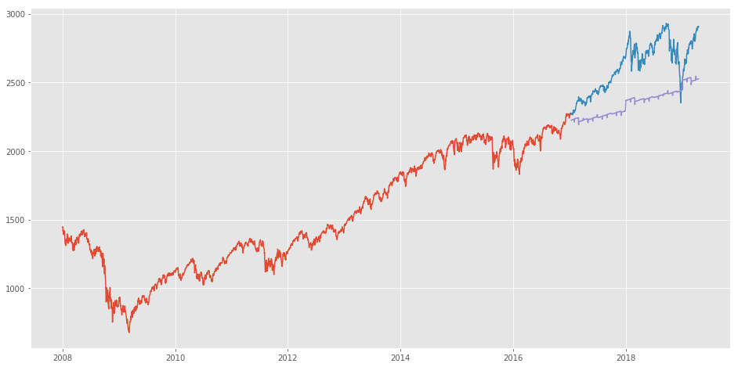
Machine Learning - Linear Regression
The root mean square error is 296.1361, prediction is 2525.14814
The RMSE value is lower than the previous technique, which clearly shows that linear regression has performed better.

Slide 15
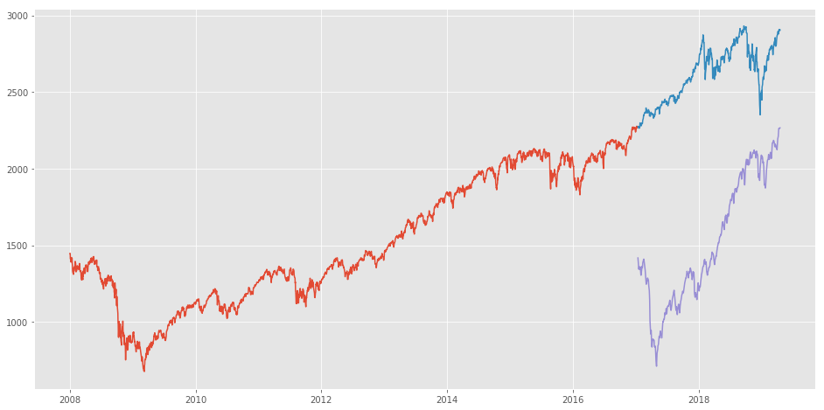
Machine Learning - k-Nearest Neighbours
The root mean square error is 1142.9905, prediction is 2266.327
The RMSE value of KNN is higher than the linear regression model and the plot shows the same pattern
kNN also identified a raising trend from January 2019 since that has been the pattern for the past years

Slide 16
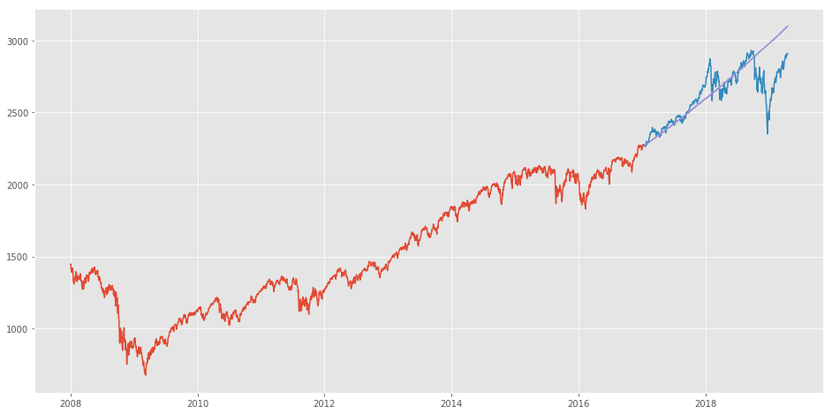
Machine Learning - Auto ARIMA
The root mean square error is 149.4734, prediction is 3098.4159
Although the predictions using this technique are far better than that of the previously implemented machine learning models, these predictions are still not close to the real values.

Slide 17

Machine Learning - Prophet
The root mean square error is 446.4384233932304, prediction is 2285.3302
Forecasting techniques like ARIMA and Prophet would not show good results for this particular problem.

Slide 18
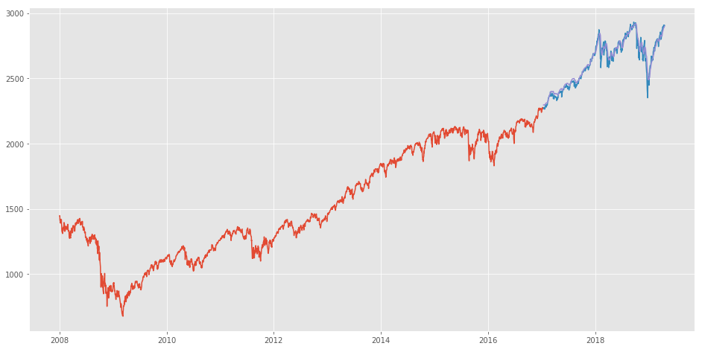
Machine Learning - Long Short Term Memory (LSTM)
The root mean square error is 36.8895, prediction is 2899.4375
LSTMs are widely used for sequence prediction problems and have proven to be extremely effective.
the model seem to predict well with real data

Slide 19
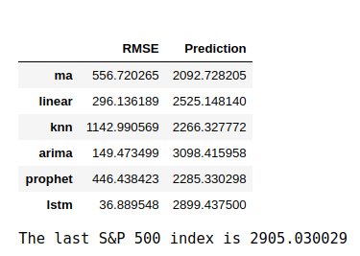
Model Comparsion
The S&P 500 index is 2905.030029 on 2019-04-18
the most lowest rmse of model is by using of Long Short Term Memory method, prediction value is 2899.4375 As we mentioned as last part, we should also consider the news about the company and other factors like demonetization or merger/demerger of the companies.

