Slide 1
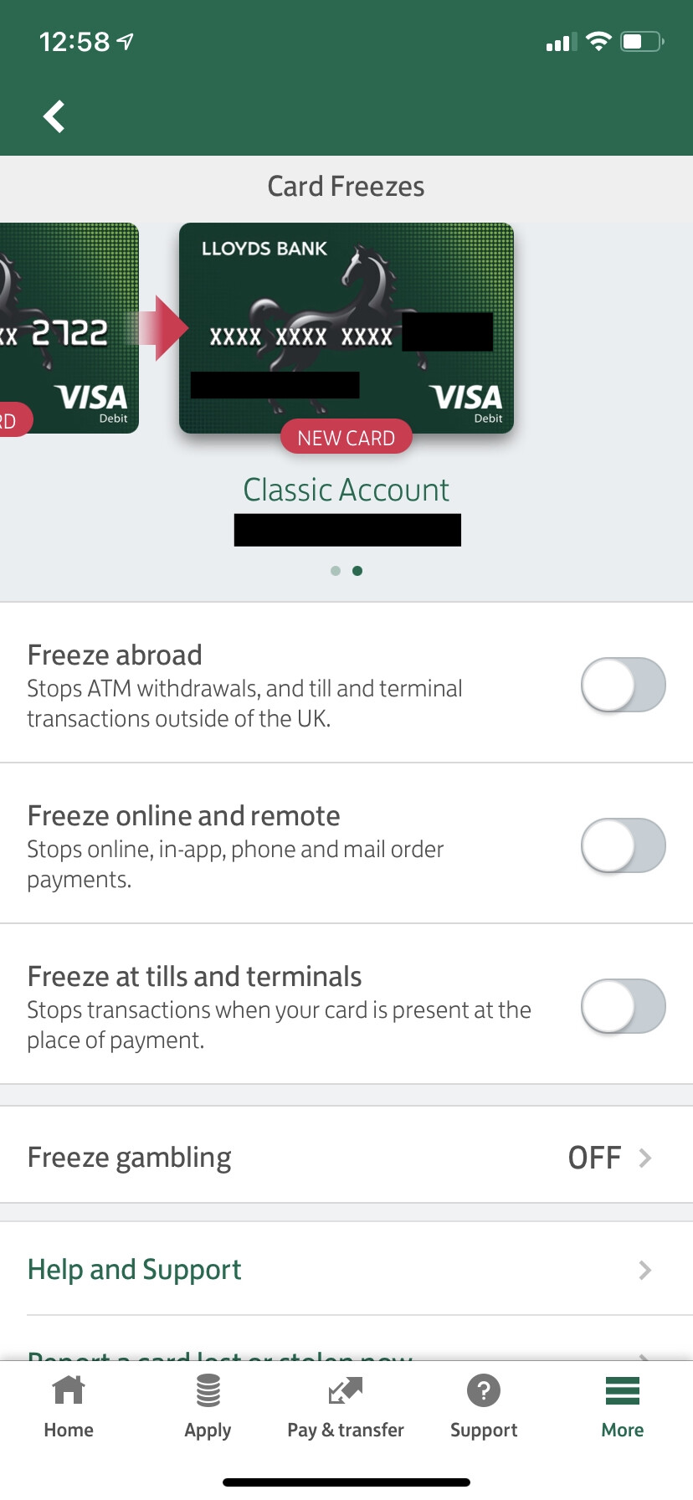
Online Payment Control
Apply additional acknowledgements when making online payments

Slide 2
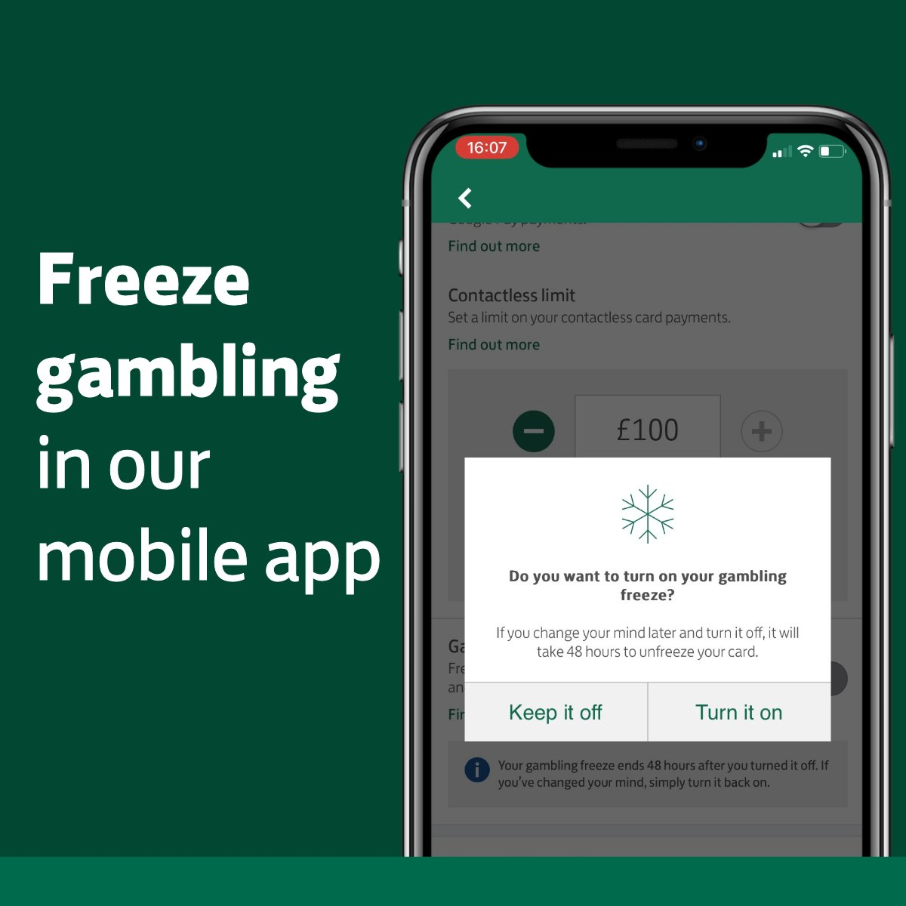

Manage your payment controls
Do you want to turn on online payment control?
If you change your mind later and turn it off, it will take 24 hours to apply

