Slide 1

Introduction to Molecular Modeling and
Computer-Aided Drug Discovery
Lecture 3: Chemical Data Representation and
Molecular Similarity

Slide 2
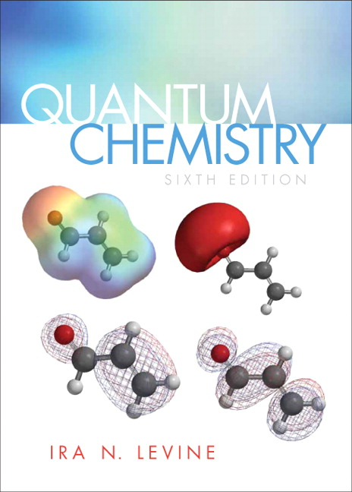
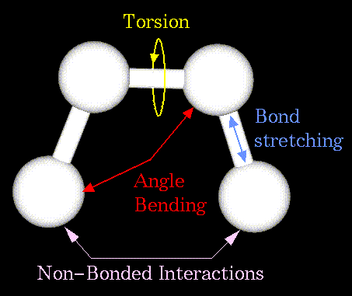
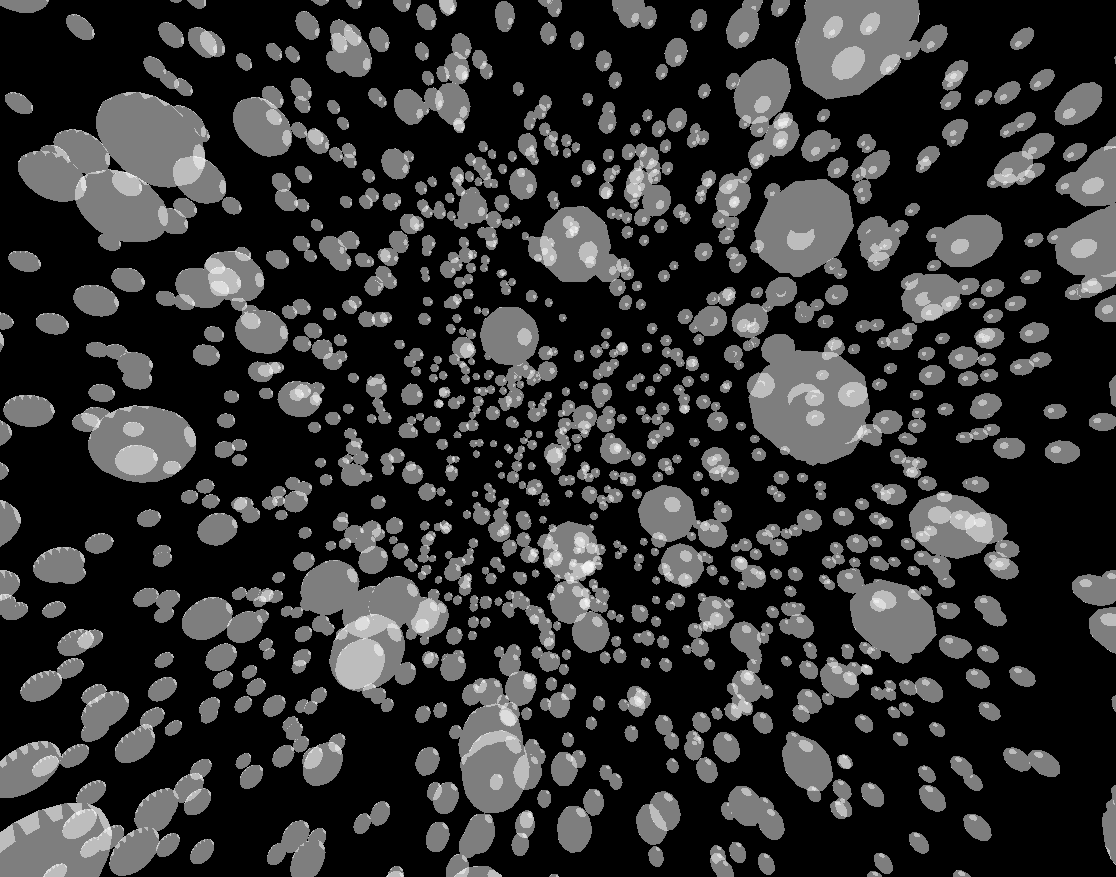
Major theoretical concepts concerning molecular structure representation
Quantum Mechanics (ab initio and semiempirical methods) - application of electronic structure theory to atoms and molecules. QM uses non-empirical physical principles in order to describe the molecule and optimize its geometry.
Molecular Mechanics - classical description of molecules as series of masses joined by springs. Molecular mechanics is an empirical approach that uses classical mechanics in order to optimize the geometry of the molecule.
Chem[o]informatics – representation of molecules as objects in multidimensional chemical space defined by chemical descriptors
Varnek A, Baskin II. Chemoinformatics as a Theoretical Chemistry Discipline.
Mol Inform. 2011 Jan 17;30(1):20-32

Slide 3
Chem[o]informatics
Informatics – combines the terms “information” and “automation” to name automatic information processing.
“Cheminformatics (also known as chemoinformatics) refers to the use of physical chemistry theory with computer and information science techniques—so called "in silico" techniques—in application to a range of descriptive and prescriptive problems in the field of chemistry, including in its applications to biology and related molecular fields” [Wikipedia]
“Chemoinformatics is the mixing of those information resources to transform data into information and information into knowledge for the intended purpose of making better decisions faster in the area of drug lead identification and optimization.” [Original definition by Frank Brown]
F.K. Brown (1998). "Ch. 35. Chemoinformatics: What is it and How does it Impact Drug Discovery". Annual Reports in Medicinal Chemistry. Vol. 33. pp. 375–384. doi:10.1016/S0065-7743(08)61100-8.

Slide 4
Cheminformatics is the field dealing with molecular objects in multidimensional chemical space defined by descriptors.
Notes:
4

Slide 5
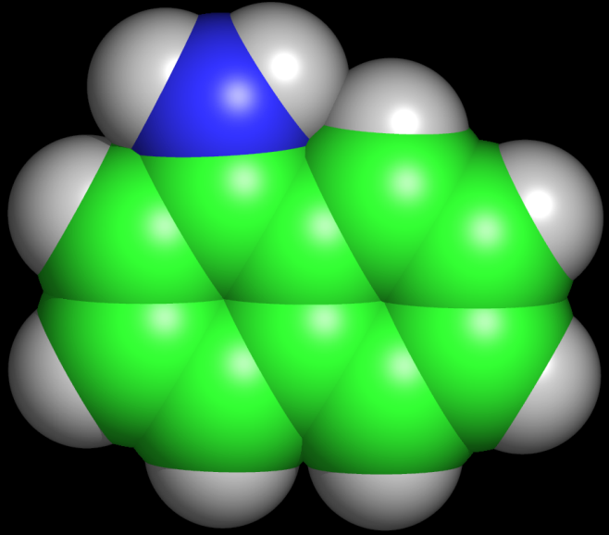
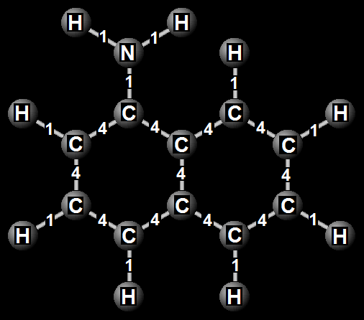
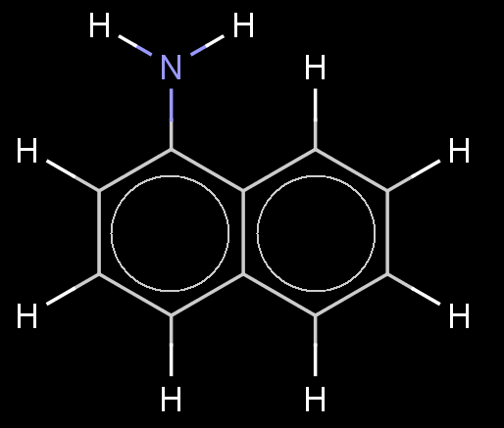
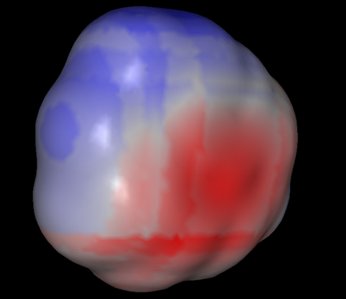
Structure representation
naphtalen-1-amine
Viewed by
computers
Viewed by
another molecule
Viewed by chemists

Slide 6
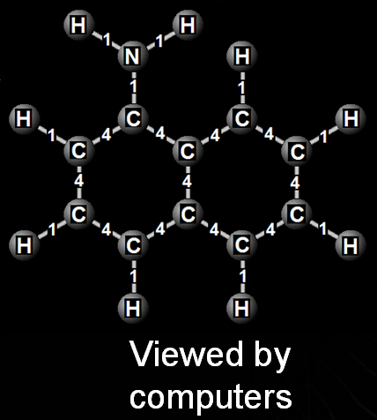
Structure representation

Slide 7
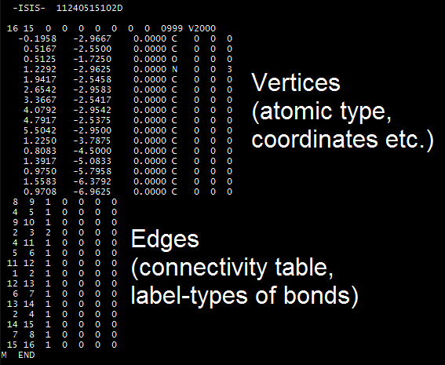
Structure representation
Graphs are widely used to represent
and differentiate chemical structures,
where atoms are vertices and bonds
are expressed as edges connecting these vertices.
MOL File
Molecular graphs allow the computation of numerous indices to compare them quantitatively.
Vertices
Edges
Molecular descriptors

Slide 8
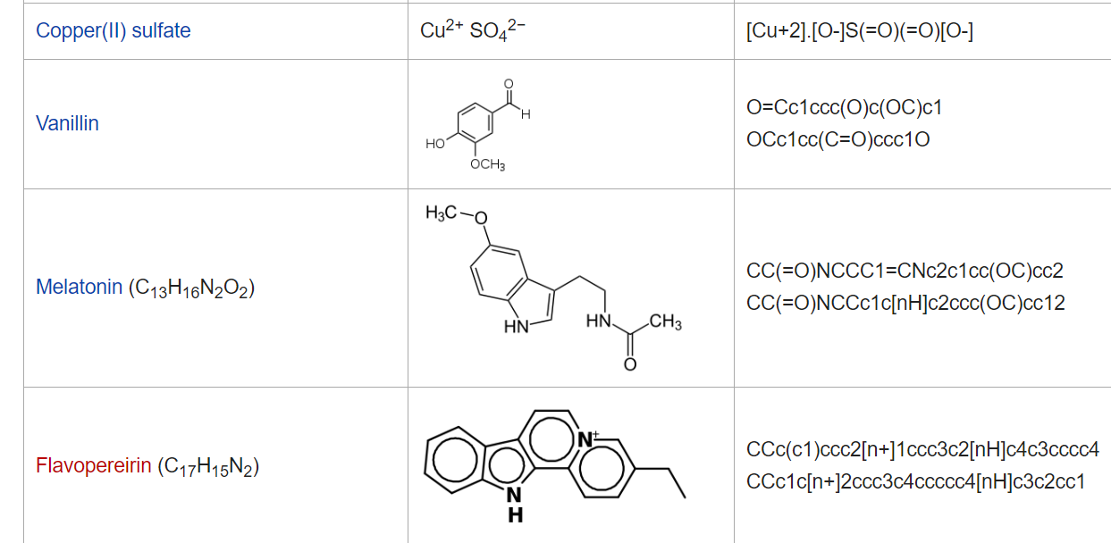
SMILES: a compact way to encode, store, and share chemical data
SMILES – (simplified molecular-input line-entry system) is a sequence of characters then encodes the molecular graph; one sequence = one molecule

Slide 9
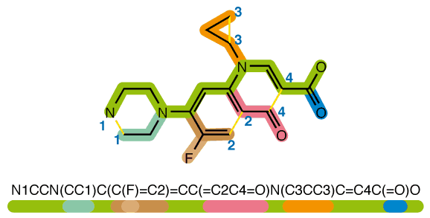
Representation of molecules by SMILES (Simplified molecular-input line-entry system)
NB: SMILES is c compact way to encode molecular structure. SMILES are not molecular descriptors
https://commons.wikimedia.org/w/index.php?curid=2556784

Slide 10
SMILES (or graphs) should be transformed into molecular descriptors
Samples (Compounds) | Variables (descriptors)
 | X₁ | X₂ | ... | X_{m}
1 | X₁₁ | X₁₂ | ... | X_{1m}
2 | X₂₁ | X₂₂ | ... | X_{2m}
... | ... | ... | ... | ...
n | X_{n1} | X_{n2} | ... | X_{nm}
Notes:
10

Slide 11
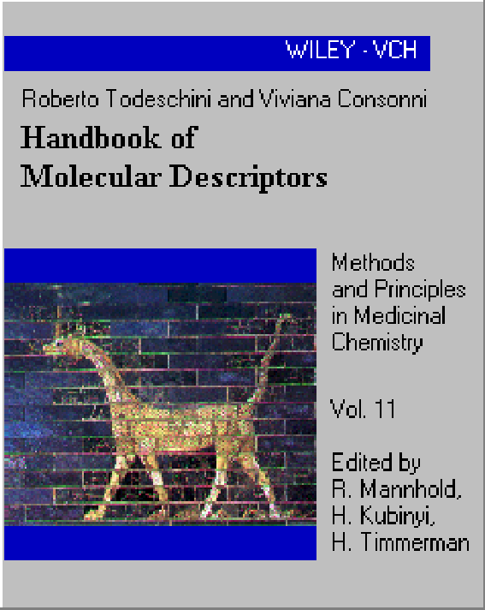
Definition of molecular descriptor
“The molecular descriptor is the final result of a logic and mathematical procedure which transforms chemical information encoded within a symbolic representation of a molecule into a useful number or the result of some standardized experiment.”
Prs. R. Todeschini and V. Consonni
≈ 3300 molecular descriptors

Slide 12
Properties of a molecular descriptor
A descriptor must have:
- invariance with respect to labeling and numbering of atoms;
- invariance with respect to roto-translation;
- an unambiguous algorithmically computable definition;
- values in a suitable numerical range for the set of molecules where it is applicable to;
- a structural interpretation;
- a good correlation with at least one property;
- no trivial correlation with other molecular descriptors;
- gradual change in its values with gradual changes in the molecular structure;
- not included in the modeled experimental properties;
not restricted to a too small class of molecular structures;
- preferably, some discrimination power among isomers;
- preferably, not trivially included in the definition of other molecular descriptors;
- preferably, allowing reversible decoding (back from the descriptor value to the Structure -> inverse QSAR).
Source : Handbook of molecular descriptors by Roberto Todeschini

Slide 13
Types of molecular descriptors
Constitutional (mol. weight, number of S, N or O atoms, …)
Topological (Randic index, informational content, …)
Geometrical (molecular size, distances between functional groups, … )
Electrostatic (electrostatic potential, charges, …)
Quantum-chemical (energies of molecular orbitals, reactivity indices, …)
Thermodynamical (heat of formation, logP, …)
Fragmental (sequences of atoms and bonds, augmented atoms, …)
Notes:
13

Slide 14
Types of molecular descriptors
Hansch π parameter (hydrophobicity)
Hammett σ parameter (electron-donating or accepting properties)
Steric parameters
Structural descriptors
Topological descriptors
Topographical descriptors, etc.

Slide 15
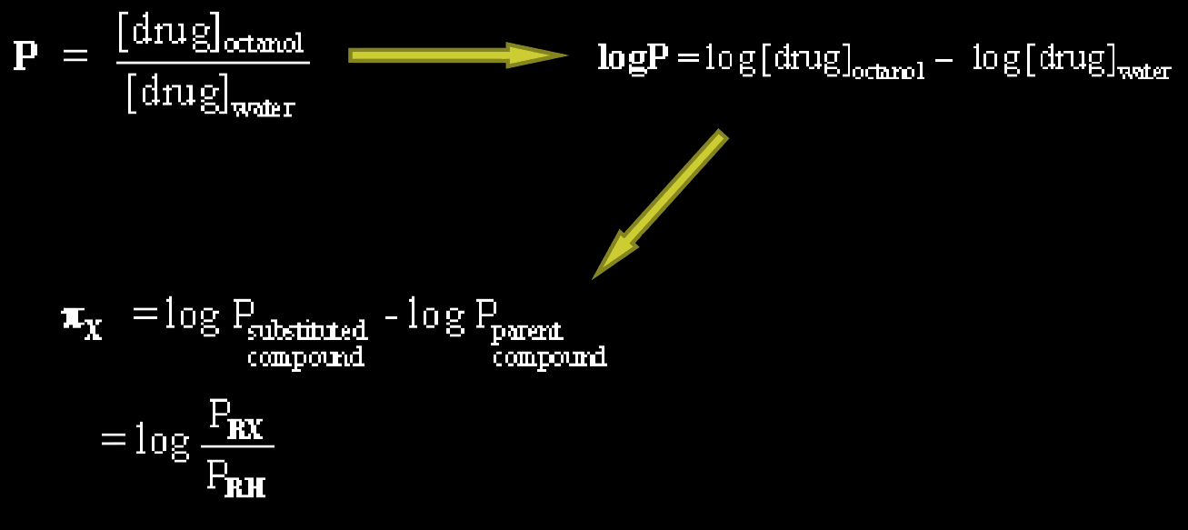
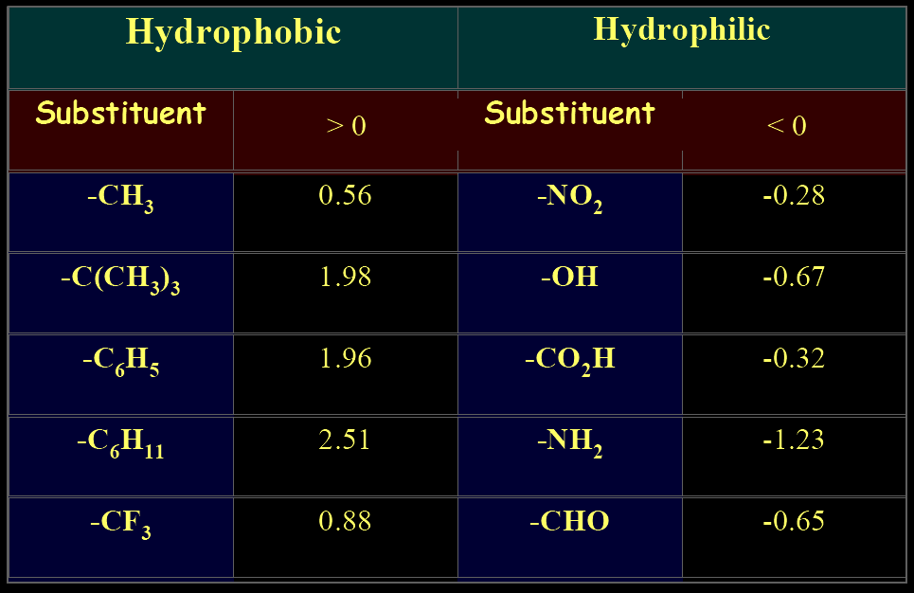
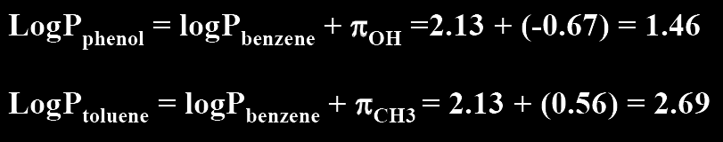
Hansch π parameter (hydrophobicity)
logP = octanol/water partition coefficient
π_{X}
π_{X} is the hydrophobic parameter for a specific substituent X.

Slide 16
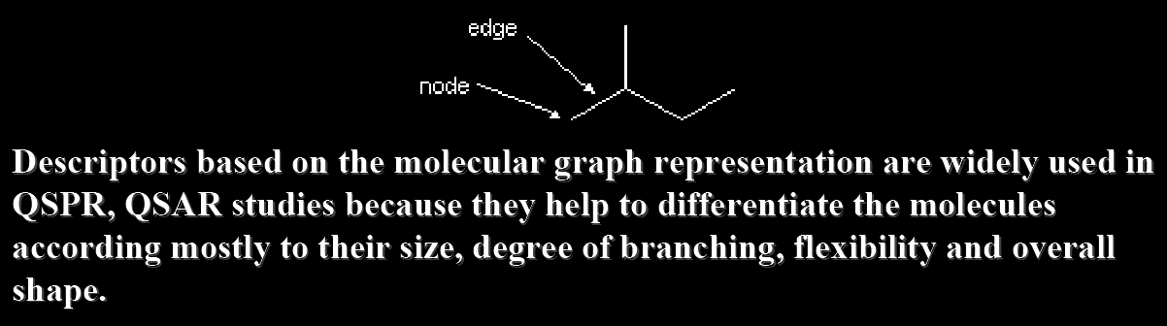
Topological Indices (TI)
Notes:
16

Slide 17
Topological Descriptors
Zagreb group indices [1]
Molecular connectivity indices
[2-5]
Hydrogen - depleted molecular graph and vertex degrees a_{i}
Extended connectivity indices [6]
Extended connectivity indices
Overall connectivity indices [7-8]
Wiener number
Platt number
Information indices
is the sum of vertex degrees connected to vertex i, ⁰b_{i}=a_{i}.
Graph radius and diameter, etc.
Connectivity indices
f=-0.5 Molecular connectivity indices
f=1 ^{n-1}M₂ Zagreb group indices
f=2 ^{n-1}M₁ Zagreb group indices
Overall connectivity indices
^{n}b^{i}_{j} vertex degree of atom j in subgraph k_{i} of order n,
f = 0, vertex degrees of subgraphs
f = 1, vertex degrees of the whole molecular graph
The number of descriptors exceeds the number of compounds
Hall, L. H.; Kier, L. B. In Reviews in Computational Chemistry II, VCH, 1991, 367-422.

Slide 18
Fragment descriptors
Sequences of atoms and bonds
I(AB, n_{min} - n_{max})
Example : I(AB, 2-4)
C-N=C-H
from n_{min} to n_{max} atoms
C-N=C
sequence
N=C-N
Atoms + Bonds
C-N
N=C
C-H
Shortest path between two atoms
n_{min} = 2; n_{max} = 15
Notes:
18

Slide 19
Fragment Descriptors^{1, 2} : sequences and augmented atoms
Suitable to encode chemical information
universal methodology for assessment of chemical properties
Derived from stuctures
Chemically interpretable
Easy to calculate
Suitable for screening of the large data sets
A. Varnek, D. Fourches, F. Hoonakker, V. Solov’ev. J. Comp.-Aided Mol. Design, 2005. 19, p. 693-703.
A. Varnek, D. Fourches, V. Solov’ev, D. Fara, A. Turanov, A. Katritzky. J. Chem. Inf. Comput. Sci., 2004. 44, p. 1365-1382.
Notes:
19

Slide 20
Atom Pair Descriptors
Distance: shortest chemical graph distance (number of
atoms) between atom i and atom j (2D AP) or physical
distance (3D AP)
i
----- (distance) -----
j
N ----- (7) ----- S
Carhart, R. E.; Smith, D. H.; J. Chem. Inf. Comput. Sci. 1985, 25, 64-73

Slide 21
Molecular Fingerprints
INFORMATION ABOUT THE PRESENCE OF MOLECULAR FRAGMENTS
Binary string of 988 bits
1
85
86
184
185
333
334
928
929
988
Bits 1-85 encode presence of two-atomic fragments with no hydrogens.
Bits 86-184 encode presence of three-atomic fragments with no hydrogens.
Bits 185-333 encode presence of hydrogen-including four-atomic fragments.
Bits 334-928 encode presence of four-to-six atomic fragments with no hydrogens.
Bits 929-988 encode presence of characteristic atoms, groups and rings.
1 – FRAGMENT IS PRESENT
0 – FRAGMENT IS ABSENT
ADJACENT 1-s, IF A COMPOUND CONTAINS MORE THAN ONE INSTANCE OF A FRAGMENT
SYBYL UNITY
Poetter, T.; Matter, H. J. Med. Chem. 1998, 41, 478-488

Slide 22
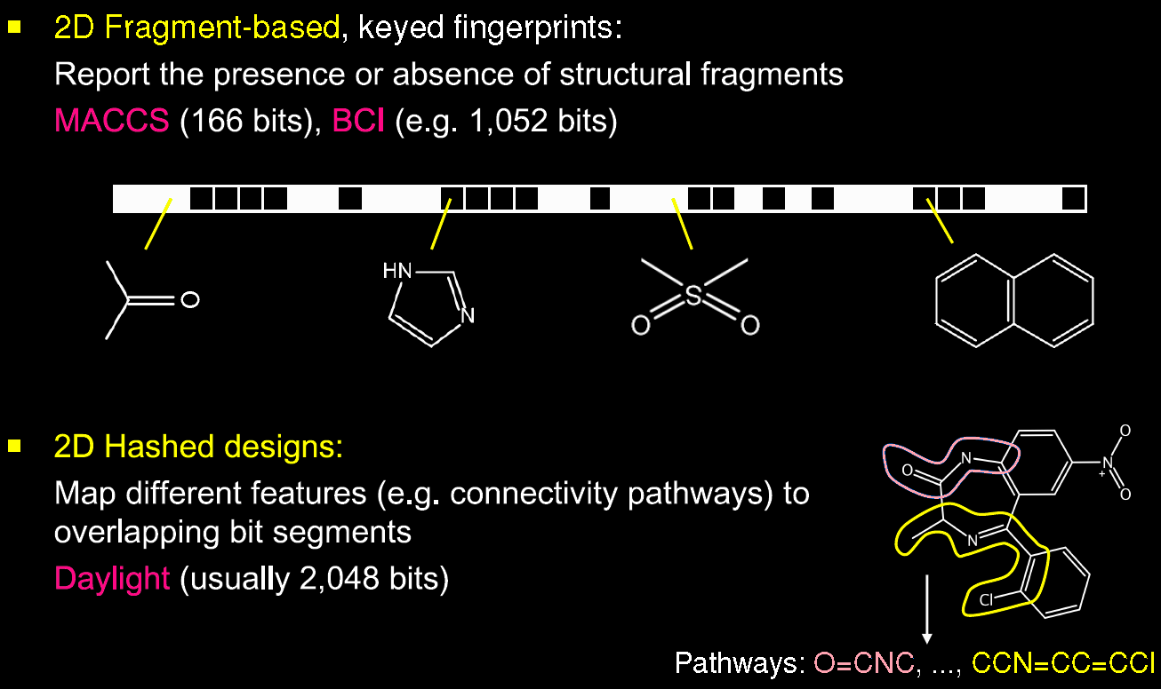
Molecular Fingerprints
each bit position monitors
From J. Bajorath, SSS Cheminformatics, Obernai 2008

Slide 23
Descriptor profiles
C-C-C-C-C-C
C-C-C-N-C-C
C-N-C-C*C
DataSet
C-C-C-N
C=O
0 10 1 5 0
0 8 1 4 0
0 4 1 2 4
Etc.
ISIDA FRAGMENTOR
Pattern matrix
Notes:
23

Slide 24
Chemical Similarity Searching
Searching for all molecules containing a given substructure or search for molecules “similar” to a given target molecule
Foundational hypothesis: similar property principle:
“structurally similar molecules are expected to exhibit similar properties or biological activities”
Mark Johnson and Gerry Maggiora (Eds.) Concepts and Applications of Molecular Similarity. Wiley, New York, 1990

Slide 25
Chemical Similarity
“Similarity is in the eye of the beholder”
Similarity can be measured in many different ways
equivalence (some arbitrary metric)
numerical measures
distance measures

Slide 26
Equivalence
Molecules identical at some level of description
molecular formula
structure graph (with no distinction between node and bond types)
reduced graph
same ring systems
same fingerprints

Slide 27
Similarity using fingerprints
similarity measures are most commonly calculated from structure fingerprints
count the bits that are “on” in both molecules
count the bits that are “on” in each molecule separately
struct A: 00010100010101000101010011110100 13 bits on (A)
struct B: 00000000100101001001000011100000 8 bits on (B)
A AND B: 00000000000101000001000011100000 6 bits on (C)
similarity coefficient can be calculated from A, B and C
B
A
C

Slide 28
Tanimoto coefficient
B
similarity = C A + B – C
= 6 / (13 + 8 – 6) = 0.4
the number of bits set in both molecules divided by the number of bits set in either molecule
The Tanimoto coefficient is the most commonly used similarity coefficient in chemical informatics
also called the Jaccard coefficient
A
C

Slide 29
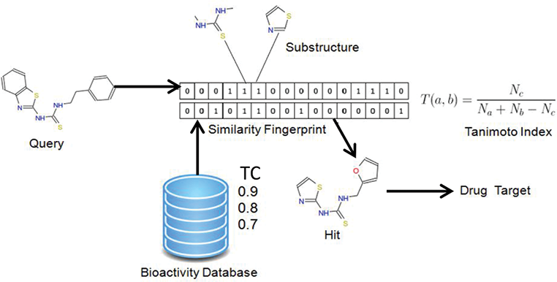
Similarity Searching against databases

Slide 30
Similarity as Euclidean distance between molecules.
Samples (Compounds) | Variables (descriptors)
 | X₁ | X₂ | ... | X_{m}
1 | X₁₁ | X₁₂ | ... | X_{1m}
2 | X₂₁ | X₂₂ | ... | X_{2m}
... | ... | ... | ... | ...
n | X_{n1} | X_{n2} | ... | X_{nm}
Molecular descriptors can be viewed as coordinates of molecules in high-dimensional descriptor space
Notes:
30

Slide 31
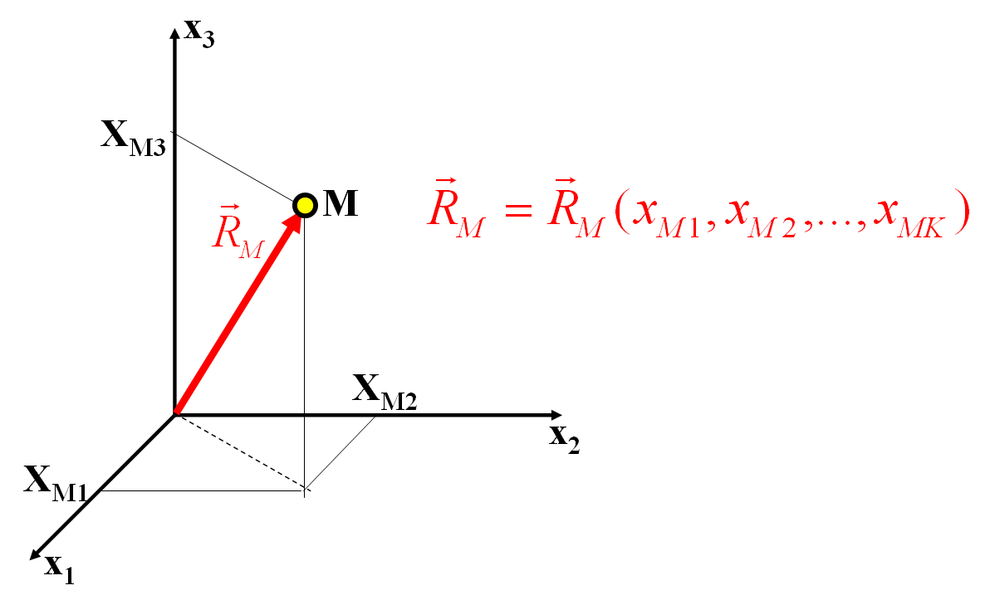
Compounds represented by vectors in a multidimensional descriptor space
Notes:
31

Slide 32
Euclidean distance
“ordinary distance”
each of n variables (descriptors) is a dimension in n-dimensional space
distance between A and B is given by
x_{jA} = value of descriptor j in molecule A
x_{jB} = value of descriptor j in molecule B

Slide 33
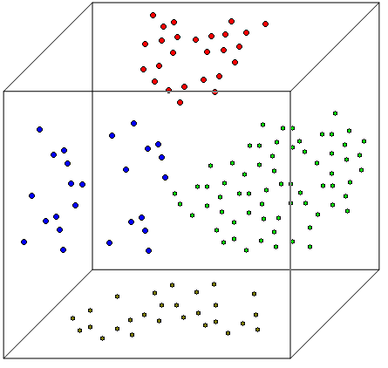
Molecules may form clusters
in chemical space
Molecules are considered as vectors in the space of descriptors (« chemical » space).
Dimensions of this space correspond to the number of descriptors.
Clustering methods are employed to analyze distances between compounds and identify clusters.
Cluster
2
Cluster
3
Cluster
1
Cluster
4
Notes:
33

Slide 34
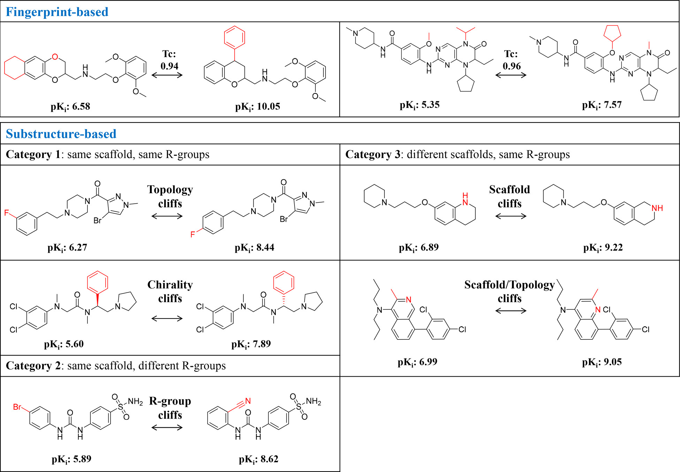
Activity Cliffs
Stumpfe et al, ACS Omega. 2019 Sep 10; 4(11): 14360–14368

Slide 35
Key take aways
Similarity searching is a fundamental concept in cheminformatics involved in practically any study
Similarity can be measured with respect to many different types of structure descriptors; none of these is “best”
Multiple similarity metrics exist; should be evaluated in the context of the “target property”
Activity cliffs represent one of the most inexplicable concepts in cheminformatics

