Slide 1
Trust… but verify!
Lecture 5
Chemical data curation

Slide 2
Objectives of this lecture
Demonstrate that a significant fraction of chemical and bioactivity data used for modeling may be erroneous
Likely to reduce the quality of derived models
Data curation is a critical and necessary step.
Discuss data curation procedures integrated into a logical functional workflow
Indicate that QSAR models using well curated primary data may be employed to spot and correct errors in databases.

Slide 3
QSAR modeling with non-curated datasets
Presence of ERRONEOUS OR
WRONG STRUCTURES
0.613
0.380
-0.222
7.08
1.146
0.491
0.301
0.141
0.956
0.256
0.799
1.195
1.005
Presence of MISPRINTS
AND WRONG NAMES
D
E
S
C
R
I
P
T
O
R
S
ERRORS in the calculation
of DESCRIPTORS
QSAR MODELS ???
Presence of DUPLICATES
Presence of MIXTURES
Presence of SALTS
Etc.

Slide 4
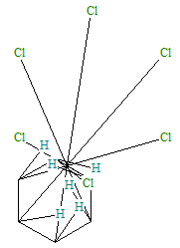
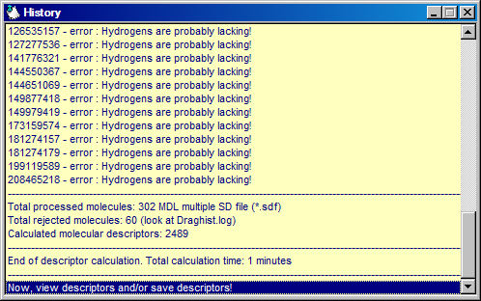
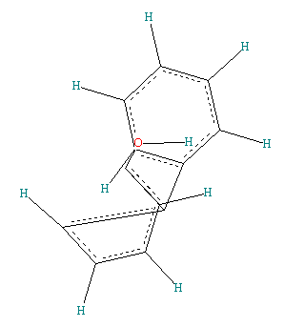
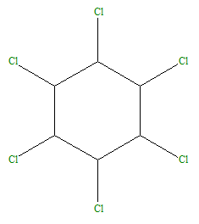
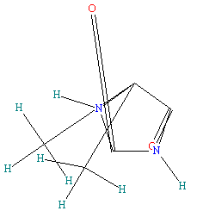
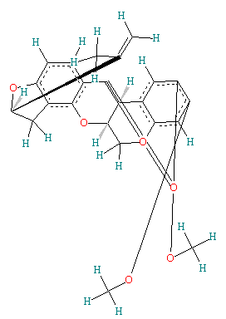
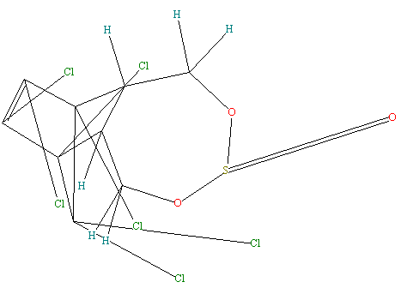
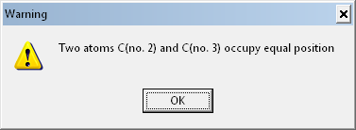
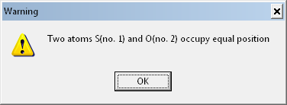
Examples of inexplicable errors in chemical databases

Slide 5
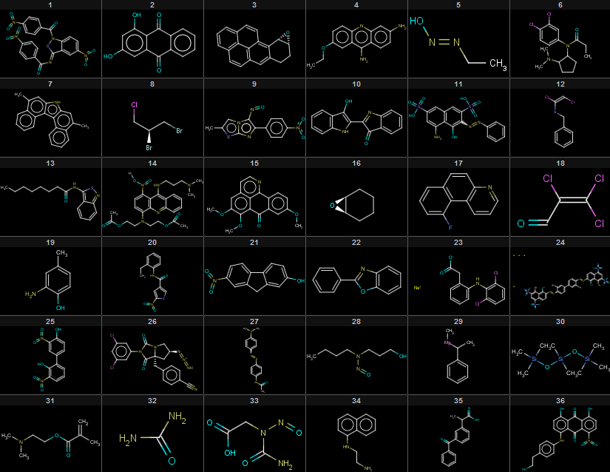
Errors are hard to spot by eyeballing
242 chemical records + 1 binary activity
Looks clean …

Slide 6
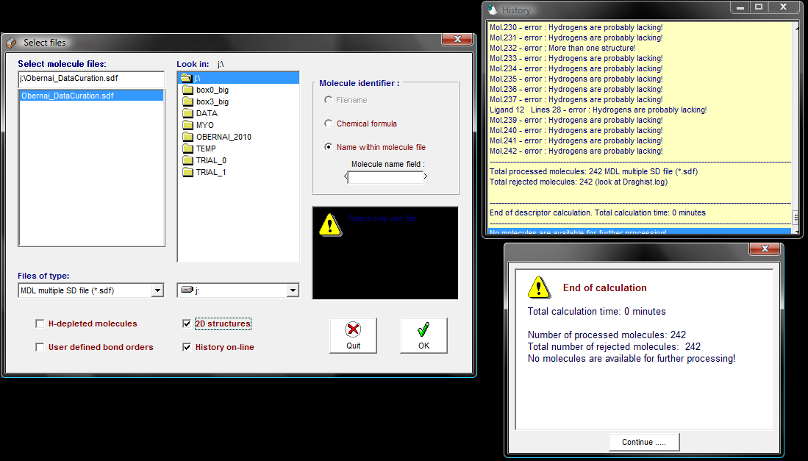
Descriptor calculation software may detect errors
Looks clean … but …

Slide 7
Data dependency and data quality are critical issues in molecular modeling
Cheminformaticians are at the mercy of data providers. Prediction performance of (Q)SAR models strongly depend on the quality of input data (both structures and activities).
Data curation is a critical procedure in the analysis of any chemical dataset. Often considered trivial, the basic steps to curate a dataset of compounds are not so obvious especially for beginners.
No universal QSAR approach guarantees to obtain the best prediction performances for any dataset. But at least, could we suggest a curation workflow that could be standardized, efficient, and successfully tested on several different datasets ?

Slide 8
Basics of data curation

Slide 9
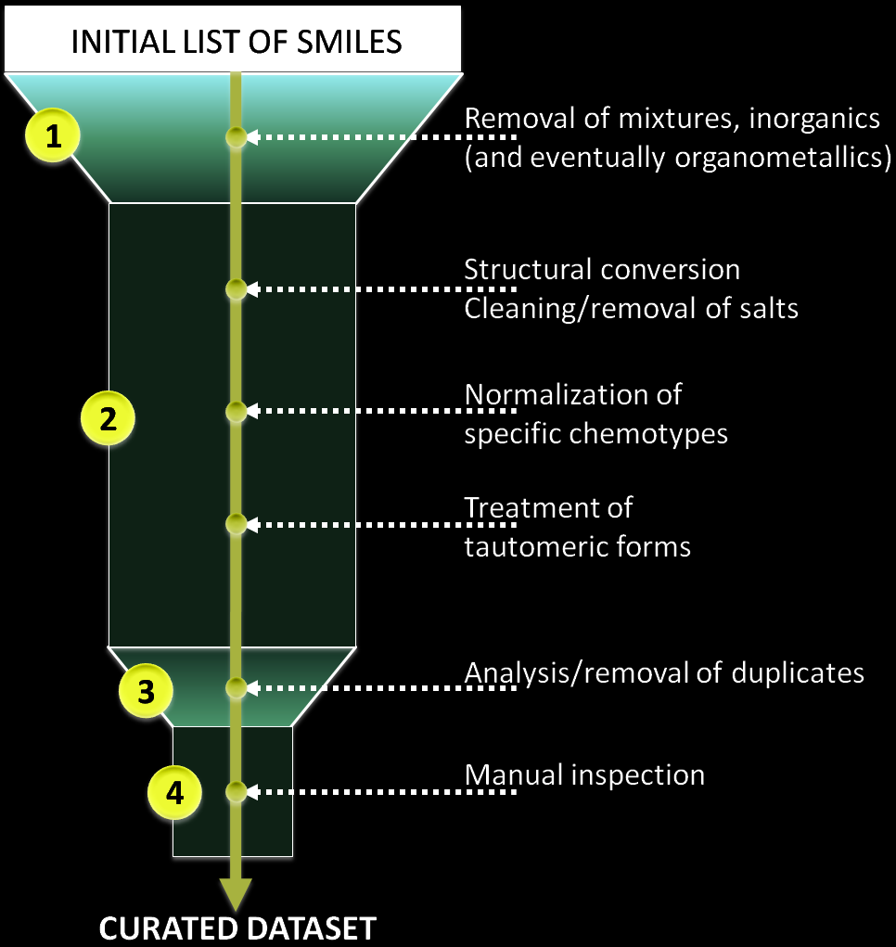
INITIAL LIST OF SMILES/STRUCTURES
difficult cases
(2D representation)

Slide 10
STEP 1 : Inorganics/Organometallics/Mixtures

Slide 11
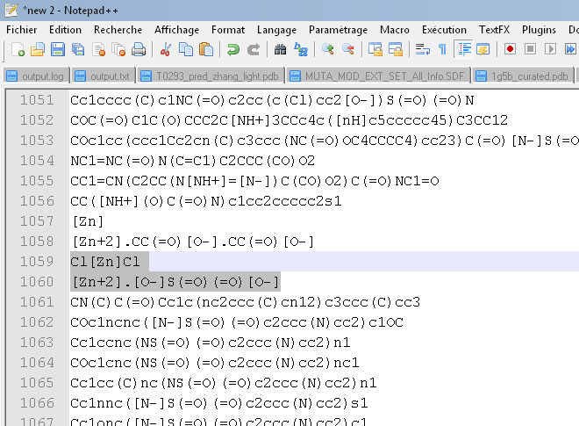
STEP 1a - Removal of inorganics
All inorganic compounds must be removed since our QSAR modeling strategy includes the calculation of molecular descriptors for organic compounds only.
This is an obvious limitation of the approach. However the total fraction of inorganics in most available datasets is relatively small.
To detect inorganics, two solutions are available:
Manual inspection of SMILES compounds possessing no carbon atom using text-editing tools.
Automatic identification using in combination Jchem (ChemAxon, cxcalc program) to output the empirical formula of all compounds and simple scripts to remove compounds with no carbon;

Slide 12
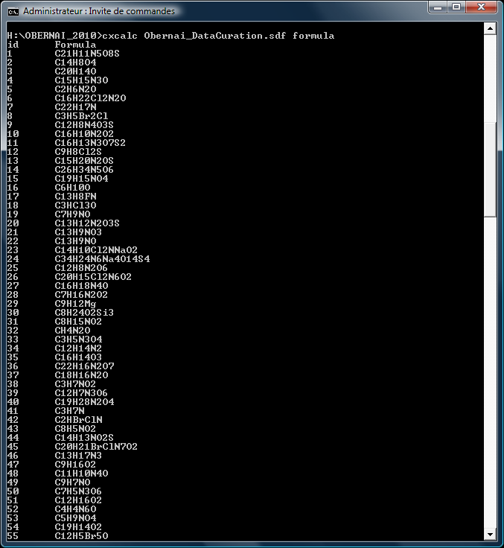
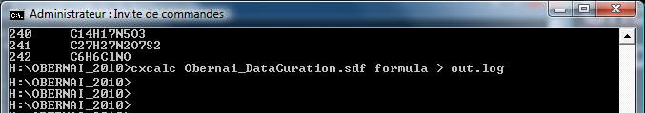
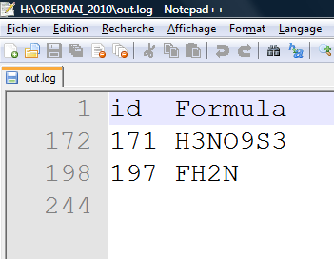
STEP 1a - Removal of inorganics
ChemAxon JChem
(cxcalc program)
2 inorganics are identified

Slide 13
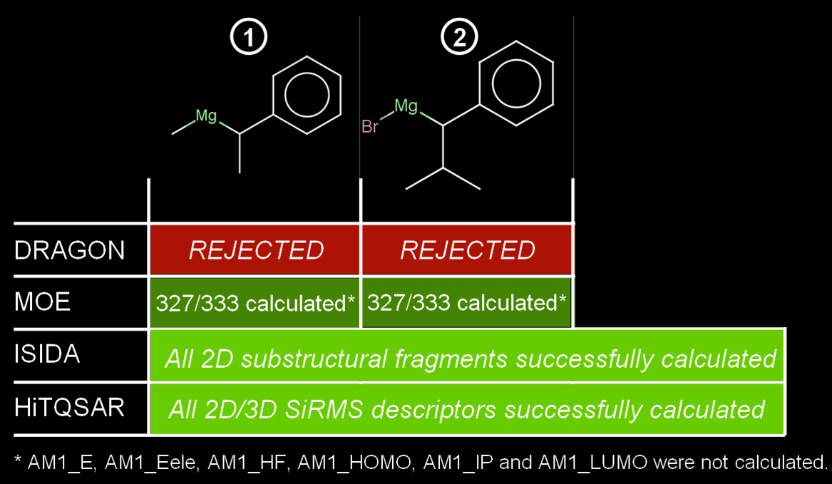
STEP 1b - Removal of organometallics
Oftentimes, a dataset includes organometallics and/or rare elements.
Relevant for the modeling?
-Are the descriptors
appropriate?

Slide 14
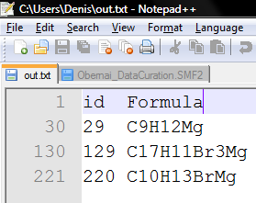
STEP 1b - Removal of organometallics
ChemAxon JChem
(cxcalc program)

Slide 15
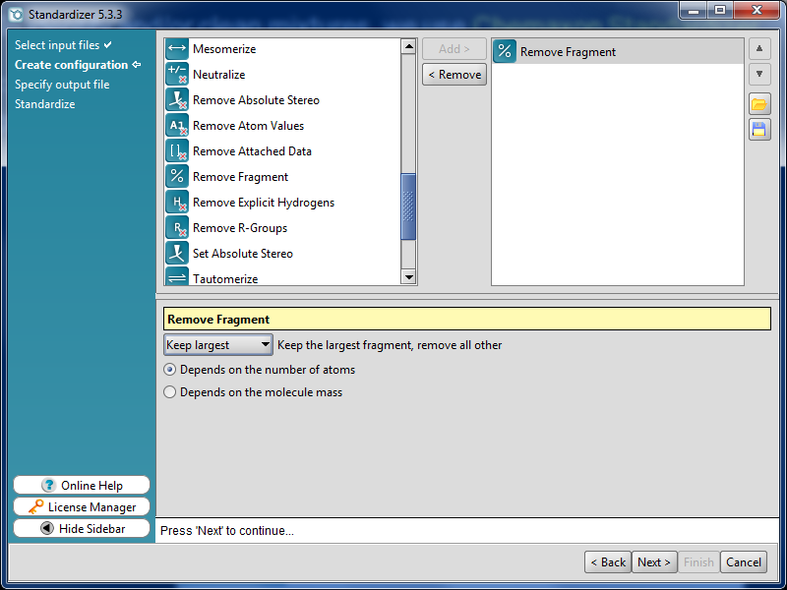
STEP 1c - Removal of mixtures
Retain the component with the highest
MW or largest number of atoms
Popular Practice
Popular Software:
ChemAxon Standardizer, MOE Wash
Large
Organic
Molecule
H₂O
HCl
Ex: hydrates,
hydrochlorides.

Slide 16
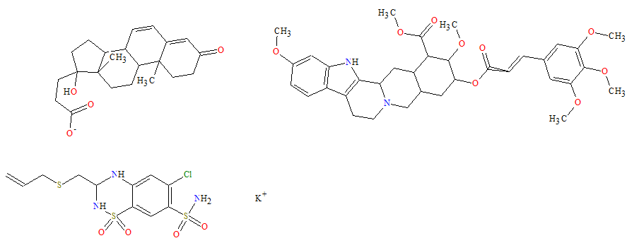
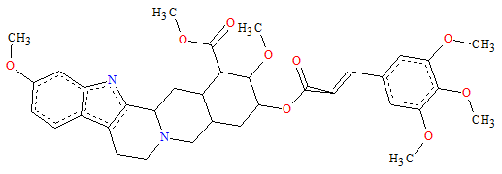
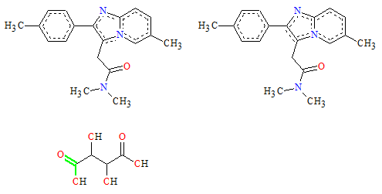
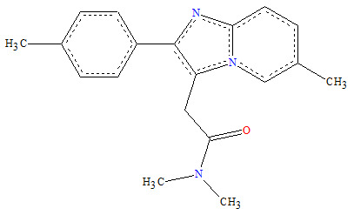
STEP 1c - Removal of mixtures
However, some cases are particularly difficult to treat.
ID=172
MANUAL INSPECTION/VALIDATION
IS STILL CRUCIAL.
CLEANED FORM BY CHEMAXON
INITIAL FORM
ID=1700
INITIAL FORM
CLEANED FORM BY CHEMAXON

Slide 17
STEP 1c - Removal of mixtures
All compounds in the mixture are identical (2D level)
Only one molecule should be kept. Racemic mixture : do both enantiomers have the same properties than the mixture ?
The mixture contains one large organic compound and several smaller ones, either organic or inorganic
Generally better to remove the entire record. However, it there are some reasons to believe that the experimental activity associated with the record is clearly caused by the largest organic molecule only, one can keep the record with this large compound only.
The mixture contains several similar organic compounds with similar MW The deletion of the entire record is recommended.
Experienced users need advanced tools to determine what kind of mixtures (type 1, 2, or 3) are present in their data sets.

Slide 18
STEP 2 :
Structural conversion/normalization

Slide 19
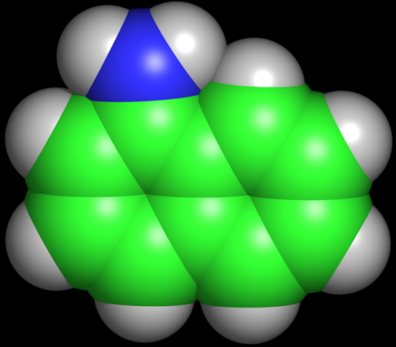
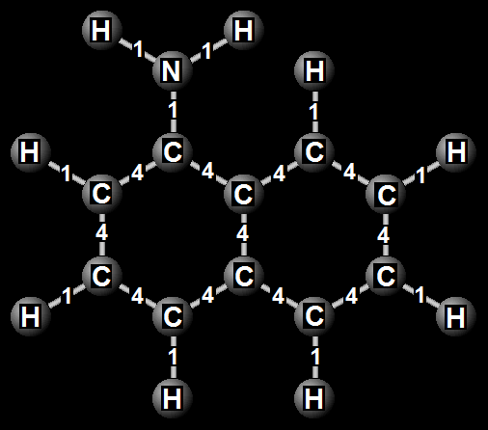
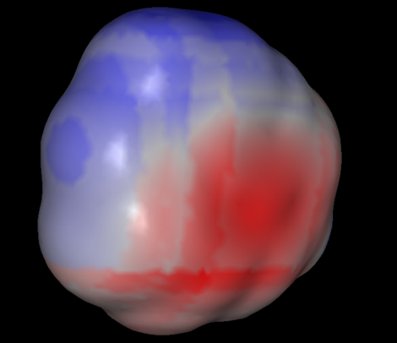
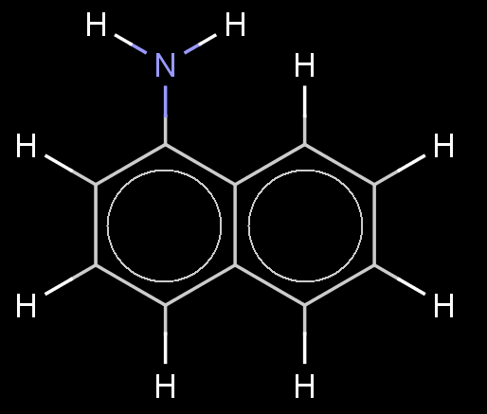
Importance of structure visualization
Without 2D conversion, it is impossible to be sure that
descriptors are calculated based on a correct
structure.
c1cccc2cccc(N)c12
Written by
cheminformaticians
naphthalen-1-amine
Viewed by another
molecule
Viewed by
computers
Viewed by chemists

Slide 20
Structure standardization
For a given dataset, chemical groups have to be written in a standardized way, taking into account critical properties (like pH) of the modeled system.
Aromatic compounds
These two different representations of the same
compound will lead to different descriptors, especially
with certain fingerprint or fragmental approaches.
Carboxylic acids, nitro groups etc.
For a given dataset, these functional groups have to be written in a consistent way to
avoid different descriptor values for the same chemical group.

Slide 21
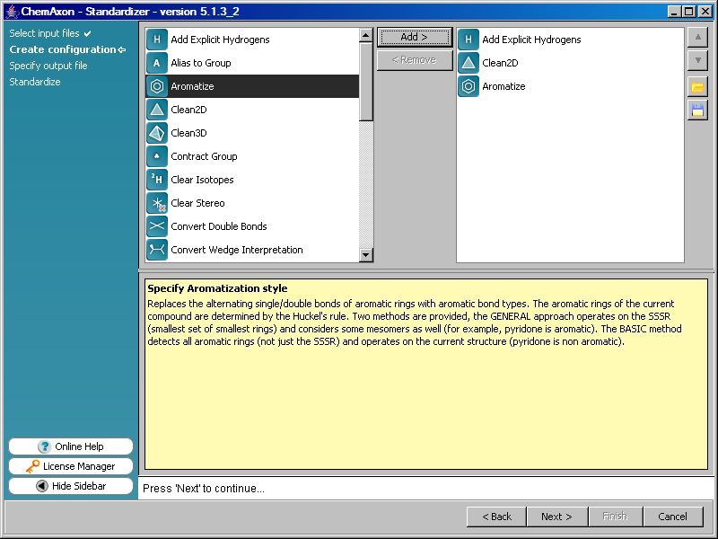
STEP 2 - Aromatization and 2D cleaning
ChemAxon Standardizer offers two ways to aromatize benzene rings,
both of them based on Hűckel’s rules.
“General Style”
“Basic Style”
Most descriptor calculation packages recognize the “basic style” only.
http://www.chemaxon.com/jchem/marvin/help/sci/aromatization-doc.html

Slide 22
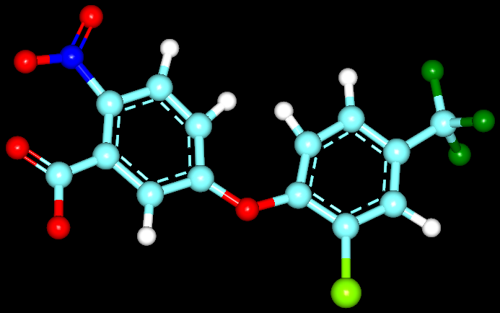
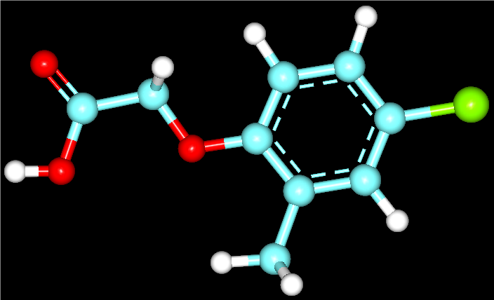
Standardization of atom types and functional group representation is needed as it affects descriptor values

Slide 23
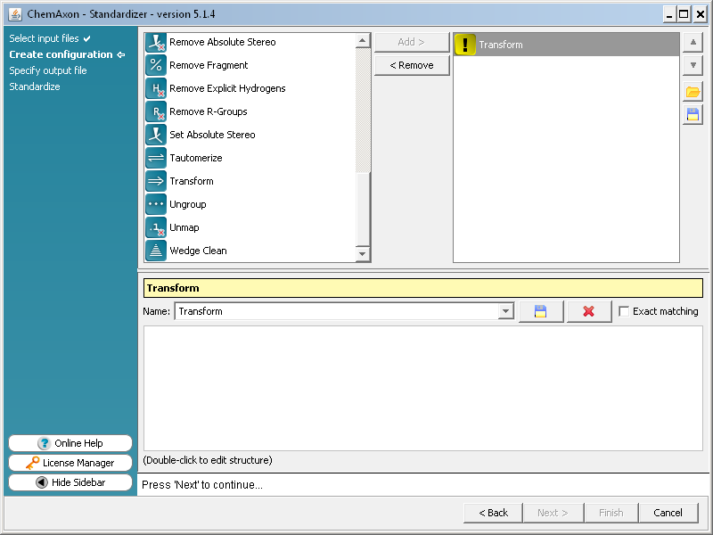
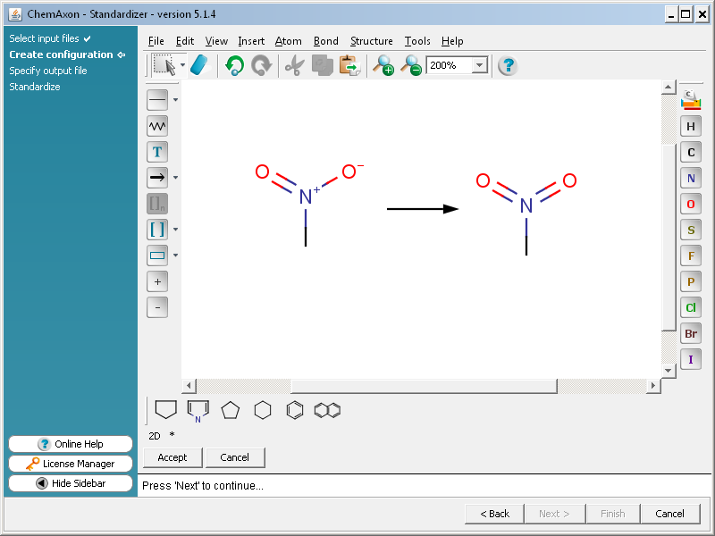
STEP 2 - Normalization of carboxylic,
nitro groups, etc.

Slide 24
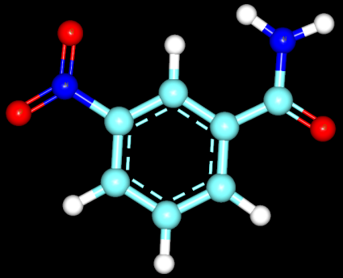
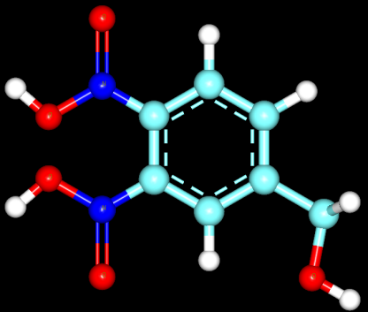
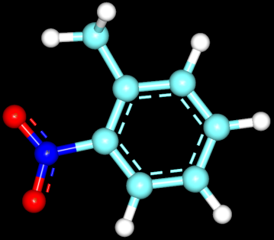
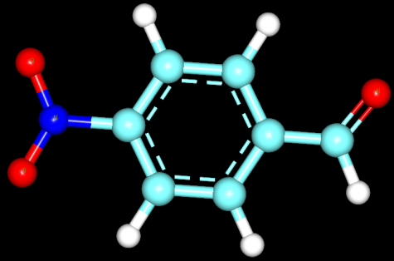
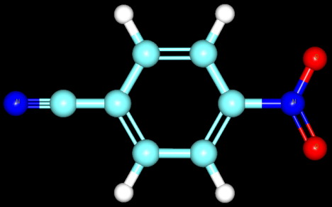
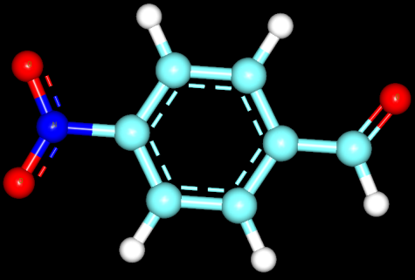
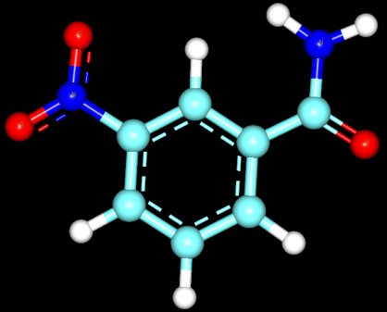
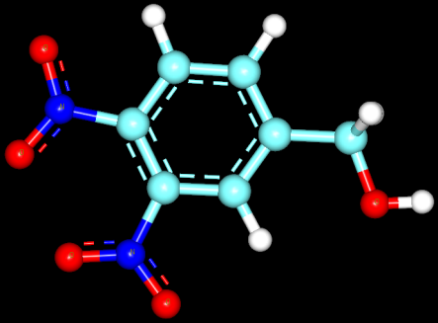
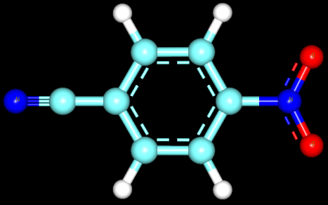
Nitroaromatic’s Tale
n = 28, R² _{test} < 0.2
n = 28, R² _{test} > 0.8

Slide 25
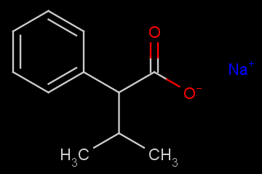
Difficult cases – “Covalent” salts
Curated by Standardizer
Not curated by Standardizer
More advanced tools are needed to treat such cases of salts
labeled with covalent bonds.
Protocol
Calculate fragment descriptors for each compound of the dataset;
Analyze the presence of certain critical fragments like Na-O, K-O,
etc.
(-Use scripts to transform selected records into regular cases)

Slide 26
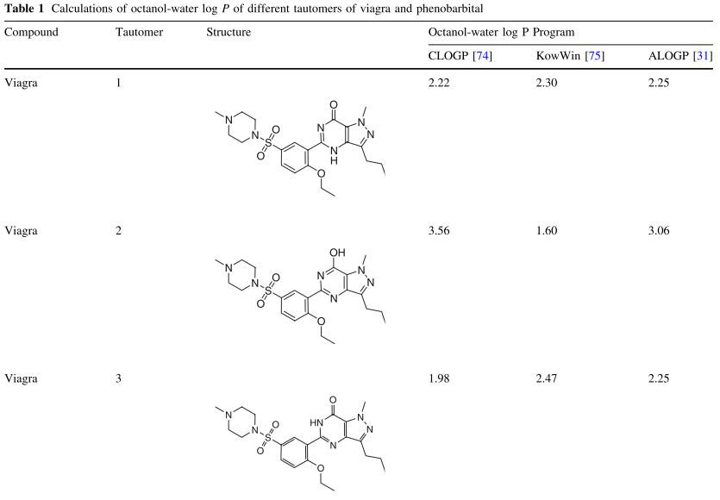
Difficult cases – be mindful of tautomers
Y.Martin. Let's not forget tautomers. J. Comput.-Aided Mol. Des., 2009, 23, 693-704.

Slide 27
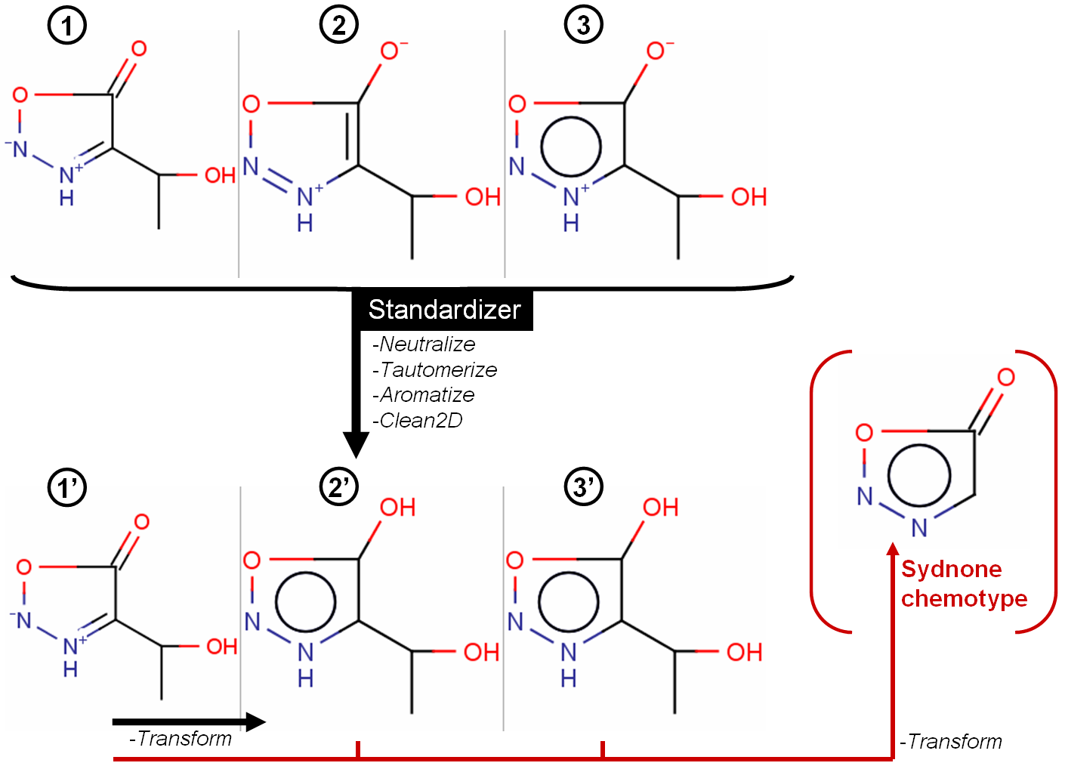
Difficult cases – Rare chemotypes

Slide 28
STEP 3 : Search for DUPLICATES

Slide 29
Why duplicates are unsafe for QSAR ?
Duplicates are identical compounds present in a given dataset.
For example:
ID = 256
ID = 879
ID = 2346
Manual identification of duplicates is practically impossible especially when the dataset is large.
Activity analysis of duplicates is also highly important to identify cases where one occurrence is identified as ‘active’ and another one as ‘weak active’ or ‘inactive’.
ACTIVE
INACTIVE

Slide 30
Why duplicates are unsafe for QSAR ?
With Duplicates
Modeling
Set
(to build and
select models)
Modeling Set
Multiple
Splits
Multiple
Split
External
Test Set
External
Test Set
(to validate
selected
models)
The presence of duplicates in both modeling and test sets may dramatically affect the statistical parameters assessing the prediction performances of models.
ENTIRE
DATASET
ENTIRE
DATASET

Slide 31
Why duplicates are bad for QSAR: case study
Ames Mutagenicity dataset includes 7096 compounds classified as mutagenic or non-mutagenic: http://ml.cs.tu-berlin.de/toxbenchmark
We have identified 598 pairs of duplicates (~9%) and removed from the entire set of 7090 compounds.
The group that provided us with the dataset has already published preliminary modeling results*. Five randomly chosen splits were checked and showed that 229-255 out of 598 pairs of duplicates were simultaneously present in both modeling and external validation set
Their presence led to an overestimated prediction accuracy of the models derived from that dataset as well as an important bias in the model building and selection.
Lack of any statement about data curation in a paper should make the reader question the reported accuracy of the model
* Schwaighofer, A.; Schroeter, T.; Mika, S.; Hansen, K.; Ter Laak, A.; Lienau, P.; Reichel, A.; Heinrich, N.; K-R., M. A probabilistic approach to classifying metabolic stability. J. Chem. Inf. Model. 2008, 48, 785-796.

Slide 32
SMILES and duplicates
CC(C)(C)C1=CC(=O)C=CC1=O
CCCCON(OC(C)=O)C(=O)C1=CC=C(Br)C=C1
O=C(OCC)C
CCCC[C@H](CC)C(O)=O
CN(C)CCOC(=O)C(C)=C
CN(N=O)C1=CC=NC=C1
CCCNC1=C2C=CC=CC2=NS1
FC1=CC=C(CN2C3C2C2=CC=CC=C2C2=CC=CC=C32)C=C1
COC1=CC=C2C=C(C=CC2=C1)C(C)C(O)=O
CC[C@@H](C)ON=O
C(=O)(OCC)C
CCOC1=CC=CC=C1OCC1CNCCO1
[H]O[N+](=O)OCCN(C)N(O)O
O=C1NC2=CC3=C(C=CC=C3)C3=C2C1=CC1=C3OCO1
Cc1c2ccccc2c(CCl)c2ccccc12
O(C(C)=O)CC
CC1=CC(=CC=C1N(=O)=O)N(=O)=O
Any duplicates ?

Slide 33
SMILES and duplicates
A current practice consists of identifying duplicates from SMILES strings, which is correct if and only if the latter are canonical SMILES.
CC(C)(C)C1=CC(=O)C=CC1=O
CCCCON(OC(C)=O)C(=O)C1=CC=C(Br)C=C1
O=C(OCC)C
CCCC[C@H](CC)C(O)=O
CN(C)CCOC(=O)C(C)=C
CN(N=O)C1=CC=NC=C1
CCCNC1=C2C=CC=CC2=NS1
FC1=CC=C(CN2C3C2C2=CC=CC=C2C2=CC=CC=C32)C=C1
COC1=CC=C2C=C(C=CC2=C1)C(C)C(O)=O
CC[C@@H](C)ON=O
C(=O)(OCC)C
CCOC1=CC=CC=C1OCC1CNCCO1
[H]O[N+](=O)OCCN(C)N(O)O
O=C1NC2=CC3=C(C=CC=C3)C3=C2C1=CC1=C3OCO1
Cc1c2ccccc2c(CCl)c2ccccc12
O(C(C)=O)CC
CC1=CC(=CC=C1N(=O)=O)N(=O)=O
Same compound
Ethyl acetate
CCOC(C)=O

Slide 34
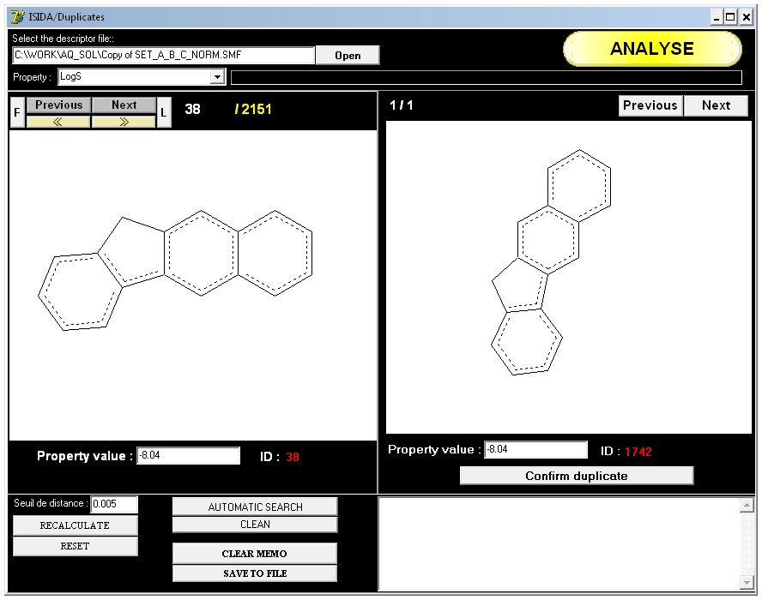
STEP 3 - Search for DUPLICATES (e.g., ISIDA-duplicates)
Based on chemical descriptors as inputs, the program can take into account isomers (including stereochemistry)
Instant recognition
of duplicates
38 and 1742
(impossible to
do it manually)
Modeled Properties
of duplicates

Slide 35
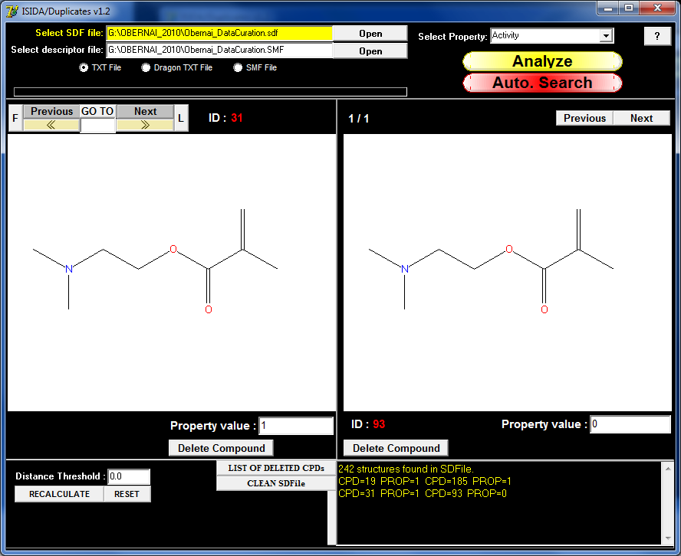
STEP 3 - Search for DUPLICATES (e.g., ISIDA-duplicates)
19 (1) 185 (1)
31 (1) 93 (0)
79 (1) 200 (0)
126 (1) 229 (1)
4 pairs of
duplicates
are
Identified.

Slide 36
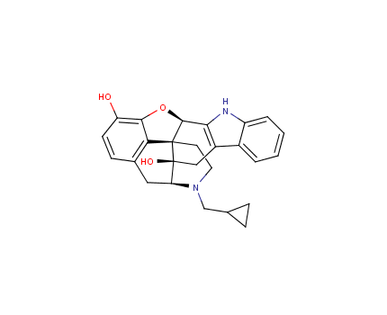
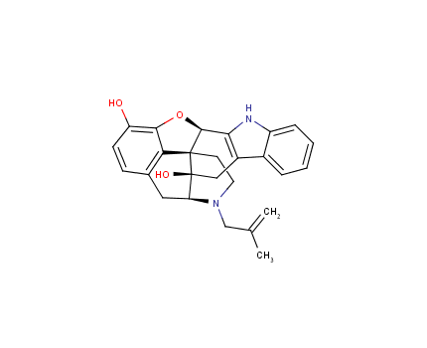
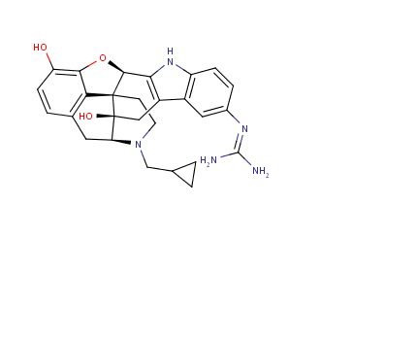
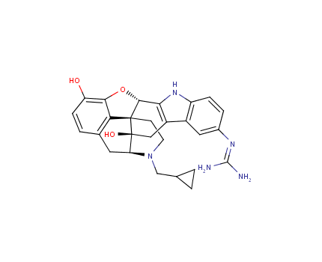


Neighborhood Analysis for Duplicates
17,000 compounds screened against five major CYP450 isozymes.
JCIM, 2011, 51, 2474–81
1,280 pairs of duplicates couples were found (874 had different bioprofiles)
2C19 | 2D6 | 3A4 | 1A2 | 2C9 | Supplier | SID | Tocris-0740
-4.5 | -6.2 | -4.6 | -4.4 | -4.6 | Tocris | 11113673 | CID_6603937
-5 | -5.6 | -8 |  | -4.4 | Sigma Aldrich | 11111504 | CID_6603937
2C19 | 2D6 | 3A4 | 1A2 | 2C9 | Supplier | SID | Tanimoto Similarity | 5 Nearest neighbors
5.5- |  | 4.5- |  |  | Tocris | 11114071 | 0.98 | 6604862
 |  | 5.1- |  |  | Sigma Aldrich | 11112029 | 0.98 | 6604106
 |  |  |  |  | Tocris | 11114012 | 0.98 | 6604846
 | 5.9- | 4.8- |  |  | Sigma Aldrich | 11112054 | 0.95 | 6604136
 | 4.5- | 4.7- | 4.4- |  | Tocris | 11113764 | 0.95 | 6604137

Slide 37
Problems with IC50 calculation

Slide 38
Unusual (and amazing!) data irreproducibility between data in a published paper and in Pubchem
From: Date: March 17, 2015 at 4:58:07 PM EDT To: Subject: RE: Ebola hits
A lot of what you are seeing in terms of discrepancies is human error. Curve fits
were done to obtain the IC50 and efficacy values.
However, sometimes the biologists take my processed results and run them
through another software called PRISM. They do this because it makes
publication grade graphics for their dose response curves. The problem
here is that PRISM does the fitting a little different than how I do it. So
the PRISM AC50 and efficacy values will be slightly different than what I
entered into PubChem but not too much so (AT: 80% concordance).
When writing the paper the biologist have probably entered a mix of PRISM
AC50s, efficacies and PubChem AC50s and efficacies. In addition
sometimes errors are made (probably) where max efficacy and AC50 are
switched, and so on.

Slide 39
STEP 4 : Final Manual Inspection

Slide 40
Manual inspection of every molecular structure is a problem for large datasets
What about large data sets?
- Check only compounds with complex structures or having a large number of atoms.
- Generate a representative sample of the set and then, check it for the presence of potentially erroneous structures.
- Rechecking of the whole data set may become unavoidable if significant errors are found.

Slide 41
Wrong structures…
- Identification of incorrect structures is the most difficult part of the data curation.
- Random human errors when structures have been drawn/converted.
Compound’s name
(if available)
Compound’s structure
Unfeasible for large data sets
It would take a restrictive amount of time to discover that particular chlorine has to be in position 2 and not in position 1 in the 58 653th compound of the studied data set…
Protocol
Mine freely available chemical databases to retrieve chemical structures from a list of names or CAS numbers;
Analyze multiple entries representing the same compounds.
(e.g., entries of 2-chlorobenzylsulfonamide or CAS 89665-79-2 must represent the same compound)

Slide 42
Summary of major procedures and corresponding relevant software for every step of the data curation process
Procedures | Software | Availability
Inorganics Removal | ChemAxon/JChem OpenEye/Filter | Free for Academia Free for Academia
Structure Normalization (fragment removal, structural curation, salt neutralization) | ChemAxon/Standardizer OpenBabel Molecular Networks/ CHECK,TAUTOMER | Free for Academia Free Commercial
Duplicate Removal | ISIDA/Duplicates HiT QSAR CCG/MOE | Free for Academia Free for Academia Commercial
SDF management/ viewer File format converter | ISIDA/EdiSDF Hyleos/ChemFileBrowser OpenBabel ChemAxon/MarwinView CambridgeSoft/ChemOffice Schrodinger/Canvas ACD/ChemFolder Symyx Cheminformatics CCG/MOE Accelrys/Accord Tripos/Benchware Pantheon | Free Free Free Free for Academia Commercial Commercial Commercial Commercial Commercial Commercial Commercial

Slide 43

Chemical-Biological Curation Workflow
Fourches, Muratov, Tropsha. J Chem. Inf. Model, 2016, 56, 1243.

Slide 44
Conclusions
It is highly risky to calculate chemical descriptors directly from smiles. It is preferable to compute descriptors (Dragon, fragments, simplex etc.) from curated 2D (or 3D if necessary) structures.
The conversion of smiles into 2D structures using Marvin, MOE, ChemOffice etc. can produce some major structural errors. That’s why an additional manual step is most of the time needed to complete the curation.
The structure normalization step is critical. Several tasks like the aromatization of bonds, salt removing, are relatively easy to perform.
Duplicates searching and removal is one of mandatory steps in QSAR analysis. In addition, it will show the quality of your data.
Nothing can substitute your participation in the process, some obvious for human errors are not obvious for computer

