Slide 1
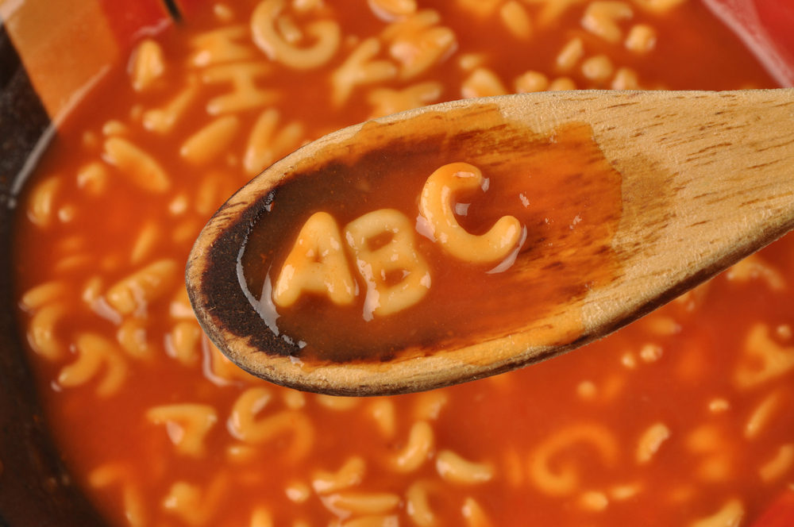
Alphabet Soup Non-Profit Foundation
Neural Network exercise to funding nonprofit applicants with the best predicted chance of success in their venture.

