Slide 1

Introduction to Parallel Programming
Center for Institutional Research Computing
Slides for the book "An introduction to Parallel Programming", by Peter Pacheco (available from the publisher website): http://booksite.elsevier.com/9780123742605/

Slide 2


Serial hardware and software
programs
input
Computer runs one
program at a time.
output

Slide 3

Why we need to write parallel programs
Running multiple instances of a serial program often isn’t very useful.
Think of running multiple instances of your favorite game.
What you really want is for it to run faster.

Slide 4
How do we write parallel programs?
Task parallelism
Partition various tasks carried out solving the problem among the cores.
Data parallelism
Partition the data used in solving the problem among the cores.
Each core carries out similar operations on it’s part of the data.

Slide 5

Professor P
15 questions
300 exams

Slide 6

Professor P’s grading assistants
TA#1
TA#2
TA#3

Slide 7
Division of work – data parallelism
TA#1
TA#3
100 exams
100 exams
TA#2
100 exams

Slide 8
Division of work – task parallelism
TA#1
TA#3
Questions 11 - 15
or
Questions 12 - 15
Questions 1 - 5
or
Questions 1 - 7
TA#2
Questions 6 - 10
or
Partitioning strategy:
- either by number
- Or by workload
Questions 8 - 11

Slide 9
Coordination
Cores usually need to coordinate their work.
Communication – one or more cores send their current partial sums to another core.
Load balancing – share the work evenly among the cores so that one is not heavily loaded.
Synchronization – because each core works at its own pace, make sure cores do not get too far ahead of the rest.

Slide 10
What we’ll be doing
Learning to write programs that are explicitly parallel.
Using the C language.
Using the OpenMP extension to C (multi-threading for shared memory)
Others you can investigate after this workshop:
Message-Passing Interface (MPI)
Posix Threads (Pthreads)

Slide 11
Essential concepts
Memory
Process execution terminology
Configuration of Kamiak
Coding concepts for parallelism - Parallel program design
Performance
OpenMP

Slide 12
.c programs we will use
loop.c
sync.c
sumcomp.c
matrix_vector.c (for independent study)
Step 1: log into kamiak
Step 2: run command: training

Slide 13
Memory
Two major classes of parallel programming models:
Shared Memory
Distributed Memory

Slide 14
Shared Memory Architecture
Threads
Threads
Threads
CPU core #1
CPU core
CPU core
…
Cache ($)
Cache ($)
Cache ($)
Memory bus
Memory (Shared address space)
All threads can see a single shared address space. Therefore, they can see each other’s data.
Compute node
I/O bus
Each compute node has 1-2 CPUs each with 10-14 cores
disk
Notes:
Ask jeff to add in notes about the standard compute node architecture

Slide 15
Multi-Threading (for shared memory architectures)
Threads are contained within processes
One process => multiple threads
All threads of a process share the same address space (in memory).
Threads have the capability to run concurrently (executing different instructions and accessing different pieces of data at the same time)
But if the resource is occupied by another thread, they form a queue and wait.
For maximum throughput, it is ideal to map each thread to a unique/distinct core
Threads
CPU cores
Cache ($)
Memory (Shared address space)

Slide 16
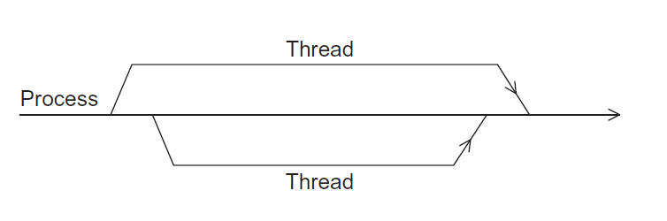
A process and two threads
the “master” thread
terminating a thread
Is called joining
starting a thread
Is called forking

Slide 17
Distributed Memory Architecture
Compute node 1
Compute node 2
Compute node m
Processes running on cores
Processes running on cores
Processes running on cores
………
Local Memory
Local Memory
Local Memory
Network Interconnect
Processes cannot see each other’s memory address space.
They have to send inter-process messages (using MPI).

Slide 18
Distributed Memory System
Clusters (most popular)
A collection of commodity systems.
Connected by a commodity interconnection network.
Nodes of a cluster are individual computers joined by a communication network.
a.k.a. hybrid systems
Kamiak provides an Infiniband interconnect between all compute nodes

Slide 19
Single Program Models: SIMD vs. MIMD
SP: Single Program
Your parallel program is a single program that you execute on all threads (or processes)
SI: Single Instruction
Each thread should be executing the same line of code at any given clock cycle.
MI: Multiple Instruction
Each thread (or process) could be independently running a different line of your code (instruction) concurrently
MD: Multiple Data
Each thread (or process) could be operating/accessing a different piece of the data from the memory concurrently

Slide 20
Single Program Models: SIMD vs. MIMD
SIMD
MIMD
// Begin: parallel region of the code
…
..
..
..
..
..
..
..
..
..
..
// End: parallel region of the code
// Begin: parallel region of the code
…
..
..
..
..
..
..
..
..
..
..
// End: parallel region of the code
All threads executing the same line of code. They may be accessing different pieces of data.
Thread 1
Thread 2
Thread 3

Slide 21
Foster’s methodology
Partitioning: divide the computation to be performed and the data operated on by the computation into small tasks. The focus here should be on identifying tasks that can be executed in parallel.

Slide 22

Foster’s methodology
Communication: determine what communication needs to be carried out among the tasks identified in the previous step.

Slide 23
Foster’s methodology
Agglomeration or aggregation: combine tasks and communications identified in the first step into larger tasks. For example, if task A must be executed before task B can be executed, it may make sense to aggregate them into a single composite task.

Slide 24
Foster’s methodology
Mapping: assign the composite tasks identified in the previous step to processes/threads. This should be done so that communication is minimized, and each process/thread gets roughly the same amount of work.

Slide 25
Example from sum.c
Open sum.c
What can be parallelized here?

Slide 26
OpenMP for shared memory multithreaded programming

Slide 27
Roadmap
Writing programs that use OpenMP.
Using OpenMP to parallelize many serial for loops with only small changes to the source code.
Task parallelism.
Explicit thread synchronization.
Standard problems in shared-memory programming.

Slide 28
Pragmas
Special preprocessor instructions.
Typically added to a system to allow behaviors that aren’t part of the basic C specification.
Compilers that don’t support the pragmas ignore them.
#pragma

Slide 29
OpenMp pragmas
# pragma omp parallel
# include omp.h
Most basic parallel directive.
The number of threads that run the following structured block of code is determined by the run-time system.

Slide 30
clause
Text that modifies a directive.
The num_threads clause can be added to a parallel directive.
It allows the programmer to specify the number of threads that should execute the following block.
# pragma omp parallel num_threads ( thread_count )

Slide 31

Some terminology
In OpenMP parlance the collection of threads executing the parallel block — the original thread and the new threads — is called a team, the original thread is called the master, and the additional threads are called worker.

Slide 32
In case the compiler doesn’t support OpenMP
# include <omp.h>
#ifdef _OPENMP
# include <omp.h>
#endif

Slide 33
In case the compiler doesn’t support OpenMP
# ifdef _OPENMP
int my_rank = omp_get_thread_num ( );
int thread_count = omp_get_num_threads ( );
# e l s e
int my_rank = 0;
int thread_count = 1;
# endif

Slide 34
Serial version of “hello world”
#include <stdio.h>
int main()
{
printf("Hello world\n");
return 0;
}
Compile it: gcc hello.c
How do we invoke omp in this case?

Slide 35
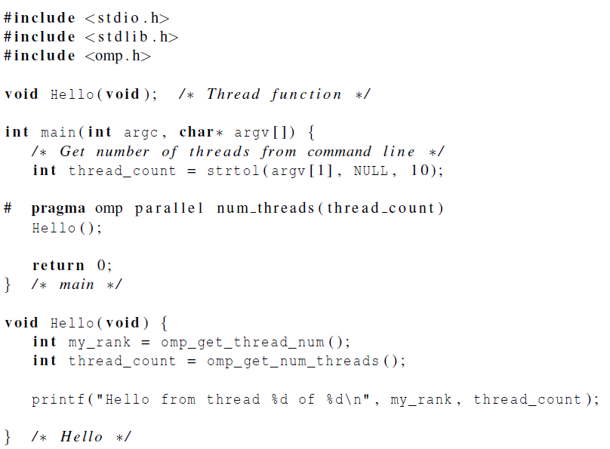
After invoking omp
Compile it: gcc –fopenmp hello.c

Slide 36
Parallel Code Template (OpenMP)
#include <omp.h>
main(…) {
… // let p be the user-specified #threads
omp_set_num_threads(p);
#pragma omp parallel for
{
…. // openmp parallel region where p threads are active and running concurrently
}

Slide 37
Scope
In serial programming, the scope of a variable consists of those parts of a program in which the variable can be used.
In OpenMP, the scope of a variable refers to the set of threads that can access the variable in a parallel block.

Slide 38

Scope in OpenMP
A variable that can be accessed by all the threads in the team has shared scope.
A variable that can only be accessed by a single thread has private scope.
The default scope for variables declared before a parallel block is shared.

Slide 39
Loop.c
Lets go over our first code – loop-serial.c
Now edit to employ omp, save as loop-parallel.c

Slide 40
Performance

Slide 41

Taking Timings
What is time?
Start to finish?
A program segment of interest?
CPU time?
Wall clock time?

Slide 42
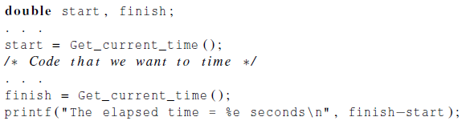
Taking Timings
theoretical
function
omp_get_wtime
MPI_Wtime
Notes:
Students would test different timings of loop.c in class.

Slide 43

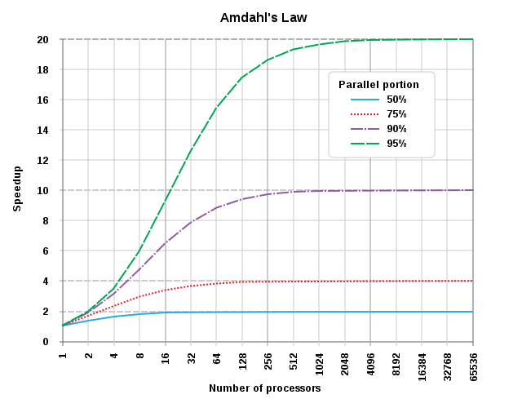
Speedup
Number of threads = p
Serial run-time = T_{serial}
Parallel run-time = T_{parallel}
T_{parallel} = T_{serial} / p
T_{serial}
S =
T_{parallel}

Slide 44
Scalability
In general, a problem is scalable if it can handle ever increasing problem sizes.
If we increase the number of processes/threads and keep the efficiency fixed without increasing problem size, the problem is strongly scalable.
If we keep the efficiency fixed by increasing the problem size at the same rate as we increase the number of processes/threads, the problem is weakly scalable.

Slide 45
Studying Scalability
Table records the parallel runtime (in seconds) for varying values of n and p.
Input size (n) | Number of threads (p)
 | 1 | 2 | 4 | 8 | 16
1,000
2,000
4,000
8,000
16,000
It is conventional to test scalability in powers of two (or by doubling n and p).
Notes:
Have animation on these slides

Slide 46
Studying Scalability
Table records the parallel runtime (in seconds) for varying values of n and p.
Input size (n) | Number of threads (p)
 | 1 | 2 | 4 | 8 | 16
1,000 | 800 | 410 | 201 | 150 | 100
2,000 | 1,601 | 802 | 409 | 210 | 120
4,000 | 3,100 | 1,504 | 789 | 399 | 208
8,000 | 6,010 | 3,005 | 1,500 | 758 | 376
16,000 | 12,000 | 6,000 | 3,001 | 1,509 | 758
Strong scaling behavior
Weak scaling behavior
It is conventional to test scalability in powers of two (or by doubling n and p).
Notes:
Have animation on these slides

Slide 47
Studying Scalability
Speedup
Time (sec)
p
p

Slide 48
Timings with loop-parallel.c (your code) or loop.c (our code)
You try!
< 10 minutes

Slide 49
Serial vs. Parallel Reduction
Serial Process (1 thread, 7 operations)
x₁
x₁₊₂
x₁₊₂₊₃
x₁₊₂₊₃₊₄
x₁₊₂₊₃₊₄₊₅
x₁₊₂₊₃₊₄₊₅₊₆
x₁₊₂₊₃₊₄₊₅₊₆₊₇
x₁₊₂₊₃₊₄₊₅₊₆₊₇₊₈
+₁
+₂
+₃
+₄
+₅
+₆
+₇
x₂
x₃
x₄
x₅
x₆
x₇
x₈

Slide 50
Parallel Process (8 threads, 3 operations)
t₁
t₂
t₃
t₄
t₅
t₆
t₇
t₈
x₁
x₂
x₃
x₄
x₅
x₆
x₇
x₈
+₁
x₁₊₂
x₁₊₂
x₁₊₂
x₁₊₂
+₂
log₂ p stages
x₁₊₂₊₃₊₄
x₅₊₆₊₇₊₈
+₃
x₁₊₂₊₃₊₄₊₅₊₆₊₇₊₈

Slide 51
Reduction operators
A reduction operator is a binary operation (such as addition or multiplication).
A reduction is a computation that repeatedly applies the same reduction operator to a sequence of operands in order to get a single result.
All of the intermediate results of the operation should be stored in the same variable: the reduction variable.

Slide 52
Computing a sum
Open sumcompute-serial.c
Lets go over it
< 5 minutes

Slide 53
Mutual exclusion
# pragma omp critical
global_result += my_result ;
only one thread can execute
the following structured block at a time

Slide 54
Example
Open sync-unsafe.c

Slide 55
Synchronization
Synchronization imposes order constraints and is used to protect access to shared data
Types of synchronization:
critical
atomic
locks
others (barrier, ordered, flush)
We will work on an exercise involving critical, atomic, and locks

Slide 56
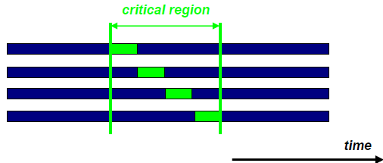
Critical
#pragma omp parallel for schedule(static) shared(a)
for(i = 0; i < n; i++)
{
#pragma omp critical
{
a = a+1;
}
}
Threads wait here: only one thread at a time does the operation: “a = a+1”. So this is a piece of sequential code inside the for loop.

Slide 57
Atomic
Atomic provides mutual exclusion but only applies to the load/update of a memory location
It is applied only to the (single) assignment statement that immediately follows it
Atomic construct may only be used together with an expression statement with one of operations: +, *, -, /, &, ^, |, <<, >>
Atomic construct does not prevent multiple threads from executing the function() at the same time (see the example below)
Code example: int ic, i, n;
ic = 0;
#pragma omp parallel shared(n,ic) private(i)
for (i=0; i++; i<n)
{
#pragma omp atomic
ic = ic + function(c);
}
Atomic only protects the update of ic

Slide 58

Locks
A lock consists of a data structure and functions that allow the programmer to explicitly enforce mutual exclusion in a critical section.
Difference from critical section:
You can have multiple locks
A thread can try for any specific lock
=> we can use this to acquire data-level locks
Threads queue up
Acquire lock(i)
// critical section
Release lock(i)
Only one thread executes
e.g., two threads can access different array indices without waiting.

Slide 59
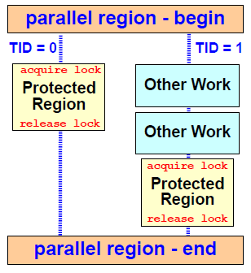
Illustration of Locking Operation
The protected region contains the update of a shared variable
One thread acquires the lock and performs the update
Meanwhile, other threads perform some other work
When the lock is released again, the other threads perform the update

Slide 60
A Locks Code Example
long long int a=0;
long long int i;
omp_lock_t my_lock;
// init lock
omp_init_lock(&my_lock);
#pragma omp parallel for
for(i = 0; i < n; i++)
{
omp_set_lock(&my_lock);
a+=1;
omp_unset_lock(&my_lock);
}
omp_destroy_lock(&my_lock);
1. Define lock variable
2. Initialize lock
3. Set lock
4. Unset lock
5. Destroy lock
Compiling and running sync.c:
gcc −g −Wall −fopenmp −o sync sync.c
./sync #of-iteration #of-threads

Slide 61
Some Caveats
You shouldn’t mix the different types of mutual exclusion for a single critical section.
There is no guarantee of fairness in mutual exclusion constructs.
It can be dangerous to “nest” mutual exclusion constructs.

Slide 62
Loop.c example
Default schedule:
#pragma omp parallel for schedule(static) private(a) //creates N threads to run the next enclosed block
for(i = 0; i < loops; i++)
{
a = 6+7*8;
}

Slide 63
The Runtime Schedule Type
The system uses the environment variable OMP_SCHEDULE to determine at run-time how to schedule the loop.
The OMP_SCHEDULE environment variable can take on any of the values that can be used for a static, dynamic, or guided schedule.

Slide 64
schedule ( type , chunksize )
Controls how loop iterations are assigned
Static: Assigned before the loop is executed.
dynamic or guided: Assigned while the loop is executing.
auto/ runtime: Determined by the compiler and/or the run-time system
Consecutive iterations are broken into chunks
Total number = chunksize
Positive integer
Default is 1

Slide 65
schedule types can prevent load imbalance
Static schedule
vs
Dynamic schedule
Thread finishing first
3
7
Idle time
3
4
2
6
2
5
Threads
1
5
1
6
0
4
0
7
Time
Time
Thread finishing last

Slide 66
Static: default
Static, n: set chunksize
chunksize
0
Static
N-1
Thread 0
Thread 1
Thread 2
Thread 3
0
Static, n
N-1
Thread 0
Thread 1
Thread 2
Thread 3
Thread 0
Thread 1
Thread 2
Thread 3
Thread 0
Thread 1
T2
0
Dynamic
N-1
Thread 0
Thread 1
Thread 2
Thread 3
Thread 1
Thread 0
Thread 2
Thread 1
Thread 3
Thread 1
T0
0
Guided
N-1
Thread 0
Thread 1
Thread 2
Thread 3
Thr0
Thr1
Thr2
Thr3
T 0
T 1
T 2
T 3
T0
T1
2
iteration number

Slide 67
Dynamic: thread executes a chunk
when done, it requests another one
0
Static
N-1
Thread 0
Thread 1
Thread 2
Thread 3
0
Static, n
N-1
Thread 0
Thread 1
Thread 2
Thread 3
Thread 0
Thread 1
Thread 2
Thread 3
Thread 0
Thread 1
T2
0
Dynamic
N-1
Thread 0
Thread 1
Thread 2
Thread 3
Thread 1
Thread 0
Thread 2
Thread 1
Thread 3
Thread 1
T0
0
Guided
N-1
Thread 0
Thread 1
Thread 2
Thread 3
Thr0
Thr1
Thr2
Thr3
T 0
T 1
T 2
T 3
T0
T1
2
iteration number

Slide 68
Guided: thread executes a chunk
when done, it requests another one
new chunks decrease in size (until chunksize is met)
0
Static
N-1
Thread 0
Thread 1
Thread 2
Thread 3
0
Static, n
N-1
Thread 0
Thread 1
Thread 2
Thread 3
Thread 0
Thread 1
Thread 2
Thread 3
Thread 0
Thread 1
T2
0
Dynamic
N-1
Thread 0
Thread 1
Thread 2
Thread 3
Thread 1
Thread 0
Thread 2
Thread 1
Thread 3
Thread 1
T0
0
Guided
N-1
Thread 0
Thread 1
Thread 2
Thread 3
Thr0
Thr1
Thr2
Thr3
T 0
T 1
T 2
T 3
T0
T1
2
iteration number

Slide 69
multiplication.c
Go over this code at a conceptual level – show where and how to parallelize

Slide 70

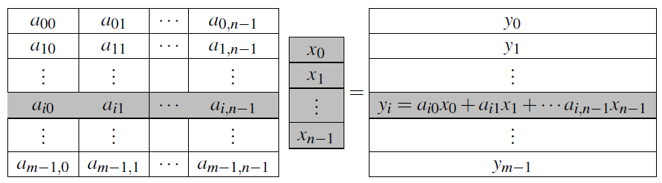
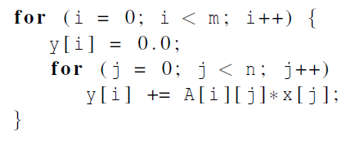
Matrix-vector multiplication
Notes:
Please refer to the detailed slides on cache coherence and thread-safety in Chapter 4.

Slide 71
M x V = X: Parallelization Strategies
Row Decomposition
m x n
n x 1
m x 1
Thread 0
Thread 0
Thread 1
Thread 1
x
=
Thread 2
Thread 2
Thread 3
Thread 3
Each thread gets m/p rows
Time taken is proportional to: (mn)/p : per thread
No need for any synchronization (static scheduling will do)

Slide 72
M x V = X: Parallelization Strategies
Column Decomposition
x0 + x1 + x2 + x3
m x n
n x 1
m x 1
Thread 0
Thread 1
Thread 2
Thread 3
Reduction
x
=
X [i]
Each thread gets n/p columns
Time taken is proportional to: (mn)/p + time for reduction : per thread

Slide 73
Extra slides

Slide 74

What happened?
OpenMP compilers don’t check for dependences among iterations in a loop that’s being parallelized with a parallel for directive.
A loop in which the results of one or more iterations depend on other iterations cannot, in general, be correctly parallelized by OpenMP.

Slide 75
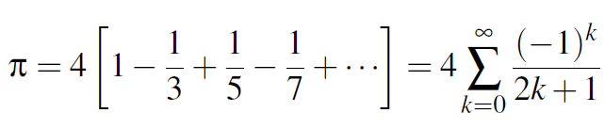
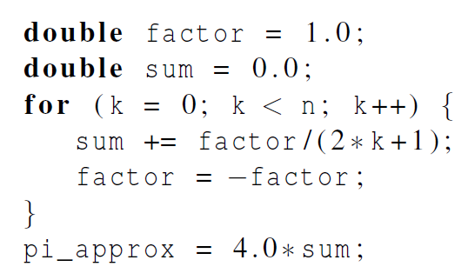
Estimating π

Slide 76
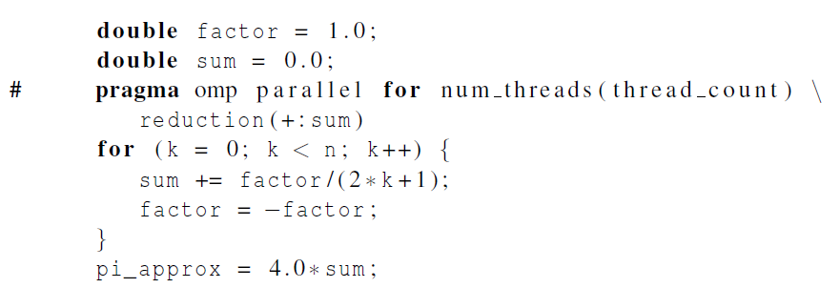
OpenMP solution #1
loop dependency

Slide 77
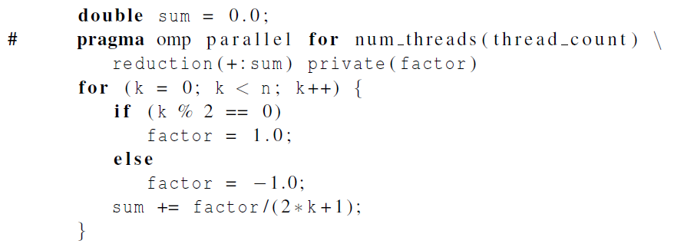
OpenMP solution #2
Insures factor has private scope.

Slide 78
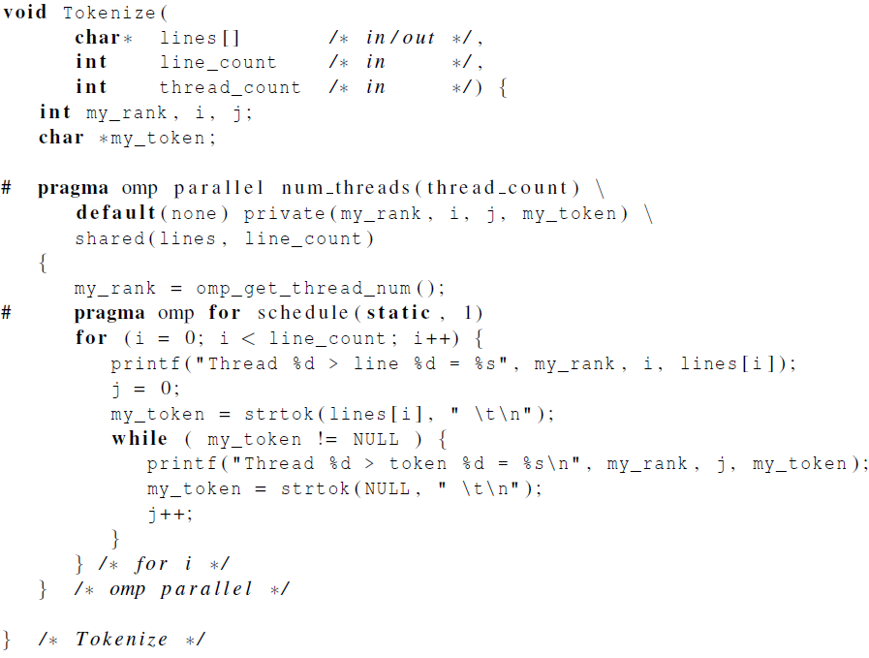
Thread-Safety
Notes:
Please refer to the detailed slides on cache coherence and thread-safety in Chapter 4.

Slide 79
An operating system “process”
An instance of a computer program that is being executed.
Components of a process:
The executable machine language program.
A block of memory.
Descriptors of resources the OS has allocated to the process.
Security information.
Information about the state of the process.

Slide 80
Shared Memory System
Each processor can access each memory location.
The processors usually communicate implicitly by accessing shared data structures.
Example: Multiple CPU cores on a single chip
Kamiak compute nodes have multiple CPUs each with multiple cores

Slide 81
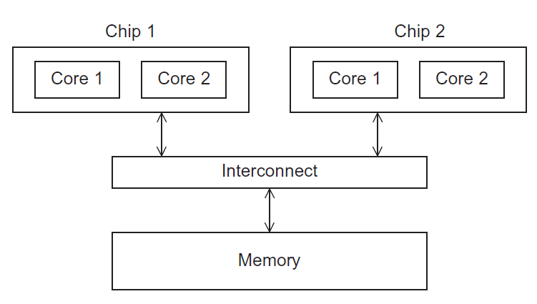
UMA multicore system
Time to access all
the memory locations
will be the same for
all the cores.
Figure 2.5

Slide 82
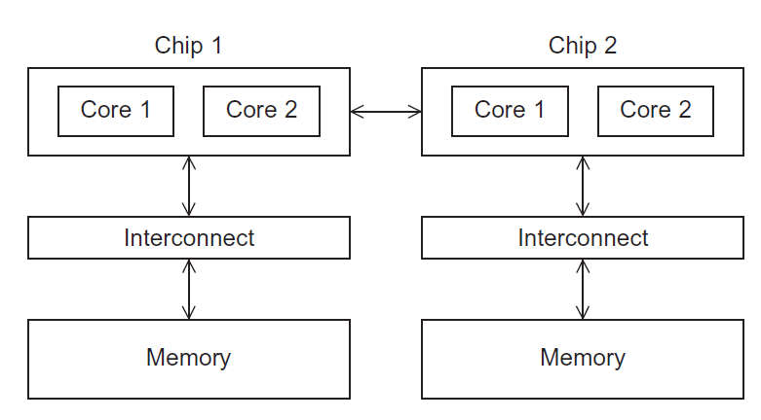
NUMA multicore system
A memory location a core is directly connected to can be accessed faster than a memory location that must be accessed through another chip.
Figure 2.6

Slide 83
Input and Output
However, because of the indeterminacy of the order of output to stdout, in most cases only a single process/thread will be used for all output to stdout other than debugging output.
Debug output should always include the rank or id of the process/thread that’s generating the output.

Slide 84
Input and Output
Only a single process/thread will attempt to access any single file other than stdin, stdout, or stderr. So, for example, each process/thread can open its own, private file for reading or writing, but no two processes/threads will open the same file.

Slide 85
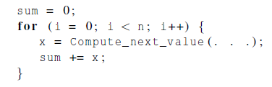
Division of work – data parallelism

Slide 86
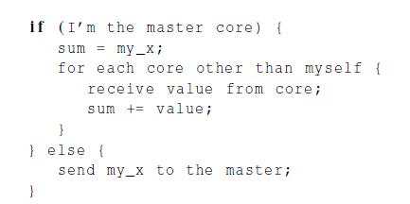
Division of work – task parallelism
Tasks
Receiving
Addition

Slide 87
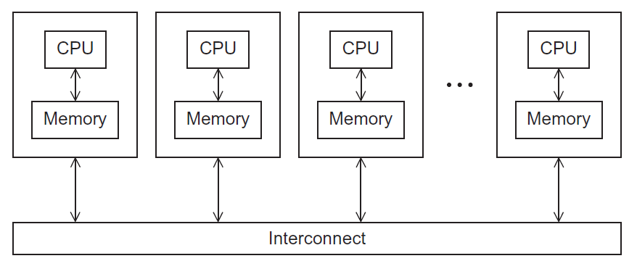
Distributed Memory on Kamiak
compute node 1
compute node 2
compute node 3
compute node N
Figure 2.4
Each compute node has 1-2 CPUs each with 10-14 cores

Slide 88
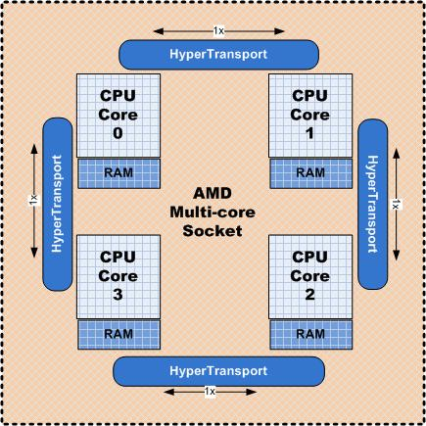
On an Individual Node
The cores can share access to the computer’s memory.
Coordinate the cores by having them examine and update shared memory locations.
Multi-core socket
Notes:
Shared-memory
The cores can share access to the computer’s memory.
Coordinate the cores by having them examine and update shared memory locations.
Example: A single system with multiple CPU cores

Slide 89
The burden is on software
Hardware and compilers can keep up the pace needed.
From now on…
In shared memory programs:
Start a single process and fork threads.
Threads carry out tasks.
In distributed memory programs:
Start multiple processes.
Processes carry out tasks.

Slide 90
Writing Parallel Programs
double x[n], y[n];
…
for (i = 0; i < n; i++)
x[i] += y[i];
Divide the work among the processes/threads
so each process/thread gets roughly the same amount of work
and communication is minimized.
Arrange for the processes/threads to synchronize.
Arrange for communication among processes/threads.
I think we will eventually introduce this when doing sum. I would remove this slide from here.

Slide 91
Ananth can you put in a simple example here?
Remove Slide

Slide 92
OpenMP (ask ananth to tailor more for the loop.c code)
An API for shared-memory parallel programming.
MP = multiprocessing
Designed for systems in which each thread or process can potentially have access to all available memory.
System is viewed as a collection of cores or CPU’s, all of which have access to main memory.
Remove Slide

Slide 93
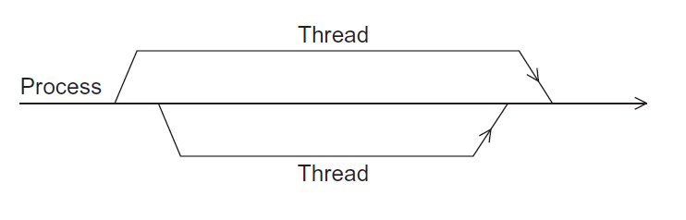
A process forking and joining two threads

Slide 94
Of note…
There may be system-defined limitations on the number of threads that a program can start.
The OpenMP standard doesn’t guarantee that this will actually start thread_count threads.
Most current systems can start hundreds or even thousands of threads.
Unless we’re trying to start a lot of threads, we will almost always get the desired number of threads.

Slide 95
Have people take serial version and make into the openMP version of loop.c
-have a small example code that has the pragma and openMP calls in it
-then have them adapt the loop.c to have the openmp in it…give them 10 minutes to do while we go around the room and help….then walk them through our parallel version of loop.c

Slide 96

Scheduling Loops in sync.c

Slide 97
Locks
A lock implies a memory fence of all thread visible variables
The lock routines are used to guarantee that only one thread accesses a variable at a time to avoid race conditions
C/C++ lock variables must have type “omp_lock_t” or “omp_nest_lock_t” (will not discuss nested lock in this workshop)
All lock functions require an argument that has a pointer to omp_lock_t or omp_nest_lock_t
Simple Lock functions:
omp_init_lock(omp_lock_t*);
omp_set_lock(omp_lock_t*);
omp_unset_lock(omp_lock_t*);
omp_test_lock(omp_lock_t*);
omp_destroy_lock(omp_lock_t*);

Slide 98
How to Use Locks
Define the lock variables
Initialize the lock via a call to omp_init_lock
Set the lock using omp_set_lock or omp_test_lock. The latter checks whether the lock is actually available before attempting to set it. It is useful to achieve asynchronous thread execution.
Unset a lock after the work is done via a call to omp_unset_lock.
Remove the lock association via a call to omp_destroy_lock.

Slide 99
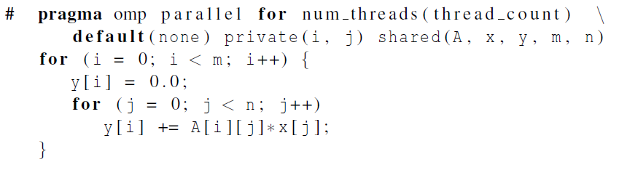
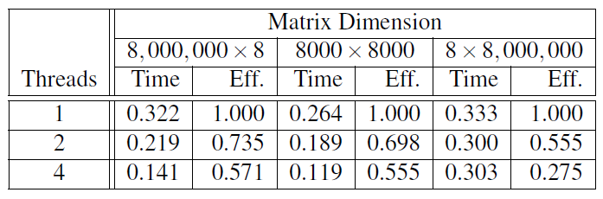
Matrix-vector multiplication
Run-times and efficiencies of matrix-vector multiplication (times are in seconds)
Notes:
Please refer to the detailed slides on cache coherence and thread-safety in Chapter 4.

