Slide 1
OLIO - A MERN STACK BASED FREE FOOD DONATOR APP
23CSP501 Reverse Engineering Project – First Review
Date:03.11.2025
Presented By
Sanjay S (727623BCS018)
Susindran N(727623BCS090)
Mohamed Thamemul Ansahee A(727624BCS312)
OLIO – A MERN STACK BASED FREE FOOD DONATOR APP
3-Nov-2025
1

Slide 2
INTRODUCTION
The project aims to replicate and enhance an existing community-based marketplace system (similar to Olio) in a modern and interactive mobile-first format.
Users such as item donors, receivers and administrators can access a unified app to share, request and manage items within their local community.
The system enables easy listing of items, location-based browsing, image upload, messaging between users and pickup coordination, thereby promoting reuse and reducing waste.
Admins can manage users, monitor listings and maintain content quality through secure role-based control panels.
The platform supports secure authentication, real-time updates for listings and messages, and map-based discovery, providing a complete community exchange environment.
Designed using a modern MERN architecture (MongoDB, Express, React Native, Node.js) to ensure scalability, smooth user experience and cross-platform mobile support.
OLIO – A MERN STACK BASED FREE FOOD DONATOR APP

Slide 3
EXISTING SYSTEM
Features:
Olio-Simple is a community-sharing marketplace platform for exchanging unused items locally.
Provides a unified mobile interface for donors, receivers, and admins.
Supports user registration, item posting with images, chat messaging, and map-based item discovery.
Enables real-time listing updates and location-based search for nearby items.
Offers secure role-based login and JWT-based authentication for data privacy.
Includes admin controls for user management, listing moderation, and viewing activity logs.
Flaws / Limitations:
Limited real-time features (messaging via REST polling instead of full WebSocket chat).
Cloud deployment and CI/CD pipelines not fully integrated in the current version.
Image uploading uses local handling instead of cloud storage (AWS / Firebase)
Some modules need optimization for smoother UX and faster data rendering
Requires technical setup steps; initial configuration may be challenging for beginners
OLIO – A MERN STACK BASED FREE FOOD DONATOR APP

Slide 4
SOFTWARE, TOOLS AND TECHNIQUES
Category | Software / Tools | Purpose
Frontend | React Native (Expo) with JavaScript (.jsx) | Provides a mobile-first interface for item posting, browsing, map view, chat and user dashboards
Backend | Node.js + Express.js | Handles APIs for listings, user profiles, chat messages and secure routing
Database | MongoDB + Mongoose | Stores user data, item listings, chat records, and location metadata
Authentication Layer | JWT (JSON Web Token) + bcryptjs | Ensures secure login, role-based access control (Admin/User), and protects user data
Maps & Location | react-native-maps, expo-location | Displays nearby items and allows users to share pickup location
Image Handling | Expo Image Picker / Multer (Node) | Allows users to upload item photos from camera or gallery
Development Tools | VS Code, Postman/Thunder Client, npm, GitHub | Used for coding, testing APIs, debugging, and version control
Testing & Preview | Expo Go App / Android Studio / Xcode | Used to run and test the mobile app on real device/emulator
Platform / Deployment | Localhost / MongoDB Atlas / Vercel / Render | Provides development and cloud environment for backend + database hosting
OLIO – A MERN STACK BASED FREE FOOD DONATOR APP

Slide 5
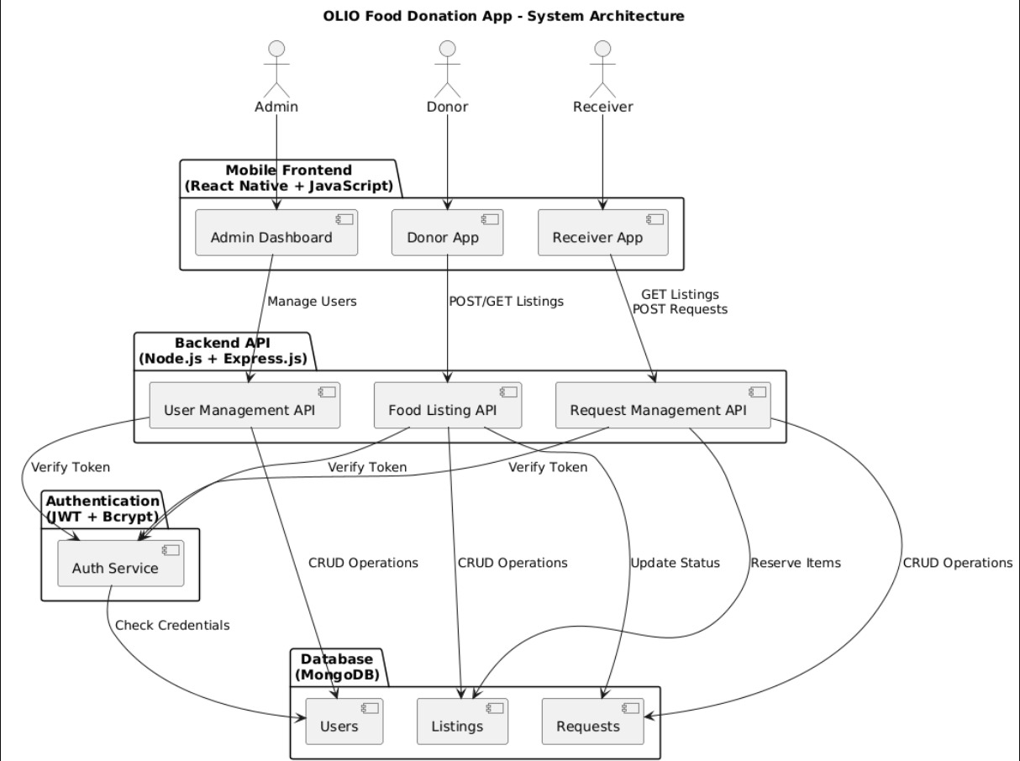
SYSTEM MODULES & ITS IMPLEMENTATION

Slide 6
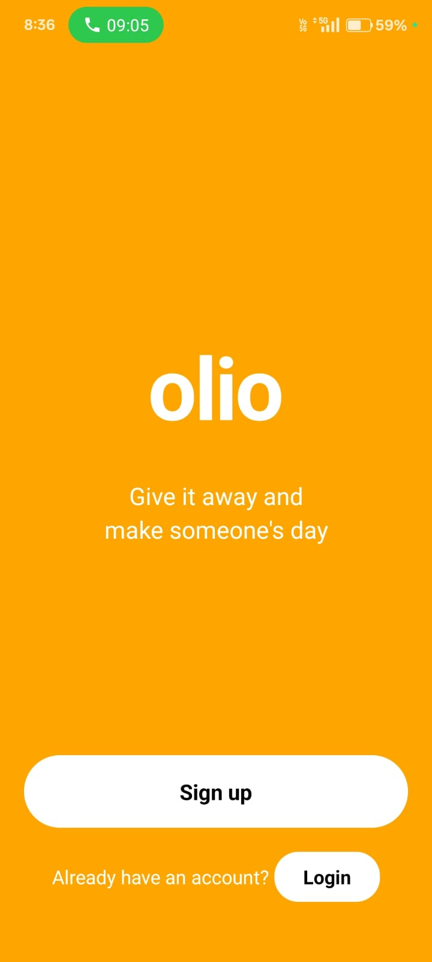
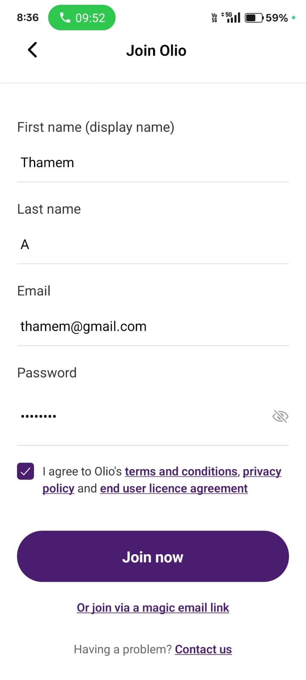
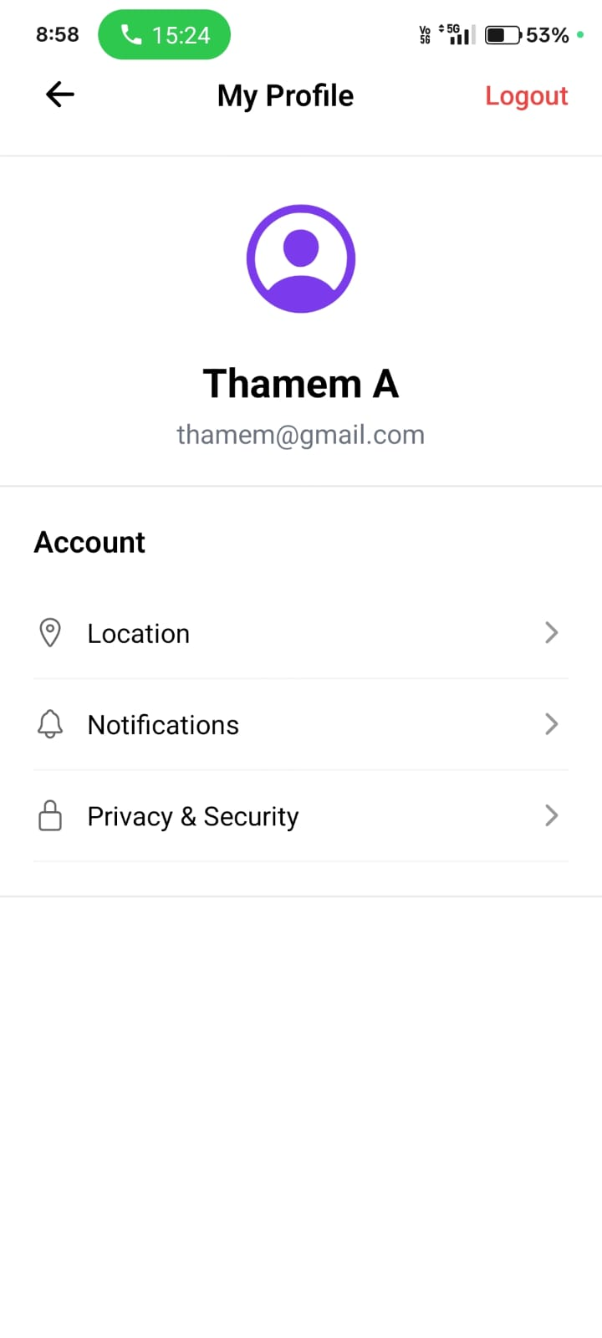
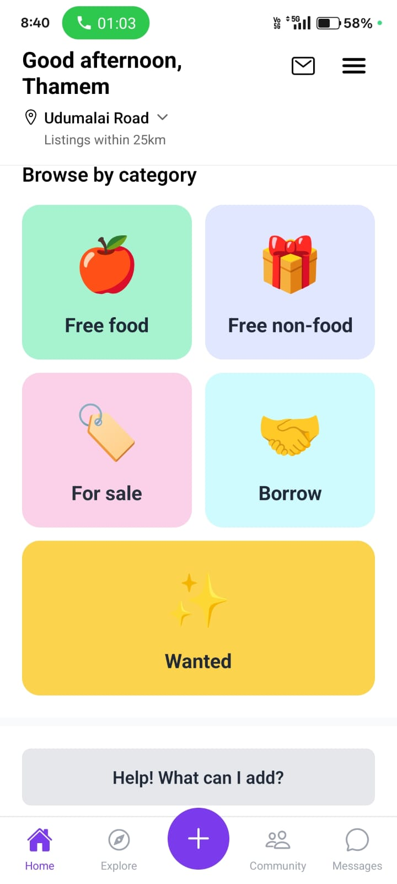
OUTPUT SCREENSHOTS OF THE IMPLEMENTATION

Slide 7
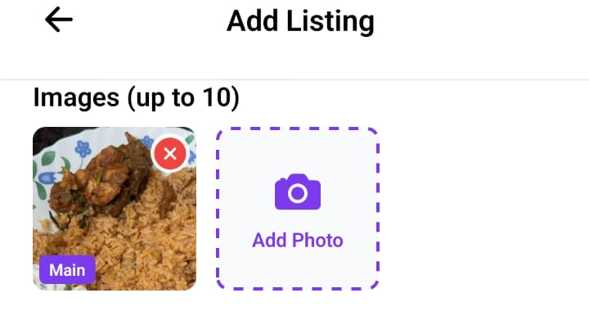
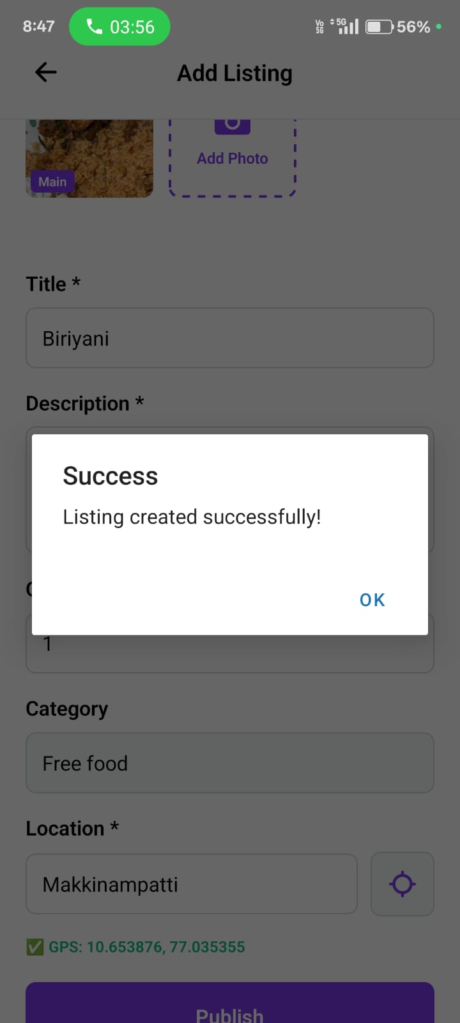
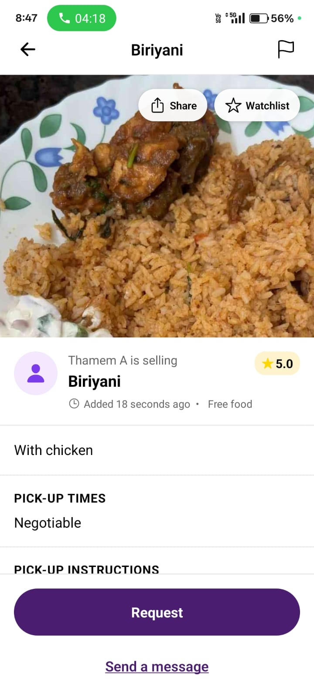
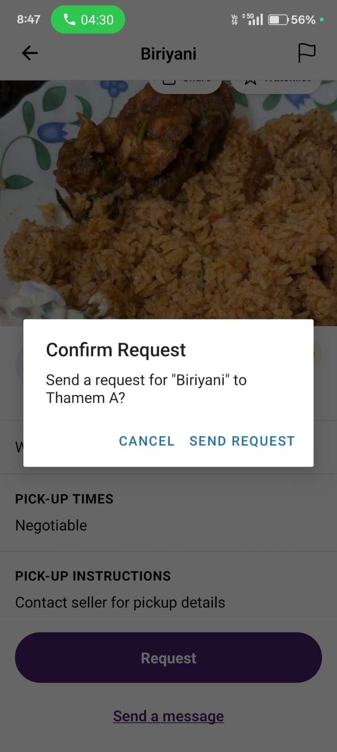
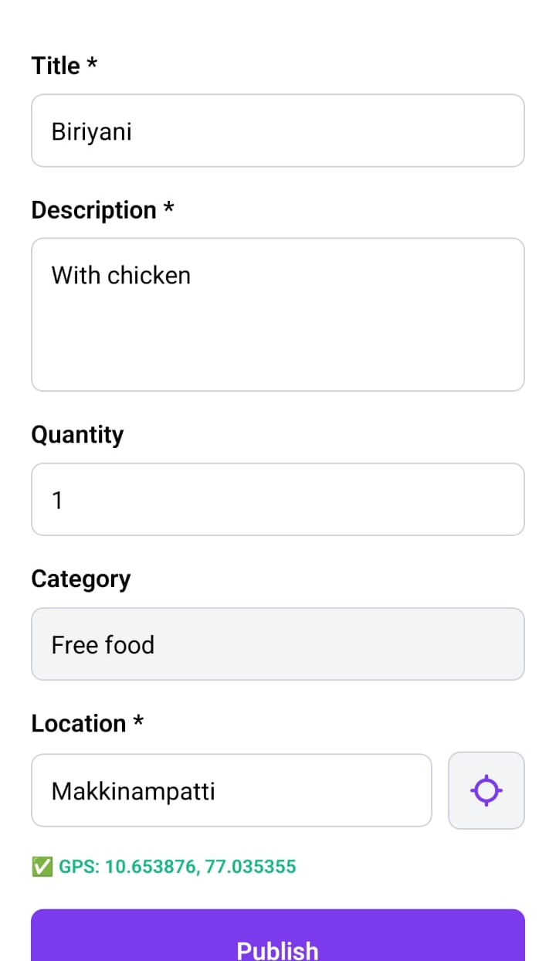
OUTPUT SCREENSHOTS OF THE IMPLEMENTATION

Slide 8
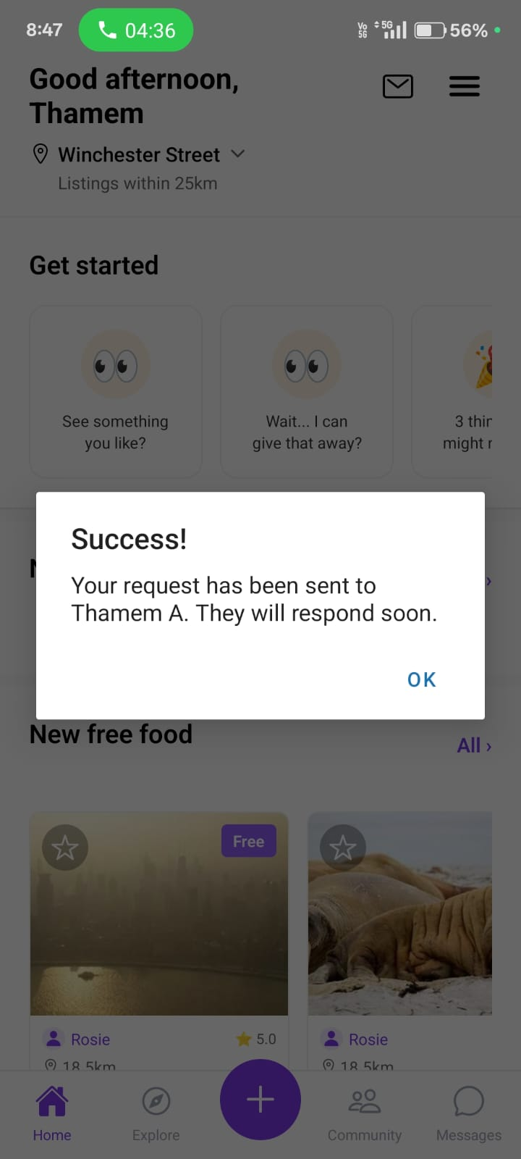
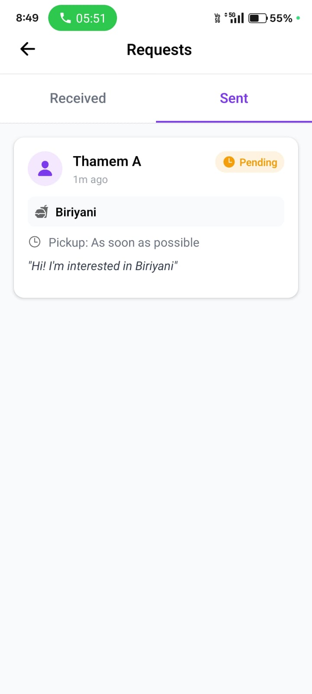
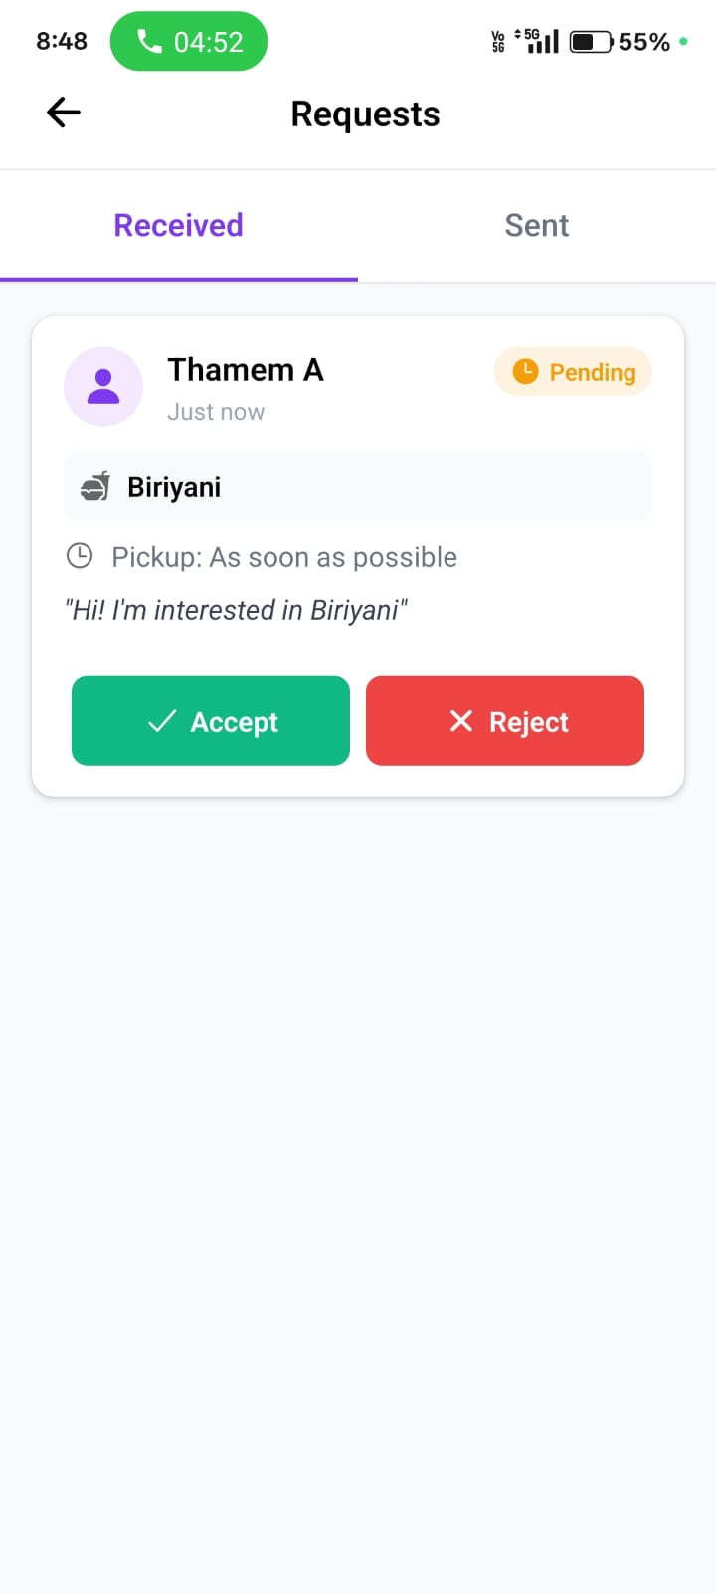
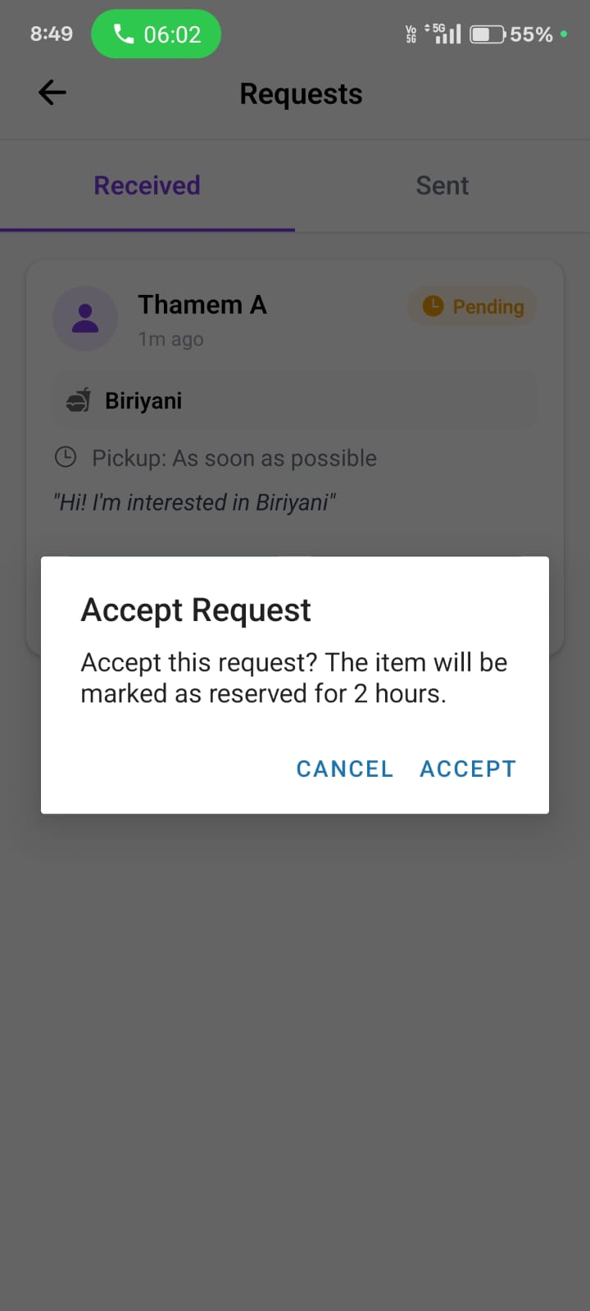
OUTPUT SCREENSHOTS OF THE IMPLEMENTATION

Slide 9
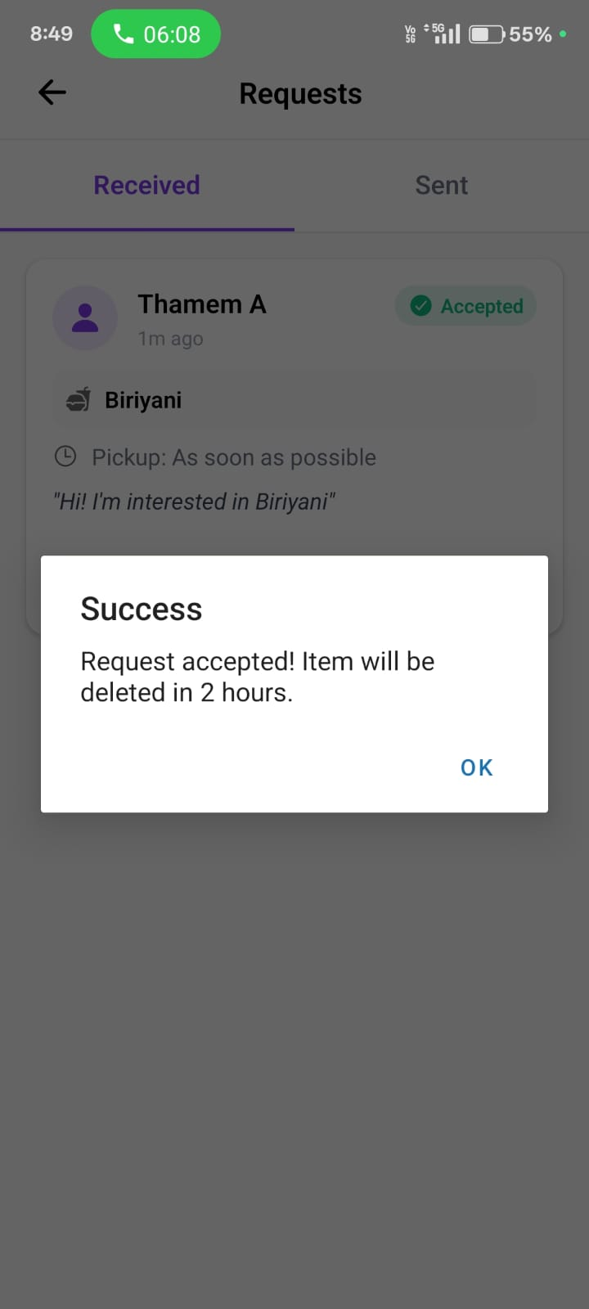
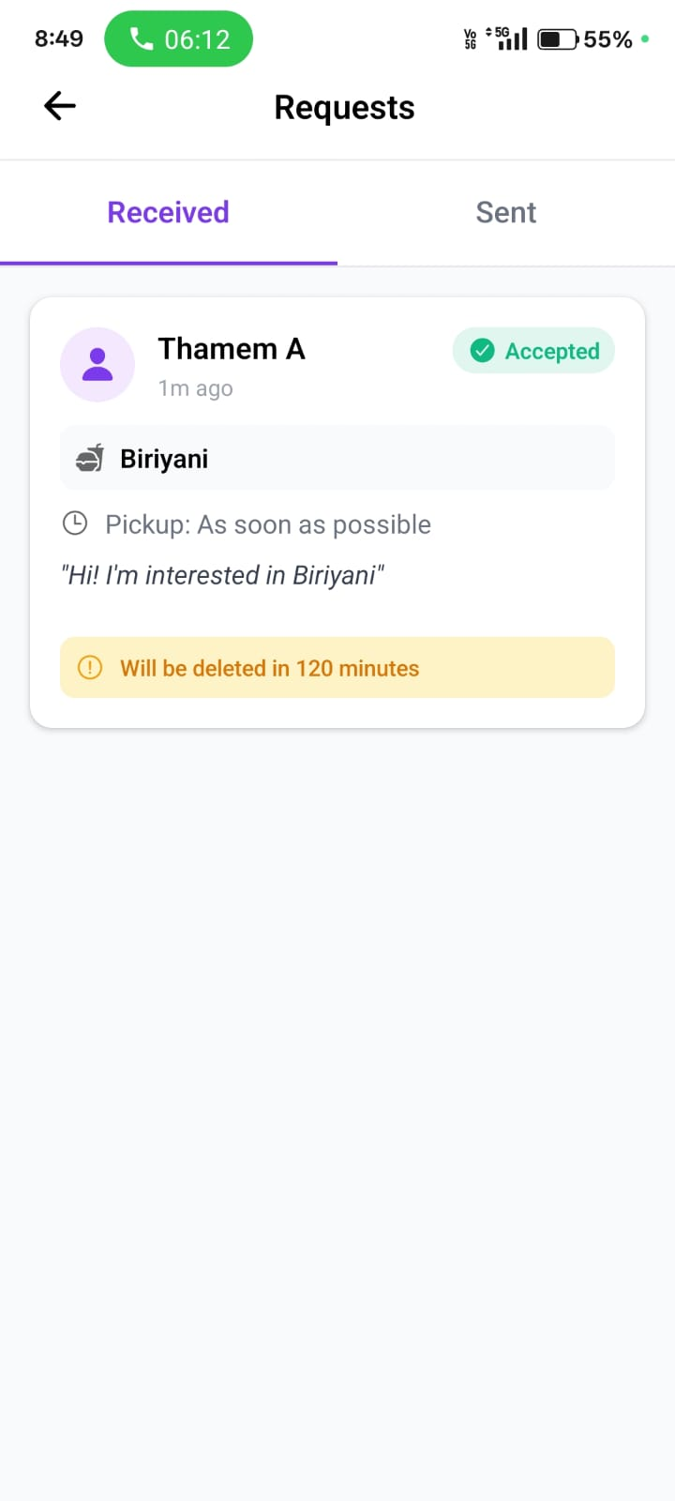
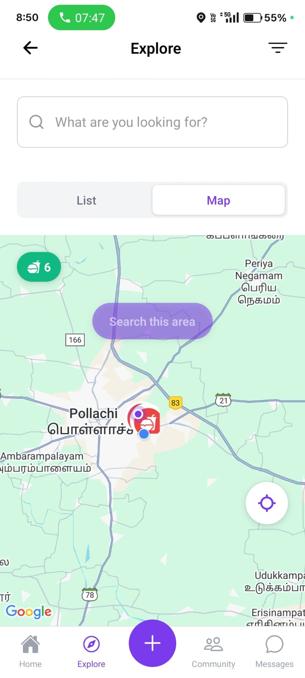
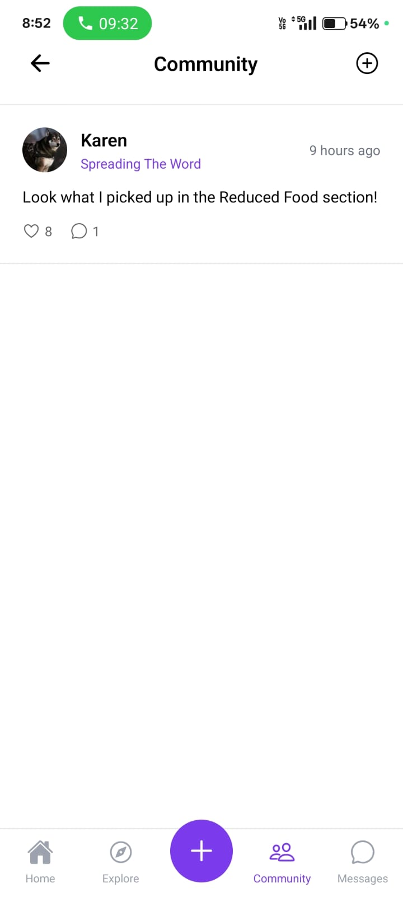
OUTPUT SCREENSHOTS OF THE IMPLEMENTATION

Slide 10
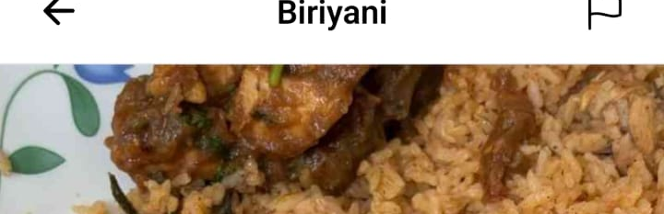
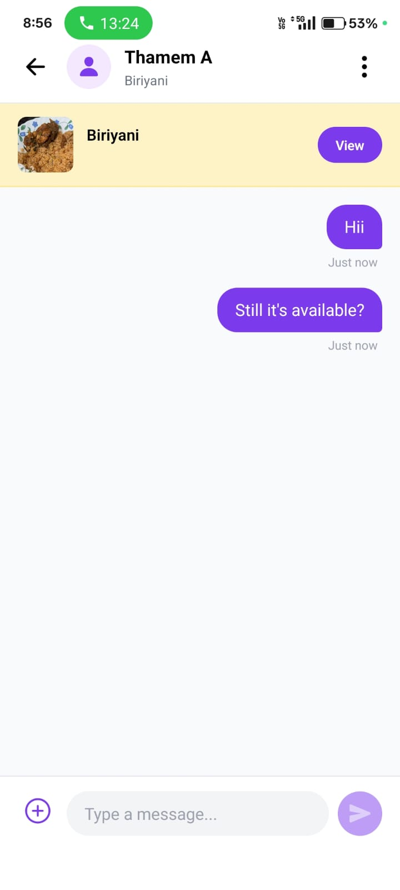
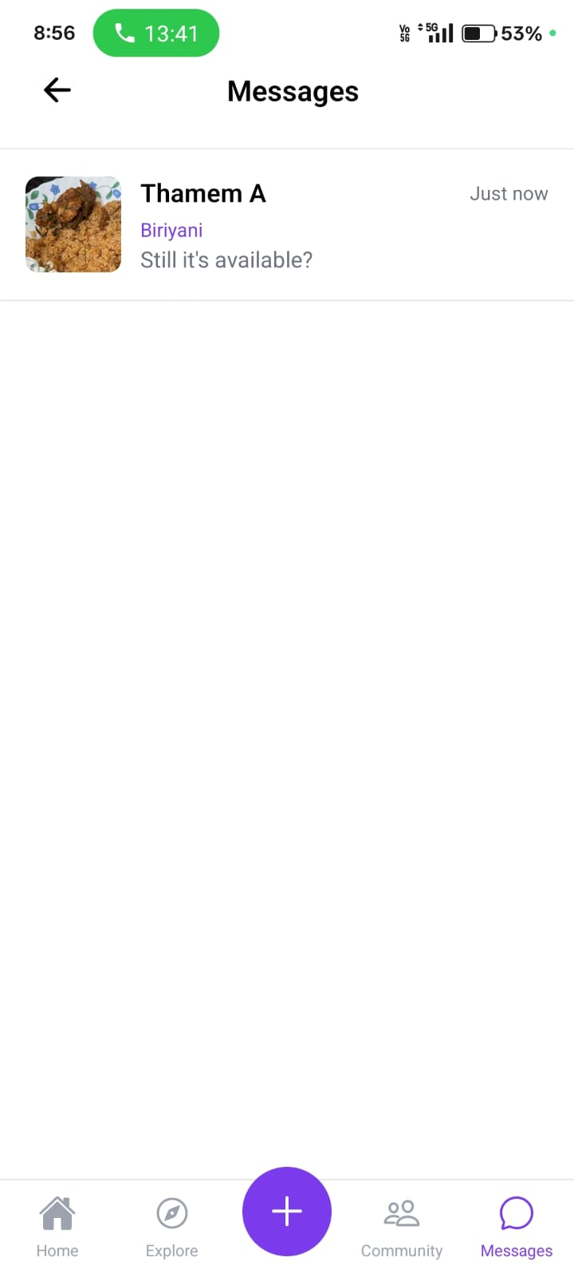
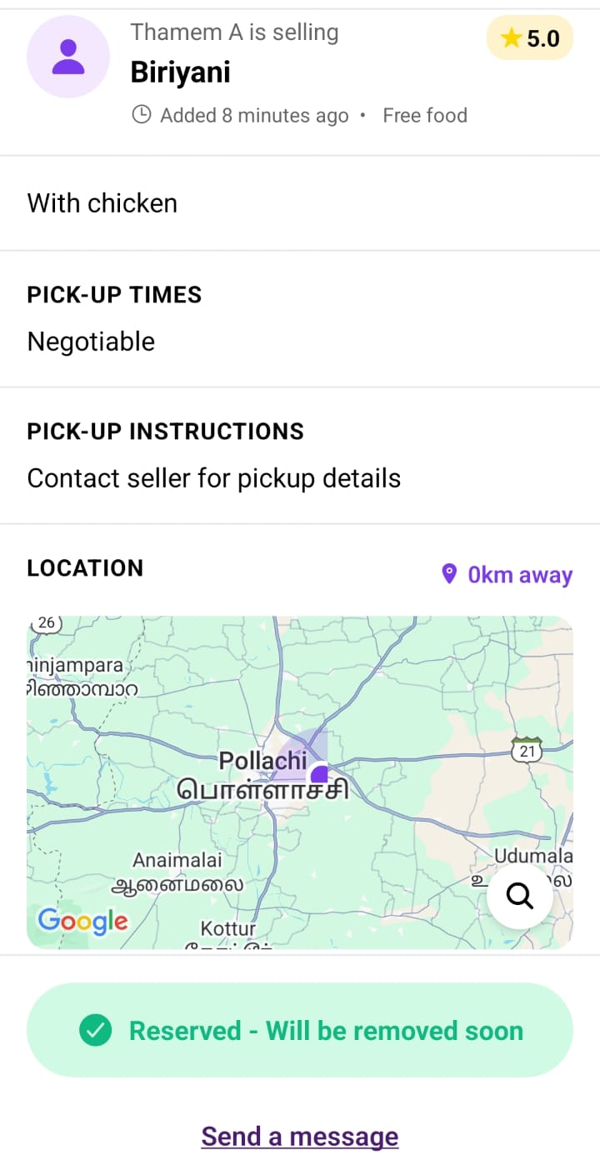
OUTPUT SCREENSHOT AND ITS IMPLEMENTATION
OLIO – A MERN STACK BASED FREE FOOD DONATOR APP

Slide 11
RESULTS AND DISCUSSION
The proposed system efficiently digitizes and streamlines food-sharing and waste-reduction processes through a unified digital platform.Performance is optimized using asynchronous Node.js operations, ensuring fast and reliable data communication between donors, receivers, volunteers and administrators.Real-time updates enable instant synchronization of food listings, pickup requests, chat communication and admin monitoring dashboards.
Real-time updates enable instant synchronization of food listings, pickup requests, chat communication and admin monitoring dashboards.
The user interface is designed to be highly interactive, responsive and intuitive, allowing users to quickly add food items, request items, chat, and track pickup status with ease.
Data handling is simplified using MongoDB’s flexible schema, enabling efficient storage and retrieval of user profiles, listings, requests, chat logs and location-based data.
Overall, the system demonstrates the modern transformation of community-based food sharing into a scalable MERN application, enhancing sustainability, promoting zero-waste culture and improving community engagement through technology.
OLIO – A MERN STACK BASED FREE FOOD DONATOR APP

Slide 12
CONCLUSION
The proposed food-sharing system delivers a complete, intuitive and efficient digital platform that encourages community-driven food redistribution and waste reduction.
It integrates a responsive frontend, real-time backend processing and secure database management to provide a seamless user experience for donors, receivers, volunteers and administrators.
By leveraging React, Node.js and MongoDB, the system ensures high scalability, strong performance and compliance with modern web application standards.
Future upgrades can include AI-based food expiry prediction, geo-tracking for delivery agents, reward-based sustainability programs, integration with NGOs and government food banks, and cloud-based analytics for large-scale hunger-reduction insights.
OLIO – A MERN STACK BASED FREE FOOD DONATOR

Slide 13
THANK YOU

