Slide 1

enter.the.matrix

Slide 2
core.matrix
Array programming
as a language extension
for Clojure
(with a Numerical computing focus)
Notes:
Today I’m going to be talking about core.matrix, and it’s quite appropriate that I’m talking about it here today at the Clojure Conj because this project actually came about as a direct result of conversations I had with many people at last year’s Conj
The focus of those discussions was very much about how we could make numerical computing better in Clojure.
And the solution I’ve been working on over the past year along with a number of collaborators is core.matrix, which offers array programming as a language extension to Clojure

Slide 3

Plug-in paradigms
Paradigm | Exemplar language | Clojure implementation
Functional programming | Haskell | clojure.core
Meta-programming | Lisp
Logic programming | Prolog | core.logic
Process algebras / CSP | Go | core.async
Array programming | APL | core.matrix
Notes:
When I say language extension, it is of course in the sense that Clojure seems to have this ability to absorb new paradigms just by plugging in new libraries.
Clojure already stole many good pure functional programming techniques from languages like Haskell
And of course we have the macro meta-programming capabilities from Lisp
More recently we’ve got core.logic bringing in Logic programming, inspired by Prolog and miniKanren
And core.async bringing in the Communicating Sequential Processes with some syntax similar to Go
And core.matrix is designed very much in the same way, to provide array programming capabilities. And if we want to trace the roots of array programming, we can go all the way back to this language called APL

Slide 4
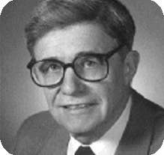
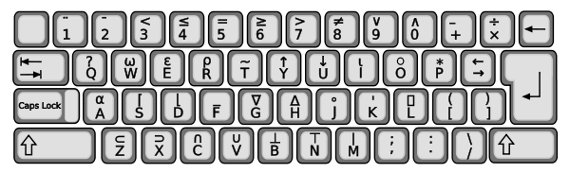
APL
Venerable history
Notation invented in 1957 by Ken Iverson
Implemented at IBM around 1960-64
Has its own keyboard
Interesting perspective on code readability
life←{↑1 ⍵∨.∧3 4=+/,¯1 0 1∘.⊖¯1 0 1∘.⌽⊂⍵}
Notes:
About the same age as Lisp? First specified in 1958
Love the fact that it has its own keyboard, with all these symbols inspired by mathematical notation
And you get some crazy code.
Might seem like a bit of a dinosaur new

Slide 5



Modern array programming
Standalone environment for statistical programming / graphics
Python library for array programming
A new language (2012) based on array programming principles
.... and many others
Notes:
Array programming has had quite a renaissance in recent years.
This is because of the increasing important of data science and numerical computing in many fields
- So we’ve seen languages like R that provide an environment for statistical computing
Highlight value of paradigm – clearly a demand for these kind of numerical computing capabilities

Slide 6

Why Clojure for array programming?
1. Data Science
2. Platform
3. Philosophy
Notes:
Why bring array programming for Clojure?
1. Data science focus – lots of interest in doing data crunching work in Clojure
2. Provides a powerful platform:
- Why should you have to introduce a whole new stack to get access to array programming paradigm? Shouldn’t have to give up advantages of a good general purpose language to do data science.
- Clojure is already a great platform to build on: JVM platform –lots of advantages
3. Clojure is compelling for many philosophical reasons: concurrency, immutability state, a focus on data. Array programming seems to be a good fit for this philosophy.

Slide 7
Elements of core.matrix
Abstraction
N-dimensional arrays
– what and why?
Implementation
How is everything
implemented?
API
What can you do with arrays?
Notes:
So today I’m going to talk about core.matrix with three different lenses
First I want to talk about the abstraction – what are these arrays?
Then I’m going to talk about the core.matrix API
Implementation: how does this all work, some of the engineering choices we’ve made

Slide 8
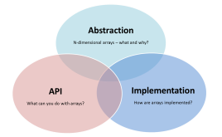

Abstraction
or: “What is the matrix?”

Slide 9
Design wisdom
abstraction
"It is better to have 100 functions operate on one data structure than 10 functions on 10 data structures."
—Alan Perlis
Notes:
Start off with one of my favourite quotes, because it contains a pretty important insight.
“It is better to have 100 functions operate on one data structure than 10 functions on 10 data structures”
There is of course one error here….. (click)
We should of course be talking about an abstraction here, not a concrete data structure.
A great example of this is the sequence abstraction in Clojure – there are literally hundreds of functions that operate on Clojure sequences. Because so many functions produce and consume sequences, it gives you many different ways to compose then together.
And it’s more than just the clojure.core API: other code can build on the same abstraction, which means that the composability extends to any code you write that uses the same abstraction. It makes entire libraries composable.
In some ways I think the key to building systems using simple, composable components is about having shared abstractions.
We’ve taken this principle very much to heart in core.matrix, our abstraction of course is the array - more specifically the multi-dimensional array
And the rest of core.matrix is really all about giving you a powerful set of composable operations you can do with arrays

Slide 10

What is an array?
Dimensions
Example
Terminology
1
0 | 1 | 2
Vector
0 | 1 | 2
3 | 4 | 5
6 | 7 | 8
2
Matrix
0 | 1 | 2
3 | 4 | 5
6 | 7 | 8
0 | 1 | 2
3 | 4 | 5
6 | 7 | 8
0 | 1 | 2
3 | 4 | 5
6 | 7 | 8
3
3D Array
(3rd order Tensor)
...
N
ND Array
...
Notes:
Overloaded terminology!
- Vector = 1D array (maths / array programming sense) – Also a Clojure vector
- Matrix: conventionally used to indicate a 2 dimensional numerical array,
- Array: in the sense of the N-dimensional array, but also the specific concrete example of a Java array
Dimensions: also overloaded! Here using in the sense of the number of dimensions in an array, but it’s also used to refer to the number of dimensions in a vector space, e.g. 3 dimensional Euclidean space.
If we’re lucky it should be clear from the context what we’re talking about.

Slide 11
Multi-dimensional array properties
Dimension sizes together define the shape of the array
(e.g. 3 x 3)
Dimensions (ordered and indexed)
Dimension 1
0
1
2
0
0 | 1 | 2
3 | 4 | 5
6 | 7 | 8
Dimension 0
1
2
Each of the array elements is a regular value

Slide 12

Arrays = data about relationships
Set Y
:R
:S
:T
:U
:A
0 | 1 | 2 | 3
4 | 5 | 6 | 7
8 | 9 | 10 | 11
Each element is a fact about a relationship between a value in Set X and a value in Set Y
Set X
:B
:C
(foo :A :T) => 2
ND array lookup is analogous to arity-N functions!
Notes:
Give you an idea about how general array programming can be –
An array is a way of representing a function using data
Instead of computing a value for each combination of inputs, we’re typically pre-computing all such values

Slide 13
Why arrays instead of functions?
0
1
2
0
0 | 1 | 2
3 | 4 | 5
6 | 7 | 8
vs.
(fn [i j]
(+ j (* 3 i)))
1
2
Precomputed values with O(1) access
Efficient computation with optimised bulk operations
Data driven representation
Notes:
Give you an idea about how general array programming can be –
An array is a way of representing a function using data
Instead of computing a value for each combination of inputs, we’re typically pre-computing all such values

Slide 14


Expressivity
Java
for (int i=0; i<n; i++) {
for (int j=0; j<m; j++) {
for (int k=0; k<p; k++) {
result[i][j][k] = a[i][j][k] + b[i][j][k];
}
}
}
(mapv
(fn [a b]
(mapv
(fn [a b]
(mapv + a b))
a b))
a b)
+ core.matrix
(+ a b)
Notes:
Example of adding a 3D array.
Java it’s just a big nested loop…
Clojure you can do it with nested maps, which is a bit more of a functional style, but still you’ve got this three-level nesting
With core.matrix it’s really simple. We just generalise + to arbitrary multi-dimensional arrays and it all just works
Does conciseness matter? Well if you’re writing a lot of code manipulating arrays it’s going to save you quite a bit of time, but more importantly it makes it much easier to avoid errors. Very easy to get off-by-one errors in this kind of code.
core.matrix gives you a nice DSL that does all the index juggling for you
Also it helps you to be mentally much closer to the problem that you are modelling. You ideally want an API that reflects the way that you think about the problem you are solving.

Slide 15
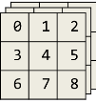
Principle of array programming:
generalise operations on regular (scalar) values to multi-dimensional data
(+ 1 2) => 3
(+ ) => 2

Slide 16

API
Notes:
So lets talk about the core.matrix API.
This isn’t going to be an exhaustive tour, but I’m going to highlight a few of the key features to give you a taste of what is possible

Slide 17
Equivalence to Clojure vectors
↔
[0 1 2]
0 | 1 | 2
0 | 1 | 2
3 | 4 | 5
6 | 7 | 8
[[0 1 2]
[3 4 5]
[6 7 8]]
↔
Nested Clojure vectors of regular shape are arrays!
Notes:
One of the important API design objectives was to exploit the “natural equivalence of arrays to nested Clojure vectors”.
1D array is a Clojure vector, 2D array is like a vector of vectors
Most things in the core.matrix API work with nested Clojure vectors.
This is nice – gives a natural syntax, and great for dynamic, exploratory work at the REPL.

Slide 18
Array creation
;; Build an array from a sequence
(array (range 5))
=> [0 1 2 3 4]
;; ... or from nested arrays/sequences
(array
(for [i (range 3)]
(for [j (range 3)]
(str i j))))
=> [["00" "01" "02"]
["10" "11" "12"]
["20" "21" "22"]]
Notes:
The most fundamental attribute of an array is probably the shape

Slide 19
Shape
;; Shape of a 3 x 2 matrix
(shape [[1 2]
[3 4]
[5 6]])
=> [3 2]
;; Regular values have no shape
(shape 10.0)
=> nil
Notes:
The most fundamental attribute of an array is probably the shape

Slide 20
Dimensionality
;; Dimensionality = number of dimensions
;; = length of shape vector
;; = nesting level
(dimensionality [[1 2]
[3 4]
[5 6]])
=> 2
(dimensionality [1 2 3 4 5])
=> 1
;; Regular values have zero dimensionality
(dimensionality “Foo”)
=> 0

Slide 21
Scalars vs. arrays
(array? [[1 2] [3 4]])
=> true
(array? 12.3)
=> false
(scalar? [1 2 3])
=> false
(scalar? “foo”)
=> true
Everything is either an array or a scalar
A scalar works as like a 0-dimensional array

Slide 22
Indexed element access
Dimension 1
0
1
2
0
0 | 1 | 2
3 | 4 | 5
6 | 7 | 8
Dimension 0
1
2
(def M [[0 1 2]
[3 4 5]
[6 7 8]])
(mget M 1 2)
=> 5

Slide 23
Slicing access
Dimension 1
0
1
2
0
0 | 1 | 2
3 | 4 | 5
6 | 7 | 8
Dimension 0
1
2
(def M [[0 1 2]
[3 4 5]
[6 7 8]])
(slice M 1)
=> [3 4 5]
A slice of an array is itself an array!
Notes:
Arrays are compositions of arrays!
This is one of the best signs that you have a good abstraction: if the abstraction can be recursively defined as a composition of the same abstraction.

Slide 24
Arrays as a composition of slices
(def M [[0 1 2]
[3 4 5]
[6 7 8]])
(slices M)
=> ([0 1 2] [3 4 5] [6 7 8])
(apply + (slices M))
=> [9 12 15]
0 | 1 | 2
3 | 4 | 5
6 | 7 | 8
slices
0 | 1 | 2
3 | 4 | 5
6 | 7 | 8
Notes:
So of course we have quite a few different functions that let you work with slices of arrays.
Most useful is probably the slices function, which cuts an array into a sequence of its slices
Pretty common to want to do this – imagine if each slice is a row in your data set

Slide 25
Operators
(use 'clojure.core.matrix.operators)
(+ [1 2 3] [4 5 6])
=> [5 7 9]
(* [1 2 3] [0 2 -1])
=> [0 4 -3]
(- [1 2] [3 4 5 6])
=> RuntimeException Incompatible shapes
(/ [1 2 3] 10.0)
=> [0.1 0.2 0.3]
Notes:
We define array versions of the common mathematical operators.
These use the same names as clojure.core
You have to use the clojure.core.matrix.operators namespace if you want to use these names instead of the standard clojure.core operators

Slide 26
Broadcasting scalars
(+ 1 1 )= ?
[[0 1 2]
[3 4 5]
[6 7 8]]
(+ 1 )=.
[[0 1 2]
[3 4 5]
[6 7 8]]
[[1 1 1]
[1 1 1]
[1 1 1]]
[[1 2 3]
[4 5 6]
[7 8 9]]
“Broadcasting”
Notes:
Question: what should happen if we add a scalar number to an array?
We have a feature called broadcasting, which allows a lower dimensional array to be treated as a higher dimensional array

Slide 27
Broadcasting arrays
(+ 1 )= ?
[[0 1 2]
[3 4 5]
[6 7 8]]
[2 1 0]
(+ 1 )=.
[[0 1 2]
[3 4 5]
[6 7 8]]
[[2 1 0]
[2 1 0]
[2 1 0]]
[[2 2 2]
[5 5 5]
[8 8 8]]
“Broadcasting”
Notes:
The idea of broadcasting also generalises to arrays!
Here the semantics is the same, we just duplicate the smaller array to fill out the shape of the larger array

Slide 28
Functional operations on sequences
map
(map inc [1 2 3 4])
=> (2 3 4 5)
reduce
(reduce * [1 2 3 4])
=> 24
seq
(seq [1 2 3 4])
=> (1 2 3 4)
Notes:
So lets talk about some higher order functions
Two of my favourite Clojure functions – map and reduce are extremely useful higher order functions

Slide 29
Functional operations on arrays
map ↔ emap
“element map”
(emap inc [[1 2]
[3 4]])
=> [[2 3]
[4 5]]
reduce ↔ ereduce
“element reduce”
(ereduce * [[1 2]
[3 4]])
=> 24
seq ↔ eseq
“element seq”
(eseq [[1 2]
[3 4]])
=> (1 2 3 4)
Notes:
So one of the interesting observations about array programming is that you can also see it as a generalisation of sequences in multiple dimensions, so it probably isn’t too surprising that many of the sequence functions in Clojure actually have a nice array programming equivalent
emap is the equivalent of map, it maps a function over all elements of an array – the key difference is that is preserves the structure of the array so here we’re mapping over a 2x2 matrix, and therefore we get a 2x2 result
ereduce is the equivalent of reduce over all elements
eseq is a handy bridge between core.matrix arrays and regular Clojure sequences – it just returns all the elements of an array in order
Note row-major ordering of eseq and ereduce

Slide 30
Specialised matrix constructors
(zero-matrix 4 3)
0 | 0 | 0
0 | 0 | 0
0 | 0 | 0
0 | 0 | 0
(identity-matrix 4)
1 | 0 | 0 | 0
0 | 1 | 0 | 0
0 | 0 | 1 | 0
0 | 0 | 0 | 1
(permutation-matrix [3 1 0 2])
0 | 0 | 0 | 1
0 | 1 | 0 | 0
1 | 0 | 0 | 0
0 | 0 | 1 | 0

Slide 31
Array transformations
(transpose )
0 | 1 | 2
3 | 4 | 5
0 | 3
1 | 4
2 | 5
Transposes reverses the order of all dimensions and indexes

Slide 32
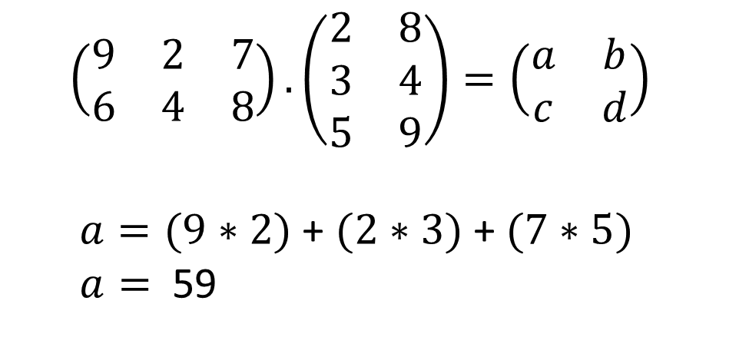
Matrix multiplication
$$\left(\begin{matrix}9 & 2 & 7 \\ 6 & 4 & 8\end{matrix}\right). \left(\begin{matrix}2 & 8 \\ 3 & 4 \\ 5 & 9\end{matrix}\right)=\left(\begin{matrix}a & b \\ c & d\end{matrix}\right)$$
$a=(9∗2)$+ $(2∗3)$+ $(7∗5)$
$a=$ 59
(mmul [[9 2 7] [6 4 8]]
[[2 8] [3 4] [5 9]])
=> [[59 143] [64 136]]

Slide 33
Geometry
(def π 3.141592653589793)
(def τ (* 2.0 π))
(defn rot [turns]
(let [a (* τ turns)]
[[ (cos a) (sin a)]
[(-(sin a)) (cos a)]]))
(mmul (rot 1/8) [3 4])
=> [4.9497 0.7071]
45° = 1/8 turn
NB: See Tau Manifesto (http://tauday.com/) regarding the use of Tau (τ)

Slide 34

Demo

Slide 35

Mutability?

Slide 36
Mutability – the tradeoffs
Pros
Cons
Faster
Reduces GC pressure
Standard in many existing matrix libraries
Mutability is evil
Harder to maintain / debug
Hard to write concurrent code
Not idiomatic in Clojure
Not supported by all core.matrix implementations
“Place Oriented Programming”
Avoid mutability. But it’s an option if you really need it.
Notes:
Basically mutability is horrible. You should be avoiding it as much as you can
But it turns out that it is needed in some cases – performance matters for numerical work
Mutability OK for library implementers, e.g. accumulation of a result in a temporary array
Once a value is constructed, shouldn’t be mutated any more

Slide 37
Mutability – performance benefit
Time for addition of vectors* (ns)
4x
performance benefit
* Length 10 double vectors, using :vectorz implementation
Notes:
Usually 4x performance benefit isn’t a big deal – unless it happens to be your bottleneck
There are cases where it might be important: e.g. if you are crunching through a lot of data and need to add to some sort of accumulator…

Slide 38
Mutability – syntax
(add [1 2] 1)
[2 3]
(add! [1 2] 1)
=> RuntimeException ...... not mutable!
(def a (mutable [1 2])) ;; coerce to a mutable format
=> #<Vector2 [1.0,2.0]>
(add! a 1)
=> #<Vector2 [2.0,3.0]>
A core.matrix function name ending with “!” performs mutation
(usually on the first argument only)
Notes:
Mutability OK for library implementers, e.g. accumulation of a result in a temporary array
Once a value is constructed, shouldn’t be mutated any more

Slide 39
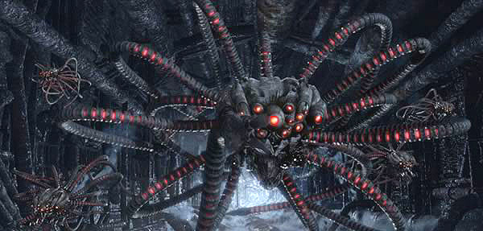
Implementation

Slide 40





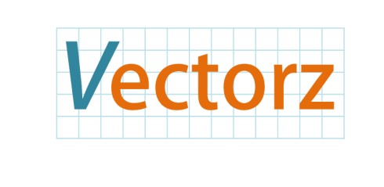

Many Matrix libraries…
MTJ
ojAlgo
UJMP
javax.vecmath

Slide 41

THIS IS MADNESS
Notes:
Clearly this is insane – why so many matrix libraries?

Slide 42
Lots of trade-offs
Native Libraries | vs. | Pure JVM
Mutability | vs. | Immutability
Specialized elements (e.g. doubles) | vs. | Generalised elements (Object, Complex)
Multi-dimensional | vs. | 2D matrices only
Memory efficiency | vs. | Runtime efficiency
Concrete types | vs. | Abstraction (interfaces / wrappers)
Specified storage format | vs. | Multiple / arbitrary storage formats
License A | vs. | License B
Lightweight (zero-copy) views | vs. | Heavyweight copying / cloning
Notes:
This explains the problem. But doesn’t really help us….

Slide 43
What’s the best data structure?
Length 50 “range” vector:
0 | 1 | 2 | 3 | .. | 49
1. Clojure Vector
2. Java double[] array
[0 1 2 …. 49]
new double[]
{0, 1, 2, …. 49};
3. Custom deftype
4. Native vector format
(deftype RangeVector
[^long start
^long end])
(org.jblas.DoubleMatrix.
params)

Slide 44

There is no spoon
Notes:
The point is – there isn’t ever going to be a perfect right answer when choosing a concrete data type to implement an abstraction.
There are always going to be inherent advantages of different approaches

Slide 45

Secret weapon time!
Notes:
Luckily we have a secret weapon, and I think this is actually what really distinguishes core.matrix from all other array programming systems

Slide 46
Clojure Protocols
clojure.core.matrix.protocols
(defprotocol PSummable
"Protocol to support the summing of all elements in
an array. The array must hold numeric values only,
or an exception will be thrown."
(element-sum [m]))
1. Abstract Interface
2. Open Extension
3. Fast dispatch
Notes:
Of course the secret weapon is Clojure protocols.
Here’s an example – PSummable protocol is a very simple protocol that allows to to compute the sum of all values in an array
Three things are important to know about
First is that they define an abstract interface – which is exactly what we need to define operations that work on our array abstraction
Secondly they feature open extension: which means that we can solve the expression problem and use protocols with arbitrary types – importantly, this includes types that weren’t written with the protocol in mind – e.g. arbitrary Java classes
Third feature is really fast dispatch – which is important if we want to core.matrix to be useful in high performance situations.

Slide 47
Protocols are fast and open
Function call costs (ns)
Open extension
✘
✘
✘
✓
✓
* Using class of first argument as dispatch function
Notes:
Protocols are really the “sweet spot” of being both fast and open
We benchmarked a pretty wide variety of different function calls

Slide 48
Typical core.matrix call path
User Code
(esum [1 2 3 4])
core.matrix
API
(matrix.clj)
(defn esum
"Calculates the sum of all the elements in a
numerical array."
[m]
(mp/element-sum m))
Impl.
code
(extend-protocol mp/PSummable
SomeImplementationClass
(element-sum [a]
………))

Slide 49
Most protocols are optional
PImplementation
PDimensionInfo
PIndexedAccess
PIndexedSetting
PMatrixEquality
PSummable
PRowOperations
PVectorCross
PCoercion
PTranspose
PVectorDistance
PMatrixMultiply
PAddProductMutable
PReshaping
PMathsFunctionsMutable
PMatrixRank
PArrayMetrics
PAddProduct
PVectorOps
PMatrixScaling
PMatrixOps
PMatrixPredicates
PSparseArray
…..
MANDATORY
Required for a working core.matrix implementation
OPTIONAL
Everything in the API will work without these
core.matrix provides a “default implementation”
Implement for improved performance
Notes:
It’s easy to make a working core.matrix implementation!
It’s more work if you want to make it perfom across the whole API
But that’s OK because it can be done incrementally
So hopefully this provides a smooth development path for core.matrix implementations to integrate

Slide 50
Default implementations
Protocol name - from namespace
clojure.core.matrix.protocols
clojure.core.matrix.impl.default
(extend-protocol mp/PSummable
Number
(element-sum [a] a)
Object
(element-sum [a]
(mp/element-reduce a +)))
Implementation for any Number
Implementation for an arbitrary Object (assumed to be an array)
Notes:
The secret is having default implementations for all protocols, that get used if you haven’t extended the protocol for your particular type
Note that the default implementation delegates to another protocol call – this is generally the case, ultimately all these protocol calls have to be implemented in terms of the lower-level mandatory protocols if we want them to work on any array.

Slide 51
Extending a protocol
(extend-protocol mp/PSummable
(Class/forName "[D")
(element-sum [m]
(let [^doubles m m]
(areduce m i res 0.0 (+ res (aget m i))))))
Class to implement protocol for, in this case a Java array : double[]
Add type hint to avoid reflection
Optimised code to add up all the elements of a double[] array

Slide 52
Speedup vs. default implementation
Timing for element sum of length 100 double array (ns)
15-20x
benefit
Notes:
Value of a specialised implementation

Slide 53
Internal Implementations
Implementation | Key Features
:persistent-vector | Support for Clojure vectors Immutable Not so fast, but great for quick testing
:double-array | Treats Java double[] objects as 1D arrays Mutable – useful for accumulating results etc.
:sequence | Treats Clojure sequences as arrays Mostly useful for interop / data loading
:ndarray :ndarray-double :ndarray-long ..... | Google Summer of Code project by Dmitry Groshev Pure Clojure N-Dimensional arrays similar to NumPy Support arbitrary dimensions and data types
:scalar-wrapper :slice-wrapper :nd-wrapper | Internal wrapper formats Used to provide efficient default implementations for various protocols

Slide 54
NDArray
(deftype NDArrayDouble
[^doubles data
^int ndims
^ints shape
^ints strides
^int offset])
offset
strides[0]
0 | 1 | 2
3 | 4 | 5
strides[1]
? | ? | ? | 0 | 1 | 2 | ? | ? | 3 | 4 | 5 | ?
0
data
(Java array)
ndims = 2
shape = [2 3]
Notes:
Makes some operations very efficient
- For example if you want to transpose an NDArray, you just need to reverse the shape and reverse the strides.

Slide 55

External Implementations
Implementation | Key Features
vectorz-clj | Pure JVM (wraps Java Library Vectorz) Very fast, especially for vectors and small-medium matrices Most mature core.matrix implementation at present
Clatrix | Use Native BLAS libraries by wrapping the Jblas library Very fast, especially for large 2D matrices Used by Incanter
parallel-colt-matrix | Wraps Parallel Colt library from Java Support for multithreaded matrix computations
arrayspace | Experimental Ideas around distributed matrix computation Builds on ideas from Blaze, Chapele, ZPL
image-matrix | Treats a Java BufferedImage as a core.matrix array Because you can?
Notes:
vectorz-clj: probably the best choice if you want general purpose double numerics
clatrix: probably the best choice if you want linear algebra with big matrices

Slide 56
Switching implementations
(array (range 5))
=> [0 1 2 3 4]
;; switch implementations
(set-current-implementation :vectorz)
;; create array with current implementation
(array (range 5))
=> #<Vector [0.0,1.0,2.0,3.0,4.0]>
;; explicit implementation usage
(array :persistent-vector (range 5))
=> [0 1 2 3 4]

Slide 57
Mixing implementations
(def A (array :persistent-vector (range 5)))
=> [0 1 2 3 4]
(def B (array :vectorz (range 5)))
=> #<Vector [0.0,1.0,2.0,3.0,4.0]>
(* A B)
=> [0.0 1.0 4.0 9.0 16.0]
(* B A)
=> #<Vector [0.0,1.0,4.0,9.0,16.0]>
core.matrix implementations can be mixed
(but: behaviour depends on the first argument)
Notes:
Not only can you switch implementation: you can also mix them!
Actually quite unique capability
How do we do this? Provide generic coercion functionality – so implementations typically use this to coerce second argument to type of the first

Slide 58
Future roadmap
Version 1.0 release
Data types: Complex numbers
Expression compilation
Domain specific extensions, e.g.:
symbolic computation (expresso)
stats
Geometry
linear algebra
Incanter integration

Slide 59
END

Slide 60

Incanter Integration
A great environment for statistical computing, data science and visualisation in Clojure
Uses the Clatrix matrix library – great performance
Work in progress to support core.matrix fully for Incanter 2.0

Slide 61
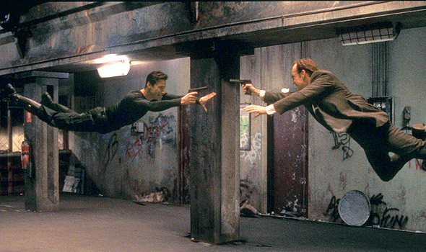
Benchmarks: Clojure vs. Python

Slide 62
Domain specific extensions
Extension library | Focus
core.matrix.stats | Statistical functions
core.matrix.geom | 2D and 3D Geometry
expresso | Manipulation of array expressions

Slide 63
Broadcasting Rules
Designed for elementwise operations - other uses must be explicit
Extends shape vector by adding new leading dimensions
original shape [4 5]
can broadcast to any shape [x y ... z 4 5]
scalars can broadcast to any shape
Fills the new array space by duplication of the original array over the new dimensions
Smart implementations can avoid making full copies by structural sharing or clever indexing tricks
Notes:
So we have some rules for broadcasting
Note that it only really makes sense for elementwise operations. You can broadcast arrays explicitly if you want to to, but it only happens automatically for elementwise operations at present.
Can only add leading dimensions.

Slide 64
Vectorz
ectorz
ectorz

