Slide 1
TensorFlow Implementation for Job Market Classification
Taras Mitran
Jeff Waller

Slide 2
HR Compensation Workflow
Scenario: ABC Corp wants to hire a statistician.
What the market rate for this job, at the 50th percentile? 60%ile?
Issue: Almost every company’s job title and description for roughly the same “job” is different than other companies.

Slide 3
HR Compensation Workflow
ABC Corp submits all salaries with job information to salary survey companies annually.
Survey companies aggregate data across companies.
They sell it back to ABC Corp in .csv format.
ABC Corp has to match several overlapping surveys to the job they want to price.

Slide 4
HR Compensation Workflow
Instead of searching the entire dataset via keyword search:
Can similar or nearly identical jobs be clustered, so the user only has to review a small subset of jobs?

Slide 5
HR Compensation Workflow
Luckily, this is being done.
The issue: its being done manually. And tens of thousands of different job descriptions are created each year.
Challenge: augment this work with machine learning

Slide 6
A sample short form job description:
Head of statistical programming co-ordinate and oversee activities of statistical programming teams develop programming standards. develop utility sas macros for use in project programs. develop programming technologies to increase efficiencies in clinical study reporting. generate summary data tables and analyses as part of clinical study reports and iss/ise documents for fda submission. key programmer for the production of interim analysis tables needed by data monitoring boards. collaborate with it department to enhance biostatistics technologies; serve as key contact for sas issues. program and validate data transfers and data conversions between sas and other software for clients and regulatory agencies. develop, test, and validate sas interfaces to non-sas data sources. supervise, instruct, and mentor junior staff. participate in business development activities. experience: likely to have had a least 10 years' experience in statistical programming. qualifications: bsc in computing, life sciences, mathematical or statistical subjects. line management experience. level responsibility: line management - high - 6+. project - high - 3+ countries. financial - medium. technical - high - expert. alternative titles: director of statistical programming. survey level 4.

Slide 7
I heard Tensorflow was good?

Slide 8
What is Tensorflow?
Python-based neural network framework
Google open source project on Github
Released November 2015
Runs highly optimized C++ code for actual calculations
Higher level APIs on top of tensorflow available, like skflow to fit within the Scikit Learn API
TensorFlow is an open source software library for numerical computation using data flow graphs. Nodes in the graph represent mathematical operations, while the graph edges represent the multidimensional data arrays (tensors) that flow between them.

Slide 9


Why Tensorflow?
Because Google?

Slide 10
Text-based Convolutional Neural Nets
Udacity Course:
https://www.udacity.com/course/deep-learning--ud730
All examples are in main repository of tensorflow:
https://www.udacity.com/course/deep-learning--ud730
ConvNet on Rotten Tomatoes data set guide:
http://www.wildml.com/2015/12/implementing-a-cnn-for-text-classification-in-tensorflow/

Slide 11
#TAGSPACE: Semantic Embeddings from Hashtags
Facebook whitepaper on convolutional neural networks:
a convolutional neural network that learns feature representations for short textual posts using hashtags as a supervised signal. The proposed approach is trained on up to 5.5 billion words predicting 100,000 possible hashtags
http://emnlp2014.org/papers/pdf/EMNLP2014194.pdf

Slide 12
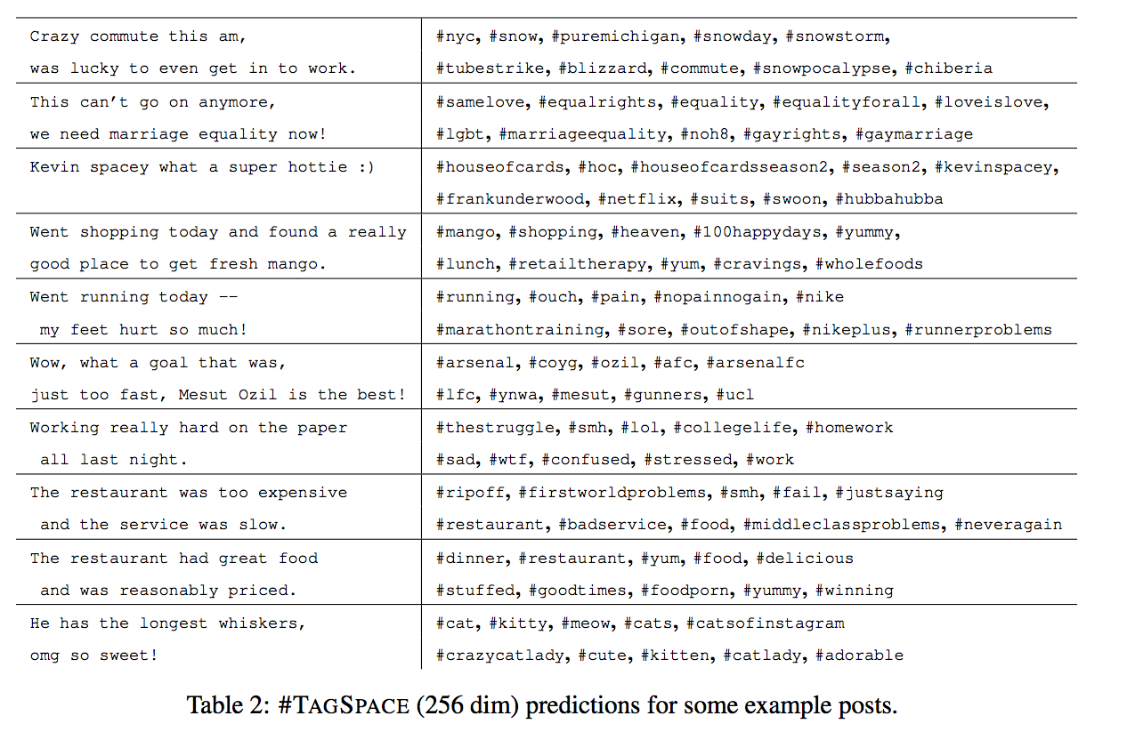

Slide 13
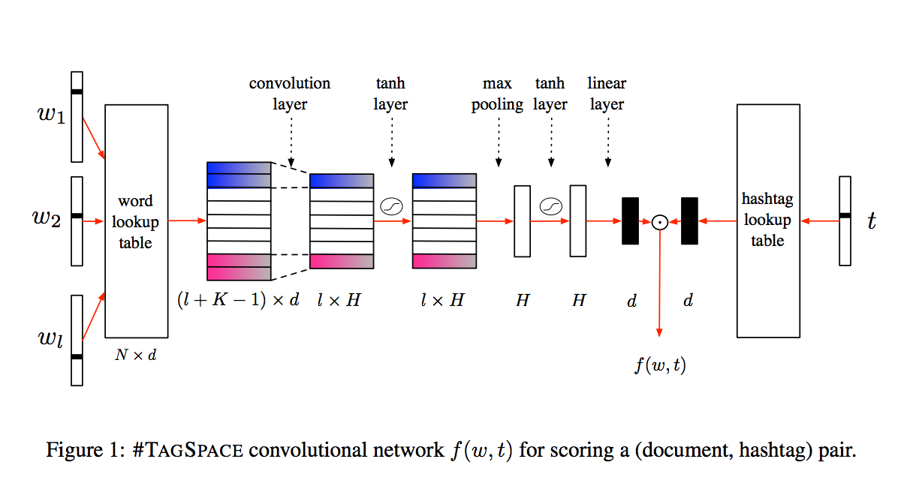
Facebook’s neural network design:

Slide 14
How to get started?
Step 1: pip install tensorflow
Step 2: ??
Step 3: Profit

Slide 15

Nvidia GPUs for NN
Neural networks are computationally simple, but require massive amounts of calculations, a problem well conditioned for computation on a GPU.

Slide 16
Nvidia GPUs for NN
The Nvidia GTX 980 is (was until the GTX 1080) the most efficient hardware for this, GTX 980 used by gamers (this is why the low price) — $520 prior to introduction of GTX 1080, $400 now. The 1080 is $650.
Neural networks do not need double sized floats, so the massively priced K80, etc GPUS are not needed.
980 GTX uses Maxwell architecture 4 GB memory (224 GB/sec bandwidth) and capable of 4.6 TFlops
GTX 1080 introduced June 2016 using Pascal architecture which comes with specialized support for neural networks (among other things support for half-word sized floats), 8 GB of memory (320 GB/sec bandwidth) 8.9 TFlops.

Slide 17
Install notes
Tensorflow can make use of of the GPU but requires Linux as the OS and it’s best to set aside a video card for computation rather than making it double as compute engine and video display.
needs the latest CUDA was well as the latest CUDNN (CUDA for Neural Networks) from Nvidia.
these libraries must be obtained from the Nvidia developer site
https://developer.nvidia.com/cuda-downloads
https://developer.nvidia.com/cudnn
follow install instructions given on nvidia site.

Slide 18
Install Cont’d
Straightforward location is /usr/local
jeffw@chill:/usr/local$ cat /etc/ld.so.conf.d/cuda.conf
/usr/local/cuda/lib64
jeffw@chill:/usr/local$ cat /etc/ld.so.conf.d/cudnn.conf
/usr/local/cudnn/lib64
install tensorflow with pip
install the normal numerical packages numpy and scikit

Slide 19
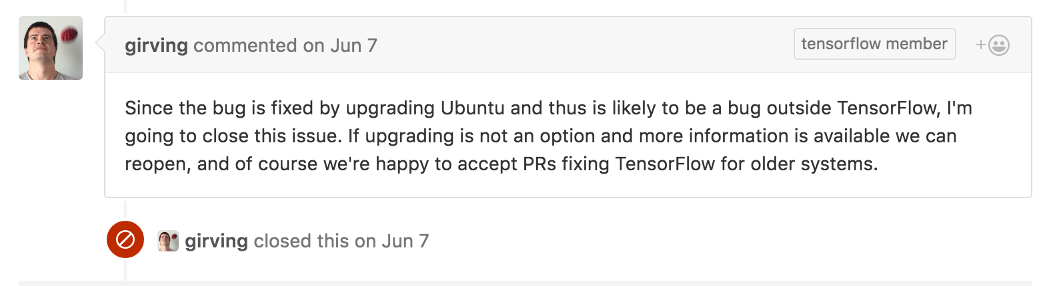
Install Cont’d.
use Ubuntu 16 to avoid the following problem:
https://github.com/tensorflow/tensorflow/issues/2190

Slide 20
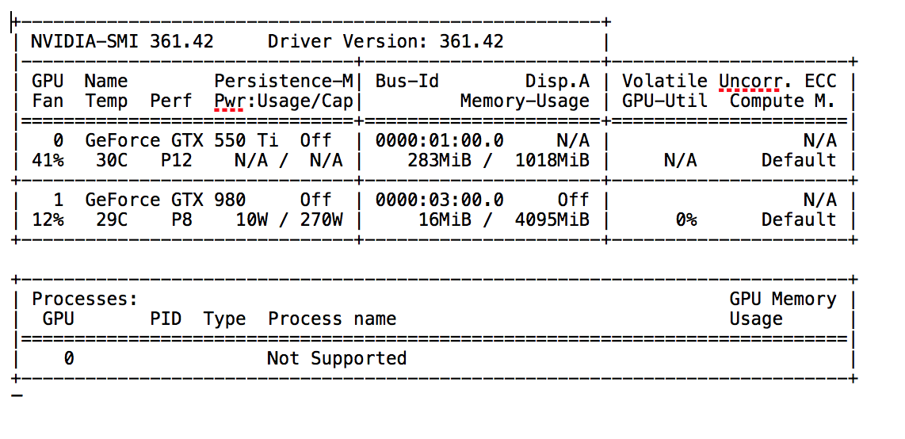
The rig:

Slide 21
Post install
Do some ETL
Create a model
Run”python mymodel.py”
Tweak the model
Buy some more video cards to make it go faster*
* Has nothing to do with wanting to play games at 120 FPS on a 4k monitor

Slide 22
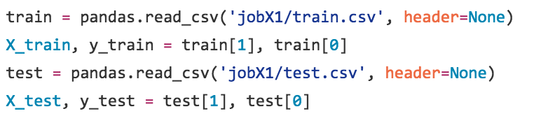
ETL
* Validation set should also be included, we just ran that in our final tool

Slide 23
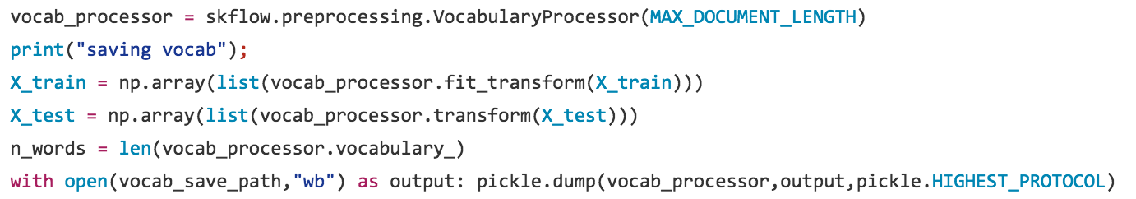
ETL Cont’d.
Map each document to a fixed length vector of integers (vocabulary IDs) of length MAX_DOCUMENT_LENGTH
each word is assigned a unique integer
Save the vocabulary token off so IDs are consistent across multiple training runs

Slide 24
We’ll come back to the model, but first an interlude:
Our experience getting the model up and running

Slide 25
First it crashed

Slide 26
And then it crashed again….
(Ubuntu 15 bug from install)

Slide 27
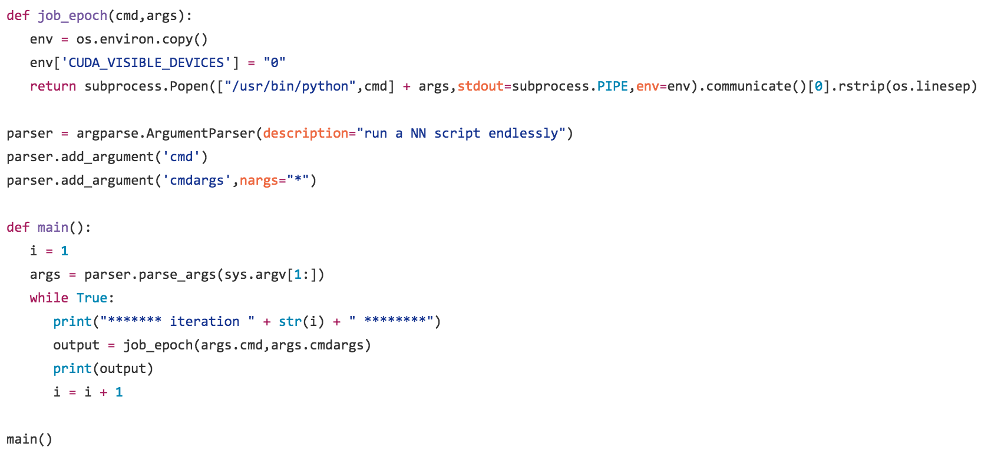
And again…

Slide 28
Then it burned
(our model didn’t perform so well)

Slide 29
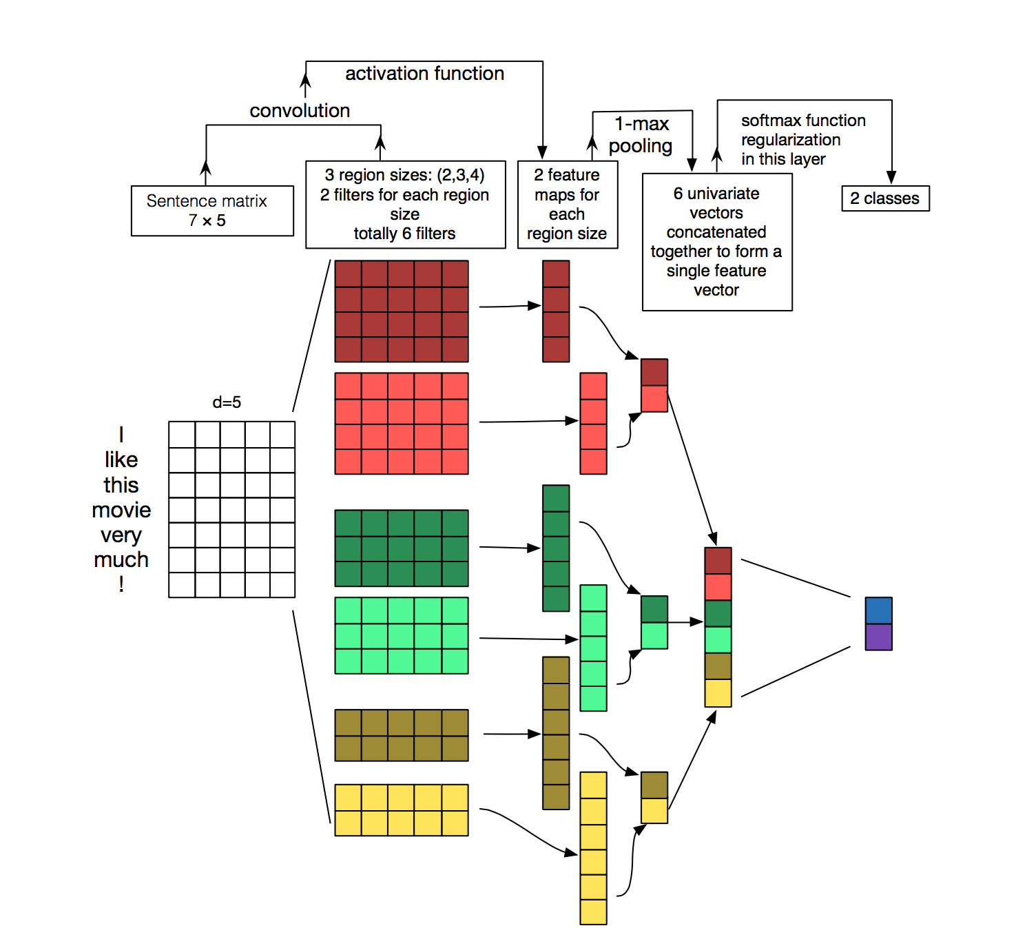
What is a Convolutional Neural Network?

Slide 30
What is a Convolution?
A sliding window function applied to a matrix.
The window is called kernel, patch, or filter.
Source: http://deeplearning.stanford.edu/wiki/index.php/Feature_extraction_using_convolution

Slide 31

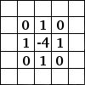
What is a Convolution?
Source: http://www.wildml.com/2015/11/understanding-convolutional-neural-networks-for-nlp/

Slide 32
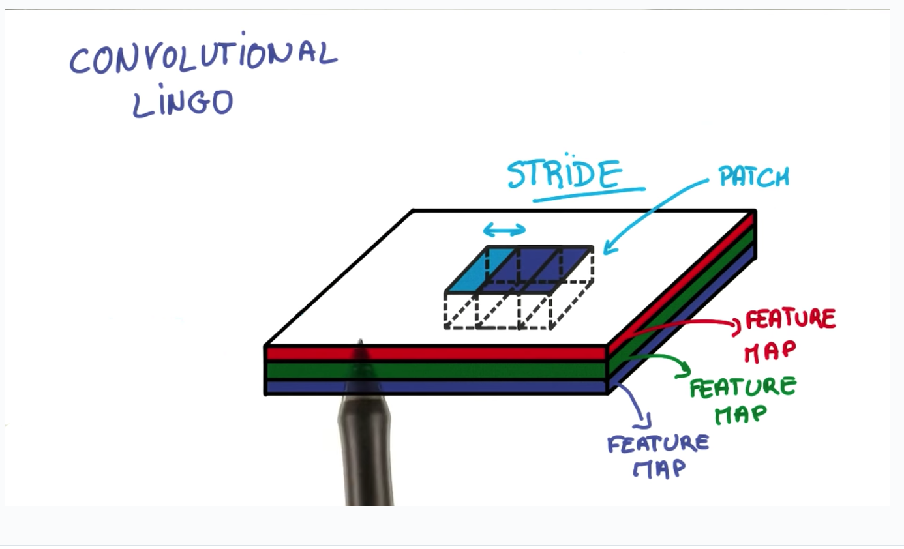
Strides
Stride = number of pixels/words/characters to shift when looping over input matrix
https://www.udacity.com/course/deep-learning--ud730

Slide 33
Embeddings
“The cat purrs”
“The cat hunts mice”
“The kitten purred”

Slide 34

Do kittens hunt mice?

Slide 35
Word2vec math
Since embeddings are vectors of floats:
Puppy – Dog + Cat = Kitten

Slide 36
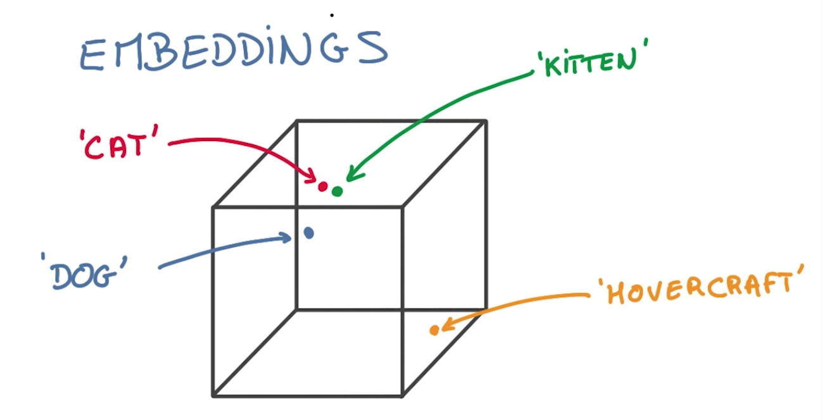
Embeddings
Alternative to one-hot encoding
Scales better with thousands of categories, but sparse values
We learned embeddings from scratch instead of word2vec
https://www.udacity.com/course/deep-learning--ud730

Slide 37
Embeddings
We tweaked the hyperparameter to:
EMBEDDING_SIZE = 32

Slide 38

Activation Function: non-linearity
We’ll skim over these details, but we used a reLU
It’s a rectified linear unit
They are an alternative to sigmoid functions, such as tanh
Linear if x > 0, 0 where x <= 0
https://youtu.be/Opg63pan_YQ

Slide 39
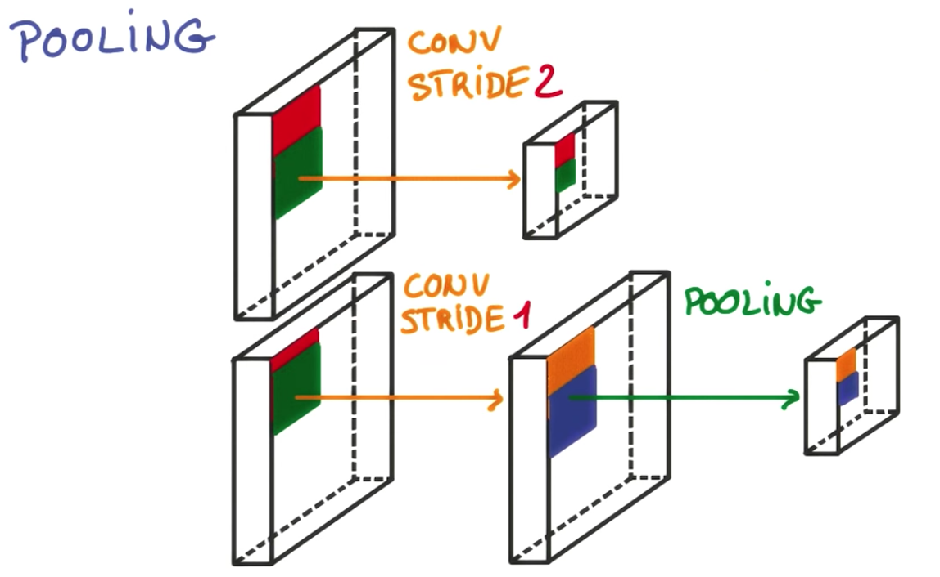
Pooling: reduce complexity while maintaining accuracy
aggregate windows of values in the matrix to reduce the output
Average pooling: similar to “blurring” an image
Max Pooling: use maximum of all values in neighborhood of each value
https://www.udacity.com/course/deep-learning--ud730

Slide 40
Pooling
Allows you to reduce stride, and increase accuracy
Lower strides increase computation cost
Another hyperparameter!
Note: Output will lose edges, so either pad with zeros for ‘same’ padding, or the output size will be smaller with ‘valid’ padding.

Slide 41
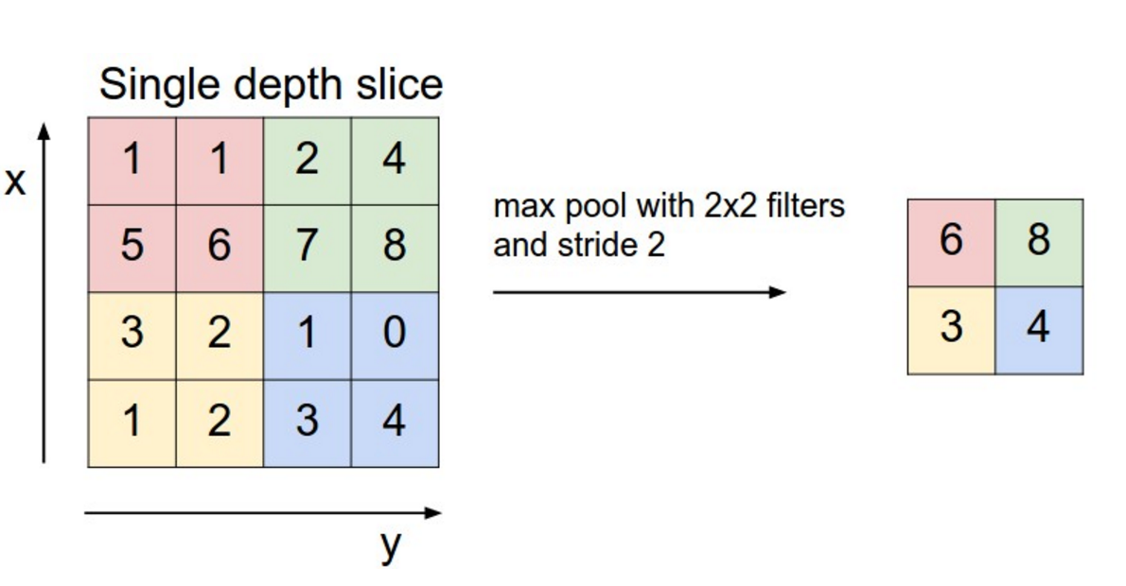
Source: http://cs231n.github.io/convolutional-networks/#pool

Slide 42
Softmax: convert scores to probabilities
Returns a NumPy array with the same shape as the input:
def softmax(x):
e_x = np.exp(x)
return e_x / e_x.sum(axis=0)
scores = [1.0, 2.0, 3.0]
print softmax(scores)
[ 0.09003057 0.24472847 0.66524096]

Slide 43
What is a Convolutional Neural Network?

Slide 44
Demo!

Slide 45
Further Steps
Most inaccurate predictions had things like “responsible for supervising the collection of, managing, and reports on <x>” where x might be “water samples” or “tax records”.
Additional layers by training sentences instead of paragraphs, and then training that output.
Common structure in job descriptions
Similar to a NN understanding edges, and then shapes
Split classification into job function and career level as additional layers
Pre-process with TF-IDF for job functionality

Slide 46
Questions?

