Slide 1
Deep Learning for Information Processing & Artificial Intelligence New-Generation Models & Methodology for Advancing AI & SIP
Li Deng
Microsoft Research, Redmond, USA
Tianjin University, July 2-5, 2013
(including joint work with colleagues at MSR, U of Toronto, etc.)

Slide 2
Learning Internal Representations: Computer Vision and Speech Recognition Tasks
DAY Two: July 3, 2013

Slide 3
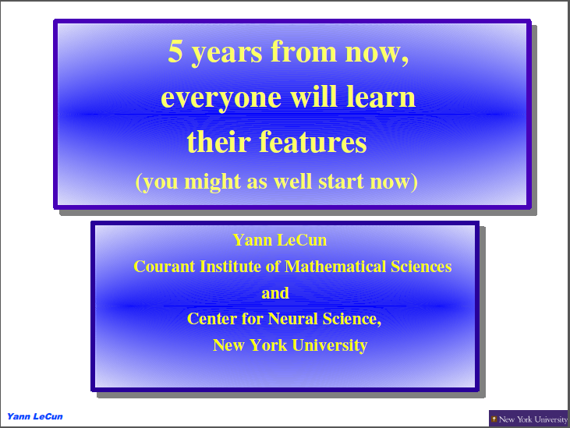
Prof. LeCun’s 2011 Talk on Computer Vision

Slide 4
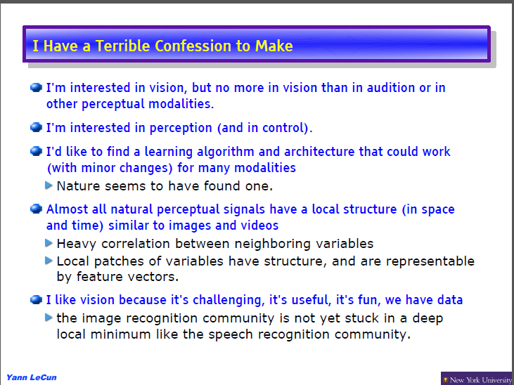

Slide 5
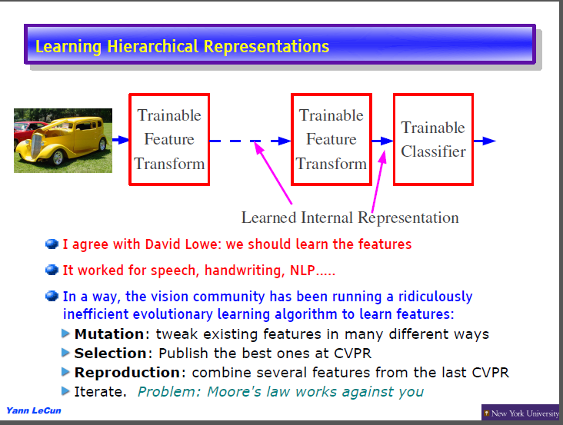

Slide 6
Feature Engineering or Feature Learning?
In Vision: SIFT, HOG, pixels, sparse coding, RBM, autoencoder, LCC, scattering net (Mallat), deep conv net (discriminative feature learning), etc.
In NLP: N-gram, hashing, XXX, YYY, ZZZ etc.
In Speech: MFCC’s, PLPs, SPLICE (for noise robustness), autoencoder, scattering spectra, learned mapping from filterbank to MFCCs, DNN, etc.

Slide 7
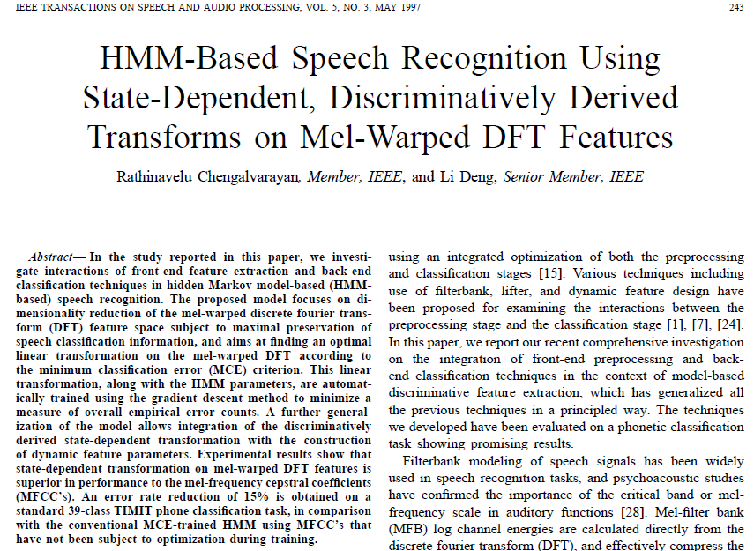

Slide 8
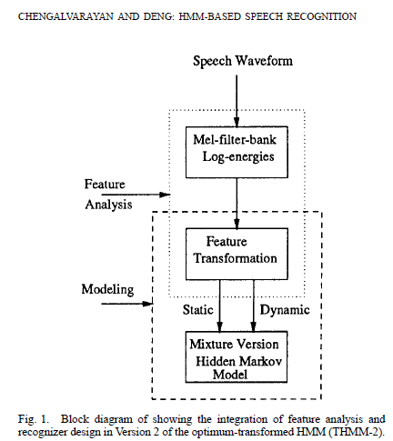
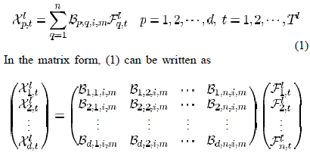
Learning B matrix rather than fixing it to
the cosine transform to form the MFCCs

Slide 9
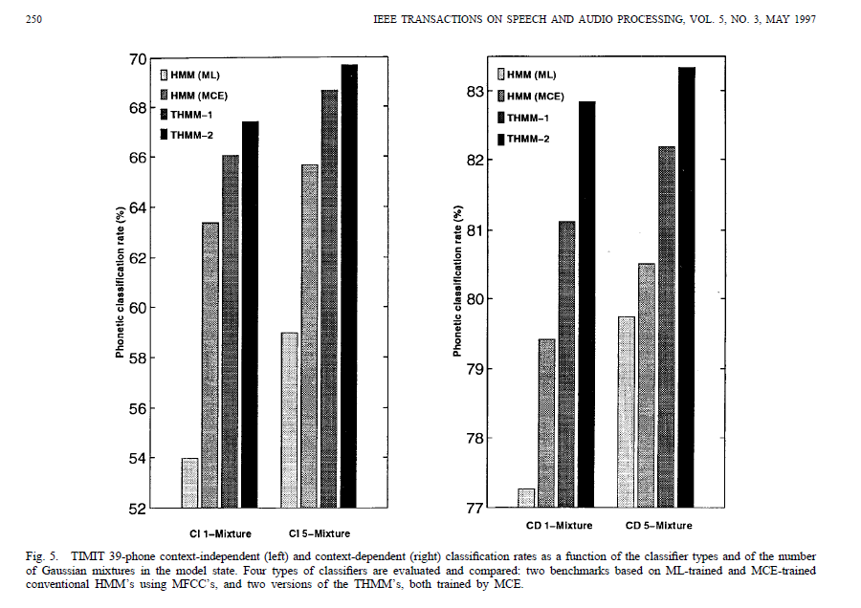
Strong results
Limited to linear mapping and did not go deeper
DNN does similar discriminative feature learning with more layers and with nonlinear
mappings

Slide 10
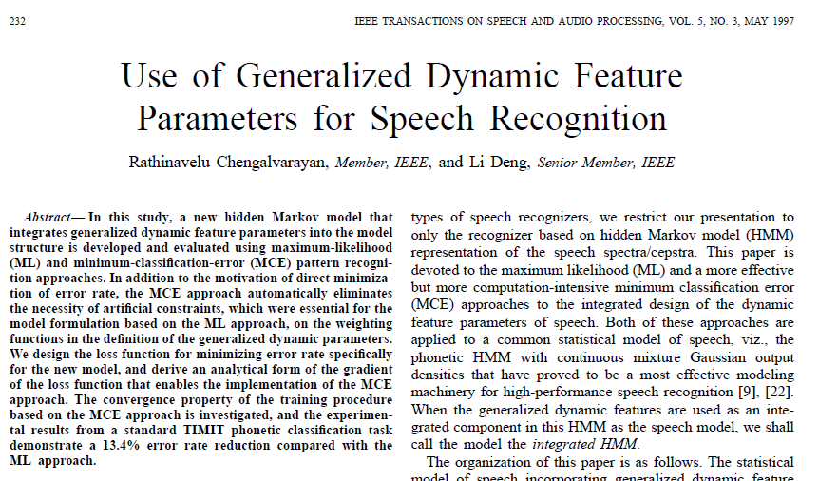
Another Example of (shallow) Feature Learning in Speech Recognition

Slide 11
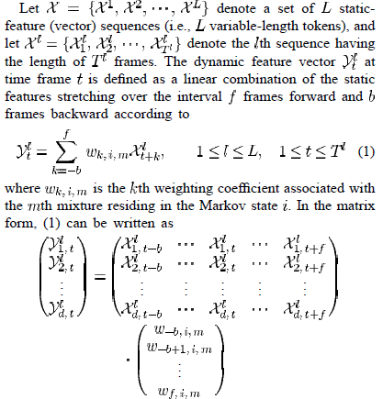
Dynamic features can be formulated as a linear transform of static features in sequence
So the same feature learning as filter-bank to MFCCs can apply

Slide 12
Comparisons with DNN feature extractions
Shallow vs. deep
Linear vs. nonlinear
“Local” vs. “distributed” representations of target classes

Slide 13
What Types of Problems Fit (not fit)
Deep Learning (some conjectures)
“Perceptual” AI
“Data matching”
e.g.: Image/video recognition
Speech recognition
Speech/text understanding
Sequential data with temporal
structure (stock market prediction?)
e.g.: Malware detection(ICASSP-2013)
movie recommender, speaker/language detection?
Non-obvious data representations
Easy data representation
e.g., histogram of events,
user-watched movies, etc.
Deep learning already shows
tremendous benefits
Deep learning may not win over
standard machine learning
Notes:
Deep networks are not a panacea, however. We know that they work well on visual object recognition and speech recognition. There is early evidence that they will work well on document understanding. In all of these kind of problems, it’s very difficult for an engineer to specify or build a representation for the data (that isn’t just the lowest-level building blocks, such as pixels or words). Deep networks should be state-of-the-art in those kind of problems.
Many machine learning applications inside and outside of Microsoft are not difficult AI problems: they fall under ‘data mining’. An example of such a problem is movie recommendation. In movie recommendation, the problem of how to represent data is very easy. For example, you just represent the movies that a user watches in a big sparse matrix. Perhaps you add the demographics of the user. Then, simply apply an existing ML algorithm. We expect deep networks will have no benefit in this (or similar) cases.

Slide 14
Computational Neuroscience (coursera)
Hebbian learning
Hopfield Net, Bolzmann machines, memory models
Bio-inspired AI
RNN
Computer vision (LeCun slides)
NLP
IR

Slide 16
Thank You

Slide 17
Selected References (updated, 2013)
Abdel-Hamid, O., Mohamed, A., Jiang, H., and G. Penn, “Applying convolutional neural networks concepts to hybrid NN-HMM model for speech recognition,” Proc. ICASSP, 2012.
Arel, I., Rose, C., and Karnowski, T. “Deep Machine Learning - A New Frontier in Artificial Intelligence,” IEEE Computational Intelligence Mag., Nov., 2010.
Baker, J., Deng, L., Glass, J., Khudanpur, S., Lee, C.-H., Morgan, N., and O’Shaughnessy, D. “Research developments and directions in speech recognition and understanding,” IEEE Sig. Proc. Mag., vol. 26, no. 3, May 2009, pp. 75-80.
Baker, J., Deng, L., Glass, J., Khudanpur, S., Lee, C.-H., Morgan, N., and O’Shaughnessy, D. “Updated MINS report on speech recognition and understanding,” IEEE Sig. Proc. Mag., vol. 26, no. 4, July 2009a.
Bengio, Y., Boulanger, N., and Pascanu. R. “Advances in optimizing recurrent networks,” Proc. ICASSP, 2013.
Bengio, Y., Courville, A., and Vincent, P. “Representation learning: A review and new perspectives,” IEEE Trans. PAMI, 2013a.
Bengio, Y. “Learning deep architectures for AI,” in Foundations and Trends in Machine Learning, Vol. 2, No. 1, 2009, pp. 1-127.
Bengio, Y., Ducharme, R., Vincent, P. and Jauvin, C. “A neural probabilistic language model,” Proc. NIPS, 2000, pp. 933-938.
Bengio, Y., De Mori, R., Flammia, G. and Kompe, F. “Global optimization of a neural network—Hidden Markov model hybrid,” in Proc. Eurospeech, 1991.
Bergstra, J. and Bengio, Y. “Random search for hyper-parameter optimization,” J. Machine Learning Research,” Vol. 3, pp. 281-305, 2012.
Bottou, L. and LeCun. Y. “Large scale online learning,” Proc. NIPS, 2004.
Bilmes, J. “Dynamic graphical models,” IEEE Signal Processing Mag., vol. 33, pp. 29–42, 2010.
Bilmes, J. and Bartels, C. “Graphical model architectures for speech recognition,” IEEE Signal Processing Mag., vol. 22, pp. 89–100, 2005.
Bourlard, H. and Morgan, N., Connectionist Speech Recognition: A Hybrid Approach, Norwell, MA: Kluwer, 1993.
Bouvrie, J. “Hierarchical Learning: Theory with Applications in Speech and Vision,” Ph.D. thesis, MIT, 2009.
Bridle, J., L. Deng, J. Picone, H. Richards, J. Ma, T. Kamm, M. Schuster, S. Pike, and R. Reagan, “An investigation of segmental hidden dynamic models of speech coarticulation for automatic speech recognition,” Final Report for 1998 Workshop on Language Engineering, CLSP, Johns Hopkins, 1998.
Caruana, R. “Multitask Learning,” Machine Learning, Vol. 28, pp. 41-75, Kluwer Academic Publishers, 1997.
Cho, Y. and Saul L. “Kernel methods for deep learning,” Proc. NIPS, pp. 342–350, 2009.
Ciresan, D., Giusti, A., Gambardella, L., and Schmidhuber, J. “Deep neural networks segment neuronal membranes in electron microscopy images,” Proc. NIPS, 2012.
Cohen, W. and R. V. de Carvalho. “Stacked sequential learning,” Proc. IJCAI, pp. 671–676, 2005.
Collobert, R. “Deep learning for efficient discriminative parsing,” Proc. NIPS Workshop on Deep Learning and Unsupervised Feature Learning, 2010.
Collobert, R. and Weston J. “A unified architecture for natural language processing: Deep neural networks with multitask learning,” Proc. ICML, 2008.
Collobert, R., Weston, J., Bottou, L., Karlen, M., Kavukcuoglu, K., and Kuksa, P. “Natural language processing (almost) from scratch,” J. Machine Learning Research, Vo. 12, pp. 2493-2537, 2011.

Slide 18
Selected References
Dahl, G., Yu, D., Deng, L., and Acero, A. “Context-dependent DBN-HMMs in large vocabulary continuous speech recognition,” Proc. ICASSP, 2011.
Dahl, G., Yu, D., Deng, L., and Acero, A. “Context-dependent, pre-trained deep neural networks for large vocabulary speech recognition,” IEEE Trans. Audio, Speech, & Language Proc., Vol. 20 (1), pp. 30-42, January 2012.
Dahl, G., Ranzato, M., Mohamed, A. and Hinton, G. “Phone recognition with the mean-covariance restricted Boltzmann machine,” Proc. NIPS, vol. 23, 2010, 469-477.
Dean, J., Corrado, G., R. Monga, K. Chen, M. Devin, Q. Le, M. Mao, M. Ranzato, A. Senior, P. Tucker, Yang, K., and Ng, A. “Large Scale Distributed Deep Networks,” Proc. NIPS, 2012.
Deng, L. and Li, X. “Machine learning paradigms in speech recognition: An overview,” IEEE Trans. Audio, Speech, & Language, May 2013.
Deng, L., Abdel-Hamid, O., and Yu, D. “A deep convolutional neural network using heterogeneous pooling for trading acoustic invariance with phonetic confusion,” Proc. ICASSP, 2013.
Deng, L., Li, J., Huang, K., Yao, D. Yu, F. Seide, M. Seltzer, G. Zweig, X. He, J. Williams, Y. Gong, and A. Acero. “Recent advances in deep learning for speech research at Microsoft,” Proc. ICASSP, 2013a.
Deng, L., Hinton, G., and Kingsbury, B. “New types of deep neural network leaning for speech recognition and related applications: An overview,” Proc. ICASSP, 2013b.
Deng, L., He, X., and J. Gao, J. “Deep stacking networks for information retrieval,” Proc. ICASSP, 2013c.
Deng, L., Tur, G, He, X, and Hakkani-Tur, D. “Use of kernel deep convex networks and end-to-end learning for spoken language understanding,” Proc. IEEE Workshop on Spoken Language Technologies, December 2012.
Deng, L., Yu, D., and Platt, J. “Scalable stacking and learning for building deep architectures,” Proc. ICASSP, 2012a.
Deng, L., Hutchinson, B., and Yu, D. “Parallel training of deep stacking networks,” Proc. Interspeech, 2012b.
Deng, L. “An Overview of Deep-Structured Learning for Information Processing,” Proceedings of Asian-Pacific Signal & Information Processing Annual Summit and Conference (APSIPA-ASC), October 2011.
Deng, L. and Yu, D. “Deep Convex Network: A scalable architecture for speech pattern classification,” Proc. Interspeech, 2011.
Deng, L., Seltzer, M., Yu, D., Acero, A., Mohamed, A., and Hinton, G. “Binary coding of speech spectrograms using a deep auto-encoder,” Proc. Interspeech, 2010.
Deng, L., Yu, D., and Hinton, G. “Deep Learning for Speech Recognition and Related Applications” NIPS Workshop, 2009.
Deng, L. and Yu, D. “Use of differential cepstra as acoustic features in hidden trajectory modeling for phonetic recognition,” Proc. ICASSP, 2007.
Deng, L. DYNAMIC SPEECH MODELS – Theory, Algorithm, and Application, Morgan & Claypool, December 2006.
Deng, L., Yu, D. and Acero, A. “Structured speech modeling,” IEEE Trans. on Audio, Speech and Language Processing, vol. 14, no. 5, pp. 1492-1504, September 2006
Deng, L., Yu, D. and Acero, A. “A bidirectional target filtering model of speech coarticulation: Two-stage implementation for phonetic recognition,” IEEE Transactions on Audio and Speech Processing, vol. 14, no. 1, pp. 256-265, January 2006a.

Slide 19
Deng, L., Wu, J., Droppo, J., and Acero, A. “Dynamic Compensation of HMM Variances Using the Feature Enhancement Uncertainty Computed From a Parametric Model of Speech Distortion,” IEEE Transactions on Speech and Audio Processing, vol. 13, no. 3, pp. 412–421, 2005.
Deng, L. and O'Shaughnessy, D. SPEECH PROCESSING – A Dynamic and Optimization-Oriented Approach, Marcel Dekker, 2003.
Deng, L. “Switching dynamic system models for speech articulation and acoustics,” in Mathematical Foundations of Speech and Language Processing, pp. 115–134. Springer-Verlag, New York, 2003.
Deng, L. “Computational Models for Speech Production,” in Computational Models of Speech Pattern Processing, pp. 199-213, Springer Verlag, 1999.
Deng, L., Ramsay, G., and Sun, D. “Production models as a structural basis for automatic speech recognition,” Speech Communication, vol. 33, no. 2-3, pp. 93–111, Aug 1997.
Deng, L. and Sameti, H. “Transitional speech units and their representation by regressive Markov states: Applications to speech recognition,” IEEE Transactions on speech and audio processing, vol. 4, no. 4, pp. 301–306, July 1996.
Deng, L., Aksmanovic, M., Sun, D., and Wu, J. “Speech recognition using hidden Markov models with polynomial regression functions as nonstationary states,” IEEE Transactions on Speech and Audio Processing, vol. 2, no. 4, pp. 507-520, 1994.
Deng L. and Sun, D. “A statistical approach to automatic speech recognition using the atomic speech units constructed from overlapping articulatory features,” Journal of the Acoustical Society of America, vol. 85, no. 5, pp. 2702-2719, 1994.
Deng, L. “A stochastic model of speech incorporating hierarchical nonstationarity,” IEEE Transactions on Speech and Audio Processing, vol. 1, no. 4, pp. 471-475, 1993.
Deng, L. “A generalized hidden Markov model with state-conditioned trend functions of time for the speech signal,” Signal Processing, vol. 27, no. 1, pp. 65–78, 1992.
Deselaers, T., Hasan, S., Bender, O. and Ney, H. “A deep learning approach to machine transliteration,” Proc. 4th Workshop on Statistical Machine Translation , pp. 233–241, Athens, Greece, March 2009.
Erhan, D., Bengio, Y., Courvelle, A., Manzagol, P., Vencent, P., and Bengio, S. “Why does unsupervised pre-training help deep learning?” J. Machine Learning Research, pp. 201-208, 2010.
Fine, S., Singer, Y. and Tishby, N. “The hierarchical hidden Markov model: Analysis and applications,” Machine Learning, vol. 32, p. 41-62, 1998.
Gens, R. and Domingo, P. “Discriminative learning of sum-product networks,” NIPS, 2012.
George, D. “How the Brain Might Work: A Hierarchical and Temporal Model for Learning and Recognition,” Ph.D. thesis, Stanford University, 2008.
Gibson, M. and Hain, T. “Error approximation and minimum phone error acoustic model estimation,” IEEE Trans. Audio, Speech, and Language Proc., vol. 18, no. 6, August 2010, pp. 1269-1279.
Glorot, X., Bordes, A., and Bengio, Y. “Deep sparse rectifier neural networks,” Proc. AISTAT, April 2011.
Glorot, X. and Bengio, Y. “Understanding the difficulty of training deep feed-forward neural networks” Proc. AISTAT, 2010.

Slide 20
Graves, A., Fernandez, S., Gomez, F., and Schmidhuber, J. “Connectionist temporal classification: Labeling unsegmented sequence data with recurrent neural networks,” Proc. ICML, 2006.
Graves, A. “Sequence Transduction with Recurrent Neural Networks,” Representation Learning Worksop, ICML 2012.
Graves, A., Mahamed, A., and Hinton, G. “Speech recognition with deep recurrent neural networks,” Proc. ICASSP, 2013.
Hawkins, J. and Blakeslee, S. On Intelligence: How a New Understanding of the Brain will lead to the Creation of Truly Intelligent Machines, Times Books, New York, 2004.
Hawkins, G., Ahmad, S. and Dubinsky, D. “Hierarchical Temporal Memory Including HTM Cortical Learning Algorithms,” Numenta Tech. Report, December 10, 2010.
He, X., Deng, L., Chou, W. “Discriminative learning in sequential pattern recognition – A unifying review for optimization-oriented speech recognition,” IEEE Sig. Proc. Mag., vol. 25, 2008, pp. 14-36.
He, X. and Deng, L. “Speech recognition, machine translation, and speech translation – A unifying discriminative framework,” IEEE Sig. Proc. Magazine, Vol. 28, November, 2011.
He, X. and Deng, L. “Optimization in speech-centric information processing: Criteria and techniques,” Proc. ICASSP, 2012.
He, X. and Deng, L. “Speech-centric information processing: An optimization-oriented approach,” Proc. of the IEEE, 2013.
Heigold, G., Vanhoucke, V., Senior, A. Nguyen, P., Ranzato, M., Devin, M., and Dean, J. “Multilingual acoustic models using distributed deep neural networks,” Proc. ICASSP, 2013.
Heigold, G., Ney, H., Lehnen, P., Gass, T., Schluter, R. “Equivalence of generative and log-liner models,” IEEE Trans. Audio, Speech, and Language Proc., vol. 19, no. 5, February 2011, pp. 1138-1148.
Heintz, I., Fosler-Lussier, E., and Brew, C. “Discriminative input stream combination for conditional random field phone recognition,” IEEE Trans. Audio, Speech, and Language Proc., vol. 17, no. 8, Nov. 2009, pp. 1533-1546.
Hifny, Y. and Renals, S. “Speech recognition using augmented conditional random fields,” IEEE Trans. Audio, Speech, and Language Proc., vol. 17, no. 2, February 2009, pp. 354-365.
Hinton, G. and Salakhutdinov, R. “Discovering binary codes for documents by learning deep generative models,” Topics in Cognitive Science, pp. 1-18, 2010.
Hinton, G., Srivastava, N., Krizhevsky, A., Sutskever, I., and Salakhutdinov, R. “Improving neural networks by preventing co-adaptation of feature detectors,” arXiv: 1207.0580v1, 2012.
Hinton, G., Deng, L., Yu, D., Dahl, G., Mohamed, A., Jaitly, N., Senior, A., Vanhoucke, V., Nguyen, P., Sainath, T., and Kingsbury, B., “Deep Neural Networks for Acoustic Modeling in Speech Recognition,” IEEE Signal Processing Magazine, vol. 29, no. 6, pp. 82-97, November 2012.

Slide 21
Hinton, G., Krizhevsky, A., and Wang, S. “Transforming auto-encoders,” Proc. Intern. Conf. Artificial Neural Networks, 2011.
Hinton, G. “A practical guide to training restricted Boltzmann machines,” UTML Tech Report 2010-003, Univ. Toronto, August 2010.
Hinton, G., Osindero, S., and Teh, Y. “A fast learning algorithm for deep belief nets,” Neural Computation, vol. 18, pp. 1527-1554, 2006.
Hinton, G. and Salakhutdinov, R. “Reducing the dimensionality of data with neural networks,” Science, vol. 313. no. 5786, pp. 504 - 507, July 2006.
Hinton, G. “A better way to learn features,” Communications of the ACM,” Vol. 54, No. 10, October, 2011, pp. 94.
Huang, J., Li, J., Deng, L., and Yu, D. “Cross-language knowledge transfer using multilingual deep neural networks with shared hidden layers,” Proc. ICASSP, 2013.
Huang, S. and Renals, S. “Hierarchical Bayesian language models for conversational speech recognition,” IEEE Trans. Audio, Speech, and Language Proc., vol. 18, no. 8, November 2010, pp. 1941-1954.
Huang, E., Socher, R., Manning, C, and Ng, A. “Improving Word Representations via Global Context and Multiple Word Prototypes,” Proc. ACL, 2012.
Hutchinson, B., Deng, L., and Yu, D. “A deep architecture with bilinear modeling of hidden representations: Applications to phonetic recognition,” Proc. ICASSP, 2012.
Hutchinson, B., Deng, L., and Yu, D. “Tensor deep stacking networks,” IEEE Trans. Pattern Analysis and Machine Intelligence, 2013.
Jaitly, N. and Hinton, G. “Learning a better representation of speech sound waves using restricted Boltzmann machines,” Proc. ICASSP, 2011.
Jaitly, N., Nguyen, P., and Vanhoucke, V. “Application of pre-trained deep neural networks to large vocabulary speech recognition,” Proc. Interspeech, 2012.
Jarrett, K., Kavukcuoglu, K. and LeCun, Y. “What is the best multistage architecture for object recognition?” Proc. Intl. Conf. Computer Vision, pp. 2146–2153, 2009.
Jiang, H. and Li, X. “Parameter estimation of statistical models using convex optimization: An advanced method of discriminative training for speech and language processing,” IEEE Signal Processing Magazine, vol. 27, no. 3, pp. 115–127, 2010.
Juang, B.-H., Chou, W., and Lee, C.-H. “Minimum classification error rate methods for speech recognition,” IEEE Trans. On Speech and Audio Processing, vol. 5, pp. 257–265, 1997.
Kavukcuoglu, K., Sermanet, P., Boureau, Y., Gregor, K., Mathieu M., and LeCun, Y. “Learning Convolutional Feature Hierarchies for Visual Recognition,” Proc. NIPS, 2010.
Ketabdar, H. and Bourlard, H. “Enhanced phone posteriors for improving speech recognition systems,” IEEE Trans. Audio, Speech, and Language Proc., vol. 18, no. 6, August 2010, pp. 1094-1106.

Slide 22
Kingsbury, B. “Lattice-based optimization of sequence classification criteria for neural-network acoustic modeling,” Proc. ICASSP, 2009.
Kingsbury, B., Sainath, T., and Soltau, H. “Scalable minimum Bayes risk training of deep neural network acoustic models using distributed Hessian-free optimization,” Proc. Interspeech, 2012.
Krizhevsky, A., Sutskever, I. and Hinton, G. “ImageNet classification with deep convolutional neural Networks,” Proc. NIPS 2012.
Kubo, Y., Hori, T., and Nakamura, A. “Integrating deep neural networks into structural classification approach based on weighted finite-state transducers,” Proc. Interspeech, 2012.
Kurzweil R. How to Create a Mind. Viking Books, Dec., 2012.
Lang, K., Waibel, A., and Hinton, G. “A time-delay neural network architecture for isolated word recognition,” Neural Networks, Vol. 3(1), pp. 23-43, 1990.
Larochelle, H. and Bengio, Y. “Classification using discriminative restricted Boltzmann machines,” Proc. ICML, 2008.
Le, H., Allauzen, A., Wisniewski, G., and Yvon, F. “Training continuous space language models: Some practical issues,” in Proc. of EMNLP, 2010, pp. 778–788.
Le, H., Oparin, I., Allauzen, A., Gauvain, J., and Yvon, F. “Structured output layer neural network language model,” Proc. ICASSP, 2011.
Le, Q., Ngiam, J., Coates, A., Lahiri, A., Prochnow, B., and Ng, A. “On optimization methods for deep learning,” Proc. ICML, 2011.
Le, Q., Ranzato, M., Monga, R., Devin, M., Corrado, G., Chen, K., Dean, J., Ng, A. “Building High-Level Features Using Large Scale Unsupervised Learning,” Proc. ICML 2012.
LeCun, Y., Bottou, L., Bengio, Y., and Haffner, P. “Gradient-based learning applied to document recognition,” Proceedings of the IEEE, Vol. 86, pp. 2278-2324, 1998.
LeCun, Y. and Bengio, Y. “Convolutional networks for images, speech, and time series," in The Handbook of Brain Theory and Neural Networks (M. Arbib, ed.), pp. 255- 258, Cambridge, Massachusetts: MIT Press, 1995.
LeCun, Y., Chopra S., Ranzato, M., and Huang, F. “Energy-based models in document recognition and computer vision,” Proc. Intern. Conf. Document Analysis and Recognition (ICDAR), 2007.
Lee, C.-H. “From knowledge-ignorant to knowledge-rich modeling: A new speech research paradigm for next-generation automatic speech recognition,” Proc. ICSLP, 2004, p. 109-111.

Slide 23
Lee, H., Grosse, R., Ranganath, R., and Ng, A. “Unsupervised learning of hierarchical representations with convolutional deep belief networks,” Communications of the ACM,” Vol. 54, No. 10, October, 2011, pp. 95-103.
Lee, H., Grosse, R., Ranganath, R., and Ng, A. “Convolutional Deep Belief Networks for Scalable Unsupervised Learning of Hierarchical Representations,” Proc. ICML, 2009.
Lee, H., Largman, Y., Pham, P., Ng, A. “Unsupervised feature learning for audio classification using convolutional deep belief networks,” Proc. NIPS, 2010.
Lena, P., Nagata, K., and Baldi, P. “Deep spatiotemporal architectures and learning for protein structure prediction,” Proc. NIPS, 2012.
Li, J., Yu, D., Huang, J., and Gong, Y. “Improving wideband speech recognition using mixed-bandwidth training data in CD-DNN-HMM,” Proc. IEEE SLT 2012.
Lin, H., Deng, L., Yu, D., Gong, Y., Acero, A., and C-H Lee, “A study on multilingual acoustic modeling for large vocabulary ASR.” Proc. ICASSP, 2009.
Ling, Z., Richmond, K., and Yamagishi, J. “Articulatory control of HMM-based parametric speech synthesis using feature-space-switched multiple regression,” IEEE Trans. Audio, Speech, and Language Proc., Vol. 21, Jan, 2013.
Markoff, J. “Scientists See Promise in Deep-Learning Programs,” New York Times, Nov 24, 2012.
Martens, J. “Deep learning with Hessian-free optimization,” Proc. ICML, 2010.
Martens, J. and Sutskever, I. “Learning recurrent neural networks with Hessian-free optimization,” Proc. ICML, 2011.
Mikolov, T. “Statistical Language Models based on Neural Networks,” PhD thesis, Brno University of Technology, 2012.
Mikolov, T., Deoras, A., Povey, D., Burget, L., and Cernocky, J. “Strategies for training large scale neural network language models,” Proc. IEEE ASRU, 2011.
Mikolov, T., Karafiat, M., Burget, L., Cernocky, J., and Khudanpur, S. “Recurrent neural network based language model,” Proc. ICASSP, 2010, 1045–1048.
Minami, Y., McDermott, E. Nakamura, A. and Katagiri, S. “A recognition method with parametric trajectory synthesized using direct relations between static and dynamic feature vector time series,” Proc. ICASSP, pp. 957-960, 2002.
Mnih, A. and Hinton G. “Three new graphical models for statistical language modeling,” Proc. ICML, 2007, pp. 641-648.
Mnih, A. and Hinton G. “A scalable hierarchical distributed language model” Proc. NIPS, 2008, pp. 1081-1088.
Mohamed, A., Dahl, G. and Hinton, G. “Acoustic Modeling Using Deep Belief Networks”, IEEE Trans. Audio, Speech, & Language Proc. Vol. 20 (1), January 2012.

Slide 24
Mohamed, A., Hinton, G., and Penn, G., “Understanding how deep belief networks perform acoustic modelling,” Proc. ICASSP, 2012a.
Mohamed, A., Yu, D., and Deng, L. “Investigation of full-sequence training of deep belief networks for speech recognition,” Proc. Interspeech, Sept. 2010.
Mohamed, A., Dahl, G., and Hinton, G. “Deep belief networks for phone recognition,” in Proc. NIPS Workshop Deep Learning for Speech Recognition and Related Applications, 2009.
Morgan, N. “Deep and Wide: Multiple Layers in Automatic Speech Recognition,” IEEE Trans. Audio, Speech, & Language Proc. Vol. 20 (1), January 2012.
Morgan, N., Q. Zhu, A. Stolcke, K. Sonmez, S. Sivadas, T. Shinozaki, M. Ostendorf, P. Jain, H. Hermansky, D. Ellis, G. Doddington, B. Chen, O. Cretin, H. Bourlard, , and M. Athineos, “Pushing the envelope - aside [speech recognition],” IEEE Signal Processing Magazine, vol. 22, no. 5, pp. 81–88, Sep 2005.
Murphy, K. Machine Learning – A Probabilistic Perspective, The MIT Press, 2012.
Nair, V. and Hinton, G. “3-d object recognition with deep belief nets,” Proc. NIPS, 2009.
Ney, H. “Speech translation: Coupling of recognition and translation,” Proc. ICASSP, 1999.
Ngiam, J., Khosla, A., Kim, M., Nam, J., Lee, H., and Ng, A. “Multimodal deep learning,” Proc. ICML, 2011.
Ngiam, J., Chen, Z., Koh, P., and Ng, A. “Learning deep energy models,” Proc. ICML, 2011.
Oliver, N., Garg, A., and Horvitz, E. “Layered Representations for Learning and Inferring Office Activity from Multiple Sensory Channels,” Computer Vision and Image Understanding,” vol. 96, pp. 163-180, 2004.
Olshausen, B. “Can ‘Deep Learning’ offer deep insights about Visual Representation?” NIPS Workshop on Deep Learning and Unsupervised Feature Learning, 2012.
Ostendorf, V. Digalakis, and O. Kimball, “From HMM’s to segment models: A unified view of stochastic modeling for speech recognition,” IEEE Trans. Speech and Audio Proc., vol. 4, no. 5, September 1996.
Papandreou, G., Katsamanis, A., Pitsikalis, V., and Maragos, P. “Adaptive multimodal fusion by uncertainty compensation with application to audiovisual speech recognition,” IEEE Trans. Audio, Speech, and Lang. Processing, Vol.17(3), pp. 423-435, 2009.
Peng, J., Bo, L., and Xu, J. “Conditional neural fields,” Proc. NIPS, 2009.
Picone, P., S. Pike, R. Regan, T. Kamm, J. bridle, L. Deng, Z. Ma, H. Richards, and M. Schuster, “Initial evaluation of hidden dynamic models on conversational speech,” Proc. ICASSP, 1999.
Pinto, J., Garimella, S., Magimai-Doss, M., Hermansky, H., and Bourlard, H. “Analysis of MLP-based hierarchical phone posterior probability estimators,” IEEE Trans. Audio, Speech, and Language Proc., vol. 19, no. 2, Feb. 2011.

Slide 25
Poggio. T. “How the Brain Might Work: The Role of Information and Learning in Understanding and Replicating Intelligence,” In: Information: Science and Technology for the New Century, Editors: G. Jacovitt, A. Pettorossi, R. Consolo and V. Senni, Lateran University Press, pp. 45-61, 2007.
Poon, H. and Domingos, P. “Sum-product networks: A new deep architecture,” Proc. Twenty-Seventh Conference on Uncertainty in Artificial Intelligence, 2011. Barcelona, Spain.
Povey, D. and Woodland, P. “Minimum phone error and I-smoothing for improved discriminative training,” Proc. ICASSP, 2002, pp. 105–108.
Prabhavalkar, R. and Fosler-Lussier, E. “Backpropagation training for multilayer conditional random field based phone recognition”, Proc. ICASSP 2010, pp. 5534-5537.
Ranzato, M., Chopra, S. and LeCun, Y., and Huang, F.-J. “Energy-based models in document recognition and computer vision,” Proc. International Conference on Document Analysis and Recognition (ICDAR), 2007.
Ranzato, M., Boureau, Y., and LeCun, Y. “Sparse Feature Learning for Deep Belief Networks,” Proc. NIPS, 2007.
Ranzato, M., Susskind, J., Mnih, V., and Hinton, G. “On deep generative models with applications to recognition,” Proc. CVPR, 2011.
Rennie, S., Hershey, H., and Olsen, P. “Single-channel multi-talker speech recognition — Graphical modeling approaches,” IEEE Signal Processing Mag., vol. 33, pp. 66–80, 2010.
Rifai, S., Vincent, P., X. Muller, X. Glorot, and Y. Bengio, “Contractive autoencoders: Explicit invariance during feature extraction,” Proc. ICML, 2011, pp. 833-840.
Robinson, A. “An application of recurrent nets to phone probability estimation,” IEEE Trans. Neural Networks, Vol. 5, pp. 298-305, 1994.
Sainath, T., Ramabhadran, B., Picheny, M., Nahamoo, D., and Kanevsky, D., “Exemplar-Based Sparse Representation Features: From TIMIT to LVCSR,” IEEE Transactions on Speech and Audio Processing, November 2011.
Sainath, T., Kingbury, B., Ramabhadran, B., Novak, P., and Mohamed, A. “Making deep belief networks effective for large vocabulary continuous speech recognition,” Proc. IEEE ASRU, 2011.
Sainath, T., Mohamed, A., Kingsbury, B., and Ramabhadran, B. “Convolutional neural networks for LVCSR,” Proc. ICASSP, 2013.
Salakhutdinov R. and Hinton, G. “Semantic hashing,” Proc. SIGIR Workshop on Information Retrieval and Applications of Graphical Models, 2007.
Salakhutdinov R. and Hinton, G. “Deep Boltzmann machines,” Proc. AISTATS, 2009.
Salakhutdinov R. and Hinton, G. “A better way to pretrain deep Boltzmann machines,” Proc. NIPS, 2012.

Slide 26
Sarikaya, R., Hinton, G., Ramabhadran, B. “Deep belief nets for natural language call-routing,” Proc. ICASSP, pp. 5680-5683, 2011.
Seide, F., Li, G., Chen, X., and Yu, D. “Feature engineering in context-dependent deep neural networks for conversational speech transcription,” Proc. ASRU 2011, pp. 24-29.
Seide, F., Li, G., and Yu, D. “Conversational Speech Transcription Using Context-Dependent Deep Neural Networks,” Interspeech 2011, pp. 437-440.
Shannon, M., Zen, H., and Byrne W. “Autoregressive models for statistical parametric speech synthesis,” IEEE Trans. Audio, Speech, Language Proc., Vol. 21, No. 3, 2013, pp. 587-597.
Sheikhzadeh, H. and Deng, L. “Waveform-based speech recognition using hidden filter models: Parameter selection and sensitivity to power normalization,” IEEE Trans. on Speech and Audio Processing, Vol. 2, pp. 80-91, 1994.
Siniscalchi, M., Yu, D., Deng, L., and Lee, C.-H. “Exploiting deep neural networks for detection-based speech recognition,” Neurocomputing, 2013.
Siniscalchi, M., Svendsen, T., and Lee, C.-H. “A bottom-up modular search approach to large vocabulary continuous speech recognition,” IEEE Trans. Audio, Speech, Language Proc., Vol. 21, 2013a.
Sivaram G. and Hermansky, H. “Sparse multilayer perceptron for phoneme recognition,” IEEE Trans. Audio, Speech, & Language Proc. Vol. 20 (1), January 2012.
Snoek, J., Larochelle, H., and Adams, R. “Practical Bayesian Optimization of Machine Learning Algorithms,” Proc. NIPS, 2012.
Socher, R. “New Directions in Deep Learning: Structured Models, Tasks, and Datasets,” NIPS Workshop on Deep Learning and Unsupervised Feature Learning, 2012.
Socher, R., Lin, C., Ng, A., and Manning, C. “Learning continuous phrase representations and syntactic parsing with recursive neural networks,” Proc. ICML, 2011.
Socher, R., Pennington, J., Huang, E., Ng, A., and Manning, C. “Semi-Supervised Recursive Autoencoders for Predicting Sentiment Distributions,” Proc. EMNLP, 2011a.
Socher, R., Pennington, J., Huang, E., Ng, A., and Manning, C. “Dynamic Pooling and Unfolding Recursive Autoencoders for Paraphrase Detection, Proc. NIPS 2011b.
Socher, R., Bengio, Y., and Manning, C. “Deep learning for NLP,” Tutorial at ACL, 2012, http://www.socher.org/index.php/DeepLearningTutorial/DeepLearningTutorial.
Stoyanov, V., Ropson, A. and Eisner, J. “Empirical Risk Minimization of Graphical Model Parameters Given Approximate Inference, Decoding, and Model Structure,” Proc. AISTAT, 2011.
Srivastava, N. and Salakhutdinov R. “Multimodal learning with deep Boltzmann machines,” Proc. NIPS, 2012.
Sutskever. I. “Training Recurrent Neural Networks,” Ph.D. Thesis, University of Toronto, 2013.

Slide 27
Sutskever, I., Martens J., and Hinton, G. “Generating text with recurrent neural networks,” Proc. ICML, 2011.
Taylor, G., Hinton, G. E., and Roweis, S. “Modeling human motion using binary latent variables.” Proc. NIPS, 2007.
Tang, Y. and Eliasmith, C. “Deep networks for robust visual recognition,” Proc. ICML, 2010.
Taralba, A, Fergus R, and Weiss, Y. “Small codes and large image databases for recognition,” Proc. CVPR, 2008.
Tur, G., Deng, L., Hakkani-Tür, D., and X. He. “Towards deep understanding: Deep convex networks for semantic utterance classification,” Proc. ICASSP, 2012.
Vincent, P. “A connection between score matching and denoising autoencoder”, Neural Computation, Vol. 23, No. 7, pp. 1661-1674, 2011.
Vincent, P., Larochelle, H., Lajoie, I., Bengio, Y., and Manzagol, P. “Stacked denoising autoencoders: Leaning useful representations in a deep network with a local denoising criterion,” J. Machine Learning Research, Vol. 11, 2010, pp. 3371-3408.
Vinyals, O., & Povey, D. “Krylov Subspace Descent for Deep Learning,” Proc. AISTAT, 2012.
Vinyals, O., Jia, Y., Deng, L., and Darrell, T. “Learning with recursive perceptual representations,” Proc. NIPS, 2012.
Vinyals O., and Ravuri, S. “Comparing multilayer perceptron to deep belief network tandem features for robust ASR,” Proc. ICASSP, 2011.
Welling, M., Rosen-Zvi, M., and Hinton, G. “Exponential family harmoniums with an application to information retrieval,” Proc. NIPS, Vol. 20, 2005.
Wohlmayr, M., Stark, M., Pernkopf, F. “A probabilistic interaction model for multi-pitch tracking with factorial hidden Markov model,” IEEE Trans. Audio, Speech, and Language Proc., vol. 19, no. 4, May. 2011.
Wolpert, D. “Stacked generalization,” Neural Networks, 5(2), pp. 241-259, 1992.
Xiao, L. and Deng, L. “A geometric perspective of large-margin training of Gaussian models,” IEEE Signal Processing Magazine, vol. 27, no. 6, pp. 118-123, IEEE, November 2010.
Yamin, S., Deng, L., Wang, Y., and Acero, A. “An integrative and discriminative technique for spoken utterance classification,” IEEE Trans. Audio, Speech, and Language Proc., 2008.
Yang, D., Furui, S. “Combining a two-step CRF model and a joint source channel model for machine transliteration,” Proc. ACL, Uppsala, Sweden, 2010, pp. 275-280.
Yu, D., Deng, L., and Seide, F. “The deep tensor neural network with applications to large vocabulary speech recognition,” IEEE Trans. Audio, Speech, Lang. Proc., 2013.
Yu, D. and Deng, L. “Efficient and effective algorithms for training single-hidden-layer neural networks,” Pattern Recognition Letters, 2012.

Slide 28
Yu, D., Seide, F., Li, G., Deng, L. “Exploiting sparseness in deep neural networks for large vocabulary speech recognition,” Proc. ICASSP 2012.
Yu, D., Siniscalchi, S., Deng, L., and Lee, C. “Boosting attribute and phone estimation accuracies with deep neural networks for detection-based speech recognition”, Proc. ICASSP 2012.
Yu, D., Chen, X., and Deng, L., “Factorized deep neural networks for adaptive speech recognition,” International Workshop on Statistical Machine Learning for Speech Processing, March 2012.
Yu, D. and Deng, L. “Deep learning and its applications to signal and information processing,” IEEE Signal Processing Magazine, January 2011, pp. 145-154.
Yu, D. and Deng, L. “Accelerated parallelizable neural networks learning algorithms for speech recognition,” Proc. Interspeech 2011.
Yu, D., Deng, L., Li, G., and F. Seide. “Discriminative pretraining of deep neural networks,” U.S. Patent Filing, Nov. 2011.
Yu, D. and Deng, L. “Deep-structured hidden conditional random fields for phonetic recognition,” Proc. Interspeech, Sept. 2010.
Yu, D., Wang, S., Karam, Z., Deng, L. “Language recognition using deep-structured conditional random fields,” Proc. ICASSP, 2010, pp. 5030-5033.
Yu, D., Wang, S., Deng, L., “Sequential labeling using deep-structured conditional random fields”, J. of Selected Topics in Signal Processing, 2010a.
Yu, D., Li, J.-Y., and Deng, L. “Calibration of confidence measures in speech recognition,” IEEE Trans. Audio, Speech and Language, 2010b.
Yu, D., Deng, L., and Dahl, G.E., “Roles of Pre-Training and Fine-Tuning in Context-Dependent DBN-HMMs for Real-World Speech Recognition,” NIPS 2010 Workshop on Deep Learning and Unsupervised Feature Learning, Dec. 2010c.
Yu, D., Deng, D., Wang, S., “Learning in the Deep-Structured Conditional Random Fields,” NIPS 2009 Workshop on Deep Learning for Speech Recognition and Related Applications, 2009.
Yu, D, Deng, L., Gong, Y. and Acero, A. “A novel framework and training algorithm for variable-parameter hidden Markov models,” IEEE Transactions on Audio, Speech and Language Processing, vol. 17, no. 7, September 2009, pp. 1348-1360.
Yu, D., Deng, L., Liu, P., Wu, J., Gong, Y., and Acero, A. “Cross-lingual speech recognition under runtime resource constraints,” Proc. ICASSP, 2009.
Yu, D. and Deng, L. “Solving nonlinear estimation problems using Splines,” IEEE Signal Processing Magazine, vol. 26, no. 4, pp. 86-90, July 2009.
Zamora-Martínez, F., Castro-Bleda, M., España-Boquera, S. “Fast evaluation of connectionist language models,” Intern. Conf. Artificial Neural Networks, 2009, pp. 144-151.
Zen, H., Nankaku, Y., and Tokuda, K. “Continuous stochastic feature mapping based on trajectory HMMs,” IEEE Trans. Audio, Speech, and Language Proc., vol. 19, no. 2, Feb. 2011, pp. 417-430.
Zen, H. Gales, M. J. F. Nankaku, Y. Tokuda, K. “Product of experts for statistical parametric speech synthesis,” IEEE Trans. Audio, Speech, and Language Proc., vol. 20, no. 3, March, 2012, pp. 794-805.
Zweig, G. and Nguyen, P. “A segmental CRF approach to large vocabulary continuous speech recognition,” Proc. ASRU, 2009.

Slide 29
Grégoire Mesnil, Xiaodong He, Li Deng, and Yoshua Bengio, Investigation of Recurrent-Neural-Network Architectures and Learning Methods for Spoken Language Understanding, in Interspeech 2013, August 2013
Ossama Abdel-Hamid, Li Deng, and Dong Yu, Exploring convolutional neural network structures and optimization techniques for speech recognition, in Proc. Interspeech, Lyon, France, August 2013
Ossama Abdel-Hamid, Li Deng, Dong Yu, and Hui Jiang, Deep segmental neural networks for speech recognition, in Proc. Interspeech, Lyon, France, August 2013
George Dahl, Jack W. Stokes, Li Deng, and Dong Yu, Large-Scale Malware Classification Using Random Projections and Neural Networks, in Proceedings IEEE Conference on Acoustics, Speech, and Signal Processing, IEEE SPS, 26 May 2013
Li Deng, Geoffrey Hinton, and Brian Kingsbury, New types of deep neural network learning for speech recognition and related applications: An overview, in IEEE International Conference on Acoustics, Speech, and Signal Processing (ICASSP), May 2013, May 2013
Po-Sen Huang, Li Deng, Mark Hasegawa-Johnson, and Xiaodong He, Random Features for Kernel Deep Convex Network, IEEE International Conference on Acoustics, Speech, and Signal Processing (ICASSP), May 2013
Li Deng, Jinyu Li, Jui-Ting Huang, Kaisheng Yao, Dong Yu, Frank Seide, Michael Seltzer, Geoff Zweig, Xiaodong He, Jason Williams, Yifan Gong, and Alex Acero, Recent Advances in Deep Learning for Speech Research at Microsoft, IEEE International Conference on Acoustics, Speech, and Signal Processing (ICASSP), May 2013
Xiaodong He, Li Deng, Dilek Hakkani-Tur, and Gokhan Tur, Multi-Style Adaptive Training for Robust Cross-Lingual Spoken Language Understanding, IEEE International Conference on Acoustics, Speech, and Signal Processing (ICASSP), May 2013
Jennifer Gillenwater, Xiaodong He, Jianfeng Gao, and Li Deng, End-To-End Learning of Parsing Models for Information Retrieval, IEEE International Conference on Acoustics, Speech, and Signal Processing (ICASSP), May 2013
Jui-Ting Huang, Jinyu Li, Dong Yu, Li Deng, and Yifan Gong, CROSS-LANGUAGE KNOWLEDGE TRANSFER USING MULTILINGUAL DEEP NEURAL NETWORK WITH SHARED HIDDEN LAYERS, in IEEE International Conference on Acoustics, Speech, and Signal Processing (ICASSP), May 2013
Li Deng, Xiaodong He, and Jianfeng Gao, Deep Stacking Networks for Information Retrieval, IEEE International Conference on Acoustics, Speech, and Signal Processing (ICASSP), May 2013
Li Deng, Ossama Abdel-Hamid, and Dong Yu, A deep convolutional neural network using heterogeneous pooling for trading acoustic invariance with phonetic confusion, in IEEE International Conference on Acoustics, Speech, and Signal Processing (ICASSP), May 2013
Po-Sen Huang, Kshitiz Kumar, Chaojun Liu, Yifan Gong, and Li Deng, PREDICTING SPEECH RECOGNITION CONFIDENCE USING DEEP LEARNING WITH WORD IDENTITY AND SCORE FEATURES, in Proc. ICASSP, May 2013
Hamid Palangi, Rabab Ward, and Li Deng, Using deep stacking network to improve structured compressive sensing with multiple measurement vectors, in IEEE International Conference on Acoustics, Speech, and Signal Processing (ICASSP), May 2013
Zhen-Hua Ling, Li Deng, and Dong Yu, Modeling Spectral Envelopes Using Restricted Boltzmann Machines For Statistical Parametric Speech Synthesis, in ICASSP 2013, IEEE International Conference on Acoustics, Speech, and Signal Processing (ICASSP), 2013
Xiaodong He and Li Deng, Speech-Centric Information Processing: An Optimization-Oriented Approach, in Proceedings of the IEEE, vol. 31 May 2013.

