Slide 1

GAMing SKILL level prediction
By Aniket Sehrawat

Slide 2
Project overview
The main objective of this project is to analyze a dataset of a popular game call of duty and predict the level of a player so that it will be categorized and matched with the same level players.

Slide 3
Technology used
Hadoop
Hive
Spark
Matplotlib
Pandas
PySpark.ML

Slide 4
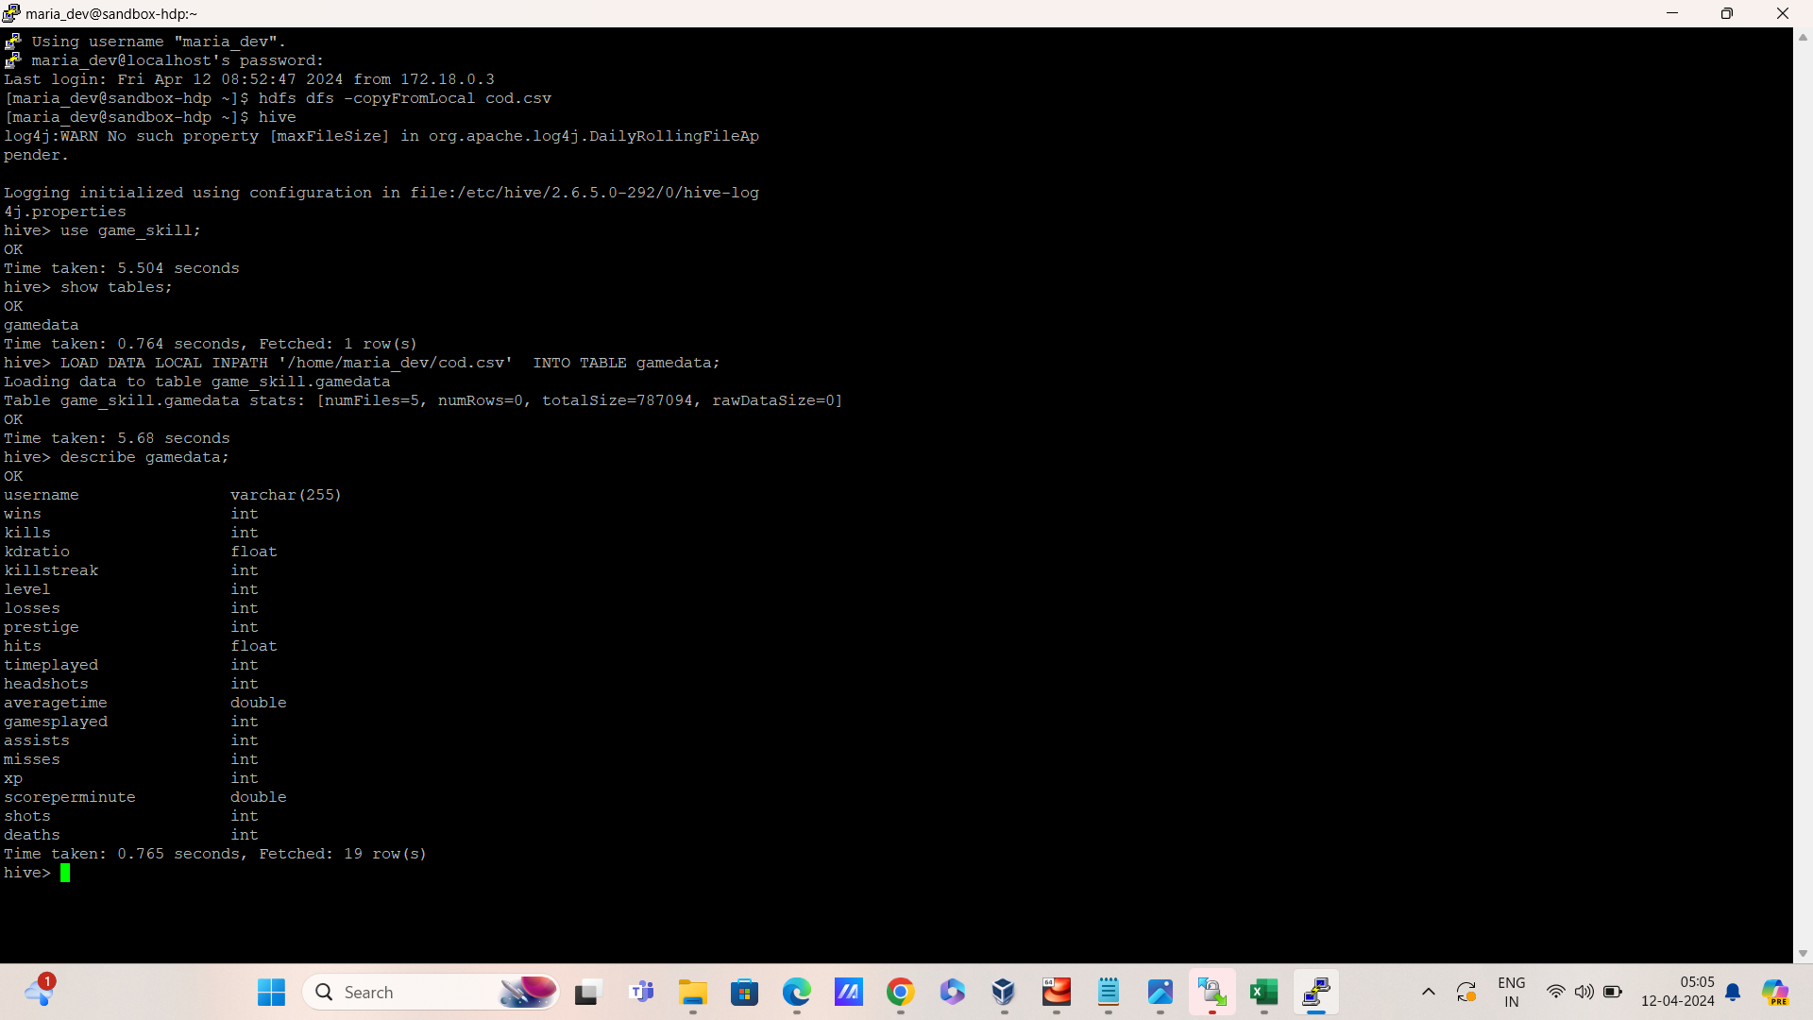
Data Ingestion using HDFS and HIVE
Uploading the dataset into HDFS server and cleaning it using hive.

Slide 5
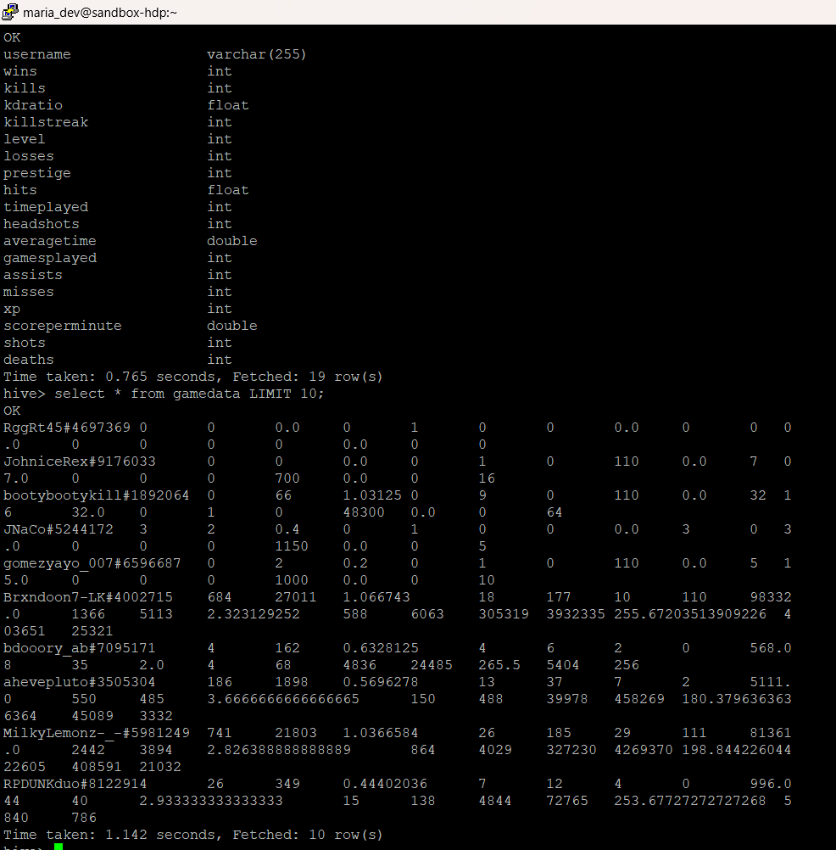
Creating the table to upload the data set.
Also, making sure if the data is uploaded.

Slide 6
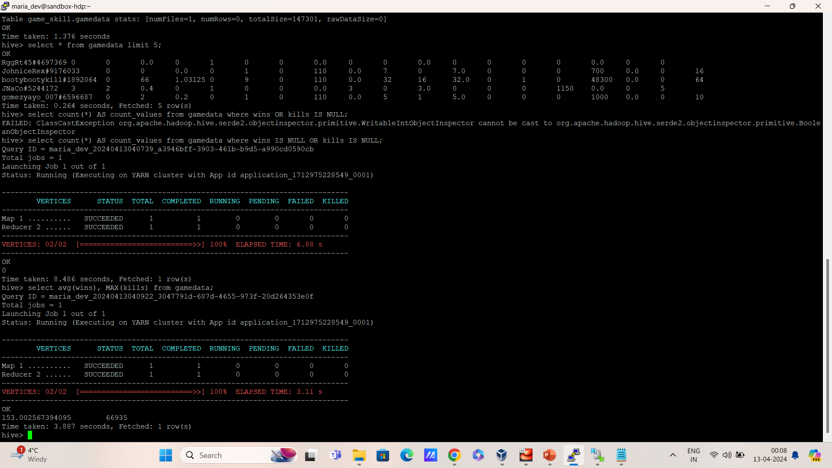
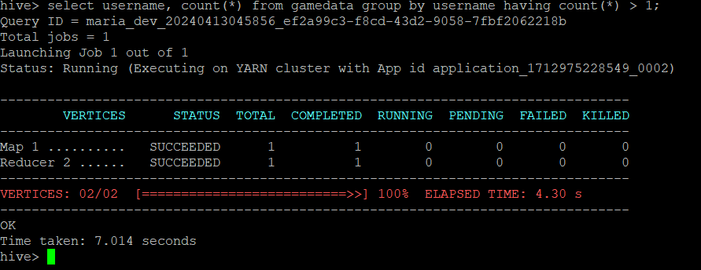
Performing the MR to filter the record for cleaning.

Slide 7
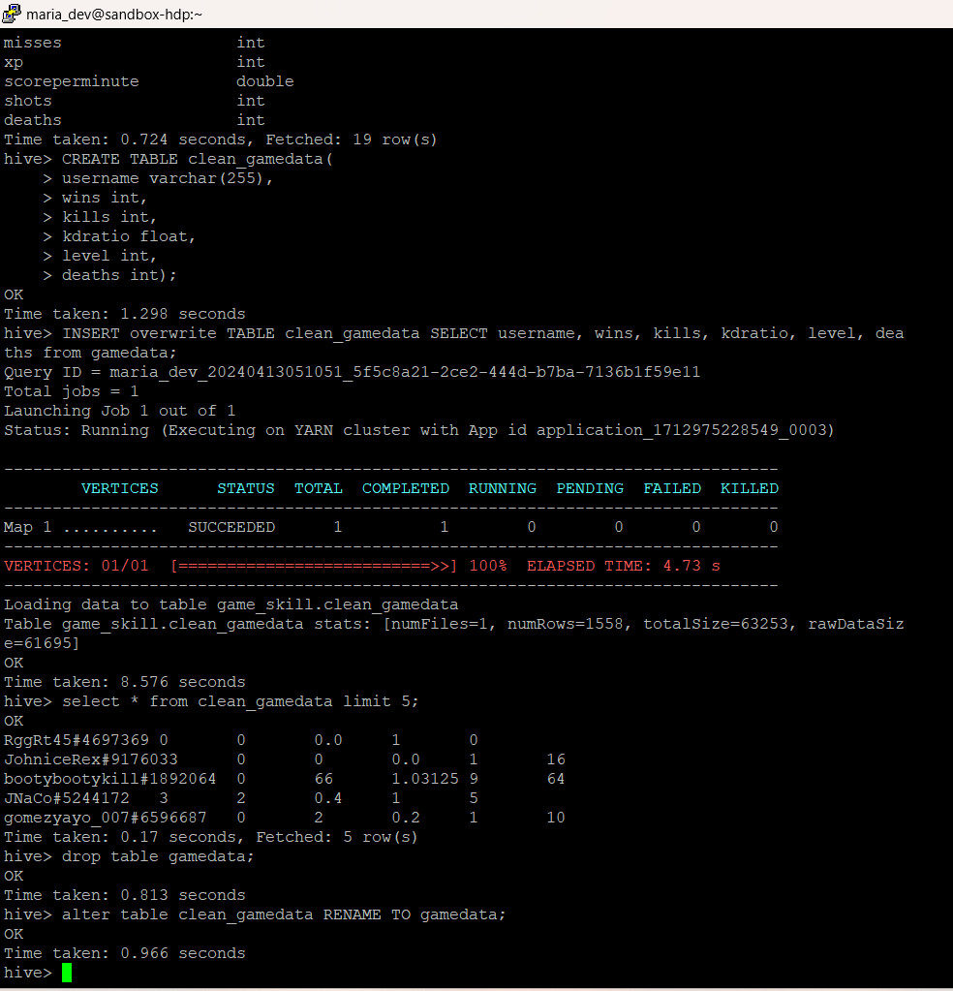
Dropping the non-required columns to increase the processing speed. Saving the cleaned data into local system for further analysis.
FEATURE ENGINEERING

Slide 8
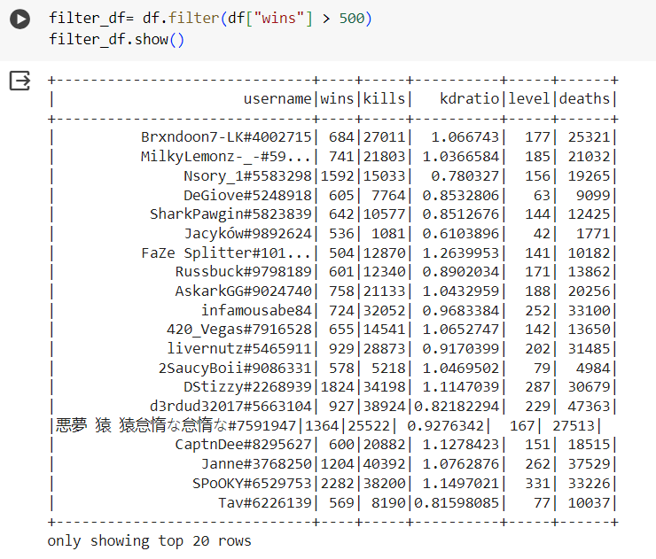
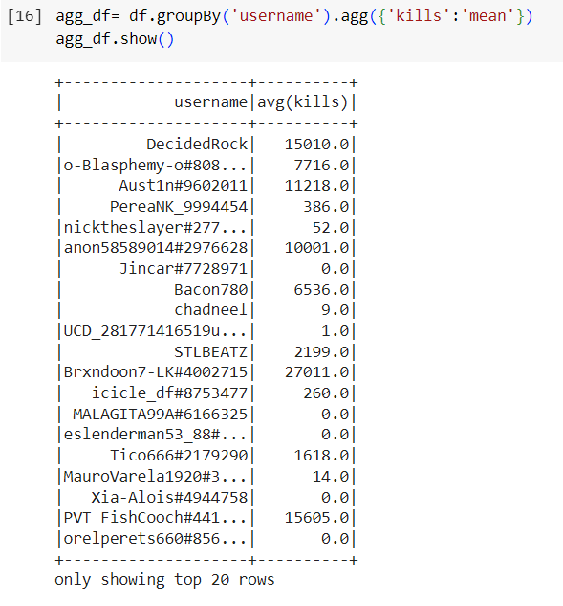
Using PySpark sql and Dataframe API, the data is utilized.

Slide 9
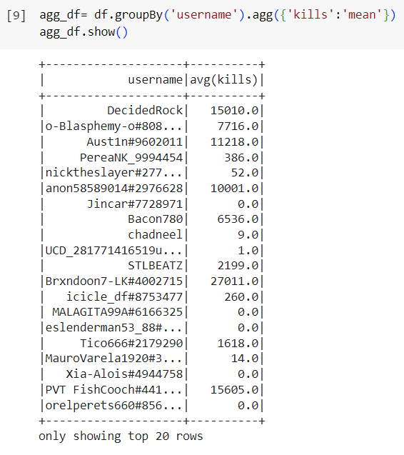
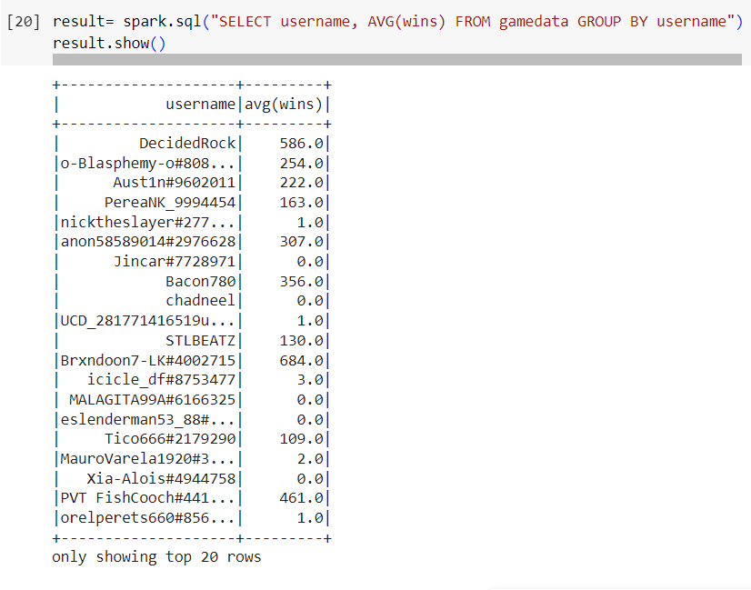
Running SQL commands using spark session

Slide 10
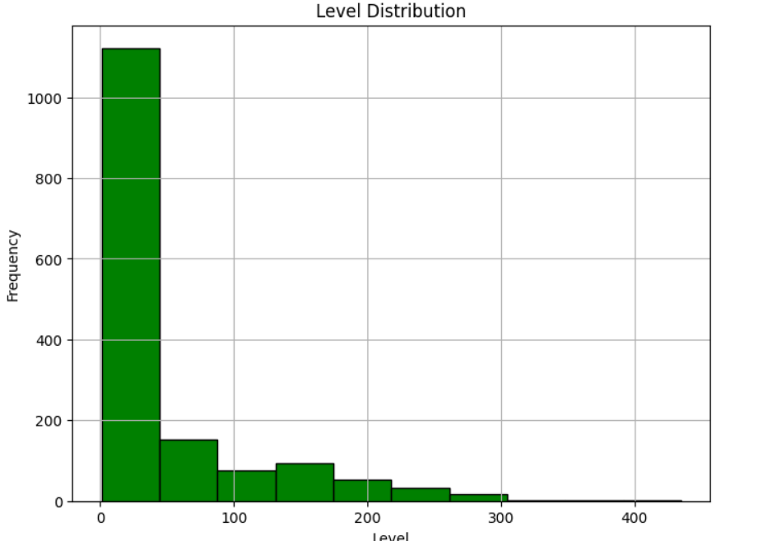
DATA VISUALIZATION
Players VS Level

Slide 11
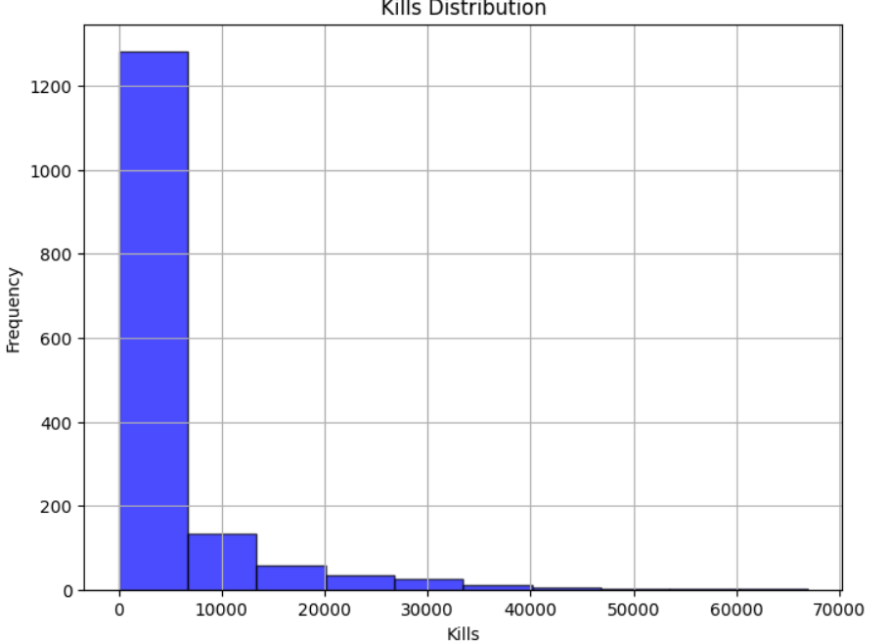
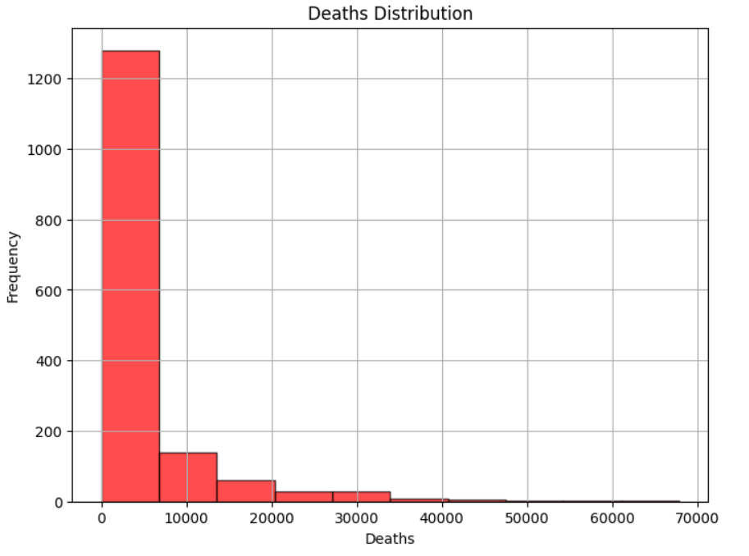
Kill and death distribution of players
More death = less players
More kills = less players

Slide 12
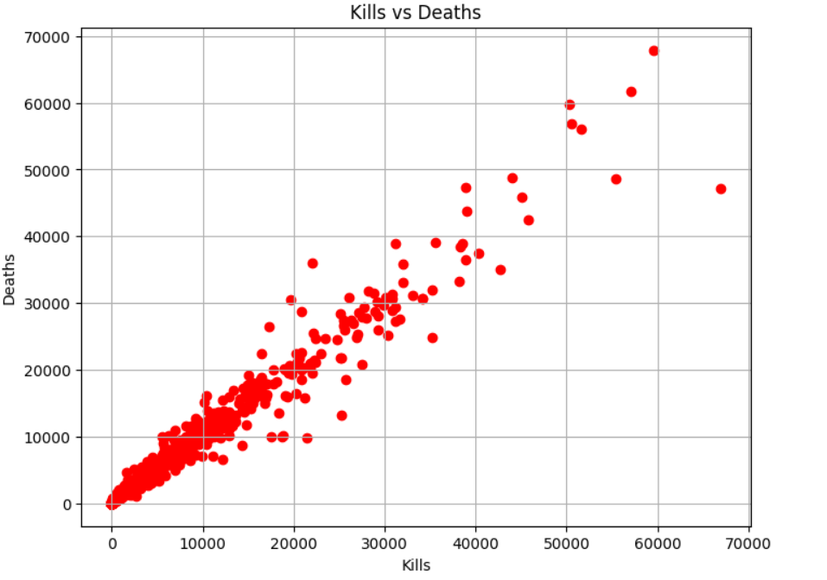
Graph represents that kills are directly proportional to each other.

Slide 13
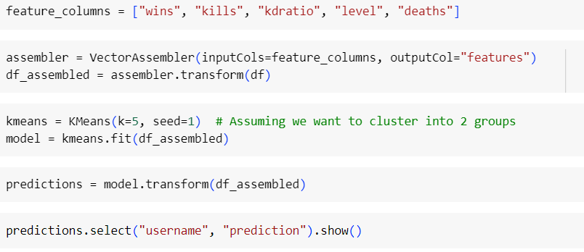
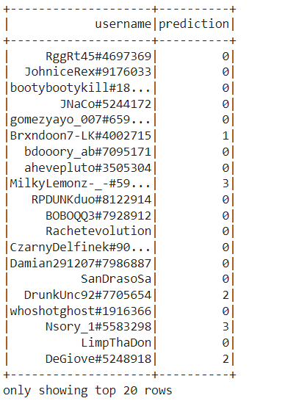
DATA CLUSTERING
Taken 5 clusters for more gaming levels

Slide 14
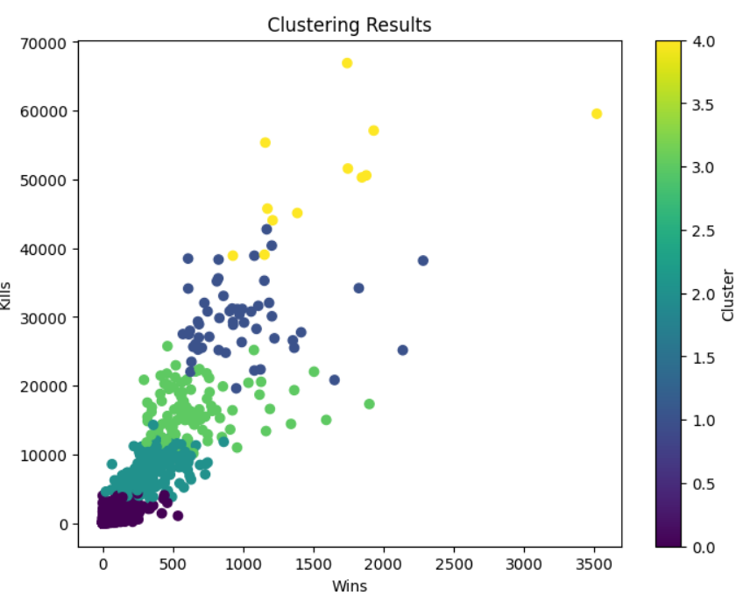
DATA VISUALIZATION AND REPORT FOR CLUSTERING
Representing the 5 different levels
of gamers using scatter plot

Slide 15


THANKS!
Do you have any questions?
Please keep this slide for attribution

