Slide 1









Replace Conditional with Polymorphism
GROUP 25：
2252092 毕雅琳 2252426 付柏瑞 2251654 付宝莹
2251926 罗诗雨 2252954 文彧婕

Slide 2
01
The Problem To Solve
02
The Solution Of Refactoring
03
Detailed Steps To Implement
CONTENTS
04
A Concrete Example
05
Benefits And Drawbacks

Slide 3
PART
1
The Problem To Solve
Notes:
In object-oriented programming, conditional statements (such as if and switch sentences) are often used to handle logic for different cases. As the code expands, these conditionals can become lengthy, complex, and difficult to maintain. So common problems are arised，now in part 1，I will introduce them。

Slide 4




THE PROBLEM TO SOLVE
1
2
3
4
Excessive Conditionals Leading to Complexity
Violation of the Open-Closed Principle
Difficulties in Extending
and Maintaining Code
Violation of the Single Responsibility Principle
When multiple conditional statements are intertwined, the code becomes harder to understand,especially if similar actions are performed in each branch
In traditional conditional statements, adding new types or behaviors requires modifying the existing logic, which violates this principle
If the core logic of the program relies on complex conditional statements, every new requirement forces modifications to these conditionals, making the code harder to extend and maintain.
A method should ideally have a single responsibility, and the presence of too many conditionals makes the method's responsibilities unclear.
Notes:
Here are four main problems:
PPT片段+A large number of if-else or switch statements can make the code structure unclear, and the logic scattered across multiple places makes it more difficult to comprehend and modify.
AS we all know, the Open-Closed Principle states that software should be open for extension but closed for modification. However,+PPT文字
As business requirements evolve, new types and behaviors may need to be introduced. +PPT文字
When a method contains multiple conditional checks, each with different logic, the method takes on multiple responsibilities. +PPT文字
To address these problems, we need to refactor the code by simplifying the conditionals and encapsulating different behaviors into separate classes

Slide 5
PART
2
Solution

Slide 6
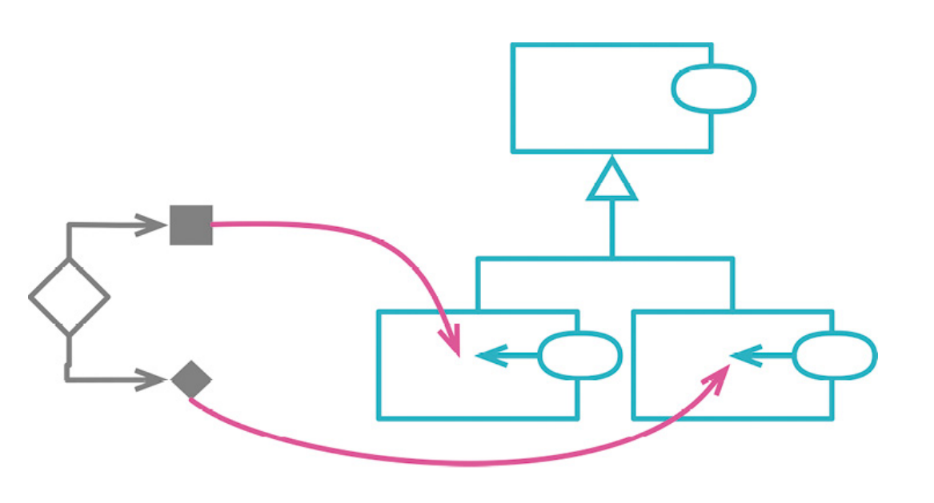
Solution
To solve the above problems,We use polymorphism to replace conditional statements and simplify the code. Polymorphism allows us to encapsulate different behaviors (such as various calculation methods or processing methods) into separate classes. The client code only needs to call these classes through a unified interface, without worrying about specific conditional logic.

Slide 7
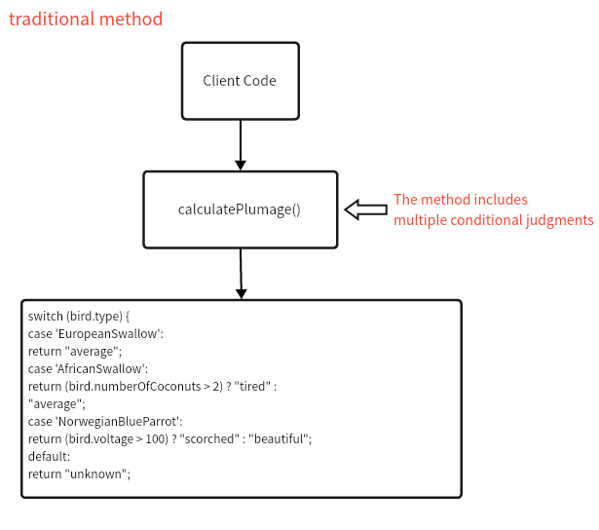
Core Idea
(1)We encapsulate the specific conditional logic into separate subclasses, with each subclass responsible for its own behavior. This ensures that each class adheres to the Single Responsibility Principle, reducing the complexity of conditional statements.
In this traditional implementation, all the conditional logic is centralized within the calculatePlumage() method. As the number of conditions increases, the code becomes more complex and harder to extend.

Slide 8
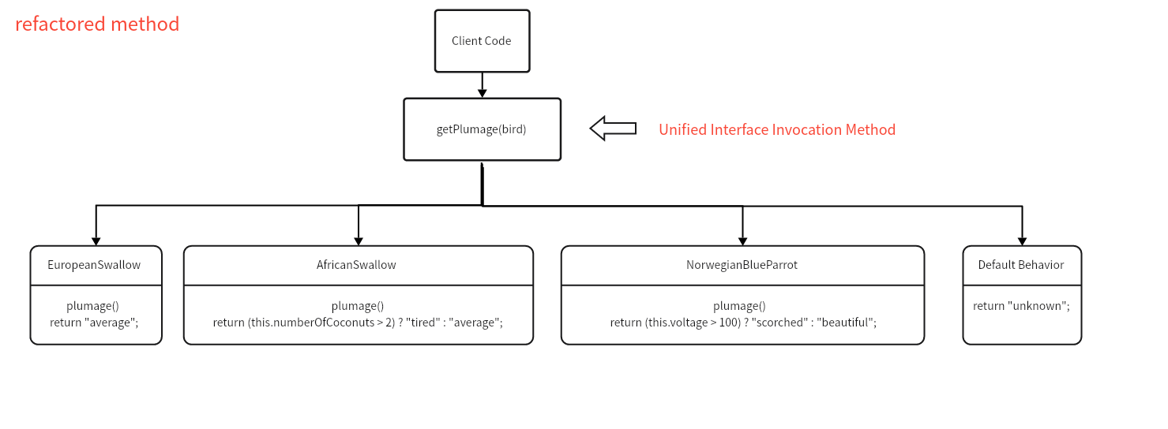
Core Idea
(1)We encapsulate the specific conditional logic into separate subclasses, with each subclass responsible for its own behavior. This ensures that each class adheres to the Single Responsibility Principle, reducing the complexity of conditional statements.
By encapsulating each conditional logic into separate subclasses, each subclass is responsible for its own behavior. The client code interacts through a unified interface and no longer needs to be concerned with the specific implementation details within each class.

Slide 9
Core Idea
(2)Using design patterns, such as the Factory Pattern.
Without the Factory Pattern, we might write conditional statements in the client code to determine which type of bird instance to create. For example, creating different bird objects based on bird.type. This approach can easily lead to complex, hard-to-maintain, and difficult-to-extend code.

Slide 10
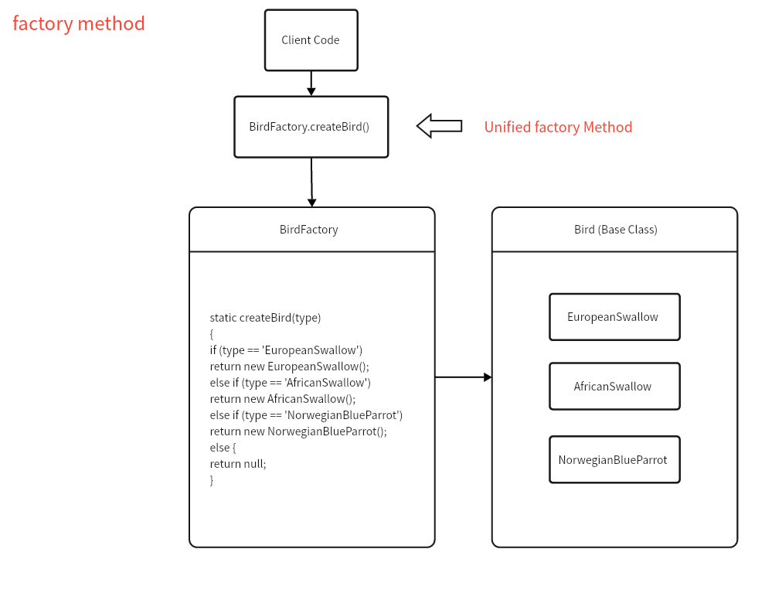
Core Idea
(2)Using design patterns, such as the Factory Pattern.
By using design patterns such as the Factory Pattern, appropriate subclass instances can be dynamically created, avoiding the need for conditional logic directly in the client code. This approach makes the system more flexible and extensible.

Slide 11
PART
3
Detailed steps of implementation

Slide 12
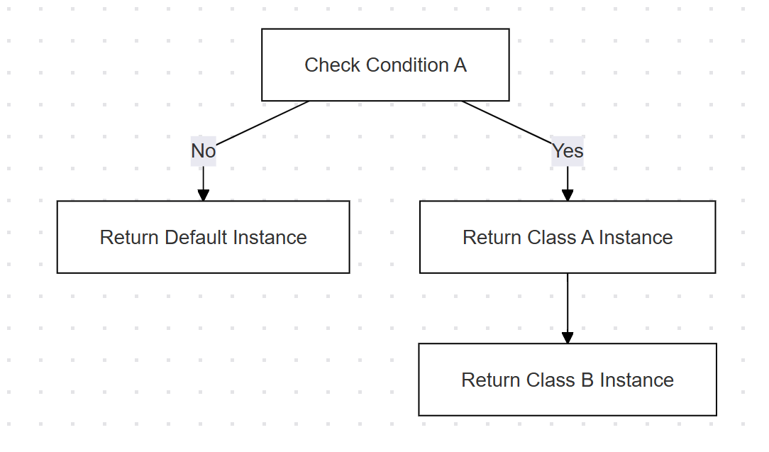
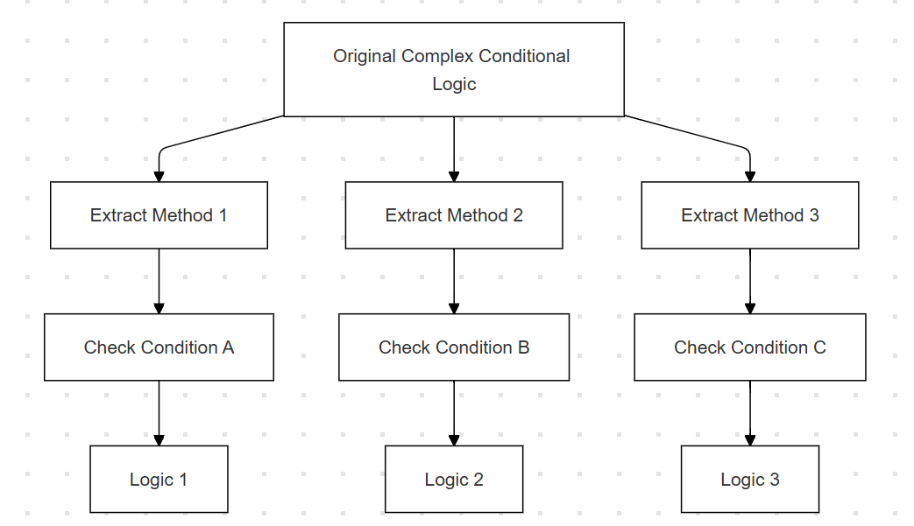
1.Introduce Factory Method
Factory method returns different object instances based on conditions. Client code interacts with the factory, avoiding direct conditional logic.
Purpose: Decouple object creation from condition checking, enhancing system extensibility.
2. Refactor Conditional Logic
Extract Method to break down complex conditional logic into smaller, clearer functions.
Purpose: Reduce method complexity, improve readability, and prepare for future refactoring.

Slide 13
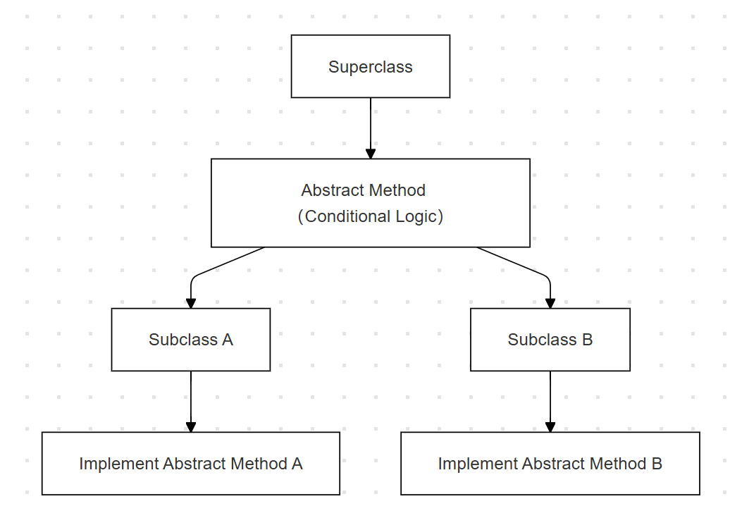
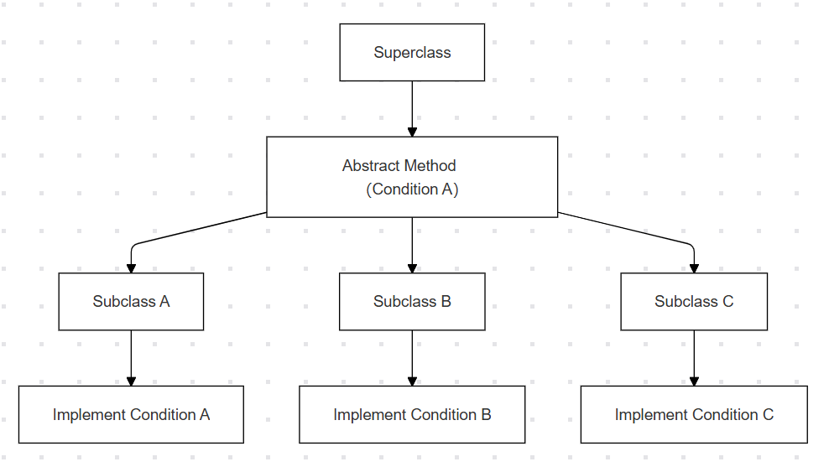
3. Move Logic to Superclass
Superclass defines an abstract method, with specific behavior in subclasses.
Purpose: Reduce complexity, define a general framework, and delegate specific behavior to subclasses.
4. Implement Logic in Subclasses
Subclasses implement the abstract method and handle specific conditional logic.
Purpose: Use polymorphism to avoid code repetition, ensuring each subclass handles its own logic.

Slide 14
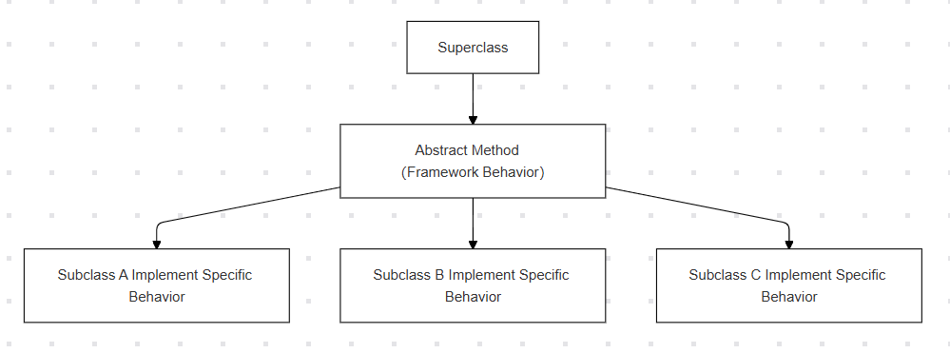
5.Remove Conditional Logic, Keep Default Behavior or Declare Abstract Methods
After all conditions are handled by subclasses, remove the conditional logic in the superclass. Retain default behavior or declare abstract methods, forcing subclasses to implement necessary behavior.
Purpose: Simplify superclass code, clarify responsibilities, and allow for easy future extension.

Slide 15
PART
4
A concrete example of implementing the refactoring technique

Slide 16

A concrete example of implementing
the refactoring technique
Use polymorphism to handle variant logic
one object is generally similar to another object, but with some differences.
Case Analysis
There is a rating agency that provides investment ratings for ocean-going vessels. The agency assigns a rating of either "A" or "B," depending on various factors related to risk and profit potential. In assessing risk, the agency considers not only the characteristics of the voyage itself but also the captain's past sailing history.

Slide 17
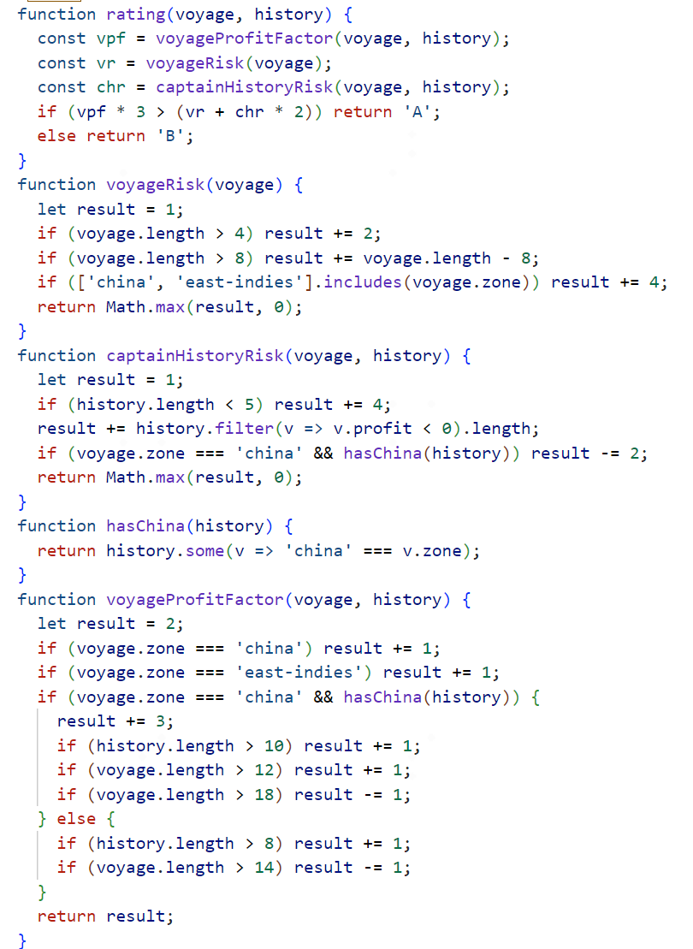
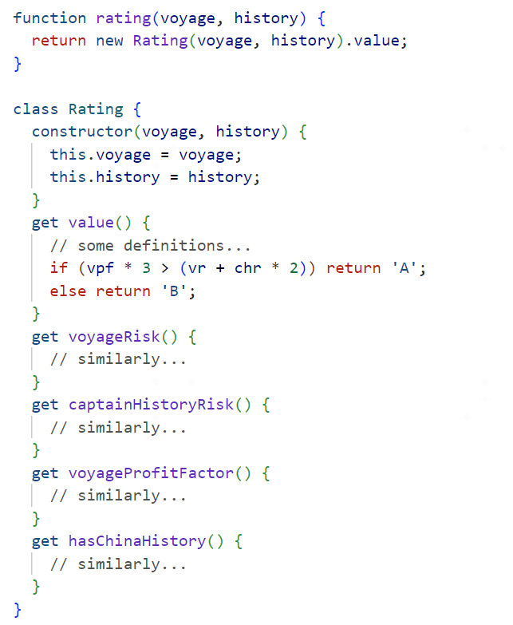
combines these three scores to provide an overall rating for the voyage
calculating the risk scores
a superclass used to hold basic logic
calculating the risk scores
First, polymorphism needs to be introduced by creating a class structure and using combine functions into class.
calculates the profit potential score
Before Refactoring

Slide 18
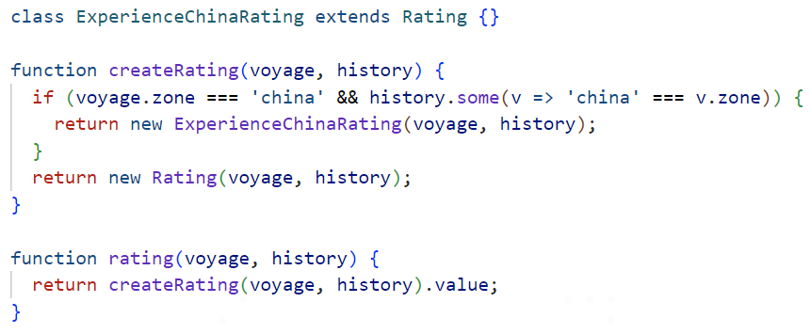
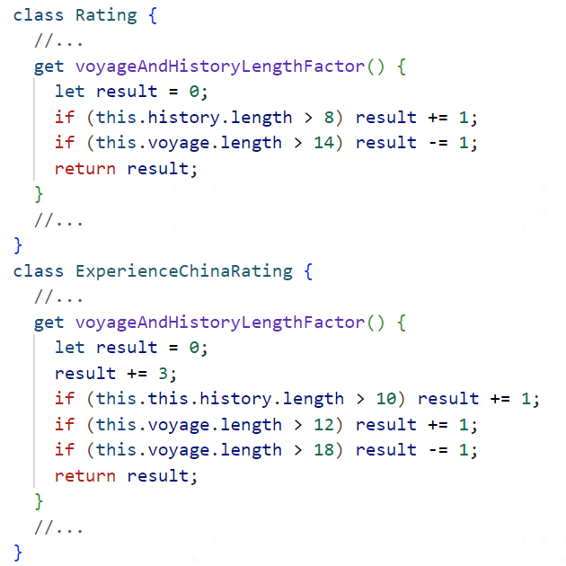
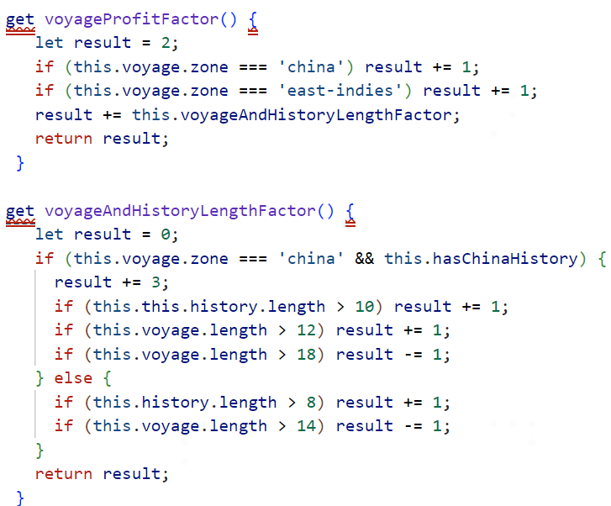
an empty subclass to store behaviors that differ from the superclass.
a factory function to replace the original direct constructor calls.
Next, create an empty subclass.
Then, establish a factory function
superclass
Next, the “voyageAndHistoryLengthFactor” can be broken down to allow for subclassing.
use the "Extract Method" refactoring to extract the entire conditional logic block.
subclass
Transfer the logic from the superclass that needs to be moved to the subclass.

Slide 19
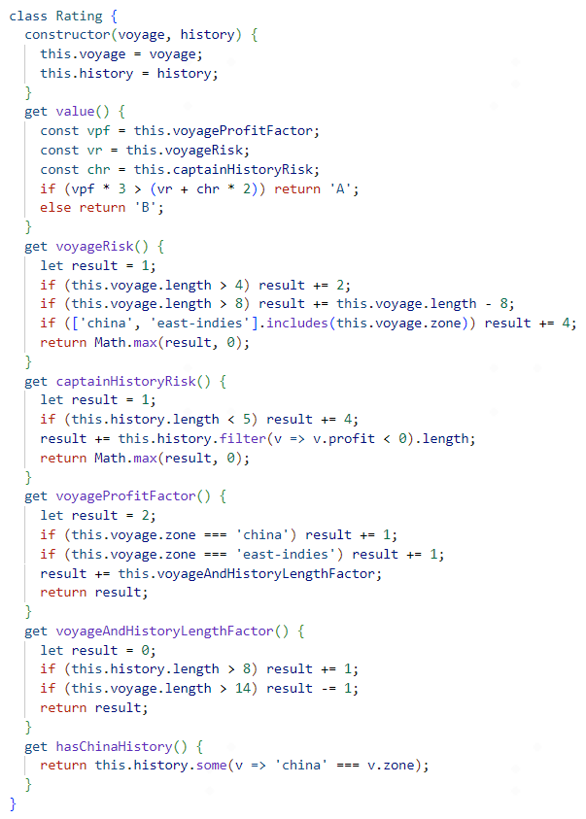
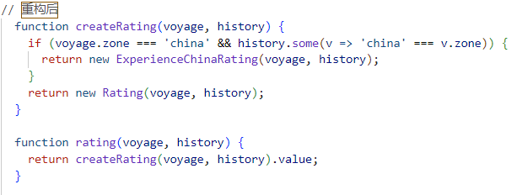
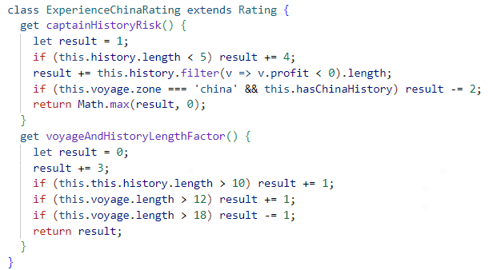
Results: After Refactoring
the condition “voyage.zone === 'china' && hasChina(history)” appears twice in the “captainHistoryRisk” and “voyageProfitFactor” functions has been removed after refactoring

Slide 20
PART
5
Benefits & Drawbacks

Slide 21
Benefits
Drawbacks
Tell-Don't-Ask principle
Removes duplicate code
Open/Closed Principle
High initial refactoring cost
Not suitable for all conditional judgement
Notes:
This technique adheres to the Tell-Don't-Ask principle: instead of asking an object about its state and then performing actions based on the state, it's much easier to simply tell the object what it needs to do and let it decide for itself how to do that.
This enhances the encapsulation of code.Keep the state of the object private, external objects do not have direct access to the internal state.And simplify external logic, external objects are only concerned with how to interact with the object and do not care about the internal implementation of the object.
Removes duplicate code. Cutting down the amount of “if”s and “switch”s, you get rid of many almost identical conditionals.
At last, it follows the Open/Closed principle.New features can be added without modifying existing code, and changes can be accommodated by extending existing systems like adding new subclasses.As a result, the likelihood of introducing new errors is greatly reduced.
____________________________________
High initial refactoring cost: replacing the conditional judgment in the existing code with a polymorphic implementation, especially when the conditional judgment is more complex or involves multiple modules, the refactoring cost is higher
Not all conditional judgment is suitable for polymorphic replacement. If the logic of conditional branching is relatively simple or there are not many conditions, the use of polymorphic substitution may make the design too complex, but increase the unnecessary cost.

Slide 22

Reference
Refactoring: Improving the Design of Existing Code (2nd Edition) (Addison-Wesley Signature Series (Fowler)) 2 ——Martin Fowler (Author)
https://dunwu.github.io/design/pages/65ee05/
https://refactoring.guru/replace-conditional-with-polymorphism

Slide 23
Thank you teachers for your criticism and correction

