Slide 1







Refactoring according to
Facade pattern
MapScene --> Battle (High Coupling)
Problems
Scattered Battle Logic And Chaotic duties
Lack of a unified access interface

Slide 2
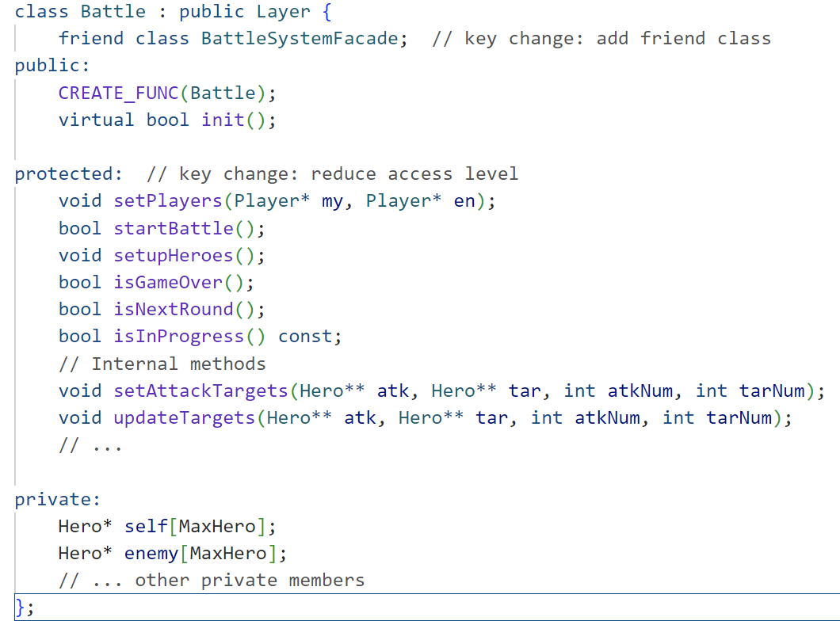
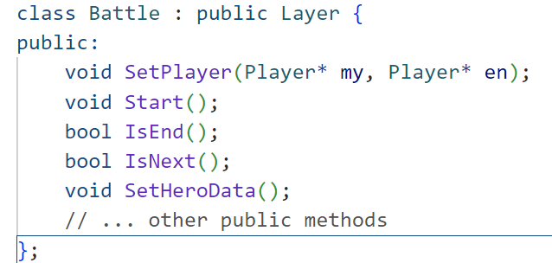
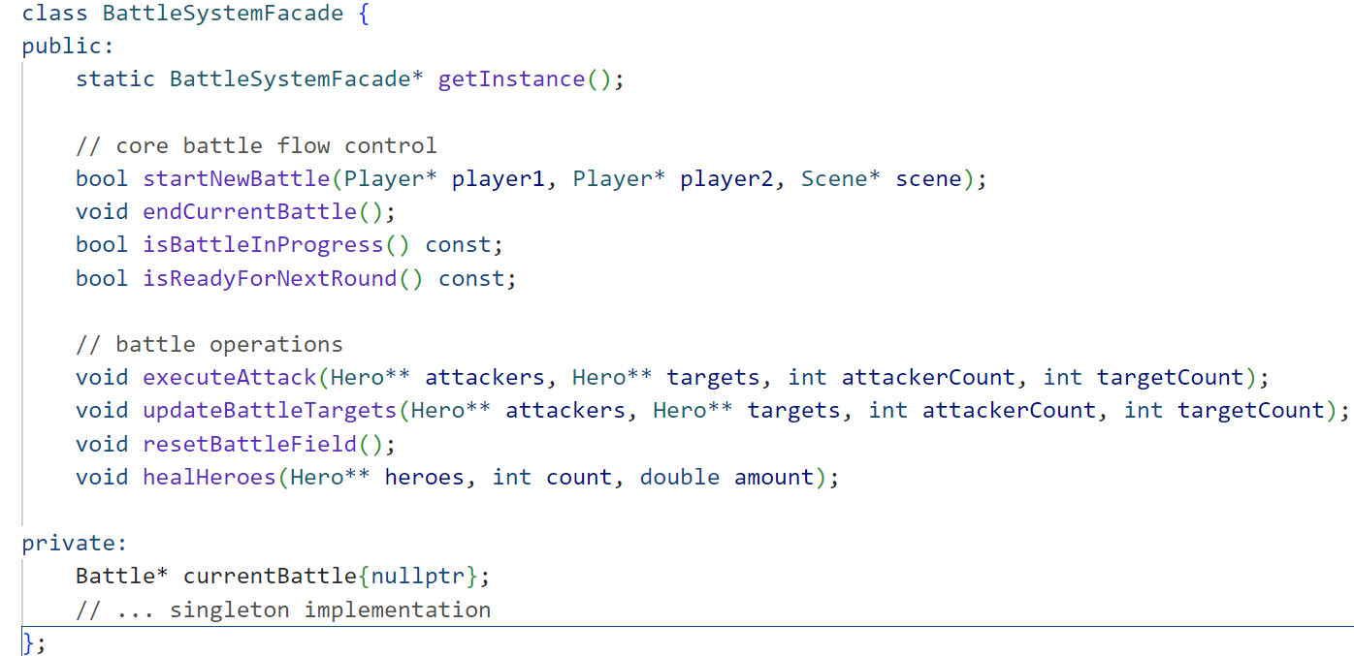
Key Changes
reduce
access level
Introducing BattleSystemFacade

Slide 3
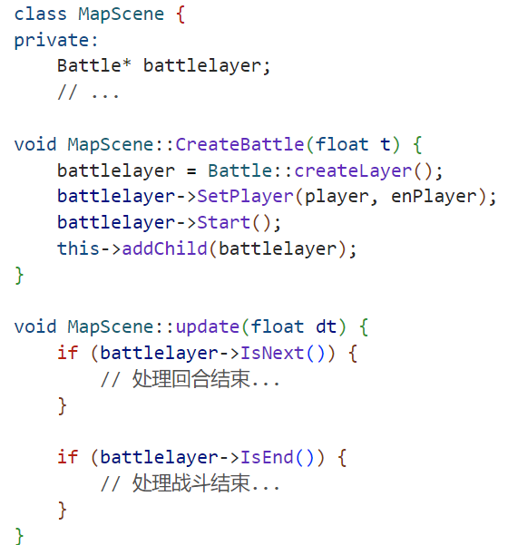
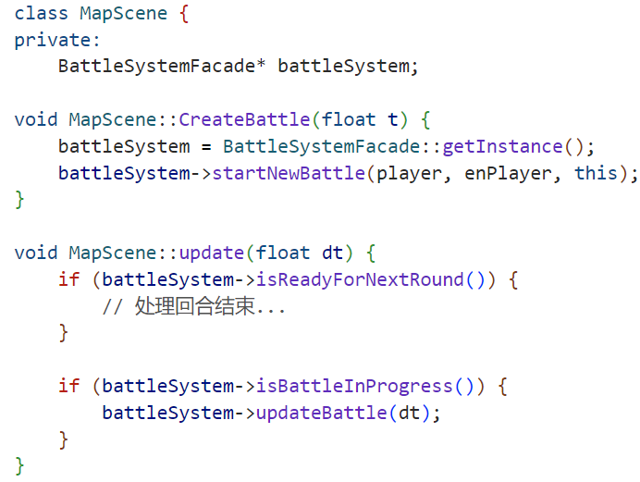
MapScene --> Battle (Direct dependency)
MapScene --> BattleSystemFacade --> Battle (Introducing appearance patterns)
Before
After
High coupling
Confusion of duties
Inconsistent interfaces

Slide 4
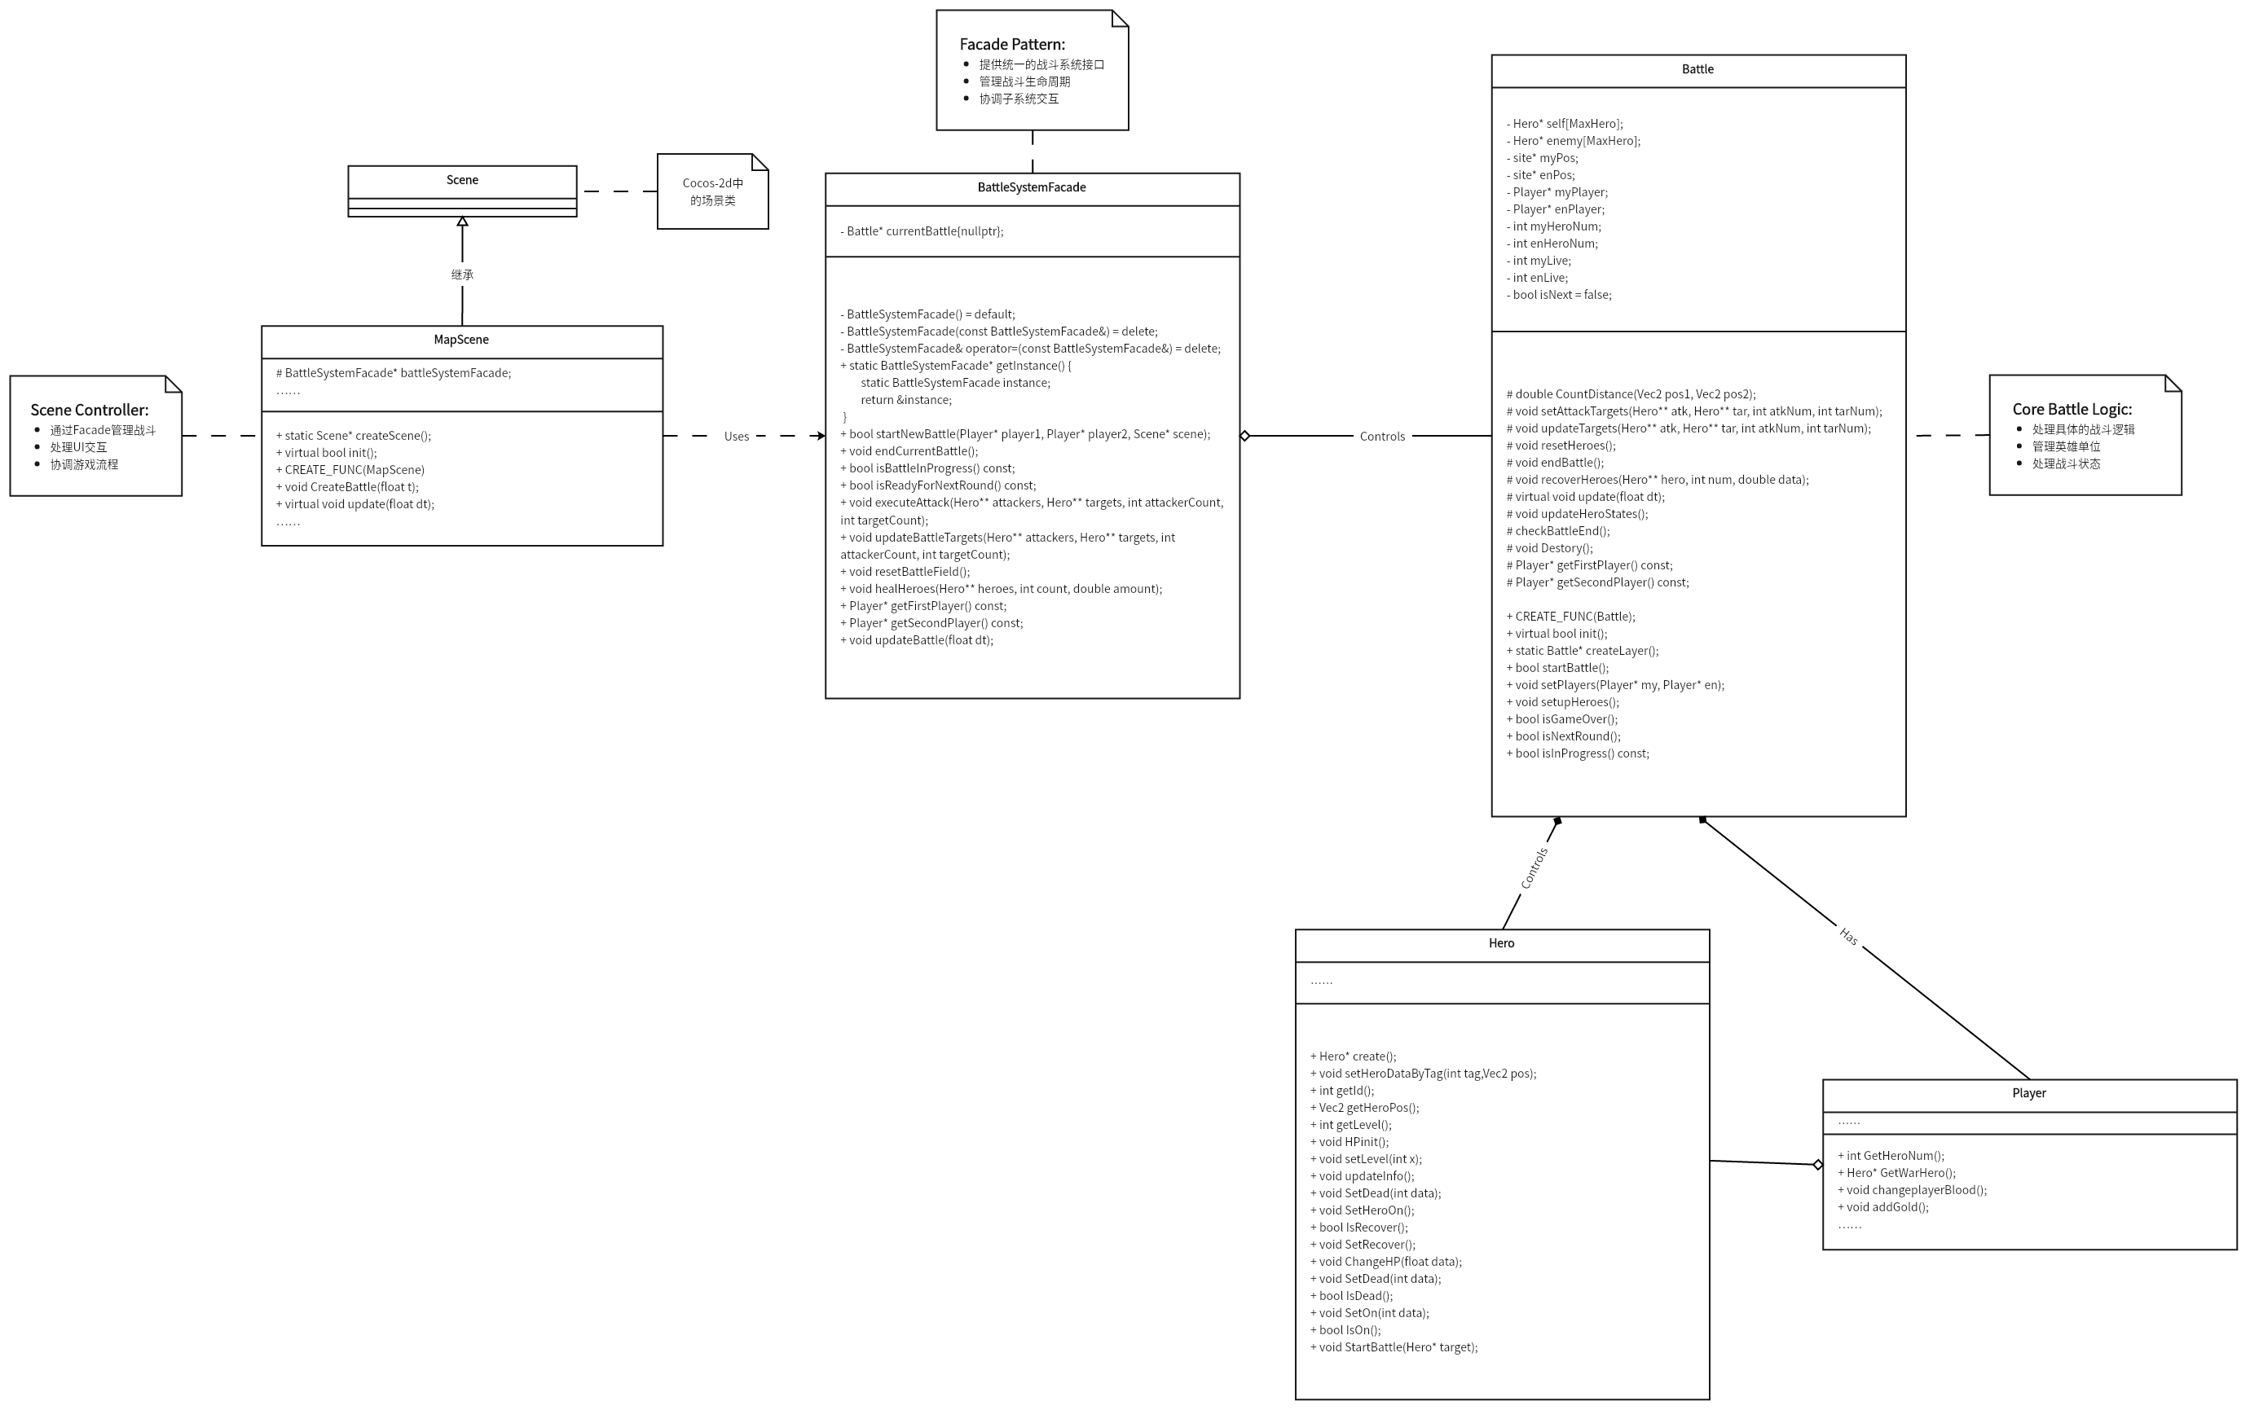
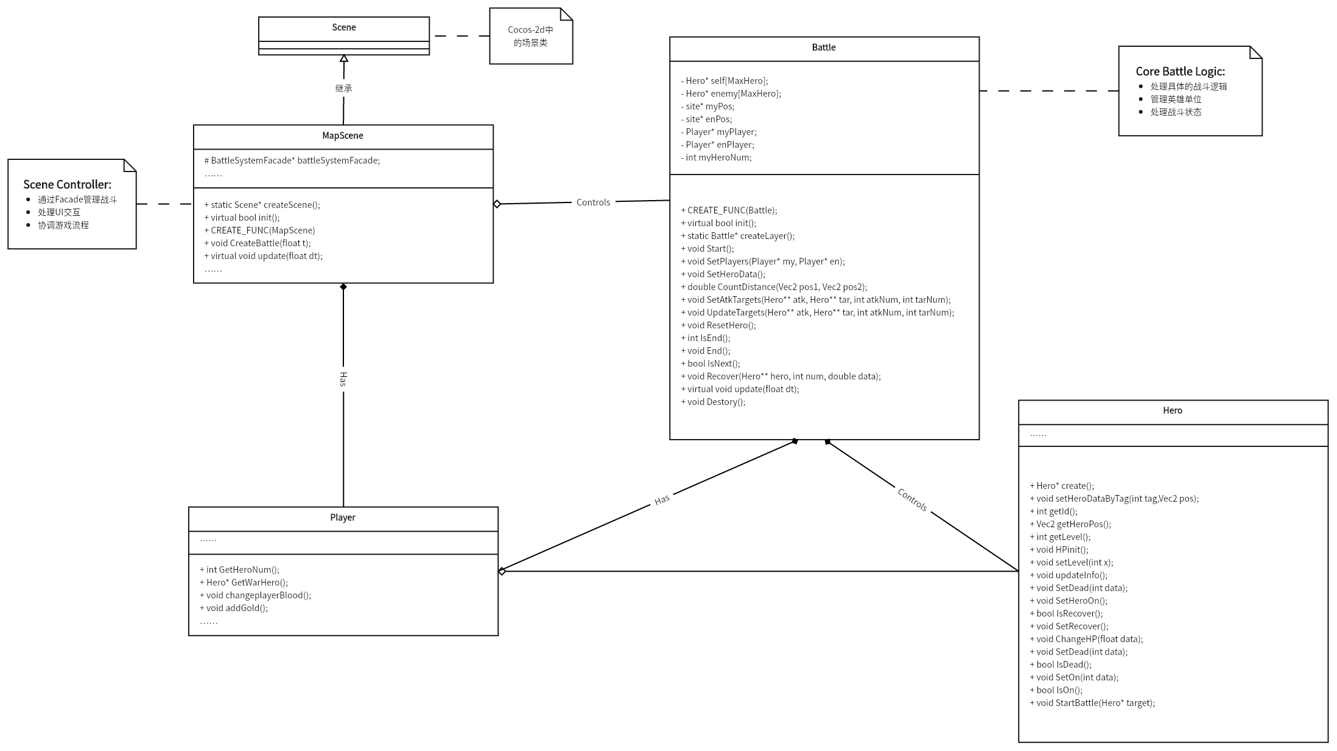
Class diagram comparison
Add a new class
BattleSystemFacade
——
All battle-related operations will carry out through it
after refactory
changed methods to be protected
——
making them invisible to external systems and BattleSystemFacade directly manage Battle

Slide 5




The need to introduce the Facade pattern
Simplify External Calls
Need to
Hide Internal Implementation Details
Reduced coupling
Improve code maintainability
Reduce coupling and improve modularity
Improve code reusability
Enhance scalability

