Slide 1
Start-Ups

Slide 2
Start-up Incubators - Concepts –
start-up ecosystem-
government start-up initiatives

Slide 3
Meaning of Business Incubators:
A business incubator is a company that helps new and startup companies to develop by providing services such as management training or office space.
This is also Facility established to nurture young (startup) firms during their early months or years.
A startup incubator is a collaborative program designed to help new startups succeed.
Incubators help entrepreneurs solve some of the problems commonly associated with running a startup by providing workspace, seed funding, mentoring, and training (see list below for a a more extensive list of common incubator services).
The sole purpose of a startup incubator is to help entrepreneurs grow their business.

Slide 4
Startup incubators are usually non-profit organizations, which are usually run by both public and private entities.
Incubators are often associated with universities, and some business schools (such as Columbia or McCombs) allow their students and alumni to take part in these programs.
What are the Most Common Startup Incubator Services?
Help with business basics
Networking opportunities
Marketing assistance
High-speed Internet access
Accounting/financial management assistance
Access to bank loans, loan funds and guarantee programs
Help with presentation skills
Connections to higher education resources

Slide 5
Connections to strategic partners
Access to angel investors or venture capital
Comprehensive business training programs
Advisory boards and mentors
Management team identification
Help with business etiquette
Technology commercialization assistance
Help with regulatory compliance
Intellectual property management and legal counsel

Slide 6
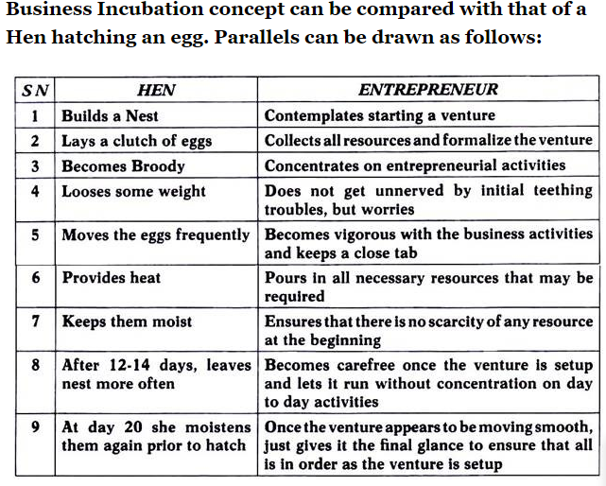

Slide 7
Three Stages of Business Incubation Development:
(i) Physical facility support – Business incubation provided within physical facility
(ii) Support service – Business incubation as business support service
(iii) Networking facilities -Business incubators provide networking facilities to the members.
Types of Incubators:
There are a number of business incubators that have focused on particular industries or on a particular business model, earning them their own name.
(i) Virtual Business Incubators: These are also known as online business incubators.
Business incubators began in the 1950s and took off in the late 1990s as support for startup companies who need advice and venture capital to get their ideas off the ground.

Slide 8
As the dot-com bubble burst, many high-tech business incubators did so too. Now the model of a business incubator is changing.
Several of the incubator companies who survived the dot-com bubble switched to a virtual model.
The old incubator model required a startup venture to set up shop at the incubator’s site.
The virtual model, on the other hand, allows a company to garner the advice of an incubator without actually being located at the incubator site.
This new model suits those entrepreneurs who need the advice an incubator offers but still want to maintain their own offices, warehouses, etc.

Slide 9
(ii) Medical Incubator:
This is a business incubator focused on medical devices & biomaterials.
For encouraging innovation and entrepreneurship in medical Technologies, through technology, busi­ness incubation support is given to innovators, start-ups and industry.
(iii) Kitchen Incubator:
It is a business incubator focused on the food industry.
Specialty foods are typically high-value and, at least in the beginning, low production.
Starting a commercial kitchen from scratch can cost a huge amount of investment.
The average food entrepreneur has to spend plenty before even making their first batch of food item.

Slide 10
This need for low-cost kitchen space has led to the development of shared commercial kitchens that can be rented for hourly or monthly rates.
But finding a place to make specialty food products is only the first step.
Entrepreneurs who want to make a profit have to successfully package, market, and sell their products, too and the food incubators provide help with all this.
(iv) Public/Social Incubator:
This is a business incubator focused on the public good. Social incubators aim to provide social entrepreneurs with the tools to expand their business.
The challenging economic environment is changing the landscape of how we do business.
At one end, some businesses avoid their social responsibility and, at the other, charities have to find ways to be more business savvy to survive.
India has embraced the concept, with a twist, creating the idea of “social business”.

Slide 11
(v) Seed Accelerator:
This is a business incubator focused on early startups. Seed accelerators, also known as startup accelerators, are fixed-term, cohort-based programs, that include mentorship and educational components and culminate in a public pitch event or demo day.
While traditional business incubators are often government-funded, generally take no equity, and focus on biotech, financial technology (“FinTech”), medical technology (“MedTech”), clean tech or product-centric companies, accelerators can be either privately or publicly funded and focus on a wide range of industries.
Unlike business incubators, the application process for seed accel­erators is open to anyone, but highly competitive.
There are specific types of seed accelerators, such as corporate accelerator, which are often subsidiaries or programs of larger corporations that act like seed accelerators.

Slide 12
(vi) Corporate Accelerator:
It is a program of a larger company that acts akin to a seed accelerator.
A corporate accelerator is a specif­ic form of seed accelerator which is sponsored by an established for-profit corporation.
Similar to seed accelerators they support early-stage startup companies through mentorship and often capital and office space.
In contrast to regular programs, though, corporate accelerators derive their objectives from the sponsoring organization.
These objectives can include the wish to stay close to emerging trends or to establish a funnel for corporate venture capital investments.
Corporate accelerators differ from Business incubators, which usually have a continuous intake, due to their fixed-term, cohort-based or­ganization (similar to seed accelerators) and are distinct to corporate venture capital which is a direct, targeted investment.

Slide 13
(vii) Startup Studio:
This is a business incubator with interacting portfolio companies.
Startup studio, also known as a startup factory, or a startup foundry, or a venture builder, is a studio-like company that aims at building several companies in succession. This style of business building is referred to as “parallel entrepreneurship”.
Idealab, founded by Bill Gross in 1996, was one of the first to introduce the ‘incubator industry’, and has started over 75 companies.
Idealab was founded to test many ideas at once and turn the best of them into companies while also attracting the human and financial capital necessary to bring them to the market.
The startup studio trend had really begun to gain momentum around 2008. Betaworks is one of the pioneers of this model.
Today, there are over 65 startup studios across the world, of which 17 have been built since 2013.

Slide 14
(viii) Venture Builder:
These are similar to a startup studio, but builds companies internally. Venture-builders are also called tech stu­dios, startup factories, or venture production studios:
They are organizations that build companies using their own ideas and re­sources. Unlike incubators and accelerators, venture builders do not take any applications, nor do they run any sort of competitive program.
Instead, they pull business ideas from within their own network of resources and assign internal teams to develop them such as Engineers, advisors, business developers, sales managers, etc.
Venture builders develop many systems, models, or projects at once and then build separate companies around the most promising ones by assigning operational resources and capital to those portfolio companies.

Slide 15
In its most basic form, the venture-building company is a holding company that owns equity in the various corporate entities it helped created.
The most successful venture builders are, however, much more operational and hands-on than holding companies-
They raise capital, staff resources, host internal coding sessions, design business models, work with legal teams, build MVPs (minimum viable products), hire business development managers, and run very effective marketing campaigns during their ven­tures’ pre-and post-launch phases.
50+ Startup Schemes By The Indian Government That Startups Should Know About

Slide 16
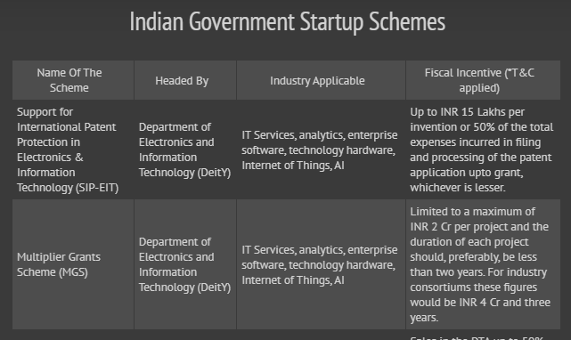
https://inc42.com/buzz/startup-scheme-indian-government-startups/

Slide 17
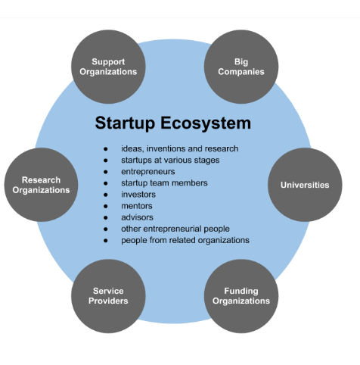

Slide 18
A startup ecosystem is formed by people, startups in their various stages and various types of organizations in a location (physical or virtual), interacting as a system to create and scale new startup companies.
These organizations can be further divided into categories: universities, funding organizations, support organizations (like incubators, accelerators, co-working spaces etc.), research organizations, service provider organizations (like legal, financial services etc.) and large corporations.
Different organizations typically focus on specific parts of the ecosystem function and/or startups at their specific development stage(s).

Slide 19
Elements Of Startup ecosystem
ideas, inventions and researches
start-ups at various stages entrepreneurs
start-up team members
angel investors
start-up mentors
start-up advisors
other entrepreneurial minded people
third people from other organizations with start-up activities
Organizations and activities with start-up activities
universities
advisory & mentoring organizations
startup incubators
startup accelerators
coworking spaces
service providers (consulting, accounting, legal, etc.)
event organizers
start-up competitions
investor networks
venture capital companies
crowdfunding portals
other funding providers (loans, grants etc.)
start-up blogs & other business media
other facilitators

Slide 20
The Prime Minister of India launched the Startup India Initiative in the year 2016.
The idea is to increase wealth and employability by giving wings to entrepreneurial spirits.
The government gives tax benefits to startups under this scheme and 798 applicants have made use of this scheme to date.
https://www.startupindia.gov.in/
States’ Startup Ranking Framework
National Startup Awards 2021
Startup India Seed Fund Scheme Launch
Startup India Showcase

Slide 21
Action Plan: Proposed Sc
Simplification and Handholding
1. Compliance Regime based on Self-certification
2. Startup India Hub
3. Rolling out of Mobile App and Portal
4. Legal Support and Fast-tracking Patent Examination at Lower Costs
5. Relaxed Norms of Public Procurement for Startups
6. Faster Exit for Startupshemes and Incentives
Funding Support and Incentives
7. Providing Funding Support through a Fund of Funds with a Corpus of INR 10,000 crore
8. Credit Guarantee Fund for Startups
9. Tax Exemption on Capital Gains
10. Tax Exemption to Startups for 3 years
11. Tax Exemption on Investments above Fair Market Value

Slide 22
Industry-Academia Partnership and Incubation
12. Organizing Startup Fests for Showcasing Innovation and Providing a Collaboration Platform
13. Launch of Atal Innovation Mission (AIM) with Self-Employment and Talent Utilization (SETU) Program
14. Harnessing Private Sector Expertise for Incubator Setup
15. Building Innovation Centres at National Institutes
16. Setting up of 7 New Research Parks Modeled on the Research Park Setup at IIT Madras
17. Promoting Startups in the Biotechnology Sector
18. Launching of Innovation Focused Programs for Students
19. Annual Incubator Grand Challenge

Slide 23
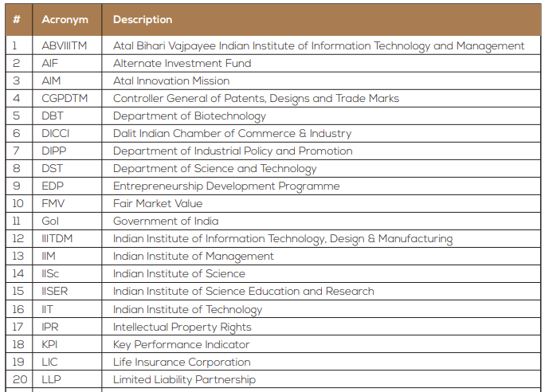

Slide 24
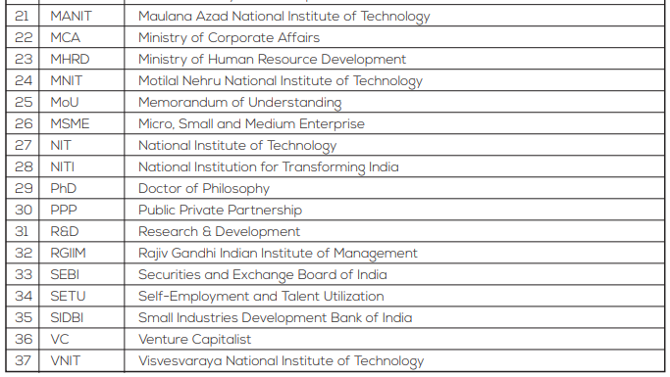
https://www.startupindia.gov.in/

Slide 25
Definition of Startup (only for the purpose of Government schemes)
Startup means an entity, incorporated or registered in India not prior to five years, with annual turnover not exceeding INR 25 crore in any preceding financial year, working towards innovation, development, deployment or commercialization of new products, processes or services driven by technology or intellectual property.
Provided that such entity is not formed by splitting up, or reconstruction, of a business already in existence.
Provided also that an entity shall cease to be a Startup if its turnover for the previous financial years has exceeded INR 25 crore or it has completed 5 years from the date of incorporation/ registration.
Provided further that a Startup shall be eligible for tax benefits only after it has obtained certification from the Inter-Ministerial Board, setup for such purpose.

