Slide 1

EIP Introduction via Camel
Enterprise Integration Patterns
谭一雄 17212010132

Slide 2
Problem to solve
The connections among enterprise applications are tend to be complex and hard to maintain.
The key of the problem
How to exchange data among applications effectively？（Different sources, structures, formats, transports…）
Generalization of the problem
Application Integration
Application Integration styles and types
File Transfer
Shared Database
Remote Procedure Invocation
Messaging
Implementation of application integration patterns
Apache Camel
Spring Integration
系统分析课程分享 - 谭一雄 - 17212010132

Slide 3
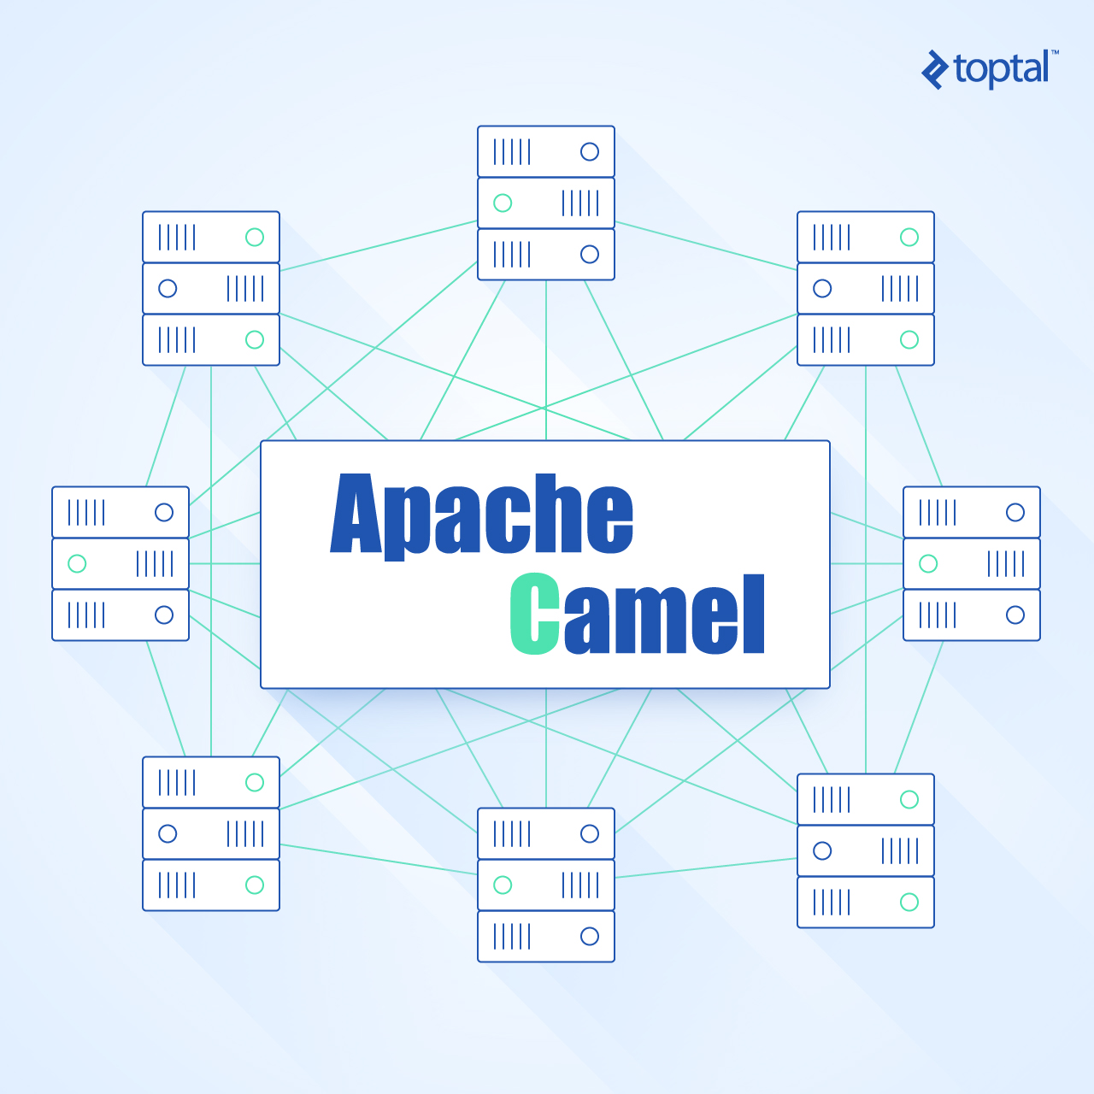
系统分析课程分享 - 谭一雄 - 17212010132

Slide 4
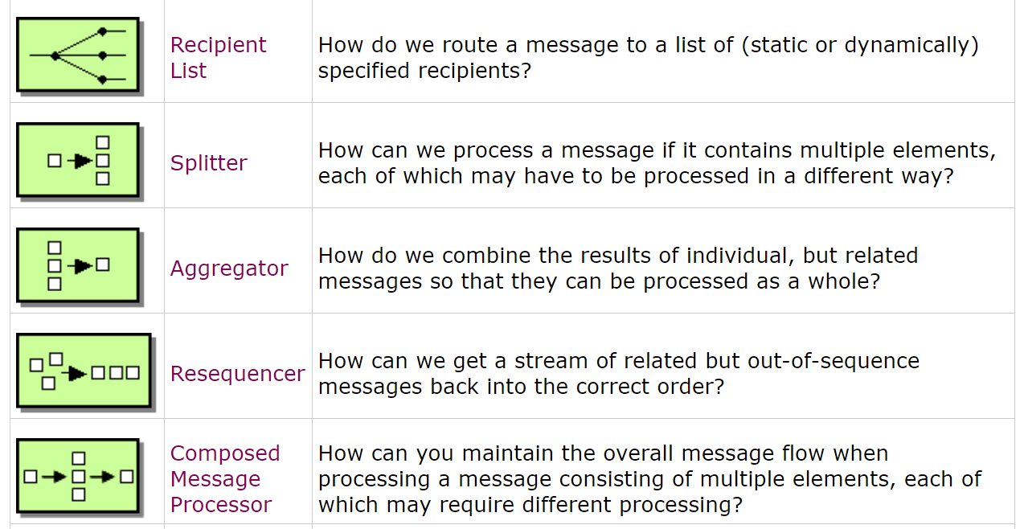
系统分析课程分享 - 谭一雄 - 17212010132

Slide 5
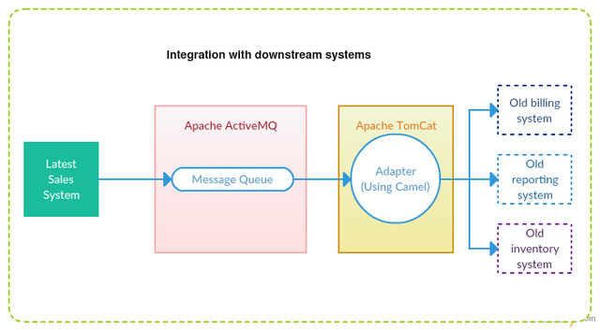
系统分析课程分享 - 谭一雄 - 17212010132

Slide 6
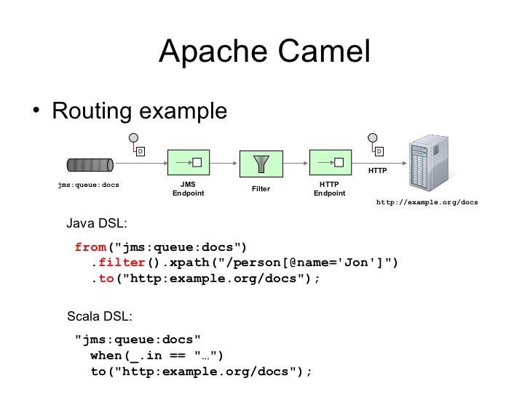
系统分析课程分享 - 谭一雄 - 17212010132

