Slide 1
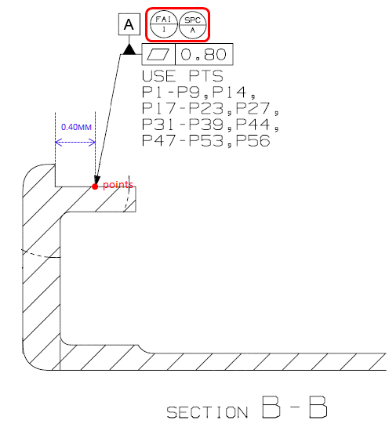
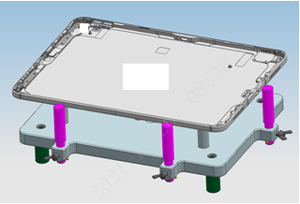
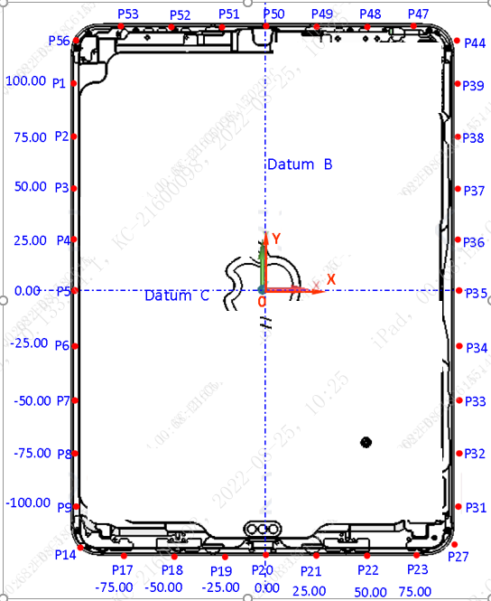
Jxxx MTD | Details of SPCs - SPC_A (Example1)
SPC | A
FAI | 1
Description | Datum A Flatness
Type | Flatness(GD&T)
SKU | Both
Nominal | 0.00
Tol+ | +0.800
Tol- | -0.000
Equipment | OMM
Fixture Positioning | 4x points support
Reference Datums | A+B+C
SPC Output | SPC_A
SPC qty | 1
Raw data Output | P1~P9, P14, P17~P23, P27, P31~P39, P44, P47~P53, P56
Raw data qty | 36
Measurement Procedure | 1. Create datum A/B/C 2. Measure Point P1~P9, P14, P17~P23, P27, P31~P39, P44, P47~P53, P56
Calculation Method | 1. Point P1~P9, P14, P17~P23, P27, P31~P39, P44, P47~P53, P56 create plane PL1 2. Calculate Flatness of PL1
Drawing Callout
Fixture
Measurement Description

Slide 2
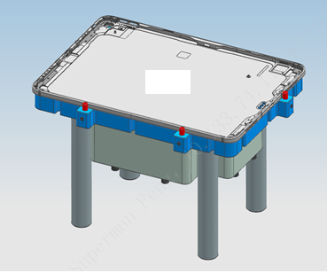
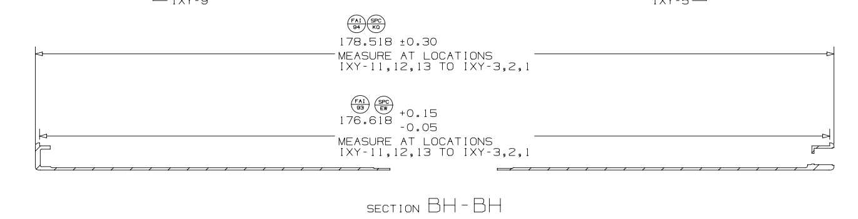
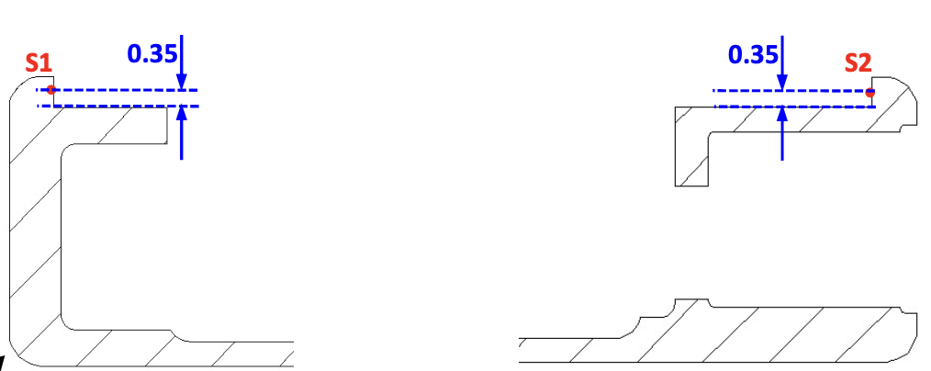
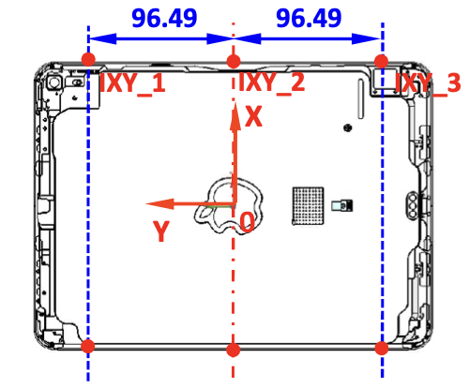
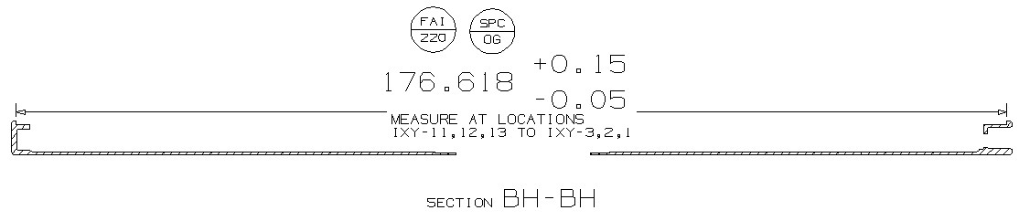
Jxxx MTD | Details of SPCs - SPC_EW (Example2)
SPC | EW
FAI | 93
Description | HSG inner width
Type | Tolerance
SKU | Both
Nominal | 176.618
Tol+ | +0.150
Tol- | -0.050
Equipment | CMM
Fixture Positioning | Vacuum adsorption
Reference Datums | A+B+C
SPC Output | SPC_EW_1 ~ SPC_EW_3
SPC qty | 3
Raw data Output | IXY_1~IXY_3, IXY_11~IXY_13
Raw data qty | 6
Measurement Procedure | 1. Capture 2 points (S1&S2) as picture right
Calculation Method | 1. SPC_EW_1 : Calculate the distance from S1 to S2 in orientation X. 2. The same method for other locations(SPC_EW_2, SPC_EW_3).
Drawing Callout
Fixture
Measurement Description

Slide 3
Jxxx MTD | Details of SPCs - CM
SPC | CM
FAI | 55
Description | description for cm
Type | Flatness(GD&T)/Profile(GD&T)/…/Tolerance/MAX/MIN
SKU | Both/Wifi/Cell
Nominal | xxx.xxx (Nomial)
Tol+ | +xx.xxx (upper tolerance, no blank between ‘+’ & value)
Tol- | -xx.xxx (Lower tolerance, no blank between ‘+’ & value)
Equipment | CMM/OMM/Calliper/Other
Fixture Positioning | Vacuum Adsorption/ 4x Points Support/ 4x Points Support + Magnet
Reference Datums | Datum1+Datum2+Datum3 (No blank before & after ‘+’)
SPC Output | SPC_A (if have more than 1x output: SPC_A_1, SPC_A_2, …)
SPC qty | 1 (qty)
Raw data Output | P1~P9, P14, P17~P23, P27, P31~P39, P44, P47~P53, P56 (example1, if drawing have defined point name, follow drawing) A_1, A_2, … (example2, if drawing have no defined point name: XX_NO)
Raw data qty | 36 (qty)
Measurement Procedure | 1. Create datum A/B/C 2. Measure Point P1~P9, P14, P17~P23, P27, P31~P39, P44, P47~P53, P56 (example)
Calculation Method | 1. Point P1~P9, P14, P17~P23, P27, P31~P39, P44, P47~P53, P56 create plane PL1 2. Calculate Flatness of PL1 (example)

Slide 4
Jxxx MTD | Details of SPCs - AM
SPC | AM
FAI | 56
Description | description for am
Type | Flatness(GD&T)/Profile(GD&T)/…/Tolerance/MAX/MIN
SKU | Both/Wifi/Cell
Nominal | xxx.xxx (Nomial)
Tol+ | +xx.xxx (upper tolerance, no blank between ‘+’ & value)
Tol- | -xx.xxx (Lower tolerance, no blank between ‘+’ & value)
Equipment | CMM/OMM/Calliper/Other
Fixture Positioning | Vacuum Adsorption/ 4x Points Support/ 4x Points Support + Magnet
Reference Datums | Datum1+Datum2+Datum3 (No blank before & after ‘+’)
SPC Output | SPC_A (if have more than 1x output: SPC_A_1, SPC_A_2, …)
SPC qty | 1 (qty)
Raw data Output | P1~P9, P14, P17~P23, P27, P31~P39, P44, P47~P53, P56 (example1, if drawing have defined point name, follow drawing) A_1, A_2, … (example2, if drawing have no defined point name: XX_NO)
Raw data qty | 36 (qty)
Measurement Procedure | 1. Create datum A/B/C 2. Measure Point P1~P9, P14, P17~P23, P27, P31~P39, P44, P47~P53, P56 (example)
Calculation Method | 1. Point P1~P9, P14, P17~P23, P27, P31~P39, P44, P47~P53, P56 create plane PL1 2. Calculate Flatness of PL1 (example)

Slide 5
Jxxx MTD | Details of SPCs - FM
SPC | FM
FAI | 557
Description | description for fm
Type | Flatness(GD&T)/Profile(GD&T)/…/Tolerance/MAX/MIN
SKU | Both/Wifi/Cell
Nominal | xxx.xxx (Nomial)
Tol+ | +xx.xxx (upper tolerance, no blank between ‘+’ & value)
Tol- | -xx.xxx (Lower tolerance, no blank between ‘+’ & value)
Equipment | CMM/OMM/Calliper/Other
Fixture Positioning | Vacuum Adsorption/ 4x Points Support/ 4x Points Support + Magnet
Reference Datums | Datum1+Datum2+Datum3 (No blank before & after ‘+’)
SPC Output | SPC_A (if have more than 1x output: SPC_A_1, SPC_A_2, …)
SPC qty | 1 (qty)
Raw data Output | P1~P9, P14, P17~P23, P27, P31~P39, P44, P47~P53, P56 (example1, if drawing have defined point name, follow drawing) A_1, A_2, … (example2, if drawing have no defined point name: XX_NO)
Raw data qty | 36 (qty)
Measurement Procedure | 1. Create datum A/B/C 2. Measure Point P1~P9, P14, P17~P23, P27, P31~P39, P44, P47~P53, P56 (example)
Calculation Method | 1. Point P1~P9, P14, P17~P23, P27, P31~P39, P44, P47~P53, P56 create plane PL1 2. Calculate Flatness of PL1 (example)

