Slide 1
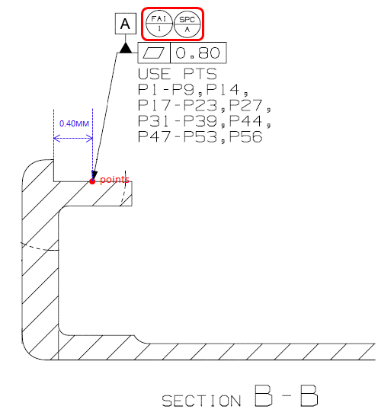
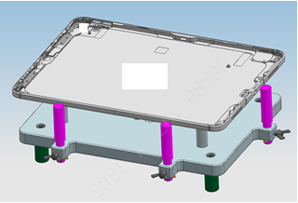
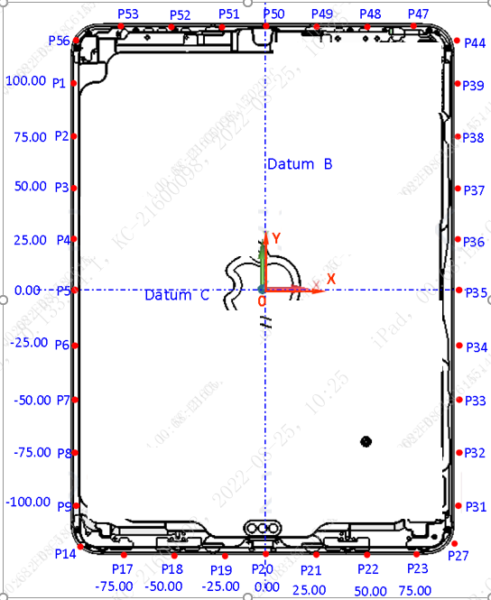
J507 MTD | Details For SPCs
SPC | A
FAI | 1
Description | Datum A Flatness
Nominal | 0.00
Tol+ | +0.80
Tol- | -0.00
Equipment | OMM
Fixture Positioning | 4x points support
Reference Datums | A+B+C
Reporting Output | 1x SPC 36x raw data
Measurement Procedure | 1. Create datum A/B/C 2. Measure Point P1~P9, P14, P17~P23, P27, P31~P39, P44, P47~P53, P56
Calculation Method | 1. Point P1~P9, P14, P17~P23, P27, P31~P39, P44, P47~P53, P56 create plane PL1 2. Calculate Flatness of PL1
Drawing Callout
Fixture
Measurement Description

Slide 2
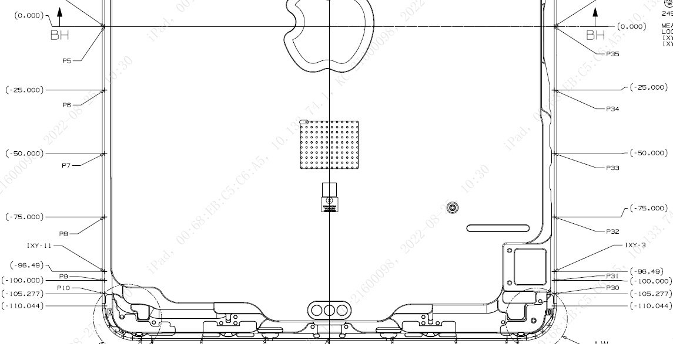
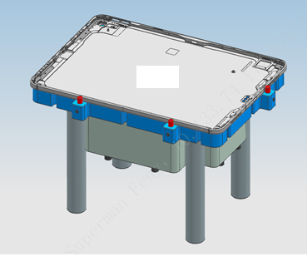
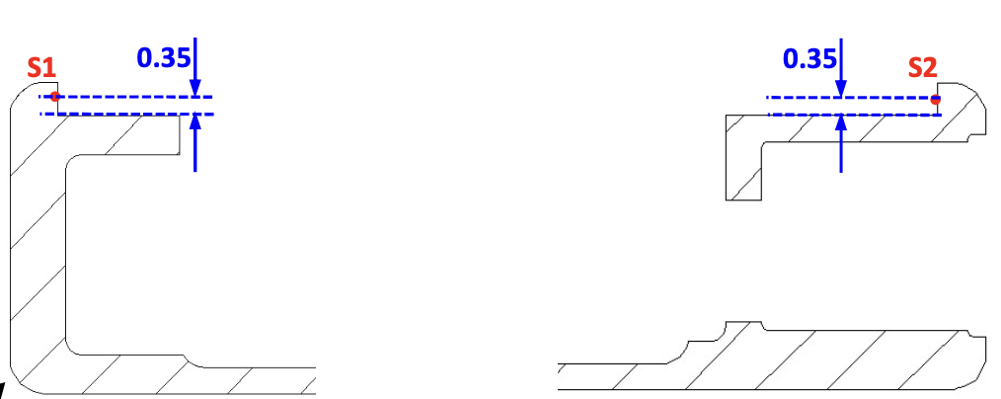
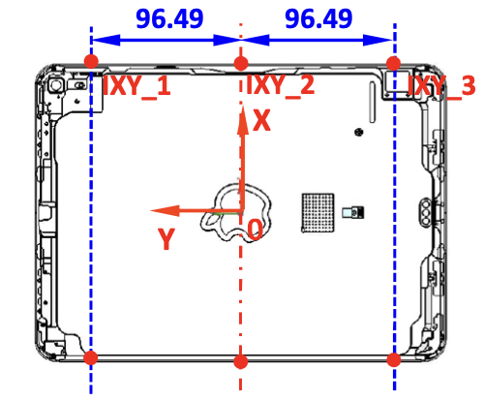
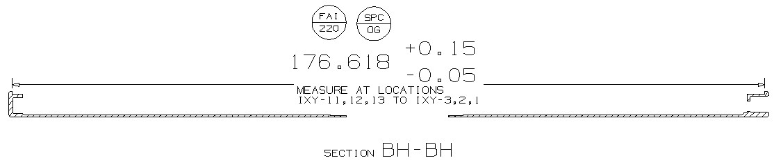
J507 MTD | Details For SPCs
SPC | EW
FAI | 93
Description | HSG inner width
Nominal | 176.618
Tol+ | +0.2
Tol- | -0.05
Equipment | CMM
Fixture Positioning | Vacuum adsorption
Reference Datums | A+B+C
Reporting Output | 3x SPC 6x raw data
Measurement Procedure | 1. Capture 2 points (S1&S2) as picture right
Calculation Method | 1. SPC EW_IXY_1 : Calculate the distance from S1 to S2 in orientation X. 2. The same method for other locations(IXY_2,IXY_3).
Drawing Callout
Fixture
Measurement Description

Slide 3
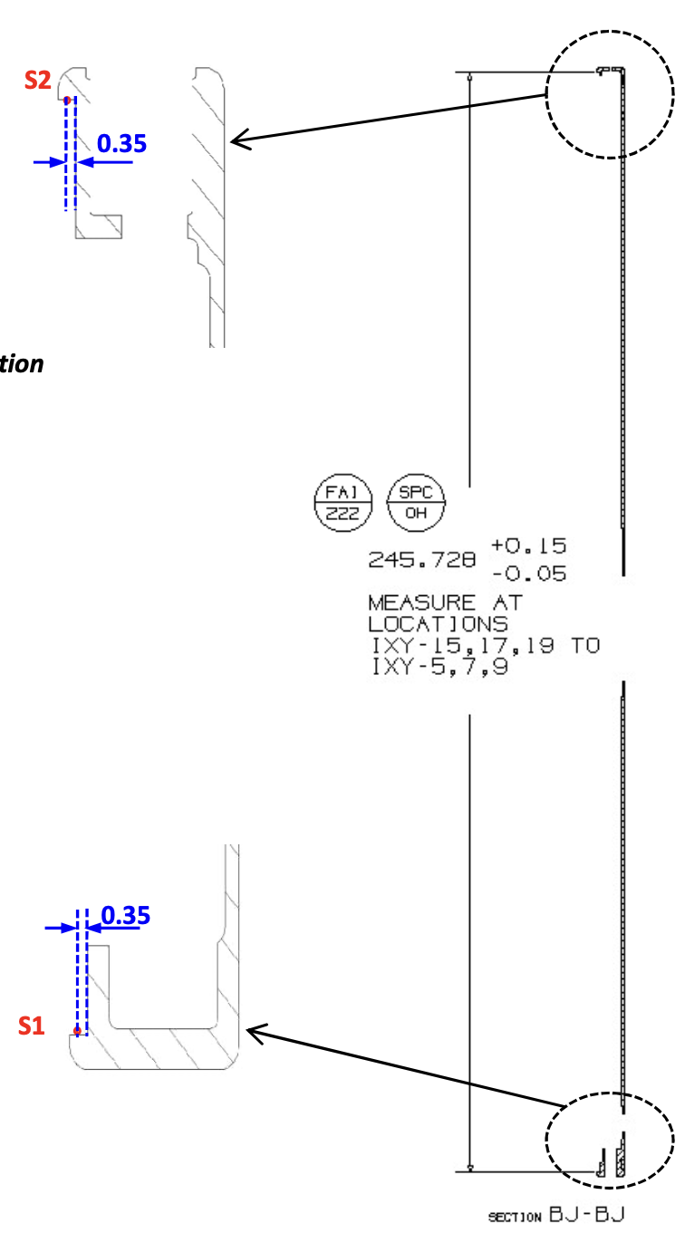
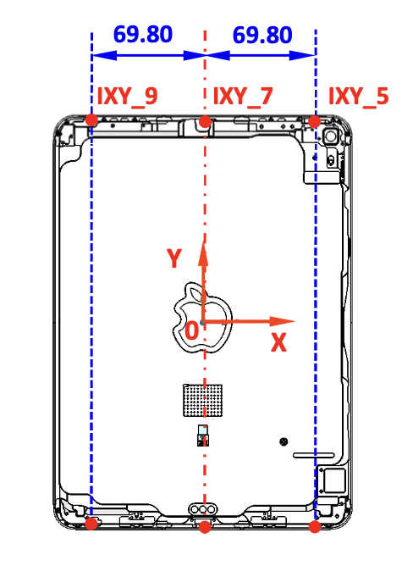
J507 MTD | Details For SPCs
SPC | EX
FAI | 95
Description | HSG inner length
Nominal | 245.728
Tol+ | +0.15
Tol- | -0.03
Equipment | CMM
Fixture Positioning | Vacuum adsorption
Reference Datums | A+B+C
Reporting Output | 3x SPC 6x raw data
Measurement Procedure | 1. Capture 2 points (S1&S2) as picture right
Calculation Method | 1. SPC EX_IXY_5 : Calculate the distance from S1 to S2 in orientation X. 2. The same method for other locations(IXY_7,IXY_9).
Drawing Callout
Fixture
Measurement Description

