Slide 1
领域驱动设计-2 Domain Driven Design-2
2013年8月15日

Slide 2
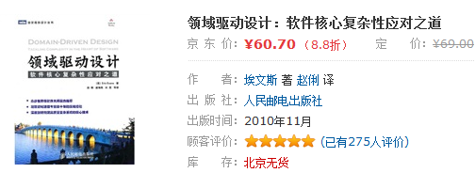
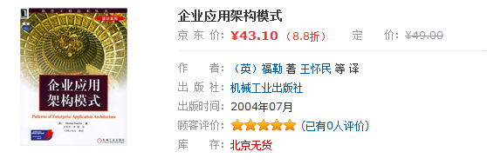
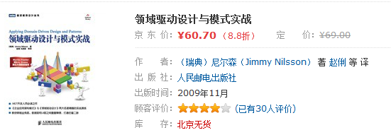
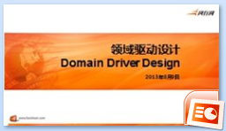
推荐阅读

Slide 3
内容
- DDD, business domain model, UML or not
- code first and layered architecture
- Java persistence options (iBatis, Hibernate, JPA2, Spring Data)

Slide 4
简单3层架构
UI
Business
Data access

Slide 5
简单3层架构
UI
V
M
C
Business
Service
Domain
Data access

Slide 6
简单3层架构 – Data Access Layer extended
UI (Representation Layer)
V
M
C
Web Service
Business Layer
Business unit tests
Service
Domain
Data access
Spring Data
JPA2 (Java Persistence)
ORM (e.g. Hibernate)
JDBC

