Slide 1

Dynamic Pixel-to-Metre Calibration in Competitive Swimming Using Lane Rope
Markers: A Computer Vision Proof of Concept
Daniel Pace
Supervised by Prof. Vanessa Camilleri
B.Sc. IT (Hons.)
Artificial Intelligence
Notes:
Good morning. My name is Daniel Pace, and my project is titled Dynamic Pixel-to-Metre Calibration in Competitive Swimming Using Lane Rope Markers: A Computer Vision Proof of Concept, supervised by Prof. Vanessa Camilleri.
[30s]

Slide 2
Chapters
Introduction
Aims & Objectives
Marker Design
Annotation Pipeline
1.
2.
3.
4.
Scale & Kinematic Analysis
Limitations & Future Work
Conclusion
5.
Evaluation of Results
6.
7.
8.
Notes:
This is how this presentation has been structured:
I'll start with the problem and objectives, then go deeper into the four main components: marker design, the annotation pipeline, scale and kinematic extraction, and finally the evaluation. I'll close with limitations and future work, finishing with a brief conclusion.
[1m]

Slide 3
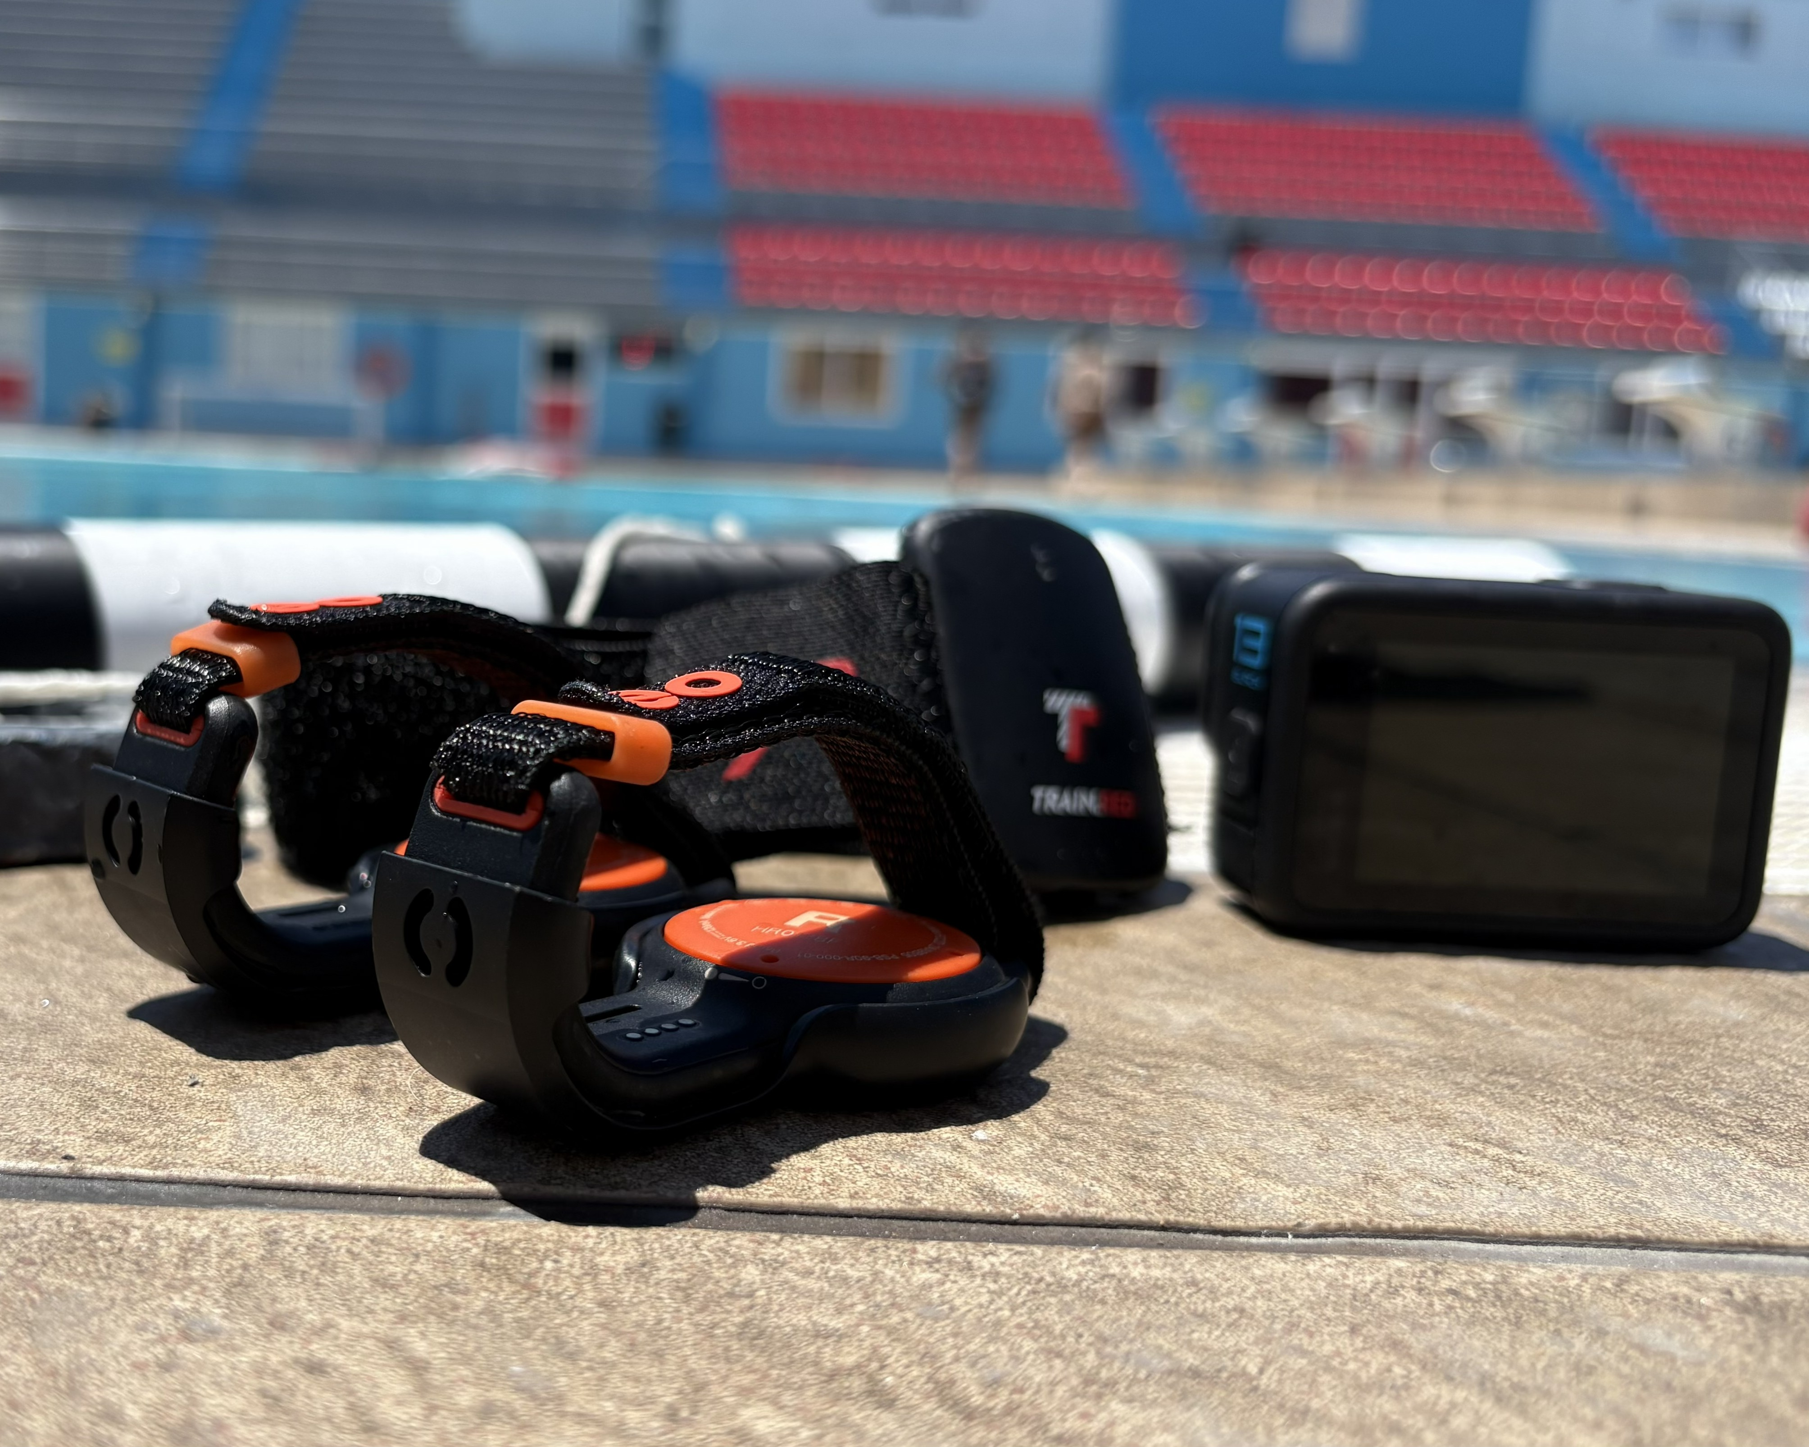
Introduction
Performance analysis in swimming currently relies heavily on manual observations or expensive and intrusive sensors.
Aquatic environment is adversarial for Computer Vision (CV): refraction, turbulence, occlusions, caustics.
No standardized, low-cost, unintrusive metric extraction system exists.
The objectives were defined as:
Design underwater calibration markers
Build an annotated dataset via MITL
Establish dynamic pixel-to-metre scaling
Extract Kinematic metrics (velocity, trajectory)
The problems:
No suitable dataset currently exist
Manual annotation is intractable at scale
The solution:
Final design decisions:
Modular
Cylindrical shape
Alternating black and white
5cm x 10cm segment
9 markers, spaced out every 2.5 metres
SAM2 temporal propagation
IQR outlier filtering
YOLO26 fine-tuning
Human verification
image of sensors.
Notes:
The problem:
So basically, this project was inspired by a core challenge identified in the SWIM-360 research project, that
Performance analysis in competitive swimming still relies heavily on manual observation or expensive wearable sensors. Both are intrusive to the athlete and impractical for routine coaching.
Computer Vision (CV) offers a non-intrusive alternative. But the pool is a very adversarial domain for it.
The niche this project fills is a standardized, low-cost, unintrusive way to extract metric swimming data from poolside footage.
[2m]

Slide 4
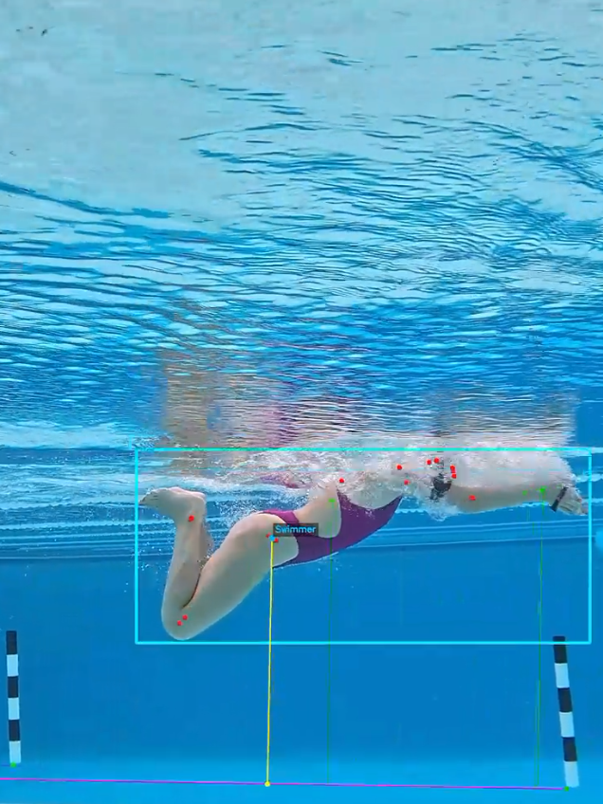
Aims & Objectives
Performance analysis in swimming currently relies heavily on manual observations or expensive and intrusive sensors.
Aquatic environment is adversarial for Computer Vision (CV): refraction, turbulence, occlusions, caustics.
No standardized, low-cost, unintrusive metric extraction system exists.
The objectives were defined as:
Design underwater calibration markers
Build an annotated dataset via MITL
Establish dynamic pixel-to-metre scaling
Extract Kinematic metrics (velocity, trajectory)
Final design decisions:
Modular
Cylindrical shape
Alternating black and white
5cm x 10cm segment
9 markers, spaced out every 2.5 metres
Scale Extraction
YOLO marker detection
MAD inlier filtering
Carry-forward when <2 markers visible
Kinematics
Ego-motion compensation
ViTPose keypoints
Kalman Filter, loop closure, Savitzky-Golay
The problems:
No suitable dataset currently exist
Manual annotation is intractable at scale
The solution:
SAM2 temporal propagation
IQR outlier filtering
YOLO26 fine-tuning
Human verification
A screenshot from the final output video.
Notes:
So the primary aim was to develop a proof-of-concept system for extracting swimming metrics from video. As I covered in the report, while CV research has made progress in detection, segmentation, and pose estimation,
annotated underwater datasets are very scarce and no standardised metric extraction system for the aquatic domain exists.
So, this project had four concrete objectives, to:
Design modular underwater calibration markers.
Build an annotated dataset using a Model in the Loop approach, because no suitable underwater dataset exists publicly.
Establish a dynamic pixel-to-metre scaling pipeline using those markers.
And
To extract meaningful kinematic outputs – more specifically the swimmer’s velocity and trajectory.
These four objectives map directly to the four technical components we’ll go through now;
[3m]

Slide 5
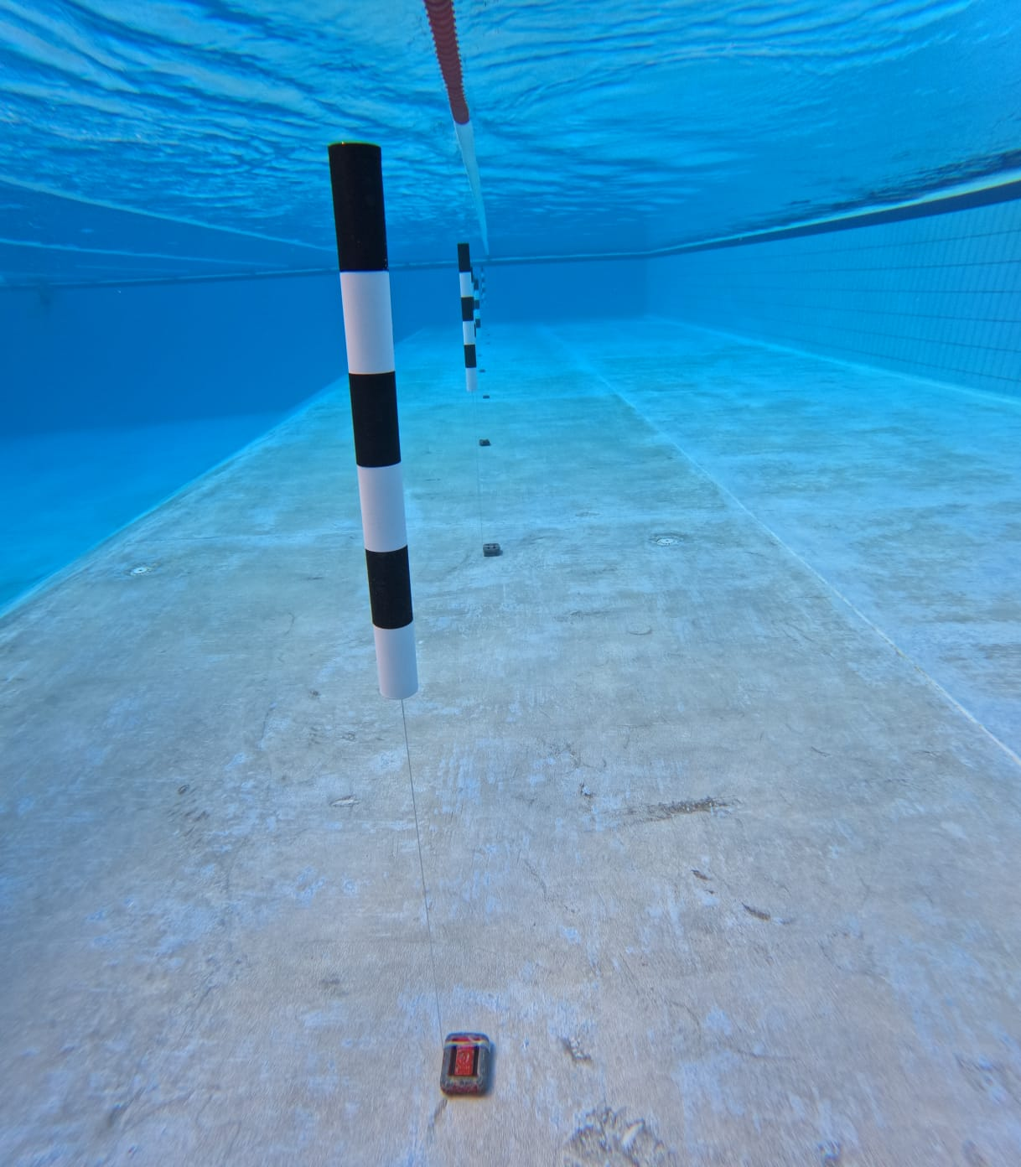
Marker Design
The objectives were defined as:
Design underwater calibration markers
Build an annotated dataset via MITL
Establish dynamic pixel-to-metre scaling
Extract Kinematic metrics (velocity, trajectory)
Final design decisions:
Modular
Cylindrical shape
Alternating black and white
5cm x 10cm segment
9 markers, spaced out every 2.5 metres
The problems:
No suitable dataset currently exist
Manual annotation is intractable at scale
The solution:
Scale Extraction
YOLO marker detection
MAD inlier filtering
Carry-forward when <2 markers visible
Kinematics
Ego-motion compensation
ViTPose keypoints
Kalman Filter, loop closure, Savitzky-Golay
Test: single 50 m breaststroke sequence, 18/20 checkpoints recovered.
MAE: 1.005 s | RMSE: 1.210 s
Peak Speed: 4.96 m/s | Mean Speed: 1.95 m/s
Limitation: Heavy outlier filtering required due to noisy keypoints. (especially at the water-air boundary)
SAM2 temporal propagation
IQR outlier filtering
YOLO26 fine-tuning
Human verification
The designed markers in use.
Notes:
Okay, so here is the marker in use.
Its a custom 3D-printed cylinder (which I designed myself), with alternating black and white segments.
Off-the-shelf targets like chequerboards and aruco markers were considered and ruled out, as at oblique angles their corner features become unreliable, and no other waterproof solution is commercially available.
The cylindrical form means that its shape remains consistent from any horizontal angle.
The black and white alternation maximizes difference in specifically luminance and not colour, since water absorbs red wavelengths within a few metres, reducing colour contrast.
Each segment is 5cm wide by 10cm tall, stacked 6 times resulting in a final marker size of 5 by 60cm.
These were spaced out every 2.5m, since from testing, wider spacing led to large periods of only one marker, where scale cannot be calculated, and any closer made setup time and effort impractical.
[4m]

Slide 6
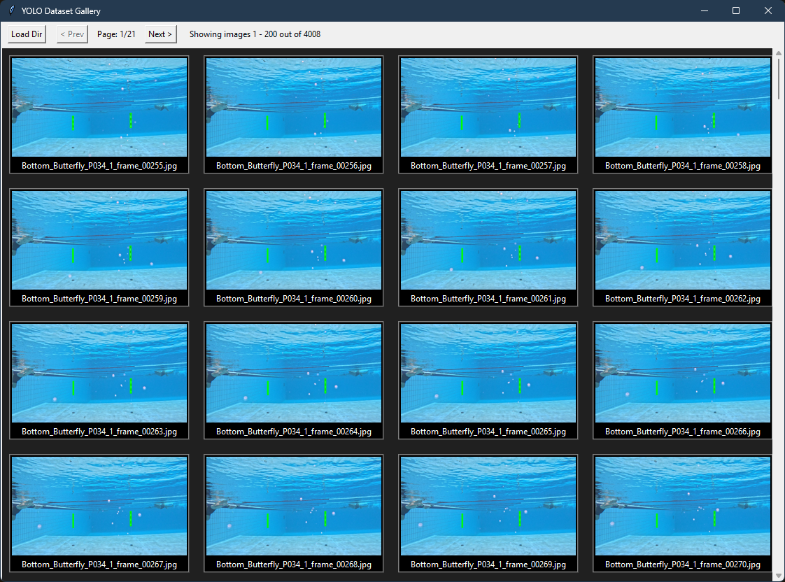
Annotation Pipeline
Final design decisions:
Modular
Cylindrical shape
Alternating black and white
5cm x 10cm segment
9 markers, spaced out every 2.5 metres
The problems:
No suitable dataset currently exist
Manual annotation is intractable at scale
The solution:
Scale Extraction
YOLO marker detection
MAD inlier filtering
Carry-forward when <2 markers visible
Kinematics
Ego-motion compensation
ViTPose keypoints
Kalman Filter, loop closure, Savitzky-Golay
Limitations:
Single pool environment; domain shift on unseen footage
ViTPose trained on terrestrial COCO (confidence collapse at distal joints)
Monocular (planar motion assumption)
Single-observer ground truths
Test: single 50 m breaststroke sequence, 18/20 checkpoints recovered.
MAE: 1.005 s | RMSE: 1.210 s
Peak Speed: 4.96 m/s | Mean Speed: 1.95 m/s
Limitation: Heavy outlier filtering required due to noisy keypoints. (especially at the water-air boundary)
SAM2 temporal propagation
IQR outlier filtering
YOLO26 fine-tuning
Human verification
The custom human verification tool.
Notes:
In order to fine-tune a marker detector, labelled data was required. But none existed.
Manual annotation at 120 frames per second was deemed intractable, since a single clip contained thousands of frames.
My solution was a model in the loop pipeline. I used meta’s segment anything model 2 (SAM2) to propogate bounding boxes throughout the video frames,
based on manual prompts, and processed in chunks to avoid drift when markers left the frame.
The raw outputs were then filtered on their bbox area and aspect ratio.
Finally, with a quick and dirty verification tool, i was able to quickly go through all the dataset, correcting anything the filter missed and adding in some extra boxes manually where necessary.
The filtered dataset resulted in a higher mean average precision than that unfiltered versions in A/B testing, and that was used for fine-tuning.
[5m]

Slide 7
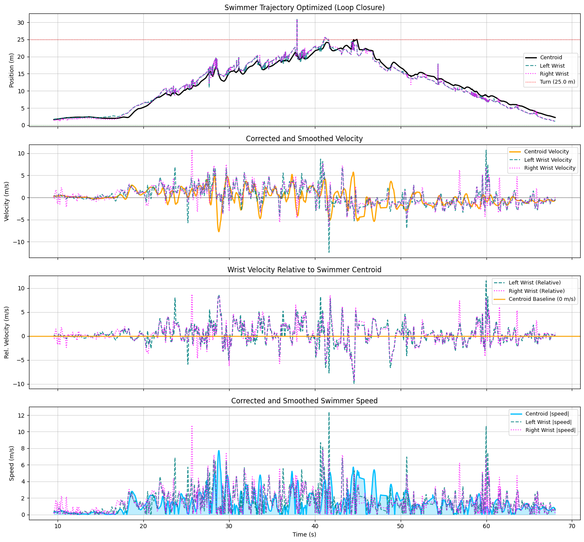
Scale & Kinematic Analysis
The problems:
No suitable dataset currently exist
Manual annotation is intractable at scale
The solution:
SAM2 temporal propagation
IQR outlier filtering
YOLO26 fine-tuning
Human verification
Scale Extraction
YOLO marker detection
MAD inlier filtering
Carry-forward when <2 markers visible
Kinematics
Ego-motion compensation
ViTPose keypoints
Kalman Filter, loop closure, Savitzky-Golay
Test: single 50 m breaststroke sequence, 18/20 checkpoints recovered.
MAE: 1.005 s | RMSE: 1.210 s
Peak Speed: 4.96 m/s | Mean Speed: 1.95 m/s
Limitation: Heavy outlier filtering required due to noisy keypoints. (especially at the water-air boundary)
Limitations:
Single pool environment; domain shift on unseen footage
ViTPose trained on terrestrial COCO (confidence collapse at distal joints)
Monocular (planar motion assumption)
Single-observer ground truths
Future Work:
Fine-tune ViTPose on aquatic domain data
IMU fusion for marker-loss intervals
Temporal transformer for inter-frame coherence
Multi-camera setup or depth estimation
Kinematic profiles for the full 50 m sequence.
Notes:
For the scale extraction: in each frame the pixel distance between the two outermost visible markers is divided by thier known, real-world separation to get a pixel-to-metre ratio.
A mean absolute deviation filter stabilizes the result from significant errors, and when less than 2 markers are detected in the frame, the most recent valid ratio is carried forward.
on the other hand, the kinematic mertrics were extracted by
Combining the motion of the camera itself with the swimmer’s displacement in the frame, using the detected markers as stationary anchors, taking the median displacement across all markers per frame.

Slide 8
Kinematic profiles for the full 50 m sequence.
Swimmer centroid and wrists trajectory, velocity, and speed.
Notes:
The swimmer’s centre of mass was estimated by taking the centre of the two hip keypoints instead of something like the bbox centroid, as the latter would oscillate with every stroke the swimmer takes.

Slide 9
Scale & Kinematic Analysis
The problems:
No suitable dataset currently exist
Manual annotation is intractable at scale
The solution:
SAM2 temporal propagation
IQR outlier filtering
YOLO26 fine-tuning
Human verification
Scale Extraction
YOLO marker detection
MAD inlier filtering
Carry-forward when <2 markers visible
Kinematics
Ego-motion compensation
ViTPose keypoints
Kalman Filter, loop closure, Savitzky-Golay
Test: single 50 m breaststroke sequence, 18/20 checkpoints recovered.
MAE: 1.005 s | RMSE: 1.210 s
Peak Speed: 4.96 m/s | Mean Speed: 1.95 m/s
Limitation: Heavy outlier filtering required due to noisy keypoints. (especially at the water-air boundary)
Future Work:
Fine-tune ViTPose on aquatic domain data
IMU fusion for marker-loss intervals
Temporal transformer for inter-frame coherence
Multi-camera setup or depth estimation
Limitations:
Single pool environment; domain shift on unseen footage
ViTPose trained on terrestrial COCO (confidence collapse at distal joints)
Monocular (planar motion assumption)
Single-observer ground truths
Kinematic profiles for the full 50 m sequence.
Notes:
The trajectory finally goes through a kalman filter, loop closure correction against the known 25m pool length, and savitzky-Golay smoothing in the velocity signal.
[6m]

Slide 10
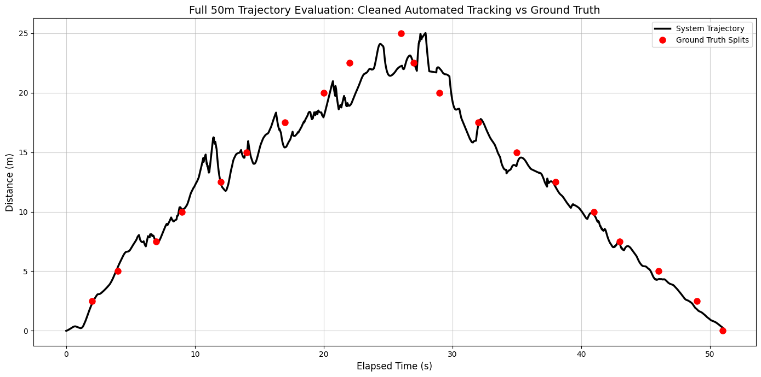
Evaluation of Results
Scale Extraction
YOLO marker detection
MAD inlier filtering
Carry-forward when <2 markers visible
Kinematics
Ego-motion compensation
ViTPose keypoints
Kalman Filter, loop closure, Savitzky-Golay
Test: single 50 m breaststroke sequence, 18/20 checkpoints recovered.
MAE: 1.005 s | RMSE: 1.210 s
Peak Speed: 4.96 m/s | Mean Speed: 1.95 m/s
Limitation: Heavy outlier filtering required due to noisy keypoints. (especially at the water-air boundary)
Limitations:
Single pool environment; domain shift on unseen footage
ViTPose trained on terrestrial COCO (confidence collapse at distal joints)
Monocular (planar motion assumption)
Single-observer ground truths
Future Work:
Fine-tune ViTPose on aquatic domain data
IMU fusion for marker-loss intervals
Temporal transformer for inter-frame coherence
Multi-camera setup or depth estimation
Full 50 m trajectory evaluation: Swimmer travels from 0 m to 25 m (outbound) and returns to 0 m.
Peaks reveal swimmer’s imperfect stroke-cycle exacerbated by tracking error.
Notes:
The system was evaluated on a single 50 m breaststroke sequence, with ground truth split times manually recorded every 2.5 m resulting in 20 total checkpoints.

Slide 11
Full 50 m trajectory evaluation: Swimmer travels from 0 m to 25 m (outbound) and returns to 0 m.
Peaks reveal swimmer’s imperfect stroke-cycle exacerbated by tracking error.
Notes:
18 of these checkpoints were recovered. The two missing ones are at the pool walls due to trajectory noise at the boundaries.
The error pattern displayed is non-linear in nature instead of simple drift, and the spikes in the graph are a result of the combination of the swimmer’s imperfect stroke cycle and the system’s own slight errors.

Slide 12
Evaluation of Results
Scale Extraction
YOLO marker detection
MAD inlier filtering
Carry-forward when <2 markers visible
Kinematics
Ego-motion compensation
ViTPose keypoints
Kalman Filter, loop closure, Savitzky-Golay
Test: single 50 m breaststroke sequence, 18/20 checkpoints recovered.
MAE: 1.005 s | RMSE: 1.210 s
Peak Speed: 4.96 m/s | Mean Speed: 1.95 m/s
Limitation: Heavy outlier filtering required due to noisy keypoints. (especially at the water-air boundary)
Limitations:
Single pool environment; domain shift on unseen footage.
ViTPose trained on terrestrial COCO (confidence collapse at distal joints).
Monocular (planar motion assumption).
Single-observer ground truths.
Future Work:
Fine-tune ViTPose on aquatic domain data
IMU fusion for marker-loss intervals
Temporal transformer for inter-frame coherence
Multi-camera setup or depth estimation
Full 50 m trajectory evaluation: Swimmer travels from 0 m to 25 m (outbound) and returns to 0 m.
Peaks reveal swimmer’s imperfect stroke-cycle exacerbated by tracking error.
Notes:
Across the recovered checkpoints, the mean absolute error was 1.005 seconds, and the root mean squared error was 1.210 seconds.
The swimmer in the test sequence achieved a peak speed of 4.96m/s and an average speed of 1.95m/s according to the system.
For context, elite race timing requires sub millisecond precision which is not achieved by this system.
But for coaching pace, splits, and technique across sessions, whole second resolution is usable.
Finally, a known limitation of the system is the heavy reliance on filtering due to the ammount of noise, especially at the water-air interface due to occlusions from splashes and bubbles.
[7m]

Slide 13
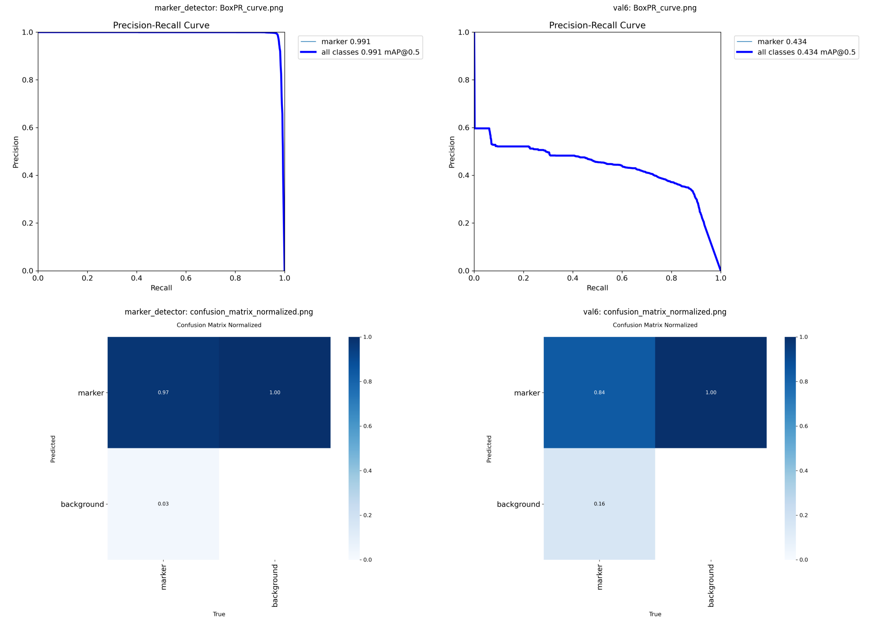
Limitations & Future Work
Test: single 50 m breaststroke sequence, 18/20 checkpoints recovered.
MAE: 1.005 s | RMSE: 1.210 s
Peak Speed: 4.96 m/s | Mean Speed: 1.95 m/s
Limitation: Heavy outlier filtering required due to noisy keypoints. (especially at the water-air boundary)
Limitations:
Single pool environment; domain shift on unseen footage.
ViTPose trained on terrestrial COCO (confidence collapse at distal joints).
Monocular (planar motion assumption).
Single-observer ground truths.
Future Work:
Fine-tune ViTPose on aquatic domain data
IMU fusion for marker-loss intervals
Temporal transformer for inter-frame coherence
Multi-camera setup or depth estimation
Comparison of marker detection accuracy on seen (left) vs unseen (right) environmental conditions.
Notes:
The most immediate limitation is generalization, since the marker detector was trained on footage from a limited range of pool environments.

Slide 14
Comparison of marker detection accuracy on seen (left) vs unseen (right) environmental conditions.
Noticeable drop in recall and precision on frames under unseen environmental conditions (e.g. different lighting).
Notes:
In the precision recall curve and confusion matrix, the marker confidence is seen to drop on unseen footage from the same facility under different lighting and pool water conditions.

Slide 15
Limitations & Future Work
Test: single 50 m breaststroke sequence, 18/20 checkpoints recovered.
MAE: 1.005 s | RMSE: 1.210 s
Peak Speed: 4.96 m/s | Mean Speed: 1.95 m/s
Limitation: Heavy outlier filtering required due to noisy keypoints. (especially at the water-air boundary)
Limitations:
Single pool environment; domain shift on unseen footage.
ViTPose trained on terrestrial COCO (confidence collapse at distal joints).
Monocular (planar motion assumption).
Single-observer ground truths.
Future Work:
Fine-tune ViTPose on aquatic domain data
IMU fusion for marker-loss intervals
Temporal transformer for inter-frame coherence
Multi-camera setup or depth estimation
Comparison of marker detection accuracy on seen (left) vs unseen (right) environmental conditions.
Notes:
ViTPose was pre-trained on the terrestrial COCO dataset, creating a systematic domain gap in the aquatic environment. Resulting in a collapse in confidence at distal joints.
The current system also relies on a single camera angle, assuming approximately planar swimmer motion, which is not a completely unreasonable assumption for competitive swimming, but fails in open water swimming.
Finally, the ground truths were obtained from a single observer, which introduces a hidden bias in the evaluation of the system.
[8m]

Slide 16
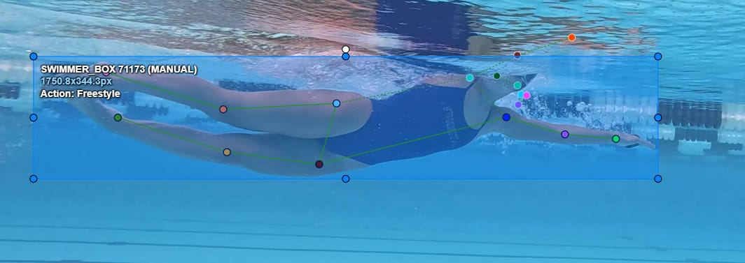
Limitations & Future Work
Limitations:
Single pool environment; domain shift on unseen footage
ViTPose trained on terrestrial COCO (confidence collapse at distal joints)
Monocular (planar motion assumption)
Single-observer ground truths
Future Work:
Fine-tune ViTPose on aquatic domain data
IMU fusion for marker-loss intervals
Temporal transformer for inter-frame coherence
Multi-camera setup or depth estimation
Manually annotated keypoints example on underwater swimming footage.
Notes:
The highest priority improvement is to fine-tune the pose estimation model specifically on aquatic domain data.
Inertial measurement units could be used to fill in the gaps where marker detection is lost.
A temporal transformer could be implemented instead of treating each frame strictly individually,
And finally, multiple cameras or depth estimation, could be added to the setupto remove the assumption about planar motion.
[9m]

Slide 17
Conclusion
Future Work:
Fine-tune ViTPose on aquatic domain data
IMU fusion for marker-loss intervals
Temporal transformer for inter-frame coherence
Multi-camera setup or depth estimation
Suitable for coaching technique
MITL pipeline
3D-printed markers for scale
Accessible, lower-cost biomechanics
Notes:
To summarize,
In this project a mean absolute error of just over one second was achieved, providing actionable data for coaching and pace tracking.
The core AI contribution is the model in the loop pipeline: using SAM2 to pseudo-label underwater data.
Another core contribution is the novel methodology using 3D-printed markers to dynamically extract pixel-to-meter scales across varying pools.
And all together, these make metric swimming analysis much more accessible, as no expensive sensors, no fixed cameras, and no bespoke hardware is required.
This concludes the presentation. Questions? [10m]

