Slide 1
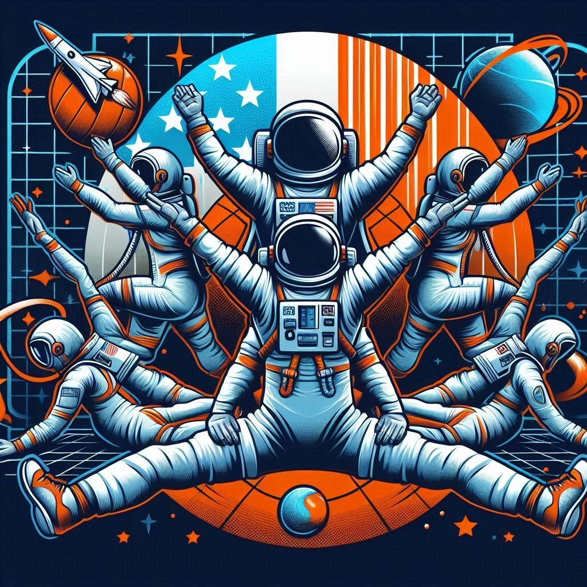
Astro-Yogi
Galactic Games
Fun in a Microgravity Environment!
Team
Jon Adair
Bill Shaw
Image credit Microsoft Copilot. Prompt: "Sports team logo with astronauts, yoga poses, and velcro suits"

Slide 2

Galactic Games:
Fun in a Microgravity Environment!
As humanity moves towards exploration of deep space, missions get longer. It is incredibly important to support both physical and psychological health for astronauts.
Physical games are a great way to promote movement. Friendly competition against a clock, goal or other players can also support a sense of well-being and elevate your mood.
Our games do all of this using readily available technology to take advantage of space environments.
Image credit https://similarpng.com

Slide 3
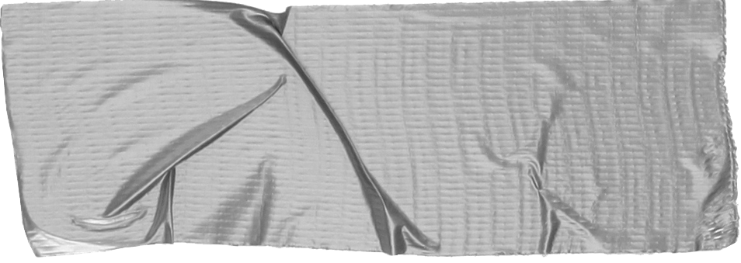

Game Design Goals
Minimize storage and mass with compact component designs.
Components should be reusable for other mission objectives.
Allow both solo and multiplayer game play.
Simple and quick setup and tear down to encourage use.
Durable design for player and environment safety.
Games are initiated and managed by a smartphone app using wireless networking.

Slide 4
Game System Components
Use existing VelcroⓇ wall fixtures
Velcro gloves, booties, elbow and knee pads with RFID tags. These track player interaction with the game elements.
Smart Video Panels . Programmable panels with touch surfaces and RFID readers provide tremendous flexibility for a wide range of applications.
Foam Balls with Rubber Cores and RFID tags provide tactile elements within games.
Rotating Anchor Pole. Usable to simulate gravity with centripedal force and provides fixed point for game features.

Slide 5
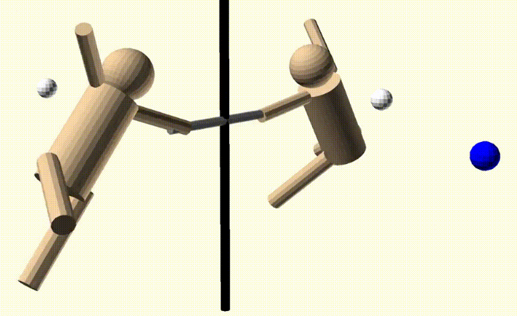
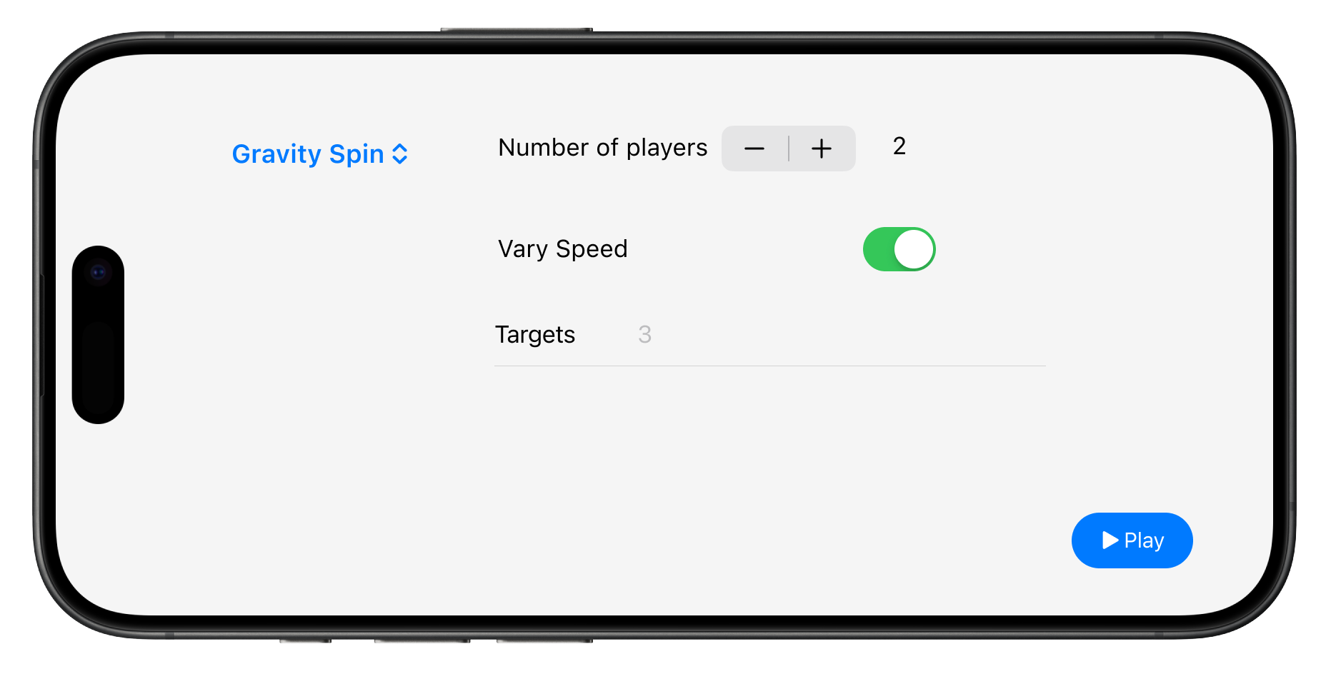
Gravity Spin
Players are tethered to a rotating pole. They need to collect trophies and coins before the line starts pulling them away from the wall and towards the pole. Targets can be on any surface. Players need to plan their
trajectories to maximize their score while avoiding penalty targets.

Slide 6
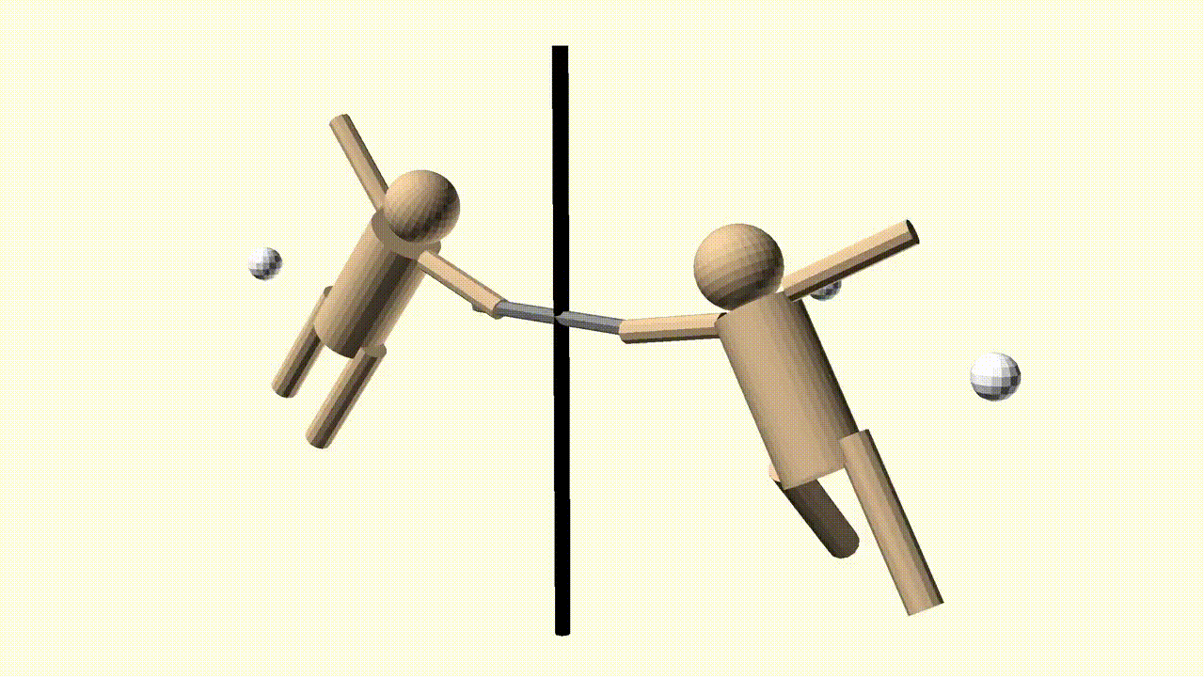

Slide 7
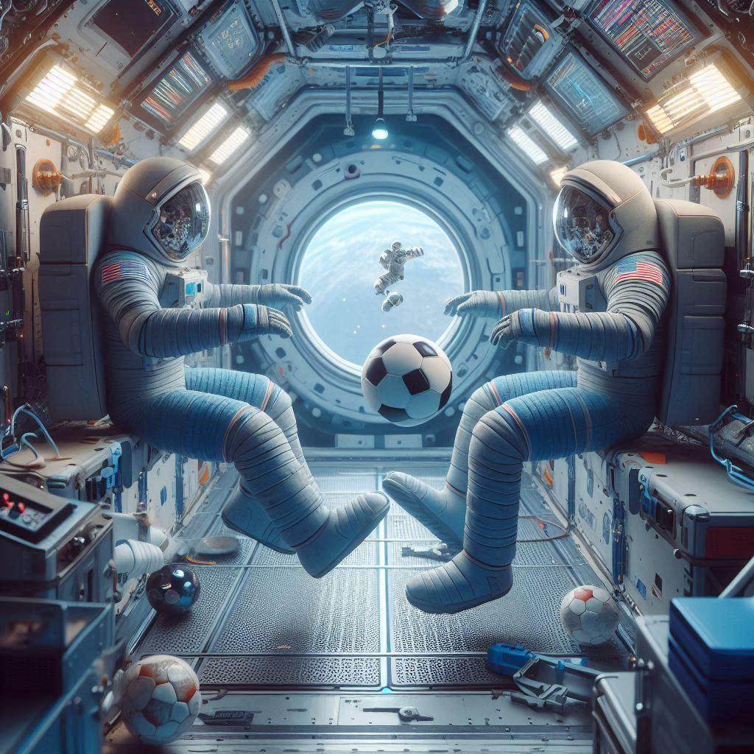
Other Game Ideas
The Walls are Lava. Effectively musical chairs with the smart panels representing the safe zones or lava.
3D Mini Golf. Balls must ricochet off smart panels before reaching the target.
Plug the Leak. Smart panels “spring leaks.” Deploy the balls to plug the leaks before you lose your air supply.
Soccer. Score by kicking the foam balls and hitting the goals using soccer rules.

Slide 8
Resources and Credits
Challenge
Microsoft Copilot
Naming inspiration https://chatgpt.com/c/670151f2-a400-8005-b29b-6ab2d5391b5d
https://www.nasa.gov/humans-in-space/one-small-step-without-ever-leaving-bed/
https://www.nasa.gov/humans-in-space/the-human-body-in-space/
ISS Baseball
Learn More
https://github.com/funwithbots/microgravity-game-design

