Slide 1


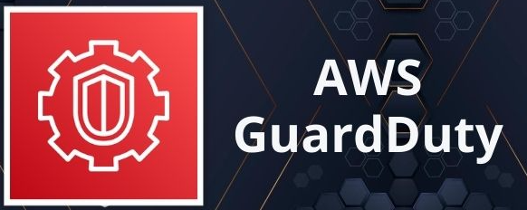

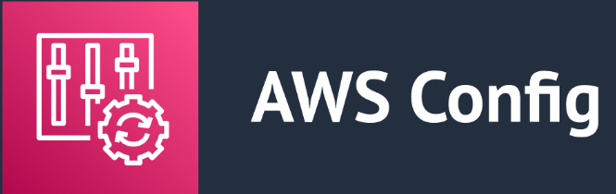
Application code or OS change
Build application container or OS image
Update cloud and infrastructure configuration
Deploy cloud configuration or application to environment
AMI or container image scanning
Infrastructure as code compliance scanning
Post-deployment compliance scanning
Infrastructure code change

