Slide 1

Accessories Shopping
TEAM 404 NOT FOUND

Slide 2
Member
. Nguyen Viet Anh
. Tran Le Thanh Thinh
. Nguyen Huu Anh Minh
. Tran Phuong Duy
. Ho Van Hoai Tri
. Le Nguyen Truc Phuong
Đàm Quang Cường

Slide 3
CONTENTS
1
Introduce project topic
2
Introduce member
3
Project Overviews
4
Design project
5
Planning
6
Disadvantages

Slide 4
Project Overview
This project is based on common platform shopping mall, it’s built for selling electronic accessories(mobile phone adapter , battery , earphone, etc...).
Advanced Functions:
Payment method : Paypal , MoMo …
Promotion
Checkout
Admin management
QR code generator
Product recommendation algorithms ,etc.

Slide 5
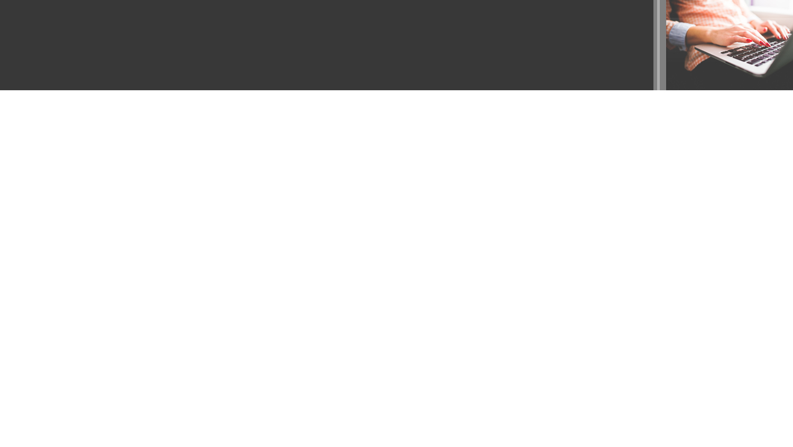
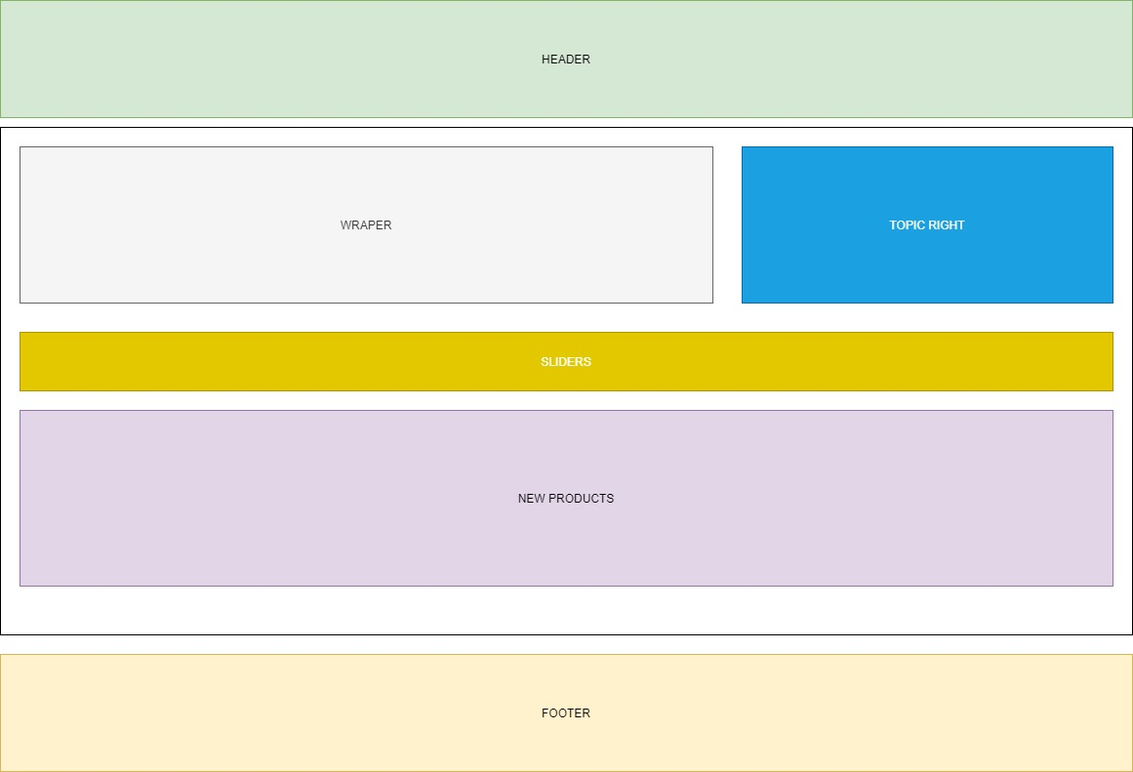
LAYOUT INDEX

Slide 6
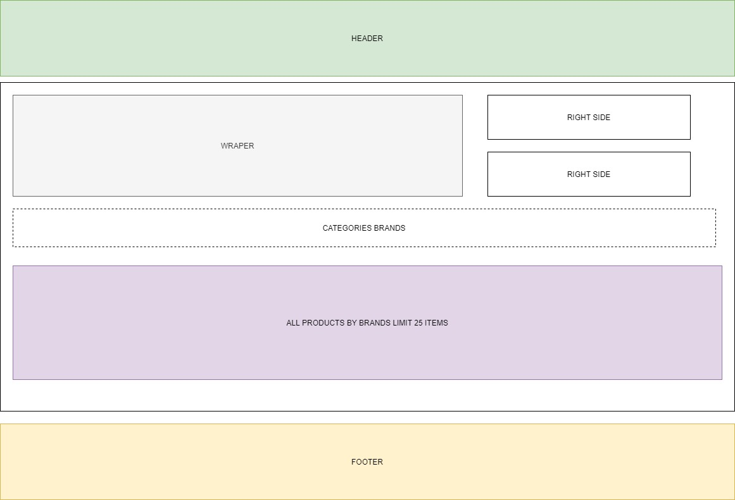
LAYOUT PAGES

Slide 7
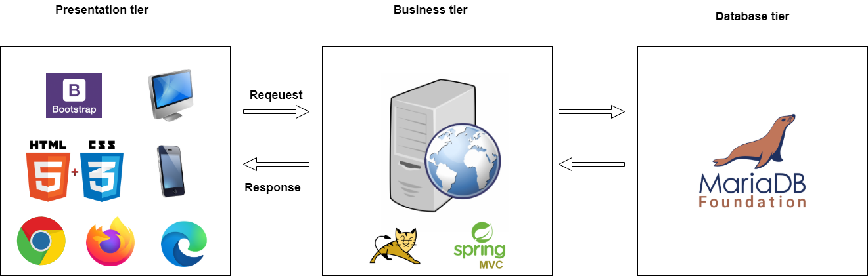
Design model
Mô hình ứng dụng

Slide 8
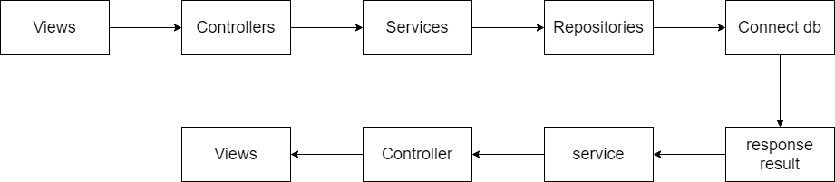
Flow systems

Slide 9
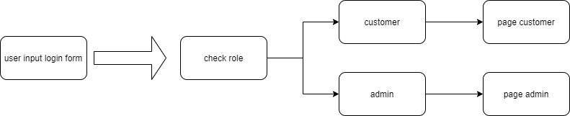
Login process

Slide 10
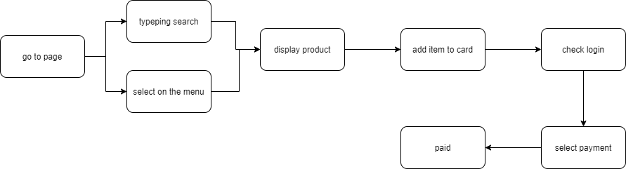
Booking process

Slide 11
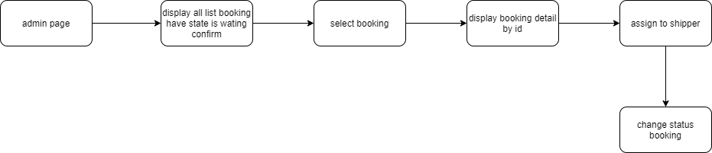
Admin booking status management process

Slide 12
Task
Member | task | module
Viet Anh | - CRUD products categories | - Client controller / products controller
Truc Phuong | - CRUD vendors , brands | Client controller / vendors controller brand controller
Anh Minh | - CRUD booking , booking details | Client controller / booking controller booking details
Hoai Tri | -Login : system , facebook gmail . | -Client controller / login controller
Phuong Duy | -CRUD user promotion | -Admin controller / user controller promotion controller
Thanh Thinh | - Confirm booking , payment | -Admin controller / payment controller state controller

Slide 13
Planning process
Sitemap
Design UI
Coding
Release
Design database
Testing

Slide 14
Disadvantages
First time do project together
Teamworks (coordination is not good)
Lacking of experiences

Slide 15
Thank You

