Slide 1
MCS Finance Club Report
Made by :–
Name – Kunal Bansal
Course – B.Tech. C.S.E.(2nd year)
Enrollment No. - 22115083
Contact – +91 8608609030
Email-id – kunal_b@cs.iitr.ac.in

Slide 2
Workflow
To start, ensure that all the necessary Python libraries have been successfully installed.
Compile a list of assets that encompass different asset classes and include multiple assets from each class to form a diversified portfolio.
Gather data from https://finance.yahoo.com and organize it into a structured format for ease of use.
Compute various parameters, such as Log Returns, Mean Returns, and the Covariance Matrix for log returns, and store them.
Define standard deviations for different portfolio profiles.
Create functions for executing Monte Carlo simulations and determining the optimal weights for different portfolio profiles.
Calculate the optimal weights for various portfolio profiles based on the predefined standard deviations.
Run Monte Carlo simulations for the different portfolio profiles using their respective optimal weights.
Generate various types of graphs and conduct an analysis based on the results.
Summarize all the findings and analysis in the report.

Slide 3

Monte Carlo Simulations:
Monte Carlo simulations are like a powerful guessing game that helps us understand things when there's a lot of uncertainty. Imagine you want to know the chances of winning a game, but the rules keep changing, or you're not sure how lucky you are. Instead of guessing once, you guess many, many times.
In each guess (simulation), you make random choices based on the possibilities, kind of like rolling dice or drawing straws. After lots of guesses, you look at all the results and see what tends to happen the most. This helps you figure out the most likely outcomes and make better decisions, even when things are uncertain or random. It's like making an educated guess by trying lots of possibilities.

Slide 4
Advantages of log returns
Additivity: Log returns exhibit the property of additivity, meaning that when you sum up the log returns over a specific period, it corresponds to the overall return for that duration. This characteristic is fundamental for representing the compounding of returns in financial simulations.
Normal Distribution: Log returns tend to approximate a normal distribution, or at least a distribution that is closer to normal compared to arithmetic returns.
Stationarity: It is reasonable to assume that log returns remain stationary over time, which serves as a critical assumption in various financial models. Stationarity implies that the statistical characteristics of log returns remain consistent over time, rendering them more predictable and suitable for modeling.
Symmetry: Log returns display symmetry around zero, making them well-suited for capturing both positive and negative price movements. In the realm of financial modeling, it is vital to account for downside risk (negative returns) in addition to the potential for positive returns.

Slide 5
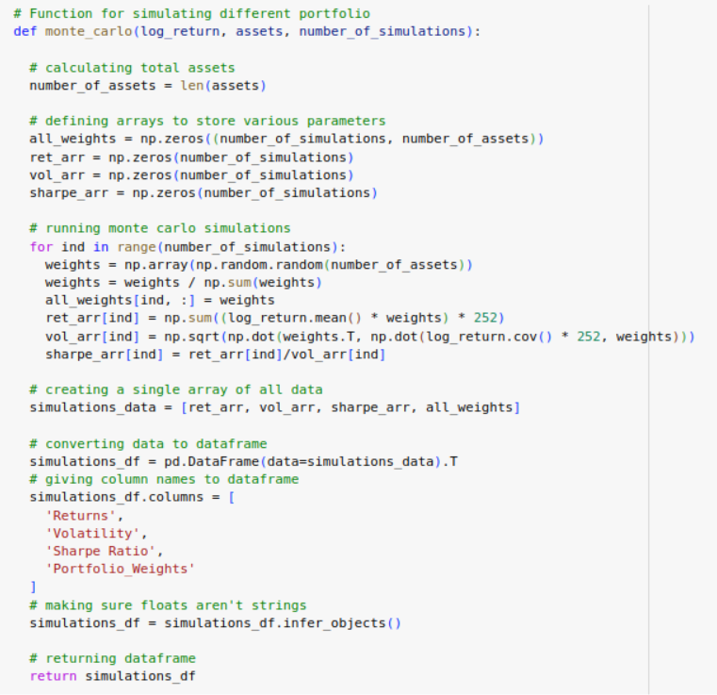
Optimal Weights
The method provided is often called Monte Carlo Portfolio Optimization. It aims to identify the optimal distribution of assets (weights) for a portfolio that maximizes the expected return while meeting a specific target level of portfolio risk (target standard deviation). Monte Carlo simulations are utilized to explore a range of potential portfolios by randomly generating various weight combinations and assessing their risk-return characteristics.

Slide 6

Cholesky Decomposition for predicting future prices
Cholesky decomposition is a method for breaking down a Hermitian, positive-definite matrix into the product of a lower triangular matrix and its conjugate transpose, which is equivalent to the original matrix. This decomposition is frequently utilized for the efficient generation of multivariate normal random variables and for solving systems of linear equations.
It's important to note that the Cholesky decomposition is not a standalone probability distribution; instead, it is closely connected to the multivariate normal distribution.
Fun Fact: The Cholesky factorization is named in honor of a French military officer, Andre-´Louis Cholesky.

Slide 7
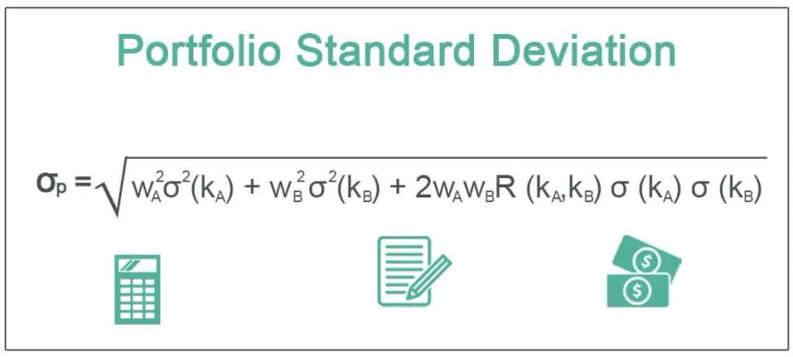
Standard deviation of a portfolio :
The standard deviation of a portfolio is like a measure of how much the investments in your portfolio tend to bounce up and down in value. If the standard deviation is high, it means your investments are pretty volatile and can have big swings in value. If it's low, it means your investments are more stable and don't change much in value. So, it helps you understand the level of risk or stability in your overall investment mix.

Slide 8

Covariance Matrix :
A covariance matrix is a tool used to understand the relationship between different things, like the performance of various assets in your investment portfolio. It helps you see how these variables move in relation to one another.
In simple terms, the numbers in a covariance matrix indicate whether two variables tend to move together, move in opposite directions, or have little to no connection. If the numbers in the matrix are positive, it suggests that the variables often move in the same direction, meaning they tend to go up or down together. Conversely, if the numbers are negative, it indicates that the variables tend to move in opposite directions, with one going up while the other goes down, and vice versa. When the numbers are close to zero, it means that there isn't much of a consistent connection between them.
So, think of a covariance matrix as a map that shows you how different elements in your portfolio are interconnected. It's like a compass that helps you navigate the ups and downs of your investments by revealing how they might influence each other, which is crucial for assessing and managing the risk and potential return of your portfolio.

Slide 9
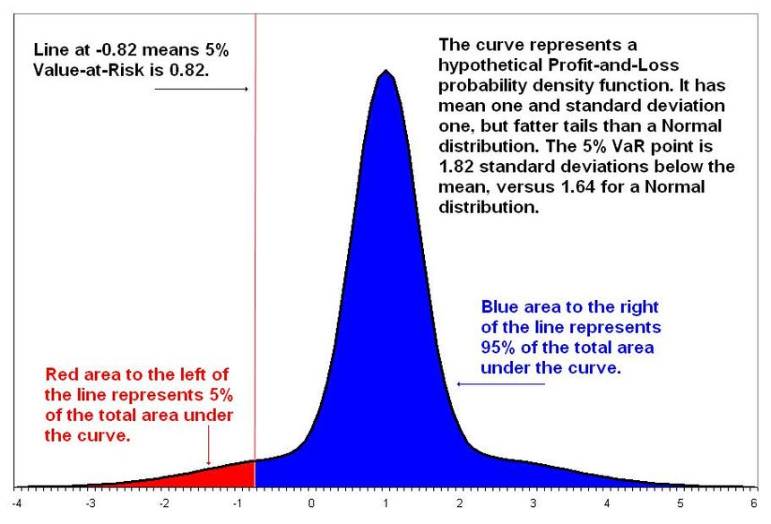
VaR
Value at Risk (VaR) is like a financial safety net that tells you how much you could potentially lose on your investments in a worst-case scenario over a certain time period. It's a way to measure and manage risk.
For example, if your portfolio has a one-day VaR of $1,000 at a 5% level, it means that there is a 5% chance (or 1 in 20) that you could lose up to $1,000 in a single day under normal market conditions. VaR helps investors understand and prepare for potential losses, which is important for managing their investments and financial security.

Slide 10

Results
Using Monte Carlo Simulations, we have mitigated our risk and maximized out returns taking risk appetite of various types of investors in consideration during the most optimum way to invest can be adopted

