Slide 1


Santosh Kumar Kar,
skkar.2k2@gmail.com

Slide 2
CHAPTER – 5
HATEOAS

Slide 3
HATEOAS Hypermedia As The Engine Of Application State
Hypermedia As The Engine Of Application State

Slide 4
HATEOAS Hypermedia As The Engine Of Application State
The term “hypermedia” refers to any content that contains links to other forms of media such as images, movies, and text.
This architectural style lets you use hypermedia links in the response contents so that the client can dynamically navigate to the appropriate resource by traversing the hypermedia links

Slide 5
Advantages of HATEOAS
Required APIs could be easily found without any specific documentation
Make the response navigable with links to common resource URIs
Get the message URL of the response itself
If any URL changes from the server-side, there's no need to do any change on the client-side
If we follow proper HATEOAS, the client actually doesn't need to spend much time understanding API documentation. As an end-user, we don't have to go through documentation every time we visit a new website. We just go to the homepage and go through the links. With HATEOAS, the web service is super helpful to the clients.

Slide 6
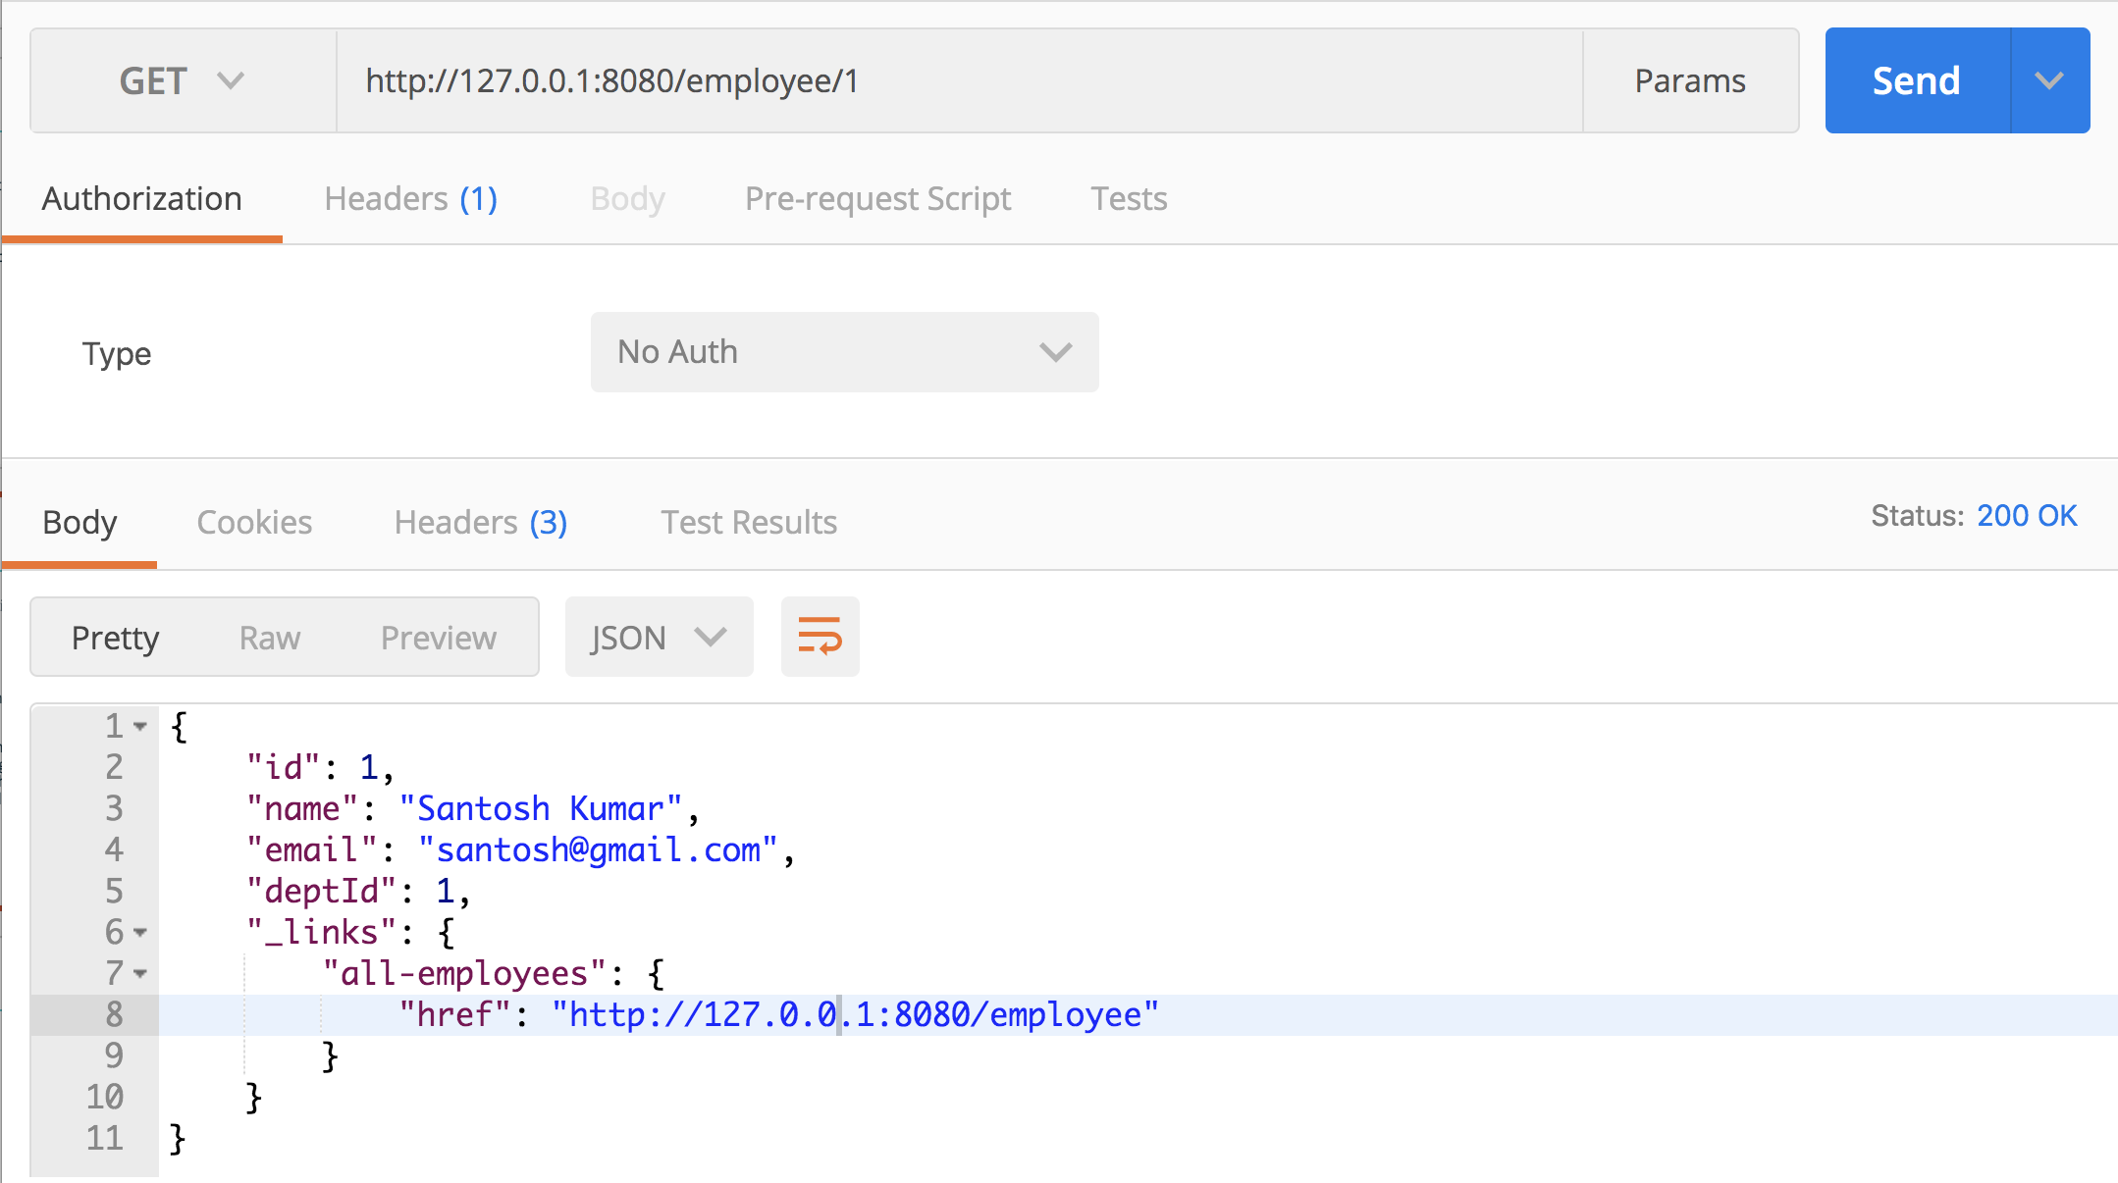
Hateoas

Slide 7

Questions
Send to skkar.2k2@gmail.com

