Slide 1

GLOBAL UNDERNUTRITION 1 IN 9 PEOPLE AROUND THE WORLD GO HUNGRY EACH DAY
Public health study(fao*)
(*)Food and agriculture organization of the united nations

Slide 2
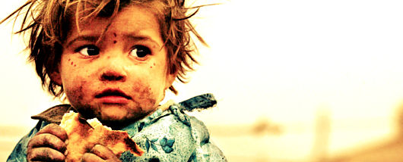
A Child Dies From Hunger Every 10 Seconds

Slide 3
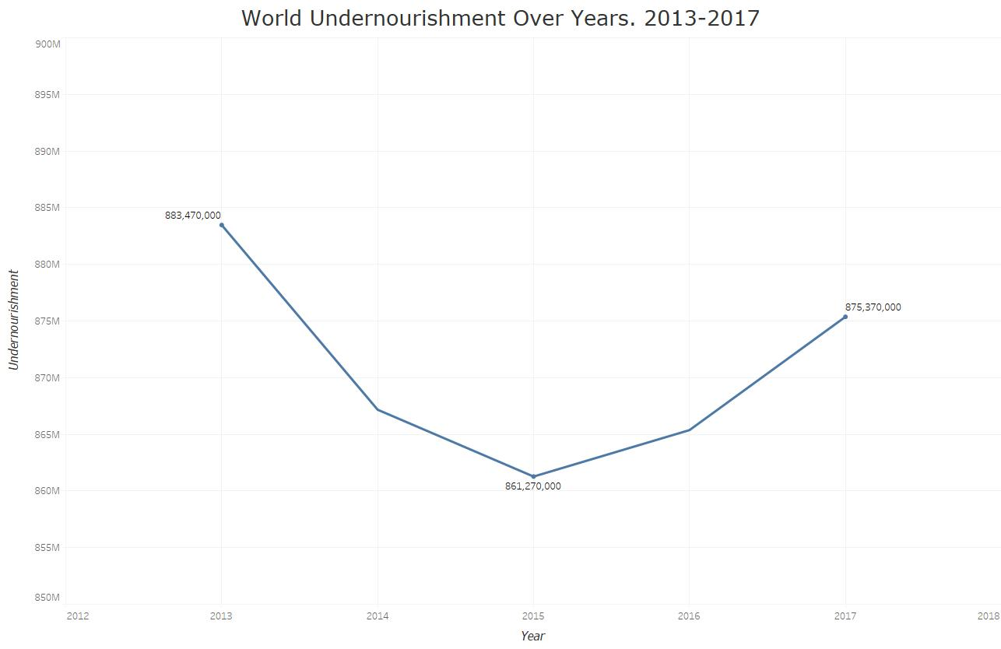
The Number Of Chronic Undernutrition is Increasing
Around 11% of the global population is undernourished

Slide 4
There are many causes of HUNGER

Slide 5
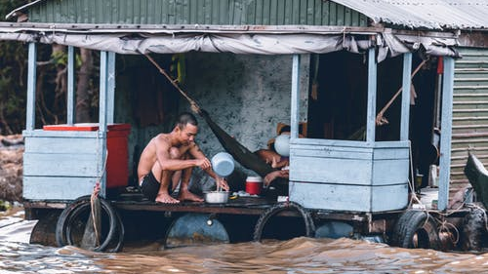
Absolute Poverty The complete lack of the means necessary to meet basic personal needs, such as food, clothing and shelter(Wikipedia)

Slide 6
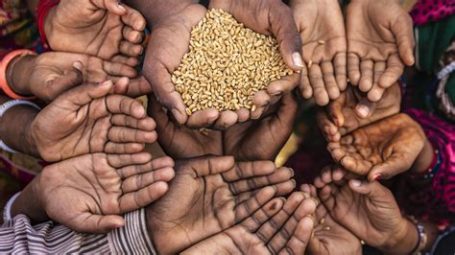
Food Shortage

Slide 7
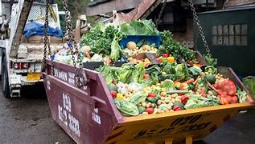
Food Waste
1/3 of the global food production is wasted each year.

