Slide 1

GLOBAL UNDERNUTRITION 1 IN 9 PEOPLE AROUND THE WORLD GO HUNGRY EACH DAY
Public health study(fao*)
(*)Food and agriculture organization of the united nations

Slide 2
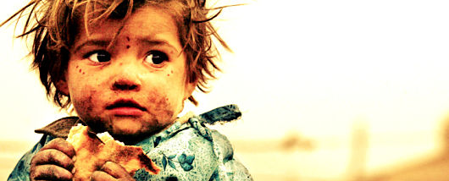
A Child Dies From Hunger Every 10 Seconds

Slide 3
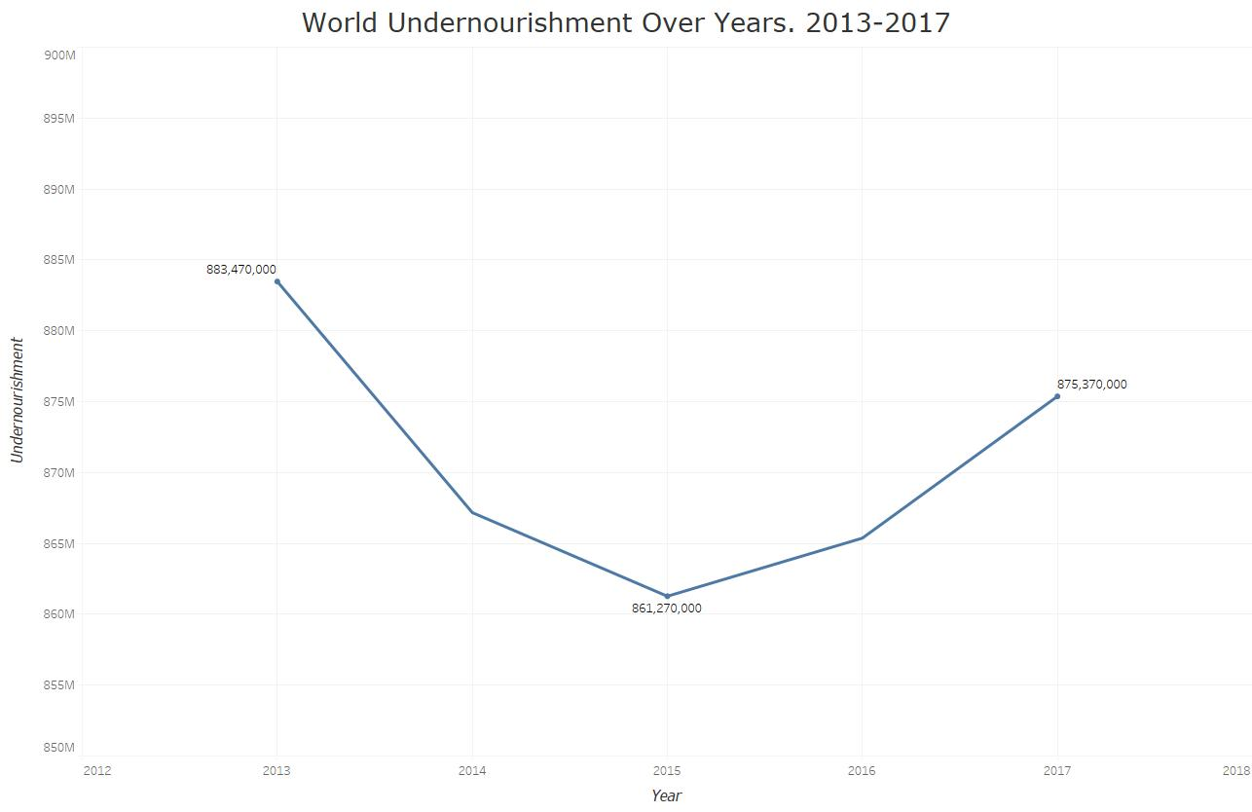
The Number Of Chronic Undernutrition is Increasing
Around 11% of the global population is undernourished

Slide 4
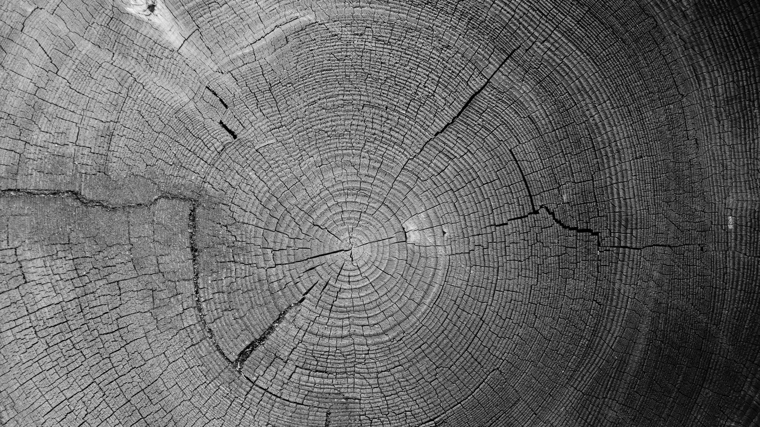
But What Are The Causes Of Hunger In The World ?

Slide 5
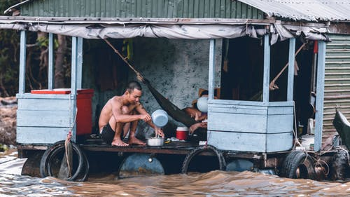
Absolute Poverty
CAUSES OF UNDERNUTRITION
The complete lack of the means necessary to meet basic personal needs, such as food, clothing and shelter(Wikipedia)

Slide 6
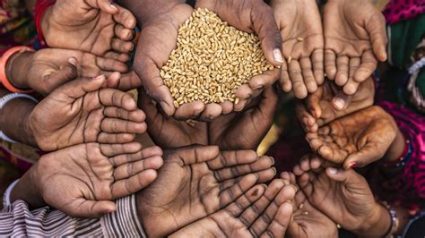
Food Shortage
CAUSES OF UNDERNUTRITION
In country afflicted by pandemic like COVID-19

Slide 7
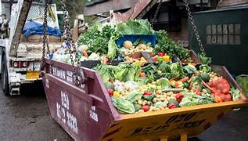
Food Waste
CAUSES OF UNDERNUTRITION
1/3 of the global food production is wasted.

Slide 8
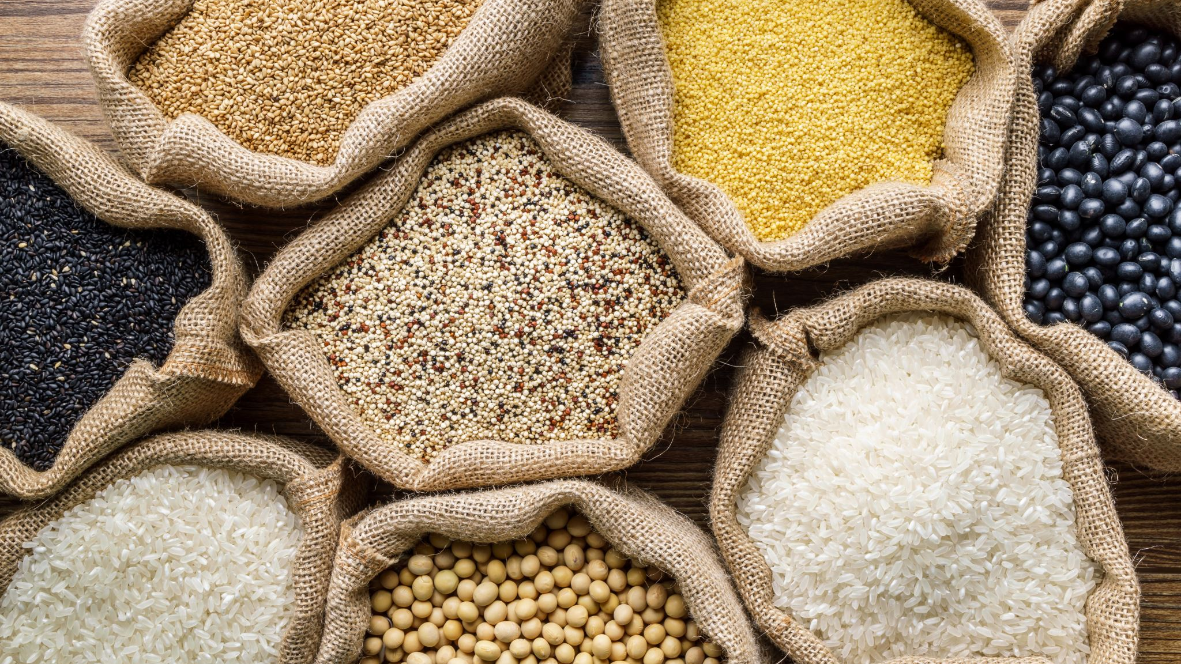
An Irrational Food Consumption

Slide 9
How is the Global Domestic Supply Used Considering Only Plant Products?

Slide 10
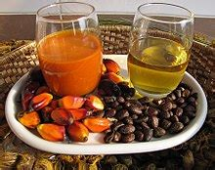
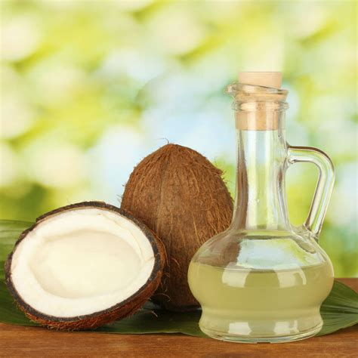
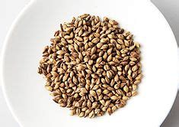
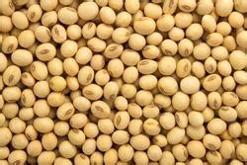
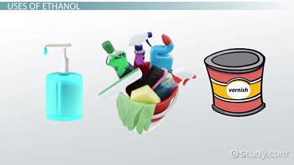
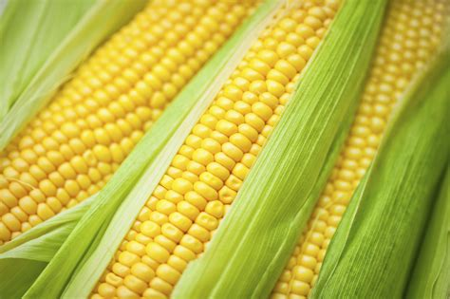
3 Highest Items Exported
Considering Other Supply Ratio
Considering Feed Food Ratio
Palm Oil
Coconut Oil
Barley
Soya beans
Alcohol
Maize

Slide 11
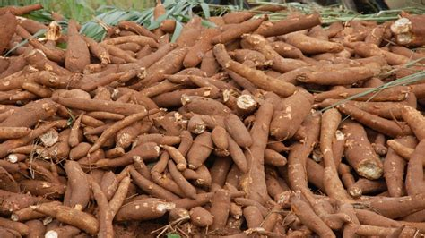
Exportation is Another Insanity
Thailand exports 83% of its production of Cassava, while around 9% of its population is undernourished.

Slide 12
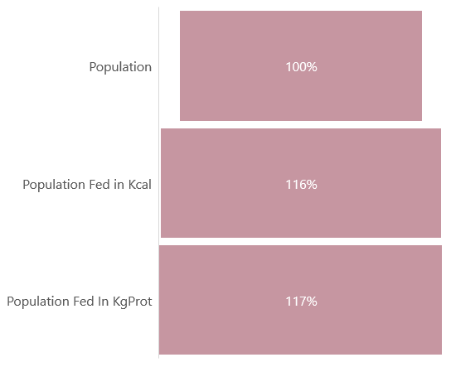
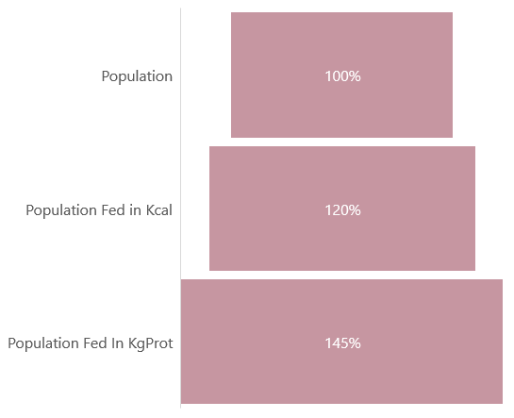
We Are Producing Enough Food For The Entire Planet
Considering Vegetal
Considering Global Food Supply
According to the Dietary Guidelines A human need an average of 2400 calories per Day.

Slide 13
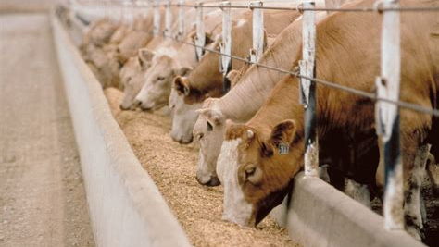
46% of Cereals is used for feed
If United States reduces its production of animal products by 10%, 14 million tons of cereals could be released.

Slide 14
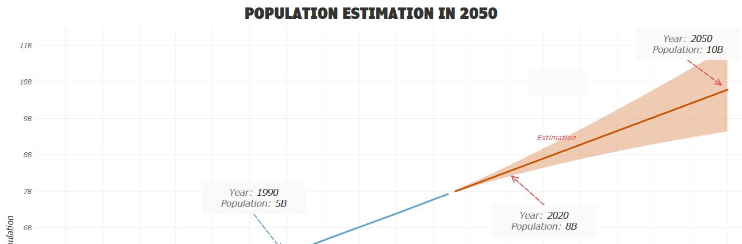
Population Growth is Not a Problem

Slide 15
Conclusion
The number of chronic undernutrition is increasing
The World hunger is not due to a lack of production
we are producing enough food to feed the entire planet.

Slide 16
But There Are Some Solutions
Reduce The Meat Consumption
Improve the Logistic to avoid food shortage
Governments must change their exportation politics

Slide 17
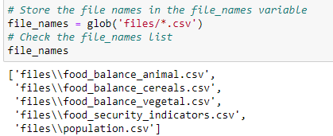
INFORMATION ABOUT THE DATASET
All the data has been downloaded from the FAO(http://www.fao.org/faostat/en/#data) website.

Slide 18
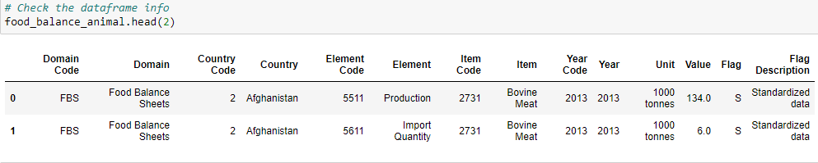
food_balance_animal.csv

Slide 19
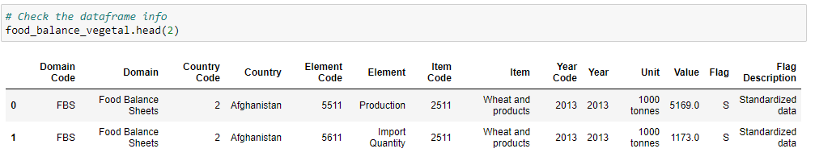
food_balance_vegetal.csv

Slide 20
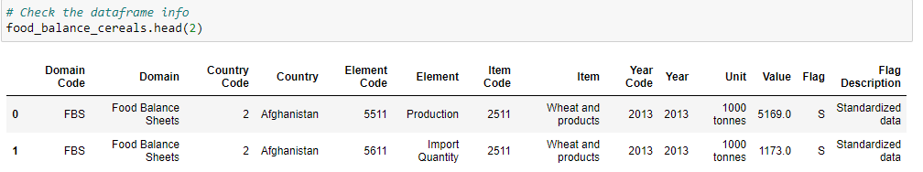
food_balance_cereals.csv

Slide 21
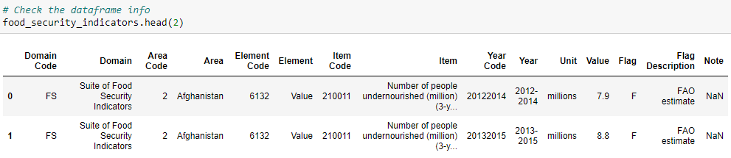
food_security_indicators.csv

Slide 22
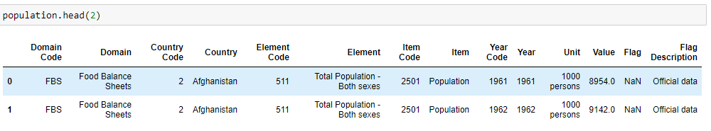
population.csv

Slide 23
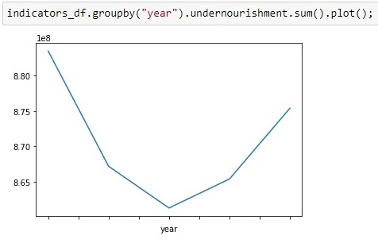
Some Relational Algebra Operations 1.Aggregation

Slide 24
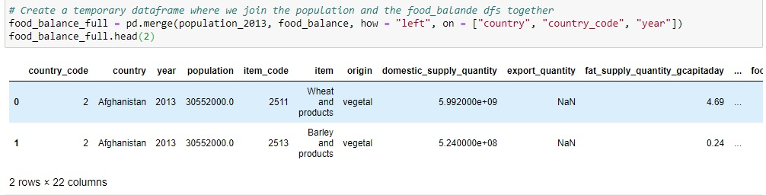
Some Relational Algebra Operations 2.Join

Slide 25
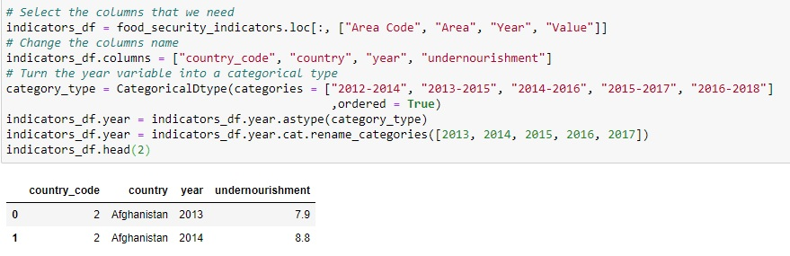
Some Relational Algebra Operations 3.Projection

Slide 26
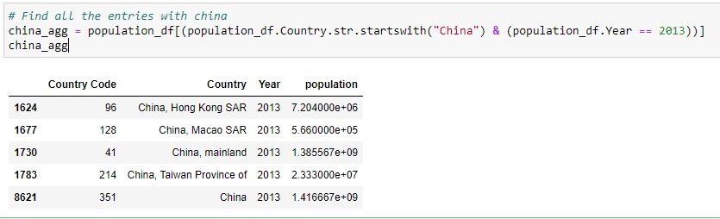
Some Relational Algebra Operations 4.Restriction

